Slide 1
SEMH Network Meeting
Tuesday 10th October 2023
Welcome to this virtual forum
Notes:
1

Slide 2
Agenda for today
Item | Who | Time
Welcome and Updates | Al Whitelaw | 3.30 pm (10 mins)
Thames Valley Police | Angela Ferrucci | 3.40 pm (15 mins)
Online Boxall Profile Updates | Joanne Davies Rebecca Pope | 3.55pm (15 mins)
Breathe | Chris Caughey | 4.10pm (15 mins)
Young Carers - Family Action | Sarah Collin | 4.25 (15 mins)
Virtual School – Oct ‘23 updates. | Suzanne Parrott Ritchie Clarke (Specialist EWO for Children with a SW) | 4.40pm (15 mins)
Questions and Feedback
https://www.leadershipupdate-rbwm.co.uk/semh-service/
https://www.leadershipupdate-rbwm.co.uk/information-for-all-schools/

Slide 3
Thames Valley Police
Angella Ferrucci

Slide 4
Thames Valley Police
PC 6351 Angela Ferrucci – safeguarding schools officer
Angela.Ferrucci@thamesvalley.police.uk
07968 190529

Slide 5




Safer Schools
4 Key Principles
This supports the policy of keeping children out of the Criminal Justice System unless it is absolutely necessary and appropriate.
It is the responsibility of the school to obtain prior parental consent for any requests for an officer to speak with a student
Reduce crime and victimisation amongst young people
Provide a safe and secure school community to enhance learning
Keeping young people in education, actively learning and achieving their full potential
Delivering a partnership approach with young people, challenge unacceptable behaviour and develop a respect for themselves and their community.

Slide 6
Interventions, Referrals & Projects
Inputs
Restorative Justice
L&D, New Leaf, LLWAK
Exploitation Tool
Projects

Slide 7
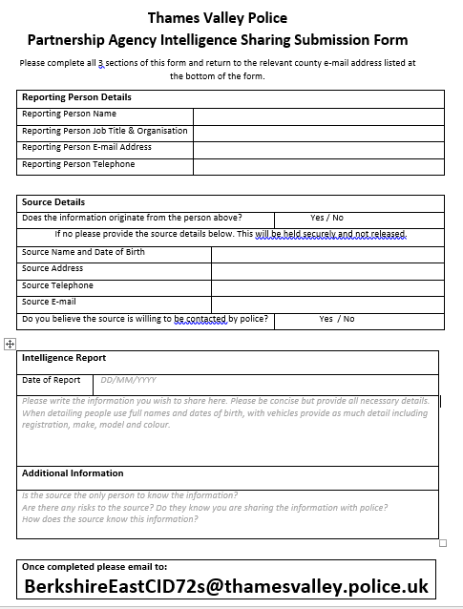
Intelligence Submission Form
Form to be completed to share intelligence with TVP
Please complete all sections of the form with as much detail as you have
It can take time for intel to be processed so if urgent please consider whether the best course of action would be 101 or 999 in an emergency.

Slide 8
Operation ENCOMPASS
Please ensure that your details are kept up to date on the ENCOMPASS database, please update us if you have a change in Headteacher or DSL
!
Only relevant to domestic abuse or domestic incidents where the child is present.
Automated email to the lead, which is usually the Headteacher.
You will only be told that there was an incident and not details of the incident. This is for your awareness should the child need support throughout the school day.
Please update your contacts with the new email address for any queries:
ENCompass@thamesvalley.police.uk

Slide 9
Nurture UK
Online Boxall Profile
Joanne Davies
Rebecca Pope

Slide 10



Boxall Profile® Online 2023 Update
Achieving for Children SEMH Network Meeting
October 2023

Slide 11


What do schools need?
At nurtureuk we are on a mission to improve the Boxall Profile® Online, to make it an even more powerful assessment tool for schools and educational settings to assess, plan, track and positively impact the social, emotional and behavioural needs of their children and young people.
We use user feedback and user engagement to identify and prioritise future product development. Many of the new features are as a result of user feedback and analysis of helpdesk tickets.
After listening to user feedback we have been working hard to update the Boxall Profile® Online to make it:
  Easy to use
  Simple to adopt across the whole school
  Easy to track progress, measure and evidence impact
nurtureuk

Slide 12
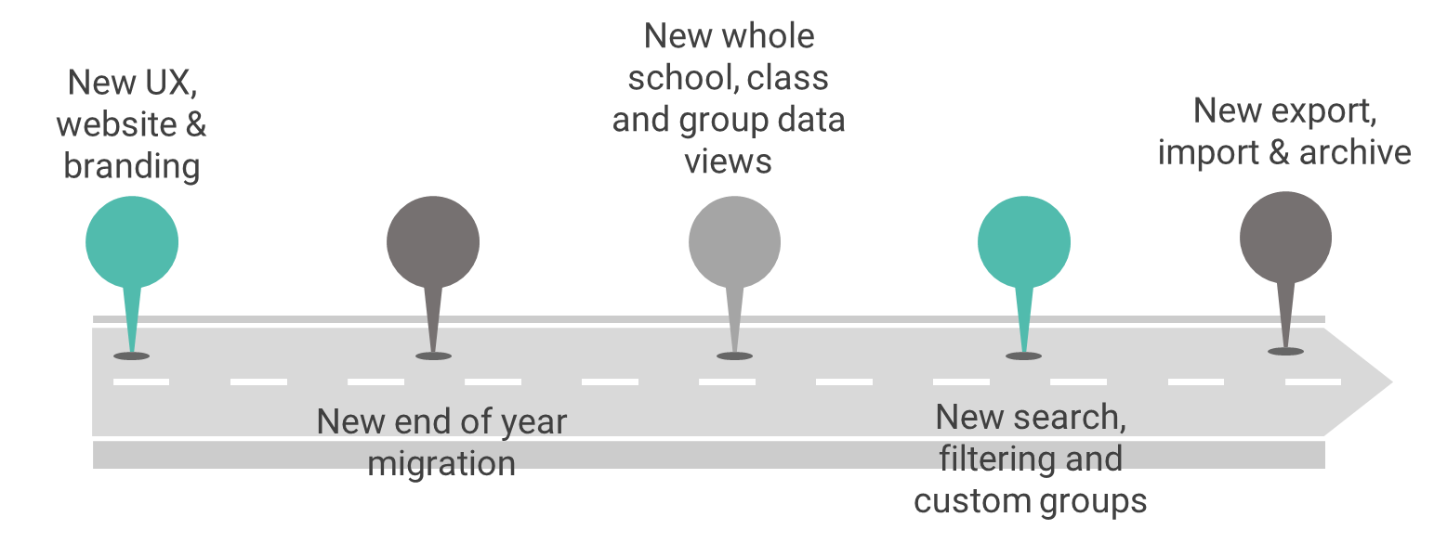
What’s new? - 2023 Features Updates
Over 20 new features added so far in 2023
nurtureuk

Slide 13

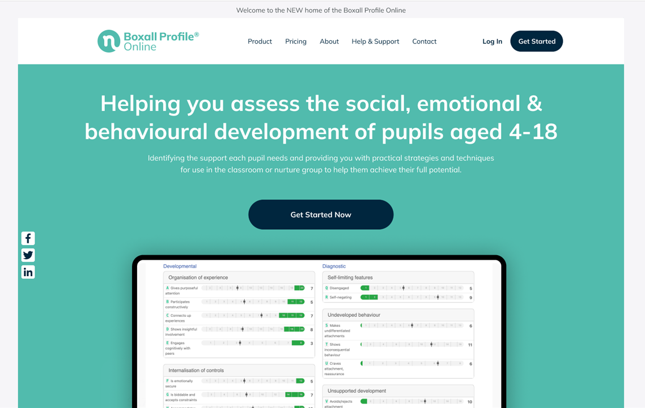
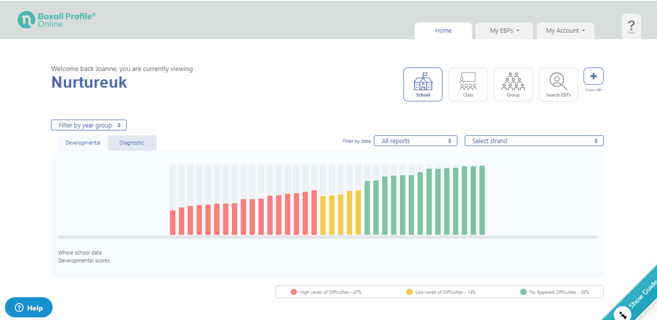


New UX, website & brand
Both the layout and design have been improved to make it easier to use and navigate and to improve the overall user experience.
nurtureuk

Slide 14
User Story
“As educators we need to have an overview of our whole school, classes and groups.”
nurtureuk

Slide 15
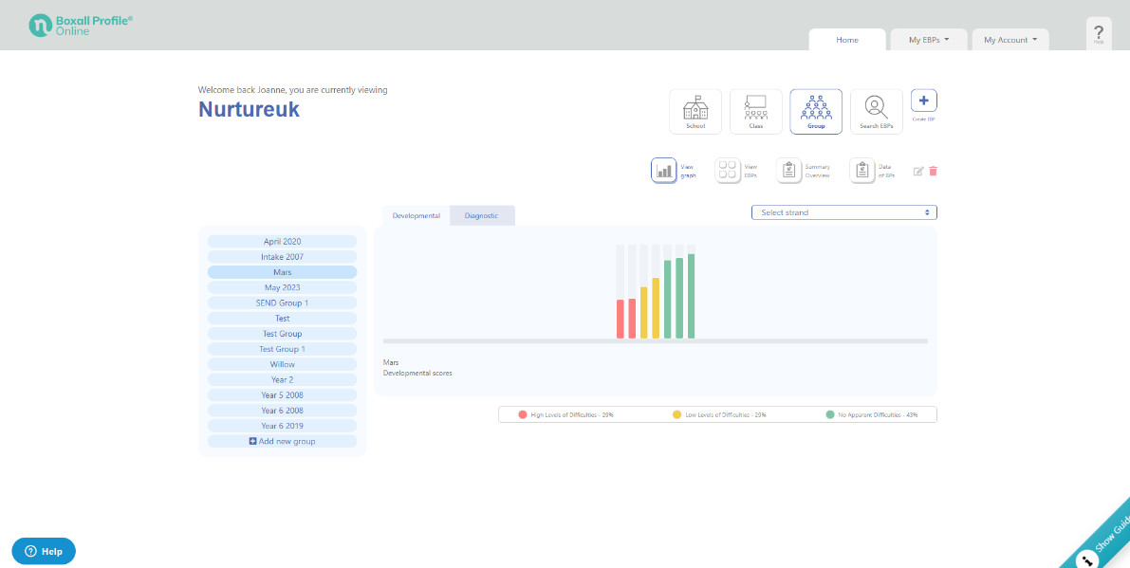
New whole school, class & group views
Your homepage is your whole school overview of your organisations data. You can view the whole school, filter by year group or by strand and by date.
From this page you can access your classes, groups and EBP’s. You can also create a new EBP.
nurtureuk

Slide 16
User Story
“We need to be able to track the progress of our pupils.”
nurtureuk

Slide 17
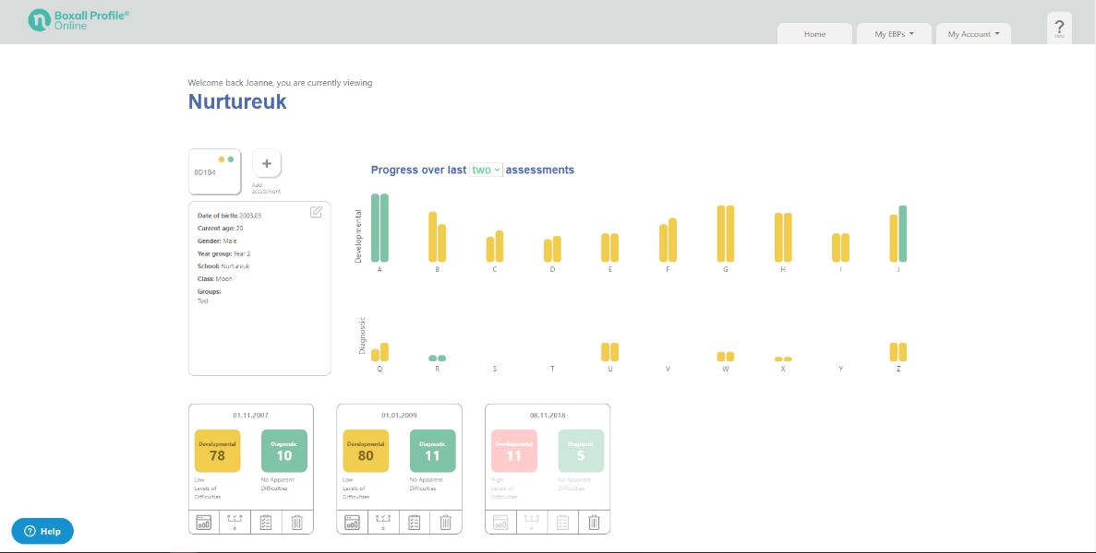
New EBP page
We introduced the new EBP page.
Here you can easily:
Access and edit the profile details
Compare assessments
Add a new assessment
Add EBP to a group
Archive an EBP
See who has access to the EBP (bottom of page)
See their previous assessments and scores (bottom of page)
View EBP reports, Learning Plans, Evaluate Learning Plan and Delete
nurtureuk

Slide 18
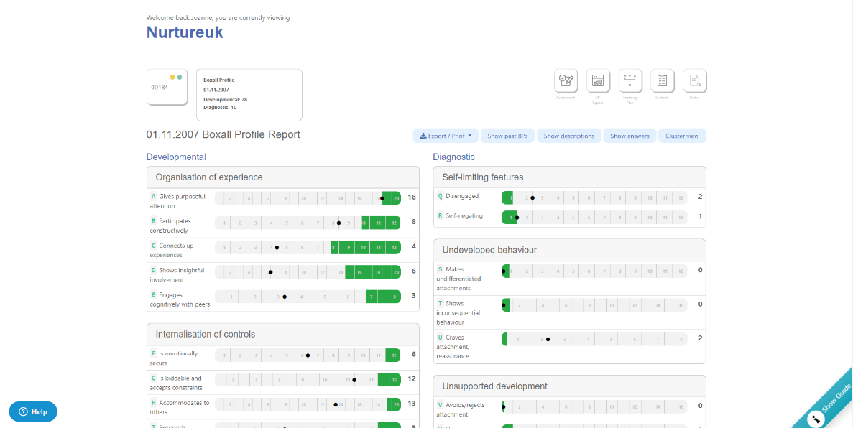
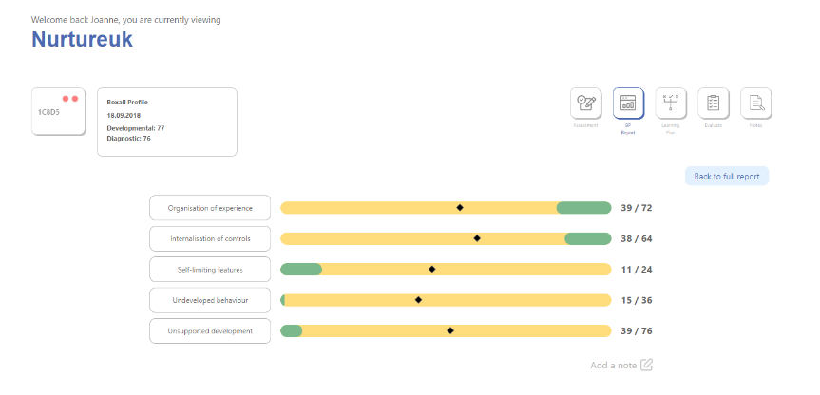
New report and cluster view
You can access the full BP report and the new cluster report.
Here you can:
Show and compare to past EBP’s
Show descriptions, answers, print, export and save as a PDF.
Here you can select the new Cluster view which shows a summary where the pupil is for each section of the assessment.
  Organisation of experience
  Internalisation of control
  Self-limiting features
  Undeveloped behaviour
  Unsupported behaviour
You can also access the assessment, learning plan, evaluate and now add notes to each strand.
nurtureuk

Slide 19
User Story
“Our staff need to find EBP’s quickly and create groups with certain characteristics.”
nurtureuk

Slide 20
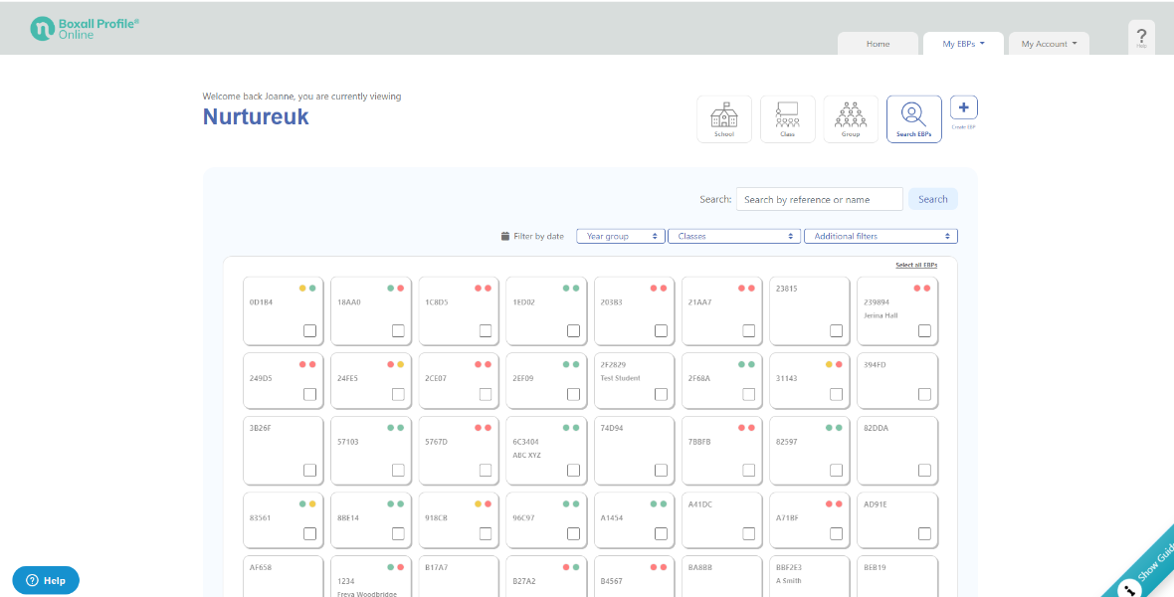
New search, filter and custom groups
You can now search and filter EBP’s and create custom groups. You can add to groups, archive and give access to users.
Search - You can use the search box to search by reference or name to find a specific EBP.
Filter - You can filter by date, year group, class or additional filters. The additional features data is populated from the EBP & profile pages.
Custom Groups - Once you have filtered your EBP’s you can select all or select individually and then add to a group (existing or create a new one) at the bottom of the page.
nurtureuk

Slide 21
User Story
“Moving children to the next school year/class is too slow and difficult!”
nurtureuk

Slide 22
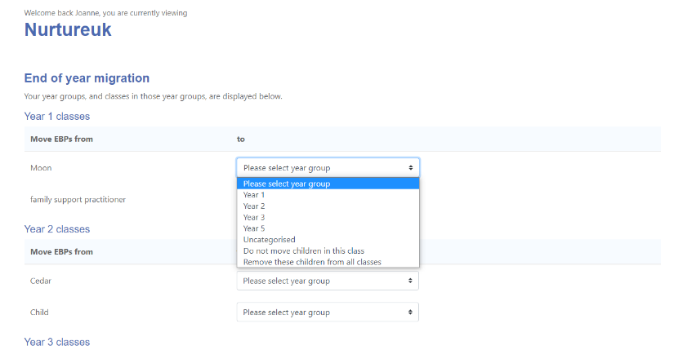
New end of year migration
Available in Manage my Organisation
We have developed a simple and easy way to move all pupils to their next class at the end of the academic year.
Simply select which class each class is migrating to. For any children that are leaving the setting you can select “remove these children from all classes”. You can also select “do not move children in the class” or use “uncategorised”
When you are happy with your selections you can submit, review, edit if necessary and then update all classes ready for the next academic year.
Organisations will still be able to move children individually if required.
nurtureuk

Slide 23
User Story
“We need to add all of our pupils in one go!”
nurtureuk

Slide 24
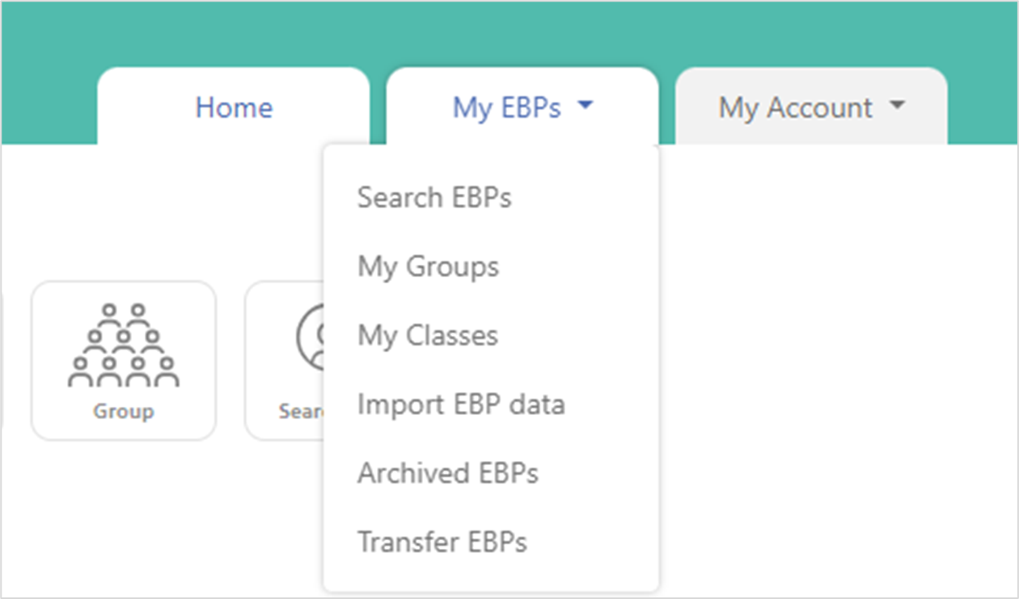
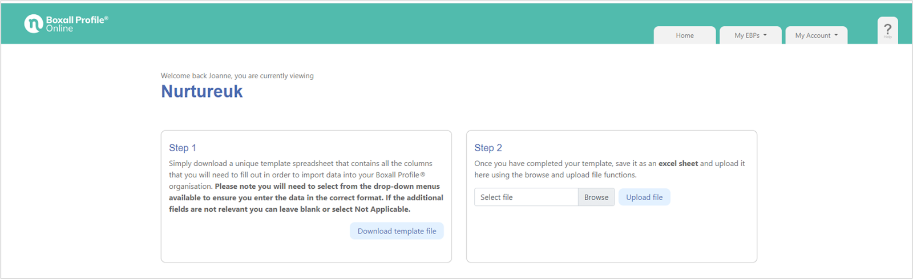
Import
We have introduced a simple way for organisations to import their pupil data through our new Import Function. This will allow organisations to bulk upload their pupil data and allocate to the correct classes. This will save settings valuable time and resources.
You will find this function in your My EBP’s menu.
nurtureuk

Slide 25
Import
Step 3
Review the import summary, make any amends if needed and re-upload.
Step 4
Once you are happy with your import, simply click “import” and your data will be added to your organisation ready for you to start adding assessments. You will receive a message when complete and see an overview of your import.
Step 1
Download the unique spreadsheet that contains all the columns that you will need to fill out in order to import data into your Boxall Profile® Online organisation.
Please note you will need to select from the drop-down menus available to ensure you enter the data in the correct format. If the additional/optional fields are not relevant you can leave blank or select Not Applicable.
Step 2
Once you have completed your template, save it as an excel sheet and upload it using the browse and upload file function.
Please note you will be able to add classes that don’t appear on the list or your organisation and these will be created for you. Year groups will need to be managed in Manage your organisation.
nurtureuk

Slide 26
User Story
“Our team need access to our pupil data for reporting and be able to remove older pupils easily (but not delete).”
nurtureuk

Slide 27
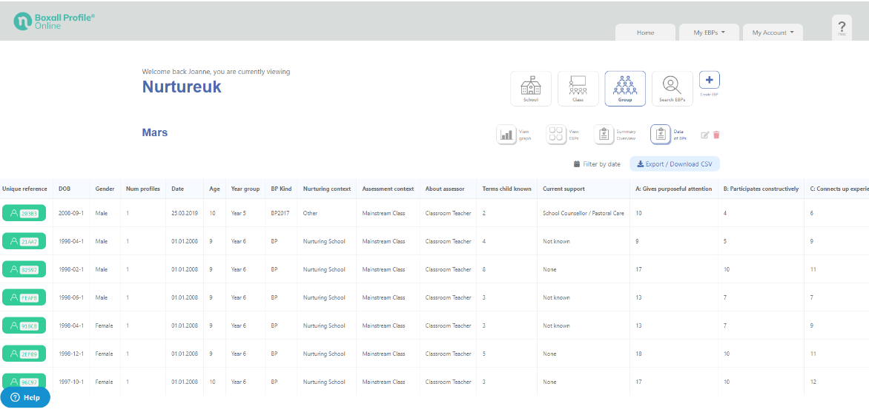
Export
You can Export BP’s Data as a CSV file.
This is will help with the creation of bespoke reports by the organisations to compare, measure and track progress over time.
nurtureuk

Slide 28
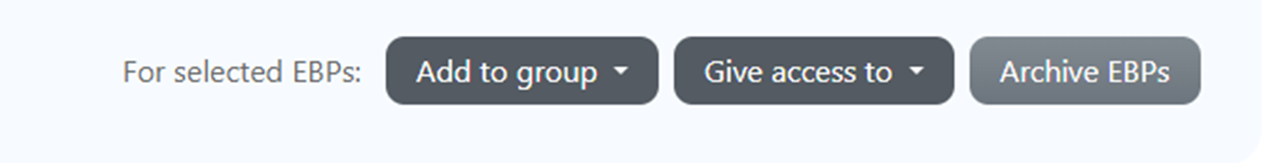
Archive
We have developed a simple way for you to archive your older pupil data so that the data you are viewing is relevant and representative of your current students. You can archive EBP’s by selecting the ones you wish to archive on the Search EBP’s page, groups and classes and selecting Archive EBP’s at the bottom of the page.
You can then view and access your archived data from the My EBP’s menu and you can also unarchive data if required.
nurtureuk

Slide 29
User Story
“We need all of our staff to be trained in the Boxall Profile® Online to improve whole school use and impact.”
nurtureuk

Slide 30
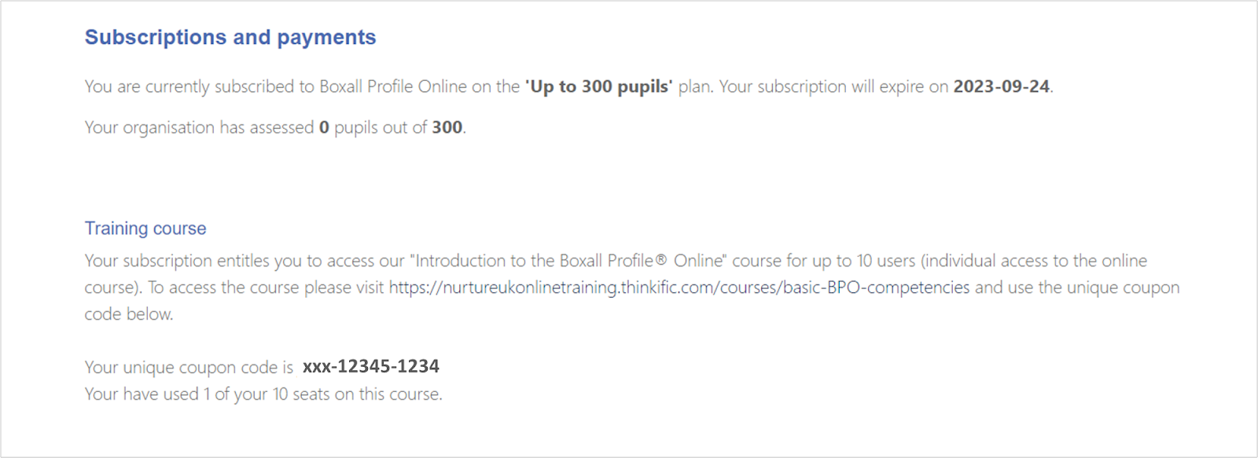
Introduction to BPO Course
To improve an organisation's experience of using the Boxall Profile® Online they will now receive a code to access the online Introduction to the Boxall Profile® Online course with every subscription. Each code will allow 10 staff members to access the course and you will find the coupon code in your Subscriptions & Payments page. You can also track your usage of the code on this page.
To access the course please visit The Introduction to the Boxall Profile® Online and use the unique coupon code provided.
nurtureuk

Slide 31
What’s next?
PLANS
2023/2024
nurtureuk

Slide 32

Product development roadmap
Over the Autumn we will be working on the following product updates:
  Parent/Carer Guidance & Engagement
  Teacher Guidance for conversations with Parents/Carers
  Class & Group Learning Plans
  New Dashboard: Whole School, Class & Group progress tracking
  Resource & Learning Plan review
All new features will be shared within the product and in our What’s New blog series on our website.
nurtureuk

Slide 33
Achieving for Children adoption
61 Organisations set up
Number of Org’s | Number of EBP’s created
21 | Less than 10
21 | 11 - 50
9 | 51 - 100
10 | 101 - 420
nurtureuk

Slide 34
Additional Training for Schools
Theory & Practice of Boxall Profile (£199 per delegate)
Duration: 1 day
Time: 9:00-16:00
Format: online via Zoom
Group size: 8-12 delegates
What Will I Learn?
How to identify, assess, interpret and plan support for children and young people using The Boxall Profile®
How to use the Boxall Profile® to complete an online assessment.
How to use the Boxall Profile® to strategically plan interventions for individuals, whole groups, classes and schools
The Six Principles of Nurture and how these link to the assessment tool
The impact of early childhood experiences on pupil development and wellbeing
The significance of neuroscience and Attachment theory
We recommend someone with strategic responsibility for the Boxall Profile in your school attends.
Other available training and resources
Beyond the Boxall Profile®: Whole Class Strategies
School membership
National Nurturing Schools Programme - embedding a whole school approach
Theory and Practice of Nurture Groups
Please contact business@nurtureuk.org for more information

Slide 35
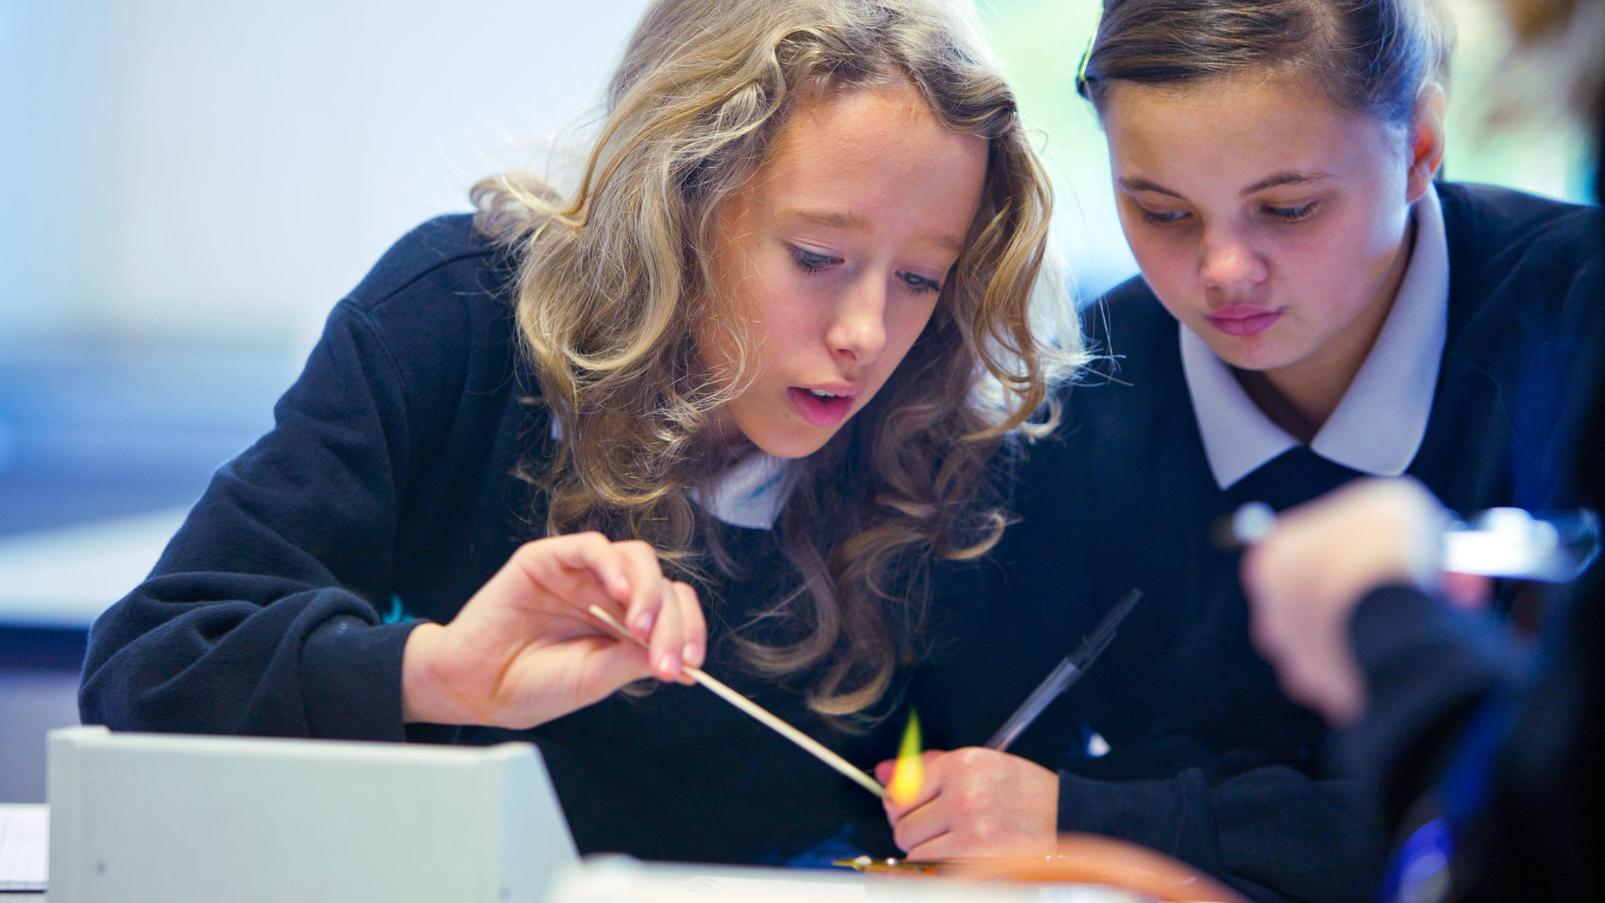








For more information
@nurtureuktweets
/nurtureuk
nurtureuk
business@nurtureuk.org
www.nurtureuk.org

Slide 36

BREATHE
Chris Caughey

Slide 37
Background
Following a gap being recognised in RBWM provision for a group supporting child/young person victims of domestic abuse, the Family Hub Service and The DASH Charity have developed a pilot programme running October - December 2023.
The programme named BREATHE will aim in supporting children and young people in RBWM who are or have been affected by unhealthy, conflicting and abusive behaviours in parent or carer relationships.

Slide 38
Programme Aims
increase confidence and esteem
reflect on past experiences
increase understanding of healthy and unhealthy relationships
learn strategies to support wellbeing
understand how to keep safe

Slide 39
Criteria
RBWM resident
Living or lived in a setting where unhealthy, conflicting and/or abusive behaviours are/were present
Parent/Carer and Child/YP must agree to referral being completed and recognise need for support
Through referral process and following pilot programme assessment
Age group yet to be determined however 8-13yrs is current focus
Additional Needs/Disabilities - individually discussed
Participant must be able to engage in a group setting
Sibling relationships to be assessed

Slide 40
Update
Location booked - Windsor Family Hub
2 x delivery staff highlighted ( 1 x AFC, 1 x DASH)
Referral information sent across relevant services at the beginning of Summer 2023 and again September 2023
15 referrals received, 9 confirmed ( 1 x school, 6 x social care, 8 x early help)

Slide 41
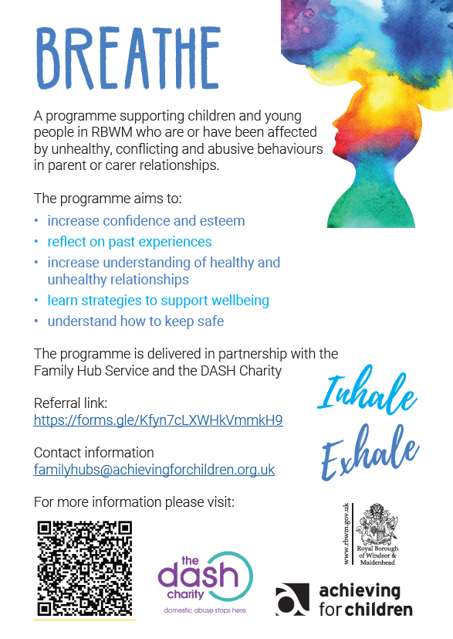

Slide 42
Referrals
https://forms.gle/Kfyn7cLXW kVm kH9
(referrals should be completed by or supported by a professional)

Slide 43
Contact Information
Email: familyhubs@achievingforchildren.org.uk

Slide 44


Slide 45
Supporting Young Carers in your School / Educational Setting
Sarah Collin

Slide 46

Supporting Young Carers in your School/ Educational Setting
Family Action Young Carers rbwm.yc@family-action.org.uk

Slide 47
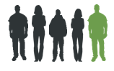
Who is a young carer?
A young carer is someone under 18 who helps look after someone in their family who is ill, disabled or misuses drugs or alcohol.
1 in 5 young people take on a caring responsibility at home
6000+ Young Carers living in RBWM

Slide 48

Young Carers’ Lived Experience
Caring Roles and Responsibilities
• Practical tasks
• Personal care
• Emotional Support
• Sibling Care
Impact of Caring
• Physical and emotional health
• Educationally
• Socially
• Environmentally
It is very important that the tasks a young carer undertakes are
age- and gender- appropriate.
While they continue to provide care, young carers should be able to lead healthy and fulfilling lives.

Slide 49
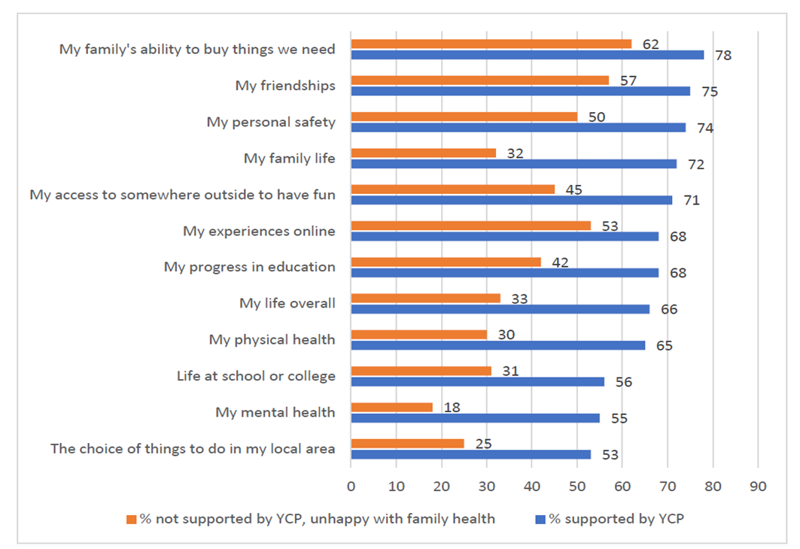
Reports on the Impact of caring (2022)
On average young carers were caring for 3 years before receiving any support, and there were some caring for more than 10 years.
Caring Together (2022)
Young Carers were generally more likely than other children to say they were unhappy with most aspects of their life. Children’s Commissioner’s Big Ask Survey (2022)
Notes:
References
1. From caring to support – we still need to close the gap for young carers, Caring Together (Feb 2022)
2. Young Carers Findings from The Big Ask, The Children’s Commissioner Report (March 2022)
In April 2021, the Children’s Commissioner for England, Dame Rachel de Souza, launched The Big Ask: a national consultation exercise with children in England
to ask them about their lives and their priorities, aspirations and worries for the future. The survey was shared with a wide range of organisations, including
children’s homes, charities and young carers’ projects. This report provides additional detail and analysis specifically focussed on youngcarers.
In The Big Ask we received 6,008 responses from children who report that they are supported by a young carers’ project
We also received an additional 25,669 responses from children aged 6-17 who indicated that they were unhappy with their family’s health but were not supported by a young carer’s project.
A recent survey by the charity Caring Together (2022) found that on average young carers were caring for 3 years before receiving any support, and there were some caring for more than 10 years. This can have a significant impact on their education, health and future opportunities.
The Children’s Commissioner’s Big Ask Survey (2022) reported that of 6,008 Young Carers surveyed, Young Carers were generally more likely than other children to say they were unhappy with most aspects of their life.
The most notable differences were that young carers were more likely to be unhappy with:
Their family’s health (15% of young carers vs 6% of other children)
Their mental health (25% of young carers vs 20% of other children)
Their family’s ability to buy the things that they need (8% of young carers vs 3% other children)
Their family life (11% of young carers vs 6% of other children)

Slide 50
Barriers to seeking support
          Fear
          Stigma
          Not recognising caring role
          Coping well enough – little disadvantage
          Previous experiences of professional support
          Cultural barriers
Professional and family barriers need to be considered in order to identify and support hidden young carers.
Notes:
Sarah Collin

Slide 51
Train Young Carers Champions
The Children’s Commissioner recommends that every school has Young Carers Champions so that every young carer has a trusted adult in school they can go to if things are difficult or they need more support.
Voices Of England’s Missing Children Report (2022)
Train the Trainer: Identification and Support of Young Carers
14th November 2023, 9am – 1pm
23rd April 2024, 9am – 1pm
24th April 2024, 1pm – 5pm
Tip: We recommend that a minimum of 2 members of staff
are nominated to become Young Carer Champions.
Contact rbwm.yc@family-action.org.uk to register your interest in this training.
Notes:
19 schools in RBWM have trained 24 YC Champions (Sept 2023
Family Action regularly trains Young Carers Champions in RBWM using the Train the Trainer: Identification and Support of Young Carers, written in partnership by the Department for Health and Social Care and Carers Trust.

Slide 52
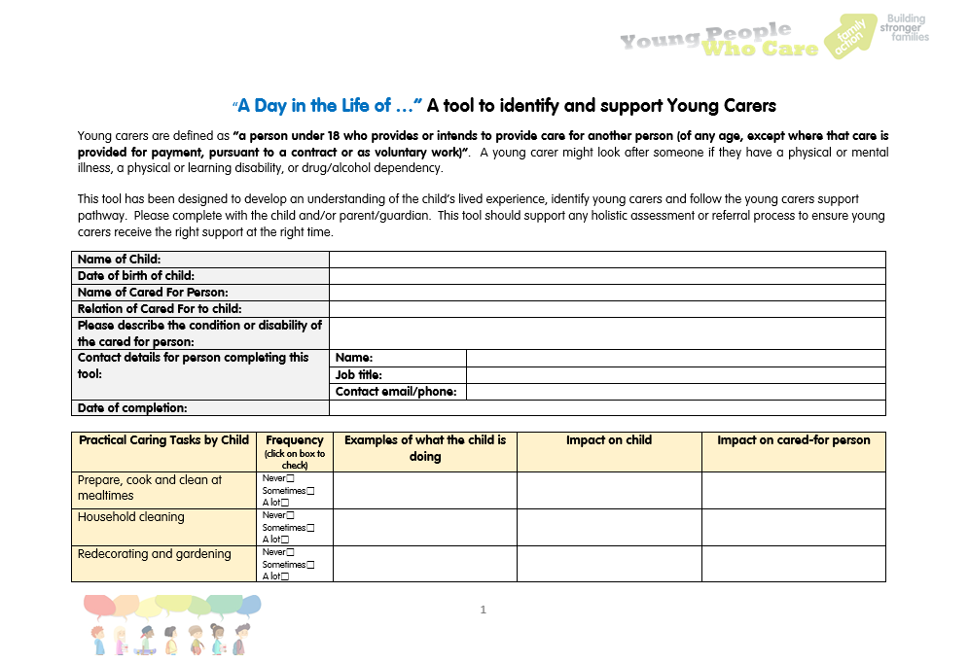
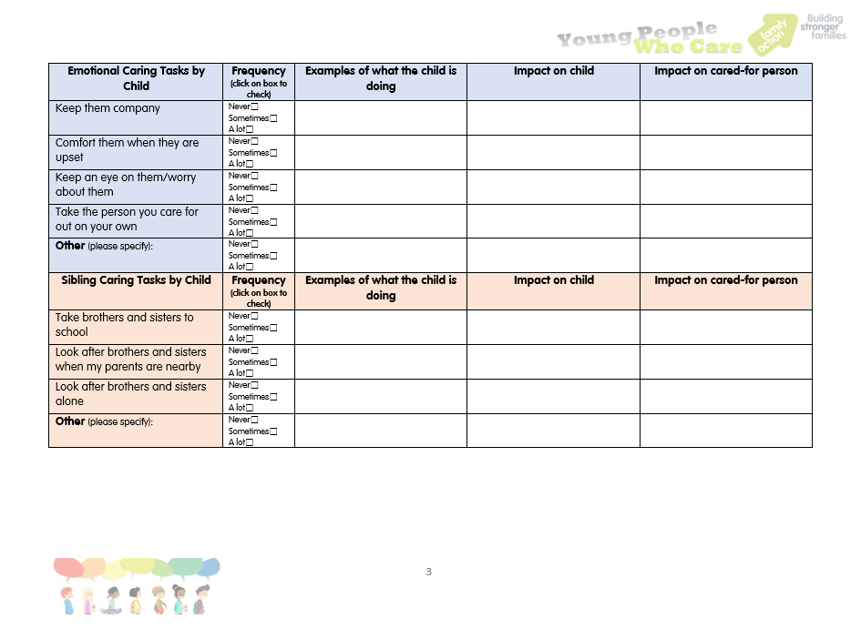
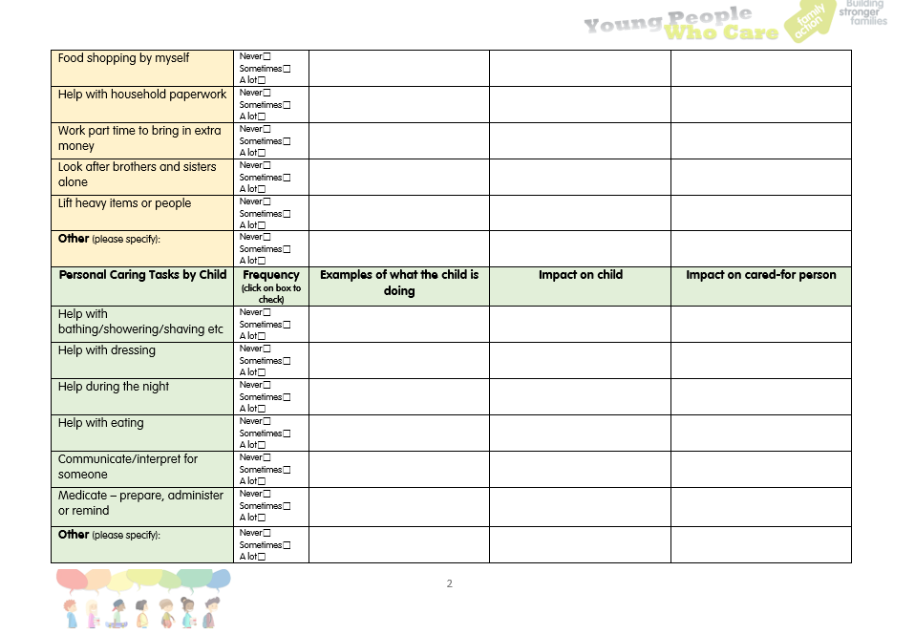
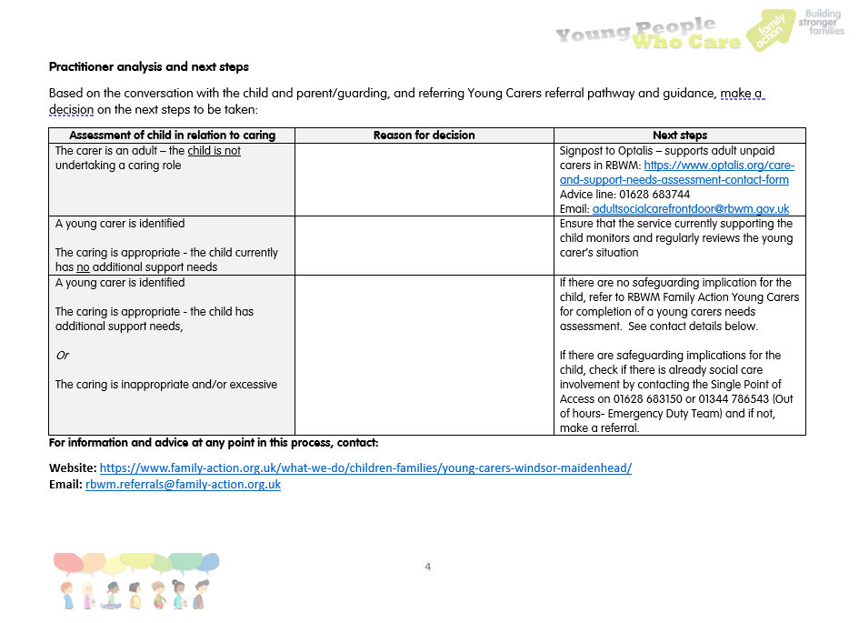
Young Carers Pre-Screening Tool
Professional curiosity
‘The capacity to explore, probe and understand what is happening within a family rather than making assumptions or accepting at face value, and applying critical evaluation to any information received’.
Notes:
For KS1 and neurodiverse Ycs, we use a playhouse and explore who is in the family, who needs extra support and look at how they support that person in each room of the house.
Consider, practical support, personal care, emotional support and sibling care
Also consider, what support is being provided outside of the home?

Slide 53
Young Carers Pre-Screening Tool
Things to consider
Are the caring tasks & responsibilities a reasonable demand on the young person?
Does the young person enjoy caring?
Is the young person safe in their caring role?
Are there any tasks or responsibilities they wish they could stop doing?
What do they worry about?
Is there potential for the care-giving tasks to have a negative impact on the young person’s physical, emotional and/or social wellbeing?

Slide 54
Additional Info
Notes:
54

Slide 55
Virtual School
Suzanne Parrot

Slide 56
AfC Virtual School
Update October 2023

Slide 57
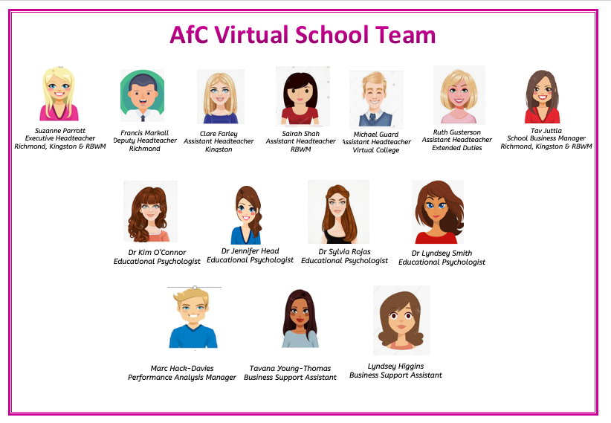
Leadership
EPs
Business Hub

Slide 58
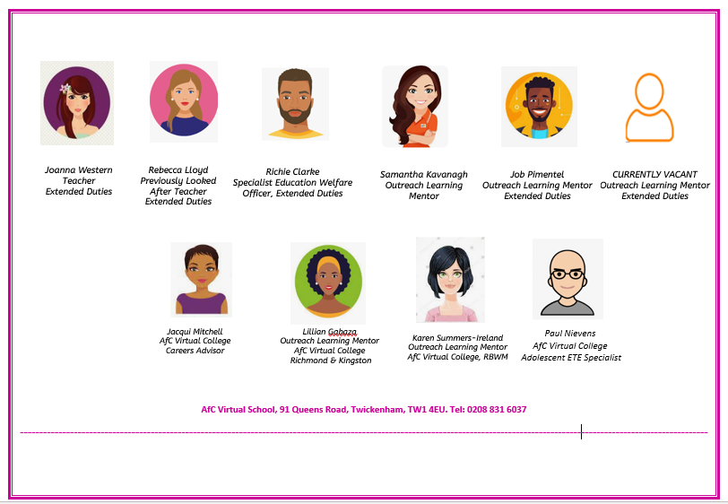
Extended Duties Team
AfC Virtual College Team

Slide 59

Attachment Aware Schools’ Award 2023
72 schools registered for this year
Bronze, Silver and new Gold Award
Bronze - Introduces
Silver- Embeds
Gold -’Ripples Out’ to families and local provisions.

Slide 60
A Message from last years Cohort…
“The Attachment Aware Schools Award has been exceptionally impactful; particularly on mindset!”
If you your school has not been on the programme then sign up for 2024-25
tav.juttla@achievingforchildren.org.uk
Notes:
SP

Slide 61

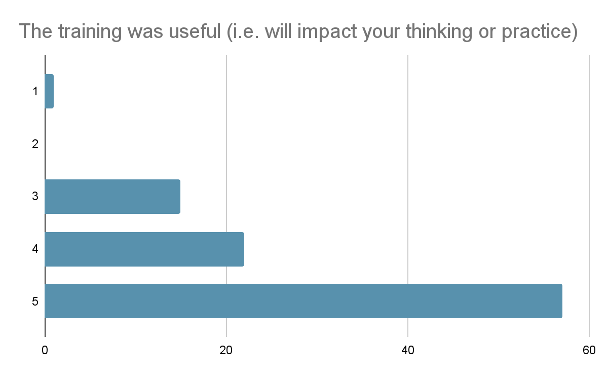
Whole school training
Notes:
JH

Slide 62

AfC Virtual School and College 2023 achievements:
KS4
Attainment 8 28 compared with 20.3 National looked after and 48.8 all pupils
English and Maths grade 5 18% compared with 11% CLA nationally
KS5
95.2% achieved qualifications at a level appropriate to their ability. This compares with 46% in 2019 and 80% in 2021
35.7% undertook level 3 qualifications compared to 51% of non-looked after young people. In 2019 22.7% of AfC young people achieved this level of qualification.
20.3% admission to University compared with 6% Nationally
14.2% of Year 13 completed the year as NEET compared with 28.5% Nationally
Notes:
SP

Slide 63
“I got into medicine at Manchester! :) Thank you for everything”
“I start College tomorrow, I’m doing level 2 Diploma in sports. Football is going great thank you.”
“...getting the business off the ground. Hustling everyday”
“My place is confirmed [Kingston University scholarship]. I will definitely go out with my friends and celebrate. I am excited”

Slide 64
Other Priorities
Extended Duties - supporting CIN and CP students
Reducing Absence- CLA currently 3.6% Average Absence and 11.4% Persistent Absence and CIn and CP although high are below national.
Reducing Exclusion - 11 Exclusions CIN and 16 CP last school year- future for these children is statistically not positive
School stability for CLA - down 10% to 69% from a year ago.
Transition Hub - 12 week programme supporting Child, Home and School
Welcome Programme - ESOL and trips for UASC students

Slide 65


Slide 66
Children and Young People’s Plan
https://rbwm.afcinfo.org.uk/pages/community-information/information-and-advice/rbwm-children-and-young-people's-partnership/children-and-young-people-s-plan
Multi-agency Threshold Guidance launch- 31 October 2023
AfC are offering a choice of two workshops on the 31/10/2023 to launch our freshly updated Multi agency threshold guidance to all partners who support our children and young people . The sessions will be facilitated by colleagues from AfC Early help, Social care and Education.
The workshops will give all attendees an update on the latest guidance and then an opportunity to discuss some case studies before sharing best practice around Information sharing and consent.
Places will be offered on a first come first served basis but in the interest of fairness we will be limiting places to two per setting
Multi-agency Threshold Guidance Launch (Windsor & Maidenhead) - Tue, 31 Oct 2023 09:30 - 12:00
Multi-agency Threshold Guidance Launch (Windsor & Maidenhead) - Tue, 31 Oct 2023 13:00 - 15:30
As part of #TheBigAmbition, Rachael deSouza wants children all across England to tell her what they would like the Government to focus on to make their lives better. To take part in my survey, head to: https://childrenscommissioner.gov.uk/thebigambition

Slide 67
Questions and
Feedback Form
Notes:
67

