Slide 1
SEMH Network Meeting
Tuesday 17th May 2023
Welcome to this virtual forum
Notes:
1

Slide 2
Agenda for today
Item | Who | Time
Welcome and Updates | Al Whitelaw | 3.30 pm (10 mins)
Early Years | Rachael Gomyer Amy Crowle | 3.40 pm (15 mins)
CAMHS Parenting and Family Worker | Jenny vanDyk | 3.55pm (15 mins)
Send Information Advice and Support Service (IAS) | Jean Hobson | 4.10pm (10 mins)
Storyy Group – Alternative Provision, Outreach and Interventions | Debbie Smith | 4.20 (10 mins)
Mental Health and Wellbeing updates | Rebecca Askew | 4.30pm (15 mins)
Questions and Feedback
https://www.leadershipupdate-rbwm.co.uk/semh-service/
https://www.leadershipupdate-rbwm.co.uk/information-for-all-schools/

Slide 3
SEMH Updates
Notes:
3

Slide 4
Early Years
Rachael Gomyer
Amy Crowle

Slide 5

Challenges Facing the Early Years cohort

Slide 6

Impact of the pandemic

Slide 7

Speech and Language
At least 50% of children are below age related expectations in regard to communication and language.
An increasing amount of children are coming in using 1-2 words rather than full sentences.
Staff are having to be upskilled by Speech and Language therapists to meet the needs. Often on level 2 SaLT interventions.
Colourful semantics are being used to support this.
Sound cluster groups are also being used.

Slide 8

Physical skills
Lack of core strength.
Concentrating so much on physical needs that they are worn out for activities.
Yoga and outside time to build strength.
Wobble cushions and seating support.

Slide 9

Parents more anxious
Enhanced Helicopter parenting
Internet adding to parental anxieties
Parents less trusting of professionals
Parents afraid to leave dysregulated children.
Negotiating with the child and increasing the child’s anxiety.
Pandemic exacerbated anxieties of adults.

Slide 10

Emotional Regulation
Enhanced transition into nursery.
Children complaining of feeling sick.
More support around daily transitions.
Not understanding relationships with peers. Seeking adults instead.
Not understanding emotions or how to manage them. A lot of work on identifying emotions. Using stories to work on these.
Persona Doll in use to support.
Using MindUP to support mindfulness.
Teaching students on feelings in the body and what they might be e.g. hungry, hot, thirsty etc.
Using ABC charts to track behaviours so that trends can be found and underpinning needs can be addressed.

Slide 11
EY SEMH Hub
UNICEF School Readiness Framework | Ready Children | Ready Schools | Ready Families
EY SEMH Hub | Tailored Rolling PSHE Curriculum inc. MindUp, Zones of regulation, Lego Build to Express, Circle of Friends, Special Friends, theraplay sunshine circles approach, ability to revisit and deepen knowledge of strategies to regulate. Tailored environment: EY set up with continuous provision, carousel approach, large outdoor area, sensory room, kitchen, regulation tools, teaching space. Rolling Curriculum: ability to change curriculum to meet developmental level through broad topic areas, ability to revisit and strengthen knowledge through rolling curriculum approach. We will cover English, Maths, Science, Geography, P.E., R.E., History, Food Technology, and Enterprise. Learning Journeys: to show progress, to celebrate success, to share with school and parents. Weekly update: on curriculum covered this week. To support schools and families to continue to support the child at home. On Entry: Children to be assessed for appropriate regulation tools. Boxall profile/ SCERTS/ SDQ to gather SEMH data. Create regulation support plans to use in the Hub, at school and at home. | Learning Journeys: to share success, learning and strategies with school. Weekly update: on curriculum covered this week. Staff Members to come on site: Training and learning strategies to support students by coming in and supporting them at the hub, a chance to observe modelling of other staff. Training: Active learning, Anxiety, Brain and behaviour, working with SEMH needs etc. Recorded and/or online/in person. SEMH Hub Staff going into schools: to help support the school in using the strategies, to support the child to regulate in school, to set up key regulation tools and support with resourcing regulation activities. A pack of regulation tools to go to schools with the child. Follow up conversations to check-in on student after leaving the SEMH Hub. Tailored transition support when moving to a full school timetable. Information gathering prior to student starting: Getting information such as learning levels in the national curriculum, medical needs, SEND information, prior interventions, safeguarding information, what the child struggles with/triggers, what the school need support with moving forward, incident records, behaviour support plans. Create regulation support plans to use in the Hub, at school and at home. | Learning Journeys: to share success, learning and strategies with home. Weekly update: on curriculum covered this week. Coffee mornings for parents. Parent information sessions on relevant topics. Recorded and in person. Home-School Communication: Books, emails or phone calls dependent on parental preference. Referrals to appropriate professionals for support. Home learning grid: with SEMH activities for parents to tick off e.g. listening walk, play a board game together, cook together, visit somewhere. Home learning packs to borrow: to support with home learning grids, visual prompts, laminated board games, recipes, activities linked to sessions. Create regulation support plans to use in the Hub, at school and at home.

Slide 12
CAMHS
Jenny vanDyk

Slide 13

A brief overview
CAMHS Getting Help Team
Jenny van Dyk
Parenting and Family Worker
CAMHS Getting Help Team

Slide 14

Background
Roadmap for transforming NHS mental health services in England
  Significant expansion in access to high quality care for children and young people
  70,000 additional children will receive evidence based mental health treatment per year
  Create a new low intensity workforce of 1700 more therapists
  Early intervention to reduce escalation
  Building capacity in community based services and providing a place based approach.

Slide 15
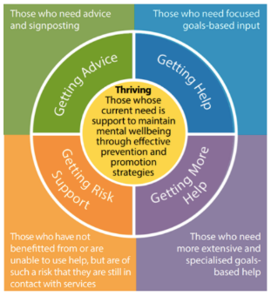
Thrive Framework
All CAMHS teams fit into the Thrive model
  Conceptualises mental health need into 5 needs-based groupings
  CAMHS Getting Help team are employed by Berkshire Healthcare, however sit within local authority Early Help Hub.
  Green refers to Universal Services
  Blue refers to Early Help Services
  Purple is Specialist CAMHS
  Orange is Rapid Response

Slide 16

Who we are
CAMHS Getting Help Team supports children and young people aged 0-18 years, with emerging, mild and moderate mental health difficulties.
  Team Lead – Rhona Edwards
  Clinical Supervisor – Bonnie Brittle
  Child Wellbeing Practitioners (CWPs)- Farzana Miah & Rachel Briggs; Trainees - Smmea Khan & Danielle Atkinson
  Administrator – Jaspreet Bhambra
  Assistant Psychologist – Ludovica Di Guardo
  Parenting and Family Worker – Jenny van Dyk

Slide 17


What we do
Our Approach and Interventions
  We provide assessment and evidence based, low intensity treatments for children & young people (0-18) who fall short of specialist CAMHS thresholds.
  Our approach is informed by Cognitive Behavioural Therapy (CBT) practice with a focus on low mood, anxiety and behaviour difficulties.
  Interventions for children under 12s are offered via their parents, known as parent-led interventions.
  Interventions for over 12s are provided by CWPs on one-to-one basis.
  6-8 sessions; on-line or in person.

Slide 18
What we do
Further support provided by the team:
  Work alongside local authority in Early Help Hub.
  Attend multi-agency triage meetings.
  Provide signposting to services such as Anxiety and Depression clinic, specialist CAMHS and neurodiversity services.
  Staff consultations, training, twilight sessions.
  Offer PEPPcare programme (Psychological Perspectives in Education and Primary Care) – designed in collaboration with Anxiety and Depression clinic and delivered by CWPs.

Slide 19

Referral Guidelines
What we can support:
  Behaviour activation for low mood
  Worry management
  Simple phobias – separation anxiety, dark, dogs
  Graded exposure for anxiety-related avoidance
  Panic Management
  Problem Solving
  Sleep Hygiene
  Assessing self harm and supporting alternative coping

Slide 20

Referral Guidelines
What we don’t support:
  Panic disorder or conduct disorder
  Complex phobias
  Chronic depression
  PTSD, trauma, historical or current abuse
  Low self esteem without low mood presentation
  Anger or pain management
  Severe, active, high-risk self harm
  Parental mental health
  Relationship or attachment problems

Slide 21

Referral Guidelines
What we may support:
  Short term phobia work
  Basic harm reduction for superficial self-harm
  Interpersonal challenges with peers (not bullying)
  Insomnia
  Low confidence and assertiveness

Slide 22

Our support offered
We work with: | We may work with: | We do not work with:
Behavioural difficulties: mostly at home (identify and brief support for children up to 11 years) | More extreme behaviour difficulties, displayed din school or other external settings | Conduct disorder, anger management or full parenting programme (e.g. Triple P)
Low mood | Irritability as a symptom of depression (may present as anger) | Chronic depression or anger management
Worry management, thought challenging e.g. negative automatic thoughts | Low confidence, assertiveness or interpersonal challenges e.g. with peers | Low self-esteem or social anxiety disorder
Anxiety/Avoidance e.g. simple phobias, separation anxiety | Some short term phobia exposure work | Extensive phobias e.g. blood, vomit, needles, OCD, extreme attachment difficulties or ritualistic behaviour
Panic management |  | Panic disorder
Assessing self-harm and supporting alternative coping strategies. History of self-harm but not active | Thoughts of self-harm or superficial self-harm. Basic harm reduction techniques. | Severe active high risk self-harm
Sleep hygiene | Insomnia | PTSD, trauma
Problem solving | Assessment of complex interpersonal challenges | Complex relationship problems (may be more suited to school counsellors)
 |  | Assessment or diagnosis of neurodevelopmental disorders and learning difficulties e.g. ADHD, ASD
 |  | Pain management
 |  | Current or historical experience of abuse or violence

Slide 23

Referral Process
A child with mental health need is identified
  Consent to make a referral is sought from parent and/or young person.
  A multi-agency referral form (MARF) is completed by the school and emailed to the Early Help Hub. mash@achievingforchildren.org.uk
  New referrals are discussed at an Early Help Hub triage meeting.
  If referral is suitable for CAMHS GHT, a child wellbeing practitioner is allocated.
  If referral is not suitable, the CAMHS GHT supports school to find an alternative, suitable service.

Slide 24
Contact Details
  CAMHSGettingHelpEast@berkshire.nhs.uk
  T: 0300 2473002
  Multi-agency Referral Form email
  mash@achievingforchildren.org.uk

Slide 25
SEND IAS
Jean Hobson

Slide 26
Information, Advice and Support (IAS) Service
Jean Hobson, Christine Doyle, Donna Hembury
and Millie Rust-Clarke

Slide 27
What we do
For parents and carers
For children and young people with special educational needs and/ or disabilities (SEND), up to 25 years of age
“Arm’s length” – impartial and independently trained advisers
Free and confidential
Information, advice and support relating to SEND - encompassing education, health and social care
Including the law, local policy and practice, the Local Offer and Education, Health and Care (EHC) needs assessments and plans
To help people make informed decisions and to find the best solutions to problems, should they arise
Notes:
For children and young people, many of those introductions are made by their parents, but CYP can self-refer.
Aim always to empower families by giving them the information they need.

Slide 28
Our aims
Responsive to individual needs, giving advice and practical support:
  to understand and contribute confidently to assessments and planning
  to participate in the decisions affecting their education, health and social care provision
  to maintain positive working relationships, confidence and trust

Slide 29
How we can help
  Time – listening to views and concerns
  Impartial perspective
  Help to organise thoughts and ideas
  Explaining options, rights, responsibilities
  Practical help with forms, letters, reports
  Preparation for meetings
  Statutory process – EHCNA, Annual Reviews, exclusions
  Resolving disagreements
  Complaints and appeals

Slide 30
How we work together
Children, young people and their parents can refer to the IAS Service as many times as they wish
We will continue to work with individuals for as long as they need our support, with the aim of increasing knowledge, skills and confidence
The focus of the IAS Service involvement is to enable children, young people and their parents to contribute their views and to manage situations as they arise by giving them relevant information, proposing and discussing strategies and giving practical support where needed

Slide 31
Referrals
Self referral by children, young people and parents/ carers
Via the IAS Service Helpline or email
Helpline: 01628 683182
Email: ias@rbwm.gov.uk
Referrals from schools and other agencies, with the consent of the parent, child or young person
Visit https://www.ias-rbwm.info/ for more SEND information

Slide 32
Storyy Group
Debbie Smith

Slide 33
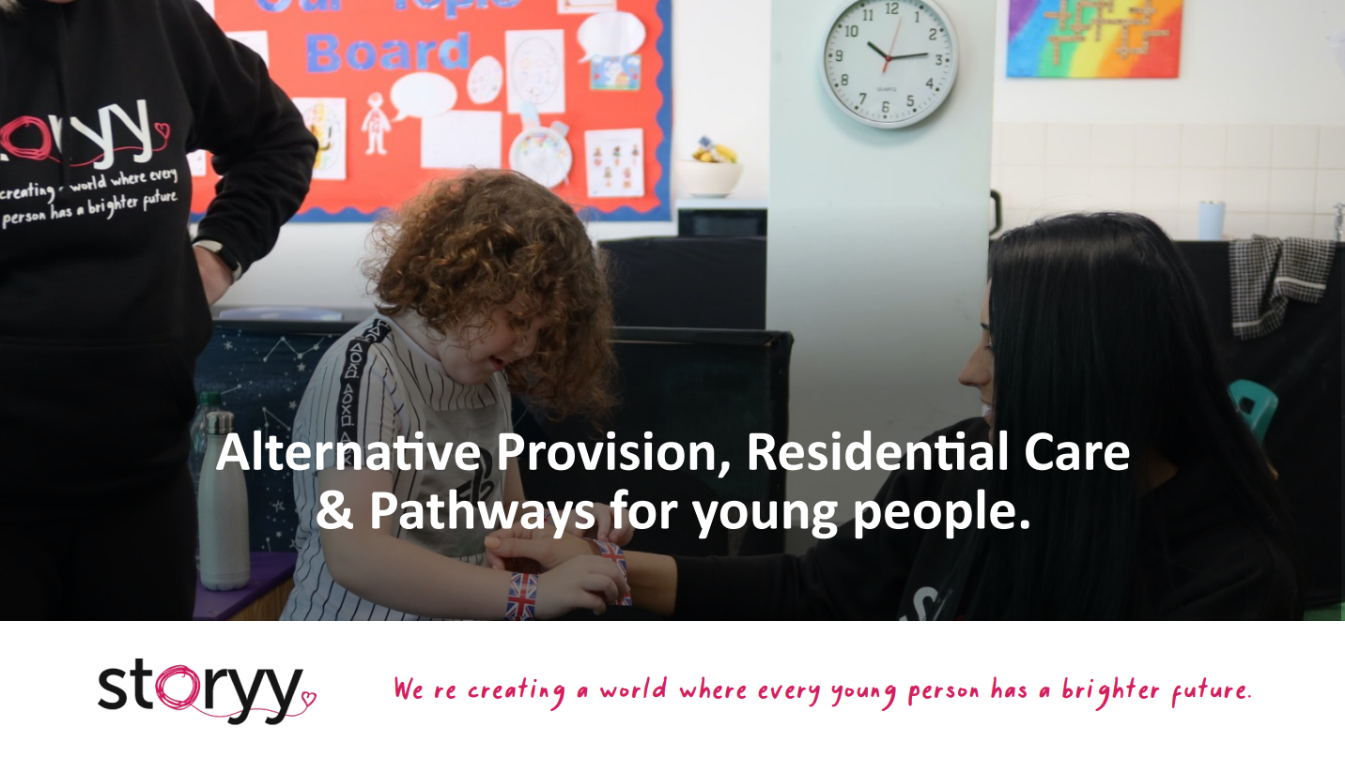
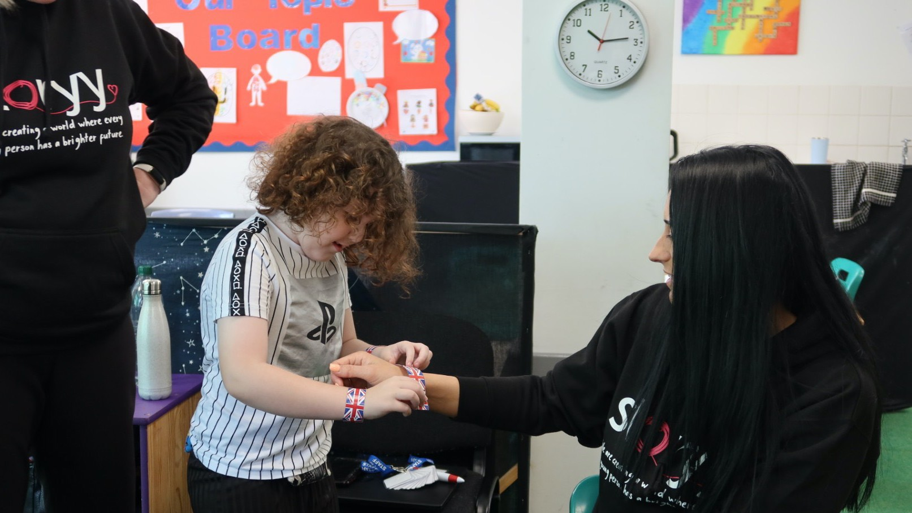


Alternative Provision, Residential Care & Pathways for young people.
We 're creating a world where every young person has a brighter future.

Slide 34
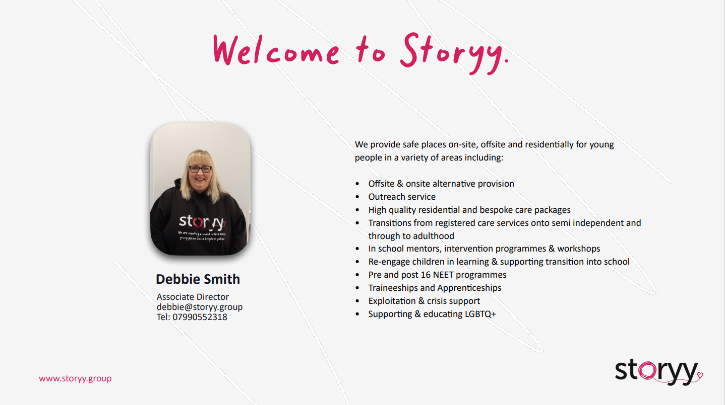


Welcome to Storyy
We provide safe places on-site, oﬀsite and residentially for young people in a variety of areas including:
Oﬀsite & onsite alternative provision
Outreach service
High quality residential and bespoke care packages
Transitions from registered care services onto semi independent and through to adulthood
In school mentors, intervention programmes & workshops
Re-engage children in learning & supporting transition into school
Pre and post 16 NEET programmes
Traineeships and Apprenticeships
Exploitation & crisis support
Supporting & educating LGBTQ+
Debbie Smith
Associate Director debbie@storyy.group Tel: 07990552318
www.storyy.group

Slide 35
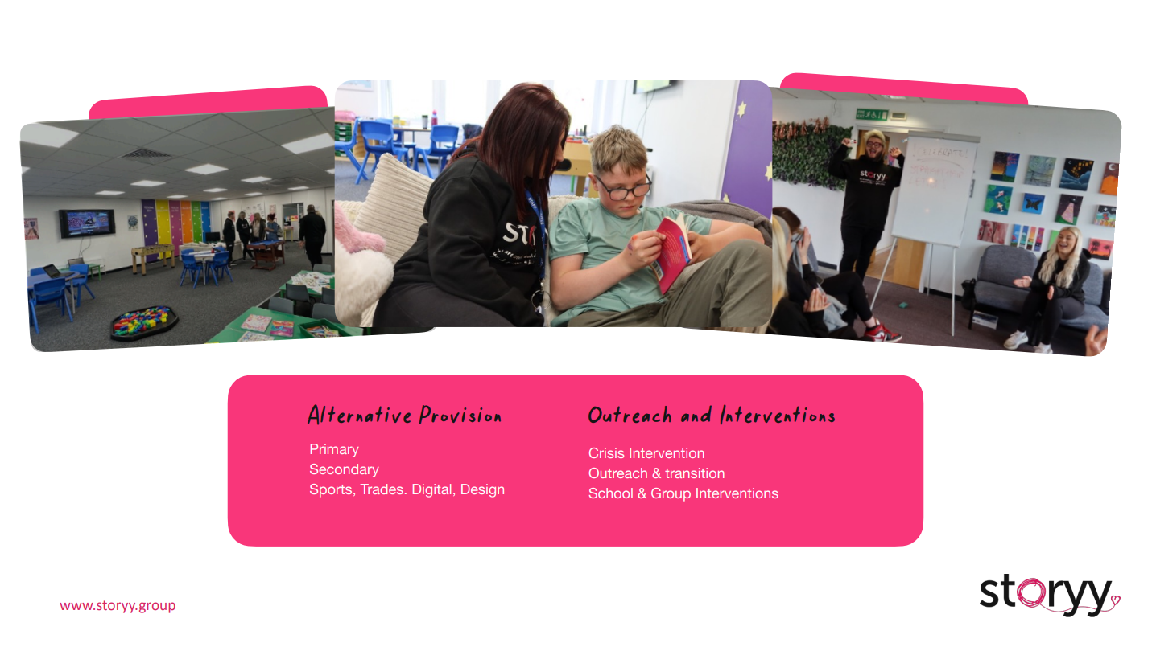
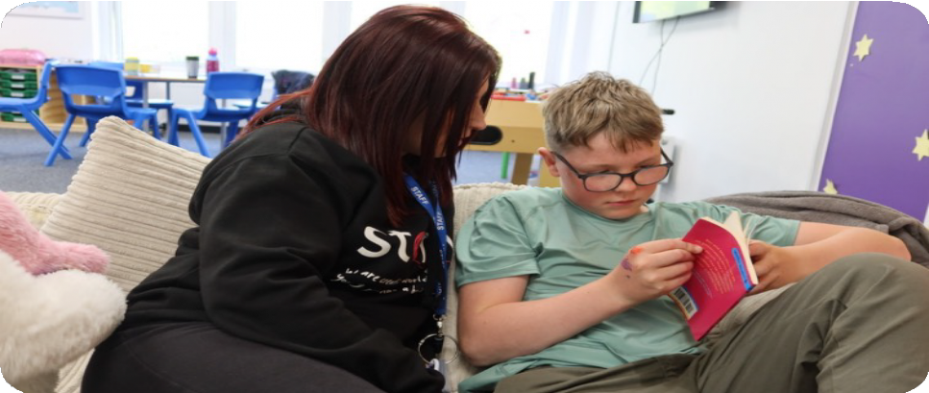
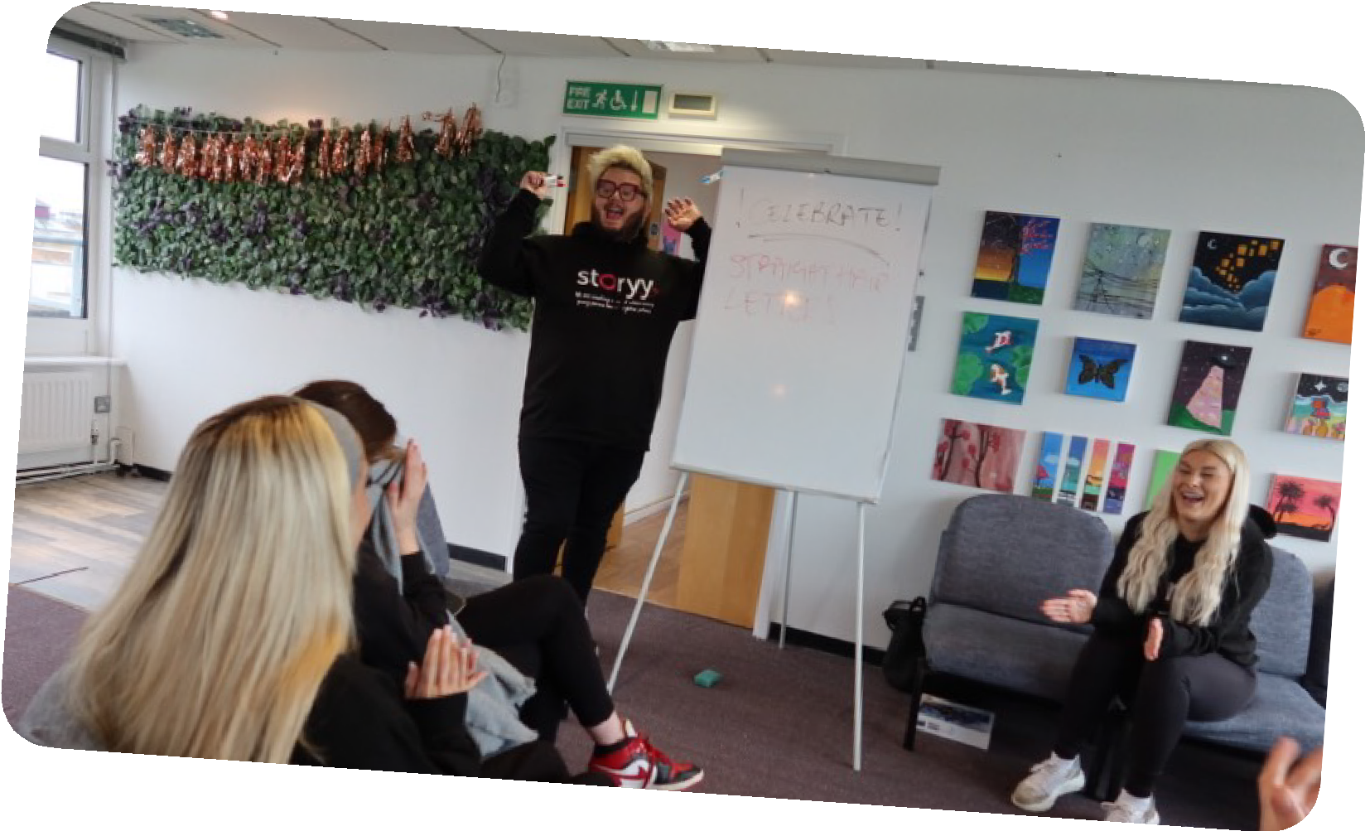
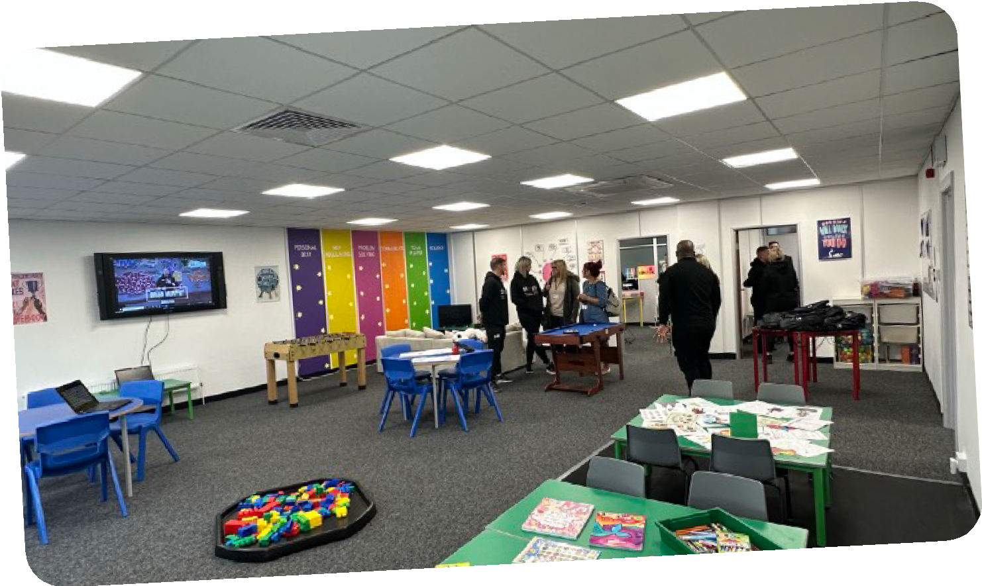
Alternative Provision
Outreach and Interventions
Crisis Intervention Outreach & transition
School & Group Interventions
Primary Secondary
Sports, Trades. Digital, Design
www.storyy.group

Slide 36
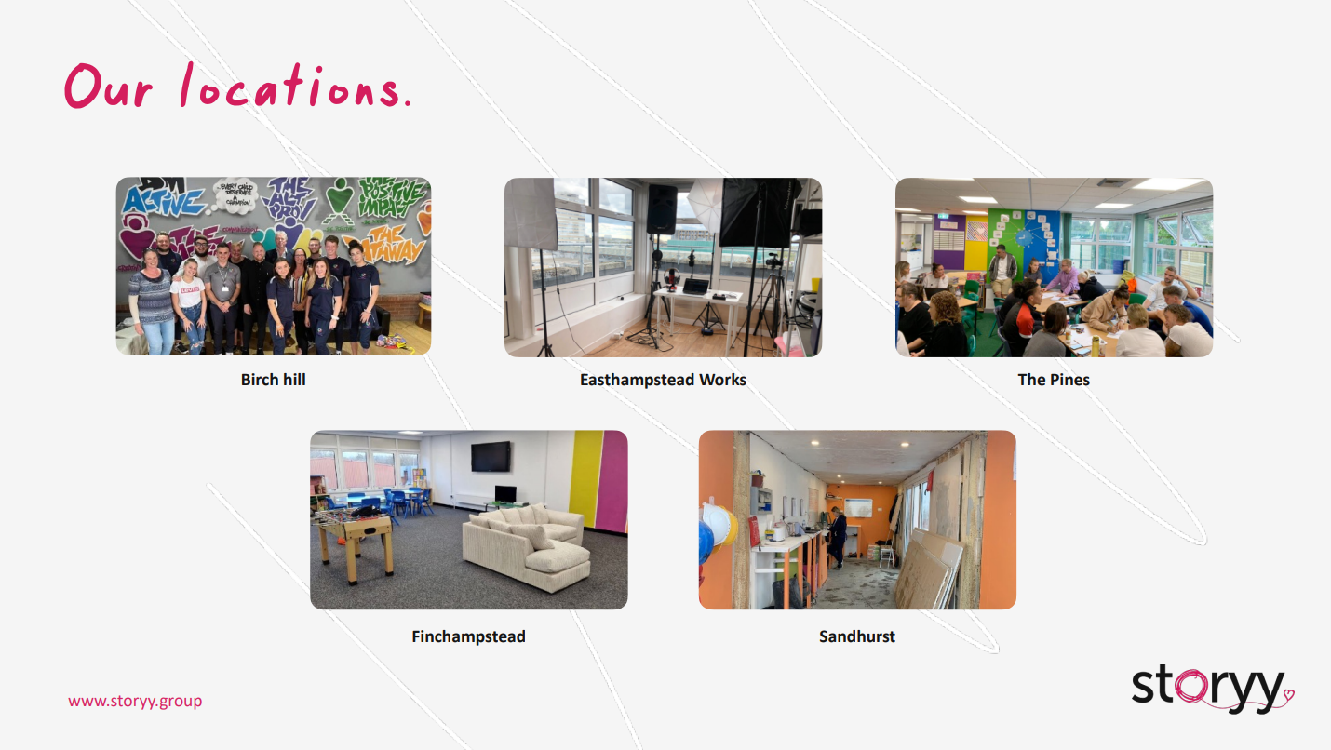
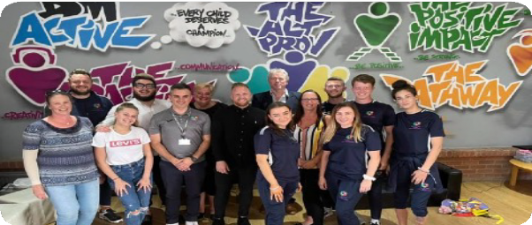
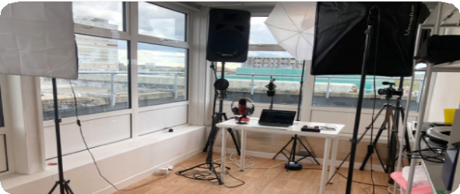
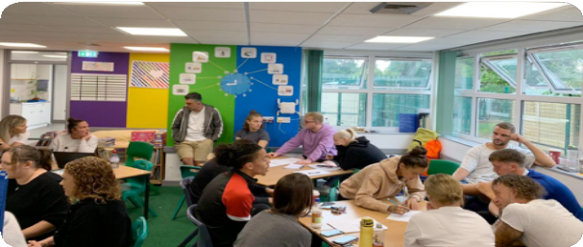
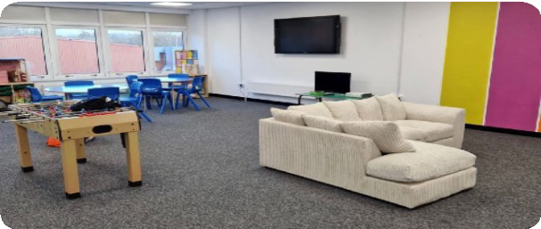
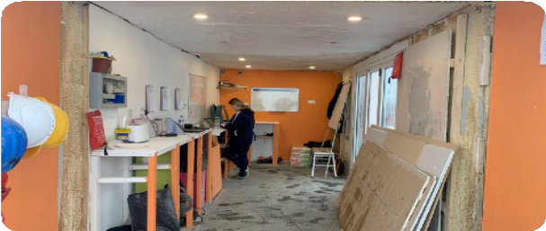
Our locations
Birch hill
Easthampstead Works
The Pines
Finchampstead
Sandhurst
www.storyy.group

Slide 37

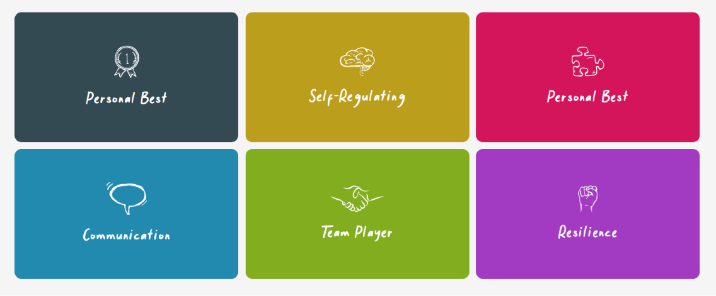
The tools to write their own storyy
Using our own experience and in-depth research, we’ve defined six key learning drivers that make life better for young people – improving their wellbeing, confidence and attitude towards learning.
You’ll find these learning drivers rooted into each of our services.
www.storyy.group

Slide 38


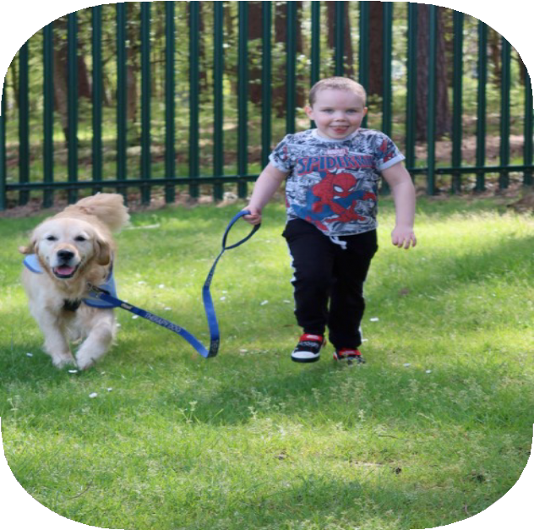

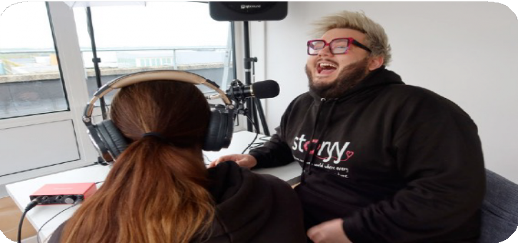

Referrals
If you have a referral or would like to chat to us about a young person in your care then this is the place to start:
www.storyy.group/referral
Alternatively, feel free to drop us a line on 01344860868.
www.storyy.group

Slide 39


Slide 40
Mental Health & Wellbeing Updates
Rebecca Askew

Slide 41
Wellbeing Service
Mindfulness
Providing calming strategies to reduce anxiety by bringing focus and awareness to the present
Whole School Environment Development
Mental Health & Wellbeing Framework
Play and Creative Arts Therapy (ages 5-18)
Therapy using toys and creative arts materials to express emotions. Combining verbal and non-verbal methods
Training for Schools and Children Services Professionals
Bespoke and PPEPCare Training for Schools
Filial Therapy Teaching parents non-directive play skills so they can undertake therapeutic play sessions
CBT Informed Strategies
For low-mood and anxiety. Interventions for young people to help with the 'here and now'
Emotional Wellbeing
Assessments
Evidence based assessments for young people whose referral has been accepted. Ensuring an individual therapy plan is formulated.
School Workshops
Mental Health Ambassadors
Anti-stigma mental health workshops and assemblies
Attachment Focused Therapy
A family therapy intervention to explore attachment trauma and start the repair process
Therapeutic School Groups Developed using a needs analysis approach with schools
Notes:
The Wellbeing Team is currently comprised of 1.8fte Psychological Wellbeing Practitioners who have been supported since July 2020 by 1.5 wte Emotional Wellbeing Practitioners from the Getting Help Team (employed by Berkshire Health Foundation Trust, BHFT).
Support from the team is open to all children and young people attending Windsor and Maidenhead schools (5 to 18 years).
The team currently offer Play and Creative Arts Therapy, Dyadic Developmental Psychotherapy, Cognitive Behavioural Therapy (low-Intensity). Alongside this the team offer training for staff, parents and young people, as well as therapeutic groups such as the ‘exam anxiety group’.
The WB team was set up in response to increasing concerns about the mental health and wellbeing of children & young people (C&YP) and was specifically identified by school audits as an area of need.
Interventions offered:
Individual short term interventions up to 12 weeks/ 15-20 weeks DDP/CBT – (OCD/PTSD)
Group Work – Mindfulness, Managing Anxiety, Exam Anxiety, Parent Support Groups – Managing Childs anxiety, Braywick Outdoor Nurture Programme.
Emotional Wellbeing Champions – Anti-Stigma Mental Health Campaigns
Mental Health Training – Parent Seminars, PPEPCare for school staff and other professionals and bespoke training.
Wellbeing Framework – Whole School Approach
0.4 of time offered to social care – has been focused on CBT – going through process of change to DDP – including a consultation approach to social workers.
How to access Wellbeing Team support?
Individual and group support via the Early Help Hub
Group Work – via the school and link Wellbeing Practitioner
PPEPCare Training, Emotional Wellbeing Champions – Contact Wellbeing Practitioners for further details and/or referral forms

Slide 42
Wellbeing Service (September 2021 – August 2022)
From September 2021- August 2022 a total of 172 individuals (42% males and 58% females) were referred to the Wellbeing and Getting Help Team from 55 RBWM schools.
10 parents attended the Managing my Child's Anxiety course (online) - Helping Your Child (F2F)
6 attended one of the Child Parent Relationship Therapy Groups.
17 young people (65% male and 35% female) accessed individual Play Therapy, the average age 8 years old.
5 young people (3 male and 2 female) completed a counselling/ trauma informed counselling intervention of 12-18 weeks.
51 young people attended the Emotional Wellbeing Champions course in 2022 – Mental Health Ambassadors
98% of participating students answered agree or strongly agree to the following questions:
‘The training day increased my knowledge about mental health and wellbeing.’
‘I learned some new self-care tips and ideas.’
‘I feel confident in sharing what I learnt with others in my school’
96% of participating students answered agree or strongly agree to the question
‘The learning was easy to understand.’
93% of participating students answered agree or strongly agree to the question
‘I understand what can affect someone's wellbeing.’
Notes:
(15 schools 2022/2023)

Slide 43
89% of participating students answered agree or strongly agree to the question ‘The activities were fun and engaging.’
87% of participating students answered agree or strongly agree to the question ‘I feel confident in recognising feelings in myself and others.’
When considering the programme as a whole, 96% of participating primary school students felt that it was beneficial to their school as a whole, and 91% shared that they now felt more confident in talking about their feelings.
Some of the campaigns that the champions ran in their schools included:
Having a worry bench for students to use at break times.
Presenting assemblies to the whole school / forms / classes.
Introducing worry boxes and/or positivity boxes within the school.
Providing opportunities to learn sign language to be able to sign feelings and therefore make it more accessible and inclusive for all.
Using slogans to help their messages be more memorable.
Sharing the ‘stress bucket’ activity with others in the school.
Creating videos to share with classes and parents around the theme of ‘worries’.
Using stories to help generate discussions.

Slide 44
Summary of the presenting difficulties of young people referred to the Wellbeing Service September 2021- August 2022. It should be noted that some cases had more than one presenting difficulty. Following initial assessment and consultation a primary need was identified and appropriate intervention was suggested.
Anxiety (unknown) 96
Other 24
Low Mood & Depression 12
Attachment Difficulties 11
Emotional Regulation 10
Anger Management/Behavioural Difficulties 6
Separation Anxiety 3
Self-Esteem/Confidence 3
GAD (Generalised Anxiety Disorder) 2
Bereavement 1
PTSD (Post Traumatic Stress Disorder) 1
Phobia 1
Panic 1
Self-Harm 1

Slide 45
Mental Health Support Team
Mental Health Support Team (MHST) have been fully operational since Sept 2021.
The MHSTs support children and young people in 14 RBWM schools (and the virtual school) who have emerging, mild or moderate mental health difficulties which may be affecting their day to day life.
Depending on the age of the child or young person, The team will either work directly with them or with their parents. They also work with school staff and offer support on different levels, with the aim of developing and supporting a whole school approach to mental health.
BA - Behavioural Activation
GE - Graded Exposure
WM - Worry Management
CR - Cognitive Restructuring
IY - Incredible Years Parenting Intervention for challenging behaviour
HYC - Helping Your Child - Child and parent intervention for child anxiety.
The MHST will start to disseminate the information they share with their link schools to other schools across RBWM.
The MHST and GHT will also be involved in the roll out of the Link actions from the Anna Freud Programme delivered last academic year. MHST involvement will focus on formulations, use of standardised measures and ROMS and evidenced based interventions for mental health and wellbeing (the key areas highlighted for improvement in RBWM though the Cascade tool).

Slide 46
Mental Health Support Team
Selection criteria
Areas of deprivation: The total of ACORN 4s and 5s is typically used as an indicator of deprivation. For RBWM the average of ACORN 4 and 5 is 21% (for comparison the lowest RBWM school 2%, median 20%, highest 59%)
% of unauthorised absence and % total absence (school)
Number of pupils eligible for free school meals
Number of Children/Young People with an EHCP
Number of Children/Young People with Social, Emotional and Mental Health (SEMH) needs with an EHCP and receiving SEND Support
Number of Children/Young People with SEND/receiving SEND Support
In addition, the selected schools were also required to meet the following criteria:
Commitment from school leadership teams and an identified mental health lead as a point of contact for the trailblazer and the level of commitment to partnership working
Ofsted Ratings of 1, 2 or 3 (Outstanding, Good or Requires Improvement)
A range of educational settings from primary through to secondary/college provision including special school provision.
8,000 pupil population per Mental Health Support Team

Slide 47
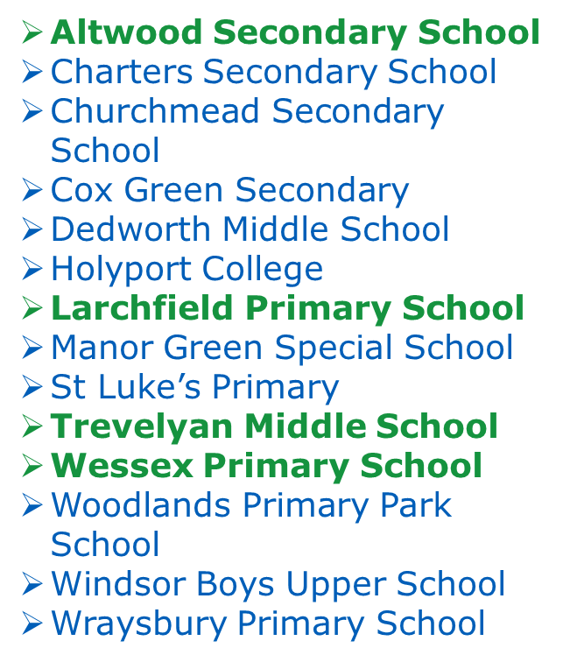
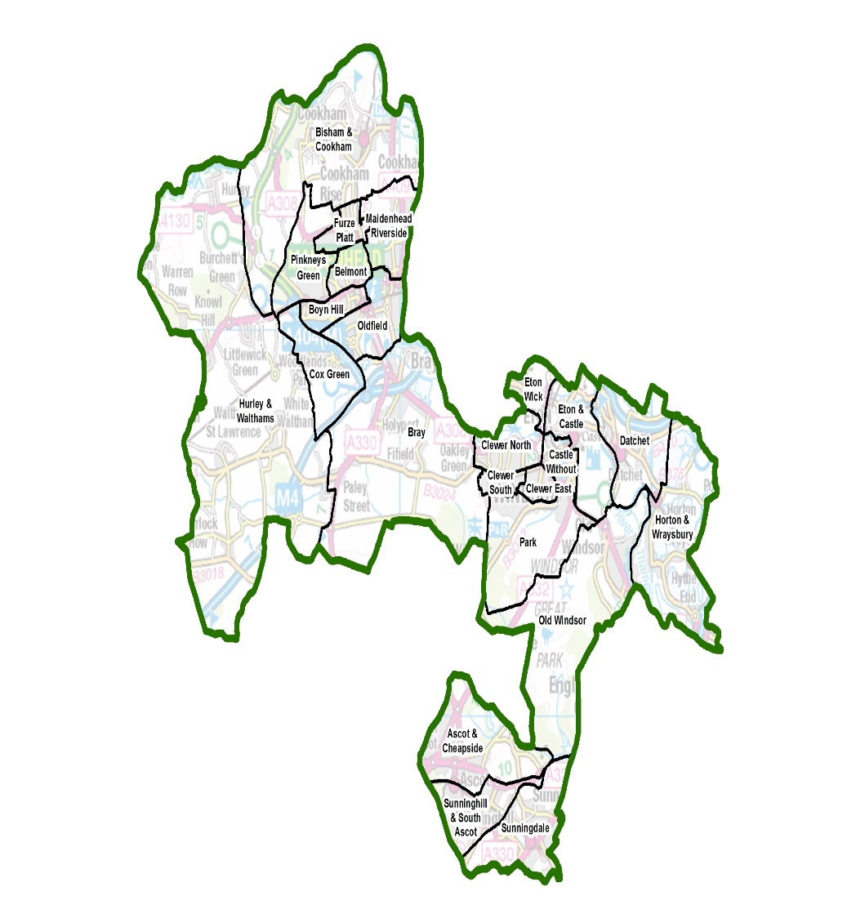

Slide 48
MHST – Royal Borough of Windsor and Maidenhead
Service Manager
Vicki Livingstone 1wte
Team Lead
Rhona Edwards 1wte
Business Support Manager(B5)
Lucy Jacobs
1wte
Senior Psychological/ Therapist (B6)
Katherine Radcliffe 1WTE
Psychological Supervisor Therapist(B6) Katie Clemmings 1wte
Admin
Jaspreet Bhambra(B4)
0.50 wte
Parenting and Family Worker
(B )
Jenny vanDyk
0.33wte
EHMP
Dunette Griffiths (B5)
1wte
EHMP
Bahara Fourgh(B5)
1wte
Trainee EHMP
Anisha Chandla(B4)
1wte
Trainee EHMP- (B4)
Julie Fairbank
1wte
Admin
Claire Kingsley(B3)
0.50 wte
Works across all 3
East Berkshire localities

Slide 49
Getting Help Team – Royal Borough of Windsor and Maidenhead
Service Manager
Vicki Livingstone
1wte
Team Lead
Rhona Edwards 1wte
Business
Support Manager (B5)
Lucy Jacobs
1wte
Clinical Supervisor (B6)
Bonnie Brittle
1wte
Qualified CWP(B5)
Farzana Miah
1wte
Qualified CWP (B5)- Rachel Briggs
1wte
Assistant Psychologist(B4)
Ludovica Di Guardo
1wte
Admin
Jaspreet Bhambra(B4)
0.50 wte
Parenting and Family Worker
(B )
Jenny vanDyk
0.33wte
Trainee CWP (B4)
Smmea Khan
1wte
Trainee CWP (B4)
Danielle Atkinson
1wte
Admin
Claire Kingsley(B3)
0.50 wte
Works across all 3
East Berkshire localities
Notes:
Bonnie will need to complete training prior to end of probation period.

Slide 50
EMHPs CAN DO | EMHPs MAY DO Discretion and close supervision | EMHPs SHOULD NOT DO Significant levels of need /complex conditions
Behavioural difficulties – identification, and brief parenting support |  | Conduct disorder, anger management, full parenting programmes (e.g. Triple P, Solihull Approach)
Training parents and teachers to support interventions with children |  | Treatment of parent’s depression and anxiety
Low mood | Irritability as a symptom of depression – (can present as anger) | Anger management training, chronic depression
Worry management | Low confidence, assertiveness or interpersonal challenges – e.g. with peers | Low self-esteem, social anxiety disorder
Anxiety/Avoidance e.g. simple phobias, separation anxiety | Some short-term phobia exposure work | Extensive phobias e.g. blood, needles, or vomit phobia
Panic management |  | Not trained to deliver interventions for panic disorder
Assessing self-harm and supporting alternative coping strategies. Pupils with history of self-harm, but not active. | Thoughts of self-harm, superficial self-harm. Basic harm reduction techniques | Severe, active, high risk self- harm
Sleep hygiene | Insomnia | PTSD, trauma, nightmares
Thought challenging – negative automatic thoughts
Problem solving | Assessment of complex interpersonal challenges | Relationship problems: counselling for issues such as relationship problems may be better suited to school counsellors
 |  | Any level of OCD, attachment difficulties or ritualistic behaviour
 |  | Assessment and diagnosis of neurodevelopmental disorders and learning difficulties
 |  | Pain management
 |  | Historical or current experiences of abuse or violence

Slide 51
RBWM Social, Emotional, Mental Health and Wellbeing Interventions
Emotional Literacy Support Assistants (ELSA) is an evidence based school intervention programme which strengthens school capacity to support CYP with mild to moderate social, emotional and behavioural difficulties.
As part of the quality assurance process, all new ELSAs attend the six day annual training programme (RBWM EPS) and are subsequently supervised by RBWM Educational Psychologists on a half termly basis. The ELSA training booking form will be sent to schools next half term.
RBWM Educational Psychology Service have been awarded the ELSA Network Quality Standards Mark.
PPEPCare
Emotional Health & Wellbeing Webinar and Resources Programme Offer for Education Settings and Wider Partners. Whole School/Service model
YogaBugs are giving every primary school within every LEA across England access to our bronze membership YogaBugs virtual platform completely FREE.
2 full length P.E yoga sessions for each Key Stage
2 Classroom yoga for EYFS
2 Classroom yoga for KS1
2 Classroom yoga for KS2
2 Bugs Brain Breaks per Key Stage
2 Breathing exercises per Key Stage
5 Mindfulness resources
Notes:
The Link Programme - Spring 2022 (Anna Freud)
Up to 50 upper tier local authorities can take part in the 2021 to 2022 academic year, including: 25 in wave 1 (from September 2021) and 25 in wave 2 (from January 2022)
This programme:
brings together local partners who can support children and young people’s mental health and wellbeing
offers structured sessions to identify priorities and agree goals to promote and support good mental health and wellbeing
supports the locality to develop a tailored action plan that will feed into strategic planning
delivers tailored support sessions focussed on improving joint working between education and mental health professionals, based on the needs assessment and goals
offers a progress review and support at three and six months to help embed change locally
10 hours over approximately 8 weeks.

Slide 52
CAMHS Developments
Collaboratively defined, evidence-based clinical pathways
High quality, timely clinical interventions to meet the needs of children, young people and their families
Appropriately skilled CAMHS clinicians, resourced to manage complex presentations and high demand
Outcomes understood and utilised to create positive outcomes for patients
Improved experience for everyone in CAMHS This project in and of itself, will not provide a ‘quick fix’ to the waiting list challenges, but it will enable more clarity about what should be offered, what skills and resources are needed, and what the gaps are between demand and capacity.

Slide 53
CAMHS - What is in place?
Nine Clinical Care Pathways agreed
First episode psychosis/mania
Anxiety disorders
Trauma/PTSD
Eating Disorders (not including ARFID)
Emotional Dysregulation
6. Depression
ADHD
ASD
Tic disorders
Agreed Routine Outcome Measures for each Pathway
ePathways, including ROMS, built into RiO
Demand/capacity information
Workforce and training needs review
Transition Pathway
Pathways on a page

Slide 54
Additional Info
Notes:
54

Slide 55
GRIT A 4MOTION CREATIVE WELLBEING PROGRAMME FOR YOUNG PEOPLE
GRIT: A creative wellbeing programme for young people
- 9-week programme running every Thursday 4-6:30pm and Friday 5-6:30pm
- Delivery dates: 25th May - 20th July 2023
- Venue: 4Motion Studio and Loading Bay Cafe, Kardelton House, Vansittart Estate, Windsor, SL4 1SE
- FREE to all young people living in RBWM
- Suitable for 11-18 years
- FREE transport available
- Weekly workshops include: Cooking, music, DJ’ing, creative arts, dance, wellbeing and a social hot meal shared as a group each week
- Contact details to join GRIT: hello@4motioncic.com | 01344 202 425
Children and Young People’s Plan
https://rbwm.afcinfo.org.uk/pages/community-information/information-and-advice/rbwm-children-and-young-people's-partnership/children-and-young-people-s-plan

Slide 56
Questions and
Feedback Form
Notes:
56

