Slide 1
SEMH Network Meeting
Tuesday 21st May 2024
Welcome to this virtual forum
Notes:
1

Slide 2
Agenda for today
SEMH Intervention Service –
Schools Consultation Form
Item | Who | Time
Welcome and Updates | Al Whitelaw Abigail Gilbert - ERSA | 3.30 pm (10 mins)
Storyy Gp Assemblies | Lee Barefoot Brad Clapson Arran Bayle | 3.40pm (15 mins)
Family Hubs update BREATHE | Chris Caughey | 3.55pm (15 mins)
Get Berkshire Active | Ryan Gordon | 4.10 pm (15 mins)
Nudge Education | Ben White – Cancelled = PEAR | 4.25 pm (5 mins)
Boxing Evolution | Matt Flavell | 4.30 pm (5mins)
Questions and Feedback
https://www.leadershipupdate-rbwm.co.uk/semh-service/
https://www.leadershipupdate-rbwm.co.uk/information-for-all-schools/

Slide 3
Pupil Inclusion & Support Manager
Al Whitelaw 07562 434 921
Business Support (0.4)
Maria Sumner 07921 846320
Education Welfare Service
Inclusion & Access Team
SEMH Intervention Service
Education Welfare Officer
Jo Barnes 07775 406 036
Inclusion & Access Manager
Rosie Gossage 07704 300 093
Behaviour Support Practitioner
Cherrelle Long 07770 811 755
Education Welfare Officer
Amber Chapman 07754 858 149
Elective Home Education Coordinator
Harmit Thiara 07955 436 162
SEMH Coach/Mentor
Debbie Nayar 07545 650 021
Education Welfare Officer
Wendy Bould 07905 716 690
Children Missing in Education Coordinator
Nico Auckbur (June)
SEMH Coach/Mentor
Sofia Sattar 07541 491 290
Education Welfare Officer
Annette Taylor 07732 825 674
SEMH Coach/Mentor
Tori Tompkins 07928 512533
Specialist EWO for children with a Social Worker
Vacant
Education Welfare Officer
Bella Wilson 07849 733 569
SEMH Coach/Mentor
Zoe Toynan 07386 688312
SEMH Intervention Service – Schools Forum Paper November 2024 – Extension until April 2026
SEMH Consultation Form.

Slide 4
SEMH Intervention Service
Service started in September 2019
45 schools support with an SEMH Coach/Mentor.
25 schools revisited for additional support.
114 children at risk of Permanent Exclusion supported.
4 subsequently Permanently Excluded.
Training schools staff
Creating a Climate For Learning = 895
SEMH Update Training = 184
Bespoke training = 47
Initial Teacher Training = 81
SEMH Network 3 times a year
SEMH Leads = 192
PEAR

Slide 5
Abigail Gilbert
Educational Psychologist
ERSA Toolkit Feedback - Form
Friday 24th May.
https://docs.google.com/forms/d/e/1FAIpQLSc2PjJAsBHEzQU_Iuj95-Mk8OC72tamBuRSeVPVcMZm1hxMwg/viewform?usp=sf_link

Slide 6
Storyy Group
Lee Barefoot
Brad Clapson
Arran Bayle

Slide 7



Slide 8

T he assembly themes we offer:
Knife Crime Awareness
County Lines
Drug Running
LGBTQIA+
Anti Bullying
Cyber Bullying
Sexual Explotation

Slide 9


Knife Crime Awareness:
Aim at secondary schools and targeted areas for schools with high knife crime rates, educating students on the legal implications and offer personal experiences.

Slide 10

County L ines:
Aimed at secondary schools educating on recognising the signs of being groomed and how they will
be recruited.

Slide 11

Drug Running:
Aimed at secondary schools to raise awareness around the legal and social implications of running drugs.

Slide 12

LGBTQIA+
Understanding the different communities in the LGBTQIA+ group and discussions on pronouns and ally-ship.

Slide 13

Anti Bullying
The cause and effect from bullying within a school setting, the effect on the person being bullied and the effect on the bully.

Slide 14

Cyber Bullying
Raising young peoples awareness both primary and secondary around what constitutes online bullying relating to comments and posts.

Slide 15

Sexual Exploitation
Understanding what Sexual Exploitation is and recognising the signs of this within your community and those around you

Slide 16
www.storyy.group / hello@storyy.group

Slide 17
Family Hub Update
Chris Caughey

Slide 18
General Updates
2023/24 annual report (see graphic)
Number of families waiting is up - Jan/Feb allocations (most families allocated within 4 months)
Youth (17) SM (3) FHW (17) Coach (26)
FHS/HV/SN working closer together

Slide 19
BREATHE
Groups 2024
31 young people have so far been referred to two programmes, one in Maidenhead and one in Windsor in 2024.
17 young people were referred to the Maidenhead group running February - May, 12 places were confirmed with 7 young people attending the first session. From week 2 there have been 5 regular attendees who have 100% attendance, all young people are female.
The next planned group in Windsor starting in June has 14 young people referred.

Slide 20
Summer Transitions
28 initial referrals received
13 schools referred + EHE/Alternate Provision
Successful referrals will be confirmed in the next 1-2 weeks
Increased need compared to last year
Exploring two groups based on numbers

Slide 21
Parenting Programmes
Triple P - Group/1-1/Online
Incredible Years
SPACE
BAME: Stress Management and Family Links
Baby Massage
Freedom
https://rbwm.afcinfo.org.uk/pages/community-information/information-and-advice/family-hub-service/support-for-parents/group-programmes

Slide 22
Get Berkshire Active
Ryan Gordon

Slide 23


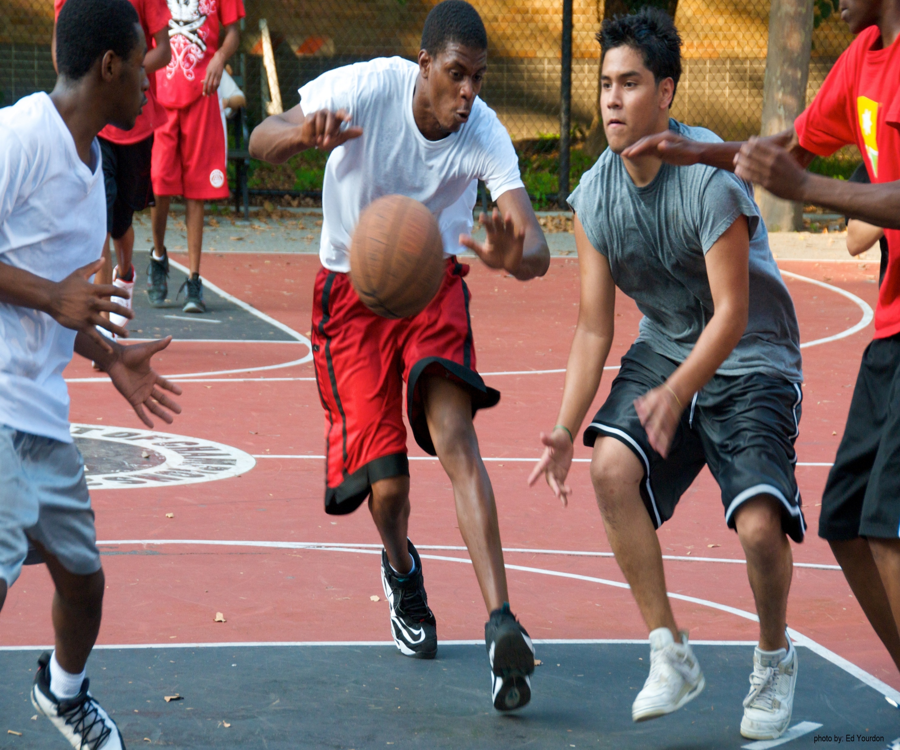
RBWM Targeted Community Sports Referral Programme
Notes:
Welcome
Introductions – your name, role and organisation in the chat please
Cameras on if possible

Slide 24


Overview of the Programme
Programme Aim
Supporting young people showing at ‘risk behaviors’ to access opportunities in sport and physical activity to create more pro-social outcomes
How
Supporting and placing (covering the cost) vulnerable young people and those at risk of violence/exploitation in community sporting activity
Partnering with experienced community sports clubs to put the young person at the heart of this project, promoting positive behaviors through being inclusive, participatory and trauma informed
Link up referral partners with sport, so sport becomes part of their ‘toolkit’
Supporting the community sport providers to deliver evidence-based interventions
Provide front line support to build capacity, capability and sustainability within community sport

Slide 25
Who for and what sports:
Who is eligible to access the project?
Young people aged 10-24yrs old, that are experiencing at least one of the following:
At risk of exclusion from school or college
Skipping or missing school (Emotional based school avoidance)
Involved in anti-social behavior
Involved or known by the police
At risk of gang related involvement or exploitation
Attended A&E due to violence or risk-taking behavior
Caught carrying a knife or weapon
Involved in substance misuse
Sports we have involved so far: the list is growing
Boxing
Football
Basketball
Gym
Rugby
Coaching and Leadership
Olympic Wrestling
Softball
Cricket
Mixed Martial Arts

Slide 26
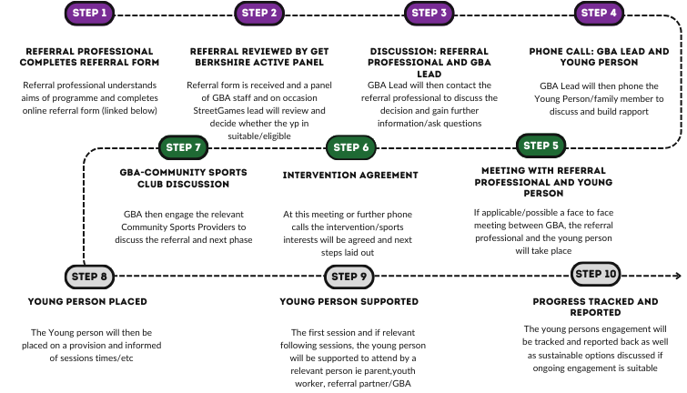
Referral Timeline:
Notes:
STAGE 1: Referral and Initial Engagement
STAGE 2: Intervention Options
STAGE 3: Placement and Further Support
-Referral form can be found here: Targeted Sports Referral Programme
-Once the referral has been submitted the GBA panel will discuss outcomes and next steps. The panel will consist of
Ryan Gordon (Lead for Workforce and Network Resilience), Izzy Heath (Physical Activity Development Officer) and
Nick West-Oram (Director of Operations)
-Engagement will start with the referral professional and then the young person and their family(if applicable)
-Discussion whether 121 support is needed or if the young person can join open provision
-GBA liaise with relevant sports providers/121 workers to establish support offered and logistics
- Young Person is placed into provision and supported in initial sessions either with a youth worker or other trusted
individual (if applicable)
-Attendance and engagement is tracked and reported back to GBA
-Placement on the programme is for a certain time (defined in STAGE 1 and 2) and suitable sustainable options will be
discussed

Slide 27
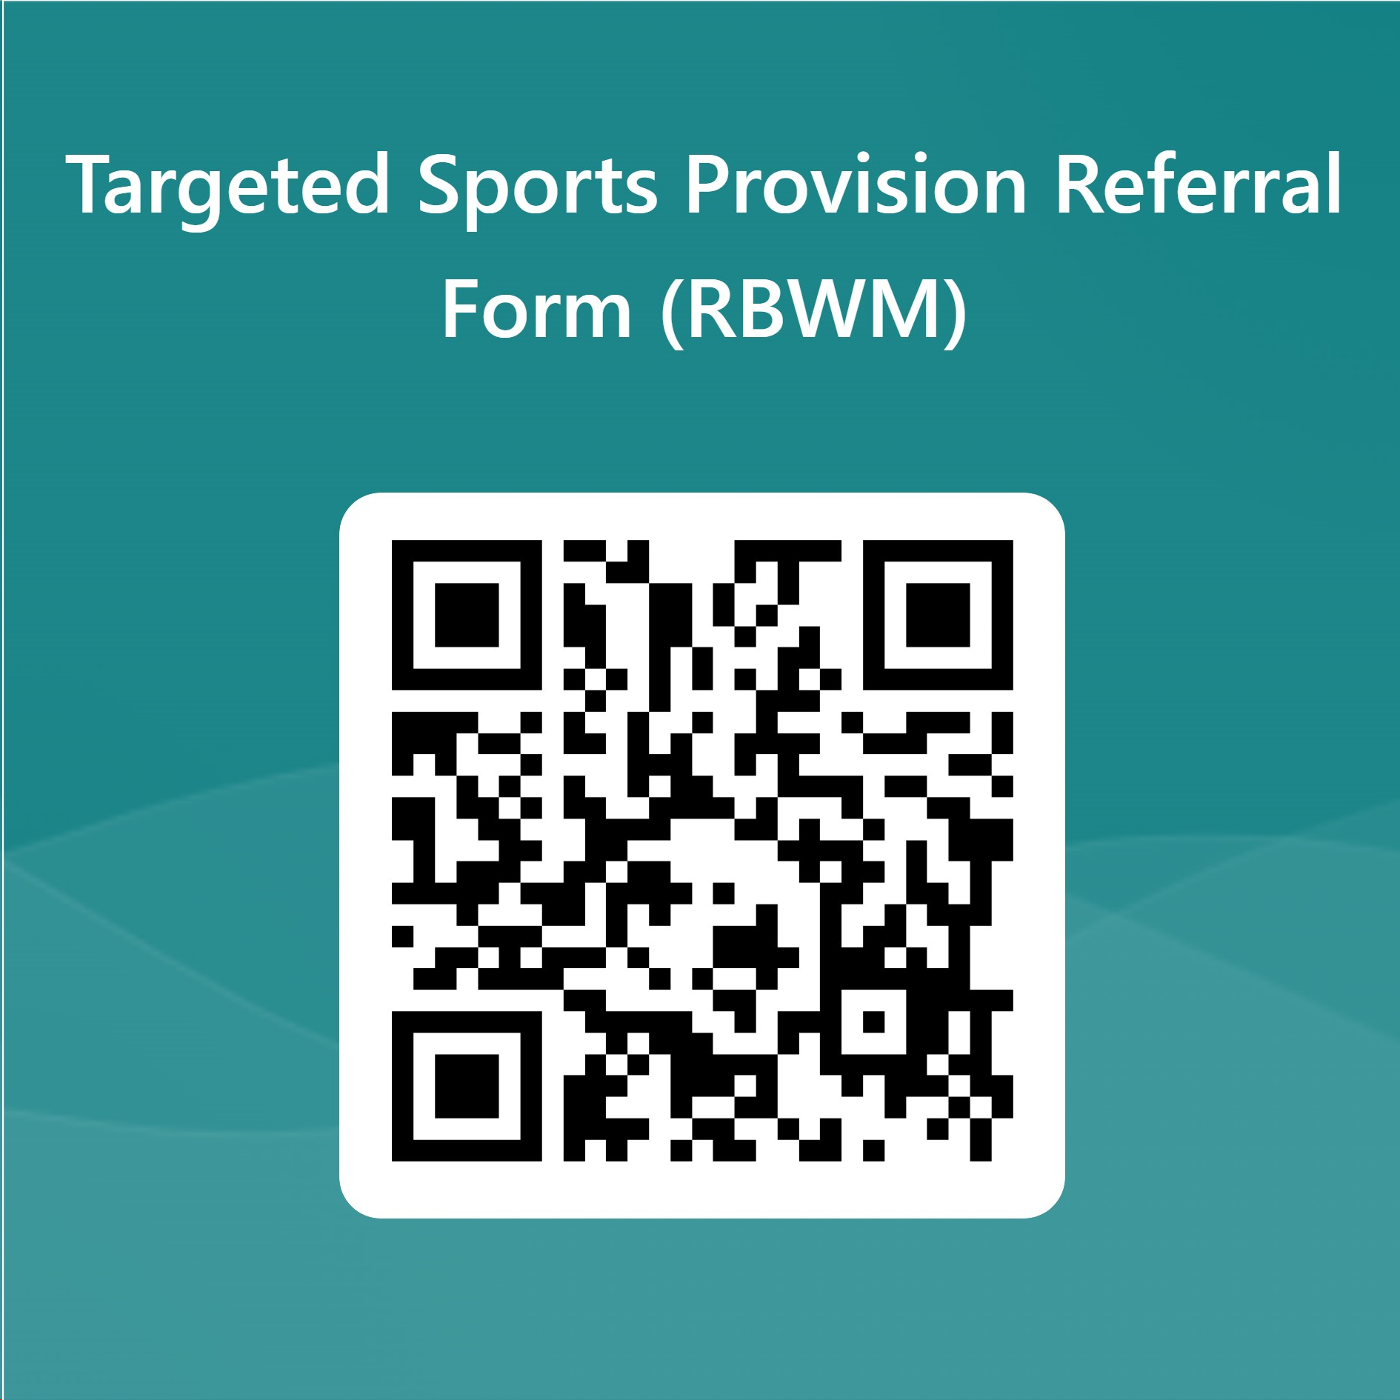
How to refer?:
We are open to referrals now, so please share the programme info (will send out after this) and the referral process far and wide:
Click on the link or scan the QR code which will take you to our referral form
Targeted Sports Programme Referral Form
Please encourage anyone who is filling out the form to put in as much detail as possible so we can process and work with the referral as quickly as possible….

Slide 28
PEAR
Nudge Education
Ben White
https://nudgeeducation.co.uk/nudgeeducation.co.uk/services/tutoring-for-schools-ntp

Slide 29
PEAR
The Pupils Educationally At Risk (PEAR) panel is multi-agency. It provides support, advice and guidance to schools but also can agree to support the funding of a place at AP for a pupil at risk of non-attendance due to them being:
medically vulnerable
at risk of permanent exclusion
or are experiencing Emotionally Related School Avoidance.
It also manages access to the following services
SEMH Intervention Service
The Anchor readiness hub
The PEAR Panel cannot financially support pupils who do not reside in RBWM or have an EHCP.
This process is intended for part-time, short term intervention, the result of which will see the pupil reintegrate back into school. Leadership Update Website
Requests are triaged by:
SEMH/ERSA - alasdair.whitelaw@achievingforchildren.org.uk
Risk of PEX - rosie.gossage@achievingforchildren.org.uk
Medically vulnerable - clare.raffaelli@achievingforchildren.org.uk
Anchor - amycrowle@eyfed.org.uk / rachel.goymer@manorgreenschool.co.uk / sarahcottle@eyfed.org.uk
Then the request form is completed and school will be invited to panel.

Slide 30
PEAR Highlights/data
2022/23
51 referrals (up by 12)
34 Secondary / 17 Primary referrals
45% Risk of PEx / 43% ERSA / 10% MV / 2% Not School Ready
1/23 risk of PEx were PExd (6 were the previous year)
45 % open to Early Help and Social Services.
8% had an EHCP (25% in 2022/23)
Every Child referred had identified SEN. 65% SEMH
35.3% qualified for PP. (RBWM - 15%)
£17,278.40 (50% funding)
Developments
The Anchor - Transition Hub - School Readiness
Panel Members and representation. (welcome visitors)
Quality Assurance where LA commissions through SEN (EHCP)

Slide 31

Boxing Evolution
Matt Flavell
https://boxingevolution.com/boxing-summer-camp/

Slide 32
Questions and
Feedback Form
Leadership Update Website.
All things SEMH and more.
Notes:
32

