Slide 1


SEMH Network Meeting
Virtual
28th September 2022
3.30pm – 5.00pm
Alasdair Whitelaw
SEMH Coordinator and EWS Manager
AfC
Providing Children’s Services for the Royal Borough of Windsor and Maidenhead

Slide 2

3.30 Welcome and outline of SEMH Network Meeting
3.35 Introductions and Updates – dysregulation feedback
3.40 Tracy Muschamp Family Friends
3.50 Danny Sweatman Lead Practitioner for Inclusion and Safeguarding Aylsham High – Norfolk
4.15 Networking Break – Q&A
4.30 Mamta Martin GEMS
4.45 Rebecca Askew updates
4.50 Feedback and Agenda items
5.00 Close
Agenda
Providing Children’s Services for the Royal Borough of Windsor and Maidenhead

Slide 3
Boxall
SEMH
EWS
Staff
Referral
Models of delivery
Developments
Staff
ERSA
Legal
New Guidance
61 Schools
47 Super User
Primary Yr 6’s (transition)
Developments
Providing Children’s Services for the Royal Borough of Windsor and Maidenhead

Slide 4
Family Friends
Tracy Muschamp
https://rbwm.afcinfo.org.uk/organisations/28774-family-friends-windsor-maidenhead

Slide 5
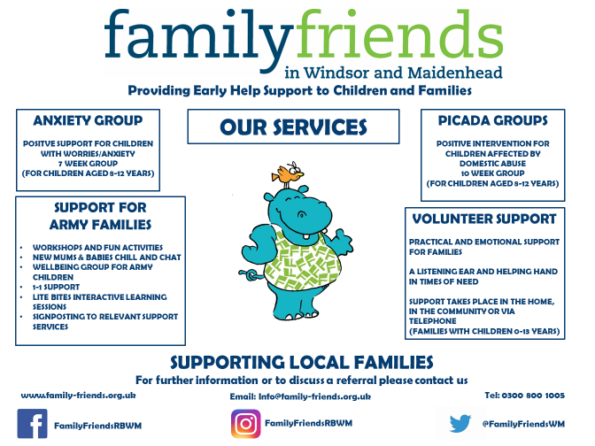


Slide 6
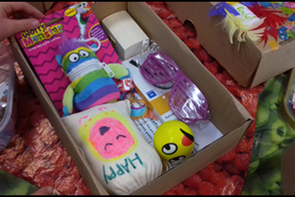
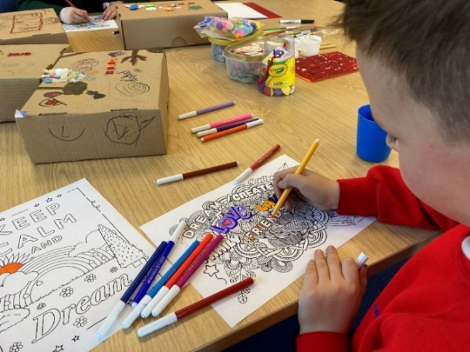
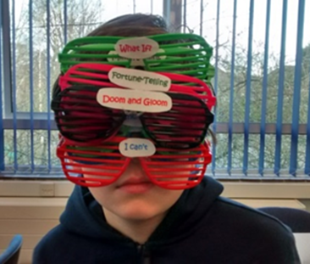
Anxiety Group…
For children 8-12yrs
Groups run once a week, 1.5hrs x 7 weeks
For children with worries/anxiety impacting on schooling, family life, self-esteem, social activities etc. (not extreme anxiety)
Small group (max 10 children)
Fun and interactive sessions with weekly messages and objects
Activities, video clips, discussion

Slide 7
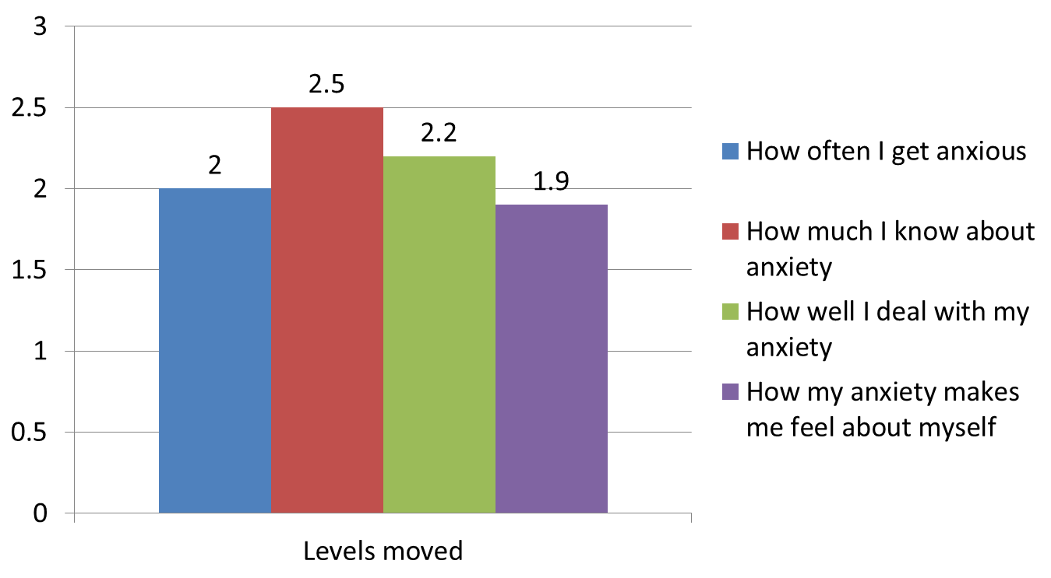
Outcomes…
Anxiety groups 2021-2022
Average levels moved (scale of 1-5)

Slide 8
Feedback from families…
“I liked the group a lot, especially week 5 when we got to eat chocolate! I liked that you had a message each week and an object that helps with the lesson…It has helped me so much and I feel less worried as I know more about what’s happening when I get worried. I learnt ways to calm down like breathing and I can go to my happy place.” (Child, Anxiety Group)
“We feel that our son has really benefited from attending this group. He has been able to tell us about anxiety and the effect it can have on your body. We feel it has really helped him to know there are other children who also struggle with their emotions and this has had a positive impact on his self-esteem. At home we have noticed that he has been less 'explosive', and he is managing to express himself in a more positive way. Thank you for all the care and effort that you put into running this group....we greatly appreciate your hard work.” (Parent, Anxiety Group)

Slide 9
Making a Referral…
Any agency can refer - complete referral form
Self referrals – contact by phone/email
The child/family must live in RBWM
Children attending must be able to engage in a structured group setting (not suitable for children who are disruptive/ aggressive)
Assessment completed with each child ahead of group
Contact: info@family-friends.org.uk
Tel: 0300 800 1005
tracy@family-friends.org.uk

Slide 10
Aylsham High
Danny Sweatmen

Slide 11



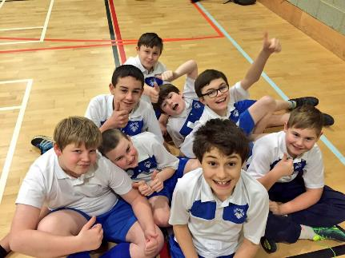
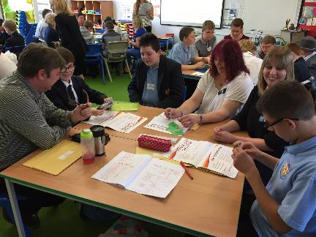
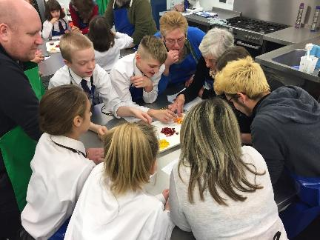
Nurture Provision – The Eagles
Danny Sweatman
Lead Practitioner for Inclusion and Safeguarding
and Head of @AHS_Nurture @aylshamhigh
dsweatman@aylshamhigh.norfolk.sch.uk

Slide 12

Aylsham High School
Medium sized rural comprehensive in North Norfolk – (roll of 1084)
In 2011 we formed The Aylsham Cluster Trust. In 2016 we then formed the Aylsham Learning Federation with Bure Valley School (roll of 255) to help support the development of education in Aylsham
In 2018 John of Gaunt Infant and Nursery School (roll of 150) joined the Federation and John Bears Nursery was established (roll of 90).
Nurture Quality Mark Award
Good reputation - care, guidance, SEND and pastoral support for our students and families
At present we have 198 students on our Special Educational Needs and Disabilities (SEND) register and 47 of these students have an EHCP. 18 of those with EHCP’s are from out of catchment
Currently have 11 Looked After Children on roll
119 students have accessed Nurture Provision – 10.9% of the school role

Slide 13

Nurture at AHS - How it all began…
2009 – Primary TES Jobs
BESD
10% of cohort – unable to engage
Challenge of Co-Morbidity – Does the need change your strategy?
Classic model?
Notes:
DS

Slide 14
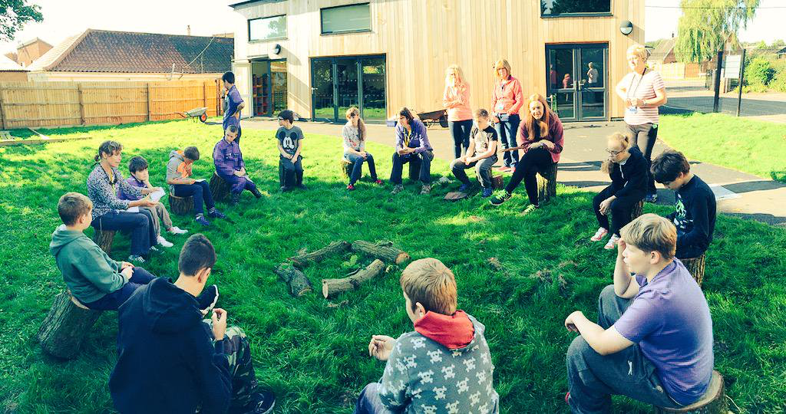
The Eagles
The AHS Nurture Group

Slide 15
The AHS Nurture Group
The Eagles
Is a small supportive class of up to twenty students run by ex-Primary School teacher and Nurture trained Mr. Sweatman and supported by a lead Nurture intervention teaching assistant and two learning support assistants
We aim to help secure effective transfer from primary school for our most vulnerable students
Students arrive with significant and complex social and emotional, learning or behavioural needs. Traditionally we found that these students were lost within the school community and that engagement with parents and carers was limited
The students are carefully selected according to their individual holistic profile of needs identified from Primary School and Parents/Carers, as well as using the Boxall Profile and other assessment methods. These needs are not linked to academic ability.
Ensures that students are given the academic, social and emotional support they need at a hugely significant transition point by following the six principles of Nurture
Notes:
DS

Slide 16
Our Aims…
Improve attendance and attainment by building confidence and self-esteem
Support parents and carers to become real partners in education
Empower staff as they see the progress the students are making
Promote inclusion, making AHS a place where all children can flourish
Teach students how to make good relationships with adults and each other
Ensure students have the opportunity to return to our mainstream setting

Slide 17
To ensure our Nurture students continue to make academic progress we have a unique curriculum that enables our students continue to access the core subjects, as well as having the opportunity to develop their social and emotional skills
The lessons within the Nurture environment are taught solely by our Head of Nurture Provision for 60% of the students’ education. This slowly decreases until they reach KS4. The Nurture environment continues to be available to the students. Social times or after a difficult morning; we continue to provide support, care and guidance
Once an Eagle, always an Eagle!
Pathway to success & our curriculum…
Notes:
DS

Slide 18
Nurture Provision – The Eagles
Danny Sweatman
Lead Practitioner for Inclusion and Safeguarding
and Head of @AHS_Nurture @aylshamhigh
dsweatman@aylshamhigh.norfolk.sch.uk

Slide 19
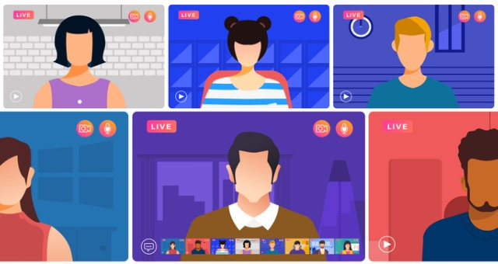
Break – Breakout rooms
Discussion of Boxall application.
Family Friends.
Autism/ADHD/SEMH – complex needs
Providing Children’s Services for the Royal Borough of Windsor and Maidenhead

Slide 20
Welcome Back
Providing Children’s Services for the Royal Borough of Windsor and Maidenhead

Slide 21
GEMS
Mamta Martin

Slide 22

GEMS offers information, support & signposting to parents & carers of children with, or likely to have autism &/or ADHD within East Berkshire.
On offer are, workshops & courses for parents & carers, and social activities for children aged 5 years and above.

Slide 23
The
GEMS team
Debbie Rowe – Programme Director
Mamta Martin – Project Manager
Elaine Dowding – Project Support Officer & workshop delivery
Anisha Oram – Project administrator
Penelope Roberts – Workshop Delivery

Slide 24


The Referral Process
  Website: https://www.gems4health.com/
  Email: Gems.4health@nhs.net
  Call: 01753 373244 / 0800 999 1342
  Online referral form for Professionals: https://www.gems4health.com/referral-form/
  Online referral form for Self: https://www.gems4health.com/parent-submission-form/

Slide 25
Case Study A
Initial Contact: Family support worker makes a professional referral for a family.
Issue: Mother is struggling with her daughters diagnosis of autism, and her challenging behaviours which are impacting the whole family.
Deep Dive: GEMS make contact with the family directly. After speaking with mother and identifying several issues: father has depression (on medication) and anxiety dealing with his daughters diagnosis. Siblings are feeling unsupported as parents spend all their time on their daughter. Mother is struggling with her overcrowded living conditions and managing the family dynamics alongside her own requirements for support.
Identify support: By speaking to mother and getting a better understanding of the support she requires, we tailor made a package of support via workshops. Those suggested were: Girls and autism, Supporting siblings and Managing anxiety. Also signposting mother to the council who can assist with housing issues.
Desired Outcome: Whole family unit is supported, mother was happy with the suggested workshops and was also very thankful for the conversation and that we had listened to her speak and guided her forward.

Slide 26
What's Available?
Provision by GEMS & our partners
GEMS
  National Autistic Society Early Bird Plus
  National Autistic Society Teen Life
  Fortnightly activity sessions for 5-10yr olds, 11-15yr olds, 16-25yr olds and for 25 years old and over.
  Autism & Food
  Animations
  Signposting
The Autism Group
  Girls and autism
  Managing anxiety
  Supporting siblings
  Adolescence
  Home visit support service.
Parenting Special Children
  Sensory Processing
  Pre and Post assessment Sleep & autism/ ADHD
  Pre & Post Assessment workshops – ADHD
  Pre & Post autism over 5’S
  Pre & Post autism under 5’s

Slide 27
Rebecca Askew
Providing Children’s Services for the Royal Borough of Windsor and Maidenhead

Slide 28
Mental Health & Wellbeing Updates
28th September 2022
SEMH Network
Rebecca Askew

Slide 29
RBWM Wellbeing Interventions
ELSA
Guidance for Line Managers
ELSA Training 27th Sept- 20th Oct 2022 – Moor Hall
Nurture
Check ins – EPS Service Nov 2022 –June 2023
Nurture Hubs – 1 per term
Nurture Practitioner Training – Feb 2023
Whole School Twilights

Slide 30
On-going MH initiatives
PPEPCare Training
Mixed model – whole school and online
Modules: Child/adolescent anxiety, communication now, depression/low mood, self harm, promoting resilience and separation anxiety.
CAMHS – workforce offer – PTSD, OCD, specific phobia, autism and eating disorders
The Link Programme
Common approach to outcome measures to support young people:
How to select and use an appropriate measure
How to use outcome measures for evaluation, temperature checking and targeted work
How to measure staff wellbeing
Development of integrated working to promote better access to support:
Using the 5Ps for multi-agency formulation in the referral process
Post referral communication and processes
Developing a service mapping tool – referral routes
Evidence-based approach to interventions:
Developing a training plan to up-skill staff on evidence-based interventions

Slide 31
On-going MH initiatives
Senior Lead Training
The Department for Education is offering a grant of £1,200 for eligible state-funded schools and colleges in England to train a senior mental health lead to develop and implement a whole school or college approach to mental health and wellbeing. This training is not compulsory, but it is part of the government’s commitment to offer this training to all eligible schools and colleges until 2025.
senior mental health lead training
Number 22 Telephone Support Line (11-25 years) www.number22.org
A bookable 25-minute telephone appointment which can be used for:
A one-off counselling session
An introduction to counselling – what could you expect from counselling?
Signposting to other services
Discussion regarding F2F appointments at GP surgeries.
Oxwell Survey – Feb-March 2023
Look out for registration details – EP support for analysis and next steps.

Slide 32
What Colour is Your Dragon?
A programme of trauma informed emotional education, aimed at children of all ages, parents and teachers.
It has been devised by a team at The Mindfulness Centre of Excellence
It is based on neuroscience, mindfulness and compassion.
The programme blends social and emotional learning, creativity, psychological insights (particularly around the importance of movement and inhibitory control)
Drawing on ideas from Professor Paul Gilbert's Compassion Focused Therapy, mindfulness, inhibitory control and embodied movement, it uses 3 coloured dragons as a metaphor for our brain’s motivational states:
Red dragon – our threat/safety system
Blue dragon – our drive system - helps us focus and get things done
Green dragon – our self-soothing system - we need to feed to maintain equilibrium of the whole system.
Led by Katherine Radcliffe (MHST Supervisor).
Initial pilot 5 schools – year 5 (MGS) with intention to roll out.

Slide 33
Yoga Bugs
What is Yoga Bugs Virtual?
An online yoga and mindfulness programme for the primary phase.
Free access for one year for 15 RBWM primary schools
The platform includes over 100 age appropriate Yoga Bugs videos for nursery – year 6.
Classroom yoga videos and mindfulness activities and resources for staff/parents to support their mental health and well-being and increase their knowledge.
Click here to view the online interactive brochure.
To take up this offer a member of the SLT within the school must contact either Zoe or Lisa on 0121 777 7792 or lisa@thebugsgroup.com
SENCo/Head email notification w/c 5th September

Slide 34
Local Transformation Plan October 2021-Oct 2024
Local Priorities:
Strengthening crisis support
Supporting children with complex needs
Improving transition arrangements – 18-25 access requirements and lowering age range to 16+
Addressing eating disorders and disordered eating – implement actions in the East Berkshire ED recovery plan
Embedding MHST principles across all RBWM schools
Enhancing parenting support
Addressing gaps in provision
Developing formal partnership arrangements – whole system collaboration / voluntary agencies
Responding to the impact of COVD 19 – Frimley ICS action plan

Slide 35
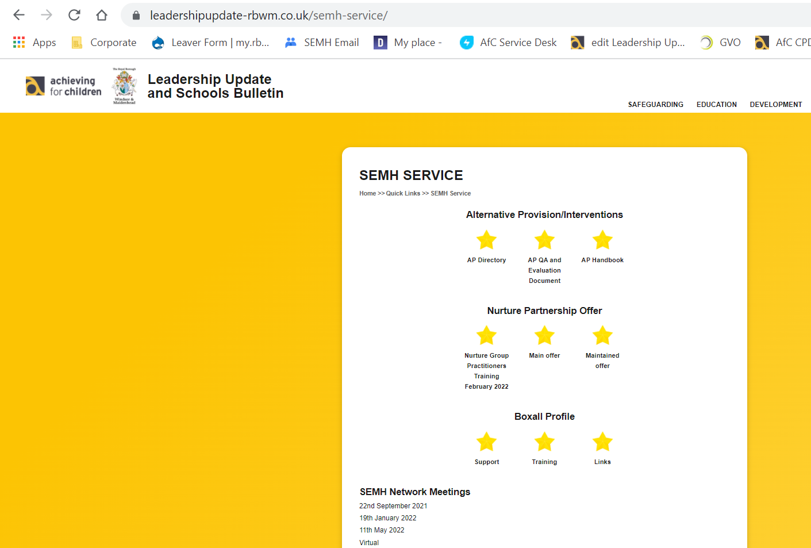
SEMH Service Updates
Leadership Update Website
Alternative Provision Documents
    Directory – updated (let me know of new provisions you use)
    Guidance
    Quality Assurance
PEAR Panel Form
Attendance Guidance
Network Meetings (New Academic Year)
  Wednesday 25th January 2023
  Wednesday 17 May 2023
https://www.leadershipupdate-rbwm.co.uk/
Providing Children’s Services for the Royal Borough of Windsor and Maidenhead

Slide 36

Questions.
Fill Out Feedback Form
Feedback
Thanks
https://docs.google.com/forms/d/18i1vSRvdHsg4uYnMGtq2s2npkCnK5KuQi7tswHK8YC4
Providing Children’s Services for the Royal Borough of Windsor and Maidenhead

