Slide 1

Clerks’ & Governance Professionals’ Briefing – April/May 2025
Wednesday 30th April
Thursday 1st May
Clive Haines & Vicky Brand

Slide 2
AGENDA
Welcome
Leadership Update for April 2025
New DfE Guidance on SEND for Governing Boards
Getting Information About Schools
Summer term governance activity
Upcoming governance and clerking training
Discussion forum… and questions

Slide 3
Welcome!

Slide 4

LEADERSHIP UPDATE – JANUARY 2025
www.leadershipupdate-rbwm.co.uk/
The Leadership Update Word Document will be circulated following the briefings. It can also be downloaded from:
Clerks' and Governance Professional's Briefing April 2025 | Leadership Update and Schools Bulletin

Slide 5
New DfE guidance on SEND for governing boards
This guidance aims to help boards with their role and responsibilities in relation to pupils with special educational needs (SEN) and disabilities and to empower governors and trustees to hold their schools to account.
The guidance sets out that, while overall responsibility rests with the board, there should be a lead member of the governing board or a sub-committee with specific oversight of the school’s arrangements for SEN and disability.
The lead member will:
champion the school’s support for pupils with SEN and disabilities, including good practice in pupil engagement.
ensure that the board has the information it needs for assurance about the school’s practice work closely with the head teacher or principal, senior leadership team and (in the case of mainstream schools) the SENCO.

Slide 6

Responsibilities under the Equality Act 2010 may benefit from the oversight of the same lead governor, trustee or sub-committee as the 2014 Children’s and Families Act responsibilities, or they may sit with other equalities responsibilities.
There is a close connection between the duties relating to SEN and equality duties relating to disability.
The guide mentions that the board should get appropriate and regular training to help it discharge its duties in relation to SEN and disability and to help ensure the best possible outcomes for those pupils. SEN and disability duties: guidance for school governing boards - GOV.UK
Wednesday 25th June – SEND Governance Training – for all Governors Anne Bishop tbc

Slide 7
Getting Information About Schools:
After extensive collaboration with departmental colleagues and incorporating feedback from clerks/governance professionals, the DfE have successfully soft launched a new feature on the GIAS platform.
This update allows for the inclusion of clerk/governance professionals' details, including clerks, on the platform.
New guidance will soon be available to assist colleagues in adding this data.
https://www.leadershipupdate-rbwm.co.uk/gias-platform-enhancement/

Slide 8
While it is not yet mandatory, it is strongly encouraged that governance boards to input their clerk/governance professionals' details into GIAS.
This enhancement aims to ensure that clerks/governance professionals receive crucial information directly and promptly from the Department for Education.

Slide 9
Summer term governance activity:
New governor recruitment and induction (induction pack) and training records
Governing board self-review including skills assessment for finance governance (eg SFVS skills matrix)
School improvement:
Monitoring the progress-to-date in the key priority areas (as per the school development plan)
Committee meetings and governor visits - monitoring key priorities and estate/resources/statutory compliance (written governor visit reports)
Triangulation at board meetings, using school leadership reports, spring term data, governor visits etc
Safeguarding:
Safeguarding governor’s termly visit and preparing the annual Safeguarding report for the GB
Financial monitoring & planning
Maintained: Budget plan approval (1 year and 3 year plan) - RBWM deadline mid-end of May
Academies
Budget planning including financial benchmarking, review of SLAs etc
Audited financial statements to Companies House (for financial year end 31st Aug the deadline is 31st May)
Annual review of risk register
An example year planner is available on Leadership Update at https://www.leadershipupdate-rbwm.co.uk/example-year-planner/

Slide 10
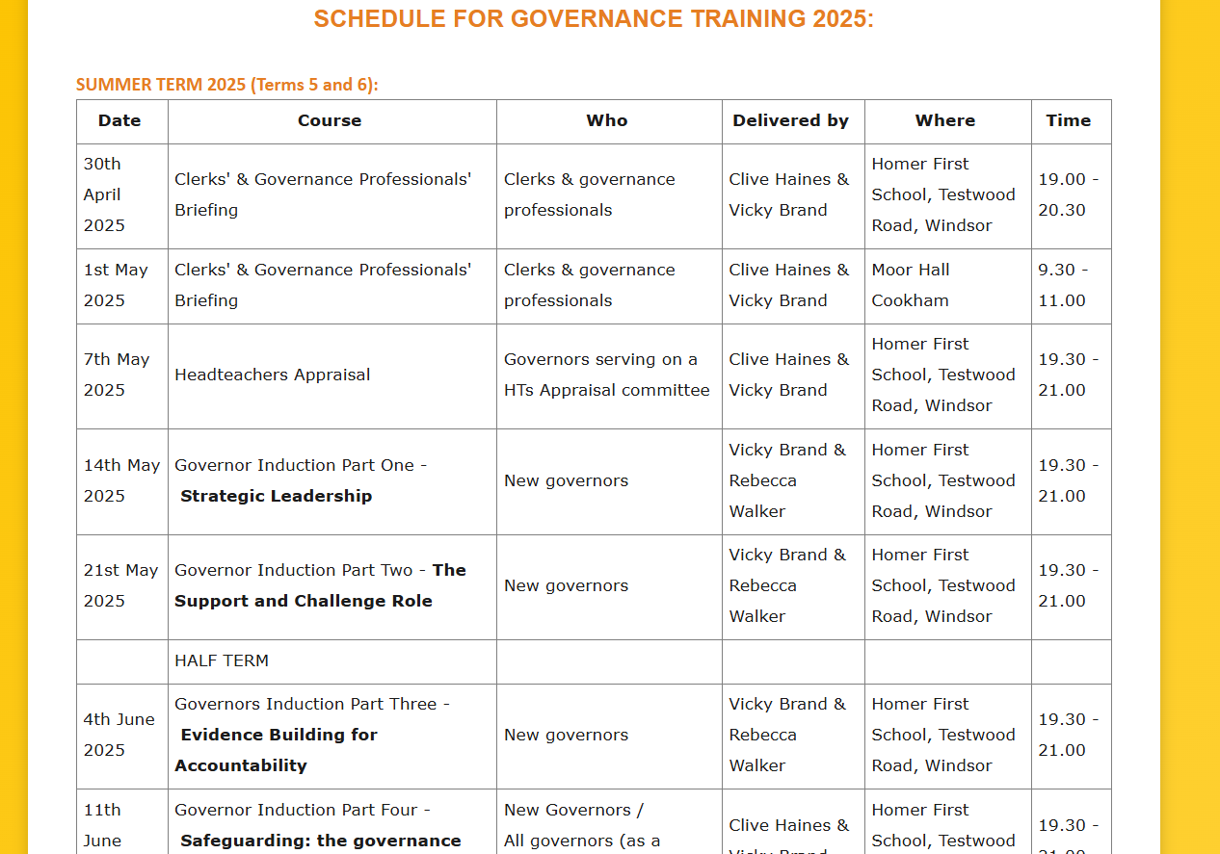
Governance and clerking training schedule for summer2025
https://www.leadershipupdate-rbwm.co.uk/core-training-programme-for-governors-and-clerks/

Slide 11
Governance and clerking training schedule for summer 2025
Wednesday 7th May – Headteacher Appraisal
Wednesday 14th May – Governor Induction Part One – Strategic Leadership
Wednesday 21st May – Governor Induction Part Two – The Support & Challenge Role
[Half Term]
Wednesday 4th June – Governor Induction Part Three – Evidence Building for Accountability
Wednesday 11th June – Safeguarding: the Governance Role (Induction Part 4 / Refresher)
Wednesday 18th June – Modern Governance
Wednesday 25th June – SEND Governance – for all Governors Anne Bishop tbc
Wednesday 2nd July – OFSTED/Curriculum tbc
Wednesday 9th July – chairs’ and clerks/governance professionals’ joint surgery
Education Leadership Forum (chairs of schools in RBWM are invited) – Friday 6th June 2025

Slide 12
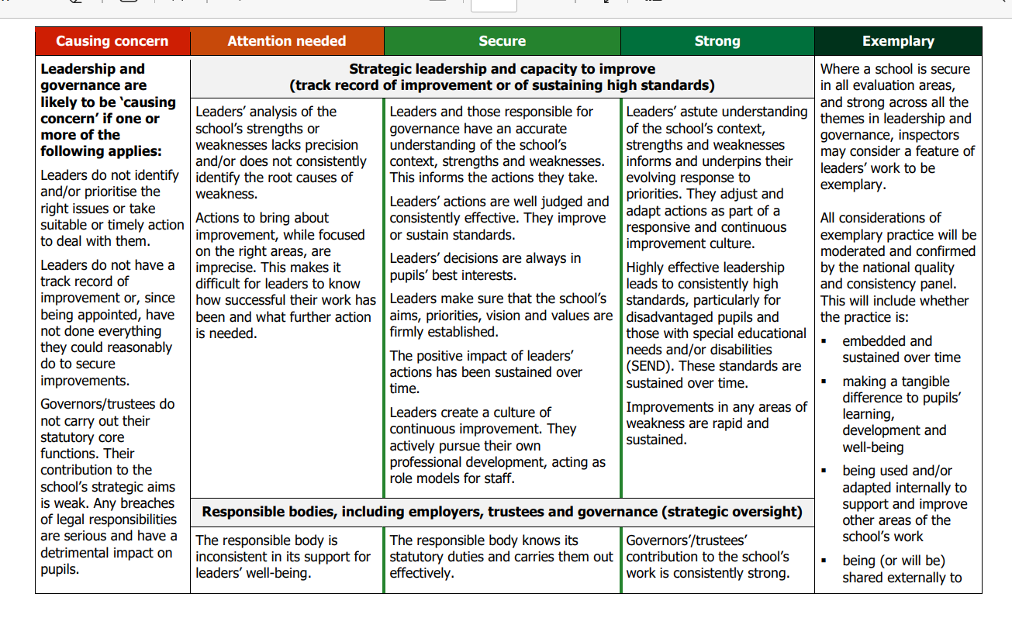

Slide 13
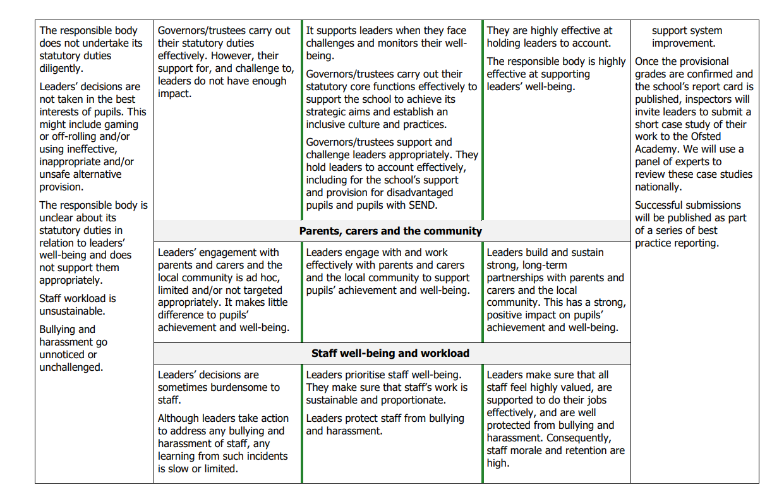

Slide 14

To download all today’s resources please scan the QR code

Slide 15
Discussion forum
and questions

