Slide 1

Clerks’ & Governance Professionals’ Briefing – January 2025
Wednesday 15th January
Thursday 16th January
Clive Haines, Vicky Brand & Rebecca Walker

Slide 2
AGENDA
Welcome
Leadership Update for January 2025
Children’s Wellbeing and Schools Bill
Spring term governance activity
Recording governor induction and training
Pupil premium strategy statements
Upcoming governance and clerking training
Discussion forum… and any questions

Slide 3
Welcome!

Slide 4

LEADERSHIP UPDATE – JANUARY 2025
www.leadershipupdate-rbwm.co.uk/
The Leadership Update Word Document will be circulated following the briefings. It can also be downloaded from:
https://www.leadershipupdate-rbwm.co.uk/clerks-and-governance-professionals-briefing-janua/

Slide 5
Children’s Wellbeing and Schools Bill:
A bill is a proposal for new laws that is presented for debate before Parliament. The laws proposed under the Children’s Wellbeing and Schools Bill will make important changes to protect children and improve education.
The Bill focuses on making sure no child falls through gaps between different services and that families can get help when they need it. It also makes the changes needed to ensure every child can get a great education at a good school in their area.
Teacher Training – from Sept 2026 all new teachers will have to have Qualified Teacher Status (QTS)
Pay and Conditions - same core pay and conditions framework across maintained and academy schools.
Curriculum and Assessment Review - published outcomes Autumn 2025 (academies will be required to follow National Curriculum)
School Places - Councils will be able to open all types of schools and be able to direct admissions for academy schools.
Failing School Changes - law repealed regarding the forced academisation of schools deemed to by Ofsted to be in a category of concern (Ofsted judgements changing). Regional Improvement for Standards and Excellence (RISE) teams.
From 1st January 2025 - the Academy Conversion grant will stop.

Slide 6
Spring term governance activity:
New governor recruitment, induction and maintaining training records (see next slide)
Governing board self-review including skills assessment for finance governance (eg SFVS skills matrix)
School improvement:
Monitoring the progress-to-date in the key priority areas (as per the school development plan)
Triangulation at board meetings, using school leadership reports, autumn term data, governor visits etc
Safeguarding:
Safeguarding governor’s termly visit and reports to the GB
Financial monitoring & planning
Maintained schools: 9-month YTD report submitted to RBWM (Jan 25) and monthly budget monitoring
SFVS (maintained schools) / School Resource Management Self-Assessment Checklist (academy trusts)
Academy trust financial statements for 2023-24 - to be published by the end January 2025
Financial year 2025-26 - budget planning (including benchmarking)
Staffing
Forward planning for the start of the 2025-26 academic year
Admissions
VA schools & academies: determination of admissions arrangements for 2026-27 (by 28th February 2025)
An example year planner is available on Leadership Update at https://www.leadershipupdate-rbwm.co.uk/example-year-planner/

Slide 7
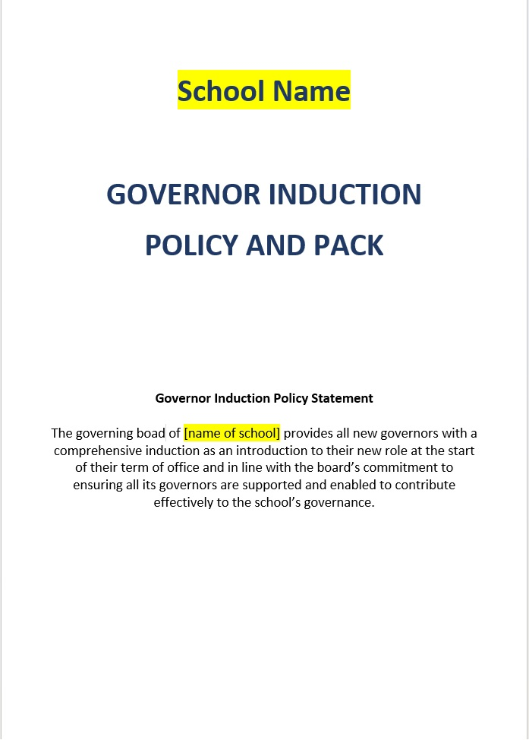
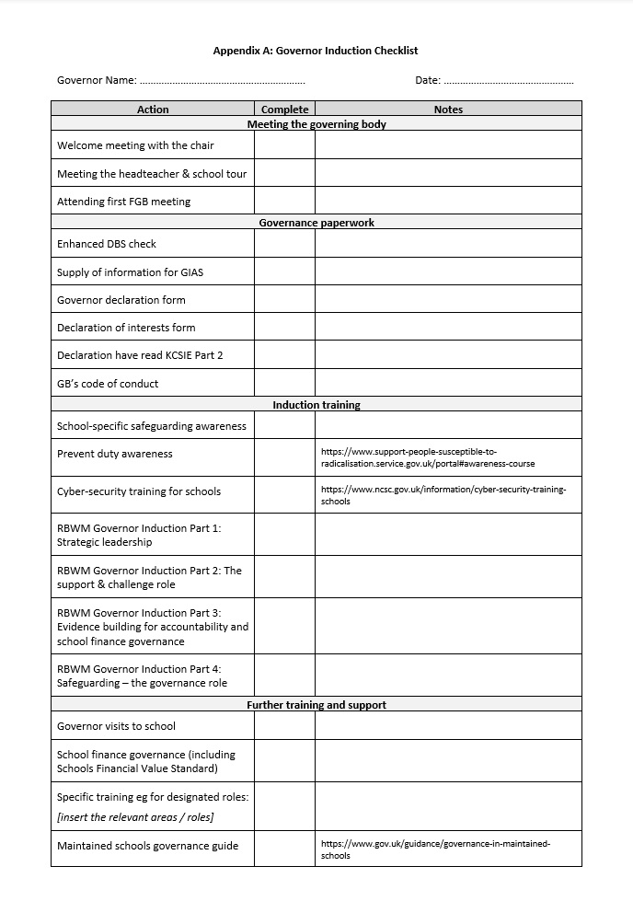
Recording governor induction and training:
How does your governing board record its new governor induction process
and
governor training attended?

Slide 8
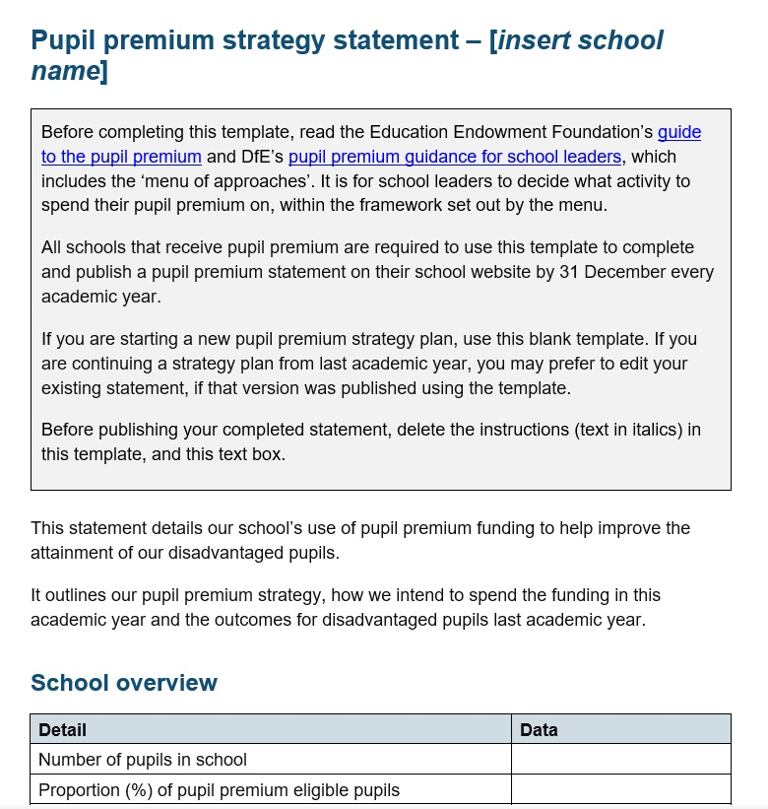
Pupil premium strategy statements:
Has the school’s pupil premium strategy statement for 2024-25 been published on the school’s website? (…by 31st December)
The DfE’s guidance on what must or should be published online was updated in Summer and Autumn 2024.
We have also updated the checklist toolkits for schools / GBs to use if they wish to.
Please see more information here: https://www.leadershipupdate-rbwm.co.uk/websites/

Slide 9
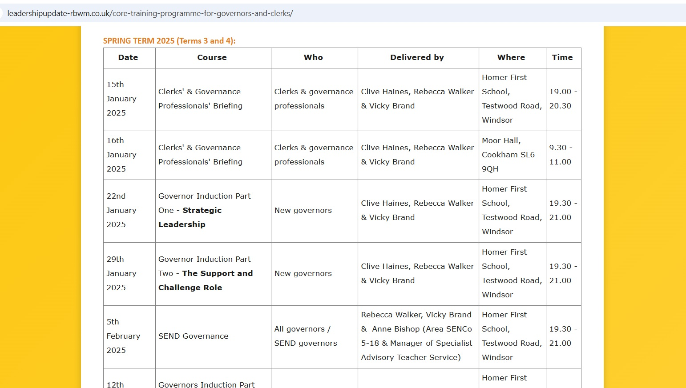
Governance and clerking training schedule for spring 2025
https://www.leadershipupdate-rbwm.co.uk/core-training-programme-for-governors-and-clerks/

Slide 10
Governance and clerking training schedule for spring 2025
Wednesday 22nd January – Governor Induction Part One: Strategic Leadership
Wednesday 29th January – Governor Induction Part Two:The Support & Challenge Role
Wednesday 5th February – SEND Governance
Wednesday 12th February – Governor Induction Part Three:Evidence Building for Accountability
[Half Term]
Wednesday 26th February – Safeguarding: the Governance Role (Induction Part 4 / Refresher)
March 2025 – date tba – Budget planning to support key priorities (finance governance)
Monday 24th March (RBWM only) – AfC Virtual School’s online training for governors
Wednesday 26th March – chairs’ and clerks’/governance professionals’ joint surgery
Education Leadership Forum (chairs of schools inside RBWM are invited) – Friday 28th March 2025

Slide 11
Governor recruitment
Timing of governor meetings
Discussion forum
GB internal communications – what works well & what are the challenges?
Is anyone using AI?
Top tips for minuting governor meetings?
What else would you like to discuss???

Slide 12
Any questions?

