Slide 1

Clerks’ & Governance Professionals’ Briefing – September 2024
Wednesday 11th September
Thursday 12th September
Clive Haines & Rebecca Walker

Slide 2
AGENDA
Welcome
Leadership Update – September 2024
KCSIE (September 2024)
Autumn term governance activity
Upcoming governance training
Discussion forum
AOB

Slide 3

LEADERSHIP UPDATE – SEPTEMBER 2024
www.leadershipupdate-rbwm.co.uk/
The Leadership Update Word Document will be circulated following the briefings. It can also be downloaded from:
https://www.leadershipupdate-rbwm.co.uk/clerks-and-governance-professionals-briefing-septe/

Slide 4
KEEPING CHILDREN SAFE IN EDUCATION (SEPTEMBER 2024)
https://www.gov.uk/government/publications/keeping-children-safe-in-education--2
The September 2024 version of the Keeping children safe in education guidance is now in force, replacing previous versions. The Department for Education initially published this for information in May.
A table of substantive changes from the September 2023 version is in Annex F of the guidance.
HAS THE SAFEGUARDING & CHILD PROTECTION POLICY BEEN RATIFIED?
The updated policy to be on the website from 1st September (labelled ‘pending ratification’ if necessary)
HAVE ALL GOVERNORS HAD RECENT SAFEGUARDING TRAINING?
Upcoming safeguarding governance training:
The Safeguarding Governor Role: NEXT WEDNESDAY 18th September 2024 @ Homer First School
Safeguarding – the governance role (Induction 4 / governor refresher): 6th November @ Homer First

Slide 5
Autumn term governance activity:
Governing board business:
Review and agree Terms of Reference for any committees & panels (must be at FGB - at least annually)
Elect the chair and vice-chair (maybe) and appoint or confirm designated governor roles
Review the GB’s Code of Conduct and ensure Declarations of Interest are up to date.
Update website to include governors’ attendance at 2023-24 FGB and committee meetings
School improvement:
2023-24 data by groups - triangulating with the other reports and information supplied to the GB
How will the GB monitor the key priorities on the SDP for 24-25? Schedule committees & governor visits
Financial monitoring & planning
Maintained schools – consider 6-month position (October 24) and monthly budget monitoring reports
Maintained schools: Schools Financial Value Standard (RBWM schools – by end January 2025)
Staffing
Appraisal and pay review committee meeting - by end of October at latest
Headteacher’s appraisal - by end of December at the latest
Admissions
Admissions policy etc annual cycle (academies & voluntary aided schools) starts at end of September.
An example year planner is available on Leadership Update at https://www.leadershipupdate-rbwm.co.uk/example-year-planner/

Slide 6
Quick check re school website:
The DfE’s guidance on what must or should be published online has been updated – and we have updated our website checklists: https://www.leadershipupdate-rbwm.co.uk/websites/
These might be on the agenda this term for info (or maybe for designated governor visits):
Sports Premium Report for 2023-24 (updated end of summer 24 – on website by 31st July)
Pupil Premium Strategy statement (reviewed autumn term – on website by 31st December)
SEN Information Report – to be reviewed at least annually

Slide 7
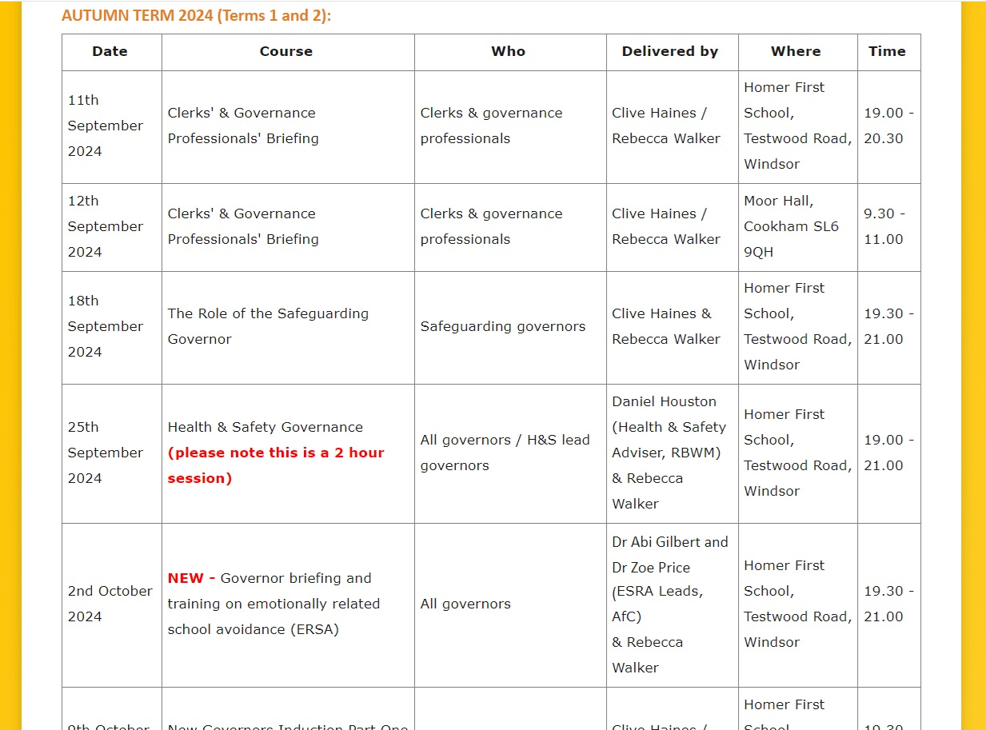
Governance training schedule for autumn term 2024
Available on Leadership Update here:
https://www.leadershipupdate-rbwm.co.uk/core-training-programme-for-governors-and-clerks/
The Autumn 2024 and the previous year’s (2023-24) training schedules can be downloaded from the top of the page for reference.

Slide 8
Governance training - autumn term 2024
18th September – The Role of the Safeguarding Governor
25th September - Health & Safety Governance
2nd October – NEW: Governor briefing & training on emotionally related school avoidance
Education Leadership Forum (chairs of schools in RBWM are invited) – 18th October
9th, 16th and 23rd October – Governor induction parts 1 - 3
After half term:
6th November – Governor induction part 4 / safeguarding refresher for governors (certificated)
13th November – School finance governance, monitoring & self-evaluation (including SFVS)
20th November – Governor visits to school
27th November (RBWM schools) – the role of school governors in championing the needs of children looked after (run by AfC Virtual School – we can book you onto this.)
27th November – Chairs’ and vice-chairs’ surgery and networking session
4th December – School complaints; investigations and panels

Slide 9
Discussion forum
The following have been mentioned as possible areas for discussion…
A possible training session for new-ish governance professionals
- and ideas for further CPD and networking
Clerks partnering-up to observe other’s GB meetings (GB collaboration)
Blue skies discussion on possible future AI tools to support clerking
… or alternatively we can discuss anything that this forum would like us to…
WHAT CAN WE DO FOR YOU??

Slide 10
Any other business
… and any questions?

