Slide 1

Appraisal of the Headteacher
Governors’ Briefing
Welcome

Slide 2

The Regulations
Maintained Schools
The statutory requirements for reviewing maintained
school headteachers' performance are set out in the Education (School Teachers’ Appraisal) (England) Regulations 2012.
The regulations apply to headteachers in community,
voluntary, foundation, community special,
foundation special and maintained nursery schools.

Slide 3


The Regulations
Academy Trusts
Academy trusts are not governed by these
regulations and are free to determine their
own appraisal arrangements (but they may
adopt similar arrangements to maintained
schools if they wish.)

Slide 4
Requirements under the current Regulations
Governing bodies and local authorities must have a written appraisal policy for its teachers (including headteachers)
Schools must have an annual appraisal process for its teachers (including the headteacher)
Objectives must be set for each teacher (including the headteacher) which will contribute to improving the education of pupils.
Governing bodies must appoint an external adviser to advise and support during the headteacher’s appraisal

Slide 5
Requirements under the current Regulations
Teachers (including the headteacher) must be given a written appraisal report, which sets out:
An assessment of their performance in the previous appraisal period
Agreed objectives for future performance
An assessment of their training and development needs
Where relevant, a recommendation on pay progression.

Slide 6
The GB’s role in staff appraisal
To establish the school’s appraisal policy
To determine the appraisal period for teachers (including the headteacher). Normally twelve months but it can be shorter/longer for newly appointed staff.
To review the headteacher’s performance annually, including appointing governors as they see fit to carry out this task.
To appoint the external adviser. This person must be well versed in the Appraisal Regulations, and in using evidence effectively to support appraisal.

Slide 7
The GB’s role in staff appraisal
To set performance standards and objectives for the headteacher which aim to improve pupil performance and are in line with the school development plan / school improvement plan – having first consulted the external adviser.
To ensure that the headteacher arranges the annual appraisal of all teaching staff, and for any pay recommendations to be made to the board.
To ensure the headteacher and every teacher is given a written appraisal report (as previously defined.)

Slide 8

The Headteachers Standards 2020
In October 2020, the DfE published Headteachers’ Standards, replacing the national standards of excellence for headteachers 2015.
These are non-statutory and are intended as guidance to be interpreted in the context of each individual headteacher and school. They are designed to be relevant to all headteachers.
https://www.gov.uk/government/publications/national-standards-of-excellence-for-headteachers/headteachers-standards-2020

Slide 9

The Headteachers Standards 2020

Slide 10
The Headteacher’s Appraisal Committee
The governing board decides who is on the Headteacher’s Appraisal Committee, and should appoint governors with appropriate skills, and who have undertaken Performance Appraisal training.
2 or 3 governors is a workable number.
(The 2006 Regulations limited the number on the Headteacher’s Appraisal Committee to 2 or 3 governors, although the 2012 Regulations do not include this restriction.)

Slide 11
Does the Headteacher have a say?
This will be determined by the school’s appraisal policy, but it is good practice for headteachers to be able to object in writing to the governing board in regards to the appointment of any particular governor.
Any objection should be on the grounds only that the governor is unsuitable for professional reasons

Slide 12
Does the Headteacher have a say?
The governing board should satisfy itself that the reasons submitted by the headteacher, if seeking the removal of an appointed governor are
professional reasons only and
the reasons themselves are significant.
The board will then appoint another governor if it accepts the objections, or it may reject the request. In the case of a rejection the governing board must state the grounds for the rejection, in writing.

Slide 13
Who sets the Headteacher’s targets?
The targets are set by the appointed governors, after consulting with the headteacher and external adviser, on an annual basis as part of the appraisal process.
Targets must be meaningful and achievable and should reflect the development priorities of the school.
The external adviser will assist in establishing targets and objectives in discussion with the appointed governors and headteacher. Every effort should be made to achieve agreement on the requirements to be placed on the headteacher.

Slide 14
The role of the external adviser
To assist the appointed governors in setting meaningful targets, and in reviewing outcomes.
Both the appointed governors and the headteacher can choose to meet separately with the external adviser to discuss the headteacher’s performance review, and possible future targets, before the review meeting.
The adviser should attend the review meeting and be available to offer advice and support to governors whilst they prepare the appraisal report.

Slide 15

The role of the external adviser
The appointed governors should pay heed to the advice given by the external advisor.
The adviser is not involved in determining any recommendation for pay progression; this is a matter for the appointed governors*
*Maintained schools must adhere to the School Teachers’ Pay and Conditions Document (STPCD)
https://www.gov.uk/government/publications/school-teachers-pay-and-conditions

Slide 16
The Headteacher’s right to appeal
The school’s appraisal policy should set out the process to be followed should the headteacher be dissatisfied with the outcome of their appraisal.
For example: this could state that the appraisal report will be given to a nominated governor who will act as the review officer (it could be the vice-chair, if the chair is on the Appraisal Committee, or vice-versa.)
If it’s the review officer’s opinion that aspects of the review are inaccurate, they can require that the statement be reviewed again.

Slide 17
Minuting the appraisal review meeting
The Education (School Teachers’ Appraisal) (England) Regulations 2012 do not specify that the clerk needs to take minutes of the headteacher’s appraisal.
However, notes should be taken at the review meeting, focussing on the outcomes of the discussion and then this record can be used, together with the evidence presented, in preparing the appraisal report.
The notes could be taken by one of the appointed governors, or by the external adviser, or by someone else (eg the clerk to the board) as decided by the GB.

Slide 18
Ratification
Must the Governing Board ratify the panel’s decision?
The outcome of the appraisal review does not need to be ratified by the GB, as long as the responsibility for carrying out the headteacher’s appraisal has been formally delegated to the appointed governors
(see Terms of Reference / Scheme of Delegation).
This applies to both maintained schools and academies.
The appointed governors should report to the board that the appraisal has been carried out.

Slide 19
Suggested process
Stage 1: Headteacher and external adviser hold
a pre-meeting
Stage 2: Appointed governors and external
adviser hold a pre-meeting
Stage 3: The Headteacher’s Appraisal Review
meeting takes place.
Breaking it down...

Slide 20
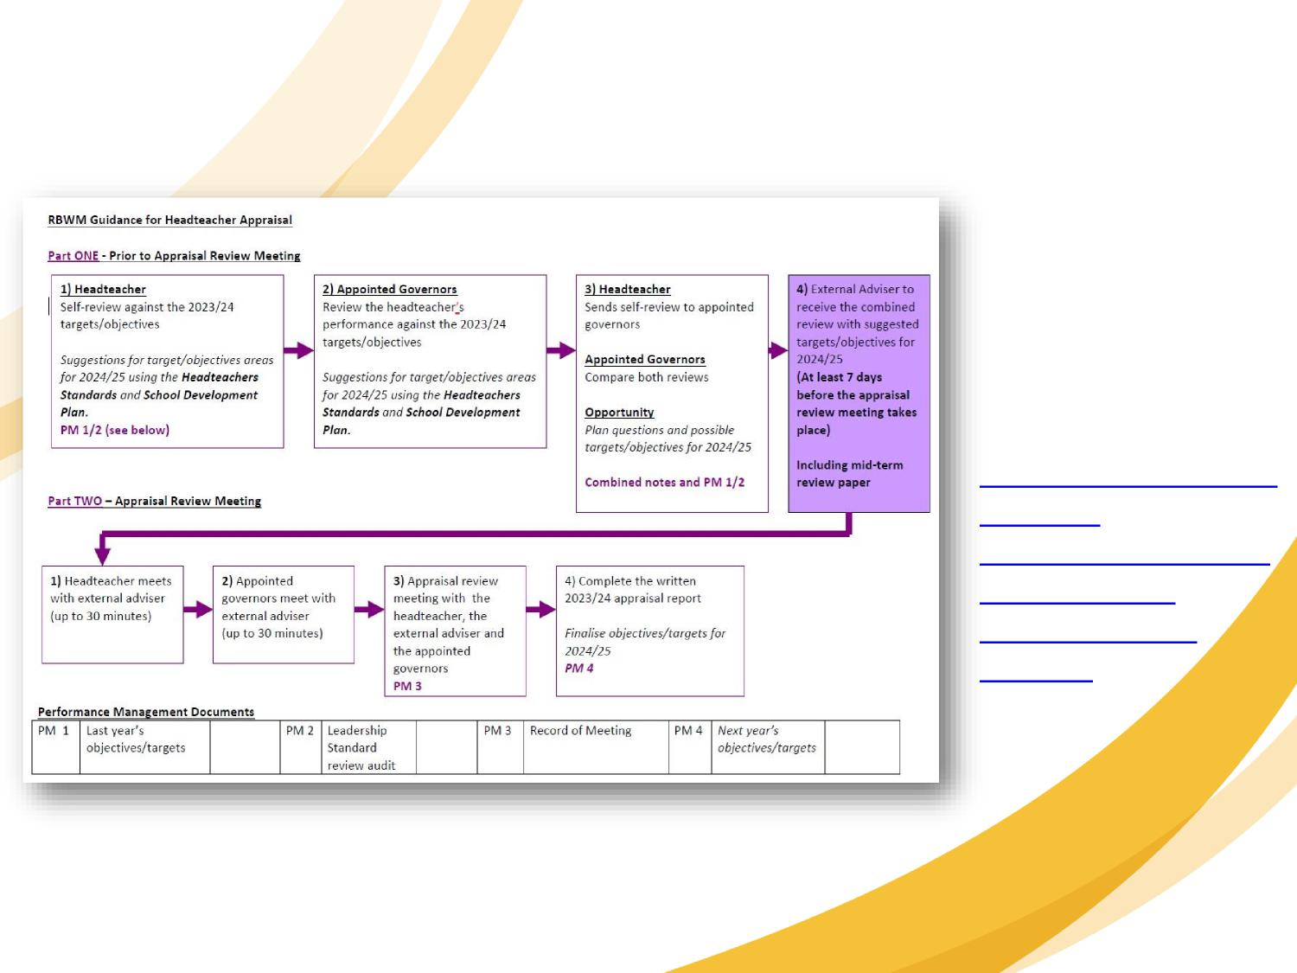
A flow chart for suggested appraisal review process*:
Available on
Leadership
Update here:
https://www.leadershi
pupdate-
rbwm.co.uk/headteac
hers-appraisal-
documents-and-
process/
(*references to the planning parts of the process might change, see slide 4)

Slide 21
Example of an objective
If one of the school improvement priorities is...
To improve attainment in Maths at both KS1 and KS2 An objective could be:
The headteacher will lead the development and implementation of strategies aimed at raising attainment in Maths at Key Stage 1 and 2, including leading on the monitoring and evaluation of the impact of these strategies.

Slide 22
Examples of success criteria
Strategies will have been decided on and implemented, and their success will have been monitored and evaluated at periodic intervals, this being led by the headteacher.
An improvement in the Maths attainment data (a specified percentage increase is not required, as the objective is to develop, implement and monitor/evaluate) and an improvement seen during scrutiny of pupils’ Maths books.
Assessment of the planning across the school shows that strategies have been adopted and embedded and that the resulting work being provided is always suitably challenging.
Tracking data shows pupils are making accelerated progress.

Slide 23
Examples of monitoring arrangements / milestones
Presentation to the governors of the strategies to be implemented.
Termly progress reports of the school’s strategies and how they are being evaluated, these being reported to the governing board at relevant governor meetings
An evaluation of success-to-date and what next steps will be put in place, to be reported to the governing board at an appropriate meeting after 6 months of implementation
The headteacher’s self-evaluation of progress against this objective to be brought to the mid-term appraisal review meeting.

Slide 24
Examples of evidence and information to support
Headteacher’s reports and minutes of FGB / committees
Minutes of staff meetings / staff training relating to planning and rolling out the strategies.
Monitoring and evaluation reports
Action plans
Pupils’ progress towards targets
Work scrutiny / lesson observations
School self-evaluation and (maybe) external evaluations
Outcomes data for Maths (including Year 6 SATs results)

Slide 25

Any questions?
???

