Slide 1
Attendance Lead Network Meeting
Tuesday 11th March 2025
Welcome to this virtual meeting
Notes:
1

Slide 2
Agenda for today
Item | Who | Time
Welcome | Al Whitelaw / Annette Taylor Attendance Update and EHE/CME | 3.30 pm (10 mins)
Reduced Timetables update | Annette Taylor | 3.40 pm (20 mins)
ERSA update | Abi Gilbert | 4.10 (15 mins)
Education Welfare Officer for Children With a Social Worker | Anisa Syed | 4.25 (15 mins)
AnDY Research Clinic | Paris Matthews | 4.25 (10 mins)
Questions | Feedback Form

Slide 3
Attendance
Updates
Notes:
3

Slide 4
Annette Taylor (EWO Coordinator)
Reduced Timetables
VYED
ASM
FPNs
CME
EWO for CWSW

Slide 5
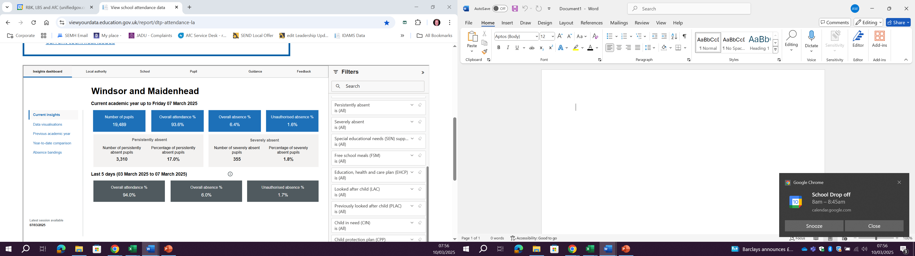
Leadership update website - EWS
Attendance Updates

Slide 6
 | Weekly Attendance Data from (VYED IdAMS) for RBWM - Statutory School Age (current accademic year up to…)
Date | Pupil Number | Overall Attendance % | Overall Absence % | Unauthorised Absence % | PA Number | PA Rate % | SA Number | SA Rate % | EHCP | SEN Sup | FSM | PP | CLA | PLAC | CP | CIN
3/5/2024 | 19,721 | 93.2 | 6.8 | 1.8 | 3,501 | 17.8 | 367 | 1.9 | 88.2 | 90.0 | 88.2 | n/a | n/a | n/a | n/a | n/a
10/5/2024 | 19,742 | 93.2 | 6.8 | 1.8 | 3,492 | 17.7 | 366 | 1.9 | 88.2 | 89.8 | 88.2 | n/a | n/a | n/a | n/a | n/a
17/5/2024 | 19,761 | 93.2 | 6.8 | 1.7 | 3,559 | 18.0 | 370 | 1.9 | 88.0 | 90.0 | 88.3 | n/a | n/a | n/a | n/a | n/a
24/5/2024 | 19,776 | 93.0 | 7.0 | 1.8 | 3,773 | 19.1 | 372 | 1.9 | 87.8 | 89.8 | 88.2 | n/a | n/a | n/a | n/a | n/a
Half Term
7/6/2024 | 17,963 | 93.6 | 6.4 | 1.6 | 2,968 | 16.5 | 309 | 1.7 | 88.1 | 90.5 | 88.9 | n/a | n/a | n/a | n/a | n/a
14/6/2024 | 17,981 | 93.6 | 6.4 | 1.7 | 2,976 | 16.6 | 313 | 1.7 | 88.1 | 90.5 | 88.8 | n/a | n/a | n/a | n/a | n/a
21/6/2024 | 17,998 | 93.5 | 6.5 | 1.7 | 3,014 | 16.7 | 320 | 1.8 | 88.1 | 90.4 | 88.7 | n/a | n/a | n/a | n/a | n/a
28/6/2024 | 18,022 | 93.5 | 6.5 | 1.7 | 3,043 | 16.9 | 322 | 1.8 | 88.1 | 90.4 | 88.7 | n/a | n/a | n/a | n/a | n/a
5/7/2024 | 18,042 | 93.5 | 6.5 | 1.7 | 3,012 | 16.7 | 322 | 1.8 | 88.1 | 90.3 | 88.6 | n/a | 88.7 | 90.2 | 84.2 | 90.8
12/7/2024 | 18,052 | 93.5 | 6.5 | 1.7 | 3,038 | 16.8 | 325 | 1.8 | 88.1 | 90.4 | 88.7 | n/a | 88.8 | 90.2 | 82.7 | 90.5
19/7/2024 | 18,059 | 93.5 | 6.5 | 1.7 | 3,070 | 17.0 | 326 | 1.8 | 88.1 | 90.3 | 88.6 | n/a | 88.8 | 90.2 | 81.9 | 90.5
Summer Holidays
6/9/2024 | 18,498 | 94.4 | 5.6 | 3 | 0 | 0 | 0 | 0 | 88.4 | 92.6 | 90.3 |  | 89.8 | 91.2 | 86.9 | 93
13/9/2024 | 18,717 | 94.9 | 5.1 | 2 | 0 | 0 | 0 | 0 | 89.6 | 92.9 | 90.9 |  | 91.6 | 92.6 | 85.4 | 89.6
20/9/2024 | 18,806 | 94.8 | 5.2 | 1.7 | 2,468 | 13.1 | 362 | 1.9 | 90.0 | 92.4 | 90.5 |  | 91.5 | 91.7 | 83.6 | 94.8
27/9/2024 | 18,958 | 94.6 | 5.4 | 1.7 | 3,111 | 16.4 | 315 | 1.7 | 89.7 | 91.9 | 90.0 |  | 91.9 | 91.7 | 82.2 | 85.7
4/10/2024 | 19,187 | 94.6 | 5.4 | 1.6 | 2,587 | 13.5 | 310 | 1.6 | 89.7 | 91.8 | 89.9 |  | 91.9 | 91.6 | 81.2 | 84.4
11/10/2024 | 19,221 | 94.6 | 5.4 | 1.6 | 2,891 | 15.0 | 301 | 1.6 | 89.6 | 91.6 | 89.8 |  | 91.7 | 91.5 | 81.2 | 84.2
18/10/2024 | 19,237 | 94.6 | 5.4 | 1.5 | 2,734 | 14.2 | 311 | 1.6 | 89.5 | 91.6 | 89.7 |  | 92.2 | 91.3 | 80.9 | 84.3
25/10/2024 | 19,249 | 94.3 | 5.7 | 1.6 | 3,028 | 15.7 | 319 | 1.7 | 89.3 | 91.3 | 89.6 |  | 92.3 | 90.7 | 80.3 | 82.7
Half Term
8/11/2024 | 19,283 | 94.3 | 5.7 | 1.6 | 3,053 | 15.8 | 325 | 1.7 | 89.3 | 91.2 | 89.6 |  | 92.2 | 90.6 | 80.1 | 82.3
15/11/2024 | 19,197 | 94.4 | 5.6 | 1.5 | 3,017 | 15.7 | 335 | 1.7 | 89.2 | 94.4 | 89.9 |  | 92.5 | 90.7 | 81.6 | 82.2
22/11/2024 | 19,025 | 94.4 | 5.6 | 1.5 | 2,924 | 15.5 | 333 | 1.7 | 89.0 | 92.5 | 89.8 |  | 92.5 | 90.5 | 81.8 | 82.3
29/11/2024 | 18,947 | 94.4 | 5.6 | 1.5 | 2,896 | 15.3 | 331 | 1.7 | 88.8 | 91.3 | 89.7 |  | 92.6 | 90.3 | 82.0 | 82.5
6/12/2024 | 18,992 | 94.2 | 5.8 | 1.5 | 2,960 | 15.6 | 330 | 1.7 | 88.6 | 91.2 | 89.7 |  | 92.5 | 90.3 | 81.0 | 81.4
13/12/2024 | 19,021 | 94.1 | 5.9 | 1.6 | 3,045 | 16.0 | 334 | 1.8 | 88.5 | 90.9 | 89.5 |  | 92.5 | 90.2 | 80.7 | 81.1
20/12/2024 | 19,058 | 93.9 | 6.1 | 1.6 | 3,230 | 16.9 | 351 | 1.8 | 88.1 | 90.6 | 89.2 |  | 92.1 | 89.9 | 80.3 | 80.8
Christmas Holidays
10/1/2025 | 19,349 | 93.8 | 6.2 | 1.7 | 3,239 | 16.7 | 348 | 1.7 | 87.9 | 90.6 | 89.2 |  | 92.2 | 90 | 79.9 | 79.9
17/1/2025 | 19,366 | 93.8 | 6.2 | 1.6 | 3,293 | 17.0 | 351 | 1.8 | 88.0 | 90.7 | 89.2 |  | 92.0 | 90.0 | 80.4 | 80.4
24/1/2025 | 19,383 | 93.8 | 6.2 | 1.6 | 3,266 | 16.8 | 326 | 1.7 | 87.9 | 90.5 | 89.2 |  | 91.5 | 89.6 | 80.8 | 80.4
31/1/2025 | 19,408 | 93.7 | 6.3 | 1.6 | 3,306 | 17.0 | 337 | 1.7 | 87.8 | 90.3 | 88.9 |  | 91.5 | 89.6 | 80.5 | 80.3
7/2/2025 | 19,421 | 93.6 | 6.4 | 1.6 | 3,299 | 17.0 | 342 | 1.8 | 87.8 | 90.3 | 88.9 |  | 91.2 | 89.4 | 80.2 | 81.1
14/2/2025 | 19,443 | 93.6 | 6.4 | 1.6 | 3,359 | 17.3 | 350 | 1.8 | 87.6 | 90.2 | 88.8 |  | 91.1 | 89.5 | 80.5 | 80.7
Half Term
28/2/2025 | 19,487 | 93.6 | 6.4 | 1.6 | 3,320 | 17.0 | 354 | 1.8 | 87.6 | 90.2 | 88.8 |  | 91.0 | 89.5 | 80.2 | 80.7
03/03/25 | 19,489 | 93.6 | 6.4 | 1.6 | 3,310 | 17.0 | 355 | 1.8 | 87.5 | 90.2 | 88.8 |  | 90.8 | 89.4 | 80.3 | 93.6
CP
123 children
59 PA
20 SA
CIN
73 Children
37 PA
14 SA

Slide 7
Alternative Provision
Directory
Registered and Unregistered (DfE)
Quality Assurance Evaluation and QA Handbook updated.
EHCP – EOTAS or Joint QA (if named provision)
PEAR (analysis) Feedback form.
AP Network – Harmony, Gone Fishing, BE A Warrior etc
Strategy and Policy.
Medical Needs Protocol (Section 19)
Arranging Alternative Provision
A Guide for Local Authorities and Schools
Traded - Buy Back
Flexi Schooling
Education Welfare 2025/26
Increase by approx. 3%
Package (days) | Hrs | Costs
20 | 120 | £6,540
15 | 90 | £4,840
10 | 60 | £3,215
5 | 30 | £1,650
2.5 | 15 | £835
1.25 | 7.5 | £415
Requests Increasing
HT decision
Child’s Best Interest Principle
Process
Data Capture
Google Form
Working Party
Expression of Interest.

Slide 8
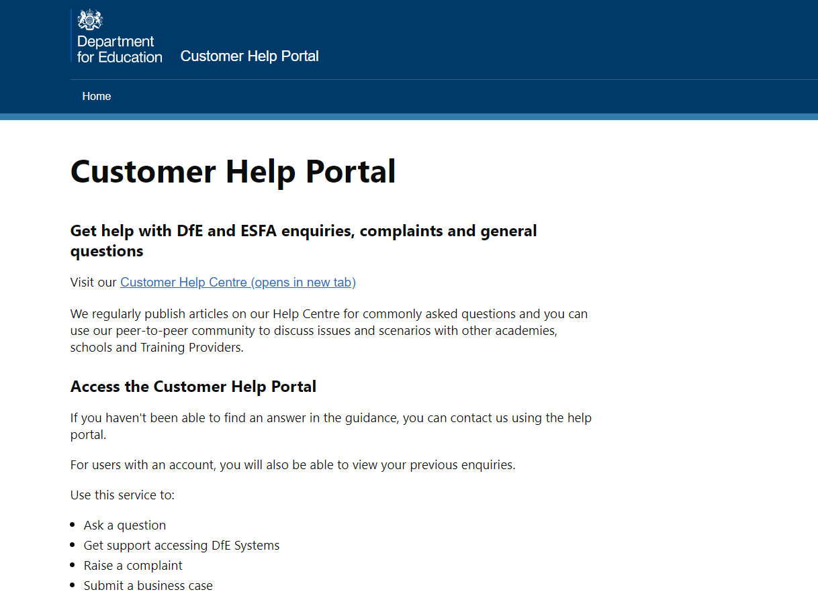
Submit a query
​If you want to tell us about a new issue then please visit:
Home - Customer Help Portal (education.gov.uk) ​
Log in / sign up to the portal
Select 'Get help with DfE systems’​
Select ‘School attendance dashboard’
DfE YouTube Webinars
https://www.youtube.com/@educationgovuk

Slide 9
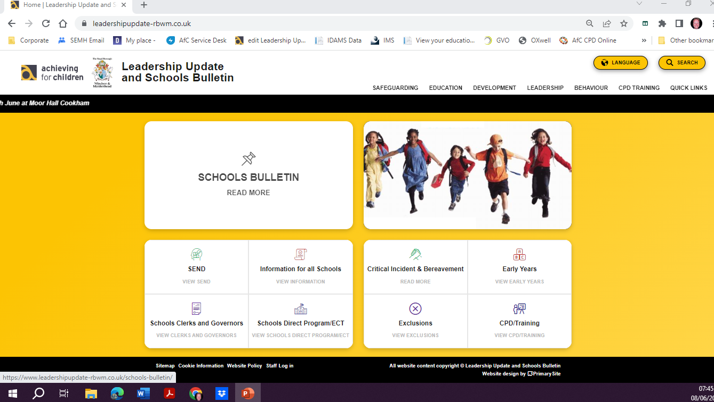
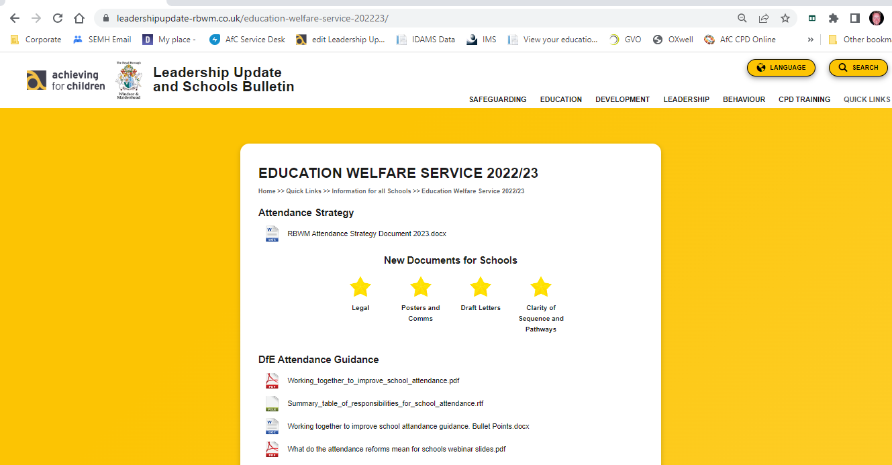
Education Welfare Documents.
Updated ERSA
Working Together to Improve School Attendance.
https://www.leadershipupdate-rbwm.co.uk/education-welfare-service-202324/

Slide 10
Reduced / Part Time Timetables
Reintegration Timetables
Annette Taylor
Education Welfare Coordinator

Slide 11
Reduced Timetables
As a quick overview part-time timetable should:
• Have the agreement of both the school and the parent the pupil normally lives with.
• Have a clear ambition and be part of the pupil’s wider support, health care or reintegration plan.
• Have regular review dates which include the pupil and their parents to ensure it is only in place for the shortest time necessary.
• Have a proposed end date that takes into account the circumstances of the pupil, after which the pupil is expected to attend full-time, either at school or alternative provision. It can, however, be extended as part of the regular review process. In some limited cases, a pupil with a long-term health condition may require a part time timetable for a prolonged period.

Slide 12
Reduced Timetables
Where the pupil has a social worker, the school is expected to keep them informed and involved in the process.
If the pupil has an Education Health Care plan, the school should discuss the part-time timetable with the local authority so that any support package that is in place can be reviewed as swiftly as possible.
Reduced timetables should be reviewed regularly and not be used to manage behaviour in schools.
Students should not be on reduced timetables long term where possible and we should always be working towards them being in school full time or as much as possible.

Slide 13
Reduced Timetables
We now have the Reduced Timetable Update in place. This is sent out every half term to schools to complete with just the names and year group of the students they currently have on a reduced timetable.
We understand school life is busy and there is not always time to update the LA straight away when a Reduced Timetable ends so this gives us an update each half term and we can update our records from there.
Reduced Timetables Update - Google Forms
It also highlights and paperwork that may not have been completed yet. Currently we are missing around 30% of paperwork for active reduced timetables.

Slide 14
Reduced Timetables
Looking forward to next academic year we are reviewing the Reduced Timetable paperwork.
Part Time and Reduced Timetable submission form 2024/25
We have had some feedback from schools around this but I would like to get feedback from all schools where possible.
Please look out for a short survey which will be circulated soon.
We would ideally like to make the process more manageable for schools moving forwards.

Slide 15
Elective Home Education
When parents inquire about Elective Home Education please have a discussion with your EWO as a first point of contact. It is important that other support has been offered or discussed with parents by school.
Often the EWO will ask to speak directly with a parent to check if elective home education is a suitable next step for the young person.
If it is deemed to be a suitable option the parent may then be referred to Harmit, our Elective Home Education Coordinator.
Please ensure that parents do not have elective home education suggested to them by staff members. The request must come from the parent.

Slide 16
ERSA
Zoe Price
Educational Psychologist

Slide 17
Anisa Syed
anisa.syed@achievingforchildren.org.uk
Education Welfare Officer
for Children with a Social Worker

Slide 18

What is the role?
Education Welfare Officer (EWO) for children with a SW
Children’s Wellbeing and Schools Bill (2024)
Specific for children on CIN / CP
Attendance below 90%
- Working with child, schools, parents, virtual school & social care
Data to inform interventions (operational and strategic)
Notes:
Add link to collab working from DfE guidance

Slide 19

The Vision
Confidence
Improved knowledge
  Policy / legislation
  Resource available
  Sharing good practice
Communication
Collaborative working
  Data / trends
  Policy updates
  Case updates
  Available resource/services
Relationships
Improved understanding
  Understanding specific contexts – case by case
  Parent / child’s voice
  Multi-agency working (professional understanding)
Notes:
Traditional - Health. difficulties engaging with families
Psychological - Social emotional mental health (SEMH) challenges Institutional - Negative experience in the school environment
Institutional - Negative experience in the school environment

Slide 20

Data Informed Approach
View Your Education Data (VYED)
Accurate data on attendance for students
Need more accuracy around CIN/CP students (46.8% no data)
 | VYED (Feb 25) | Social Care record (Feb 25)
CIN | 83 | 158
CP | 127 | 58
Notes:
Outline number difference in VYED and SC record
Outline number of schools not filling in (unknown)
Outline duplication of CIN/CP
Discussion around how is data collected?

Slide 21
Anisa Syed
Education Welfare Officer for Children with a Social Worker
anisa.syed@achievingforchildren.org.uk
Tel: 07586050977

Slide 22
Paris Matthews
AnDY Research Clinic
Assistant Psychologist

Slide 23
The Anxiety and Depression in Young People (AnDY) Clinic
Calum McDonald (Supervisor / Senior Children’s Wellbeing Practitioner) - AnDY Research Clinic
Naomi Tromans (Research Assistant) – University of Oxford CAMY Lab

Slide 24
Overview
Overview of the AnDY Research Clinic?
OSCA Research Project
Schools Outreach Project
  How to refer pupils for support
Questions

Slide 25
Who we are
Research Unit
  Support research into anxiety and depression in childhood and adolescence
  Research directly informs treatment delivered in the clinic
Clinical Service
  Commissioned by Frimley and BOB Integrated Care Boards (ICBs)
  Covers the whole of Berkshire
  Brief evidence-based, low-intensity treatments mainly delivered by Children’s Wellbeing Practitioners (CWPs)
Training Centre
  Host Trainee CWPs and support staff employed by local NHS Trust
  Also offer training opportunities for psychology undergraduates, postgraduates, and doctoral students

Slide 26
Research-ready service
Run in partnership with Berkshire Healthcare NHS Foundation Trust (BHFT)
Led by Clinical Psychologists with assessments and treatment mainly delivered by Children’s Wellbeing Practitioners (CWPs)
Assessment includes a full diagnostic interview using the ADIS and K-SADS
Offer brief, evidence-based psychological interventions for children and young people aged 5-17 experiencing difficulties with anxiety and depression
Emphasis on routine outcome monitoring of symptoms, functioning, and goals (i.e., at every session)
  Also monitor experience of service
Capacity to work with approximately 240 families PA

Slide 27
Difficulties we support
Major Depressive Disorder
Generalised Anxiety Disorder (GAD)
Separation Anxiety Disorder
Social Anxiety Disorder
Specific Phobia
  Including needle/injection and vomit phobia
Agoraphobia
Panic Disorder
Illness Anxiety Disorder
Obsessive Compulsive Disorder (OCD)

Slide 28

Introducing CAMY
  We are part of the Cognitive and behavioural Approaches to Mental health in Young people (CAMY) Lab based in the University of Oxford.
  Our broad aim as a team is on understanding and improving treatment of common mental health problems in young people.
  A particular focus we have is on Social Anxiety Disorder. This is a persistent fear of social situations and of being embarrassed or humiliated in a social situation.

Slide 29


What does Social Anxiety look like?
Amal has lots of friends at school and people would say he’s quite popular. He’s always ‘playing the joker’ and being loud in class. When he gets home though, Amal thinks back on all of the times he was talking with others during the day, thinking they didn’t find his jokes funny and he was being weird. He often feels like he needs to prepare jokes to say so he can come across well and doesn’t feel like his true self when he’s talking to his friends.
Sara doesn’t like going to school because she feels like everyone is looking at her when she’s in the classroom. She worries that if she contributes in class she’ll sound stupid so she holds back and tends to keep
to herself. She avoids big groups and tries not to talk too much when she’s with her friend. She often misses
days of school because she feels
too anxious to go in and be around
other pupils.

Slide 30
Why Social Anxiety Disorder is a Problem in Young People
  The peak period of onset is adolescence
  It is common among young people
  It rarely gets better without treatment
  It is impairing
  It is also linked to peer problems and lower academic attainment at every stage of education
  The current treatment offered to young people was not developed specifically for social anxiety disorder.

Slide 31

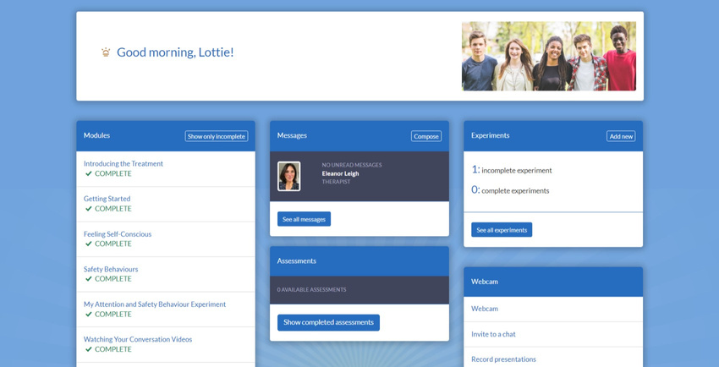
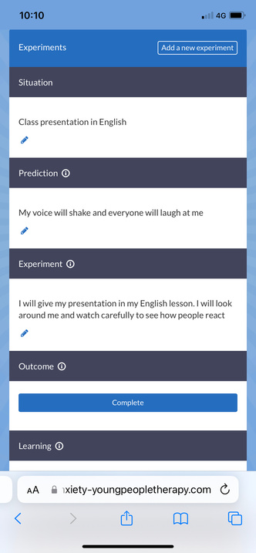
OSCA
(Online Social Anxiety Cognitive Therapy for Adolescents)
  Based on adult Cognitive Therapy
  Young people are guided through modules covering key aspects of social anxiety. Additional modules are released tailored to the young person’s specific worries.
  Weekly therapist calls and
between-call messaging
  Online site is accompanied by young person & parent apps.

Slide 32


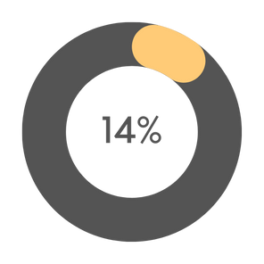
Why OSCA?
  Created specifically for social anxiety
  Content informed by young people e.g. adding modules addressing social anxiety in the classroom and peer problems
  Online delivery provides young people and families with more flexibility
  Maximises therapist time
  Effective compared to waitlist, leading to recommendation in NICE 2023 Early Value Assessment
OSCA
WLC

Slide 33


The GOOSCA Trial
  We are working with 2 research clinics to test the clinical and cost effectiveness of OSCA compared to treatment as usual in the NHS for young people with social anxiety disorder.
  We will compare outcomes for young people between the two treatments, mainly looking at change in their social anxiety symptoms. We will also ask clinicians to provide feedback on how they found delivering each therapy. We will also be making sure that OSCA is cost-effective
  Results of this trial will help inform the use of OSCA in the NHS

Slide 34
How to refer to the AnDY Research Clinic

Slide 35

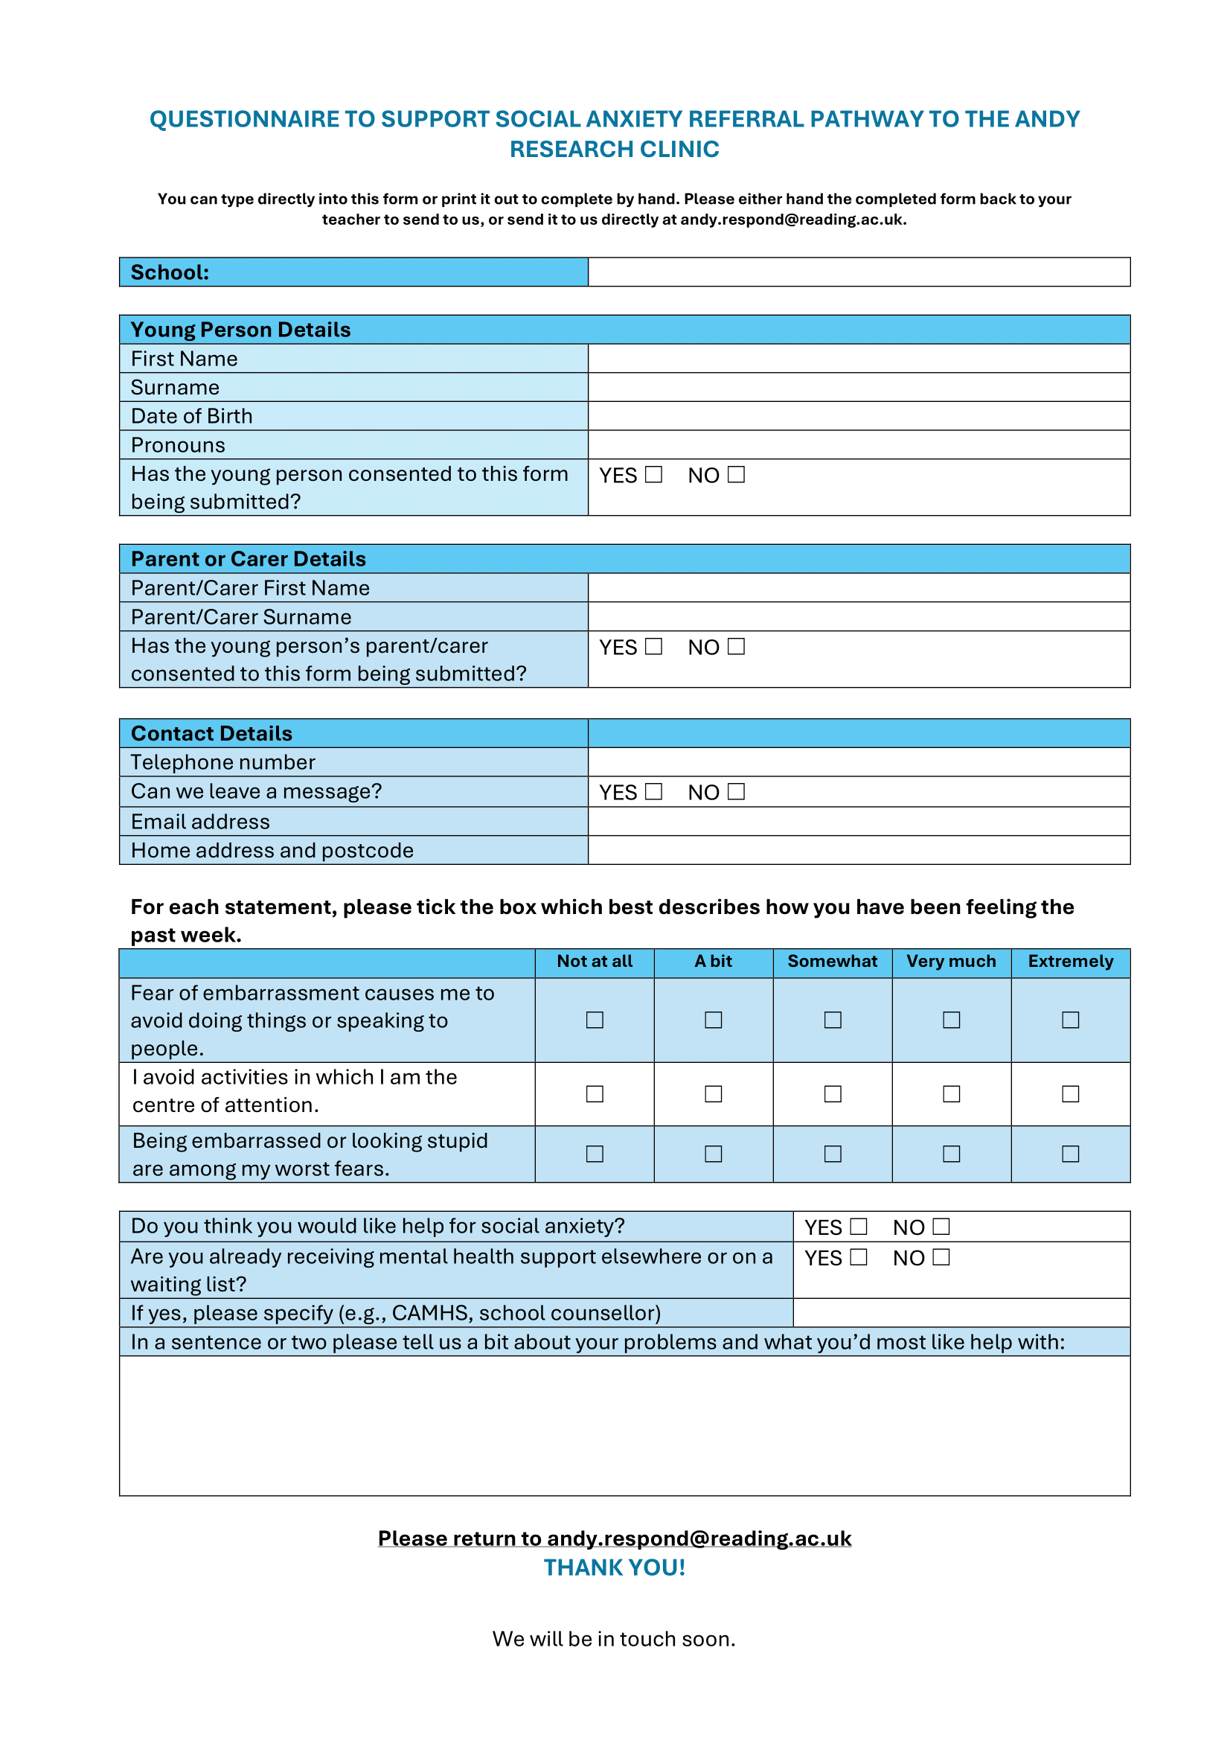

Slide 36
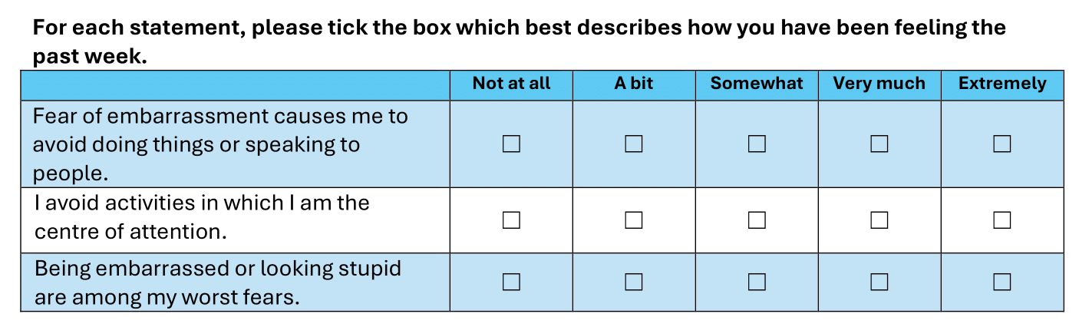
Mini-SPIN

Slide 37
Contact us
AnDY Referrals Team:
  Calum McDonald (Supervisor / Senior Children’s Wellbeing Practitioner)
  Paris Matthews (Assistant Psychologist)
  andy.respond@reading.ac.uk
  0118 378 4682

Slide 38

Questions?

Slide 39
Questions and
Feedback
Notes:
39

