Slide 1
Attendance Lead Networks
Tuesday 22nd November 2022
Welcome to this virtual forum
Notes:
1

Slide 2
Agenda for today
Item | Who | Time
Welcome | Al Whitelaw | 3.30 pm (5 mins)
Overview of New Guidance. Working together to improve school attendance. | Al Whitelaw Background Roles and Responsibilities Policy | 3.35 pm (20 mins)
Virtual School Extended Duties update | Ruth Gusterson Joanna Western | 3.55pm (20 mins)
Whole School Culture of Attendance | Alasdair Whitelaw | 4.15pm (15 mins)
Questions

Slide 3
Attendance
Updates
Notes:
3

Slide 4

The big changes
Collectively, it’s the biggest set of changes to the attendance system since 1870 –
Clarity of expectation: schools, trusts and local authorities will all have clearly defined statutory roles for the first time, set out in a clear table of responsibilities
Earlier intervention: Schools will have legal responsibilities to proactively improve attendance for the first time (beyond existing requirements to record accurately) underpinned by timelier sharing of attendance data
Support first: All pupils and parents no matter where they live in the country will have clear expectations from their school, be informed about their child’s attendance and have access to early intervention and support first before any legal action if it becomes problematic
Targeted whole family support: Attendance teams in LAs will work in tandem with early help to provide a whole-family response with a single assessment, plan and lead practitioner
Independent schools: data will be collected for the first time, and will receive the same support from LAs (which currently happens in some LAs but not others)

Slide 5
What that means in practice for families.
Every parent, regardless of where in the country they live, can expect:
    Clear expectations around attendance, punctuality and the processes for requesting leave of absence from their child’s school
    Regular updates on their child’s attendance
    Where their child’s attendance is at risk of becoming, or becomes problematic, they can also expect:
    Schools to work with them to remove barriers to their child’s attendance
    Signposting to voluntary support services and a multi-agency response to out of school barriers
    A formal parenting contract or early help plan with a single assessment, plan and lead practitioner across services for cases where it is needed
    Formalised support (including through legal intervention) where support does not work, is not engaged with or is not appropriate

Slide 6
What that means in practice for schools
Every school will be required to:
      Have a Senior Attendance Champion on the leadership team
      Have a clear school attendance policy published on their website
      Have robust day to day processes for recording, monitoring and following up attendance
      Analyse their data regularly and prioritise families to work with to understand and address the reasons for absence, including any in-school barriers to attendance.
      Work with local partners to remove out of school barriers and act as the lead professional where they are the best placed service
      Work jointly with the local authority on an agreed approach/ plan for every severely absent pupil
      Develop strategies for cohorts of pupils with poorer attendance than their peers (including groups of vulnerability)
      Inform a pupil’s social worker if they have an unexplained absence or leave the school roll
      Work with their LA to formalise support where voluntary help hasn’t been effective, through use of parenting contracts or other forms of legal intervention
      Share data electronically with the department and continue to inform the LA of pupils not attending regularly or being added to or removed from the roll

Slide 7
What that means in practice for trusts and governing bodies
All trustees and governors will be required to:
      Take an active role in attendance improvement in their school(s) by regularly reviewing data, discussing and challenging trends and helping leaders to focus their improvement efforts
      Set high expectations of the school’s leadership and hold them to account for delivery against them
      Ensure high aspirations are maintained for all pupils but that processes and support are adapted to individual needs of particular types of pupils (inc. all vulnerable children)
      Ensure school staff receive training on attendance
      For schools struggling with attendance, work with the leadership to agree a comprehensive attendance action plan
MATs and federation trustees and governors will also be required to:
        Share effective practice on attendance across their schools

Slide 8
What that means in practice for LAs
Every local authority will be required to:
      Agree a strategic approach to improving attendance for the whole area
      Make attendance a key focus of ALL frontline council services
      Have an attendance support team (AST/EWO) which works with all schools in their area
      Provide every school with a named point of contact in the AST to support with queries and advice
      Hold a termly Targeting Support Meeting with every school in their area to identify pupils who need support with removing barriers to attendance
      Work jointly with all local partners to offer multi-agency support to pupils who need it, including acting as lead practitioner where the the best placed service is an LA one
      Offer opportunities for all schools in the area to share effective practice
      Work jointly with schools on an agreed approach/ plan for every severely absent pupil
      Develop strategies to remove common area-wide barriers to attendance
      Work with schools to formalise support or take forward legal action where voluntary support does not work
      Secure the regular attendance of pupils looked-after as their corporate parent
      Provide support and advice to previously looked-after children
      Monitor and improve the attendance of children with a social worker through their Virtual School

Slide 9
The new guidance on school attendance includes seven expectations of schools from September 2022: Statutory from 2023
Develop and maintain a whole school culture that promotes the benefits of high attendance.
Have a clear school attendance policy which all staff, pupils and parents understand.
Accurately complete admission and attendance registers and have effective day to day processes in place to follow up absence.
Regularly monitor and analyse attendance and absence data to identify pupils or cohorts that require support with their attendance.
Build strong relationships with families, listen to and understand the barriers to attendance and work with families to remove them.
Support for pupils with medical conditions, special educational needs and disabilities.
Share information and work collaboratively with other schools in the area, local authorities and other partners when absence is at risk of becoming persistent or severe.

Slide 10
School Attendance Policy

Slide 11
Expectations of the school attendance policy
Every school has a clear, written school attendance policy.
The policy is applied consistently and fairly BUT also in a way that considers individual needs.
Published on the school website.
Sent to parents with any initial information when a pupil joins at the beginning of each school year.
All staff, pupils and parents should know where to find it and are familiar with contents
Schools should seek the views of pupils and parents in developing/ refreshing it.
It should be regularly reviewed.

Slide 12
Contents of the policy
The school’s day to day processes for managing attendance, for example first day calling and processes to follow up on unexplained absence.
How the school is promoting and incentivising good attendance.
The school’s strategy for using data to target attendance improvement efforts to the pupils or pupil cohorts who need it most.
The school’s strategy for reducing persistent and severe absence, including how access to wider support services will be provided to remove the barriers to attendance and when support will be formalised in conjunction with the local authority.
The point at which Fixed Penalty Notices for absence and other sanctions will be sought if support is not appropriate (e.g. for an unauthorised holiday in term time), not successful, or not engaged with.

Slide 13
Clarity of sequence
0-2 days off | 99-100% | Class Teachers/Form Tutors | Warm Welcome Praise Texts Praise Points Positive Texts Home Jump the Lunch Queue Attendance awards Class / Tutor group competitions Request for unauthorised absence and update MIS Attendance reports
4 – 7.5 days off | 96 – 98%
9.5 – 17 days off | 93 – 95% | Class Teacher/ HOY /Attendance Lead | 100% weeks notes in planner/home contact book Letter 1 (Green) Class teacher/tutor develop Attendance plan with family Home visit. Minibus pickup Monitor 3 weekly Attendance panel in school
19 – 25 days off | 90 – 92% | Attendance Lead / Pastoral / DSL | 100% weeks notes in planner/home contact book Letter 2 (yellow) Well done letter for improving attendance Stakeholders develop PA / at risk of PA support plan Home visit. Minibus pickup Early Help discussion with Family
27+ days off | Under 89% | Attendance Lead / DSL | Early Help referral 100% weeks notes in planner/home contact book Letter 2 (yellow) Well done letter for improving attendance Attendance panel Formalise support plan with EWS

Slide 14

Core Components of the policy
What is good attendance and why is it important to us?
What are our daily routines?
Expectations and Daily Routines
How do we track the attendance of children?
How do we ensure that our work is effective?
Data and Monitoring
How will we ensure children are safe and tackle absence together?
Escalation of Procedures

Slide 15
Expectations & daily routines
What is good attendance and why is it important to US?
Safe, healthy and successful children
Improving attendance is in everyone’s interests and it’s everyone’s business
What are OUR daily attendance routines?
Meet & greet
Register open and close
Register check & follow up on unexplained absence
First day calling & home visits
Engaging external agencies
Promotion & celebration
Data & monitoring
How will WE track the attendance of children?
Routines- daily, weekly, half termly, termly and annual
Thresholds, allocation & referral
Reporting
How will WE ensure that our work is effective?
Meet with families
Review plans
Measure impact
Escalation of procedures
How will WE ensure children are safe & tackle absence together?
Roles & responsibilities
Tailored Support
Formalising Support
Clarity on sequence

Slide 16

AfC Virtual School Extended Duties CiN and CP supporting
Richmond, Kingston and RBWM
November
2022
Ruth Gusterson
AHT
Joanna Western
Lead Teacher
AfC Virtual School

Slide 17

Aims
To raise attendance and progress
To promote positive social engagement
To promote the education of children with a CiN or CP plan
To break down barriers to education

Slide 18
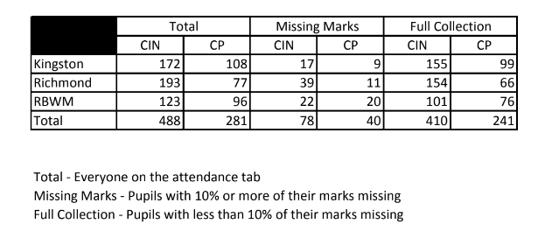
Data Highlights Attendance

Slide 19
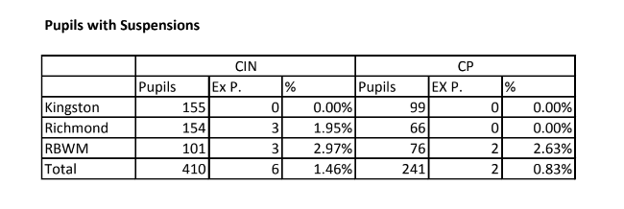
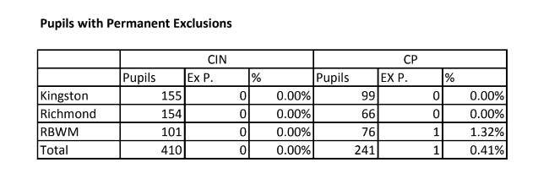
Exclusions

Slide 20
Data
Combined Issues is a formula is applied to the pupils attendance and exclusion
5 pts are awarded if on a CIN plan, 10 for CP.
10 pts are awarded for every permanent exclusion, 2 pts for a suspension
1 is awarded for each day lost to permanent exclusion or suspensions *
1 pt is awarded for every for ever percentage point in average absence *
e.g. a pupil with 87% attendance will get 13pts
* these two criteria will pro rata for decimal places

Slide 21
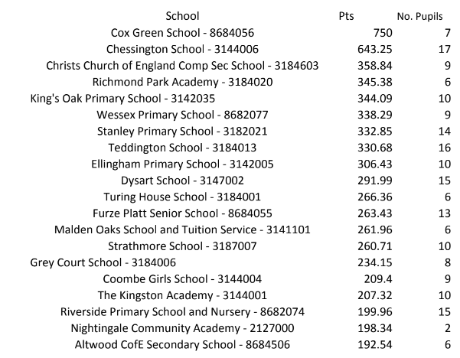
Data

Slide 22

Targeted Support to Schools
We will use the data to target our support to schools
In collaboration with schools we will support those with the highest needs
We will work to address the issues and barriers to education for children on a CiN or CP plan.
Designated Safeguarding Leads will be invited to receive training on attendance and strategies for raising attendance
Working collaboratively with schools to introduce interventions and think of next steps

Slide 23
Joanna Western
Clinics – Purpose
Providing SW with supportive forums to discuss children on CiN and CP plans
A space to think through what can be done to raise child's attendance
A space to think through what the barriers are to the child's education and progress

Slide 24

Clinics…
NEW Social Worker Consultation Clinics
A collaborative problem solving approach for Social Workers supported by Virtual School colleagues and Specialist Educational Psychologists
Together Let’s…
Boost attendance
Reduce exclusion
Raise educational progress
Promote belonging
To book email joanna.western@achievingforchildren.org.uk
SAVE THE DATE (ops 2)
9/11/22 (am)
23/11/22 (am)
7/12/22 (pm)
More dates available in the new year!
* Age related expectations

Slide 25
Clinics…
The aim of this service is to promote a “joined up” problem solving approach to supporting the education of children who have a Social Worker.
Importance of us knowing movements of students CIN-CP-CLA- plan ended.
Why attendance matters - safeguarding, impact on learning etc.
Why 90% sounds good but isn't etc National expectation of 95%
Who else can help EWO / SIP / link EP etc
We not case holding but strategic lead for CIN, CP students.

Slide 26
CP Plans 2022-23
Capturing education more on the plan
CP forms below highlight good practice where education is monitored and less good where we can see a pupil is PA and this is not noted as an issue or followed up
Weekly attendance shared with families and schools and challenged at clinics/Headteachers

Slide 27

AASA Schools 2022-23

Slide 28

What has been the focus of AAS whole school change projects?
● Developing Policy and Systems
(e.g. develop and embed attachment aware behaviour, SEND, transition, exclusion policies)
● Transforming Environment
(e.g. physical changes within and outside normal teaching spaces; developing safe, quiet spaces within schools)
● Staff and Pedagogical Development
(e.g. identification of key adults for vulnerable learners; developing role of ‘key adult’ in schools; empowering staff through continued action research)
● Pupils
(e.g. young people at the centre of whole school change)
● Extending relationships with parents/carers
(e.g. establishing strong links between school and the home; developing open and honest lines of communication; using transitional objects and shared language)
Kelly et, al. (2020)

Slide 29
Whole School Culture
& Next Steps

Slide 30
Why the changes?
Prevent
Intervene early
Target support for persistent (90%) and severe (50%) absentees
To make that a reality for pupils, we need:
  Schools to proactively manage attendance,
  More accurate data
  Evidence based interventions
  Properly trained attendance experts – in school and LA
  Local authorities to proactively remove out of school barriers to attendance
Absence Statistics
Guidance on Leadership update website

Slide 31
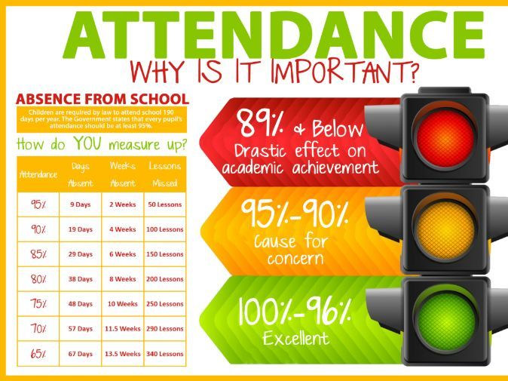
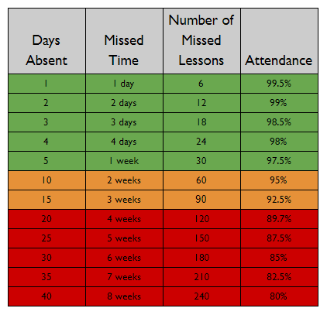


Everybody’s responsibility.
Promote Positively.
Capture parents early. (easy to think “Phew they are not in”)
Every Minute Counts
Always on the agenda
Competition / rewards
Relationships are everything
Foster that sense of belonging. (ERSA)

Slide 32
What does that mean here?
Attendance Lead on SLT
Attendance policy
Develop strategies
Robust and embedded processes
Communicate with Social Care/Virtual School
Data analysis and Governance/Trustees
Work with partners/stakeholders – Early Help etc
Work with LA for to provide support for persistently absent children - 90%
Agree joint approach with LA for severely absent pupils - 50%
Legal intervention where necessary/FPNs
Share data electronically - https://www.gov.uk/guidance/share-your-daily-school-attendance-data
DfE – What does the new attendance guidance mean for schools

Slide 33
Attendance Support / Education Welfare Service
Named point of contact for all schools.
Targeting Support Meetings every full term
      Discuss and agree targeted actions for pupils who are persistently or severely absent and those at risk of becoming so
      Analyse school data and strategies.
Joint Working in line with summary of responsibilities table
Facilitate and signpost. multidisciplinary support.
Join multidisciplinary support for severely absent pupils
Virtual Drop in sessions, Network meeting, newsletters etc
Reduced Time Table coordination / FPNs / Legal support / FPN
Section 5: Persistent and severe absence
• Parenting contracts
• Education supervision orders
• Attendance prosecution
• Parenting orders
• Fixed penalty notices
Section 6: Attendance legal intervention
Monitor and improve the attendance of children with a social worker through their Virtual School Head
Notes:
Rather than holding significant numbers of cases, the School Attendance Support Team should support and advise the family’s lead practitioner on any attendance related elements of the plan, be part of the team around the family if necessary, and step in to lead any formal support or legal intervention when required. This could include acting as the responsible officer if support is formalised in a parenting contract, education supervision order or parenting order (see section 5). A member of the team may, however, act as lead practitioner if they are the most appropriate person.

Slide 34
Questions and
Feedback Form
Notes:
34

