Slide 1
Attendance Lead Network Meeting
Wednesday 29th November
Welcome to this virtual meeting
Notes:
1

Slide 2
Agenda for today
Item | Who | Time
Welcome Attendance Update | Al Whitelaw | 3.30 pm (10 mins)
Ofsted | Johnathan Keay Claire Jones | 3.40 pm (20 mins)
Health Minor Illness guidance | Ellen Duke Dr Alexandra Streeter de Diego | 4.00 (15 mins)
Specialist EWO for Children with a Social Worker | Richie Clarke | 4.15pm (10 mins)
Questions

Slide 3
Attendance
Updates
Notes:
3

Slide 4
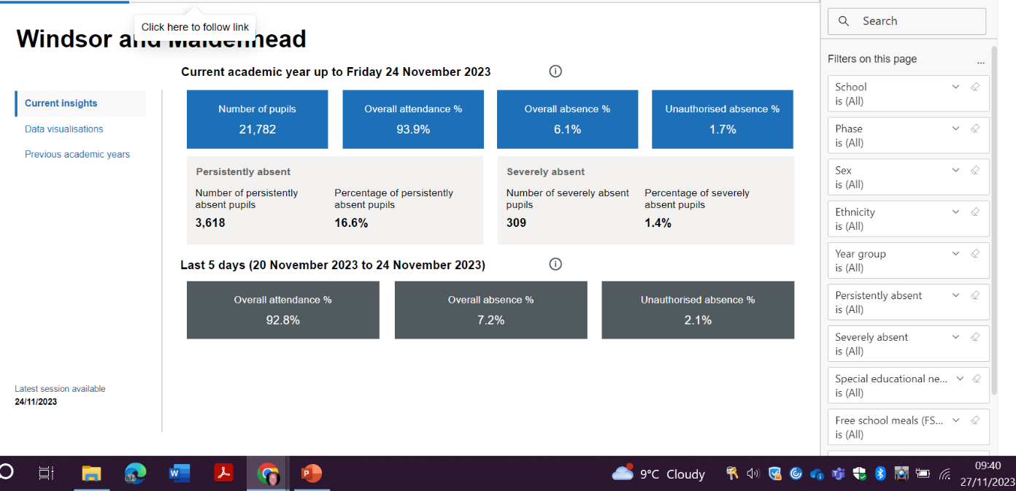
https://www.leadershipupdate-rbwm.co.uk/education-welfare-service-202223/
Attendance Updates
4.25 EWO – 88 Schools – Core Offer and Traded
Attendance Policy
Attendance Lead on SLT
Attendance Network Meetings – feedback
Submitting Data through Wonde
All Schools signed up IdAMS

Slide 5
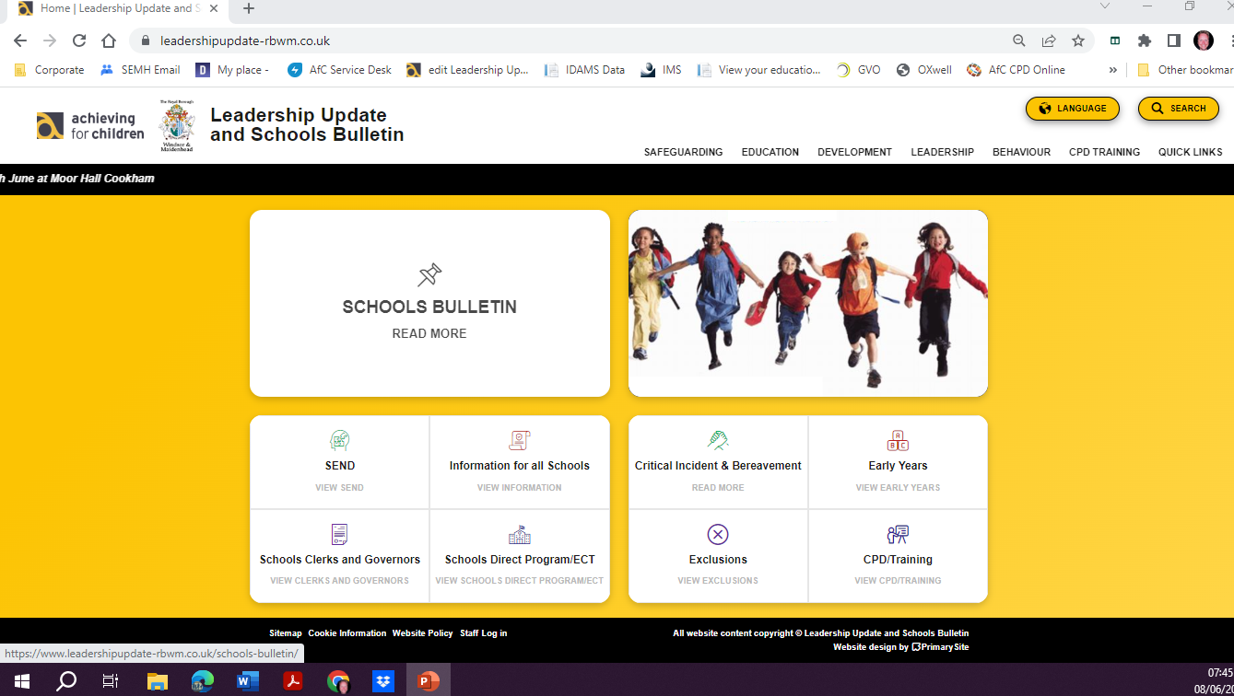
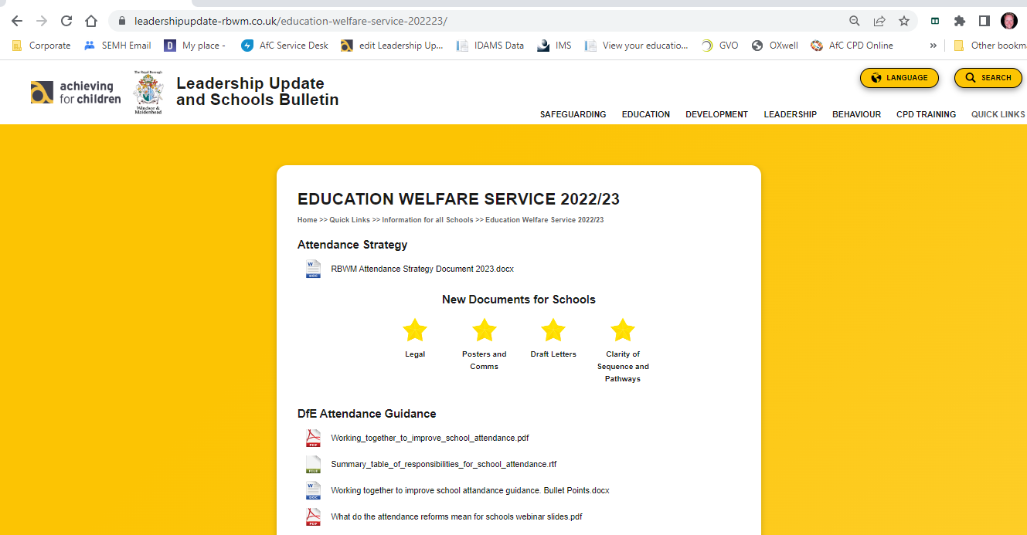
Education Welfare Documents.
Working Together to Improve School Attendance.
https://www.leadershipupdate-rbwm.co.uk/education-welfare-service-202223/

Slide 6
Ofsted and Attendance
Johnathan Keay
Claire Jones
Notes:
6

Slide 7

Health - Minor Illness guidance
Ellen Duke
Team Lead
CAMHS Getting Help and Mental Health Support Team
Dr Alexandra Streeter de Diego
GP Partner Farnham Dene Medical Practice
Paediatric Clinical Fellow Frimley Park Hospital

Slide 8
Extended Duties
AfC Virtual School
Richie Clarke
AfC Virtual School - Specialist Education Welfare Officer
Extended Duties

Slide 9


Slide 10

Introducing a new role for AfC Virtual School
I am the Specialist Education Welfare Officer for Children with a Social Worker with AfC Virtual School Extended Duties team
I am working across Operational Areas’ 1 and 2
Passionate about ensuring all children have equal opportunities to access education
My Experience
  Senior Monitor - The Independent Children’s Monitor
  Special Education Advisor - The Ministry of Education, New Zealand
Notes:
Our role was to assess whether organisations supporting and working with young people in care are meeting their needs and delivering services effectively
We monitored compliance with the Oranga Tamariki Act and the associated National Care Standards Regulations (Which was NZ legislation designed from the United Nations Rights of the Child). We do this through monitoring system performance and looking at outcomes for young people who engage with agencies in the system.
We also look at the quality of practice, and identify areas for improvement, across the wider system under the Oversight of the Oranga Tamariki System Act in New Zealand
Systems level role
Special Education Advisor - Enabling young people to access the curriculum in mainstream education by ensuring the necessary supports were in place for them.
This required comprehensive assessment of need, advocacy and ensuring the right supports are in place at the right time
Schools would request support from our service when they were working with young people demonstrating challenging behaviour in the classroom when they felt that all internal school supports had been exhausted and had not been effective.

Slide 11
Attendance
CIN Average Absence
October 2023 Feb 2023
R- 16.1% R- 18.2%
K-18.4% K- 17.7%
RBWM- 13.8% RBWM- 19.1%
National 16.4% - In February 2023 all areas were above this figure. In October 2023 Richmond and RBWM are below the national absence with Kingston 2% above.
CP Average Absence
October 2023 Feb 2023
R- 16.8% R- 23.6%
K-15.9% K- 22.0%
RBWM- 18.4% RBWM- 23.4%
National 19.5% - in February 2023 all areas were above this figure and in October 2023 all areas have improved to below the national figure.
CLA Average Absence
October 2023 Feb 2023
R- 6.7% R- 13.5%
K-5.2% K- 9.9%
RBWM- 4.4% RBWM- 8.1%
National 7.8%- In February 2023 all areas exceeded the national absence figure. In October 2023 there have been improvements in all areas with Kingston and RBWM significantly below the national absence figure.
Notes:
At extended duties we collect data for average absence and persistent absence for CiN, CP and CLA
CiN Average Absence
The average absence rate for young individuals on Child in Need (CiN) plans is 16.4% nationally. However, in February 2023, Richmond, Kingston and RBWM surpassed this average. As of October 2023, Richmond and RBWM have average absence rates below the national average, while Kingston's rate is 2% higher than the national average.
CP Average Absence
Let's delve into the attendance rates for young individuals on Child Protection (CP) plans. The national average absence stands at 19.5%. In February 2023, the absence rates for those on CP plans exceeded the national average across all three boroughs. I’m pleased to share that by October, all three boroughs are now below the national average.
CLA Average Absence
Now, let's shift our focus to the attendance rates for children looked after (CLA), with the national average absence set at 7.8%. In February 2023 the average absence rates for children looked after exceeded the national average across all three boroughs. As we move to October 2023, there's positive news. Improvements have been observed in all three boroughs.
Both Kingston and RBWM stand out with absentee rates significantly below the national average for children looked after. This showcases notable progress in these areas
This positive trend highlights the collective efforts and effective strategies in place, resulting in improved attendance rates for all three groups across all three boroughs. So a massive well done to all!

Slide 12
CIN Persistent Absence
October 2023 Feb 2023
R- 39.5% R- 49.1%
K-50.9% K- 43.9%
RWBM- 36.6% RBWM- 49.1%
National 48.5% - in February 23 Richmond and RBWM exceeded the national figure now it is only Kingston which has had a rise this month from 48.3% where it had been below national.
CP Persistent Absence
October 2023 Feb 2023
R-42.0% R- 53.6%
K-35.6% K-66.3%
RWBM-36.7% RBWM-53.6%
National 56.2%- in February 2023 Kingston exceeded this and now all three areas are significantly below.
CLA Persistent Absence
October 2023 Feb 2023
R-21.4% R- 25%
K-12.1% K-34.1%
RWBM-13.6% RBWM-16%
National 19.1 - in February 2023 all areas exceeded national now Kingston and RBWM are comfortably below.
Notes:
Introduction:
"Now, let's turn our attention to persistent absences for children in need (CiN), with the national figure set at 48.5%."
"In February 2023, Richmond and RBWM exceeded the national average of 48.5% for persistent absences
"As of October 2023, there have been noteworthy changes. Notably, both Richmond and RBWM have improved, now falling below the national figure of 48.5% for persistent absences."
"Kingston has experienced a rise in persistent absences this month, moving from 48.3% to a figure slightly above the national average. This is a change from its previous position below the national figure."
"Shifting our focus to persistent absences for children on Child Protection (CP) plans, we note that the national figure is set at 56.2%."
"In February 2023, Kingston exceeded the national average of 56.2% for persistent absences, highlighting a particular challenge in that area."
"Fast forward to October 2023, and there's positive news. All three areas—Kingston, Richmond, and RBWM—have made significant improvements, now falling well below the national figure of 56.2% for persistent absences.
"This progress highlights the collective efforts of our boroughs in prioritising attendance for young people on Child Protection Plans
"Now, let's explore the persistent absences data for children looked after (CLA), with the national figure set at 19.1%."
"In February 2023 across all areas, persistent absences for children looked after exceeded the national average of 19.1%."
"Moving to October 2023, there's positive news. Kingston and RBWM have made substantial improvements, and both are now comfortably below the national figure of 19.1% for persistent absences among children looked after."
"This positive shift not only reflects a commitment to improving attendance rates but also contributes to fostering a more supportive and consistent educational environment for children looked after in these areas."
In reviewing the attendance data across these groups, a consistent and positive trend emerges. From February 2023 to October 2023, there has been a commendable improvement in attendance rates across various areas and for different groups, reflecting a collective effort from our community
The improvements in attendance rates, whether for children in need (CiN), children looked after (CLA), or those on Child Protection (CP) plans, signify more than just numerical progress. They underscore a commitment to providing better and more consistent educational experiences, contributing to the overall well-being and development of our young people.

Slide 13
Why am I sharing this?
“Successfully treating the root causes of absence and removing barriers to attendance, at home, in school or more broadly requires schools and local partners to work collaboratively with, not against families” (DfE, 2022)
We want to celebrate our successes, while maintaining high expectations for our young people
We want to work collaboratively with you to improve attendance as it’s in all of our best interest
We know that by working together we can achieve better outcomes for our young people
Notes:
Why am I sharing this?
We want to celebrate our successes because what we are doing is working and that means better outcomes for our young people
HOWEVER we need to keep the focus on attendance high on our priorities as we are seeing a gradual decline in the latter half of this term

Slide 14
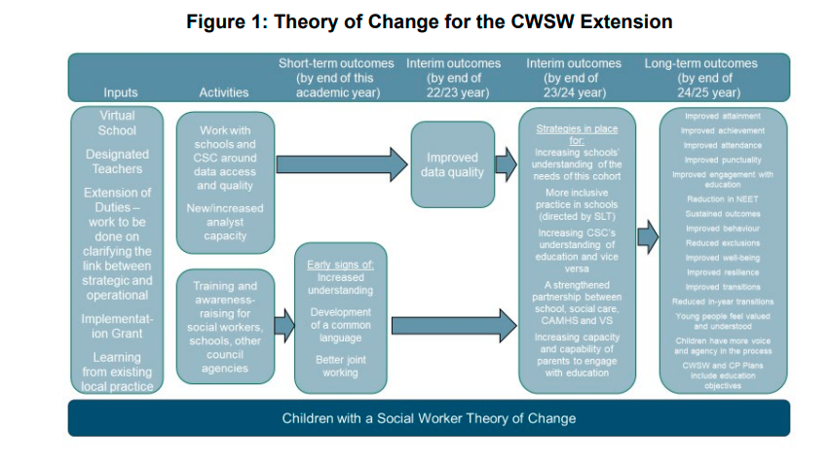
St Mary’s Evaluation of the Introduction of
Extended Duties
Notes:
Importance of Data and compliance
To this end the majority of schools have provided access to our partners at Welfare Call.
We give Welfare Call the pupil numbers for our CIN and CP children which limits data collection to these children The criteria that we collect on is Attendance and Exclusion.
Apart from the obvious safeguarding reasons that we would want to know if CIN and CP are in school, sharing this data means we are able to provide interventions and support to your school, children's families and partner agencies.
This process is in line with the system we already have in place for looked after children and care leavers.
We would like to thank the large majority of schools who are already providing us with this data. If you’re not currently providing us with this data and you’d like more information. Feel free to get in contact with my manager Ruth Gusterson.
Introduction Notes:The Department for Education has extended the duties of Virtual Schools to support the education of CIN and CP children and improve their attendance.
St Mary's University have been evaluating the introduction of Extended Duties
Purpose of Research: This study evaluates the progress in implementing strategies and practices outlined in the Theory of Change, specifically for Children with a Social Worker (CWSW). The focus is on how these changes are influencing the educational and welfare support systems for these children.
Significance: The insights gained from this evaluation are vital for assessing the effectiveness of the new measures introduced for supporting Children with a Social Worker (CWSW). It sheds light on the collaboration between educational and welfare services, improvements in data handling, and a deeper understanding of the educational needs of children with a social worker.

Slide 15
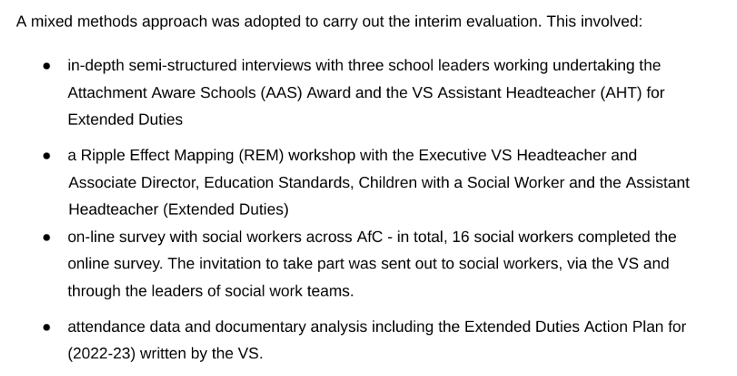
Method
Notes:
The evaluation was completed using a mixed methods approach, the first part being
Semi structured interviews with three school leaders undertaking the AASA and the VS assistant headteacher for extended duties
A ripple effect mapping workshop with the executive VS head teacher, the associate director, education standards, children with a SW and the assistant head teacher.
An online survey with Social Workers across AFC
Attendance data and documentary analysis including the extended duties action plan for 2022-2023 written by the VS
Ripple Effect Mapping (REM) is a participatory evaluation method used to visually map the impact of a program or project. It combines elements of appreciative inquiry, mind mapping, and social network analysis to identify and document the direct and indirect effects of an initiative. Here's a brief summary:
Collaborative Approach: REM involves stakeholders who are directly or indirectly affected by the project. This collaboration ensures diverse perspectives and comprehensive understanding of the project's impacts.
Visual Mapping: The process starts with a central event or action (the initial 'ripple') and expands outwards to map subsequent effects and changes. This visual representation helps in understanding how initial actions lead to a series of outcomes and impacts.
Capturing Direct and Indirect Impacts: REM is particularly useful in identifying not just the direct outcomes of a project but also the indirect or secondary effects that may not be immediately apparent. This includes changes in behavior, practices, policies, or social relationships that occurred as a result of the project.
Appreciative Inquiry: The method often incorporates appreciative inquiry, focusing on the strengths and successes of a project, rather than just problems or deficits. This positive approach helps in understanding what worked well and why.
Useful for Evaluation and Learning: REM is used not only for evaluating the effectiveness of a project but also for learning and improving future initiatives. It provides a rich, detailed picture of the project's impact, including unintended consequences and areas for future development.

Slide 16
Mary’s Evaluation of the introduction of
Extended Duties
This is being achieved through implementing a thoughtfully considered strategic and extensive programme of activities that combine universal and targeted activities and interventions.
The particular strengths of the programme to date have been the: very swift collection of CIN/CP data which has then been effectively used to underpin other activities including: the focus on attendance in training, AAS Award, Social Worker Consultation Clinics, the strengthening of existing partnerships and establishing of new collaborations.

Slide 17
Extended Duties
Strengthen Partnerships within three Local Authorities - working with multi-agencies
Weekly Data Gathering and sharing with SWs on children's Persistent and Average Absence
Targeted School Supports
  Attachment Aware Schools Award (AASA) 67 Schools Bronze, Silver or Gold
  Schools’ Safeguarding Clinics
  Offering Transition Hub support
  Tailored support for individual students on CiN and CP plans
Targeted support for Social Workers
  Education Consultation Clinics with Ed Psychs
  Signposting to services and supports
  Team coordination
Notes:
Part of our role is to be the glue between social care and education, we want to ensure that supports are collaborative and co-ordinated because we know that will lead to better outcomes for young people
To achieve this, our goal has been to combine universal and targetted activities and interventions.
We collect data on persistent and average absences for young people on CiN and CP plans. This informs where we want to target our support. When we notice a drop in attendance for young people on CiN and CP plans we will contact you guys to see how we might be able to support.
In terms of what we can offer schools. we have the attachment aware schools award -
This aims to provide all students with an education that is inclusive and sensitive to trauma by supporting schools to develop attachment aware and trauma informed practices.
The program emphasises making changes in whole school practice that are both observable and measurable
There are currently 67 schools completing the program at either the bronze, silver or gold level
We also have the transition hub
We work with schools to rengage students with education and improve attendance for young people who are either new into care or those on a CiN or CP plan, whose attendance is between 80% and 89.9%
The transition hub is a 12 week program that provides holistic support aimed at reengaging the student in education and developing the 6 cs of positive youth development. Competence, Confidence, Character, Contribution, Caring, Connection
Suzanne also offers safeguarding clinics for head teachers, these are completely anonymous and are an opportunity to talk through any challenges that a HT might be facing in regards to young people on CiN and CP plans

Slide 18

Thank you for listening
Any Questions?
Richie Clarke
Richard.Clarke@achievingforchildren.org.uk

Slide 19
Questions and
Feedback
Notes:
19

