Slide 1
Attendance Lead Network Meeting
Tuesday 19th November 2024
Welcome to this virtual meeting
Notes:
1

Slide 2
Agenda for today
Item | Who | Time
Welcome | Al Whitelaw / Annette Taylor Attendance Update and EHE/CME | 3.30 pm (10 mins)
DfE - Attendance Adviser | Victoria Franklin | 3.40 pm (20 mins)
ERSA | Zoe Price | 4.10 (15 mins)
Understanding attendance (inclusion Conference feedback) | Judith Street (Queen Anne’s First) | TBC
Paediatric Sleep Training | Wendy Bould | 4.25 (10 mins)
Annual Report | Al Whitelaw | 4.35 (10 mins)
Questions | Feedback Form

Slide 3
Attendance
Updates
Notes:
3

Slide 4
Annette Taylor (EWO Coordinator)
Reduced Timetables
VYED
ASM
FPNs
CME
EWO for CWSW

Slide 5
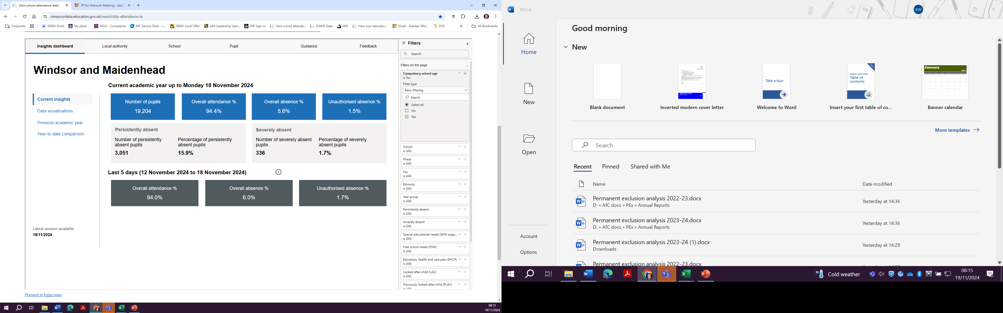
Leadership update website - EWS
Attendance Updates

Slide 6
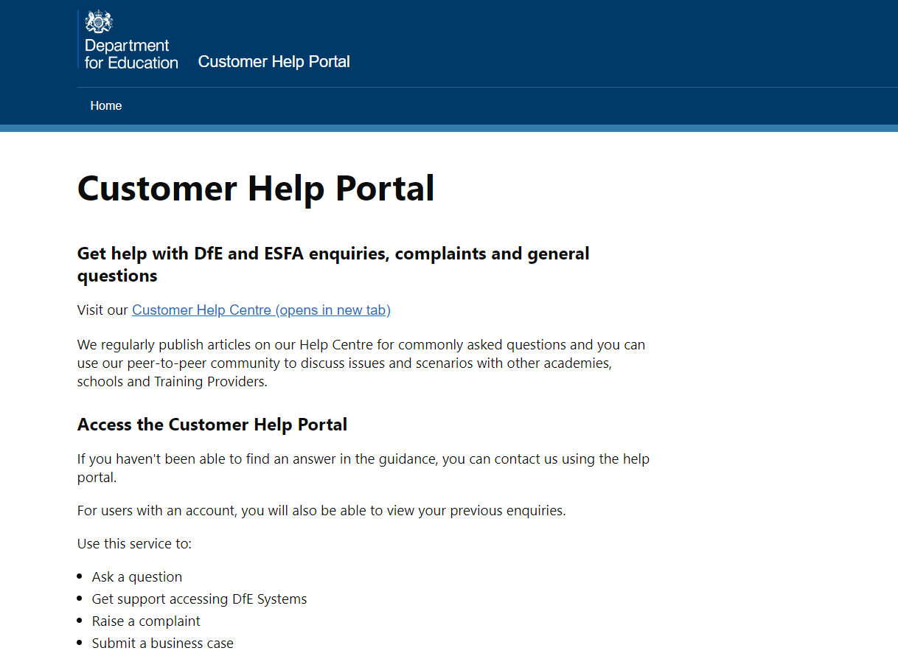
Submit a query
​If you want to tell us about a new issue then please visit:
Home - Customer Help Portal (education.gov.uk) ​
Log in / sign up to the portal
Select 'Get help with DfE systems’​
Select ‘School attendance dashboard’
DfE YouTube Webinars
https://www.youtube.com/@educationgovuk

Slide 7
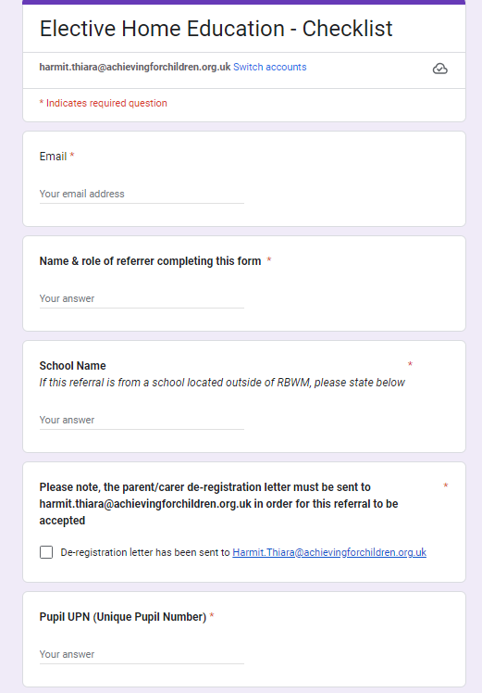
EHE checklist
The EHE checklist forms an integral part of a range of initial enquiries that I use to ascertain suitability of elective home education. It also provides important information that helps to safeguard pupils who are being electively home educated in RBWM.
As with all documents, there is always room for improvement. I would be happy to take suggestions if there is anything else that should be added/tweaked.
Below are some areas that I would like to highlight as of particular importance when completing this form.
EHE should not be suggested to families as an option but should be explored if a parent asks about it. Please feel free to share my contact details or invite me to any scheduled meetings so that families can make an informed decision.
DSL to complete the form, or at least the safeguarding section please, as attendance officers may not be aware of, or have access to, safeguarding/SEN/attainment information.
Please remember to send the deregistration email/letter. This should be written by the parent/carer who has made the decision to home educate and should not be given as a template by the school for the parent to sign.
Please provide up to date contact information for all parents/guardians that have parental responsibility as there is a legal obligation to contact them.
SEN - please use the space in this section to explain what SEN the pupil has. It is helpful to have a code, but understanding the SEN in more depth is much more useful. It enables me to signpost families to more tailored support, but also builds a bigger picture of the young person and a better understanding of whether the provision at home is suitable.
DfE guidance states that the education that is being provided at home should be suitable to a pupil’s age, ability and needs. Providing a pupil’s most recent attainment information would help to assess this. A previous report would be great, but basic information such as whether a young person is meeting ARE is also helpful.
I appreciate how busy staff are in schools, so I wanted to take this opportunity to thank you for taking the time to complete this form and for reaching out to me about families who are considering EHE. Early intervention is key to supporting pupils, especially our most vulnerable, to remain in school, accessing education/SEN support and gaining qualifications.

Slide 8
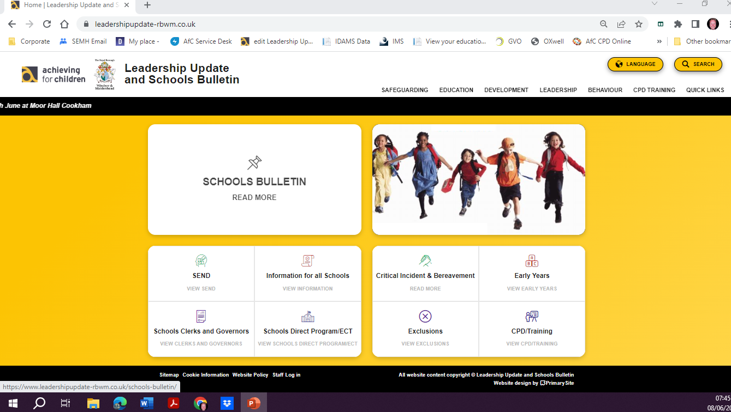
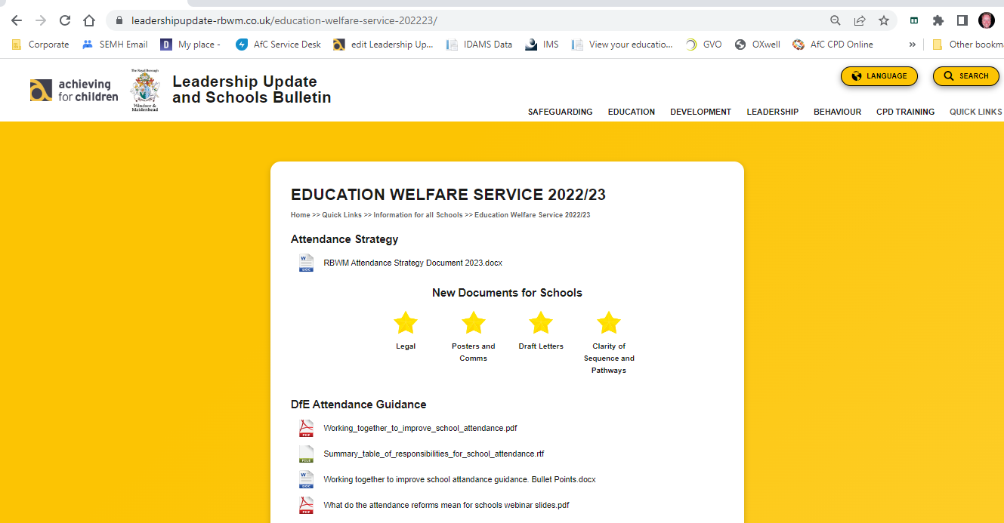
Education Welfare Documents.
updated
Working Together to Improve School Attendance.
https://www.leadershipupdate-rbwm.co.uk/education-welfare-service-202324/

Slide 9
Department for Education
Victoria Franklin
Education Advisor

Slide 10
Victoria Franklin
DFE Attendance Adviser

Slide 11

Attendance is everyone’s responsibility
Notes:
Just like safeguarding

Slide 12
Update on the national picture
No change in Government Policy – attendance a very high priority
Cross party support for attendance improvement work
Attendance Mentoring Pilot Expansion programme will work across 10 additional areas and be delivered by Etio. Working with persistent and severe absentees in areas with the highest absence rates
www.gov.uk/government/news/thousands-of-pupils-receive-support-to-boost-school-attendance--2

Slide 13
Update on the national picture
Attendance toolkit –produced by Rob Tarn based on work and best practice from the Attendance Hubs covering 6 key areas of practice aligning with WTTISA and supported with case studies
https://attendancetoolkit.blob.core.windows.net/toolkit-doc/Attendance%20toolkit%20for%20schools.pdf

Slide 14
Latest absence data – census data overall absence
Published 17th October for Autumn/Spring 2023/2024
explore-education-statistics.service.gov.uk/find-statistics/pupil-absence-in-schools-in-England
Overall absence has decreased compared to Autumn/Spring data 22/23
Absence decreased in primary schools from 6.0% to 5.4%
Absence decreased in secondary schools from 8.7% to 8.5%
Absence decreased in special schools from 13.2% to 13.0%

Slide 15
Latest absence data- census data persistent and severe absence
Persistent absence rates have decreased, and severe absence rates have increased compared to autumn and spring 2022/23, across all school types
Decrease in primary schools from 17.3% to 14.7%
Decrease in secondary schools from 25.2% to 23.9%
Decrease in special schools from 39.1% to 36.8%
Increase in primary schools from 0.7% to 0.8%
Increase in secondary schools from 3.1% to 3.5%
Increase in special schools from 6.1% to 6.4%

Slide 16
Latest attendance data- fortnightly publication
Published fortnightly from shared data
explore-education-statistics.service.gov.uk/find-statistics/pupil-attendance-in-schools
Not finite data but a strong indicator as we go through the year and
attendance is stronger than at this time last year
.

Slide 17
What’s coming next ?
Children’s Well Being Bill – Children Not in School register and free breakfast clubs
SEND and AP Action Plan
RISE teams -Regional Improvement for Standards and Excellence Teams
New OFSTED inspection framework – attendance as a separate focus

Slide 18

Revised codes
DFE have produced a FAQ sheet
FAQ_admission_and_attendance_registers_October2024.pdf
https://www.youtube.com.mcas.ms/watch?v=H0z1lgeSacU&list=PLXjcCX3hH9LXqKNI35VTWirdJnzjO3s2b&index=21&t=9s

Slide 19
Links to useful documents
Working together to improve school attendance – statutory updated guidance
Summary of responsibilities
Toolkit for Schools
Guidance for parents
https://www.gov.uk/government/publications/working-together-to-improve-school-attendance

Slide 20
Links to Research
Behavioural Insights Team – communicating with parents about absence and attendance
educationendowmentfoundation.org.uk/projects-and-evaluation/projects/bitup-updating-parents-on-number-of-school-days-missed-2022-23-trial
DFE recent research publication – looking at PA and other unauthorised absence
www.gov.uk/government/publications/persistent-absence-for-unauthorised-other-reasons-who-is-at-risk
Public First Report on parental attitudes
www.publicfirst.co.uk/wp-content/uploads/2023/09/ATTENDANCE-REPORT-V02.pdf
www.centreforsocialjustice.org.uk/library/the-missing-link
www.evaluation.impactedgroup.uk/research-and-resources/understanding-attendance-report-2#report

Slide 21




Working together to improve school attendance
Guidance overview for schools
April 2024

Slide 22
ERSA
Zoe Price
Educationalsychologist

Slide 23


Emotionally related school avoidance (ERSA) project 2024-25
Dr. Frances Lee, Associate Director Educational Psychology & Wellbeing
Dr Zoe Price, Educational Psychologist, ERSA
Dr Abigail Gilbert, Educational Psychologist, ERSA

Slide 24
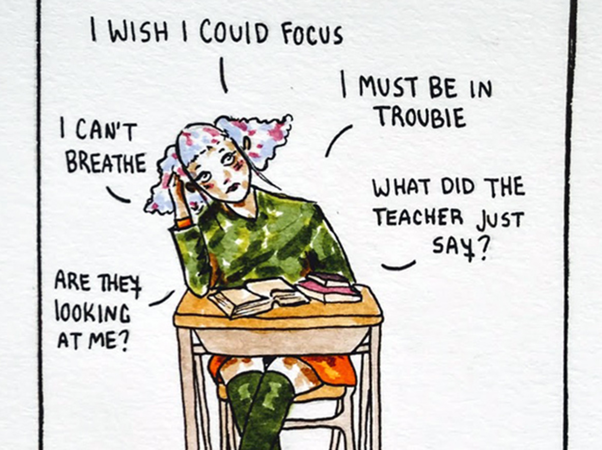


What do we mean by ERSA?
Emotionally related school avoidance (ERSA) describes a group of children and young people (CYP) who experience difficulties attending school which can be linked to a range of factors. The roots of ERSA lie in emotional, psychological and relational issues.
The Continuum of ERSA
In school with heightened anxiety. Occasional absences. Parents may report some reluctance to attend. | Increased absences. These may be sporadic or have a pattern. Parents may report some reluctance to attend. | Persistent non-attendance and extreme reluctance to attend school.
Notes:
ERSA describes a group of children and young people who experience difficulties attending school, which can be linked to school, parent and or child factors, as well as wider societal factors. You may have also heard the term school refuser to describe his group of children and young people, such as in academic literature or in supporting documents online. However, this language is misleading as the term refuser implies its student has control over the school non attendance and therefore this language locates the problem within the student. Typically, school avoidance is a complex interplay of both individual and environmental factors. For this reason, ERSA is a more appropriate term to use to describe this group of children.
Emotionally Related School Avoidance (ERSA) can be considered as a continuum ranging from children & young people (CYP) who are still attending school but present with anxiety (perhaps somatic symptoms such as stomach aches or headaches) through to complete absence from school for an extended period of time. Although CYP’s behaviours might not be readily recognisable as ERSA at the early stages of the continuum, it highlights their vulnerability to becoming ERSA if action is not taken. CYP with ERSA often do want to attend school, however, their anxiety, or an absence of necessary skills or resources or wider risk factors leaves them unable to do so. It is important to note that the continuum is BI directional and is dependent on the child or young person's context such as home, school or community, their relationships and risk and resilience factors

Slide 25
Local and national context
Persistent absence is classified when a young person's attendance is lower than 90%, or they have missed more than 19 days of school.
 | National 22/23 | RBWM 22/23 | National 23/24 | RBWM 23/24 | National 24/25 to date | RBWM 24/25 to date
Primary | 17.2% | 17.4% | 15.2% | 12.8% | No data | 13.1%
Secondary | 28.3% | 22.7% | 26.7% | 25.9% | No data | 18.4%
Themes in RBWM (to date 24/25):
Highest rates in Year 10 (22.8%) and lowest rates in Year 3 (10.7%).
Those on a SEND register (24.1%) experience higher rates than general population (19.6%).
Those who are Pupil Premium (31.3%) experience higher rates (13.9%)
Those with an EHCP (29.9%) experience higher rates (19.6%). This includes SEMH and
neurodiverse needs.
New DFE attendance legislation requires schools to record ERSA going forward
Notes:
Since the pandemic, 1 in 6 CYP aged 5-16 years have a probable mental health problem (an increase from 1 in 9 in 2017). At the same time, some vulnerable CYP with additional needs, including medical needs have reported feeling happier studying from home rather than attending school.
ERSA cases have risen significantly.National and local statistics are not kept on ERSA so it has been challenging to fully grasp the extent to which non-attendance is due to ERSA.
Overall persistent absence 10.3% RBWM (National 22%). In RBWM, CYP home educated has nearly doubled from 100 to 182 and CYP missing in education has risen from 30 to 76 cases in the last 2 years. These categorisations may mask underlying ERSA issues. In RBWM, ERSA is not consistently identified or recorded on any databases. More recently, the Educational Psychology Services, Education Welfare Services, Wellbeing Services & SENDIAS and the EPS have started to record ERSA if it is a primary need for concern.

Slide 26
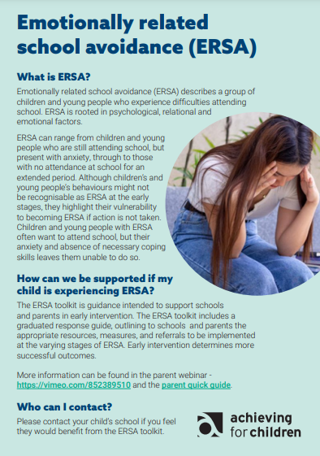
ERSA project so far - September 2022 to now….
2022-2023 an ERSA coordinator was appointed.
All RBWM schools will have received initial ERSA training or consultation by December 2024.
The ERSA coordinators have also provided training to 15 different education, early help, community and social care teams across the local authority to ensure all of those supporting this group of young people feel equipped to provide the right support and are utilising the ERSA toolkit.
In addition, support has been provided to parents within the community in partnership with GEMS and SENDIASS through the use of parent groups and webinars to build their confidence and knowledge with identifying, understanding and supporting their child who may be struggling with ERSA, working in partnership with schools.
Development of an ERSA leaflet which schools are asked to send out with their initial attendance letter

Slide 27
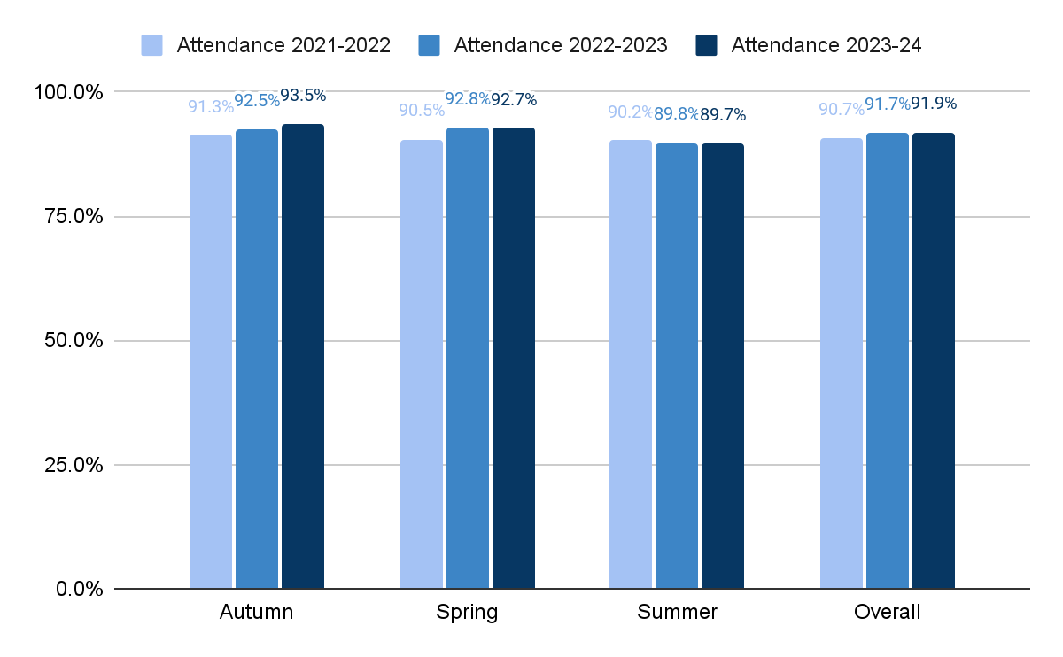
Persistent Absence ERSA outcomes and impact
Across the schools who have entered data on IDAMS we have seen an increase in overall attendance each academic year.
Notes:
Across the schools who are entering data on IDAMS we have seen an increase in overall attendance from the previous academic year to this year
Hypothesis: summer holiday, dysregulation with upcoming change
Note from Al: IDAMS data may not be fully accurate especially for the upper schools

Slide 28
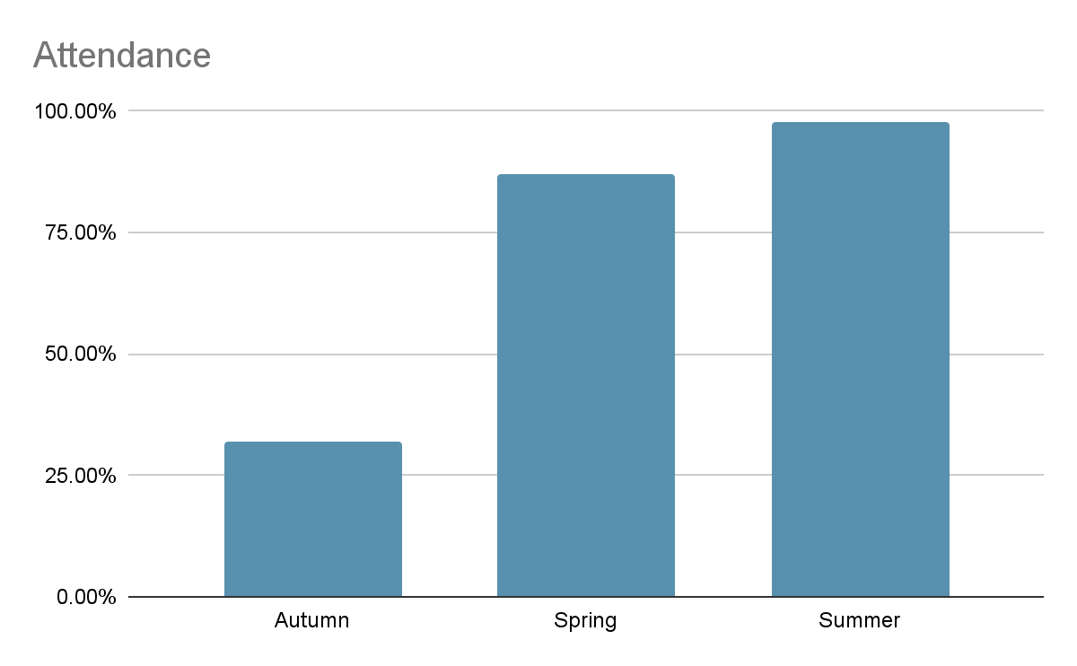
ERSA case studies
Year 8 female pupil
ASC
SHINE support
PEAR hub
Pattern of Monday’s absent
Reduced timetable
Gave her complete autonomy as to when and how she increased it.
School, mum and YP would meet every Monday morning to discuss the week ahead and what she felt she was able to achieve.
Because she felt completely in control, this alleviated much of her anxiety.
Attendance increased from 32% to 98%

Slide 29
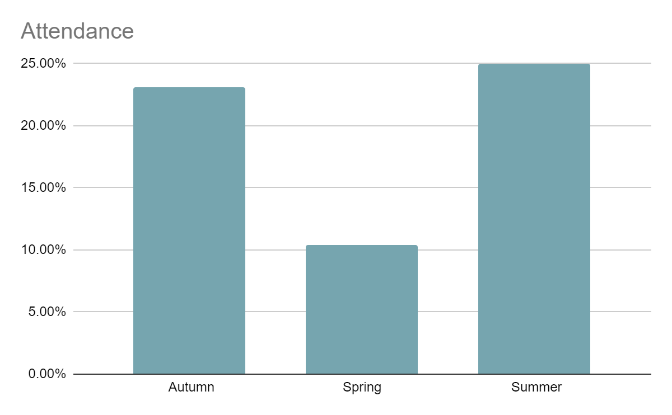
Year 10 pupil
Transferred in 2021 after being excluded from previous school. At risk of exclusion.
On the ADHD pathway awaiting assessment from CAMHS.
Short period of being LAC due to incidents of physical aggression at home. Currently on CIN plan.
Support from Young Person's Substance Misuse Team and Youth Offending Team
Concerns around suicidal ideation, self-harm, disordered eating and anxiety. Did not engage with therapy through CAMHS. Previous suicidal attempt
Academically below expected rates.
Recommendations included things such as: the use of three Rs relational responses in school and at home, brainstem calmers, emotion coaching techniques

Slide 30
Key feedback
Feedback from schools
“The training helped to see how to set manageable targets for these pupils to come back into school.”
“The training gave understanding of why a child might struggle to come to school.”
“The training highlighted the importance of looking at patterns of absence and how we might identify an ERSA student.”
“I now understand how broad the continuum of ERSA is.”
“We found giving the young person control of their support plan alleviated much of their anxiety”
Feedback from parents
“Overall positive session and explaining the use of the toolkit and how we can support our children who are struggling with ERSA.”
“It is helpful to be informed of the local authority ERSA roadmap and developments and to be clear about signposting for parent support”
“The ERSA guidance is helpful to show linked partnership with schools”

Slide 31
Key feedback
Feedback from young people
“I was able to talk to pupil services to change my sets for one class and I have a new teacher that is able to explain things to me clearer. I also have started counselling since stating the toolkit”
“ERSA lead was helpful as she kept me in a smaller class until I was ready to go back and do some lessons”
“When I come into pupil services people are telling me I am doing well and it is nice that someone cares about me”
“I got put on a reduced timetable until I got used to being back in school, this helped a lot”
“When I come into the smaller class I don’t worry as much, I just get on with the work.”
“I have started to see someone about my sleep schedule because before I was always getting up too late for school”

Slide 32
Sustainability - next steps 2024-2025
Relaunch of ERSA revised toolkit based on service user feedback
Training delivered to governors, social care, early help, family support hubs, colleges & independent schools in RBWM.
Extend support and reach with parents through online webinars and coffee mornings through partner services such as IAS, SEND voices, GP surgeries & GEMS.
Work in partnership with virtual school to support embedding the ERSA toolkit within CIC cohort.
Further consultation and support to family hubs, social care, school nurses and education welfare officers who work directly with the families - Multi-agency Communities of Practice ERSA working group to develop ERSA charter that also addresses needs of the ERSA associated themes found in slide 4..
Standing ERSA slot within attendance and SEMH networks.
Complete follow-ups with schools who were trained in the previous academic year to consider quality assurance of application of the toolkit and impact to see how many students they are currently using the toolkit with.
ERSA coordinators to support schools in establishing parent/school partnership ERSA workshops. (24/25).
Partnership with DBV project to create ERSA Communities of practice charter.
Strengths based approach- ERSA leaflet is attached to all school & EWO letters where there is an initial concern about attendance.
Develop additional section to CYP’s ERSA guidance ‘Worried about a friend?’ (Sept. 2024).

Slide 33
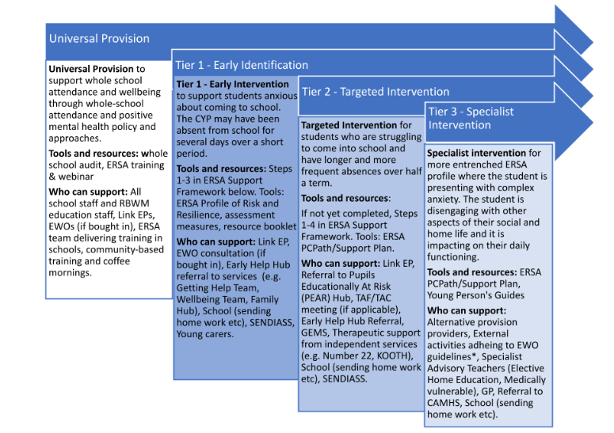
Phase Two: Sustainability
ERSA toolkit relaunch

Slide 34
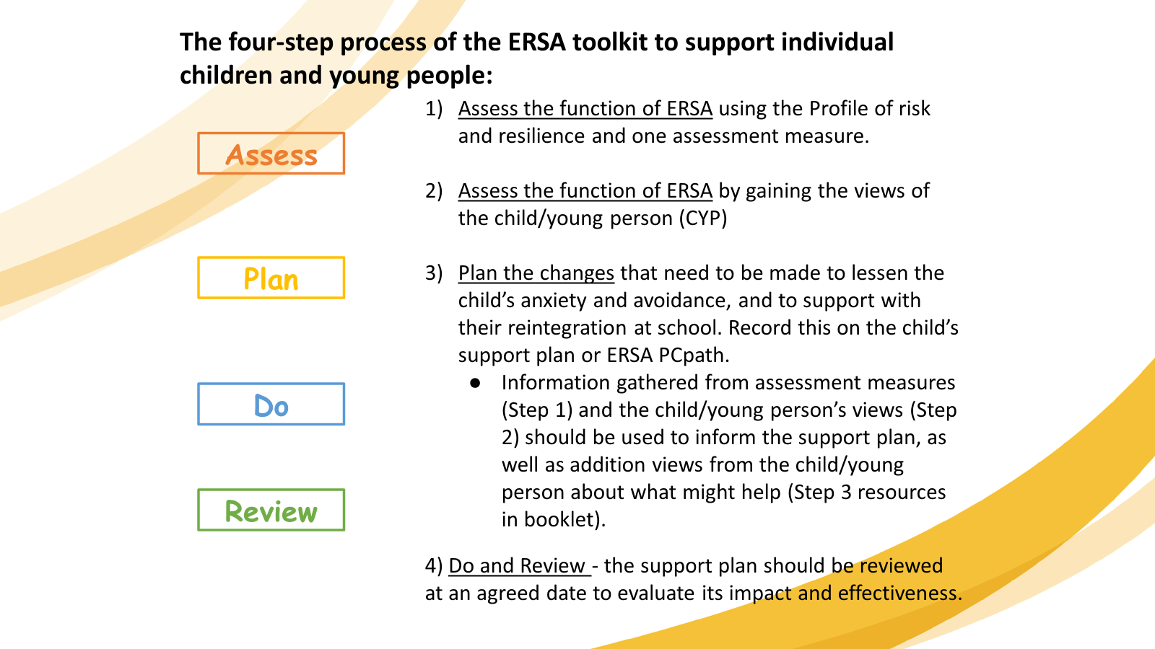
3. ERSA project so far
2022-2023 an ERSA coordinator was appointed.
All RBWM schools will have received initial ERSA training or consultation by December 2024.
The ERSA coordinators have also provided training to 15 different education, early help, community and social care teams across the local authority to ensure all of those supporting this group of young people feel equipped to provide the right support and are utilising the ERSA toolkit.
In addition, support has been provided to parents within the community in partnership with GEMS and SENDIASS through the use of parent groups and webinars to build their confidence and knowledge with identifying, understanding and supporting their child who may be struggling with ERSA, working in partnership with schools.

Slide 35
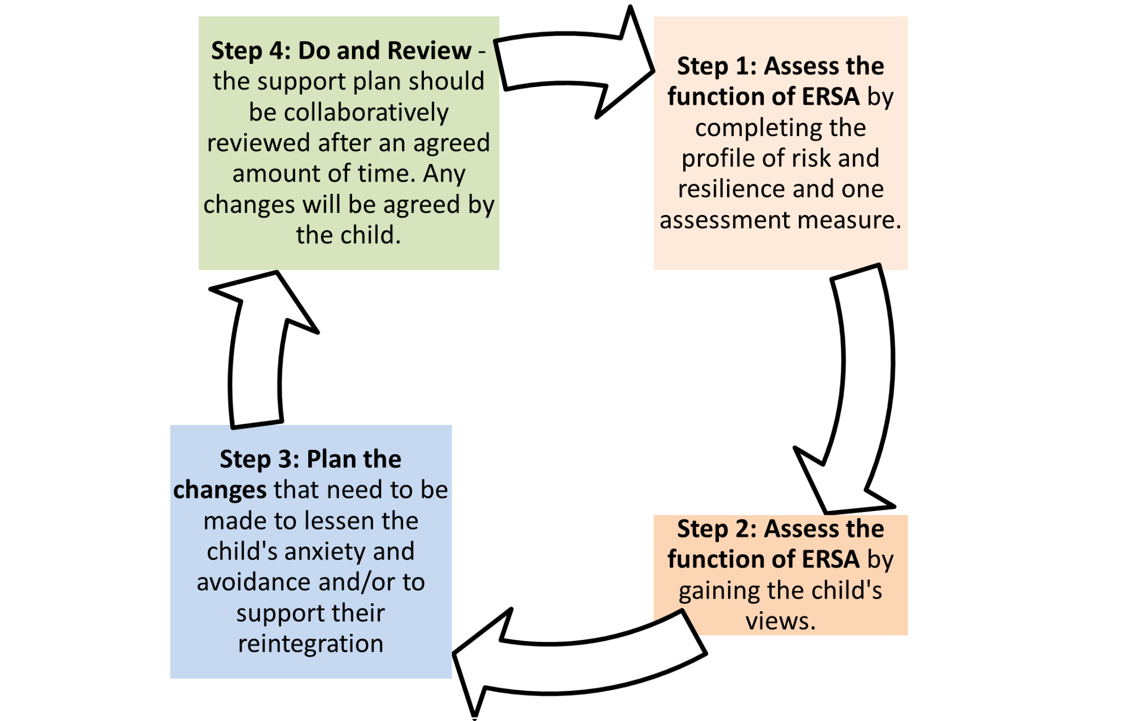

Slide 36
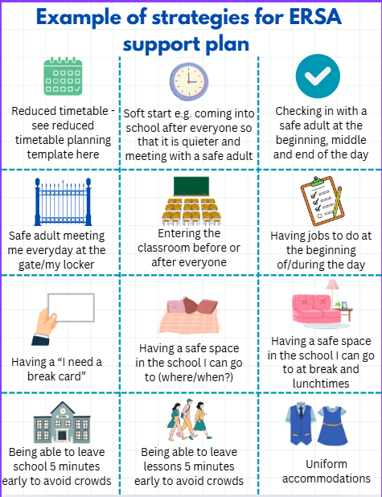
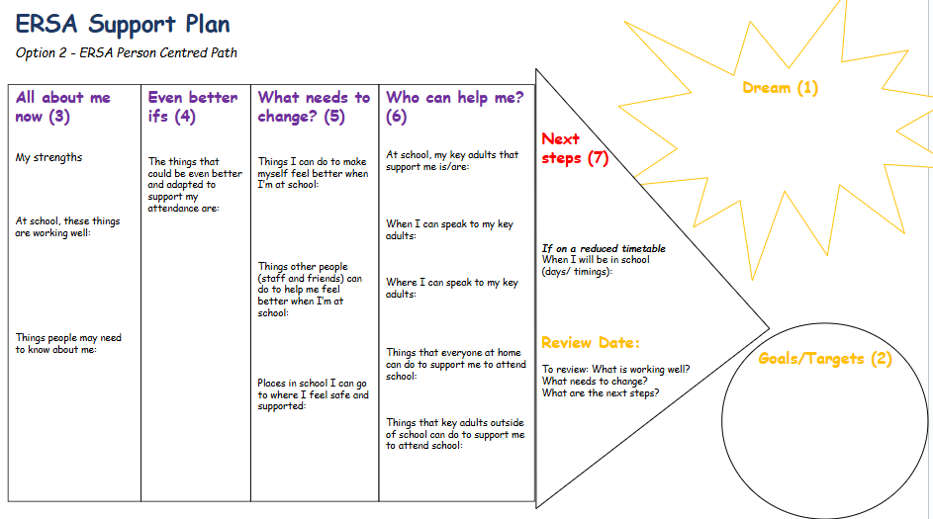
Toolkit Resources
Whole School Audit
Profile of Risk and Resilience
School Readiness Profile of Risk and Resilience
Resource booklet (with activities for gaining the CYP voice)
ERSA Support Plan (Option One)
ERSA Support PcPath plan (Option Two)

Slide 37

Follow up support - Spring Term 2025
Two goals:
Work with schools who were trained in the previous academic years to consider quality assurance and confidence in implementing the toolkit and impact.
support schools in establishing parent/school partnership ERSA workshops.
Please fill in form (2 minutes) if you would like to access this support:
https://forms.gle/jAf2C3oVUDKYC89aA.

Slide 38
Judith Street
Queen Anne First School

Slide 39
ATTENDANCE CONFERENCE
ASC
17 10 24

Slide 40
KEY MESSAGES :
Attendance is everyone’s responsibility.
Support first can not be underestimated - culture of kindness.
Build relationships and identify which member of staff could be the best to offer support
Notice the little things which could indicate a family in need & could impact on attendance.
Attendance improvements are a long-term process not quick fix
Talk about number of days lost rather than percentages in absence letters.
Talk about what the child has missed/ will miss during their absence. FOMO
Identify the barrier & support. Avoid getting drawn into the process of just issuing letter after letter- step back & try to find what they family need to help them make a difference.
Children with broken week absence lose out more than children, who have good attendance , taking a holiday for a week
Monitor & support the children who were absent in the first week of September term. They’re more likely to have lower absence throughout the year.

Slide 41
High expectation of attendance for all children
Soft starts to support SEN but not reduced timetables unless essential
Research shows the following make a difference
Belonging
Strong relationships
School culture
Clear attendance policy
Accuracy of register
Forensic analysis of data

Slide 42
Have a script known by all staff:
Tom, Great to see you back.
To parent
I am sure that you want Tom to do well at school – pause
We do too and to do so Tom needs good attendance, Currently he has the lowest attendance in his class. Because of this Tom’s falling behind in….
What could help to make a difference for Tom /family ?
High level listening – not just reaching for your bag of ideas
Reinforce the positives when they happen

Slide 43
Key questions for schools
Does your policy/ procedures make a difference ? If not change it.
What is your school early help offer – Before you refer to LA Early Help ?
Data – who are the children who did not attend in the first week of Autumn term – why not? & what are you doing to support attendance going forward? Who are you worried about?
What is the culture in your school? How do you know? Ask the children – what’s it like to be a child in your school and what’s it like to miss lessons ?
How can you get to know your families better?

Slide 44
Paediatric Sleep Training
Wendy Bould
Education Welfare Officer

Slide 45

Why We Sleep

Slide 46

Why is sleep so important
Sleep Helps our brain refresh and detox from the days input.
During sleep chemical reaction takes place this stores facts to our long term memory it gets rid of information we don't need from the day .It repairs for the next day .
It's important for our immune system re build and maintain it self .
During sleep our hormones develop and regulate .
Our appetite levels are maintained to support healthy weight levels .
Our bodies repair and grow.

Slide 47
The Science of Sleep
Our Circadian Rhythms responds to light and dark these external cues result in many chemicals being released throughout the day to support our brain and body function .
Melatonin is important as mother nature has set it up for our bodies to be insync with the outside world . Night and day / light & dark
The CR controls our body temp , our hunger . During 24 hr day we also produce melatonin which rises energy and lowers energy to induce sleep An chemical is adenosine which influences how tired we become .
Blue light from devices / not getting enough sleep all suppress the 24 cycle our bodies need to be healthy and function adequately .
IT in bedrooms used as self soothers for primary age . Secondary the boundaries around phones and games consoles are a challenge and play a big part in poor sleep hygiene

Slide 48

What can we do ?
Talk with our children / families re promoting healthy sleep routines in our young people .
Remind Parents about the importance of sleep for our brain function and overall well being .
Discuss limiting IT usage .

Slide 49
Sleep Deprivation
Cognitive function impaired .Struggling to learn .
Our long and short term memory function is impaired . Can't recall information . Affects our ability to organise/ pre plan /prepare.
Emotional dysregulation . Poor behaviour . low mood , anxiety
Fidgety & hungry .
Sleep deprivation is misdiagnosed as ADHD sleep specialist are recommending if a child is presenting as ADHD that a sleep programme is tried first as they can present in very similar ways .

Slide 50
Annual Report
If time….

Slide 51
Questions and
Feedback
Notes:
51

