Slide 1

Modern Governance
Refresher training on the core functions of school governance
Welcome

Slide 2
Aim of this session
To review the core functions of the governing board and how we carry these out as governors.
What are the core functions of school governance?

Slide 3
The maintained schools governance guide says
The core functions of the governing body are as set out in Regulation 6 of the School Governance (Roles, Procedures and Allowances) (England) Regulations 2013 and include […] ensuring:
that the vision, ethos and strategic direction of the school are clearly defined
that the headteacher performs their responsibilities for the educational performance of the school
the sound, proper and effective use of the school’s financial resources
The governing body also has legislative responsibility and strategic oversight for the school’s safeguarding arrangements.
Maintained schools governance guide (March 24)

Slide 4
The academy trust governance guide says
In [academy] trusts, the purpose of governance is to provide:
strategic leadership
accountability and assurance
strategic engagement
The board has collective accountability and strategic responsibility for the trust.
It has a focus on ensuring the trust delivers an excellent education to pupils while maintaining effective financial management
The board also has strategic and statutory responsibility for safeguarding and SEND arrangements within (and across) the academy trust [and] ensuring the promotion of pupil welfare and for keeping their estates safe and well-maintained.
Academy trust governance guide (March 24)

Slide 5
… strategic leadership
… that the vision, ethos and strategic direction of the school are clearly defined
CORE ROLE 1:
STRATEGIC LEADERSHIP
… strategic engagement
… strategic responsibility
… that the headteacher performs their responsibilities for the educational performance of the school
CORE ROLE 2:
“SUPPORT AND CHALLENGE”
… accountability
and assurance
… the sound, proper and effective use of the school’s financial resources
…maintaining effective financial management
CORE ROLE 3: FINANCIAL OVERSIGHT
Statutory responsibilities & assuring compliance: eg for SEND, Health & Safety, the Equality Act and Public Sector Equality Duty
SAFEGUARDING

Slide 6
Strategic Leadership that sets and champions vision, ethos & strategy by
defining medium and long-term goals, including development and improvement priorities
monitoring and reviewing progress against agreed strategic goals
initiating and leading strategic change in the best interest of children, young people and the school, advocating the reasons and benefits to all stakeholders
THE STRATEGIC PLAN
Agreed by the governing board and senior leadership
Sets out the school’s vision and its broad ambitions
Developed in discussion with staff, parents, pupils and other stakeholders.
THE SCHOOL DEVELOPMENT PLAN
Developed by the senior leadership, based on the desired outcomes of the strategic plan.
Carried out by the senior leadership and staff.
Monitored for its IMPACT by the governing board.

Slide 7
Being strategic - asking
Where do we want to get to? –> vision and strategic plan
Where are we now? -> school self-evaluation
What will we do to achieve our vision? –> school development plan
What are the key priorities for school improvement to get there?
What is the impact (over time)?
-> how well are we doing towards achieving the key priorities?

Slide 8


Strategic vs Operational
Strategic: to review and agree the plans and actions to be taken to enable the school fulfil its intended purpose.
- eg for a school policy
Operational: to be involved in the actual ‘doing’ of these plans and actions.
Strategic
Operational
Review the IMPACT of the current policy
Revise the policy to reflect the school’s current needs and situation
Review the revised policy
Does it reflect the school’s values?
Implement the changes across the school
Review the IMPACT of the reviewed policy
Ongoing – is the policy embedded and continuing to have the desired impact ?

Slide 9
Strategic vs Operational – the boundaries
Strategic
Operational
?
Any questions on this?
Top tips for staying strategic:
Focus on KEY PRIORITIES (agenda setting)
Regular review of the GB’s Code of Conduct
Challenge ourselves, as a board, to stay strategic

Slide 10
The Governing Body’s code of conduct
Confidentiality…
7 principles of public life…selflessness, integrity, objectivity, honesty, openness, accountability, leadership
Commitment to training
Meeting attendance
Declaration of Interests
Discussion and questions
https://www.gov.uk/government/publications/the-7-principles-of-public-life

Slide 11
Core Role 2: The “support and challenge” role
Holding school leaders to account for the school’s educational and financial performance and ensuring money is well spent.
As governors, what do we think “support” and “challenge” looks like?

Slide 12
The ‘support and challenge’ cycle:
Recognising and celebrating the achievements of the school.
Recognising where the school is not achieving as it should.
Encouraging the school to research, develop and implement strategies for school improvement - to meet key priority targets.
Monitoring the effectiveness and impact of these strategies
– over time

Slide 13
Balancing ‘support and challenge’
Support
Challenge
Be receptive to ‘blue skies’ ideas
Focus on the key
priorities
Celebrate the successes
Triangulate findings
Step up when needed (eg panels)
Prepare well for meetings and understand the data

Slide 14
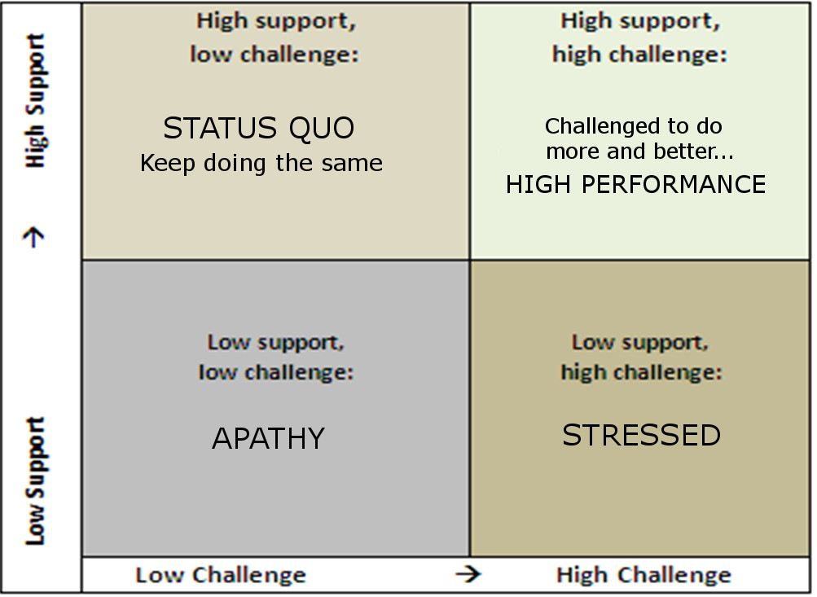
Balancing ‘support and challenge’
High support,
low challenge
High support,
high challenge
STATUS QUO
Keep doing the same
Challenged to do more and better…
HIGH PERFORMANCE
Low support,
low challenge
Low support,
high challenge
APATHY
STRESSED

Slide 15
Support and challenge – using data
How does your board monitor pupil progress over time?
How does this involve using data?
Which different groups of pupils does it monitor and how?
How does your board benchmark the school’s performance?

Slide 16
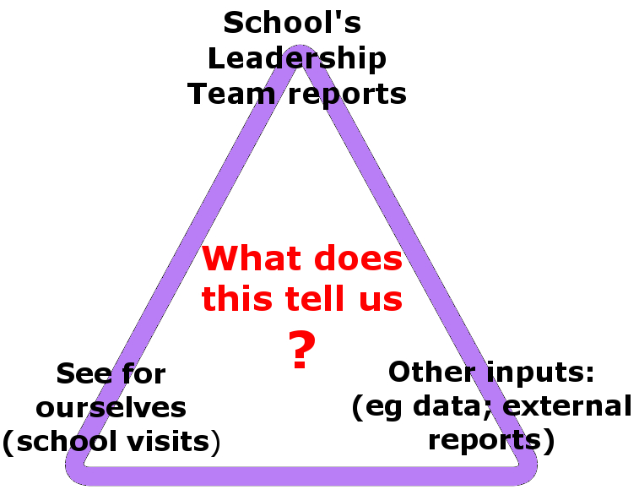
Triangulating reports and data:

Slide 17

Governor meeting cycle
having a regular cycle of meetings and appropriate processes to:
- support business and financial planning
- manage the school within the available resources
- ensure regularity, propriety and value for money
How does your governing board set its meeting cycle?
How does your governing board oversee the financial performance of the school?

Slide 18
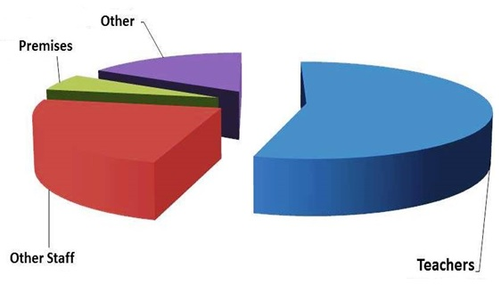
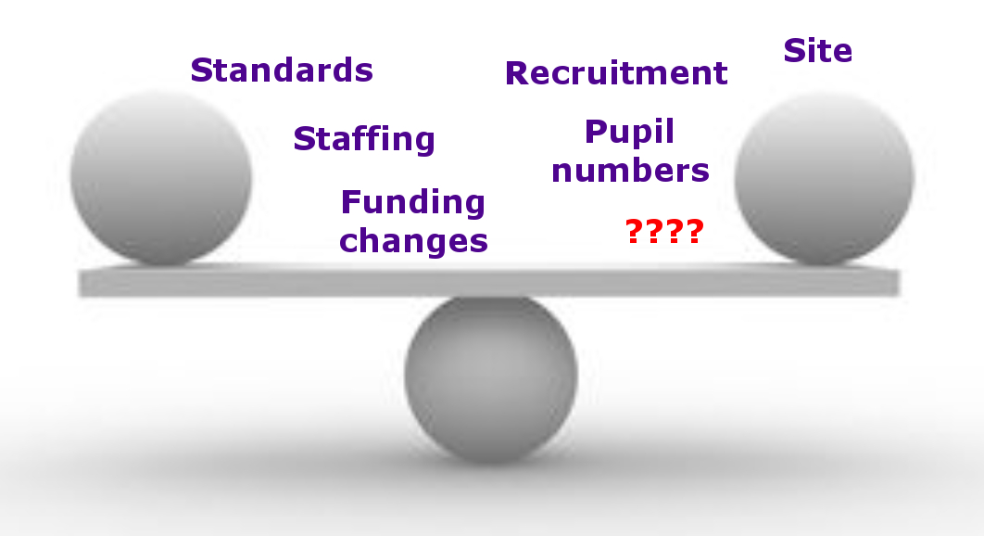
Business and financial planning
Are we allocating resources in line with our
strategic priorities? Is our school development
plan costed?
Are we making full use of all our assets and
most efficient use of our resources?
Have we sought best value?
What factors do we consider when three-year-planning?

Slide 19
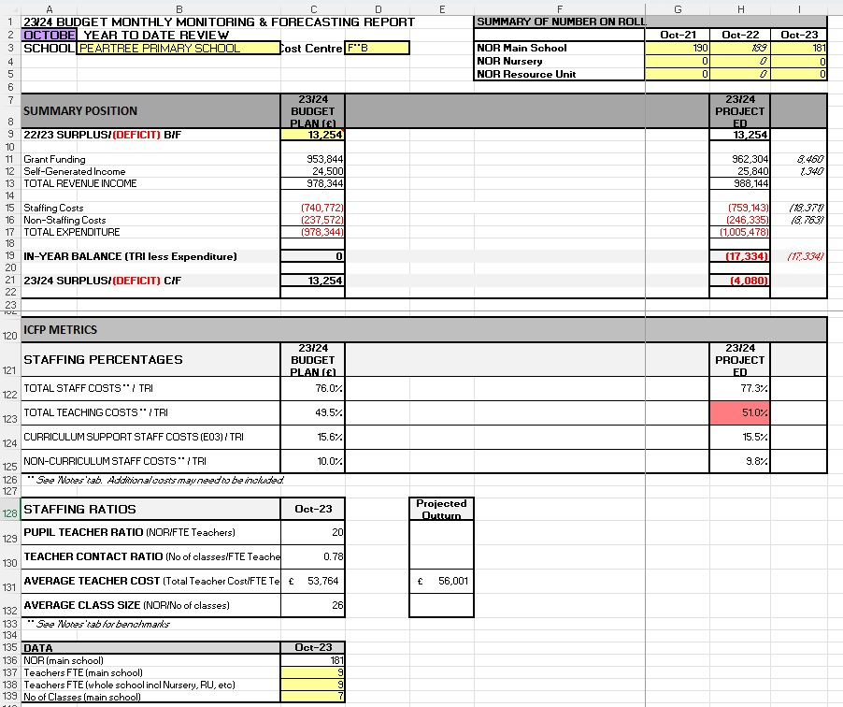
Budget monitoring – year to date expenditure reports
Any questions on this aspect of school governance?

Slide 20
Governance Structures & Roles
What do our lead Governors (eg safeguarding or SEND) do?
???
Statutory responsibilities & assuring compliance: eg for SEND, Health & Safety, the Equality Act and Public Sector Equality Duty
SAFEGUARDING

Slide 21
Any questions???

