Slide 1
The SEND Governance Role training
Anne Bishop
Area Senco
Notes:
1

Slide 2
Aims:
To gain an understanding of the statutory requirements relating to Special Educational Needs and Disabilities (SEND)
To understand the SEND governance role including recommendations and best practice within the role.

Slide 3





Agenda:
Definitions
The Legislation
The Governing Board’s responsibilities
SEND Governor
Governing Board meetings

Slide 4
The SEND Code of Practice
(2025) 0-25years
A child or young person has SEN if they have a learning difficulty or disability which calls for special educational provision to be made for them.
A child or young person has a learning difficulty or disability:
if they have a significantly greater difficulty in learning than the majority of others of the same age, or
if they have a disability which prevents or hinders them from making use of facilities of a kind generally provided for others of the same age in mainstream schools.
A pupil has SEN where their learning difficulty or disability calls for special educational provision, namely provision different from or additional to that normally available to pupils of the same age.

Slide 5
The Equality Act 2010
‘Defines disability as.. ‘a physical or mental impairment which has a long-term and substantial adverse effect on the ability to carry out normal day-to-day activities.’
Long-term is defined as “a year or more”
Substantial is defined as “more than minor or trivial”
Sensory (sight/hearing) impairments are included, as are long-term health conditions such as asthma, diabetes, epilepsy and cancer.

Slide 6
Legislation and Guidance
SEND code of practice (0-25 years) 2015- chapter 6
Special Educational Needs and Disability Regulations 2014
SEND and Alternative Provision Improvement Plan 2023
Equality Act 2010
-Equality Act 2010 and disabled pupils: A guide for governors and trustees (January 2025)
Children and Families Act 2014
Special educational needs (SEN) and disabilities: guidance for school governing boards 2025
The common focus is:
Inclusive practice and removing barriers to learning

Slide 7
What does this mean for schools?
Children with long-term health conditions do not necessarily have SEN (and vice versa) but there is a significant overlap.
Schools must not discriminate (directly or indirectly, for a reason arising in consequence of the disability) and they must make reasonable adjustments.
Schools/leaders must have regard to both the Equality Act and the SEND Code of Practice when they are planning their provision.

Slide 8
Inclusion is everyone’s responsibility not just the SENCo’s
Be clear of roles and responsibilities
School Leadership and Governors - to support and challenge as well as hold the strategic overarching school vision and development plan, including SEND.
SENCo - Has whole school oversight, coordinates provision, quality assurance.
Class Teacher - ‘All teachers are teachers of SEND’ (CoP Jan 2015)
Deliver high quality teaching for all children, implement the graduated approach and work collaboratively with parents.
Learning assistants - deployed effectively to ensure good outcomes, promoting independence and resilience.
Notes:
8

Slide 9
Governing Board Responsibilities
Boards of maintained schools and academies have legal duties in relation to pupils with SEND, including that they must:
Ensure that pupils with SEND engage in the activities of the school alongside those who do not have SEND.
Use their best endeavours to make sure any child with SEND gets the support they need.
Ensure parents are informed when making special educational provision for their child.
Ensure arrangements are in place to support children with medical conditions.
Co-operate with the LA on local provision and the Local Offer.

Slide 10
Governing Boards must also..
Provide a broad and balanced curriculum.
Have a clear approach for identifying and responding to SEND - including regarding the use of resources, keeping up to date, and the accurate recording of provision. (SEND Policy)
Publish on their websites re the implementation of the board’s policy for pupils with SEND (SEN Information Report.)
Publish their arrangements for admission of disabled children, the steps being taken to prevent disabled children being treated less favourably than others, the facilities provided to assist access for disabled children and their accessibility plans.
Co-production and communication with parents on their child’s progress.
Notes:
Gov duty to publish
Add detail around the SEND info report audit- what needs to be included
Is it updated vs a date change?
Good practice for it to be coproduced
10

Slide 11
The SEND Governor
There should be a member of the governing board, or a sub-committee, with specific oversight of the school’s arrangements for special educational needs (SEN) and disability The SEND Code of Practice 2015 (page 92 para 6.3)
Notes:
Menti?
11

Slide 12
The SENCo
Governing Boards must ensure that there is a qualified teacher designated as Special Educational Needs Coordinator (SENCo) for the school.
“ …most effective if part of senior leadership team” (para 6.87)
achieve the relevant mandatory qualification within 3 years of appointment
have sufficient administrative support and time away from teaching to enable them to fulfil their responsibilities in a similar way to other important strategic roles within the school
are empowered to support high quality outcomes for pupils with SEN and disabilities
Notes:
Menti?
12

Slide 13

Working with the SENCo

Slide 14
The role of the SENCo
Code of Practice 2015
Drive strategic vision for Inclusion
Overseeing the day-to-day operation of the school’s SEN policy
Update statutory documentation (SEND policy, SEND information report, website)
Advising on the deployment of the school’s delegated budget and other
Accuracy of SEND register
Coordinating provision for children with SEN
Liaise with external professionals
Staff training
Quality assurance (teaching and learning/plans)
Oversight of EHCP provision, annual reviews, consultations, EHC NA requests
Ensure interventions are evidence based, high impact and cost effective
Offer support, advice and guidance to class teachers AFTER at least once cycle of APDR.

Slide 15
The SENCo
“The school should ensure that the SENCo has sufficient time and resources to carry out their functions. This should include providing the SENCo with sufficient administrative support and sufficient time away from teaching to enable them to fulfil their responsibilities in a similar way to other important strategic roles within a school. “
Notes:
Be present
Challenge and support
Understand the balance between strategic and operation tasks
How is the SENCo managing?
What are the current challenges, how are these impacting, what support is needed?

Slide 16
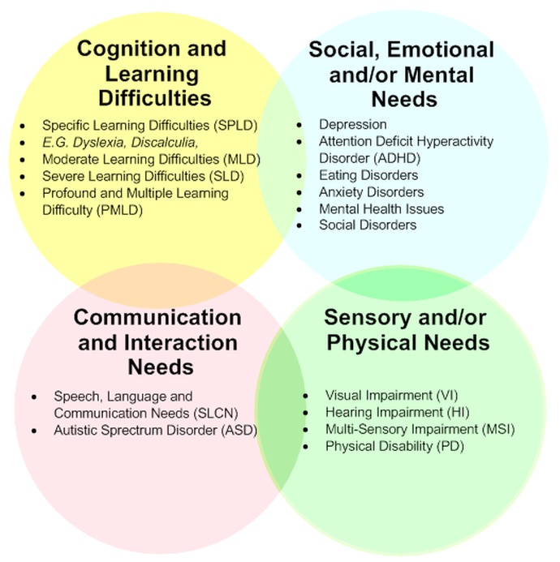
School context
It is an important part of a board’s role to analyse school performance data and build an evidence base to underpin its strategic oversight.
SEND demographic compared to national
How does school provision meet the need?
How is progress measured?
Notes:
How does your school share this information with you?
The most common type of need among pupils with an EHC plan is autistic spectrum disorder (ASD)
One in three pupils with an EHC plan are identified with a primary need of ASD (33.0%).
The most common type of need among pupils with SEN support are speech, language and communication needs
The primary need identified for one in four pupils is speech, language and communication needs (25.6%). This is followed by social, emotional and mental health needs (22.3%) and moderate learning difficulty (15.8%)
16

Slide 17
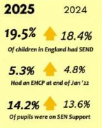
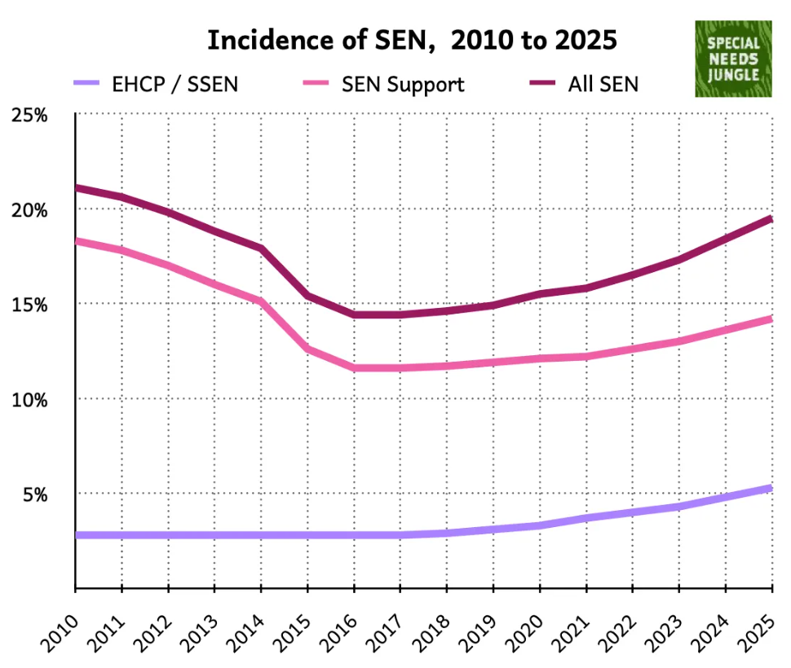
In primary, 18.2% have an EHC plan (3.5%) or SEN support (14.8%), an increase from 17.1%.
In secondary, 16.5% have an EHC plan (3.1%) or SEN support (13.4%), an increase from 15.16%
Notes:
Ensure understanding of SEN support and EHCP

Slide 18
Funding
The SENCO, headteacher and governing body or proprietor should establish a clear picture of the resources that are available to the school. They should consider their strategic approach to meeting SEN in the context of the total resources available, including any resources targeted at particular groups, such as the pupil premium.
The SEND Code of Practice 2015 (page 110)
Notional funding- Funding formula given to schools from the LA towards their best endeavours to meet needs of children and young people.
High needs funding- Top up funding to provide the targeted and specialist support detailed in EHCP plans- statutory provision
Notes:
data relating to SEN funding information, for example, notional SEN funding and top up funding, and:
how that funding is spent and its impact
if that funding is targeted strategically based on what is known of the school SEN and disability profile
if the funding provided for those with SEN and disabilities is contributing to improved progress and if so, how
18

Slide 19
Discussion: Thoughts on the SEND Governor visit template
How often should visits take place?
What should the SEND Governor do… and report?
Notes:
Discussion- any other templates they use? Good starting point?

Slide 20
Governing board meetings
As well as SEND Governor verbal and written reports:
SENCo presentations / reports to the Board (maybe)
Documents such as SEF/SEND review/SEN audits
Headteacher’s reports (including statistics relating to attendance, behaviour and exclusions)
Finance committee minutes/reports: SEND notional funding and allocation; resources and facilities
Standards committee minutes/reports:
- Progress and attainment data for groups of pupils
- Quality of teaching and assessment (including CPD)
- Curriculum and co-curriculum/extended provision
Notes:
20

Slide 21
Does the Board… ?
Allocate appropriate meeting time to SEND?
Could this be a standing item on agendas?
Review the SEND Policy on a regular basis, and ratify the SEN Information Report annually?
How is the SEN Information Report reviewed?
Ensure all the school’s policies fully support the principle of inclusion of pupils with SEND (behaviour, outdoor learning, educational visits…. )
Provide a succession plan opportunity for prospective SEND governors?
Notes:
21

Slide 22
The SEND Governor – final points
Keep an aspirational strategic whole-school overview. It is not the remit of the SEND Governor to become drawn into issues relating to individual children.
Respect confidentiality. The SEND governor may on occasion receive sensitive information about the circumstances of children who, although anonymised, may be identifiable by process of deduction - particularly in smaller schools. It is essential that the SEND Governor respects the confidentiality of such information.
Notes:
22

Slide 23


Slide 24
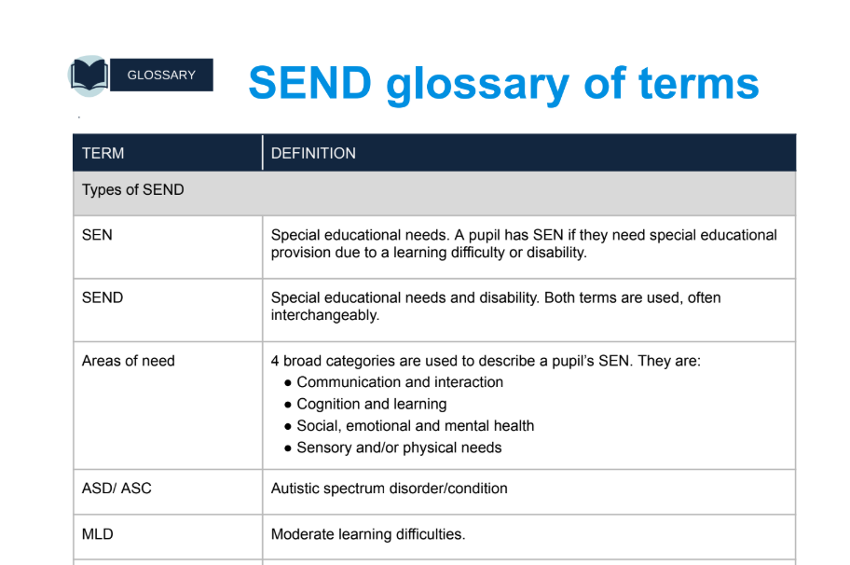

Slide 25
Royal Borough of Windsor and Maidenhead (RBWM) SEND Governor Directory
 | Local Offer Website link
The Role of the SEND Governor | https://www.leadershipupdate-rbwm.co.uk/send-governor-role/
Governor visits | https://www.leadershipupdate-rbwm.co.uk/governor-visits-and-delegated-roles/
SEND policy and SEND information reports | AfCinfo website - Windsor and Maidenhead :: Local Offer / Information and advice / Education / About SEN Support in schools / SEND policy and SEND reports
RBWM's Special Educational Needs or Disability (SEND) Strategy (2022-2027) | AfCinfo website - Windsor and Maidenhead :: Local Offer / Information and advice / Local area SEND policies and plans / RBWM's Special Educational Needs or Disability (SEND) Strategy (2022-2027)
SEND code of practice: 0 to 25 years - GOV.UK (www.gov.uk)
Special educational needs (SEN) and disabilities: guidance for school governing boards
Equality Act 2010 and disabled pupils: A guide for governors and trustees

Slide 26
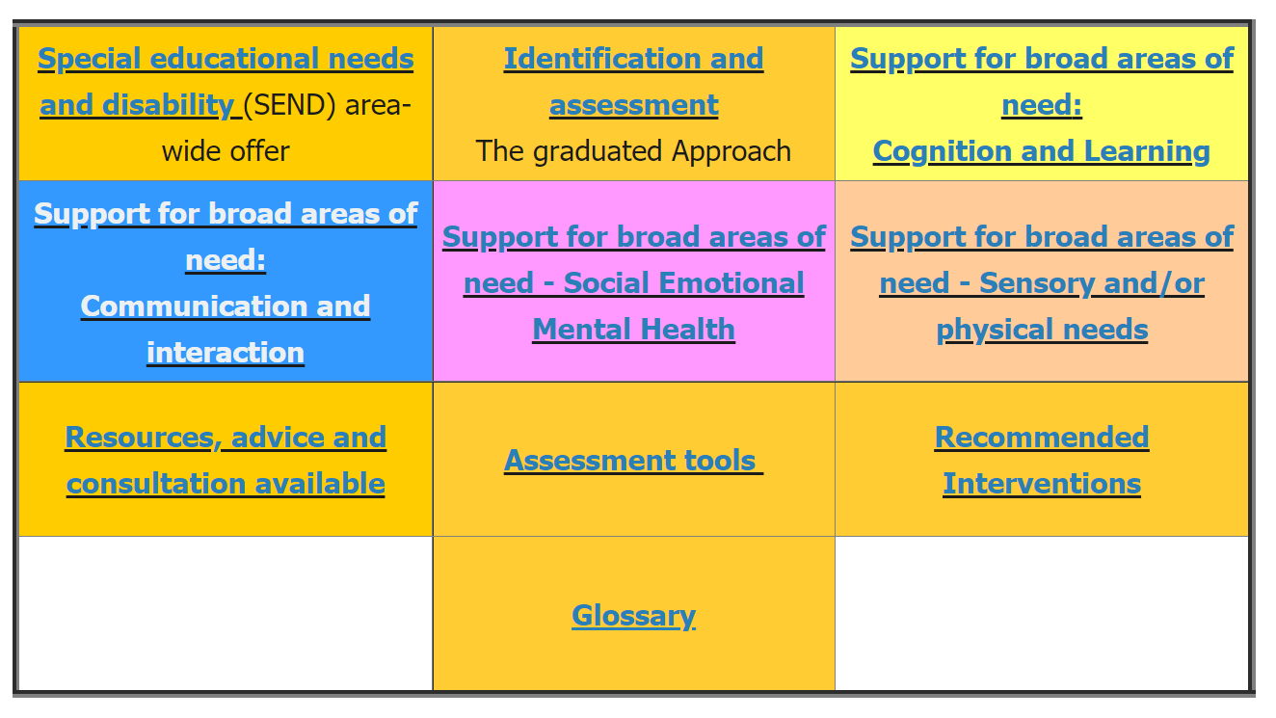
Where can schools go for advice and support?
Collaborative responsibility resource (AfC/RBWM)
*Co-produced for professionals, parents and carers as a useful resource to share ideas for reasonable adjustments and quality first teaching strategies in the classroom for all four broad areas of need.
*Clear guidance on graduated offer, assessment tools, interventions, with a useful glossary.
*Signposting to external professionals
https://www.leadershipupdate-rbwm.co.uk/collaborative-responsibilities-resource/

Slide 27

Key messages of the Collaborative Responsibility Document
Support for pupils is ‘needs led’
It is full of practical strategies
Encourages co-production
In-line with inclusion charter
Reinforces and supports the graduated response
Quality first
teaching is at the centre
Notes:
27

Slide 28

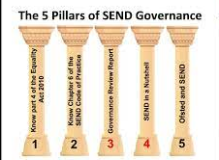

Slide 29
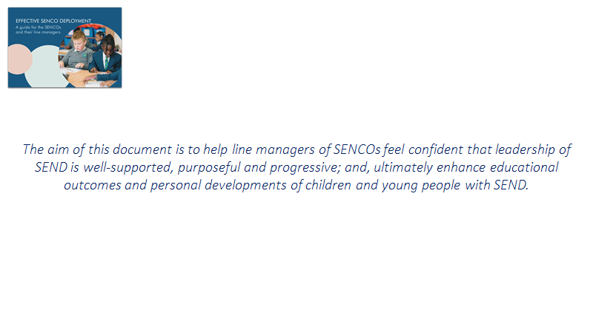
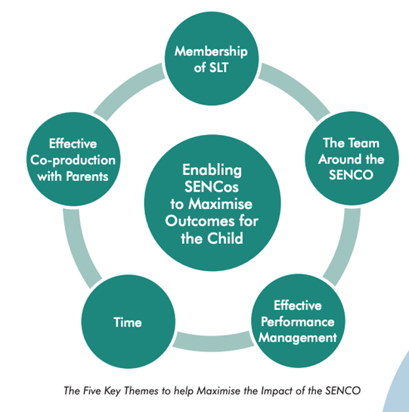
Effective SENCo Deployment Guide - WSS
https://www.youtube.com/watch?v=YX6QPn0RCK0
https://www.sendgateway.org.uk/resources/effective-senco-deployment
Notes:
29

Slide 30
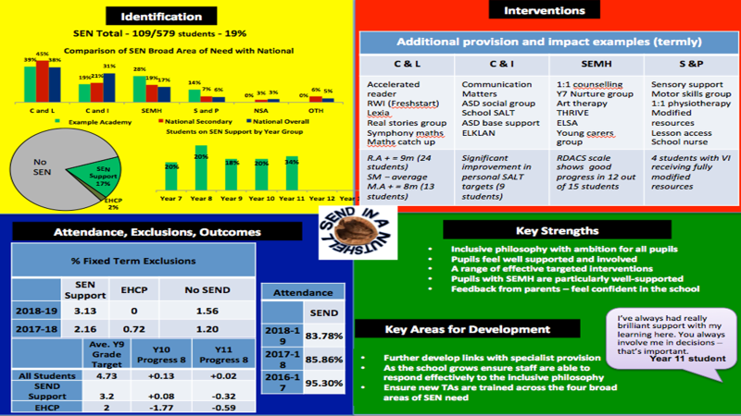
SEND in a nutshell
Schools have responsibility for deciding who has SEND based on the implementation of the assess, plan, do, review approach
Notes:
30

Slide 31
Any questions?
?
Governor Services Support Officer: vicky.brand@achievingforchildren.org.uk
Area SENCo
anne.bishop@achievingforchildren.org.uk
Notes:
31

