Slide 1
Adaptive teaching: Removing Barriers to Learning
29.01.2025
Helen Huntley - SEND Consultant

Slide 2
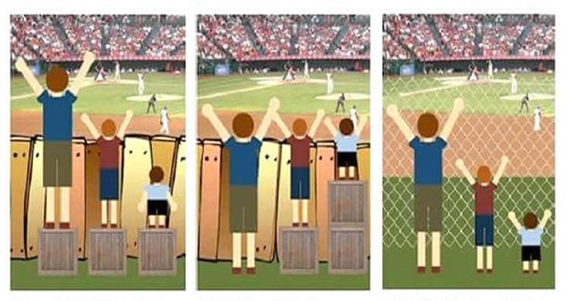
Doing different ‘things’ vs doing it differently...
What things come to mind? How could this link to reasonable adjustments or QFT?
Notes:
Look at the pictures - what things come to mind? How could they link to reasonable adjustments or QFT?
Picture 1 - Being treated ‘fairly’ everybody getting the same (no reasonable adjustments) not all can access
Picture 2 - Support teachers to understand the QFT/RA they make become the ‘boxes’ to allow pupils to access and progress. Reasonable adjustments need to be made to make access equitable for all. It is about giving everyone the same chance rather than the same ‘thing’ Knowing and understanding pupils is key.
Picture 3 - Focus on mindset shift ‘what is good for SEND is usually good for all!’ We don’t want staff to feel overwhelmed to do lots of ‘different’ things for a number of pupils, By embedding QFT and RAs in their everyday practice (although it is because of one or two particular pupils) will benefit on a whole class level.

Slide 3
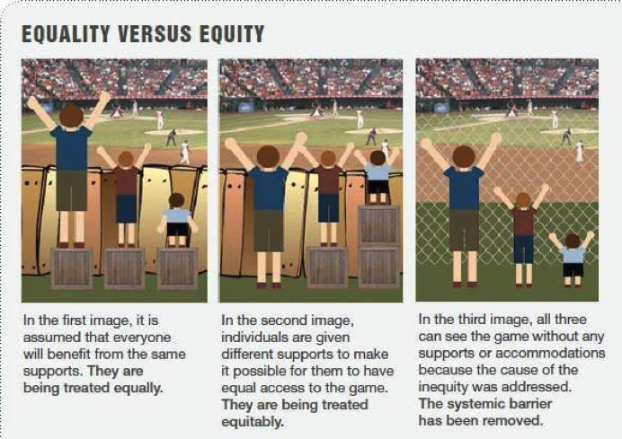

Slide 4
What is Universal Provision?
Universal provision forms the foundation for all other provision or support in schools, colleges and other settings, and comprises high quality teaching that is made available to all.
This includes strategies, resources and adaptations to the curriculum and environment that teaching staff use to remove barriers to learning for children and young people.

Slide 5
What is Adaptive teaching?
Adaptive teaching is an approach where teachers continually assess the strengths and needs of learners and adapt their teaching accordingly to ensure that all learners meet expectations. It involves adjusting the pace, support and materials to cater to individual strengths and weaknesses.

Slide 6
Activity
Identify barriers to learning for children on the autistic spectrum
Identify reasonable adjustments
How can you support in your role as a TA?

Slide 7



What is autism?
Autistic pupils have differences in three areas of development. These are:
Social understanding and communication.
Flexibility, information processing, and understanding.
Sensory processing and integration.
We need to look at these differences in terms of both the strengths and challenges that might arise.
Notes:
You should highlight that strengths and barriers to learning might arise as a result of the areas of difference. Practitioners should begin thinking about how they can adapt their own ways of communication, interacting, and teaching to enhance the learning and wellbeing of the pupil, and to develop positive relationships.
Make it clear to delegates that these three areas of difference are not diagnostic criteria for autism.

Slide 8
Reducing Systemic barriers to learning
What are the barriers?
How can we remove them?

Slide 9
1.Social understanding and communication
Autistic pupils have differences in the way they communicate, understand, and use language. They engage in social life from a different perspective (Milton, 2011).
Differences in the areas of social understanding and communication can influence how the pupil develops relationships.

Slide 10

Barriers to Learning

Slide 11

Reasonable adjustments
This Photo by Unknown Author is licensed under CC BY-NC-ND

Slide 12

Supporting as a Teaching Assistant
This Photo by Unknown Author is licensed under CC BY-NC-ND

Slide 13

Social understanding and communication
Creating a calm environment
Visual support to support verbal instructions
Facilitating peer discussions.

Slide 14
2.Flexibility, information processing, and understanding
Autistic pupils will have differences in their attention, interests, and how they learn. This can include being very focused on particular interests. They have a different way of being flexible, so often feel safer and more comfortable with routines and structure as this lessens uncertainty.

Slide 15
Barriers to Learning

Slide 16
Reasonable adjustments
This Photo by Unknown Author is licensed under CC BY-NC-ND

Slide 17
Supporting as a Teaching Assistant
This Photo by Unknown Author is licensed under CC BY-NC-ND

Slide 18
Flexibility, information processing, and understanding
Providing a sense of safety and security to reduce anxieties.
Now and next visual clues
Establishing routines and expectations
Supporting unstructured times

Slide 19
3.Sensory processing and integration
When the brain finds it difficult to integrate all this information coming in at the same time and knowing how to respond, autistic people have described this as being like a traffic jam in your head, with conflicting signals coming from all directions. This can make it difficult to make sense of it all.

Slide 20
3. Sensory processing and integration
Sensory differences can include hyper (high) or hypo (low) sensitivity in relation to the eight senses of sight, hearing, touch, taste, smell, interoception (understanding and feeling what is going on inside our bodies), balance (vestibular system), and body awareness (proprioception).
These differences will vary from person to person and can actually fluctuate in their responsiveness depending on a number of different factors (a bit like how we all have good days and bad days).

Slide 21
Barriers to Learning

Slide 22
Reasonable adjustments
This Photo by Unknown Author is licensed under CC BY-NC-ND

Slide 23
Supporting as a Teaching Assistant
This Photo by Unknown Author is licensed under CC BY-NC-ND

Slide 24
Sensory processing and integration
Getting to know the pupils' individual sensitivities.
Avoid too much simulation or provide additional stimulation
Be aware of any signs of distress – be prepared to stop talking and don’t touch

Slide 25

Barriers to learning – non negotiables for you when supporting a child with autism.

Slide 26


This Photo by Unknown Author is licensed under CC BY-SA-NC

