Slide 1
Scaffolding
RBWM Teaching Assistant Training
Anne Bishop
Wednesday 29th January 2025

Slide 2
Scaffolding
RBWM Teaching Assistant Training
Anne Bishop
Wednesday 29th January 2025
Thinking point:
  What does scaffolding mean to you?
  Think of a time when you or someone else has scaffolded an activity. Was it successful in supporting the pupil to make progress? Why?

Slide 3
Agenda
What does the research tell us?
What is scaffolding?
The scaffolding process
Scaffolding aids
Key takeaways

Slide 4

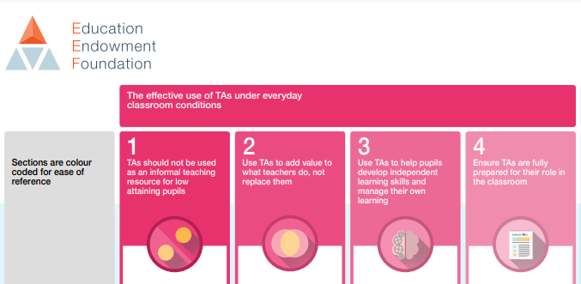

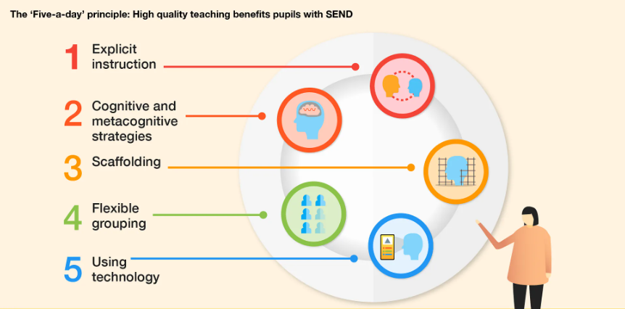
What does the research tell us?

Slide 5
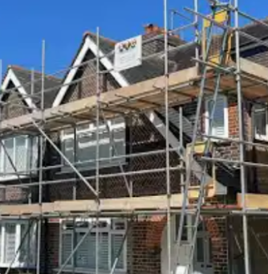
What is scaffolding?
Temporary support that allows the pupil to move towards independence
Scaffolds can be visual, verbal or written
Promotes confidence and competence in pupils
Knowing when to step in (not stepping back)
Avoids learned helplessness
Steps to independence

Slide 6
Steps to independence?
What parts can they do? Persistent and consistent expectation
1
Pupil attempts challenging parts using strategies learned via adult interactions
2
Pupil does all parts independently confidently and competently
3

Slide 7
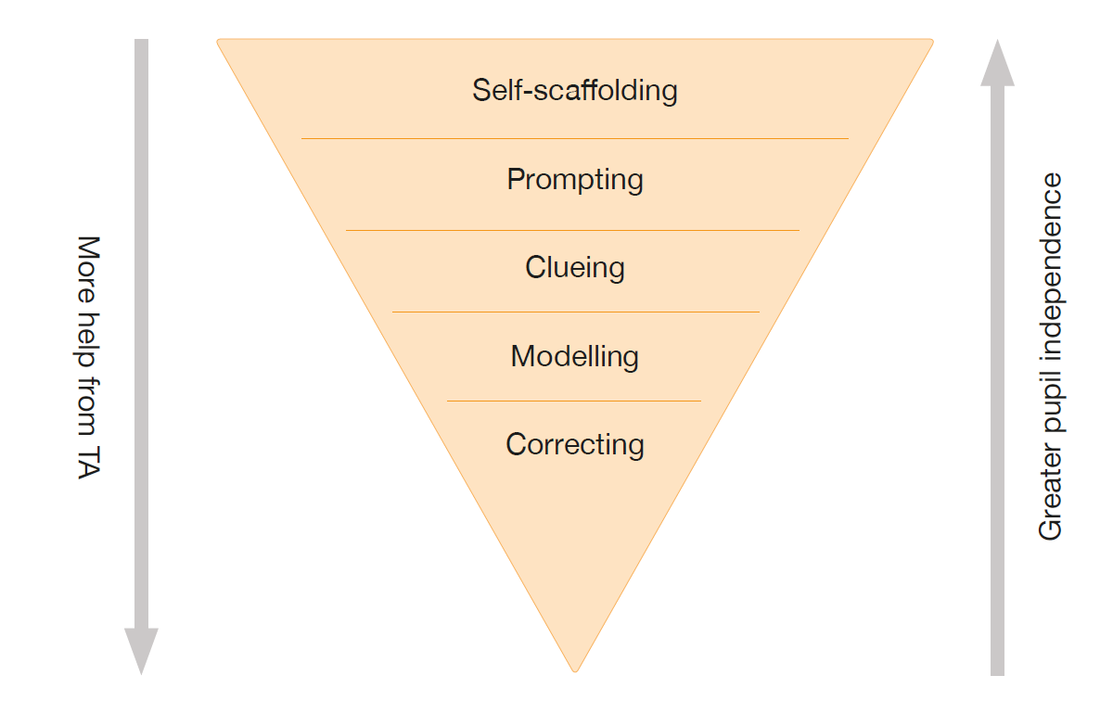

Framework for scaffolding: least amount of help first

Slide 8
Self-scaffolding
Initial step whilst adult observes their performance
Least amount of support first
Adult gives time for processing and thinking
Self-scaffolders know how to approach a task, problem-solve and review
Self-scaffolders demonstrate high levels of independence
Know how to use the resources available

Slide 9
Prompting
Adult prompts when pupils are unable to self-scaffold
Encourages pupils to draw on own knowledge
Adult provides the stepping stone into deploying self-scaffolding techniques
Allows pupils to attempt challenging parts
‘What do you need to do first?’
‘What’s your plan?’
‘What can help you with this?’

Slide 10
Clueing
Providing a hook to remind students of what they know
Giving clues to support pupil solve the problem
Questions that provide a hint
‘What did we do yesterday that will help us?’
‘Could….help you?’

Slide 11
Modelling
When the task requires new skill or strategy
Adult models the task while pupils actively watch and listen
Pupil completes same steps for themselves directly following the modelling
Adult provides the structure for challenging task
Tips:
Talk your thought process out loud
Refer to previous learning or resources that you will use to help you with the task you are modelling

Slide 12
Correcting
Greatest help from adult
No independent thinking
Reflect on the difficultly of the task when this step is necessary

Slide 13
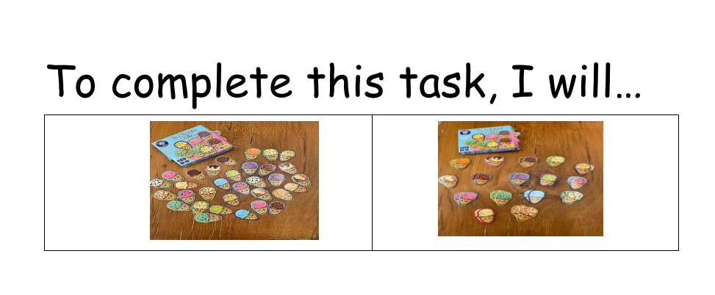
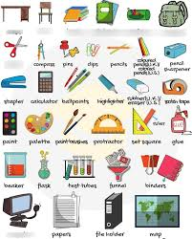
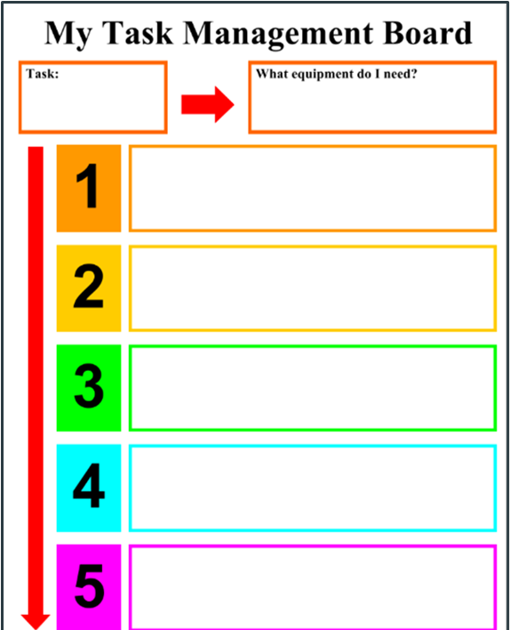
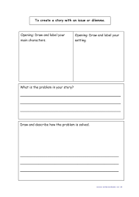
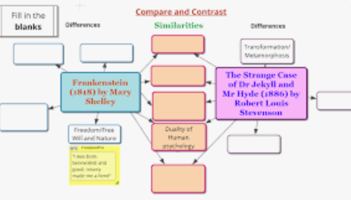

Scaffolding aids
Visual aids
Pre-teaching
Breaking down into steps
Sentence starters
Writing frames
Feedback
Collaborative learning

Slide 14

Key takeaways

