Slide 1



Supporting Oracy
© Sweeting's Greetings

Slide 2

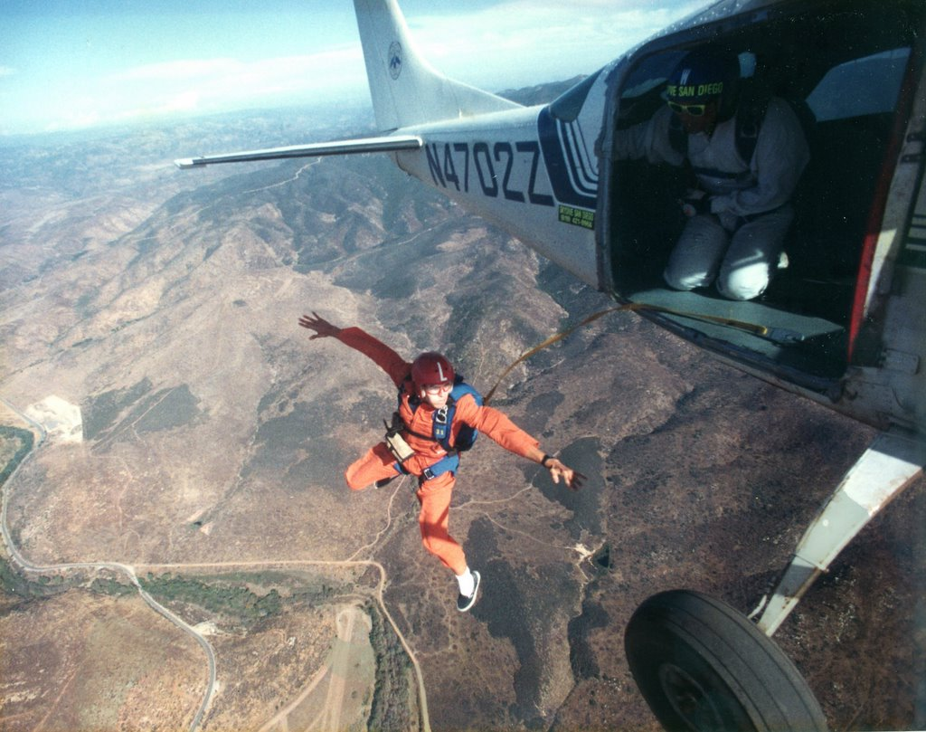
Would you rather…
jump out of an aeroplane
or
swim with sharks?

Slide 3
What is Oracy?
“The ability to articulate ideas, develop understanding and engage with others through spoken language.” Voice 21
Notes:
Being able to express yourself well across a range of contexts.
Having the vocabulary to say what you want to say and the ability to structure your thoughts so that they make sense to others.
Voice 21 - UK Oracy Charity.
Launched in 2015 - innovative practice, research conducted with Cambridge University and EEF.
2016 - commissioned The State of Speaking in Our Schools report - identified a need for resources and professional development for Oracy in UK
2019 - Oracy Benchmarks published outlining what constitutes a high-quality oracy education - a framework for leaders and teachers
Watch video: https://www.youtube.com/watch?v=jhWfhpeyFUc

Slide 4
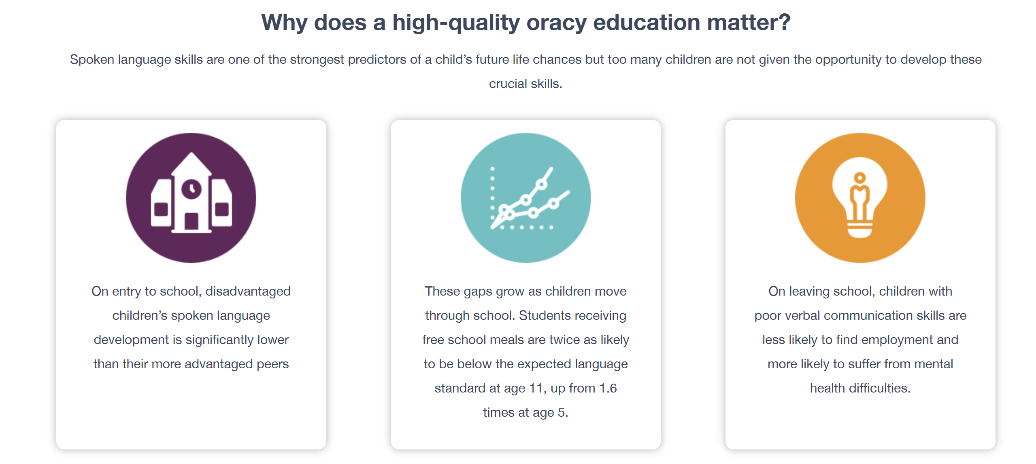
What does Voice21 say?
Notes:
Voice 21 is the UK’s oracy education charity. We work with schools to transform the learning and life chances of young people through talk. We campaign for oracy to have a higher status in the education system.
Voice 21 - UK Oracy Charity.
Launched in 2015 - innovative practice, research conducted with Cambridge University and EEF.
2016 - commissioned The State of Speaking in Our Schools report - identified a need for resources and professional development for Oracy in UK
2019 - Oracy Benchmarks published outlining what constitutes a high-quality oracy education - a framework for leaders and teachers

Slide 5
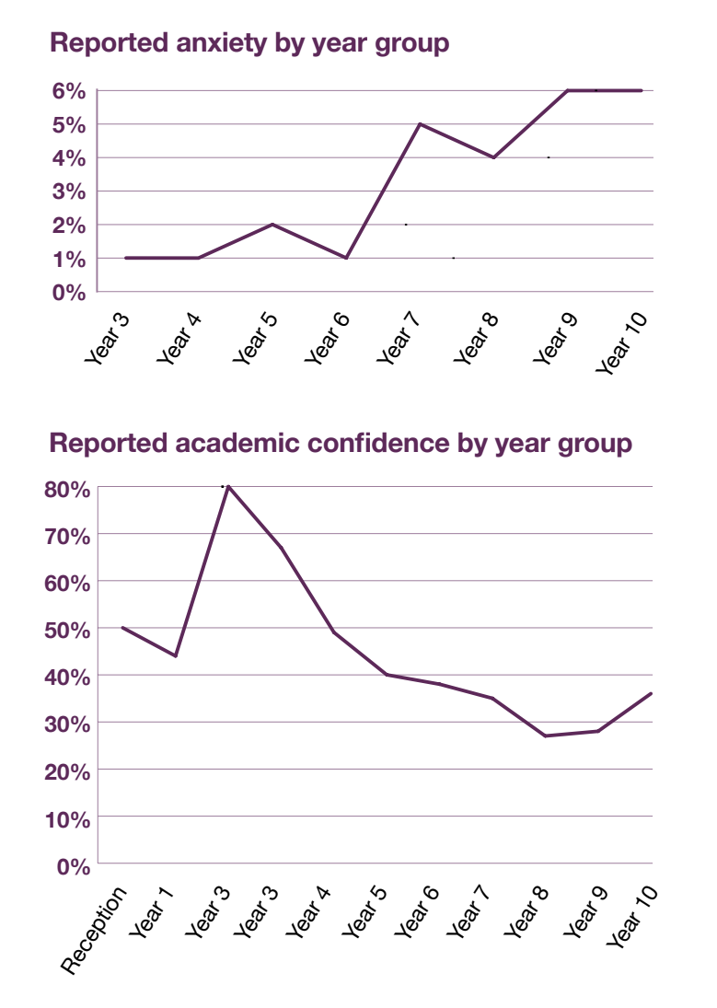
Notes:
Each year Voice 21 surveys students in Voice 21
Oracy Schools to understand their self-perceptions
of oracy and their experience of oracy education.
These surveys reveal that anxiety and nervousness
in relation to speaking increase dramatically in
Year 7 and rise steadily throughout secondary
school. They also indicate that primary school
students are more likely to perceive that
oracy education has benefited their academic
performance (‘It is important to me because it
has helped me to progress in school’) than their
secondary counterparts. However, as students
move into secondary school, they are less likely
to report that oracy education supports their
academic confidence. This shift is indicative of
the challenge of moving into a new environment.
Teachers and school leaders should be aware
of this increased nervousness or anxiety when
planning for oracy in their settings. By teaching
students the oracy skills they need to be effective
speakers in different contexts (rather than simply
expecting them to have these) and fostering
supportive classroom cultures in which every
voice is valued, they can better prepare students
to speak in a new, unfamiliar context and boost

Slide 6
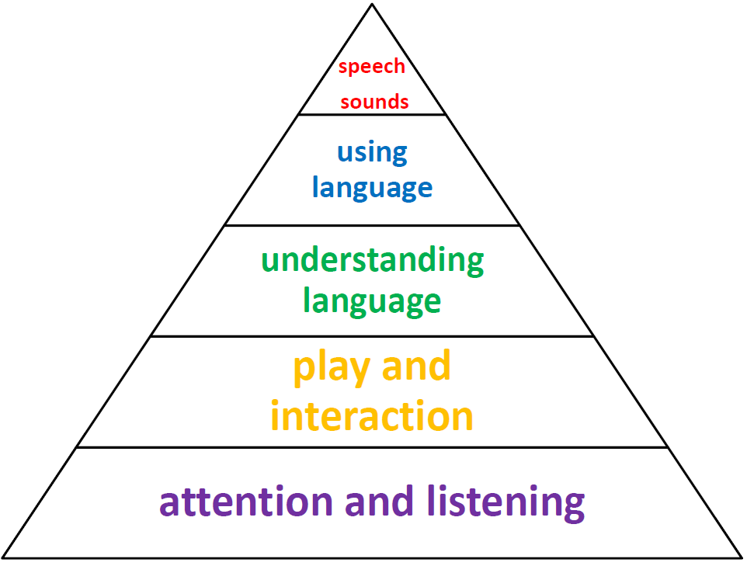
What skills does a child need to develop language?
Speech sounds
Using language
Play and interaction
Attention and listening
Understanding language
Notes:
Activity in teams - build Language Development Pyramid
The Language Development Pyramid is a visual representation of the general order in which children acquire non-verbal and verbal communication skills. This tool is helpful to anyone involved in the lives of children because it provides a reference explaining what skills are needed before other skills are acquired. For instance, back-and-forth interactive games such as peek-a-boo typically occur before children follow two-step directions. It also shows that teaching articulation is not yet appropriate for the child who is babbling. Although some skills can develop simultaneously, such as attention skills and language comprehension, the pyramid demonstrates the overall expectations of typical language development.

Slide 7
Notes:
Also - early interactions and pre-verbal skills: eye contact, cause and effect, pointing, turn taking and joint attention
C+L needs to be secure before moving onto early literacy (reading and writing)

Slide 8
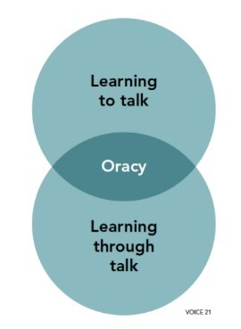
Notes:
How C+L links to Oracy – one of the three prime areas in EY’s. Key area for child development.

Slide 9
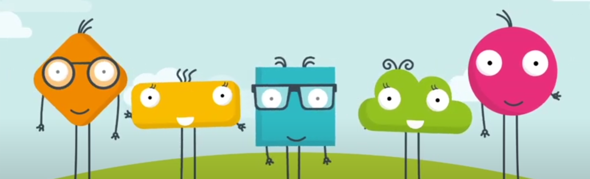
Why is Oracy important?
“It is nothing more than being able to express yourself well.”
“Having the vocabulary to be able to say what you want to say.”
“Being able to structure your thoughts”
“Simply because it helps you to be the best you can be.”
Voice 21
Notes:
Watch video

Slide 10

The Oracy Framework
The Oracy Framework provides a structure through which we can understand what constitutes good speaking and listening in different contexts.
It breaks down the skills within oracy into four distinct but interlinked strands:
Physical
Linguistic
Cognitive
Social & emotional.

Slide 11
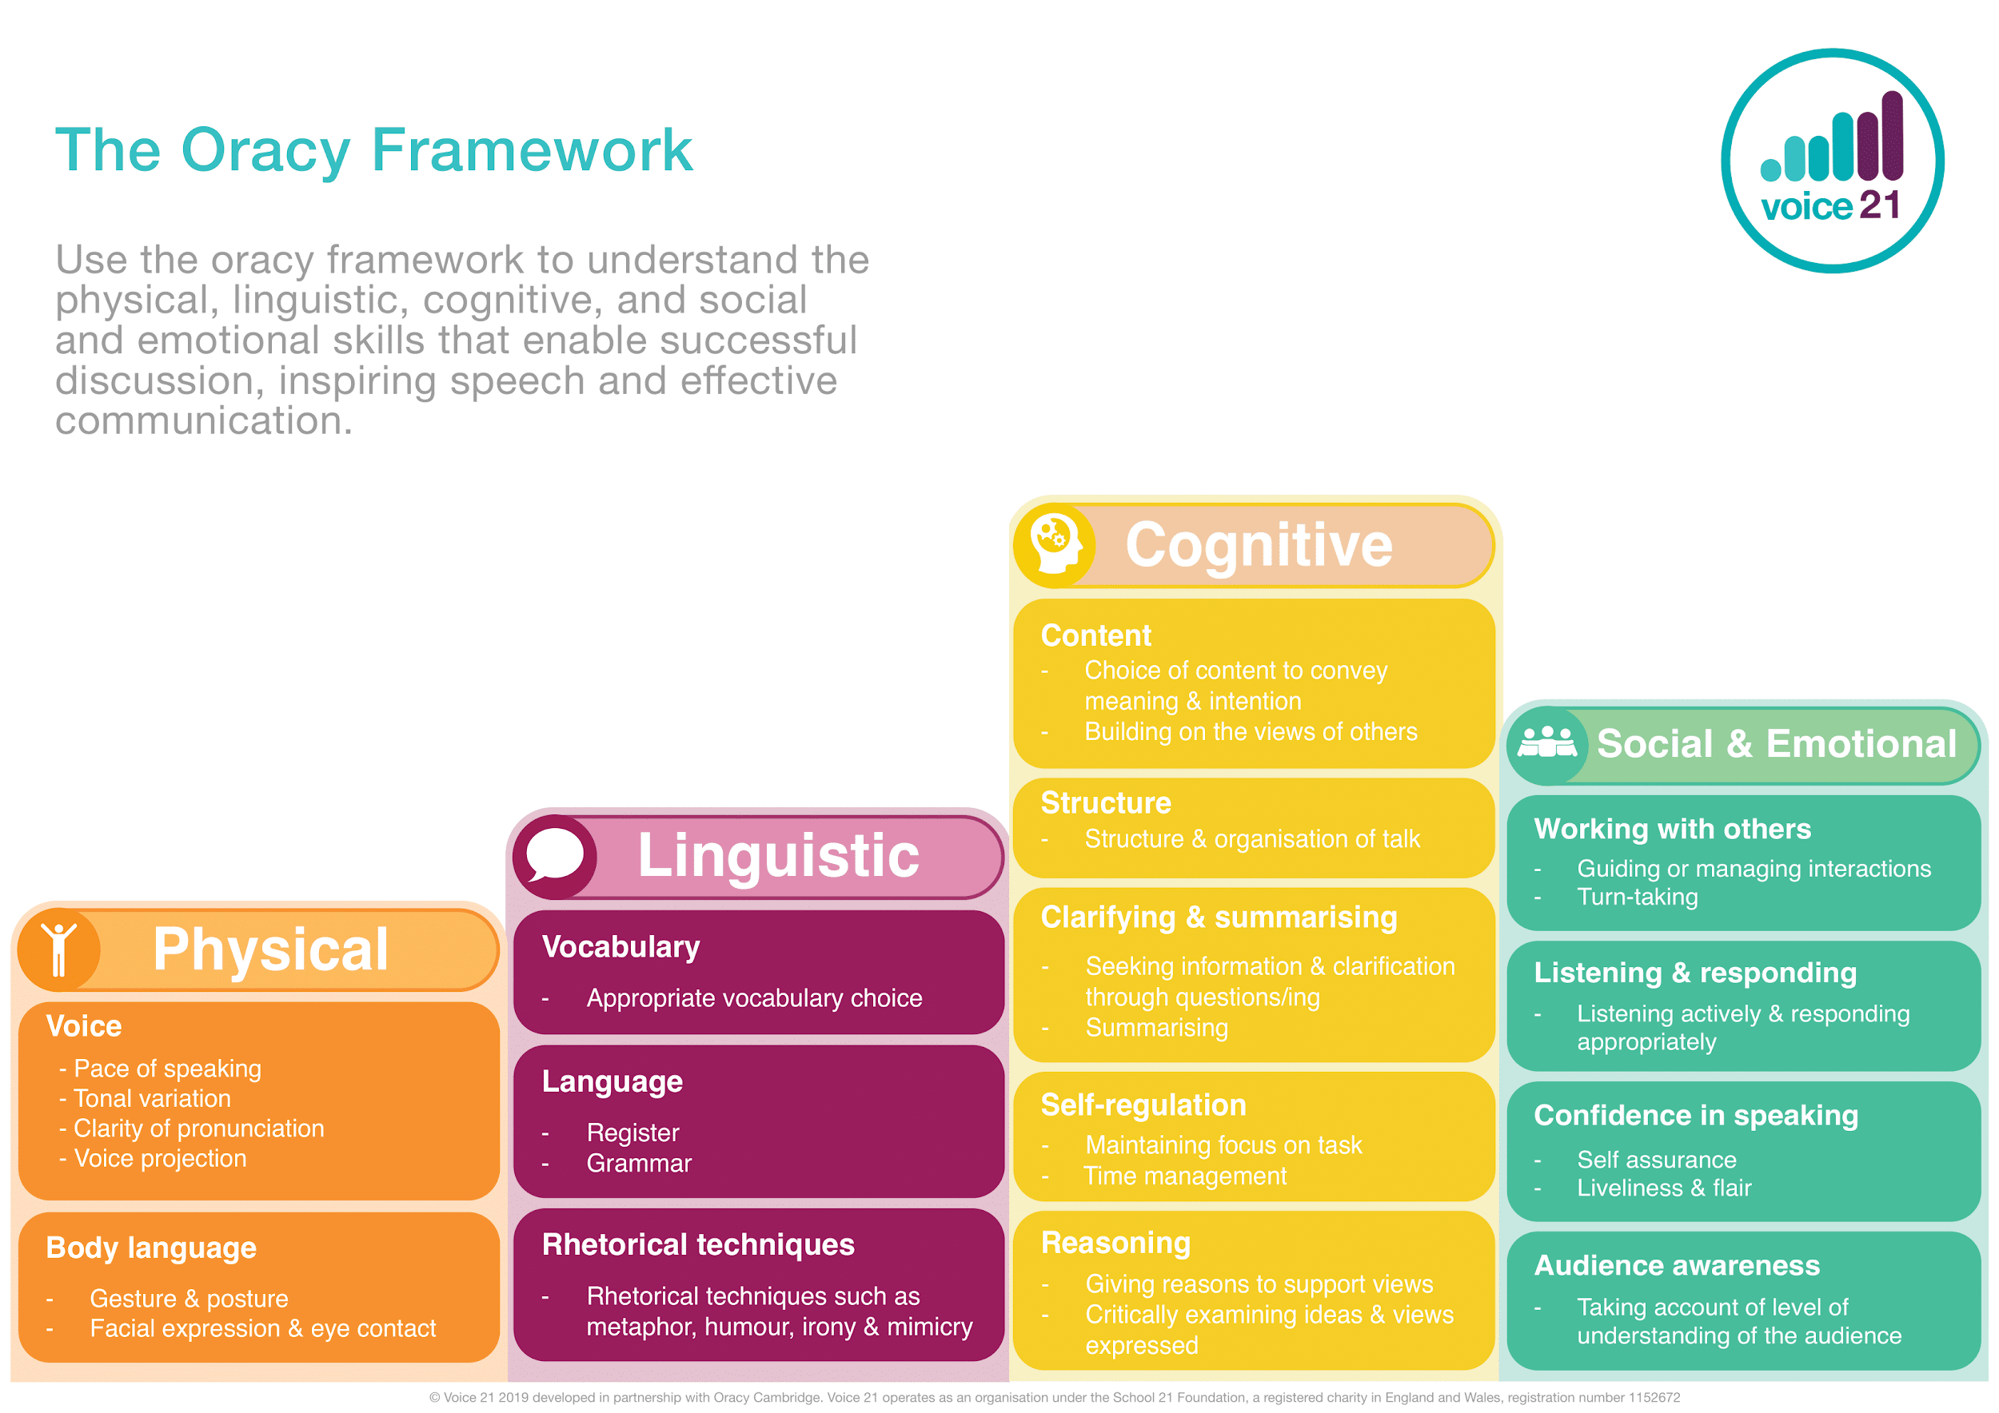

Slide 12
What does this look like in practise?

Slide 13
Physical – in action
Reception: To speak audibly so they can be heard and understood.
To use the appropriate tone of voice in the right context. E.g. speaking calmly when resolving an issue on the playground.
To start to use gesture to support the delivery of ideas e.g. gesturing towards someone of referencing their idea, pr counting off ideas on their fingers as they say them.
Deliberately varies tone of voice in order to convey meaning. E.g. speaking authoritatively during an expert talk or speaking with pathos when telling a sad part of a story.
To consider movement when addressing an audience.
To project their voice to a large audience.
To speak fluently in front of an audience.
Notes:
Based on the key skills progression document

Slide 15
Linguistic – in action
Reception: To use talk in play to practise new vocabulary.
To use vocabulary appropriate and specific to the topic at hand.
To adapt how they speak in different situations according to audience.
To be able to use specialist language to describe their own and others’ talk.
To carefully consider the words and phrasing they use to express their ideas and how this supports the purpose of talk.
To use an increasingly sophisticated range of sentences stems with fluency and accuracy.
To vary sentence structures and length for effect when speaking.
Notes:
Based on the key skills progression document

Slide 17
Cognitive – in action
Reception: To use ‘because’ to develop their ideas.
To offer reasons for their opinions.
To ask questions to find out more about a subject.
To offer opinions that aren’t their own.
To be able to give supporting evidence e.g. citing a text, a previous example or a historical event.
To be able to draw upon knowledge of the world to support their own point of view and explore different perspectives. E.g. In a discussion about vegetarianism rather than saying ‘my mum is a vegetarian so eating meat is wrong’ to be able to say, ‘lots of people don’t eat meat because they believe killing animals is cruel’.
To construct a detailed argument or complex narrative.
Notes:
Based on the key skills progression document

Slide 19
Social and Emotional – in action
Reception: To look at someone who is speaking to them.
Listen to others and is willing to change their mind based on what they have heard.
To start to develop an awareness of audience e.g. what might interest a certain group.
To adapt the content of their speech for a specific audience.
To use more natural and subtle prompts for turn taking.
Listening for extended periods of time.
To use humour effectively.
Notes:
Based on the key skills progression document

Slide 20
Support pupils’ understanding of turn-taking in talk by using a physical object such as a toy to signify whose turn it is to speak.
Support pupils to develop an awareness of the volume of their voice through modelling and chances for them to practise speaking at different levels. Tell your partner what you had for breakfast in a whisper…now tell me your favourite colour in a playground voice!
Reception
Provide opportunities to take on different roles, ensuring they are equipped with the appropriate knowledge and vocabulary to do this successfully. E.g. A shopkeeper speaking to a customer might say ‘How can I help you today?’ Ensure that you provide specific praise when they adopt a tole and use language appropriately.
Support pupil’s understanding of listening through partner conversations. Break down what it means to listen and frequently return to this through praise. E.g. ‘Perfect partners sit calmly and face each other when they are listening.’
Introduce new language and sentence stems through call and repeat, ‘my turn, your turn’.
Give, give, give!!

Slide 21
Introduce pupils to different protocols to scaffold turn-taking. This could be putting a thumb in when they want to speak.
Play games which encourage pupils to elaborate on their ideas.
Tell me more about…
Teach me about…
Create different role play scenarios which enable pupils to practise speaking in different contexts. This could include, having tea with the King, talking to a friend on the playground, managing a dispute.
Use hot-seating and question tennis to develop pupils’ questioning skills.
Key Stage 1
Introduce pupils to the roles of the ‘builder’ and ‘challenger’. Equip pupils with stem sentences to fulfil each role.
Draw pupils’ attention to the role that listening has in developing understanding. E.g. ‘Now that we have heard that, has anyone changed their mind?
Explicitly model your own use of questions to clarify your understanding. ‘I didn’t understand that so I’m going to ask a question to help me. What did you mean by X?’

Slide 22
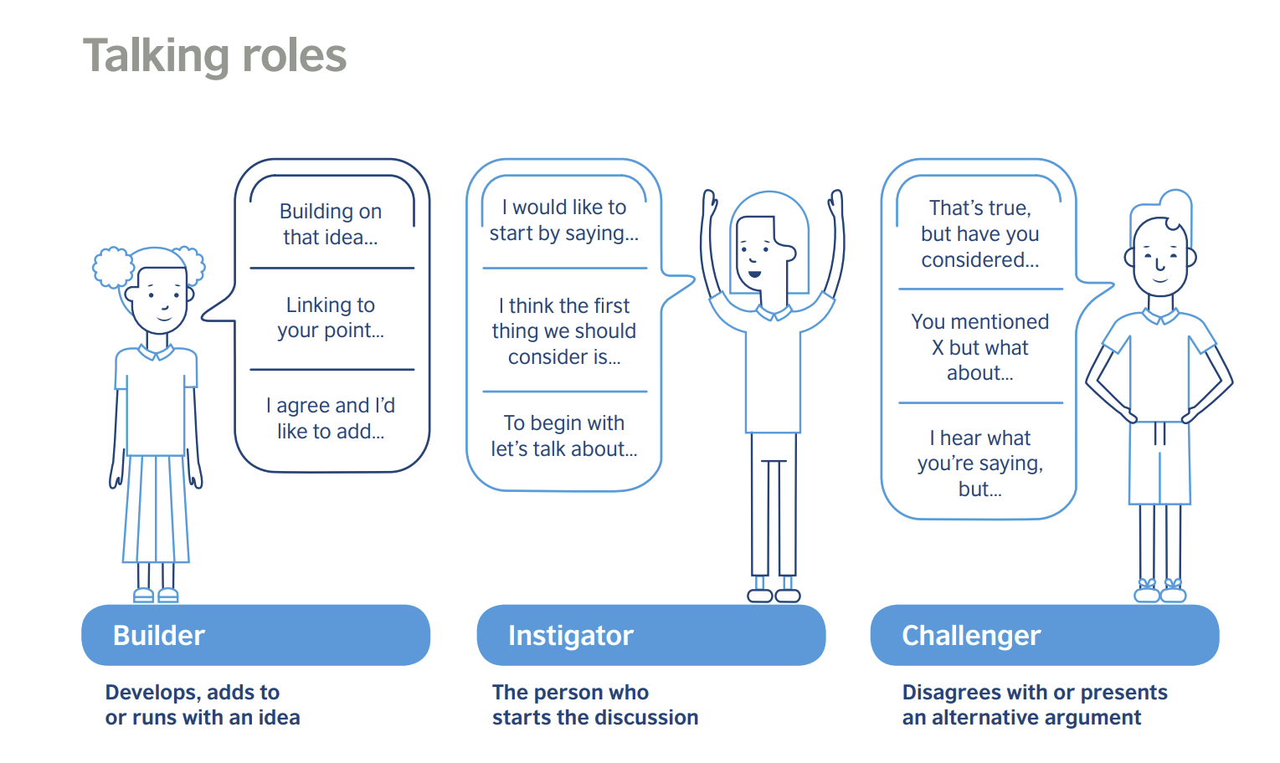

Slide 23
‘Talk Detectives’ can be used to support pupils to reflect on their talk and raise pupils’ awareness of what makes good discussion.
Practise ‘power poses’ to explore physical aspects of speaking.
Encourage a child to be a ‘chair’ and be explicit about what the expectations are. This should include being prepared to ask probing and clarifying questions and encourage others to do so too.
Key Stage 2
Trio discussions are a great way of encouraging oracy.
During a trio discussion encourage one member to take on the role of the questioner. Their sole responsibility during the trio discussion is to ask questions of the rest of the group.
Use vocal warm-ups and diaphragm breathing exercises to support voice projection. Some examples are on the next slide.
Play games like ‘just a minute’ to practise fluency when talking about a given topic such as climate change.

Slide 24
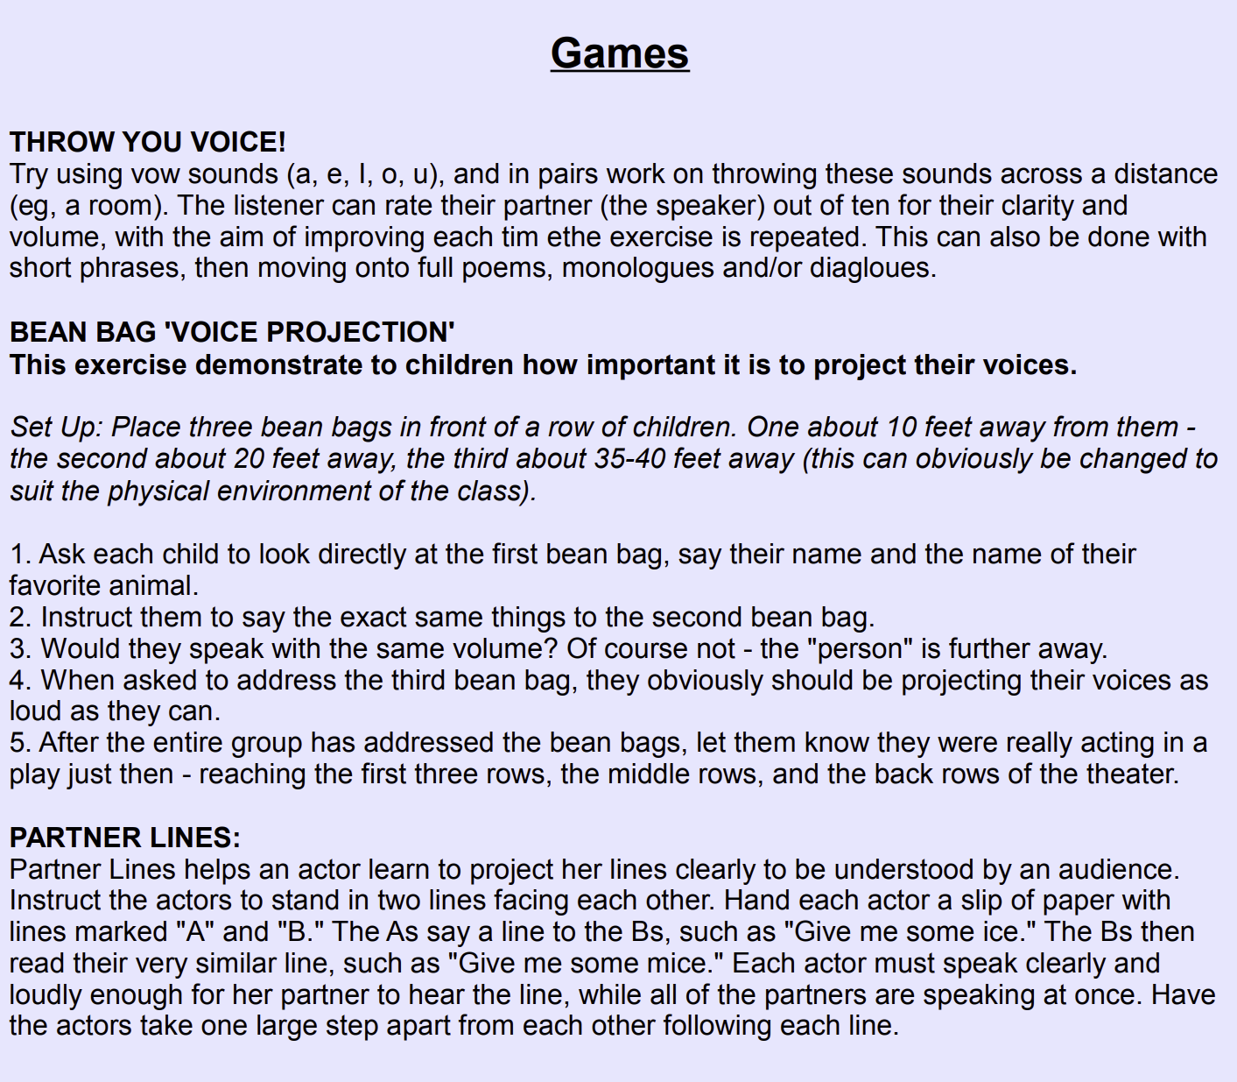

Slide 25
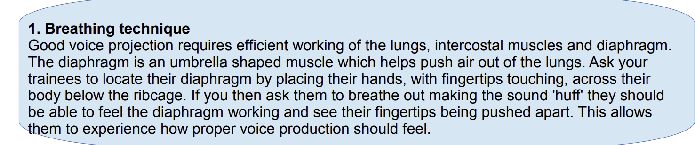

Slide 26
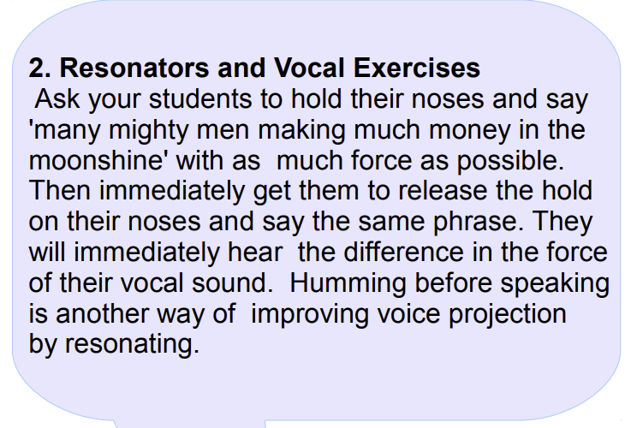

Slide 27
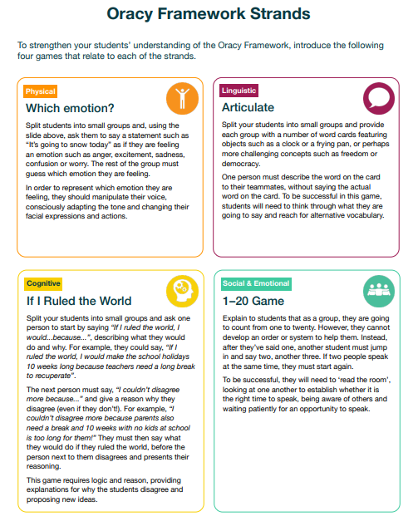

Slide 32
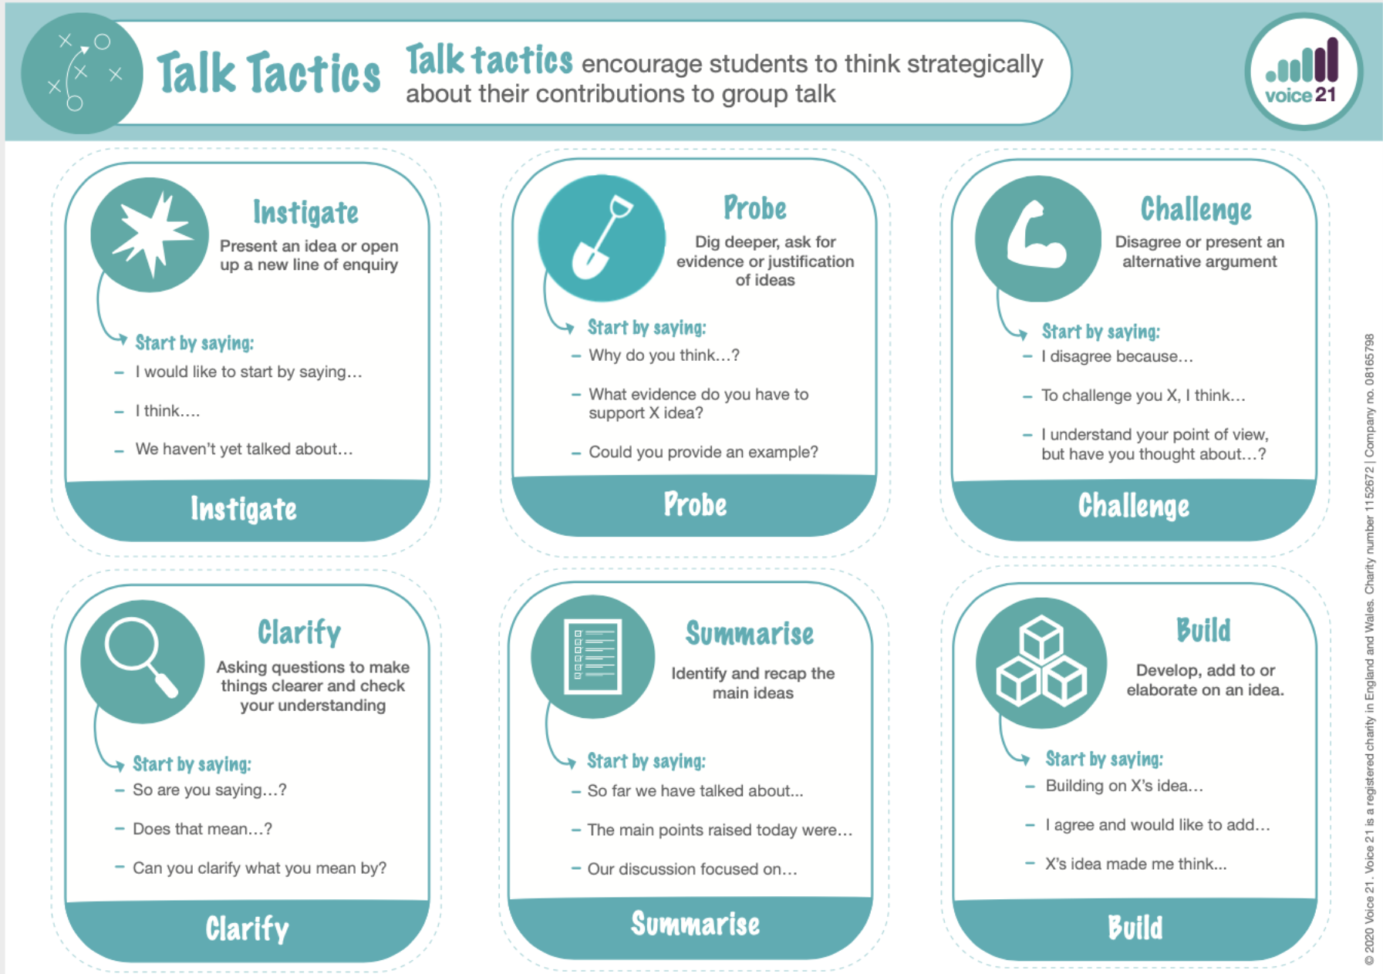

Slide 33
Using a child-friendly framework to support the explicit teaching of Oracy at FPIS…

Slide 34
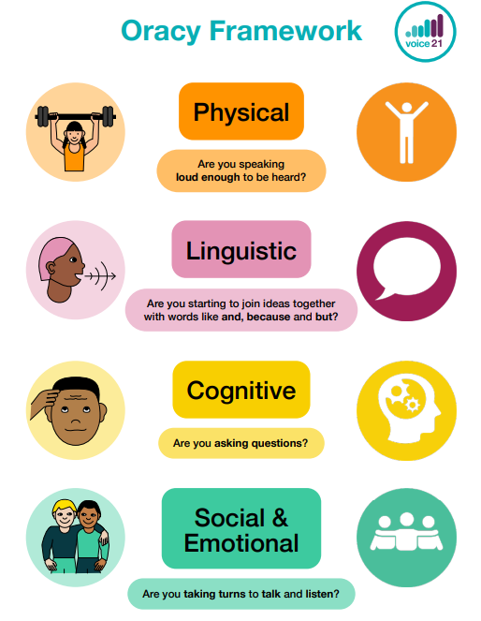
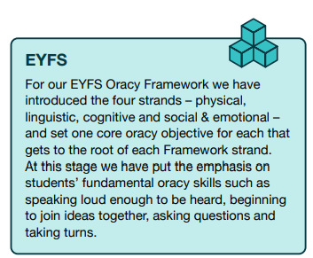

Slide 35
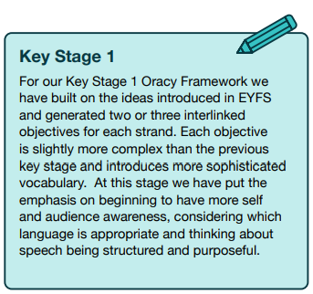

Slide 36
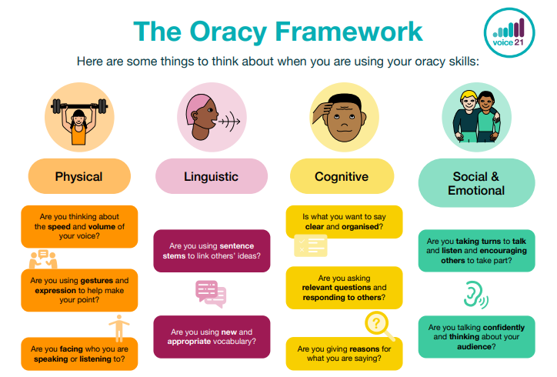

Slide 37
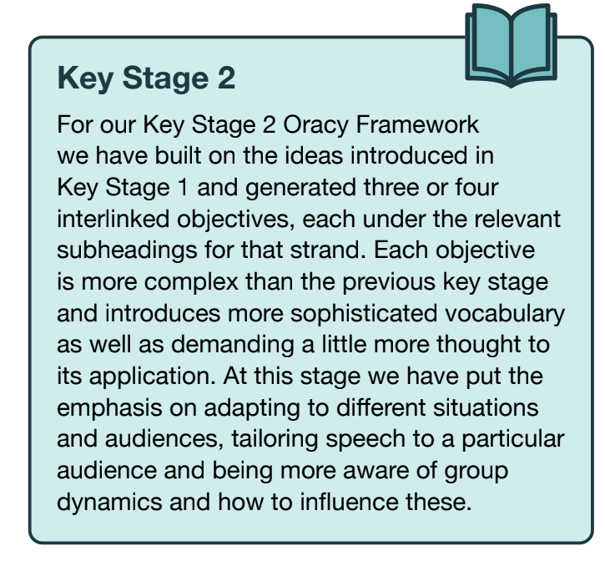

Slide 38
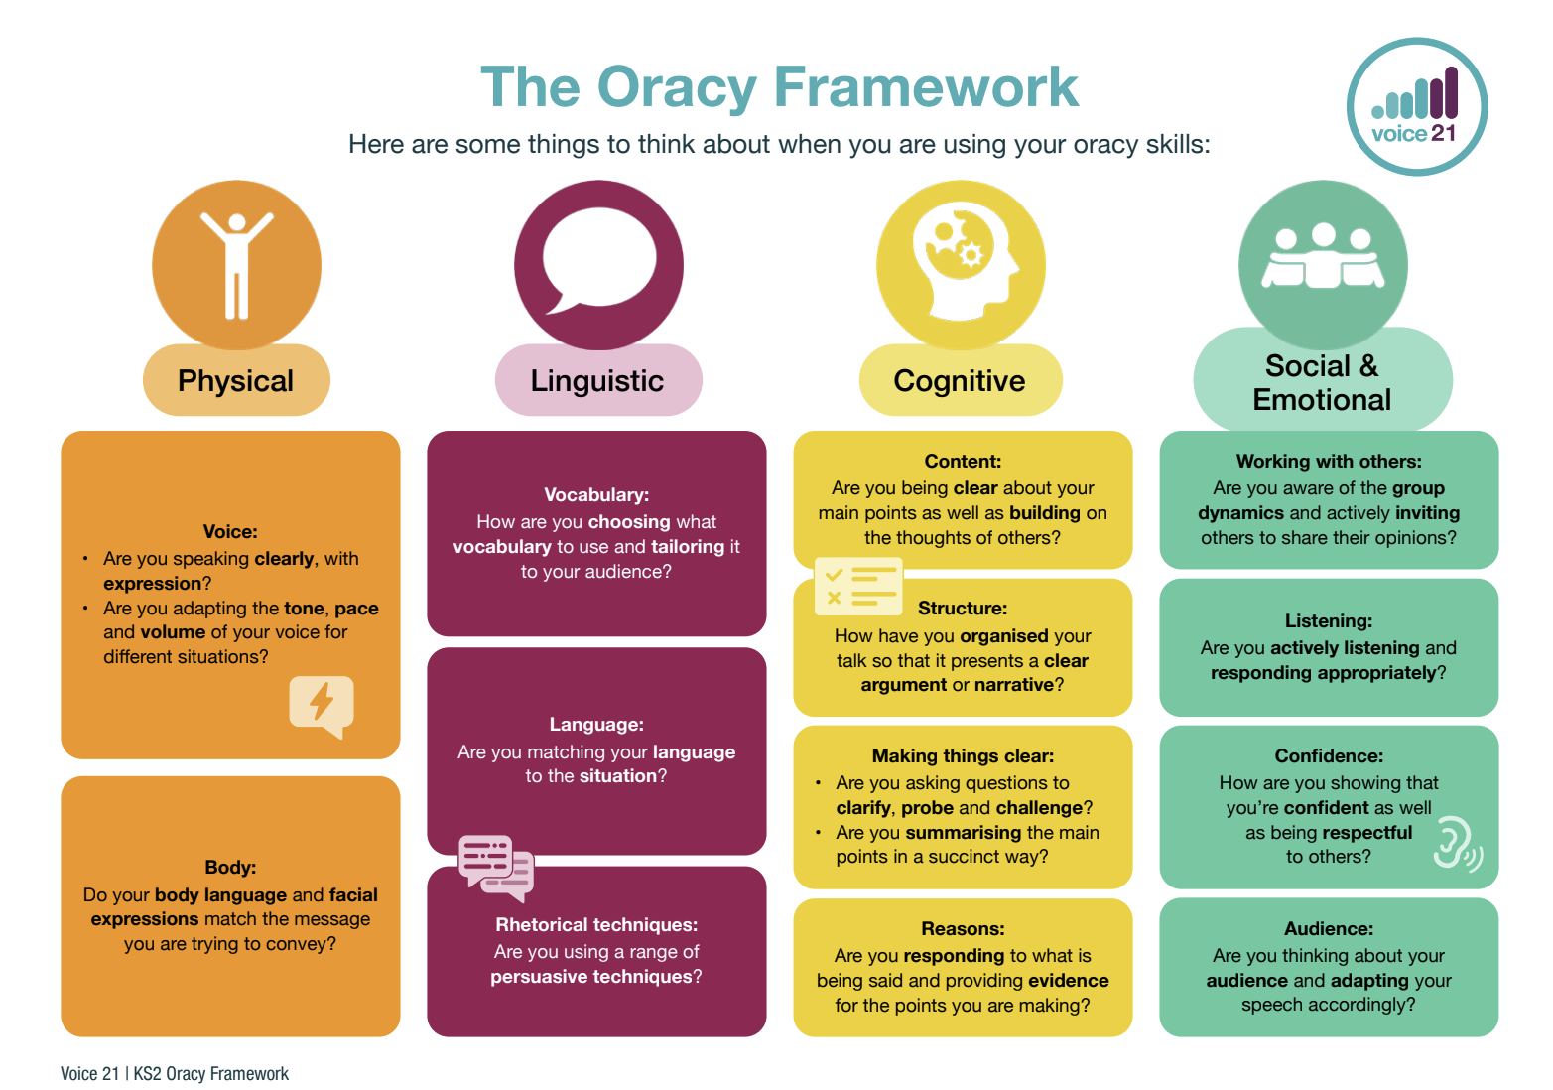

Slide 39
How can this be encouraged in the classroom?

Slide 40
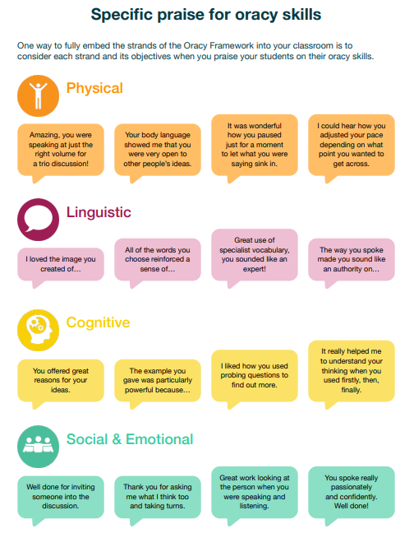

Slide 45
What does Oracy look like in your classroom?
In your year group?
In your school?

Slide 46
What is one activity you could take away and use?

