Slide 1
RBWM Teaching Assistant Training
Day 1
Monday 27th January 2025

Slide 2

Welcome and Introductions
This Photo by Unknown Author is licensed under CC BY-SA-NC

Slide 3
Context
Delivering Better Values: Grant to support the development of our Ordinarily Available Provision.
Tom Sherrington Walk Thrus
Hugely important role of the Teaching Assistant in these initiatives. – often with very little training or support.

Slide 4
Context
Whole Education: Whole School Improvement of SEND.
Leadership of SEND – self evaluation and Action Plans.
Quads and other training

Slide 5
The week ahead
Today: Supporting learning in the classroom.
Tuesday – Thursday: A range of one-hour virtual CPD activities.
Friday: Feedback and RBWM top tips for TA’s

Slide 6

Starter Activity
Read the statements and decide whether you agree with them or not.
Put the one that you agree with the most at the top of the grid.
Put the one that you totally disagree with at the bottom of the grid
Rank the others accordingly.

Slide 7
Key Facts (DfE, 2020)
Teaching assistants (TAs) account for 28% of the overall school workforce in mainstream schools in England
35% of the primary workforce and 14% of the secondary school workforce are TAs.
The number of full-time equivalent TAs has more than trebled since 2000: from 79,000 to 262,800.
There are currently more TAs in English nursery and primary schools than teachers: 273,200 vs. 248,900
Schools spend approximately £4.4 billion each year on TAs, corresponding to 13% of the education budget.

Slide 8
Rise in TAs
In 2003, the government introduced The National Agreement to help raise pupil standards and tackle excessive teacher workload. There was an increase in the number of TAs to help deal with problems with teacher workloads.
The growth in the numbers of TAs continued to be driven by the push for greater inclusion of pupils with special educational needs and disabilities (SEND) into mainstream schools.
TAs often work more closely with pupils from low-income backgrounds. Expenditure on TAs is one of the most common uses of the Pupil Premium in primary schools.

Slide 9
Research around Deployment of TAs
Deployment and Impact of Support Staff (DISS) project, (2008)
Key Findings
TAs help ease workload and stress, reduce classroom disruption and allow teachers more time to teach. Also working with TAs can lead to improvements in pupils’ attitudes.
TAs can encourage dependency, pupils not thinking and acting for themselves. Focus on task completion rather than learning.

Slide 10
Research around Deployment of TAs
Making Best Use of Teaching Assistants - Education Endowment Foundation (EEF) guidance report for schools (2015)
Key Findings
TAs are deployed in a mixed and flexible way that differs from school to school, but generally two main objectives:
Targeted deployment in which TAs deliver targeted interventions to individual pupils or small groups, typically out of class
General deployment, where they provide general support in the everyday classroom environment.
The research suggests that these approaches have vastly different impacts on pupil attainment. It also suggests TAs are not given adequate training for their role in classrooms.

Slide 11
EEF Recommendations
The most important principle underpinning deployment of TAs is that:
all pupils should have access to high quality teaching, particularly those who are disadvantaged and need additional support to succeed.
Investing in professional development for TAs can be a cost effective approach to improving attainment outcomes.

Slide 12
MAKING BEST USE OF TEACHING ASSISTANTS Guidance Report (EEF 2021)
This EEF Guidance Report is designed to provide practical, evidence-based guidance to help primary and secondary schools make the best use of teaching assistants (TAs).
It contains seven recommendations, based on the latest research examining the use of TAs in classrooms.

Slide 13


Slide 14
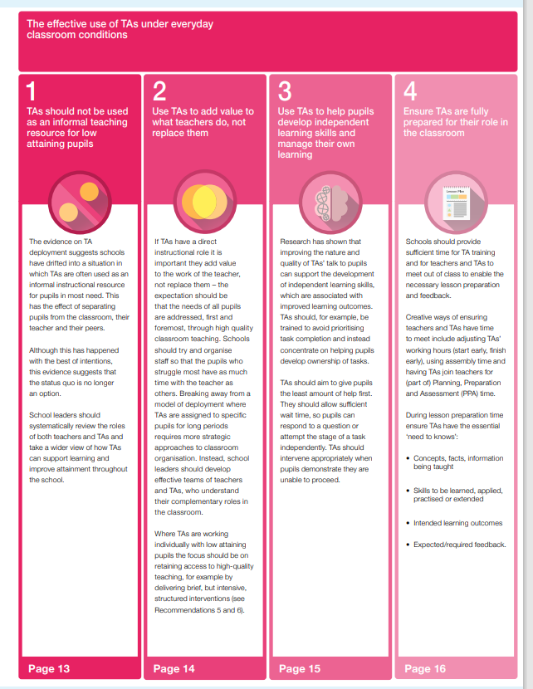
The effective use of TAs under everyday classroom conditions

Slide 15
Use of teaching assistants in schools (DfE 2024)
Key findings:
The roles and responsibilities of TAs have increased significantly in recent years. TAs perform a variety of tasks to support teaching and learning.
TA roles and responsibilities extend beyond supporting pupil learning and include pastoral and non-classroom
activities such as administration break and lunchtime.
Leaders, TAs and teachers reported that the increased role of TAs is largely driven by the changing characteristics of the pupils they support. They describe a rise in the number of pupils with SEND in mainstream settings as well as the increased social, emotional and mental health (SEMH) needs of pupils further to the COVID-19 pandemic.
The report finds that TAs are highly valued by leaders and teachers who report significant positive impacts at the pupil, teacher and school level. They agree TAs are essential to the classroom.
Professional development is typically restricted to free courses meaning hugely variable.
Only a minority of teachers have received any training about how to deploy TAs effectively in the classroom.

Slide 16
To help children learn effectively, teachers and Teaching Assistants must understand and apply the science of learning

Slide 17
Learning Outcomes
The session will introduce and apply the evidence around:
Helping children attend to learning
2. Finding out what children already know
3. Helping children focus on key ideas
4. Helping children commit information to long-term memory
5. Helping children remember what they learn
Based around research on The Learning Curriculum from Ambition Institute

Slide 18
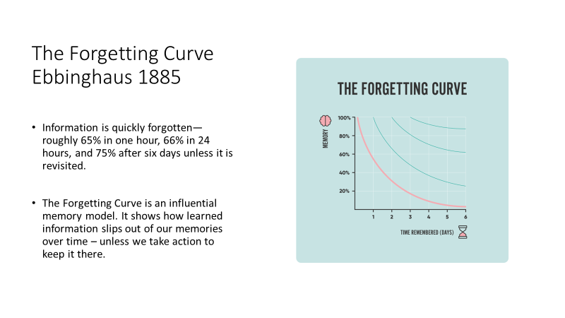
Retrieval practice

Slide 19
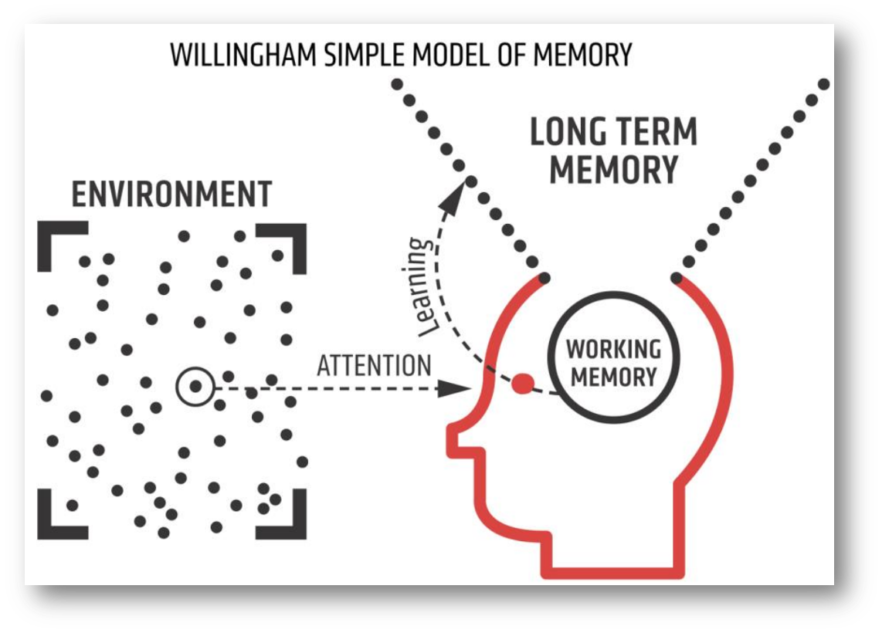
How pupils learn
Notes:
An important factor in learning is memory. Memory can be thought of as comprising two elements:
Working memory: this is where information that is being actively processed is held, but its capacity is limited and can be overloaded, for example, if pupils are required to process multiple pieces of information simultaneously (CCF, DfE 2019).
Long-term memory: this can be considered as a store of knowledge that changes as pupils learn by integrating new ideas with existing knowledge (CCF, DfE 2019).
To learn, pupils must transfer information from working memory, where it is consciously processed, to long-term memory, where it can be stored and later retrieved (Deans for Impact, 2015).
The primary goal of teaching should be to facilitate long-term learning; that is to create relatively permanent changes in comprehension, understanding and skills of the types that will support long-term retention and transfer (Soderstrom and Bjork, 2015).
Effective teaching should support both retention and transfer. Retention refers to keeping something in one’s long-term memory, while transfer means being able to move knowledge from long-term memory back into our working memory, in different contexts, as and when required (Willingham, 2009).
An important factor in learning is memory. The diagram is of Willingham’s (2009) simple model of the mind is used to help develop understanding of the learning process.
Watch the video on the next slide to further consider how this knowledge might be applied to create the optimal conditions for learning, particularly when planning classroom instruction.
Record notes as you watch the video.

Slide 20

1. Environment and Attention
HOW CAN TAs HELP PUPILS TO ATTEND TO LEARNING?

Slide 21
How pupils learn
Notes:
An important factor in learning is memory. Memory can be thought of as comprising two elements:
Working memory: this is where information that is being actively processed is held, but its capacity is limited and can be overloaded, for example, if pupils are required to process multiple pieces of information simultaneously (CCF, DfE 2019).
Long-term memory: this can be considered as a store of knowledge that changes as pupils learn by integrating new ideas with existing knowledge (CCF, DfE 2019).
To learn, pupils must transfer information from working memory, where it is consciously processed, to long-term memory, where it can be stored and later retrieved (Deans for Impact, 2015).
The primary goal of teaching should be to facilitate long-term learning; that is to create relatively permanent changes in comprehension, understanding and skills of the types that will support long-term retention and transfer (Soderstrom and Bjork, 2015).
Effective teaching should support both retention and transfer. Retention refers to keeping something in one’s long-term memory, while transfer means being able to move knowledge from long-term memory back into our working memory, in different contexts, as and when required (Willingham, 2009).
An important factor in learning is memory. The diagram is of Willingham’s (2009) simple model of the mind is used to help develop understanding of the learning process.
Watch the video on the next slide to further consider how this knowledge might be applied to create the optimal conditions for learning, particularly when planning classroom instruction.
Record notes as you watch the video.

Slide 22
Practical Demonstration
https://youtu.be/IGQmdoK_ZfY

Slide 23
Key Learning Point
If teachers or TAs do not explicitly draw pupils’ attention to what it is to be learned, their attention may be drawn to less important stimuli.
The Monkey Business Illusion demonstrates that, when the viewer’s attention is drawn to one aspect of the environment (the number of passes), other aspects (such as the colour of the curtains and the departing player) are missed.
Non-example:
The teacher is teaching pupils about musical notes. They use a piano keyboard image background and display the different notes alongside images of famous musicians.
Example:
The teacher is teaching pupils about musical notes. They display the different notes on a plain slide without competing images.

Slide 24
Possible Applications
Limit distractions: both visual (such as classroom decorations) and audible (such as music, external noise or speaking by peers and teachers) to allow pupils to concentrate on key stimuli.
Make explanations and instructions concise -use as few words as possible. Try to repeat subject specific target vocabulary multiple times.
Guide pupils’ attention:
Signal key points, for example stress key words in speaking, use arrows or pointing with images or text
Use questions to guide students’ attention to critical ideas ‘how many times did you have the sound’
Design experiential activities carefully: learning not just engagement.

Slide 25

2. Linking New Knowledge to Prior Knowledge
HOW CAN TEACHERS and TAs FIND OUT WHAT PUPILS ALREADY KNOW?

Slide 26
How pupils learn
Notes:
An important factor in learning is memory. Memory can be thought of as comprising two elements:
Working memory: this is where information that is being actively processed is held, but its capacity is limited and can be overloaded, for example, if pupils are required to process multiple pieces of information simultaneously (CCF, DfE 2019).
Long-term memory: this can be considered as a store of knowledge that changes as pupils learn by integrating new ideas with existing knowledge (CCF, DfE 2019).
To learn, pupils must transfer information from working memory, where it is consciously processed, to long-term memory, where it can be stored and later retrieved (Deans for Impact, 2015).
The primary goal of teaching should be to facilitate long-term learning; that is to create relatively permanent changes in comprehension, understanding and skills of the types that will support long-term retention and transfer (Soderstrom and Bjork, 2015).
Effective teaching should support both retention and transfer. Retention refers to keeping something in one’s long-term memory, while transfer means being able to move knowledge from long-term memory back into our working memory, in different contexts, as and when required (Willingham, 2009).
An important factor in learning is memory. The diagram is of Willingham’s (2009) simple model of the mind is used to help develop understanding of the learning process.
Watch the video on the next slide to further consider how this knowledge might be applied to create the optimal conditions for learning, particularly when planning classroom instruction.
Record notes as you watch the video.

Slide 27
Practical Demonstration
What do pupils need to know to make sense of this sentence from a Key Stage 3 history textbook:
“Some say that Henry only made the Break with Rome because the Pope would not let him have a divorce
(Byrom et al., 1997, p.49).”

Slide 28
“Henry” is Henry VIII, King of England.
“the Break with Rome” is the separation of the church in England from the Roman Catholic church.
“the Pope” governed the Catholic church and lived in Rome.
“would not let him have a divorce” a divorce required church permission; for a monarch this had to
come from the Pope; Henry was a Catholic.
“Some say” – historians interpret the past differently.

Slide 29
How pupils learn
Notes:
An important factor in learning is memory. Memory can be thought of as comprising two elements:
Working memory: this is where information that is being actively processed is held, but its capacity is limited and can be overloaded, for example, if pupils are required to process multiple pieces of information simultaneously (CCF, DfE 2019).
Long-term memory: this can be considered as a store of knowledge that changes as pupils learn by integrating new ideas with existing knowledge (CCF, DfE 2019).
To learn, pupils must transfer information from working memory, where it is consciously processed, to long-term memory, where it can be stored and later retrieved (Deans for Impact, 2015).
The primary goal of teaching should be to facilitate long-term learning; that is to create relatively permanent changes in comprehension, understanding and skills of the types that will support long-term retention and transfer (Soderstrom and Bjork, 2015).
Effective teaching should support both retention and transfer. Retention refers to keeping something in one’s long-term memory, while transfer means being able to move knowledge from long-term memory back into our working memory, in different contexts, as and when required (Willingham, 2009).
An important factor in learning is memory. The diagram is of Willingham’s (2009) simple model of the mind is used to help develop understanding of the learning process.
Watch the video on the next slide to further consider how this knowledge might be applied to create the optimal conditions for learning, particularly when planning classroom instruction.
Record notes as you watch the video.

Slide 30
Key Learning Point
Pupils can only make sense of new information, appreciate its meaning and commit it to memory by connecting it with what they already know.
Non-example:
The teacher begins a new unit of work on pronouns by defining them and identifying them in
sentences.
Example:
The teacher begins a new unit of work on pronouns by revisiting their knowledge of nouns. She then checks how much students recall about nouns using a short, low-stakes quiz. She uses this to check whether students’ prior knowledge is secure, revisiting any knowledge gaps she identifies.

Slide 31
Checking Prior Knowledge
Retrieval Practice:
Starters, Do Now Tasks, Starter for 5, Flashback 4, Yesterday, last week, last month, last year.
Effective Questioning:
Multiple Choice Questions
Strategies to elicit responses:
Think, Pair, Share
Show Me boards
Cold calling

Slide 32

3. Working Memory, Load and Thought
CAN TEACHERS and TAs HELP PUPILS FOCUS ON WHAT MATTERS?

Slide 33
How pupils learn
Notes:
An important factor in learning is memory. Memory can be thought of as comprising two elements:
Working memory: this is where information that is being actively processed is held, but its capacity is limited and can be overloaded, for example, if pupils are required to process multiple pieces of information simultaneously (CCF, DfE 2019).
Long-term memory: this can be considered as a store of knowledge that changes as pupils learn by integrating new ideas with existing knowledge (CCF, DfE 2019).
To learn, pupils must transfer information from working memory, where it is consciously processed, to long-term memory, where it can be stored and later retrieved (Deans for Impact, 2015).
The primary goal of teaching should be to facilitate long-term learning; that is to create relatively permanent changes in comprehension, understanding and skills of the types that will support long-term retention and transfer (Soderstrom and Bjork, 2015).
Effective teaching should support both retention and transfer. Retention refers to keeping something in one’s long-term memory, while transfer means being able to move knowledge from long-term memory back into our working memory, in different contexts, as and when required (Willingham, 2009).
An important factor in learning is memory. The diagram is of Willingham’s (2009) simple model of the mind is used to help develop understanding of the learning process.
Watch the video on the next slide to further consider how this knowledge might be applied to create the optimal conditions for learning, particularly when planning classroom instruction.
Record notes as you watch the video.

Slide 34
Practical Demonstration
This demonstration gives an indication of a person’s digit span: their verbal short-term memory capacity.
Look at the list of numbers. Taking each line of digits in turn, read the digits and then cover the line and repeat them back to your partner.
Continue moving through the lines until you fail to correctly recall BOTH lines with the same number of digits.
The digit span is one less than the number of digits in the lines that were both failed.
For example, if you fail to correctly recall the 5th line but successfully recall the 6th line you can continue to line 7
because lines 5 and 6 both contain 6 digits. If you then failed to recall both lines 7 and 8 you would stop because
you have failed to recall two lines with the same number of digits. Your digit span would be 6 (one less than 7, the
number of digits in lines 7 and 8).

Slide 35
Key Learning Point
If teachers or TAs ask their pupils to work with too many new ideas at once, their working memory will be overloaded. Processing in working memory is necessary (although not sufficient) for long-term storage: so overloading their working memory will restrict pupils’ ability to comprehend the ideas or to learn from the experience.
Non-example:
After modelling how to add one more to a given number whilst on the carpet, the teacher asks the pupils to go to their tables. They then ask two children to give out the maths books and tell all students to rule the margin, write the date and title. Pupils then begin to practise adding one more.
Example:
Before modelling how to add one more to a given number at the carpet, the teacher ensures that the pupils already have their maths book, have ruled the margin, written the date and title. Once the teacher has modelled the process at the carpet, the students begin practising at their tables immediately

Slide 36
Possible Application
Scaffolding:
Use of manipulatives, writing frames, key vocabulary, number squares
Break tasks down into small parts
Pupils to focus on one step at a time.
Provide worked examples demonstrating how to complete tasks.
Phrase questions simply, so that students need not use working memory capacity decoding them.
When asking questions, provide students with wait time to think about the answer before responding [wait time 15 seconds]
Remove support gradually to help pupils complete problems increasingly independently. If pupils appear to be managing the existing problems, considering making practice harder by varying it.

Slide 37
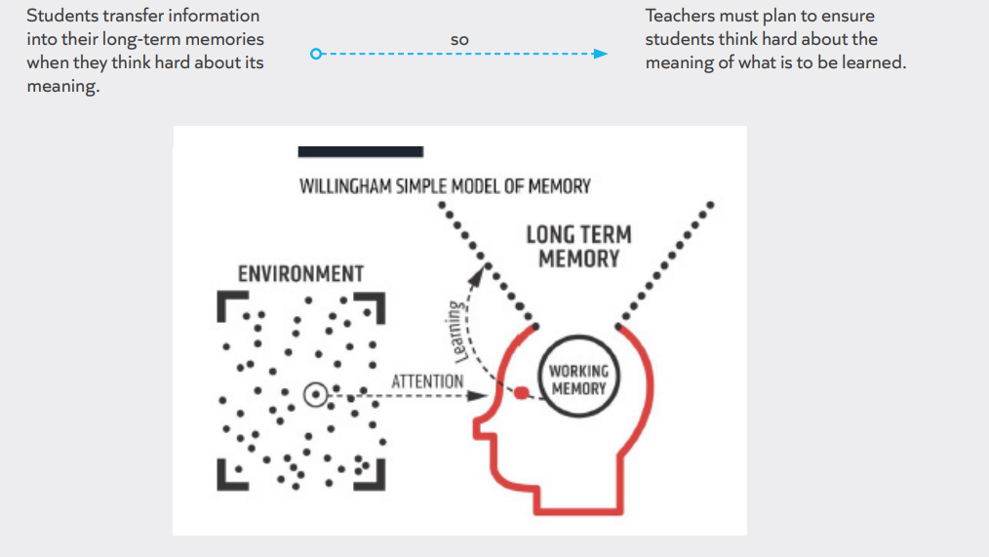
4. Long Term Memory
HOW CAN TEACHERS HELP PUPILS COMMIT INFORMATION TO LONGTERM MEMORY?

Slide 38
Practical Demonstration
We’re now going to try an experiment to see what helps learners remember new information.
I’m going to read 30 words aloud. For each word, I’ll ask one of three questions:
Does it have an A or U in it?
Does it rhyme with the word ‘train’?
Is it pleasant?
I’ll tell you the question, then the word: please just write ‘Yes’ or ‘No’: you don’t need to record the words.
For example, if I said, “A or U. Cheese.” you would record no (since cheese does not have an A or U in it). If I said “Is it pleasant? Sewer.”, it’s highly likely you’d record no.”

Slide 39
Which column did you remember the most words from?
Teachers are likely to remember the most words from the pleasant column because they were forced to think about what the words meant. Teachers could respond to A or U just by thinking of the spelling and rhyming just by listening to the sound of the words. To respond to the question “Is it pleasant?” teachers had to think of meaning, and that’s what really helps memory (Craik and Tulving, 1975).
Non-example:
The teacher gives students a map showing the extent of Viking voyages to help students understand why Viking raids were so successful. They ask them to list the different places to which Vikings travelled.
Example:
The teacher gives students a map showing the extent of Viking voyages and a historian’s description of the
different ways their boats could be used (for example, pulling them ashore for roads, carrying them across rapids,
sailing up rivers). The teacher asks students to use the historian’s description to explain why the Vikings were able to
travel and raid so successfully

Slide 40
Possible Application
Design activities so that all pupils must think hard
If pupils are learning about multiple factors (such as causes/ reasons/ explanations), ask them to rank the factors or explain their importance, not just summarise them.
When teaching new vocabulary to pupils, design activities ensuring they think about the meaning of the word in context: “Why might someone feel anguished on their birthday?” is a better question than “What does anguished mean?”
If you want pupils to think at length about something, ask them to write something, rather than to think about it: this encourages them to process the ideas more fully.
Where there is no obvious meaningful structure but an idea is important (times tables, a scientific formula) use mnemonics, songs or repetition to help students commit it to memory.

Slide 41
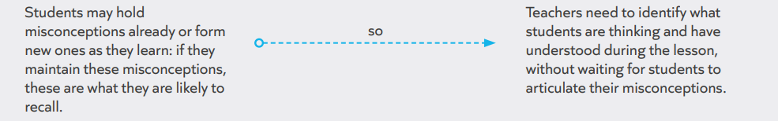
Identify and Address Gaps and Misconceptions

Slide 42
Practical Demonstration
Identify all the things pupils will struggle to understand if they believe that:
You multiply by 10 by adding 0 to the end of the number
You use a comma every time you pause to take a breath
Objects sink because they are heavy
The Church is (only) a building

Slide 43
they will be unable to multiply numbers with a decimal point correctly
they will place commas incorrectly
they will not understand density
they will not understand the Church as a universal institution

Slide 44
Common misconception (Primary)
Decimals
Children may think that add a 0 when multiplying decimals by 10
Evaporation and condensation:
Children may not understand the concept of evaporation before moving on to condensation and precipitation.
Adverbs
Students may think that all adverbs end in "-ly", but this is not always the case
Verbs
All verbs are doing words
Compound sentences
Students may think that compound sentences only have two coordinating clauses, but they can have more

Slide 45
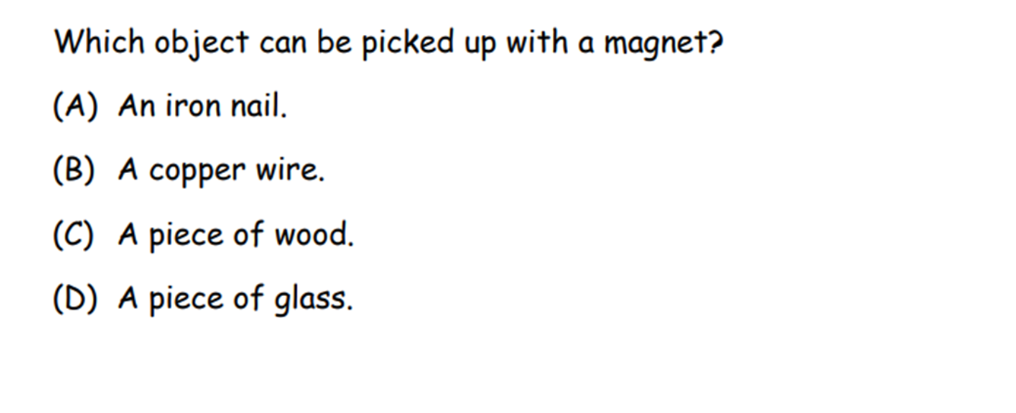
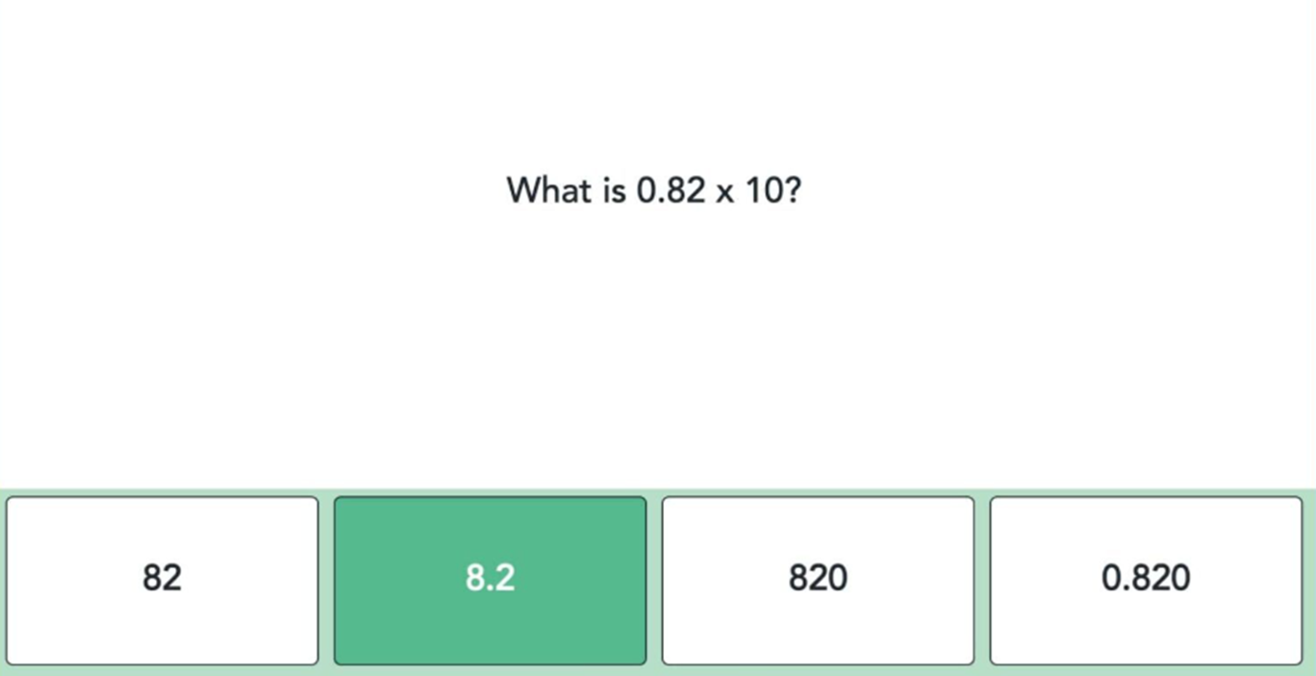
Key Learning Point
Can address misconceptions using Multiple Choice questions

Slide 46
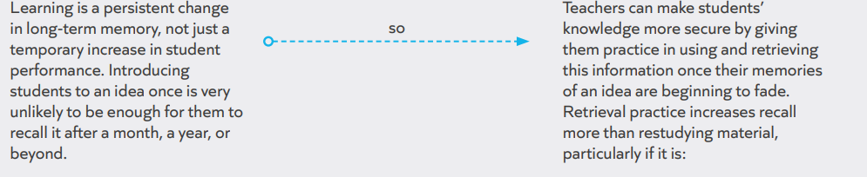
5. Forgetting
HOW CAN TEACHERS and TAs HELP PUPILS TO REMEMBER WHAT THEY LEARN?
Varied: students practise different tasks, rather than one task at a time, increasing the number of cues helping students recall the idea, and increasing its usefulness.
Spaced (for verbal materials): increasing delays between practice episodes, especially if students answer correctly.

Slide 47
Practical Demonstration
What was the first 2 numbers in the digit activity?

Slide 48
Quiz – Retrieval Practice
Question: Which of these will diminish pupils’ attention towards learning?
Playing music during lessons while students work
b. Allowing a small amount of off-task discussion
c. Emphasising key points in the lesson

Slide 49
Answer
Although (a) playing music could prove helpful if it reduces the impact of more distracting noises, both music and (b) off-task discussion will diminish students’ attention towards learning, because both
provide additional stimuli which students need to try to ignore.
These drains on students’ attention can be harmful to their learning.
Emphasising key points in the lesson (c) should draw students’ attention towards them.

Slide 50
Quiz – Retrieval Practice
Question: Planning should disregard students’ prior knowledge…
If the topic is completely new to students
b. Students’ prior knowledge is likely to contain many errors
c. Never

Slide 51
Answer
Some teachers may believe that Pupils’ prior knowledge is sometimes irrelevant to their planning, but this is never the case (c is correct).
Even when a topic is completely new to students (a) they will have some relevant prior knowledge from previous topics, other subjects or their own experience, which should help them to make sense of new information. If student’s prior knowledge is likely to contain many errors (b) this is particularly important for teachers.

Slide 52
Assessment
Question 1: Which of these is most likely to help students learn without overloading their working memory?
a. Focus on topics in which students are interested.
b. Prioritise two or three ideas for students to think about at any one time.
c. Ensure the lesson is engaging for students.
Question 2: An explanation is most likely to remain within students’ working memory capacity if it is…
a. Detailed.
b. Concise.
c. Stimulating

Slide 53
Answers
Some teachers may believe that engaging students (c) is crucial to learning but this does not diminish the load on students’ working memories. Students may have more existing knowledge about topics which interest them (a), but teachers can still overload their working memories, and focusing on topics which interest students will impede teachers from educating students beyond their existing experience. Only (b) helps keep learning within the limits of working memory.
Detailed (a) and stimulating (c) explanations provide additional chunks of information which strain the capacity of students’ working memory. A concise explanation (b) which offers the minimum required information is most likely to remain within students’ working memory

Slide 54
Assessment
Question: Students are most likely to commit information to long-term memory if they are…
a. Emotionally engaged in an activity.
b. Interested in what they are studying.
c. Making sense of a new idea using what they already know
Question: Students are most likely to commit information to long-term memory if we ask them to…
a. Complete a fun activity about it.
b. Use several pieces of information at once.
c. Think about the meaning of the information.

Slide 55
Answers
Students are more likely to remember events and experiences during which they are emotionally engaged.
However, this is a problematic strategy for ensuring students’ memory of key ideas: not all teaching can be emotionally engaging, and there is no guarantee what students recall about the event. So although teachers may believe this is important, (a) is incorrect. Students may be more motivated if they are interested in what they are studying – and motivation supports effective learning – but unless they are processing it meaningfully, it will not be committed to long-term memory, so (b) is also incorrect.
(c), making sense of a new concept with what they already know, is most likely to help them commit new information to long-term memory.
Teachers may believe that a fun activity stimulates learning (a) or that they should challenge students with a lot of information (b) but the biggest support for learning is ensuring students think about the meaning of the information (c).

Slide 56
Quiz – Retrieval Practice
Question: The most valuable information which a check for understanding can provide during a lesson is whether:
a. Students will remember what they have been taught
b. Students have made progress
c. Students have gaps in their understanding
Question: Teachers can be assured students do not hold major misconceptions if:
a. Students are confident they have understood the key ideas
b. Targeted students answer questions well
c. Students respond correctly to a hinge question

Slide 57
Answers
Teachers may believe (a), that a check for understanding demonstrates what students will recall, but current performance does not guarantee learning. They may also be accustomed to using checks for understanding to demonstrate students are making ‘rapid’ progress (b), but checks for understanding are much more useful if they give teachers a genuine appreciation of students’ understanding and misconceptions (c), so they can adapt the lesson.
Teachers may be satisfied by students’ confidence (a), but this is not a valid measure of what students know; teachers may feel content that the correct answers of some students reflect the whole class (b), but the response of some students may mask the misconceptions of others. Of these options, only a hinge question (c) demonstrates that students do not hold major misconceptions.

Slide 58
Quiz – Retrieval Practice
Question: Students benefit from practice if…
a. They are not yet good at what they are practising.
b. They are already good at what they are practising.
c. Both of the above.
Question: When revising new vocabulary, students are likely to benefit more from:
a. Half an hour of practice today
b. Fifteen minutes practice today, and fifteen minutes next week
Question: If students have been introduced to new information today, retention quizzing will be most useful…
a. Every lesson for the next fortnight
b. In one week, one month and six months
c. In one month and six months

Slide 59
Answers
Teachers may underestimate students’ capacity to practise if they are not yet good at something (a) or may
believe that some success renders further practice unhelpful (b). However, practice increases students’ automaticity and fluency in using any new knowledge or skill, so (c) is correct.
Half an hour of practice today (a) will allow students to perform well today, however they will soon forget
what they have learned; splitting the practice between two lessons (b) will be harder for students, but this will mean they are thinking harder about the learning, and it will therefore last longer.
Quizzing every lesson for a fortnight (a) will lead to gains in performance, but this may be more practice than
students need, and they will subsequently forget. An initial gap of one month (c) may be too long, and students may have forgotten most of what they knew by then. So one week, one month and six months (b) is likely to be the most effective interval.

Slide 60


