Slide 1
RBWM Teaching Assistant Training
Day 5
Friday 31st January 2025

Slide 2
Learning Outcomes
In this session will re-visit the learning from Monday
We will then -
Look at key learning from the week and consider what you feel would be most useful to share with your team at school and how this might be done
Co-produce advice back to school leadership teams about the most effective use of TAs in school and what they can do to help
Consider future training needs

Slide 3
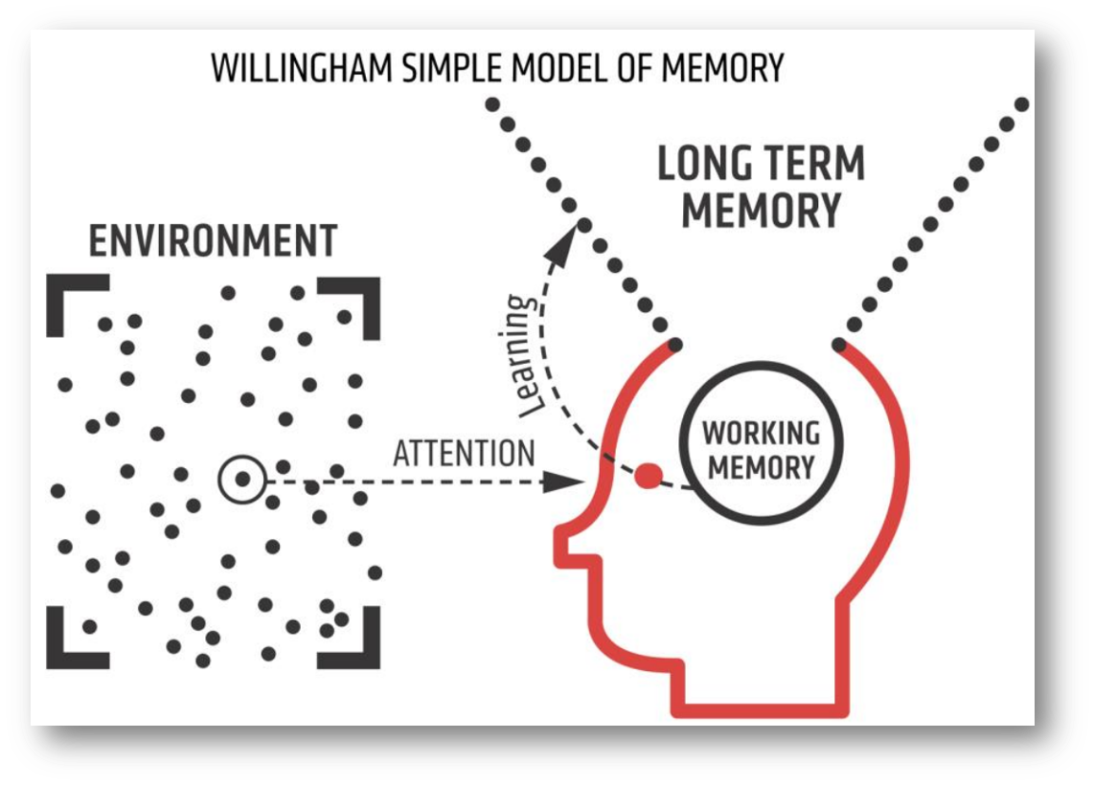
How pupils learn
Notes:
An important factor in learning is memory. Memory can be thought of as comprising two elements:
Working memory: this is where information that is being actively processed is held, but its capacity is limited and can be overloaded, for example, if pupils are required to process multiple pieces of information simultaneously (CCF, DfE 2019).
Long-term memory: this can be considered as a store of knowledge that changes as pupils learn by integrating new ideas with existing knowledge (CCF, DfE 2019).
To learn, pupils must transfer information from working memory, where it is consciously processed, to long-term memory, where it can be stored and later retrieved (Deans for Impact, 2015).
The primary goal of teaching should be to facilitate long-term learning; that is to create relatively permanent changes in comprehension, understanding and skills of the types that will support long-term retention and transfer (Soderstrom and Bjork, 2015).
Effective teaching should support both retention and transfer. Retention refers to keeping something in one’s long-term memory, while transfer means being able to move knowledge from long-term memory back into our working memory, in different contexts, as and when required (Willingham, 2009).
An important factor in learning is memory. The diagram is of Willingham’s (2009) simple model of the mind is used to help develop understanding of the learning process.

Slide 4
Retrieval Practice
In pairs on your table annotate the model of learning with post-its to show the work TAs do in class to support the various elements of the model.

Slide 5
How pupils learn – learning from Monday’s session
Limit cognitive load (overloading working memory will restrict pupils’ ability to comprehend the ideas or to learn from the experience)
Scaffold / use manipulatives / break down into small parts / re-phrase / give think time
Encourage ‘hard thinking’
Summarise / mnemonics / emotional engagement
Link knowledge to what they already know
Check what they already know -
Retrieval Practice:
Starters, Do Now Tasks, Starter for 5, Flashback 4, Yesterday, last week, last month, last year.
Effective Questioning:
Multiple Choice Questions
Strategies to elicit responses:
Think, Pair, Share
Show Me boards
Cold calling
Limit distractions
Make explanations and instructions concise
Guide pupils’ attention

Slide 6
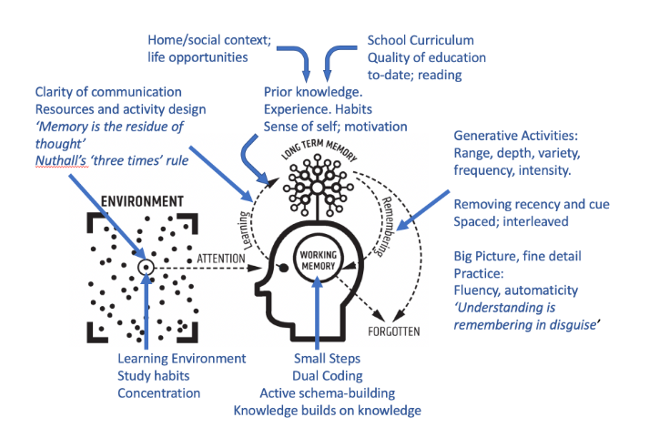
How pupils learn
Notes:
An important factor in learning is memory. Memory can be thought of as comprising two elements:
Working memory: this is where information that is being actively processed is held, but its capacity is limited and can be overloaded, for example, if pupils are required to process multiple pieces of information simultaneously (CCF, DfE 2019).
Long-term memory: this can be considered as a store of knowledge that changes as pupils learn by integrating new ideas with existing knowledge (CCF, DfE 2019).
To learn, pupils must transfer information from working memory, where it is consciously processed, to long-term memory, where it can be stored and later retrieved (Deans for Impact, 2015).
The primary goal of teaching should be to facilitate long-term learning; that is to create relatively permanent changes in comprehension, understanding and skills of the types that will support long-term retention and transfer (Soderstrom and Bjork, 2015).
Effective teaching should support both retention and transfer. Retention refers to keeping something in one’s long-term memory, while transfer means being able to move knowledge from long-term memory back into our working memory, in different contexts, as and when required (Willingham, 2009).
An important factor in learning is memory. The diagram is of Willingham’s (2009) simple model of the mind is used to help develop understanding of the learning process.
Further explanations:
Nuthall’s three times rule - students need at least three different encounters with “the complete set of information” necessary to understand a concept in order to retain it in long-term memory
Dual coding - a strategy used in traditional classroom teaching to improve learner engagement and knowledge retention. It refers to the process of combining visual (image-based) and verbal (language-based) elements to convey information.
Generative activities - Generative learning activities are behaviors that the learner engages in during learning with the goal of improving understanding of the material - summarising, mapping, drawing, imagining, self-testing, self-explaining, teaching, and enacting

Slide 7


Slide 8
What has been the key learning from the week?
What have you learned?
What have other TAs reported they have learned?
What do you feel are the key training needs back at your school and how could you be part of delivering this?

Slide 9

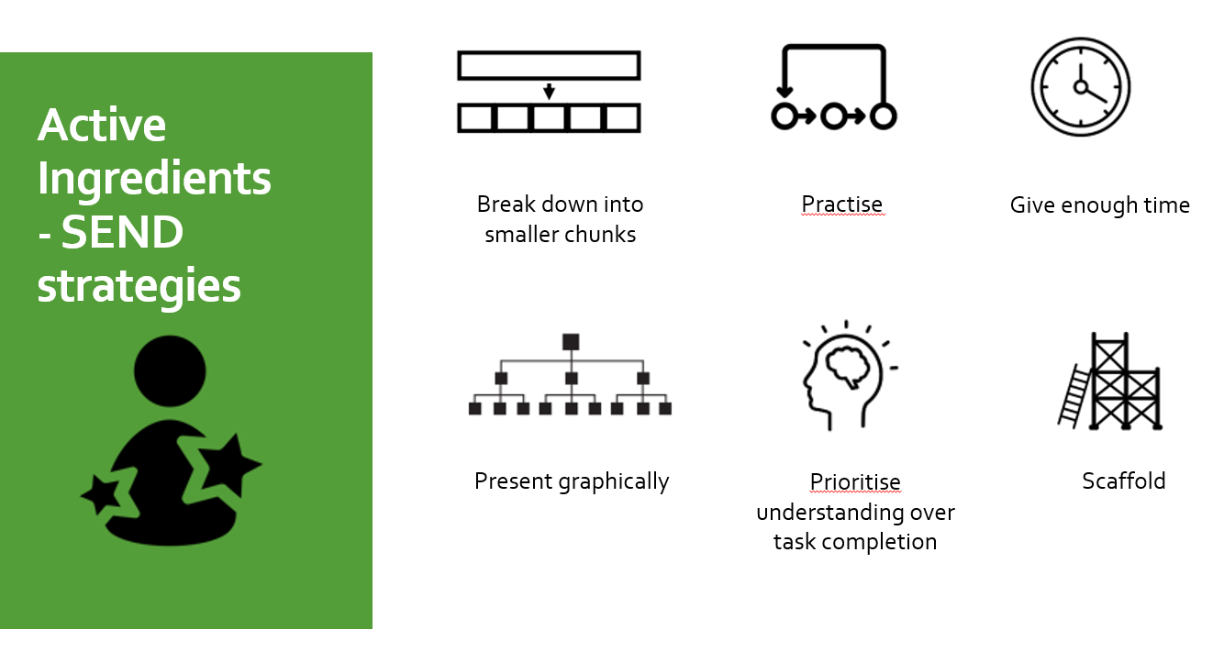

Active ingredients / Do’s and Don’ts

Slide 10

Ways forward

Slide 11

Schools could consider:
- Are children being separated too much from their peers and taught by TAs?

Slide 12
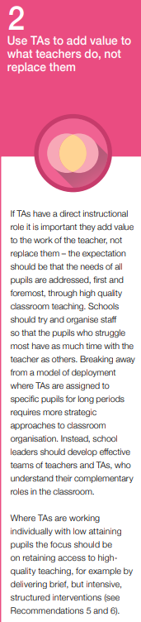
Schools could consider:
Are all children having equal access to the class teacher?
Do some pupils consistently miss out on input from the class teacher?

Slide 13
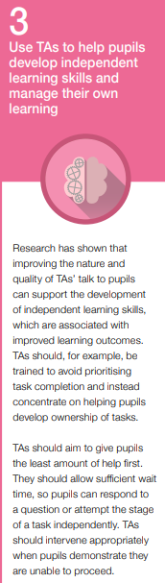
Schools could consider:
Have TAs been able to access high quality training?
(there are lots of ways this can happen aside from attending courses e.g. working alongside other professionals such as SALT, observations of other members of staff, accessing online resources)
Do TAs have strategies to support children to be more independent or are they inclined to do work for them?

Slide 14
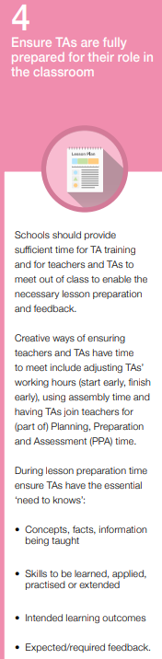
Schools could consider:
Whether time can be made available for TAs to meet with teachers they work with on a regular basis?
Whether TAs can attend after school training or INSET days?
How TAs are kept up to date with key information e.g. expectations regarding feedback to pupils?

Slide 15
The ‘stuff’
1. Pupils knowing stuff helps them to learn more stuff background knowledge
2. It is effective and efficient to explicitly teach pupils the stuff explicit instruction
3. Pupils cannot learn lots of new stuff at any one time working memory limitations
4. We need to teach with pupils’ limited working memory in mind cognitive load theory
5. We need to make helpful connections between the complex stuff schema building
6. Plan to revisit the stuff with careful timing to secure remembering spacing and retrieval
7. Reading strategically is also vital to understanding complex stuff reading comprehension strategies
8. Pupils need to build confidence in their ability to learn and know stuff self-efficacy
9. Pupils need to exercise their attention and control their emotions to learn stuff self-regulation
10. Pupils need to pick the right strategies to learn the stuff successfully metacognition

Slide 16

What would you like to share back with school leaders?

Slide 17

This QR code will take you to all the resources

Slide 18

Please take time to complete this evaluation form

