Slide 1

TA Training
Supporting Behaviour in the Classroom
Needs and Communication
Alasdair Whitelaw
Pupil Inclusion and Support Manager
29th January 2025
Notes:
Last Training was 22/12/2021

Slide 2

Housekeeping
1 hr.

Slide 3

Aims / Objectives
Understand the potential communication behind behaviour and the brain.
The importance of relationships and language

Slide 4

Why are they dysregulated?
Why do children behave like this?
What does that look like?
Presentation
Triggers
Antecedents
Narrative
SEN

Slide 5


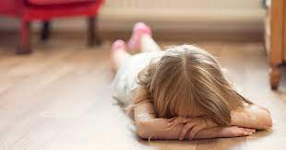
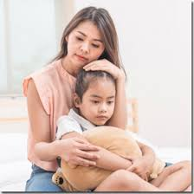
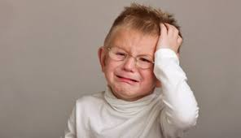
What does the behaviour look like?
Body Language
Throwing
Dysregulated child
Hitting
Shouting/screaming
Kicking
Spitting

Slide 6
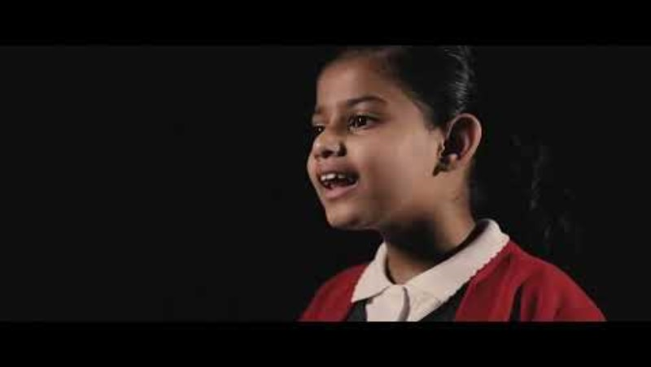

Slide 7
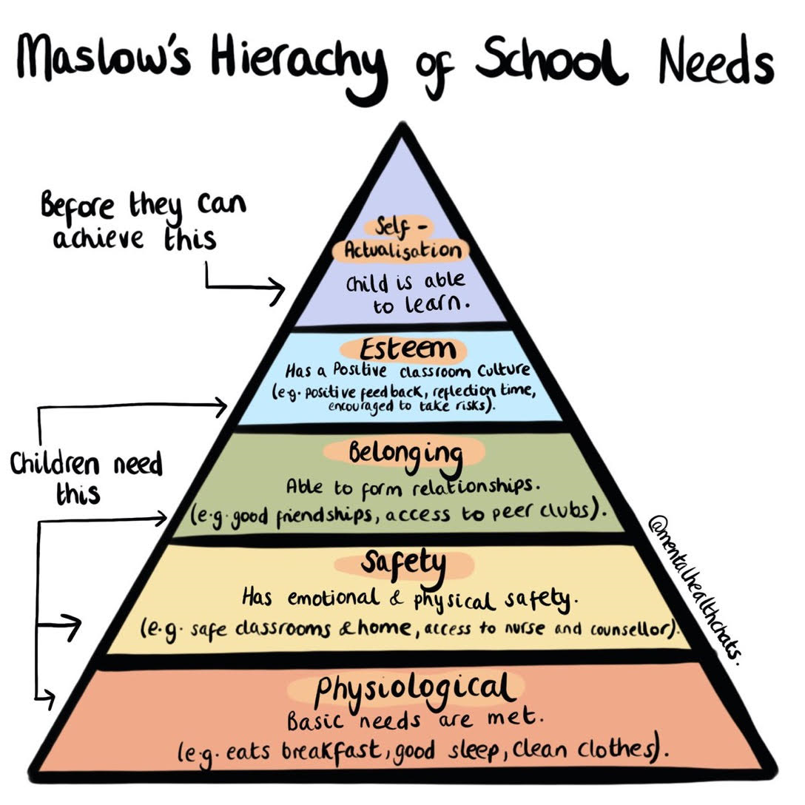

Consider how, as an individual, we can ensure that a young person has these needs met in a classroom setting

Slide 8

Behaviour is a form of Communication
This Photo by Unknown Author is licensed under CC BY-NC

Slide 9

The Brain….

Slide 10
Anxiety
Potential Behaviours
Separation Anxiety
Tearful and spending a lot of time thinking and talking about their anxieties
Being hypervigilant
Feeling angry and an increase in controlling behaviours including a refusal to comply
Threat
Control
Responsibility
Uncertainty

Slide 11
Many engage in criticising others in order to feel better about themselves
Many hurt others physically
Many harm themselves – eating disorders or other kinds of physical harm.
May be excessive worriers.
May often seem to be unhappy.
Low Self Esteem

Slide 12
We are all Teachers – especially TAs
If a child doesn’t know how to read?
        We teach.
If a child doesn’t know how to swim?
        We teach.
If a child doesn’t know how to count?
        We teach.
If a child doesn’t know how to behave…..?
WE TEACH

Slide 13
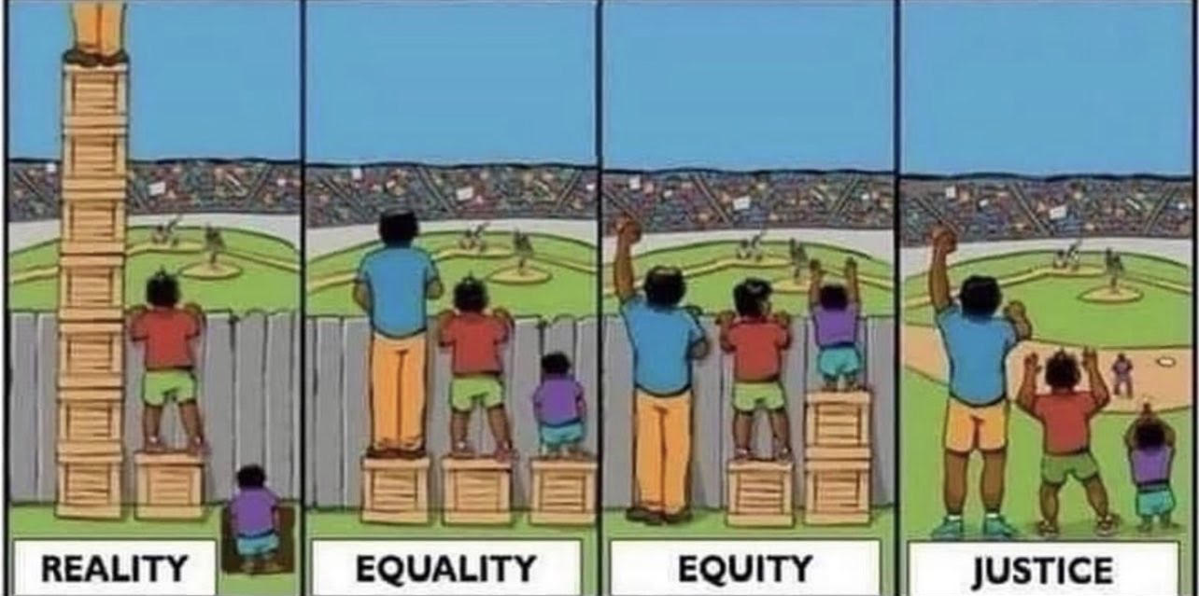
Doing different ‘things’ vs doing it differently...
What things come to mind? How could this link to reasonable adjustments or QFT?
Notes:
Reality – White Privilege – One gets more than is needed while the other gets less than need… huge disparaity
Equality – The assumption is that everyone benefits from the same support. This is considered to be equal treatment.
Equity – Everyone gets the support that they need – level playing field.
Justice – Take away the cause.

Slide 14
SEN Code of Practice 2014
The Code of Practice 2014 states the expectation that all teachers are teachers of pupils with Special Educational Needs or Disabilities (SEND). Quality First Teaching ensure this “High-quality teaching, differentiated for individual pupils, is the first step in responding to pupils who have or may have SEN. Additional intervention and support cannot compensate for a lack of good quality teaching.” Special Educational Needs and Disability Code of Practice.

Slide 15

What drives the behaviour? What can I control?
What is the child communicating?
What were the antecedents?
What will help deescalate?
Relationships
Those in pre frontal cortex mode
Staff for support (change of face etc)
Environment
Physical intervention.
Myself

Slide 16
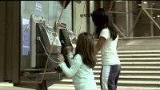
Video

Slide 17

ABC of Behaviour Management.
Antecedent
Behaviour
Consequence.

Slide 18

ASD
Commands as a threat

Slide 19

What about ourselves?
This Photo by Unknown Author is licensed under CC BY-SA

Slide 20
Firm
Fair
The Four Fs
Flexible
Forgiveness

Slide 21

As a a member of Ashley Hill Trust within the education workforce, I possess tremendous power to make a child’s life miserable or joyous. I am the decisive element in the classroom, on the playground and in the lunch hall.
It is my daily mood and personal approach that creates the climate.

Slide 22

Thank You
Evaluation
and
Feedback
to Al

