Slide 1
Designated Safeguarding Leads
Network Training
28th – 29th June 2021
Notes:
1

Slide 2
Agenda
Time | Item | Who
3.00 – 3.05pm | Welcome and safeguarding audit | Clive Haines
3.05 – 3.30pm | Parental Substance Misuse - Understanding the impact of parental substance misuse on young people and children | Jess Montague Young Person's Substance Misuse Worker AFC
3.30pm – 4.00pm | An introduction to the Thames Valley Police Drugs Deflection Scheme and commissioned PSHE material to reduce harm from substance use. | Brendan Murray and Russell Massie Force Tactical Lead for Child Centred Policing Thames Valley Violence Reduction Unit
4.00pm – 4.30pm | A research-based insight into how unidentified SALT needs can lead to wider difficulties including SEMH and Youth Offending and information on training to support schools with this next year | Emma Ahern MSc SLT, BSc (Hons), MRCSLT Highly Specialist Speech and Language Therapist Youth Offending Services
4.30pm | Close

Slide 3
Safeguarding Audit – update
Notes:
3

Slide 4
Parental Misuse – Impacts on Young People
June 2021

Slide 5
Research
•Alcoholism is a disorder which affects the whole family – parents, partners and children are often left to deal with the alcoholic alone.
•A research study shows that children in the UK living with parental alcohol problems, are:
•Six times as likely to witness domestic violence
•Five times as likely to develop an eating problem
•Three times as likely to consider suicide
•Twice as likely to experience difficulties at school
•Twice as likely to develop alcoholism or addiction
•Twice as likely to be in trouble with the police
Notes:
NACOA in 2019 had carried out some research looking at the impacts of a child over a period of their life, which shows that some of the impacts can include domestic violence and that they are 6 times more likely to witness this.
These will be very complex cases, therefore sometimes parental substance misuse isn’t always seen. It might be the school exclusions or the mental health of the parent or the child that is brought to the attention of professionals before seeing the parental substance misuse.
For example…as you can see… young people are 5 times more likely to develop an eating disorder or 3 times more likely to develop addiction themselves.

Slide 6
Figures
•28-30% of children live with at least one binge drinking parent, equating to 3.3 to 3.5 million children.
•2.6 million children (1 in 5) live with a hazardous drinker and 705,000 with a dependent drinker.
•Problem parental alcohol and/or drug use was recorded in 36% of serious case reviews carried out in 2014-2017 where a child died or was seriously harmed.
•Intergenerational vulnerability: parents who have a substance use disorder and harm their children have often experienced parental substance misuse and child abuse themselves.
Notes:
The NSPCC were receiving 200 referrals a week. Since the beginning of the first lockdown, this has increased by 66%.
We need to be more mindful of potential substance or alcohol misuse, when working with our families. We must ensure we are sharing information across all relevant departments that are around our families to ensure the best support is provided.
•In 2019-20, 16.3% of children in needs assessments identified alcohol misuse by a parent or other adult living with the child as an issue. Drug misuse was a factor in 17% of assessments.

Slide 7
How do you tell if a child is being affected by substance misuse?
•Their behaviour – are they more Anxious? Angry? Quiet? Withdrawn?
•Recent research indicates a multitude of difficulties experienced by children of alcoholics (or COAs) of all ages.
•Young COAs (up to the age of 12) are more likely to nap more during the daytime, have diagnosable mental health disorders, show behavioural issues such as aggression and have poorer academic attainment and cognitive function.
Notes:
Physical health impact
Children whose parents misuse substances are more likely to sustain an accidental injury – increased hospital admissions
Poor dental hygiene and increased dental problems
Psychological impact
Attention difficulties
Violent and rebellious behaviour
Lack of trust - impacting on establishing close relationships
Fear of being abandoned - Parents are often emotionally and physically unavailable
Identity issues as the young person grows older - they are hard on themselves
Open to more vulnerabilities- exploitation
They internalise a lot developing depression and anxiety
More likely to use substances themselves
Higher risk of self harm/suicidal ideation
Low school performance (particularly aged 15-16yrs)
Increased likelihood to be placed in care/CP

Slide 8
Factors that Influence Parental Misuse
Grieving a death
End of a relationship
Domestic Abuse
Mental illness
Environmental influences
Relaxation
Self-medication
Financial burdens
Career pressures
School pressures
Family demands
Feelings of inadequacy
Abuse and trauma
Boredom
Curiosity and experimentation
Rebellion
To be in control
To enhance performance
Isolation
Misinformation or ignorance
Instant Gratification
Wide availability

Slide 9
Protective Factors in Children, Family, Community & Professional
Secure attachment
Strong self-esteem
Absence of violence
Existing family rituals and structured family activities
Positive, nurturing school experiences
Cultural connection, value and identity
Socially comfortable environment
Health Visitors - regular visits and identify concerns
Nursery staff, Nurture groups, Schools
Access to recovery support
Schools
Notes:
Children -
Ability to use adults as resources, often including a supportive and trusting relationship with an adult in either the extended family or a friend’s family
Absence of early loss and trauma
Family -
Effective management of any parental mental health problems
Availability of at least one stable, nurturing caretaker
Acknowledgment of the substance misuse problem and its effects in the home
Professionals -
For the young person to have access to support, someone they trust and have a relationship within the school. Giving them opportunity to speak, that they feel safe, Listen, let them speak, don’t nag or argue, Let them explain their point of view, Use open ended questions, Show understanding / empathy, Pick the right time to talk to them about it, Have an open discussion and express your views on drugs appropriately – have the right information. Exaggerating drug harms will make it less believable, Don’t assume or judge, Know the difference between recreational use and addiction, Try not to react in an angry manner
For further support we have the 7Cs programme

Slide 10
What is the 7Cs?
The “Seven C’s” was developed by the National Association for Children of Alcoholics”
“I didn’t CAUSE it, I can’t CURE it, I can’t CONTROL it, I can take better CARE of myself, by COMMUNICATING my feelings, making healthy CHOICES and CELEBRATING me”.
This model has been used and adapted to meet the needs of young people who are affected more by drug misuse and not just alcohol.
Notes:
Children living in homes where there is parental substance abuse can find life difficult, unpredictable, and confusing. Sometimes they even believe the alcohol or drug abuse is their fault. Dealing with this chaos and unpredictability can leave kids feeling insecure and uncertain. Additionally, they may receive inconsistent messages from their parents.
As a result, children can feel guilt and shame trying to keep the family's "secrets." And they often feel abandoned due to the emotional unavailability of their parents.
To support young people aged between 8 yrs and 18 yrs who are affected by a family members alcohol/drug misuse.
To help the young person see that the misuse is not their fault.
To help them to make healthy choices, increase their knowledge of addiction, their self confidence, give them the opportunity to communicate their feelings, support them to make positive improvements in their lives by giving them strategies to keep safe, stress management and give young people tips on coping while a parent is in recovery
Ensure that clear communication takes place with the referrer and any other agencies the young person work with
Building a toolbox of skills
Building on self esteem
Looking at strategies on how to keep safe
Building small goals and celebrating
Refer for this programme using your normal method via the spa and early help

Slide 11
‘the 7Cs has massively helped me, I can relate to so much of what you talked about, it has changed my perspective and will help me in my future’
‘my feelings towards dad are different, I feel so much calmer when thinking about him or when I see him. Because of these sessions’
Notes:
Some feedback from young people, after completing the 7Cs.

Slide 12
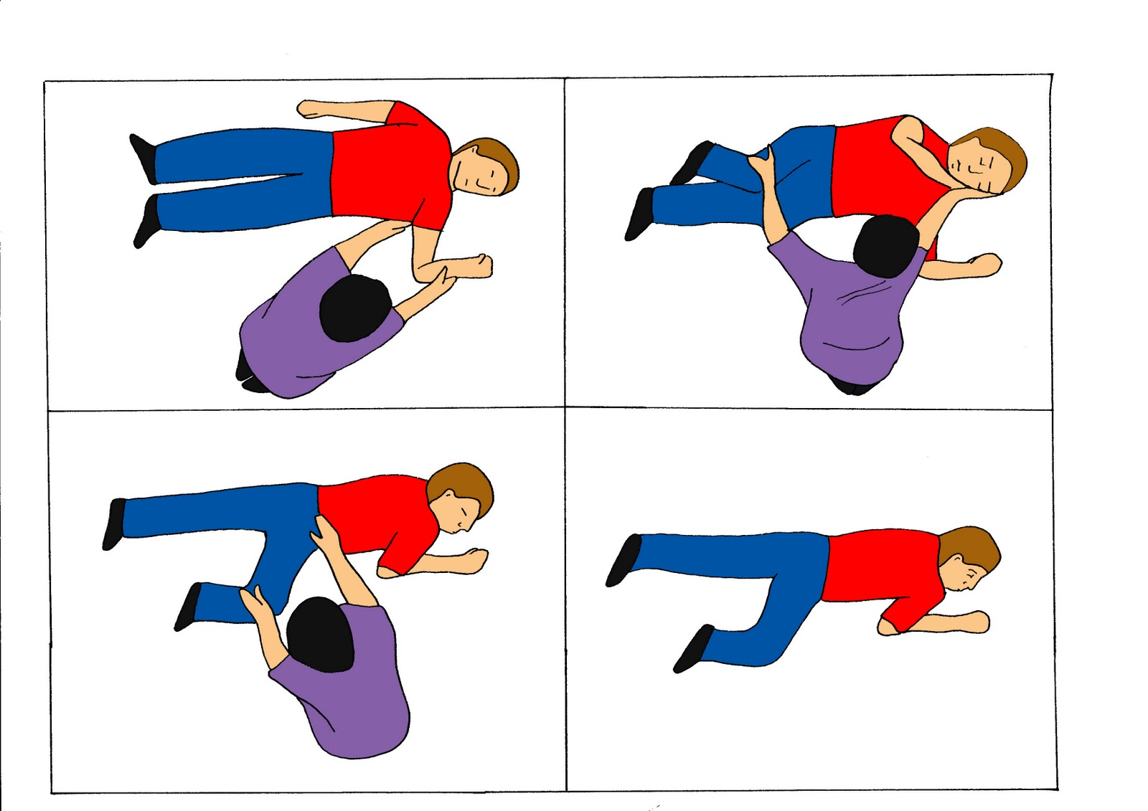
Recovery Position
Notes:
What you could do is, teach young people the recovery position. If you are working with a young family, it is important they know this information about the recovery position.
Important to save a life
Important to know how to call 999 or 101
If you are unsure about how to do the recovery position, there are many videos on youtube that can assist.

Slide 13
Finally
Affect attachment, family dynamics and relationships
Increases risk of physical and emotional neglect
Implications in behavioural and mental health problems in children and young people
Impacts on school performance and academic attainment
Can erode self confidence, self esteem and self identity
Reduces level of safety and oversight - inside and outside the home
There are a range of protective factors that can promote resilience and reduce risk
Notes:
Parental Substance Misuse can...
Finish on this -
Reducing the harm to children from parental substance and or alcohol misuse should become a main objective of policy and practice.
Parental substance misuse can and does cause serious harm to children at every age from conception to adulthood.
Addiction carries through families breaking the cycle of addiction for these young people is much more difficult
Predisposed to addiction pool of certain genes that affects how our brain works - Dopamine
Epigenetics turn certain genes on and off and if passed on from parents that increases the risk of 50% for a young person to become addicted. Include environmental factors you are looking at that 4 times more likely

Slide 14
Thank you for listening
Any Questions?
jess.montague@achievingforchildren.org.uk
Theresa.allen@achievingforchildren.org.uk

Slide 15
Brendan Murray and Russell Massie
Force Tactical Lead for Child Centred Policing
Thames Valley Violence Reduction Unit
Notes:
15

Slide 16
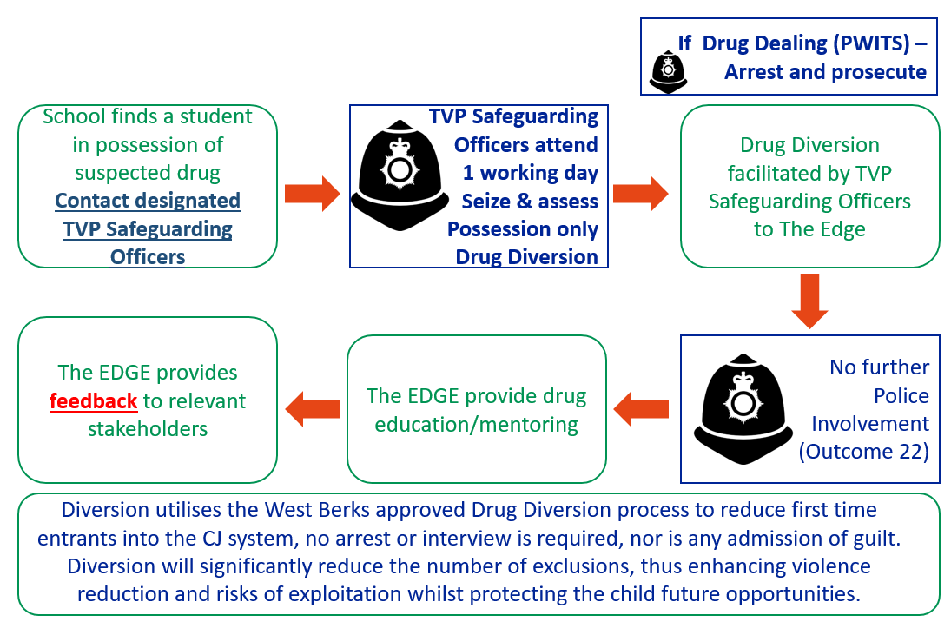

Thames Valley VRU support for secondary education
Drugs deflection scheme for schools
Deflecting children in possession of or at risk from using controlled drugs.
In cases of possession for personal use only.
Officer attendance to evaluate within 48h
Evidence-led bespoke educational inputs
Moving the multi-agency response from criminal to health-based, removing shame and stigma.
Available to schools concerned about a child as well as following an incident.
This is designed as an alternative to exclusion.

Slide 17
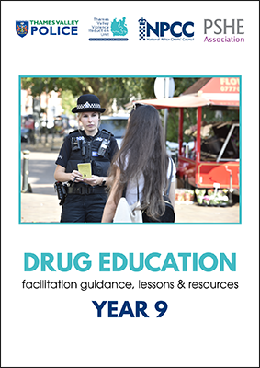
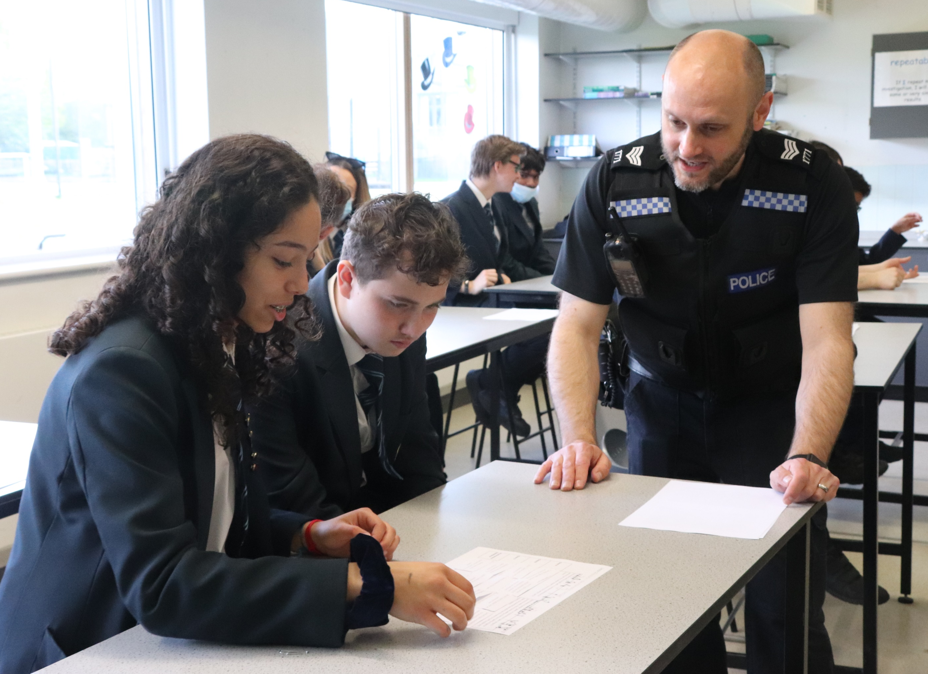
Thames Valley VRU support for secondary education
PSHE lesson: Drugs and Violence
PSHE curriculum inputs designed and quality assured by PSHE Association on drugs and violence based on research by LSE and NPCC that trained officer delivery enhances learning on legal terms and consequences and improves trust and legitimacy in the police.
Drugs sessions (Year 9)cover reasons for drugs use and definition, consequences (both legal, personal and societal) and harm reduction and signposting.
Violence sessions (KS3) cover protective behaviours, recognising escalation, appropriate behaviours, consequences and de-escalation tactics.
All TVP Schools Officers are being trained in safe classroom delivery by PSHE Association and National Police Chiefs Council.
Thames Valley Police 'Drug Education' lesson pack, year 9 | www.pshe-association.org.uk

Slide 18
Emma Ahern MSc SLT, BSc (Hons), MRCSLT
Highly Specialist Speech and Language Therapist
Youth Offending Services
Notes:
18

Slide 19

Communication Breakdown
The link between language/communication needs and “offending” behaviour
Presented by: Emma Ahern, Speech and Language Therapist (working for youth justice service across East Berkshire)

Slide 20
Prevalence of SLCN in YOT (RCSLT)
60% of young offenders have a SLCN – most likely to have been excluded from education
Up to 1/3 of children with SLCN develop mental health problems resulting in criminal involvement
Young people with SLCN are most likely to have:
Low self esteem, poor educational attainment, early exclusion/ disengagement from school
People with SLCN are at higher risk of reoffending – cannot access talking therapies, difficulty with reading or understanding legal terminology and formal documents

Slide 21
Speech, language and communication needs (SLCN) describes difficulties across one or many aspects of communication including:​
Difficulty with with producing speech sounds accurately , stammering ​and/or voice problems, such as hoarseness and loss of voice ​
Problems with understanding the meaning of words​, being able to think of words you want to say​, and/or putting words together in a way that makes sense​
Attention and listening difficulties, Poor memory, Problems with using and understanding non-verbal communication, Sensory needs, Emotional regulation needs, Difficulties understanding emotions , Problems with making/keeping relationships ​

Slide 22
SLCN in YOT:
- reduced cognitive/EF skills
- reduced social skills
- reduced understanding
- reduced vocabulary
- Emotional regulation difficulties
Developmental Diagnosis:
- ASD
- ADHD
- DLD
- Dyslexia
Adverse Childhood Experience (ACE) :
- Anxiety
- Attachment disorder
- Reduced EF skills
- Maladaptive behaviours
Notes:
Physical abuse
Sexual Abuse
Emotional Abuse
Living with someone who abused alcohol or other drugs
Living with someone with serious mental illness
Living with someone who’d been incarcerated
Exposure to domestic violence
Loss of parent through divorce, death, abandonment

Slide 23
What we see… (smoke) | What the young person might have difficulty with… (underlying fire)
Always late | Executive functioning (organising and planning) Understanding time concepts Remembering what was said to them
Refuses to do any school work or homework | Hearing what the teacher told them to do – auditory processing or sensory difficulties Remembering what was said Understanding the topic or what they need to do Fear of failure or looking stupid
Follows the “wrong crowd” - no best friend but seems to always be part of a bigger group - generally a “nice kid” and always seems remorseful but keeps getting in trouble | Possible social communication difficulties e.g. ASD Possible ADHD (impulsivity) Attachment disorder resulting from ACEs
Very quiet, always looks bored, barely says anything to anyone, wears hoodie/big jacket, smokes cannabis | Sensory processing disorder ASD Trauma Language disorder (expressive/receptive)
Finds it hard to sit still in class: always fidgeting, distracting other students, often storms out of the class | Attachment disorder Low self-esteem (fear of failure so displays fear aggression) Language disorder (finds it hard to explain themselves) Sensory processing disorder (ADHD, ASD, ACEs etc.)

Slide 24

Some SLCN are short term and can be addressed through effective early intervention. ​
​
Others are more permanent and will remain with a person throughout their childhood and adult life.​​

Slide 25
Road to nowhere - RCSLT
55% of 4yr olds in areas od deprivation have SLCN
Locke et al
4Yr olds with SLCN are more likely to develop behave probs by age 8
If untreated, 33% of children with SLCN will develop mental illness and over 50% will become involved in criminal activity
Breakthrough Britain
Over 60% of young people in the youth justice system have SLCN
80% of adult prisoners have SLCN
88% of unemployed men have SLCN – compared to 8% of the general population
?
Where to next?
Benasich et al
Bercow, RCSLT
RCSLT
Children’s Communication Coalition

Slide 26


A few places to start:
Rethink behaviour – look at it as an expression of need – what is missing?
Connection before correction
Case history – family/childhood trauma (it’s all relative), language delay when younger, ASD traits…
Teach them how to think: mindfulness, self-esteem, consequential thinking, friendships/relationships
Give them a sense of purpose/a place to belong: student/social groups, school projects (not curriculum based)
Support with: tuition, exams, study skills, classroom environment, reduce the demand of the day (e.g. timetable, sensory breaks), mentoring
Referral to other professionals for additional assessments or advice
CPD for staff/ whole school training: Developmental language disorder, sensory processing disorder, trauma/ACEs, ASD, ADHD, emotional regulation, sensory regulation,

