Slide 1
Safer Recruitment Training

Slide 2
The Bichard Inquiry
Recommendations for schools
Recommendation 16:
Head teachers and school governors should receive training on how to ensure that interviews to appoint staff reflect the importance of safeguarding children.
Recommendation 17:
From a date to be agreed, no interview panel to appoint staff working in schools and colleges should be convened without at least one member being properly trained.

Slide 3
Objectives of the training
Based on an understanding of offender behaviour to:
Identify the key features of staff recruitment that help deter or prevent the appointment of unsuitable people
Consider policies and practice that minimise opportunities for abuse or ensure its prompt reporting
Help participants begin to review their policies and practice in recruitment with a view to creating a safer culture
NB this is not intended to be a comprehensive workshop on staff recruitment and selection

Slide 4
Training outline
Scale of the problem – abused and abuser
Model to understand abusers / abusing
Application into education context
Prevention of abuse through recruitment/selection
Ongoing culture of vigilance

Slide 5
Group agreement
espect people’s right to speak and be heard
mbrace diversity and Enjoy the course
haring information and confidentiality
articipate safely
xpress your views and opinions
hallenge appropriately
reat yourself kindly
R
E
S
P
E
C
T
Notes:
5
Move on to ground rules asking for everyone to go with them and are there any additional ones

Slide 6
Session 1 – setting the context for safer recruitment
Background and context
The scale of abuse
A model of offending behaviour
Some characteristics of abusers
Implications for recruitment and selection and creating a safer environment for children

Slide 7
The wider context
The Bichard Inquiry Report
Legal duties on schools, FE colleges and a wide range of partner organisations to safeguard and promote the welfare of children
Statutory guidance ‘Keeping children safe in education’ (DfE 2020)
For boarding & residential schools, the National Minimum Standards (NMS)
Adopting “safer recruitment” practice is an essential feature of the arrangements organisations need to have in place
Notes:
Maintained, non-maintained & vc schools & FE colleges – Education Act 2002 s175
Independent & free schools, academies – Independent School Standards Regs 2015

Slide 8
Exercise 1 – what is harm?
There are four categories of child abuse: physical, sexual, emotional and neglect
Discuss how children might be harmed by an adult
in a school setting:
By accident
As a result of neglect or recklessness
Deliberately

Slide 9
Statistics – LADO referrals
Each year, 1 in 4 schools will contact the LADO regarding an allegation or concern about a member of staff
Schools make up 1/3rd of all LADO referrals
About 40% of all allegations are for physical abuse and 36% for sexual abuse
Varied significantly across different regions but 12 – 24% relate to emotional abuse or neglect
Where it is recorded as a separate category, 9% of allegations relate to conduct outside the workplace
Review of LSCB annual reports 2015-16 / 2016-17 (Eyre 2017)
Notes:
Literature review of all published LSCB annual reports that included LADO referral numbers and break-down by type of abuse. Some LSCBs also publish the number of consultations received which did not progress to a formal referral or where no strategy meeting was convened.
The significant drop in % physical harm allegations is affected by low referral % in areas that count consultations separately – suggests that complaints about physical interventions / restraint are not being recorded as physical harm as often as in the past

Slide 10
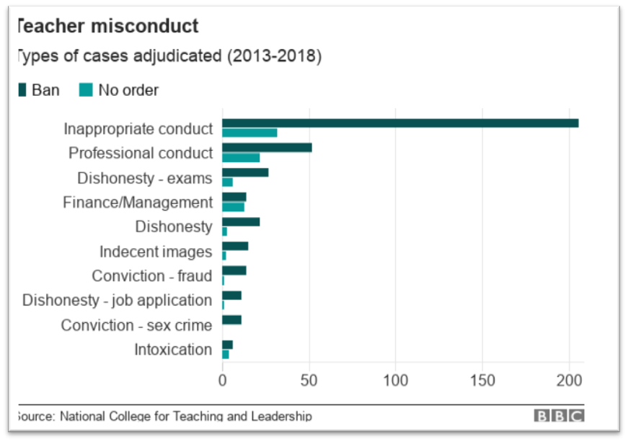
Statistics – NCTL*
*replaced by the TRA in April 2018
From April 2016 – March 2017 there were 977 initial investigations in relation to teachers
In the same period there were 168 proceedings leading to 119 prohibition orders
Between 2013 – 2017, 25 prohibition orders were made for alcohol or drugs, 14 for violence and 11 in relation to indecent images NCTL 2017
A total of 450 prohibition orders made between 2013 – 2018
Approx 1/3 of all prohibition orders relate to sexually motivated inappropriate conduct by a teacher BBC 2018
Notes:
516,000 teachers in England (NCTL)
70% of all prohibitions are against male staff

Slide 11
Statistics - DBS
7,437 referrals for discretionary barring in 2016/17
There were 59,530 people on the children’s barred list in March 2017
There were 64,044 people on one or both lists
Approx 350,000 DBS certificates processed each month
On average, 6% include Police National Computer data
0.2% also include additional info after filtering has been applied
0.01% of DBS applications have a barred list match
Disclosure & Barring Service October 2017
Notes:
DBS numbers – less than a quarter of discretionary referrals lead to a bar.
Apr 16 – Feb 17 About 350,000 applications per month – average 6% with PNC info, 0.2% with additional info after filtering has been applied. 0.01% have a barred list match

Slide 12
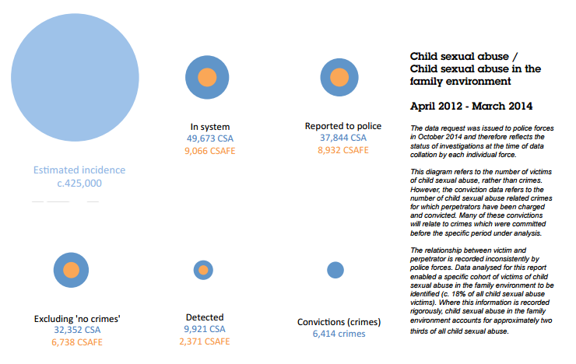
Children’s experiences of sexual abuse
Protecting children from harm (Children’s Commissioner Nov 2015) suggests that approximately 1 in 8 victims of CSA come to the attention of statutory agencies. This finding is consistent with various other pieces of research. Data suggests that about 2/3rds of cases are within the family environment
Why do Children not report abuse?
Notes:
Conviction rate = 17% of cases reported to the police but the % of perpetrators will be much lower as many will ask for a number of crimes to be taken into account
13% of all cases known to social services
1.5% of the total number of children estimated to be experiencing sexual abuse

Slide 13
Reasons children don’t report abuse
it was nobody else’s business
didn’t think it was serious or wrong
didn’t want parents to find out
didn’t want friends to find out
didn’t want the authorities to find out
frightened
didn’t think they would be believed
desire to protect the abuser
communication difficulties
Notes:
Source for many of these was Child Maltreatment in the UK (Cawson (2000))

Slide 14
Who are the sex offenders?
97.8% of those charged with a sexual offence are male
Victim studies suggest that 1 in 9 sexual offences are committed by a woman
Between 2004 – 2009 Childline saw a 132% increase in number of children reporting sexual abuse by a woman
Source: Darling 2017
“Between 23-40% of all alleged sexual abuse of children and young people is perpetrated by other young people, mainly adolescents”
Source: Harmful sexual behaviour NSPCC 2013
“The majority of perpetrators sexually assault children known to them, with about 80% of offences taking place in the home of either the offender or the victim”
Source: Sexual Offending against Children: Understanding the Risk Grubin (1998)
Notes:
Female perpetrators 6.5 x more likely to abuse their own child than someone else’s
Female perpetrators are more likely to abuse younger children than those over 13
Female professional perpetrators are more likely to follow teacher / lover model – they don’t enter the profession with the intention of abusing but given opportunity and lack of challenge, will target an adolescent. This group of perpetrators are likely to have only one victim.

Slide 15


Finkelhor – four preconditions
Adapted from D Finkelhor Child Sexual Abuse: New Theory & Research 1986
Sex with a child
Thoughts
Motivation
‘wanting to’
Internal inhibitors
‘conscience’
External inhibitors
‘creating opportunity’
Overcome victim resistance
‘doing it and getting away with it’

Slide 16
Exercise 2 - audio presentation
The grid provided in your hand-out contains the stages of Finkelhor’s model
As the clip plays write down, in the appropriate box, what the offender says about this pattern of abusing

Slide 17
‘Professional perpetrators’
92.5% aware of interest by 21
67.5% offended by 21
15% chose career solely to abuse
41.5% state abuse part of motivation
77.5% arranged meetings outside work for abuse
67.5% took children away overnight
Average of 49 admitted victims
41.9% had reputation as ‘touchy’, ‘pervy’ etc.
Source: Sullivan & Beech 2004 – Sample of 41 workers with children who were serious sexual offenders

Slide 18
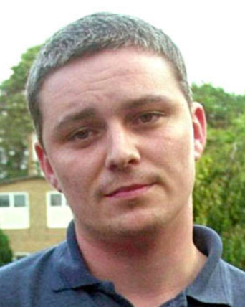
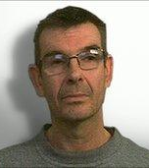
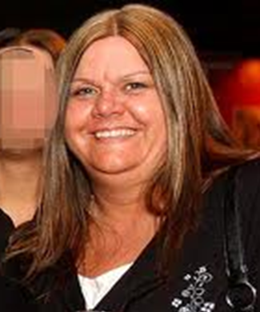
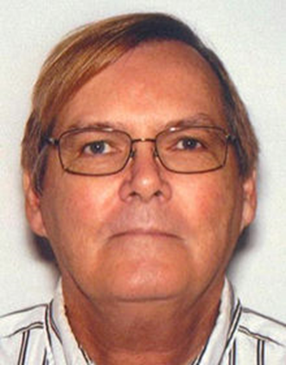
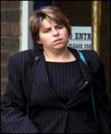
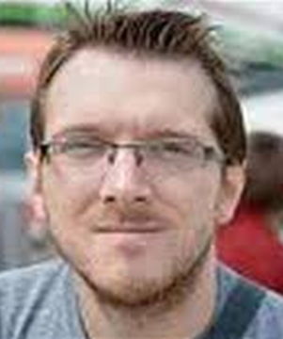
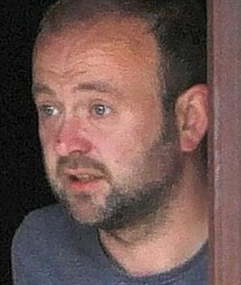
A culture of vigilance - learning lessons
Safer recruitment procedures not in place
Lack of safe working practice guidance - staff unclear on boundaries
Standard operating procedures not being followed
Poor management oversight / issues identified in inspection not actioned
Voice of parents / pupils not heard
Voice of staff / whistleblowing – raising concerns / exit interviews
Human / professional / personal relationships
Lack of effective supervision
Ineffective governance and challenge
Case reviews tend to raise the same issues over & over again
From left – Ian Huntley, Nigel Leat, Vanessa George, William Vahey, Tracey Wright, Jeremy Forrest, Geoffrey Bettley
Notes:
Case reviews tend to raise the same issues over & over again
From left – Ian Huntley, Nigel Leat, Vanessa George, William Vahey, Tracey Wright, Jeremy Forrest, Geoffrey Bettley

Slide 19
Other behaviours often displayed include:
Poor boundary keeping
Breaching policy or procedures ‘in the best interests of the child’
Lack of awareness of their behaviour on others
Charismatic
Dutiful, over-helpful and committed
Notes:
These have been themes of recent high-profile cases

Slide 20
Applying the Finkelhor model to recruitment
Deter Application stage
Reject Interview stage
Prevent Appointment and induction
Prevent & Detect Developing and maintaining a
culture of vigilance

Slide 21
“For those agencies whose job it is to protect children and vulnerable people, the harsh reality is that if a sufficiently devious person is determined to seek out opportunities to work their evil, no one can guarantee that they will be stopped. Our task is to make it as difficult as possible for them to succeed...”
Bichard Inquiry Report, 2004, p 12 para 79

Slide 22
Safer recruitment assessment

Slide 23
Safer Recruitment Assessment
You will now be shown 13 questions which should be answered as directed
Ample time will be given to answer each question.
After the assessment you will be awarded a certificate which will indicate the score achieved
You will then need to identify targets for future professional practice and review. This should be presented as a completed Safer Culture questionnaire and action plan for your organisation

Slide 24
Question 1: Session 1
Which three of the following are accurate statements about child sex abusers?
A Most mask their sexual preferences with apparently fulfilling sexual relationships with adults
B Most will aim to create an environment in which they can exploit vulnerable children
C The majority of teachers who sexually abuse pupils enter the profession with the intention of abusing children
D They have convinced themselves that abusing children is acceptable
E Many strive to be seen as respectable adults with children’s welfare at heart

Slide 25
Question 2: Session 1
Describe a typical sequence of child grooming activities by
placing the listed activities in the order you think is correct:
A Develop a relationship with a susceptible child
B Access an environment where there are opportunities for contact with children
C Test the boundaries of each child to identify those who show the least rejection of physical contact
D Form relationships with several children

Slide 26
Session 2: a safer recruitment process
Features of a safer recruitment process for : -
  employees, contractors, agencies & volunteers
Sending the right message
The application form
The selection criteria
References
Review and next steps

Slide 27
Exercise 3: what does a safer recruitment process look like?
Each group has a set of cards showing the activities that make up the recruitment and selection process
In groups take 10 minutes to put the cards in the order of the sequence of activities from identifying a vacancy to making an appointment
Group together any activities that could be done at the same time. Also identify 2 activities that are “red herrings”

Slide 28
Defining the role
Produce a job description and person specification or volunteer role profile
Include skills, abilities, experience, behaviours and attitude/motivation and values towards children and young people
Boundaries of role and expectations
Responsibility for children in the role and opportunity for contact with children – is it Regulated Activity?

Slide 29
Advertising: Sending the right message
Three deterrents
State the organisation’s commitment to safeguarding and / or the need for DBS certificate / Barred list check in adverts
Include statements about the safeguarding responsibilities of the post in the job description and person specification
Send information about the organisation’s safeguarding policy and practices to candidates

Slide 30
Key information on application forms
Personal details
Present employment and reason for leaving
Full history since leaving school (education and employment or voluntary work)
Qualifications
Referees
Personal statement to meet person specification
Signed declaration about any relevant criminal record
Signed declaration that all information is true
Notes:
Issues around DOB? Some posts have a minimum age (EYFS / residential) and so age would be part of the application form.
Can’t check identity without seeing DOB. Some include it in Eq Ops monitoring sheet instead. Perhaps not on application form but must be checked as part of identity verification at interview??

Slide 31
Criminal background: Self-disclosures
Purpose
To give candidates an opportunity to share relevant information at an early stage
To allow information to be discussed and considered before the DBS check comes back
To deter unsuitable people
Process
It is discriminatory to use disclosed information for shortlisting
Only consider the information of shortlisted candidates
Should not rule someone out – apply fair assessment criteria
Continue with DBS check and compare information

Slide 32
Agreeing selection criteria and process
Base criteria for shortlisting and assessment process on person specification and job description
Consistent for all candidates
Specific to work with children
Review criteria regularly

Slide 33
Scrutinising applications and short listing
Take time to properly scrutinise
At least two people shortlisting
Identify any inconsistencies
Application form fully completed
Evidence provided relating to person specification and job description
Scrutinise for gaps
Apply shortlisting criteria equally

Slide 34
Exercise 4 – short listing
In your groups
Use the example person specification, job description and completed application form
Choose 1 of the criteria in the person spec that is relevant to safeguarding children
Use the information on the application form to score the candidate against the chosen criterion
Also scrutinise the application form and consider whether there are any gaps or inadequacies in the information provided or the way the form has been completed
Would you shortlist the candidate?

Slide 35
References
Important part of process of gathering information:
Must have a reference from current employer
If not working with children, at least one reference from previous employers where the role involved working with children
Ask whether aware of any behaviour that might give rise to concern, including any disciplinary action
Ask specifically about allegations about their behaviour towards children
Specific confirmation of the details and responsibilities of previous post given by applicant
Consideration of any request by an applicant to delay seeking references from their current employer
Reminder KCSiE 2020 paras 134 - 137 – schools are no longer required to seek references prior to interview but KCSiE sets out the benefits of doing so. SR Consortium is clear that seeking references prior to interview remains an essential element wherever possible.
Notes:
Remind participants of KCSiE 2018 paras 134 - 137 – schools are no longer required to seek references prior to interview but KCSiE sets out the benefits of doing so. SR Consortium is clear that seeking references prior to interview remains an essential element wherever possible.

Slide 36
Open references and testimonials
Candidates may sometimes bring ‘open’ references or letters of recommendation to interview. These:
May be the product of a settlement agreement to avoid disciplinary action
Should never be accepted at face value
Always take up your own references and/or contact the author of the open reference to verify the content
Notes:
Settlement agreements used to be known as compromise agreements

Slide 37
Scrutinising references
Importance of reading references – active consideration
Equally, importance of comparing information provided by referee with information provided by applicant
If any inconsistencies, or doubts about suitability, follow up and explore with referee
Employer should verify that electronic references are from a legitimate source
In residential settings, references should always be confirmed by telephone
Notes:
New for 2018 – “employers should ensure electronic references are from a legitimate source”

Slide 38
Safer recruitment assessment

Slide 39
Question 3: Session 2
What is the main reason for including the phrase ‘required to provide a DBS certificate at the appropriate level’ and / or a statement about the employer’s commitment to safeguarding children in a job advert?
A To obtain specific information on the individual and any prior convictions / cautions or bind-overs
B To satisfy a legal requirement
C To encourage suitable applicants to apply for the post
D To deter unsuitable applicants from applying for the post

Slide 40
Question 4: Session 2
From a safeguarding perspective, what is the most important reason for only accepting fully completed standard application forms from applicants?
A To reveal any gaps in an applicant’s history
B To judge applicants against the same criteria
C To ensure consistency of information
D To meet equal opportunities requirements

Slide 41
Question 5: Session 2
An applicant supplies an open reference with her application form. Which three of the following statements about an open reference are true?
A It is as useful as a normal reference
B It might be the product of a settlement agreement
C It suggests the applicant might not want you to contact a previous employer
D It will save you time and effort in writing for a reference
E It should never be considered as part of the recruitment process.

Slide 42
Session 3: making the right decisions
Importance of making the right decision
The interview and the selection process
Pre-appointment checks
Using criminal disclosure information
Review and next steps

Slide 43
Safer selection
Good practice
Range of selection tools – not just an interview
Explore motives/attitudes as well as skills and experience
Assessors should be well briefed or trained
Assess interaction with others – role plays, group exercises
Appropriate involvement of children

Slide 44
Selecting the right people
Interviews
At least two people
Structured questions and criteria previously agreed
Probe gaps, frequent changes in employment, vagueness
or areas of concern
Ask about attitudes towards children and child protection and where appropriate motives for working with children
Avoid hypothetical questions and seek positive examples or evidence
Give and receive information
Clearly document your decisions
Beware of prejudices and discrimination

Slide 45
Making decisions using selection criteria and indicators
Based on the Person Specification
Indicators – what would you expect a good candidate to say?
Guide not a tick box
Bespoke to the position
Use to make decisions and clarify why someone is suitable or unsuitable for appointment
Review regularly

Slide 46
Areas of potential concern
No understanding or appreciation of children’s needs
Wanting role to meet own needs at the expense of children’s
Inappropriate language when talking about children
Expression of views that are extreme or do not support safeguarding
Unclear boundaries with children
Vagueness about experiences and gaps or unable to provide any examples to support what they tell you
Maverick – non rule-following, unwilling to work with others

Slide 47
Exercise 5 – Interview questions
Identify one criterion from the person specification relevant to safeguarding children
Devise an interview question that would test out a candidate’s attitudes, motives and suitability for this role
Discuss what you would expect to hear from a candidate in response to the question you have devised and write down some positive and negative indicators
There is an example of an interview assessment form on p34 of the delegate workbook

Slide 48
Pre-appointment checks
A conditional offer of employment can be made pending the following:
Identity - including DOB
Eligibility to work in the UK
DBS Barred List (replaced List 99 & PoCA list in 2009)
Enhanced DBS check
That those in ‘teaching work’ are not subject to a prohibition order or interim prohibition order
S128 Prohibition from management (independent / free schools / academies and governors of maintained schools)
Qualifications
Status: QTS, HCPC, disqualified from EY / later years childcare, etc
Overseas checks (may include EEA list / overseas criminal certificates / overseas references)
Notes:
Overseas checks – mention new directive from Home Office – people applying for visas – 12 months overseas in last 10 years
S128 – makes clear that someone prohibited from management of an independent school is also prohibited from serving as a governor of a maintained school

Slide 49
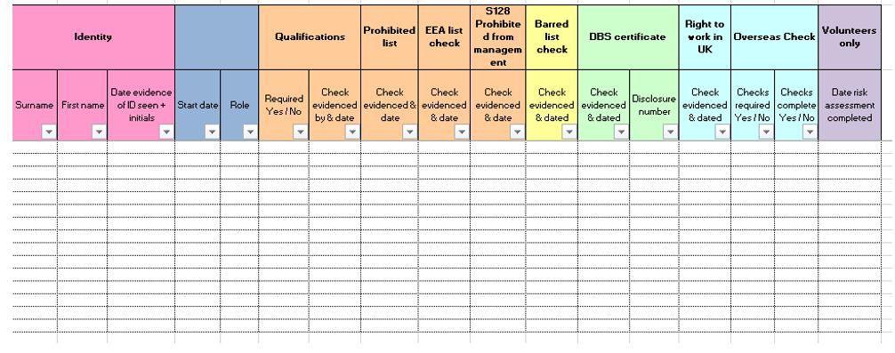
Register of checks
NB s128 column should be completed for all management posts in Independent schools, academies and free schools, plus members of the governing body in maintained schools
Identity |  |  |  |  |  | Qualifications |  | Prohibition register | Barred list check | DBS certificate |  | Right to work in UK | Overseas Checks
Name | Address | DOB | Check evidenced & dated | Start date | Role | Required Yes / No | Check evidenced & dated | Check evidenced & date | Check evidenced & dated | Check evidenced & dated | Disclosure number | Check evidenced & dated | Police check required Yes / No | EEA Checks teacher complete check? Yes / No

Slide 50
Regulated activity & DBS checks
Individuals employed to work regularly in a school are in regulated activity (RA) with children
It is a legal requirement to check people working in RA are not barred from that work before they commence in post
People not in RA can still be asked to undertake a DBS disclosure (without Barred list check)
It is unlawful to check the Barred list if the person is not in RA
Employer must see the original certificate and should only retain a copy in certain circumstances
KCSE says that new regular volunteers should have an enhanced DBS certificate even if they are not in RA and will not be checked against the barred list
Notes:
KCSE says that new regular volunteers should have an enhanced DBS certificate even if they are not in RA and will not be checked against the barred list

Slide 51
DBS Barred list - children
At present people are barred by law from working in RA with children if they are:
    on the DBS children’s barred list
    banned by a court on conviction of a specified offence
A DBS certificate obtained in regard to work with children will usually* show whether the person is barred from RA with children.
* But not in the case of supervised volunteers
People barred from working in RA with adults are not automatically barred from working with children or vice versa
Notes:
Refer participants to kCSiE part 3 flowchart

Slide 52
Exercise 6
Relevance of criminal offences
Look at the list of offences
Discuss whether you think these offences should deem someone unsuitable for working with vulnerable groups, have no relevance or would be a grey area?
Notes:
If any of these appeared on a DBS certificate, would they have any impact on your decision to appoint?

Slide 53
Relevance of criminal records
When assessing an applicant’s criminal history, consider the offence in terms of
Nature, seriousness and relevance
How long ago it occurred
Whether it was a one-off or part of a history
Circumstances of it being committed
Changes in applicant’s personal circumstances
Country of conviction
Decriminalisation
It is unlawful to take offences that are ‘protected’ into account
Notes:
Refer participants to the Unlock flowchart referenced in their delegate workbook & hyperlinked on the example application form. Protected (or filtered) offences – we should not be using the phrase ‘spent’ – some minor offences are now filtered and will not appear on an enhanced DBS certificate if:
The offence was more than 11 years ago
The penalty was light (less than 6 months imprisonment etc)
There has been no more than 1 conviction
If under 18 at time of offence, there are differences (5.5 years etc)

Slide 54
Safer recruitment assessment

Slide 55
Question 6: Session 3
Which one of the following statements describe a best practice approach to interviewing?
A Before conducting the interviews, the panel should agree a completely identical set of questions for all candidates and should not deviate from them
B The interview panel should consistently pose hypothetical questions in order to uncover an applicant's attitudes about unsuitable behaviour
C The interview panel should agree questions for all applicants relating to the requirements of the role and person specification including questions for each one relating to the information provided on his/her application form and in references.

Slide 56
Question 7: Session 3
In an interview, you ask the candidate if he can think of a recent
situation in which he took action to help protect a child. In response, he
describes a situation in which one of the girls in his tutor group had been
threatened by an ex-boyfriend.
He explains that he gave the girl a lift home a few times because she
was worried about the boy. Considering his response, which one of the following statements about the candidate do you think is most accurate?
A His behaviour demonstrated a good understanding of safeguarding
B His behaviour supported a safe culture in the organisation
C His behaviour was justified in the context
D His behaviour was inappropriate

Slide 57
Question 8: Session 3
A local resident volunteers to come into school every Friday morning to listen to pupils reading. She will be working in the classroom and will be supervised by staff.
In order to minimise the risk to children, which one of the following is the correct level of checks for this situation?
A Barred list check only
B Enhanced DBS certificate with barred list check
C No checks
D Enhanced DBS certificate without barred list check
Notes:
New regular volunteers that are supervised should undertake an enhanced DBS certificate even though they are not in regulated activity and will not be checked against the barred list so D is the correct answer

Slide 58
Question 9: Session 3
In an interview for a teaching post, you ask the candidate about how he approaches discipline in class. He says: “I never have any discipline problems. The pupils know exactly where they stand with me.”
Considering his response, what question should you ask next?
A That's great. We need people who are effective classroom managers.
B Please describe a recent situation where you had to deal with disruptive behaviour and explain what action you took?
C What do you think you would do if a pupil used offensive language in your class?
D Have you ever had an allegation of physical violence brought against you by a pupil?

Slide 59
Session 4: an ongoing culture of vigilance
Features of a safer culture
Audio presentation
Creating an open culture
Individual responsibilities for expressing concern
Dealing with allegations of professional abuse
Next steps and other resources

Slide 60
Southbank International School
“A feature of the evidence is that ... staff … consistently assumed that the fact Vahey (and other teachers) had been subject to a vetting process on recruitment in some way certified him as a person that did not – could not – represent a threat to children.”
Hugh Davies QC, 2014

Slide 61
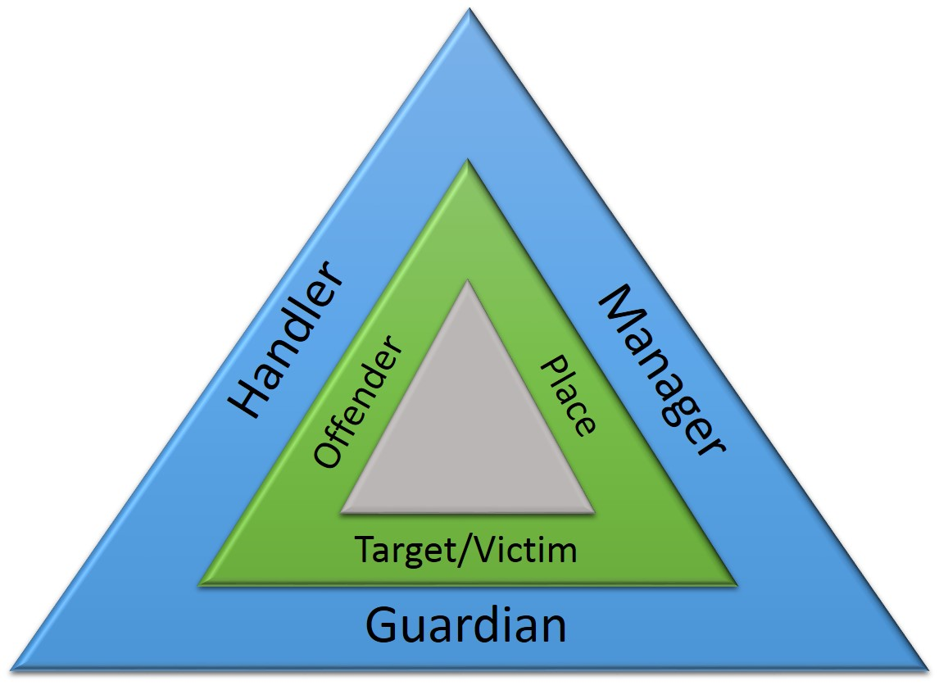
The crime triangle –Prevent
Control - Equipped to help
Person or environment
Crime

Slide 62
Offenders can sometimes be controlled by other people: those people are known as handlers.
Targets and victims can sometimes be protected by other people as well: those people are known as guardians.
Places are usually controlled by someone: those people are known as managers.
Understanding the weaknesses in the problem analysis triangle in the context of a particular problem will point the way to new intervention

Slide 63

Alternative exercise 7 – crime triangle
Please consider and discuss in groups:
What do we already do in schools to create
  capable guardians
  competent handlers
  effective managers?
What else could we put in place?

Slide 64
Exercise 7 – creating an open culture
Empowering and encouraging members of staff and volunteers to report concerns or allegations about the behaviour of others is essential if we are going to tackle inappropriate or abusive behaviour. Please consider and discuss:
What might stop me reporting concerns?
What would help me overcome those problems?

Slide 65
Features of a safer culture
Open, no secrets
Belief that ‘it could happen here’
Clear staff behaviour / safe working practice guidelines
Clear procedures for reporting concerns / whistleblowing
Support in raising concerns & commitment to take action
Commitment to safeguarding & an ongoing culture of vigilance
Policies and procedures put into practice
Good use of induction and probationary periods

Slide 66
Disclosing potential issues
‘Disqualification under the Childcare Act 2006’ (DfE August 2018) says all schools should have:
A clear expectation that staff will discuss with managers any relationship / association (in or out of school or online) that may have implications for the safeguarding of children in school
These discussions can help schools
safeguard their employees’ welfare and contribute to their duty of care towards their staff
identify whether arrangements are needed to support these staff
manage children’s safety, providing them with information that will help them consider whether there are measures that need to be put in place to safeguard children (e.g. by putting arrangements in place to stop or restrict a person coming into school where a potential risk to children has been identified)

Slide 67
Dealing with allegations against staff and volunteers in schools
Keeping children safe in education (DfE 2018) outlines the
framework that should be followed in all cases in which it is alleged that a teacher, other member of staff, or volunteer in an establishment providing education for children under 18 has:
Behaved in a way that has harmed a child or may have harmed a child
Possibly committed a criminal offence against or related to a child
Behaved towards a child or children in a way that indicates he or she may pose a risk of harm to children

Slide 68
Breach of Trust
A breach of trust occurs when the boundaries of the relationship between a professional and a child or young person is broken due to inappropriate behaviour by the professional, which involves an abuse of power.
The behaviour itself does not necessarily have to be illegal to breach this trust – even if the child is over the age of consent e.g:
  A youth leader (19 years old) at a youth club starts a relationship with a 16 year old youth club member
  A teacher becomes sexually involved with a 6th form pupil

Slide 69
Structure for managing allegations
Working Together to Safeguard Children (DfE 2018)‏
Head teacher / Head of service / registered manager
Local authority designated officer (LADO)
Named senior officers for all partner organisations
LSCB / Multi-agency partnership

Slide 70
Safe working practice
Child Protection
Induction
& training
A ‘listening’ culture
Supervision
Governance
ONGOING CULTURE OF
VIGILANCE
PSHE/ Curriculum
Whistle blowing
E-safety
Allegations management procedures
Safe recruitment & selection
The school environment

Slide 71
Remaining vigilant
Never think you have done enough in terms of creating a safer culture
Always believe it could happen here
Keep safeguarding high on everyone’s agenda
Never rely on any one process to keep children safe

Slide 72
Next steps
Action planning for your organisation:
  Please take time to complete the questionnaire on pages 53 – 54 of your workbook and begin to develop an action plan
  Handout workbook – do this in your own environments

Slide 73
Safer recruitment assessment

Slide 74
Question 10: Session 4
An NQT joins a Secondary school and undergoes induction training. Later that year she sees her Head of Department leaving an empty classroom with his arm around a female pupil’s shoulder. The Head of Department removes his arm quickly when he realises that someone else is present.
The NQT is worried about the incident but despite her suspicions, does not report it. Which 1 of the following is the most likely reason for this?
A The incident is not serious enough to report
B The school lacks induction training
C The NQT needs more experience to make the right decision
D The school has failed to put in place effective procedures for whistleblowing and dealing with allegations.

Slide 75
Question 11: Session 4
A school needs a new classroom assistant. Mr. Sinclair, the grandfather of one of the pupils, is the obvious candidate. He has done good work for the school organising events for the PTA and has asked to be considered if a classroom assistant job came up.
If Mr. Sinclair is appointed, which 1 of the following actions is not appropriate?
A Provide general training in child protection
B Wait until he has been in post for 6 months before reviewing his performance, to allow him time to settle into his role
C Provide induction training and copies of relevant policies and procedures
D Arrange for Mr. Sinclair to be ”mentored” by a more experienced member of staff

Slide 76
Question 12: Session 4
Allegations have been brought against a member of staff, Peter Wright, about his relationship with an 18 year old pupil. You discuss the allegations separately with Mr. Wright and the pupil.
Mr. Wright says: ‘We became close after the pupil asked my advice on some personal matters following their 18th birthday. Our relationship has developed since then, but we’re not doing anyone any harm and we’re very much in love.’
The pupil says: ‘I’ve consented to everything we’ve done and Pete’s been a perfect star at a very difficult time in my life’.
On the basis of their responses, which one of the following statements most accurately describes Mr Wright’s behaviour?
A it is abusive
B it is inappropriate but forgivable
C it is inappropriate, a breach of trust, and possibly abusive
D it is naïve

Slide 77
Question 13: Session 4
Which 2 of the following topics are a statutory requirement of induction training for new staff in schools and FE colleges?
A First aid training
B Staff code of conduct
C Child protection arrangements
D Physical intervention / restraint
E E-safety

Slide 78




The Safer Recruitment Consortium
© 2018

