Slide 1




Alasdair Whitelaw
SEMH Coordinator

Slide 2
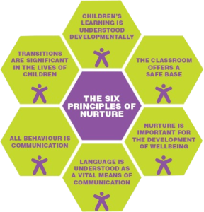
Who Is NurtureUK?
NurtureUk is a national charity working to improve the life chances of children and young people through a nurturing approach.
They work to support children and young people’s wellbeing in education and prevent exclusions.
Everything they do is guided by the six principles of nurture.

Slide 3
Flagship’ intervention is nurture groups, they campaign for the nurturing approach through a tiered application, working from the bottom upwards.
The nurture pyramid approach is designed to ensure every single child’s wellbeing is measured, supported and they are given the tools to succeed.
The whole-school approach is their holistic programme, ensuring every child has the support they need, and includes the Boxall Profile as the starting point.

Slide 4
What is the Boxall Profile?
The Boxall Profile is a unique psycho-social assessment tool designed to support all children and young people, by identifying social, emotional and mental health needs. It is owned and operated by nurtureuk.
It was developed in the 70’s by Educational Psychologist Marjorie Boxall, together with classroom teachers. They designed the tool in schools through pupil observations to create a resource that could help children and teachers everywhere. It is regularly re-standardised to reflect the ‘norms’ of children today.

Slide 5
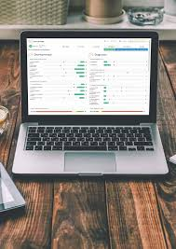
Reminder for Admin
In order for rich and effective data across the borough please add alasdair.whitelaw@achievingforchildren.org.uk as Super-User when allocating to your staff.
How does it work?
The assessment consists of two profiles, with 34 questions in each profile.
The Developmental Profile, assessing the social, emotional needs of children and young people. This measures progress through the different aspects of development in the child's early years.
The first assessing the child and young person's organisation of their learning experiences.
The second, their internalisation of controls.
The Diagnostic Profile, assessing the behaviours that limit learning experiences. This consists of items describing behaviours that inhibit or interfere with the child's satisfactory involvement in school These include self-limiting features, undeveloped behaviour and unsupported development. They are directly or indirectly the outcome of impaired learning in the earliest years.
The earlier such children are identified the greater the hope of being able to address and remediate their social, emotional and behavioural difficulties through Quality First Teaching.

Slide 6
How do you use it?
• The assessment should be completed a minimum of twice in a school year, ideally three times. It should be completed by the person who knows the child best.
• The website takes you through the assessment asking simple questions about the child. Once comfortable with the platform, an assessment can be completed as quickly as 10 minutes per child on average.
• Once you register a child on the website, they are assigned a randomly generated code, known as an EBP (E Boxall Profile). This helps to keep data as non identifiable as possible, with schools keeping records of which code corresponds to which child in their own database. However, if you like, you can add the child’s name to make it easier for your own purposes. The data is secured and safe.
• you can have as many staff members as you like registered to your organisation, and you can complete as many assessments as you like for up to 300 pupils for the year.
*Remember to add Al Whitelaw as Super-User

Slide 7
What are the questions?
See two example questions, one from each profile.
(Sample data not from a real child)
The staff member that knows the child best will score them according to their understanding of the child’s presentation.

Slide 8
I’ve done an assessment, now what?
Now you have completed an assessment, you create a learning plan.
The learning plan is the ‘so what’ element.
Now you have identified their needs, the OBP provides strategies to support progress.
You must always start with the questions to address the developmental need in order to see progress in the diagnostic profile.
It is recommended to focus on no more than two/three questions or ‘strands’ for improvement at a time.
Red strands highlight ‘significant need’
Amber means ‘has some need’
Green means ‘no apparent needs’
Let’s Click on this question…

Slide 9
Learning plans
It will now suggest strategies you can adopt to support that question. You can click on strategies to use and also add your own..

Slide 10
Learning plans
It will also suggest resources you can use to support progress, but you can also add your own.

Slide 11
Learning plans
Select or set criteria to measure progress…

Slide 12
Learning plans
And now you have a tangible action plan to support that child’s ability to pay purposeful attention

Slide 13
The value of data
When used on a group of children or young people, or on a whole-class level, you can identify trends within a group, using the group overviews tool.
And now you can adapt your teaching style to support learning in the way the children learn best, and weave in strategies that support development as well as teaching the curriculum.

Slide 14

How some schools approach Boxall…

