Slide 1
SEMH Network Meeting
Virtual
19th January 2022
3.30pm – 5.00pm
Alasdair Whitelaw
SEMH Coordinator
AfC

Slide 2

3.30 Welcome and outline of SEMH Network Meeting
3.35 Online Boxall Profile update and overview
3.40 Ellie Noon (Homer First) Whole school approach to Boxall
4.00 Working Break.
Breakout rooms BPO application.
BPO application strategy Individual Setting.
4.15 Family Hub update – Danny Gomm
4.30 Rebecca Askew Children and Young People with Eating disorders
4.50 SEMH Updates and Feedback.
5.00 Close.
Agenda

Slide 3
Online Boxall Profile NurtureUK
65 licences (300 pupil)
SEMH Leads - Administrator
Super-User - Data
Other SEMH initative updates
hello@boxallprofile.org

Slide 4
Boxall update from Homer First School
Ellie Noon, Deputy SENCO

Slide 5
SEMH support that we offer
Nurture group has been running for over 3 years
2 Nurture trained members of staff, 1 awaiting training
Trained ELSA’s and Drawing and Talking support staff, 1 family link support worker

Slide 6
Why do we use the Boxall?
To help identify SEMH needs within the classroom
To identify pupils that may benefit from our Nurture group
To track and monitor SEMH needs of children receiving support from external professionals
CPD for class teachers – whole school nurture approach

Slide 7
How do we use the online boxall profile within our nurture group?
Children are highlighted as requiring nurture support using the diagnostic scales
When a child is selected by their class teacher (based on their Boxall result) a baseline Boxall will be completed. We will review their Boxall 3 times a year to measure progress
Areas of need will be identified within the main part of the Boxall. Alongside the Boxall we use staff and parent questionnaires to determine a child's main area of need. Nurture staff will then identify appropriate targets and plan appropriate activities to further support this
To help children apply this to their classroom environment, targets are written on clouds that the children take backwards and forwards from nurture to their classrooms. Class teachers can record on their bubble when they see a child achieving their target in class. When a child receives 3 marks on their cloud, nurture staff will set them a new target

Slide 8
Whole school nurture approach – what is it and how have we used it?
As a school we were invited to take part in a whole school nurture project run by Lisa Chung
Applying nurture as a whole school approach - A framework to support self-evaluation | Self-evaluation | National Improvement Hub (education.gov.scot)
Teachers were asked to select 4 targets from the above to work on over the year.
Class teachers were asked to complete Boxalls on 4 children (1 SEND, 1PP, 1 MA, 1 HA) as a baseline for the above project
We then reviewed these at the end of the academic year
This data however was not accurate due to COVID and the interruptions to their school life
We are rolling this out again this year, baselines have been completed
More accurate data will be accumulated for this academic year

Slide 9

Questions…

Slide 10
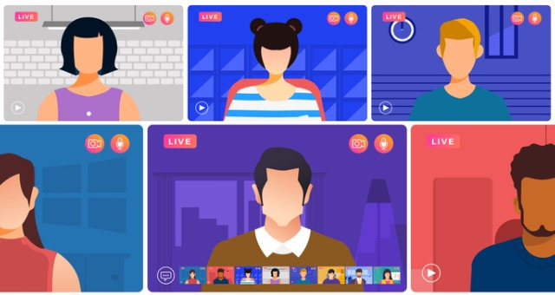
Break – Breakout rooms
Discussion of BPO application.
Boxall Profile application strategy Individual Setting.

Slide 11

Welcome Back
Family Hub Service – Danny Gomm

Slide 12



Slide 13
Introduction
The Family Hub Service was launched on 1st May 2021 to replace Children's Centres, Youth Service, Family Resilience and Parenting
The FH sits within Early Help but will support children, young people and families on statutory plans inc Children in Care
A majority of staff are divided into 2 main hubs (Windsor and Maidenhead) - Each team has a Lead (Manager), a Snr FH Worker, a Lead Youth Worker, Family Coaches and Family Hub Workers
The work is focussed on supporting targeted families across the age range of 0-19 years (or age 25 years where young people have learning difficulties and/or disabilities).

Slide 14
Priorities
Children not meeting their health and development milestones
C&YP at risk of or already experiencing poor mental health.
C&YP who are living with parents with poor mental health.
C&YP whose parents require extra support in their parenting i.e. teenage parents, parents with physical disabilities or learning needs.
C&YP who misuse substances or are affected by parental substance misuse.
C&YP at risk of exploitation and online dangers.
C&YP who go missing
Children who don't attend school or have poor school attendance thus risking achieving their educational potential.
C&YP who are exposed to violence, either at home or in their communities, including those young people at risk of becoming involved in gangs, serious youth violence or engaging in extremism

Slide 15
1-1 support for families
Substance Misuse
Support for children and young people who are impacted by parental substance or alcohol misuse - 7Cs
Children Criminal Exploitation
Child Sexual Exploitation
Digital Life
Knife carrying/Youth Violence
Low mental health
Harmful Sexual Behaviour
Employment, education and training support
Housing and benefits advice
Healthy Relationships
Family Relationships
Managing emotions
Parenting
Restorative Intervention
Parental Conflict
Reunification
Parents as first teachers
Baby Massage
Emotional first aid for parents
Domestic Abuse
As part of wider work can also help with:
Charity Funding Referrals.
Baby Bank referrals.
Wishes & Feelings
Foodshare referrals
Complete return Home Interviews

Slide 16
Group support for families
For Parents
Online live Q&A covering:
  Child Criminal Exploitation
  Child Sexual Exploitation
  Substance Misuse
  Digital World and Safety
  Parenting
  Early Years
Freedom Programme
Emotional First Aid (PaUSE)
Incredible Years
Triple P Parenting
Baby Massage
BAME Parenting groups
For Children/Young people
Esteem Project
Valu (for those at risk of exploitation)
School workshops covering:
  Child Criminal Exploitation
  Child Sexual Exploitation
  Substance Misuse
  Digital World and Safety
  Realities of Pornography
  Youth Violence
Other Groups
Youth Participation Groups (Girls Policy Forum, Youth Council, Kickback)
Young Health Champions
ALSO: FUEL- Holiday and activity programme

Slide 17
Family Hub key delivery roles
Family Coach
Work with the whole family due to entrenched, complex needs - interventions will be directly delivered to all family members within the home. At least 1 session week with family. Support should be completed within 9 months
Family Hub Worker
Work focussed on short term interventions that consider the whole family and may focus on an specific individual within the family e.g a child, yp or a parent. Weekly/fortnightly sessions. Support should be completed within: 6 months if multiple interventions across the family or 3 months if focussed on an individual child/young person
Lead Family Hub Youth Worker
Focus on direct work with young people 8-18 and consideration to the wider needs of family members and predominantly signposting in nature. Would generally support young people with more complex needs. Weekly/fortnightly sessions. Support should be completed within 3 months unless exploitation or HSB related intervention
Parenting Worker
Focus on direct work with parents/caregivers with consideration given to the wider needs of the family, predominantly signposting in nature. Interventions are evidenced based. Weekly sessions. Support should be completed within 3 months.
Substance Misuse Worker (inc Snr)
Focus on direct work with young people 8 -18 and consideration to the wider needs of family members and predominantly signposting in nature. Weekly/fortnightly sessions. No max length of support

Slide 18
Helen Smith
(Family Hub Lead)
Rob Hathorn
(Lead FH Youth Worker)
Diane Whittaker
Eunice Da Silva
(Snr Family Hub Worker)
Arifa Naeem
(Specialist Parenting Worker)
Heather Piper
Becky Hill
VACANT
(Family Coach)
Gemma Kelly
Louise Hildreth
Todorka Baker
Pinder Sagoo
Leticia Sant'Anna
Laura Penman
Mandy Perera
Sarina Akhtar
Amanda McGiffen
(Family Hub Worker)
Danny Gomm
(Family Hub Manager)
Debbie Oates
(Family Hub Lead)
Rosie Coombes
(Lead FH Youth Worker)
Chris Caughey
(Snr Family Hub Worker)
Sofina Hanif
Vinisha Patel
Tricia Phillips
(Family Coach)
Amanda Beldom
Sumera Sharif
Abby Read
Andrew Long
Franki Lynn-Ovidi
Mia Kielty-Bande
Margaret Moffatt
Gill Way
(Family Hub Worker)
Elaine Keating
(Youth Engagement Officer)
Theresa Allen
(Snr YP Substance Misuse Worker)
Dan Saunders
(Youth Centre Coordinator)
Jazmin Harvey- O'Donnell
(Schools Youth Worker)
Jess Montague
(YP Substance Misuse Worker)
Debbie McEwan
(Parenting Worker)
Satnam Bahra
Sue Leonard
(Business Support)
VACANT
(FUEL Co Ordinator)
Tayaba Hussain
(Youth Engagement Apprentice)
Ruby Jones
(FH Apprentice)
Maidenhead Area
Boroughwide
Windsor Area

Slide 19
Other referral routes
Strategy meetings or referrals from SPA/D&A Exploitation, substance misuse, online safety only
YOT (inc drug diversion)
Return home interview
Group referrals
For parenting groups, parents can self refer or a professional can refer on their behalf (basic form) Family Hub Group Referral Form
How to refer
Early Help referral pathway:
Requests for families from universal (ie schools) or early help or those stepping forward from a statutory intervention (ie closing to a Social Worker) should be submitted by completing this form Early Help Referral form (Part 1-Assessment) and sending to MASH@achievingforchildren.org.uk
Statutory referral pathway
1-1 requests for families where the social worker is the lead professional should be submitted by completing this form: Family Hub Referral Form and sending to familyhubs@achievingforchildren.org.uk

Slide 20
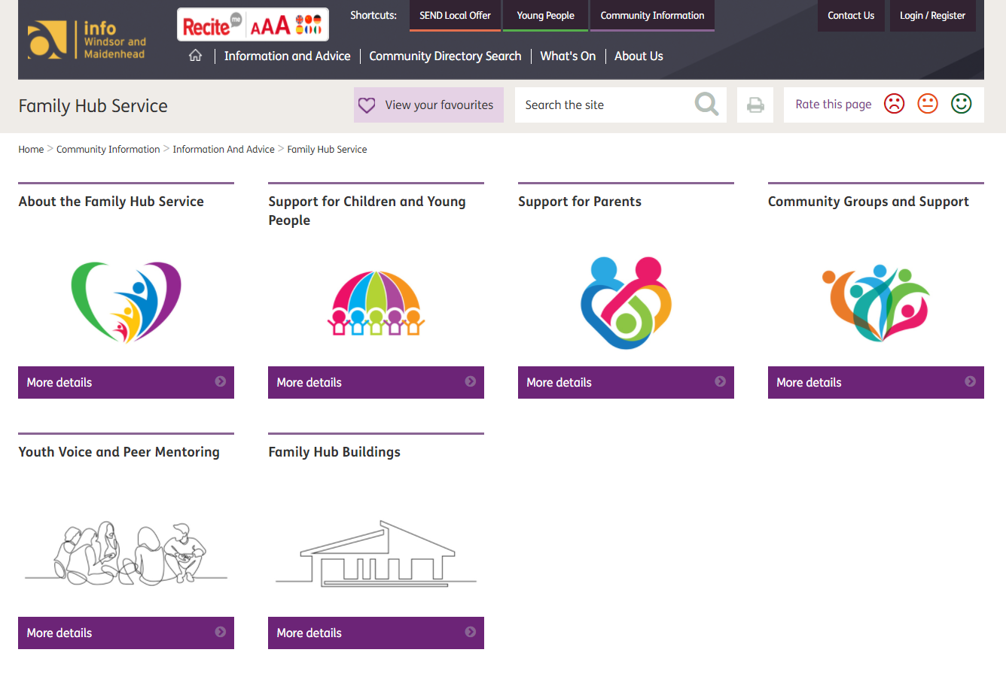
Website
https://rbwm.afcinfo.org.uk/pages/community-information/information-and-advice/family-hub-service

Slide 21
Questions…

Slide 22
Eating Disorders and Disordered Eating
Early Identification, Prevention and Support
Rebecca Askew
Senior Specialist Educational Psychologist – Wellbeing

Slide 23
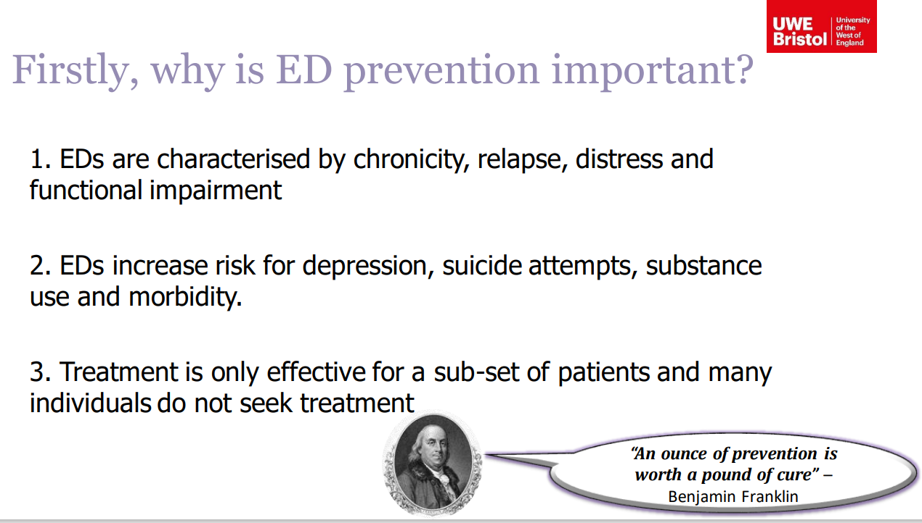
Notes:
Professor Phillippa Diedrichs – findings
Short overview

Slide 24
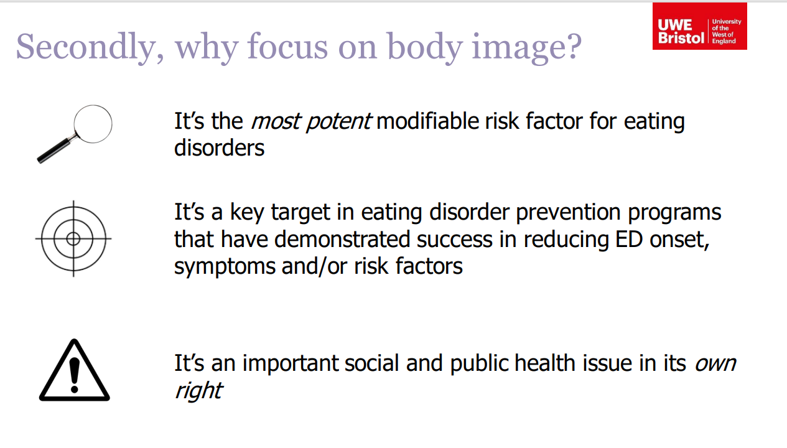
Notes:
The most effective programme target body dissatisfaction – prevention.

Slide 25
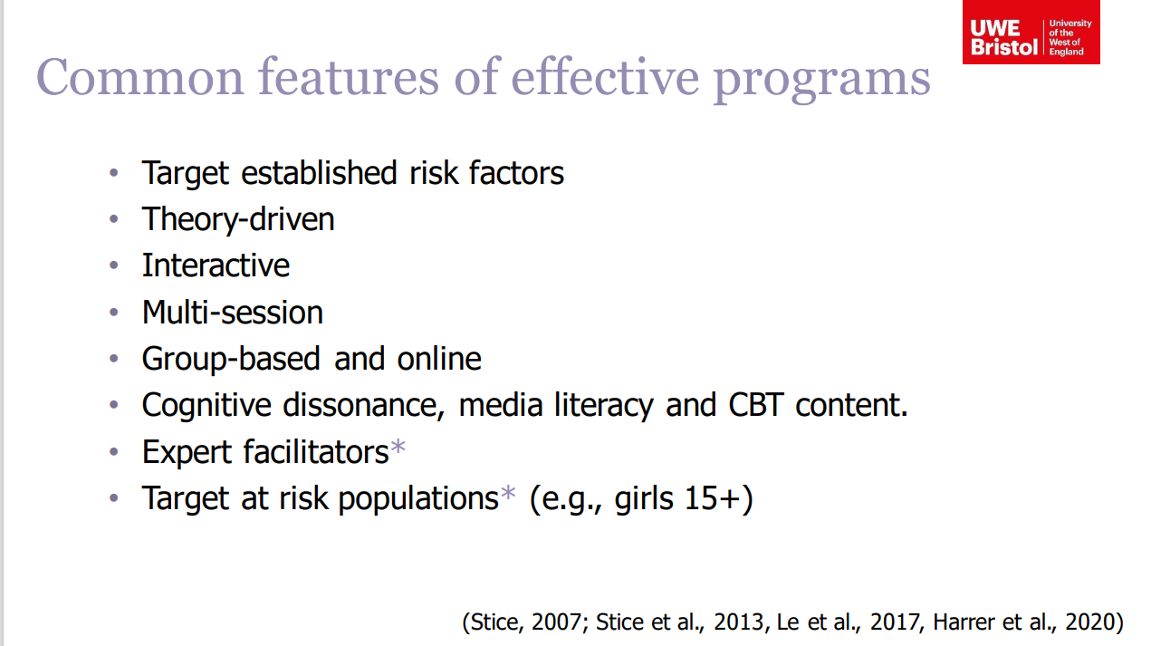

Slide 27
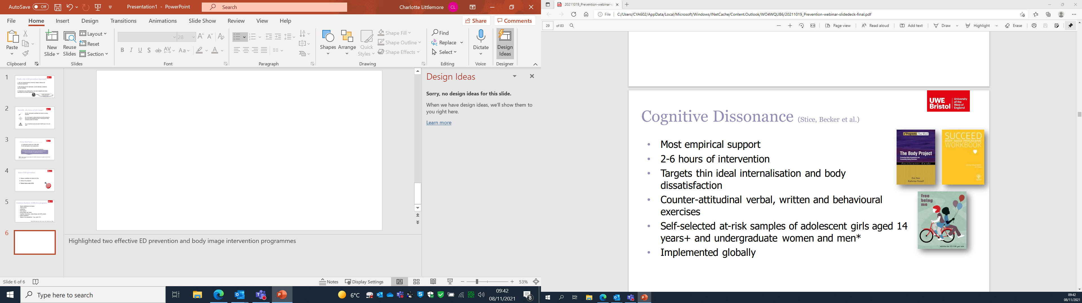
Notes:
Highlighted two effective ED prevention and body image intervention programmes
Targeted programme

Slide 28
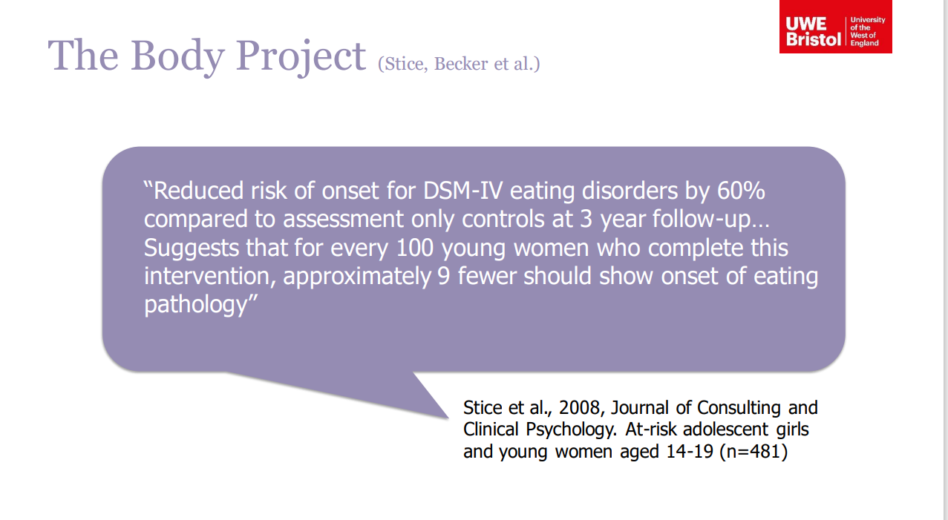

Slide 29
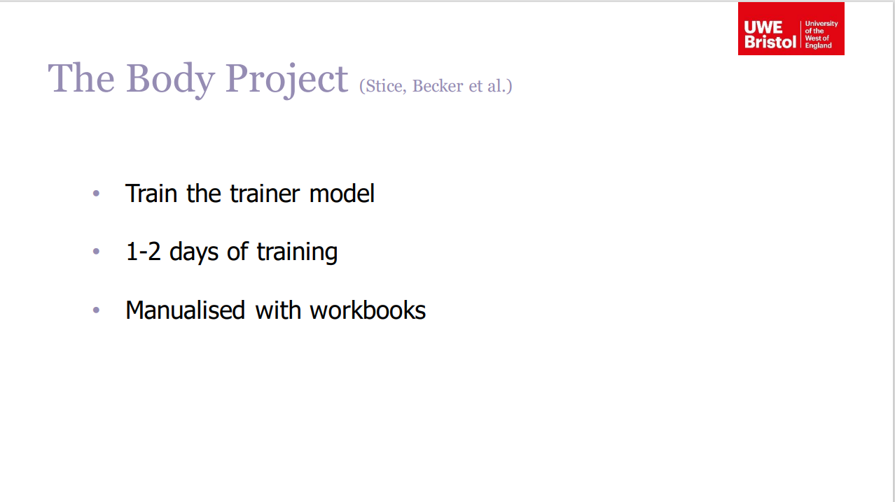

Slide 30
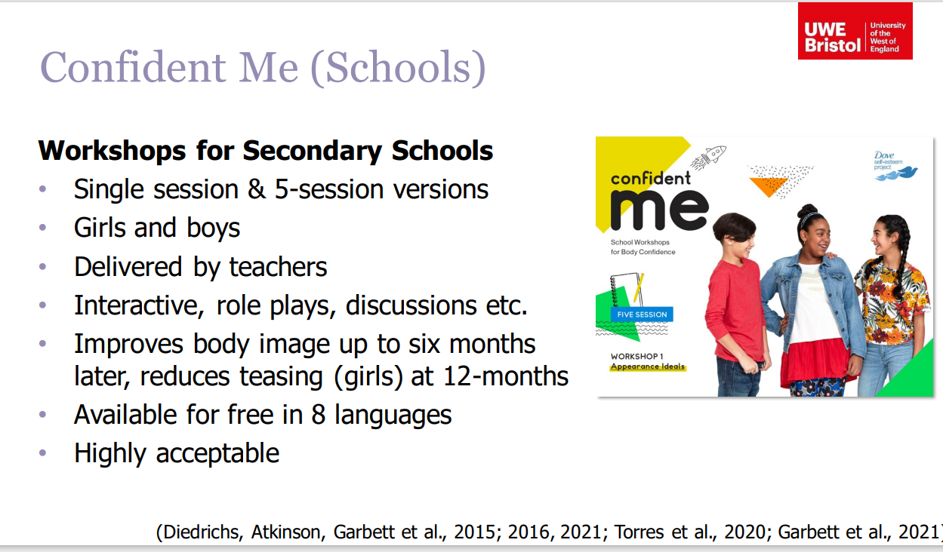
Notes:
Universal programme – FREE online and downloadable.

Slide 31
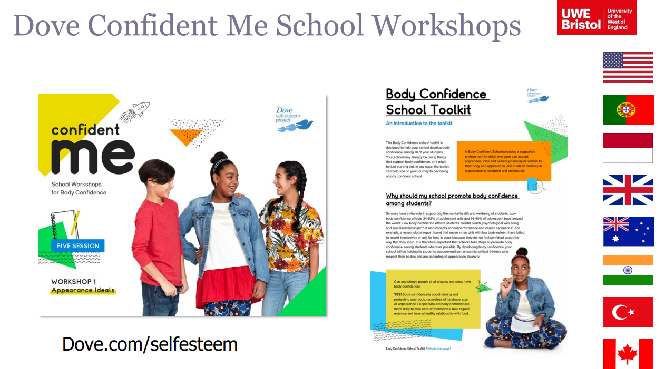

Slide 32
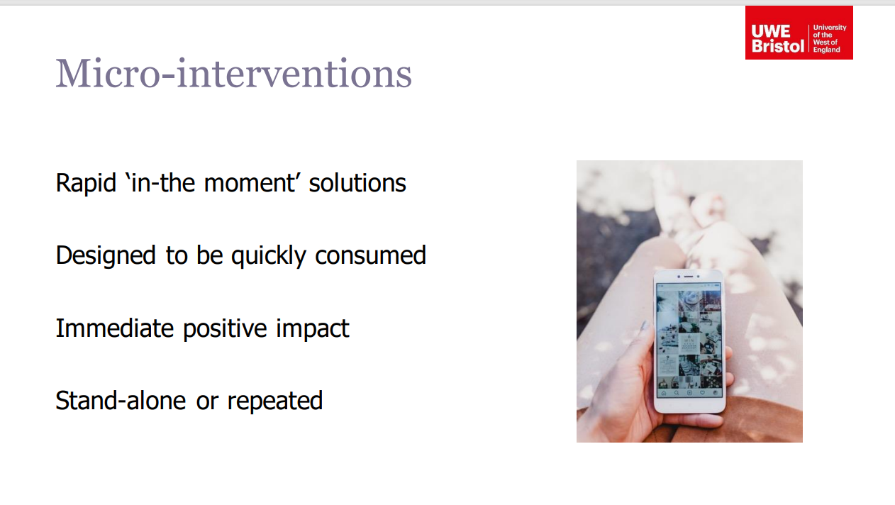

Slide 33
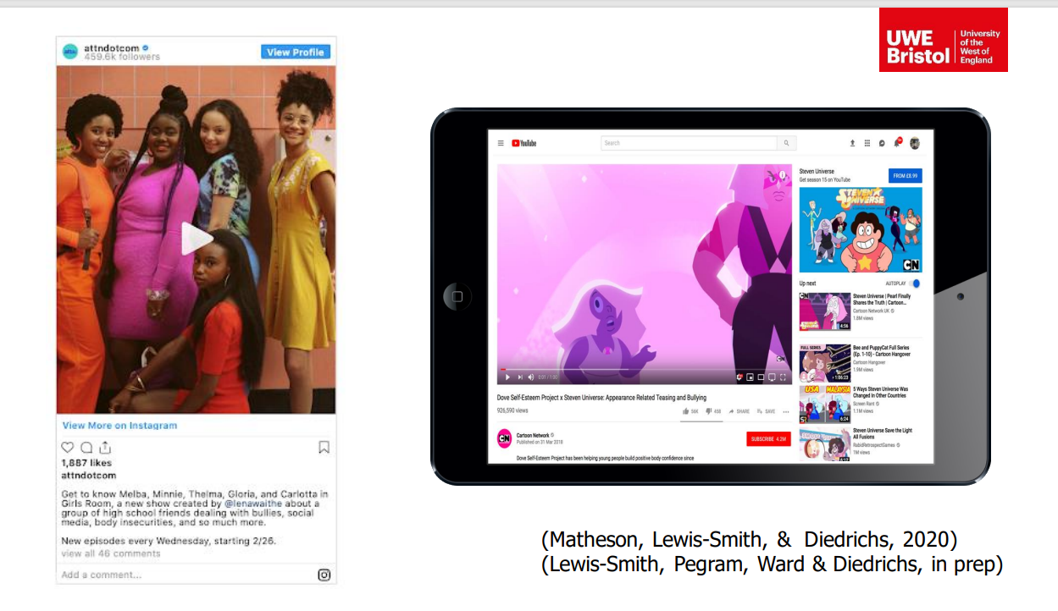
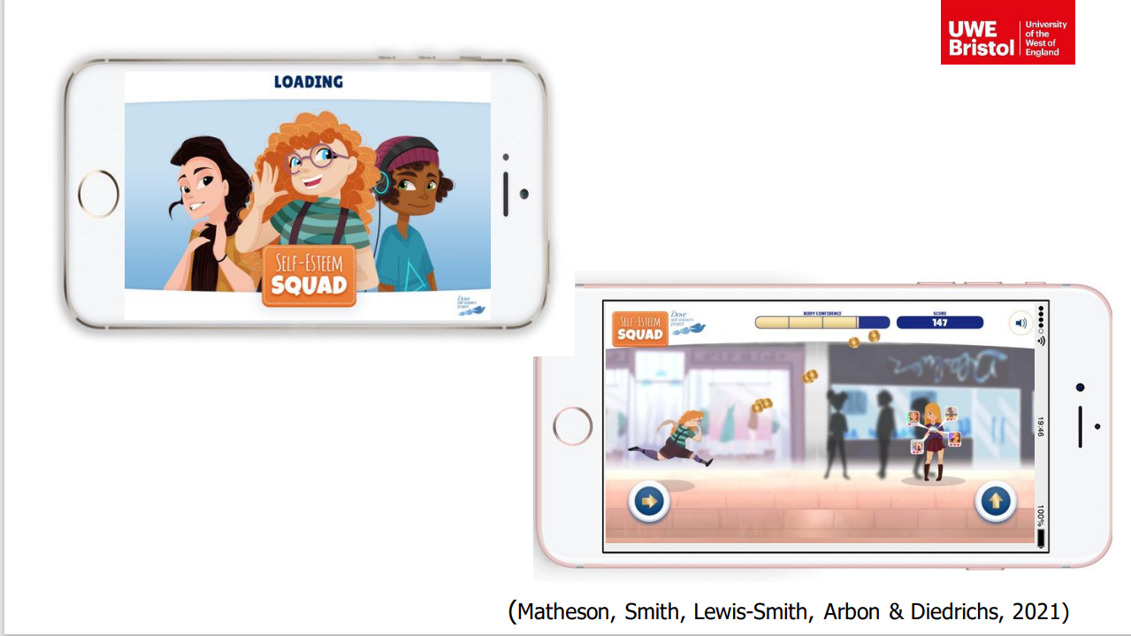
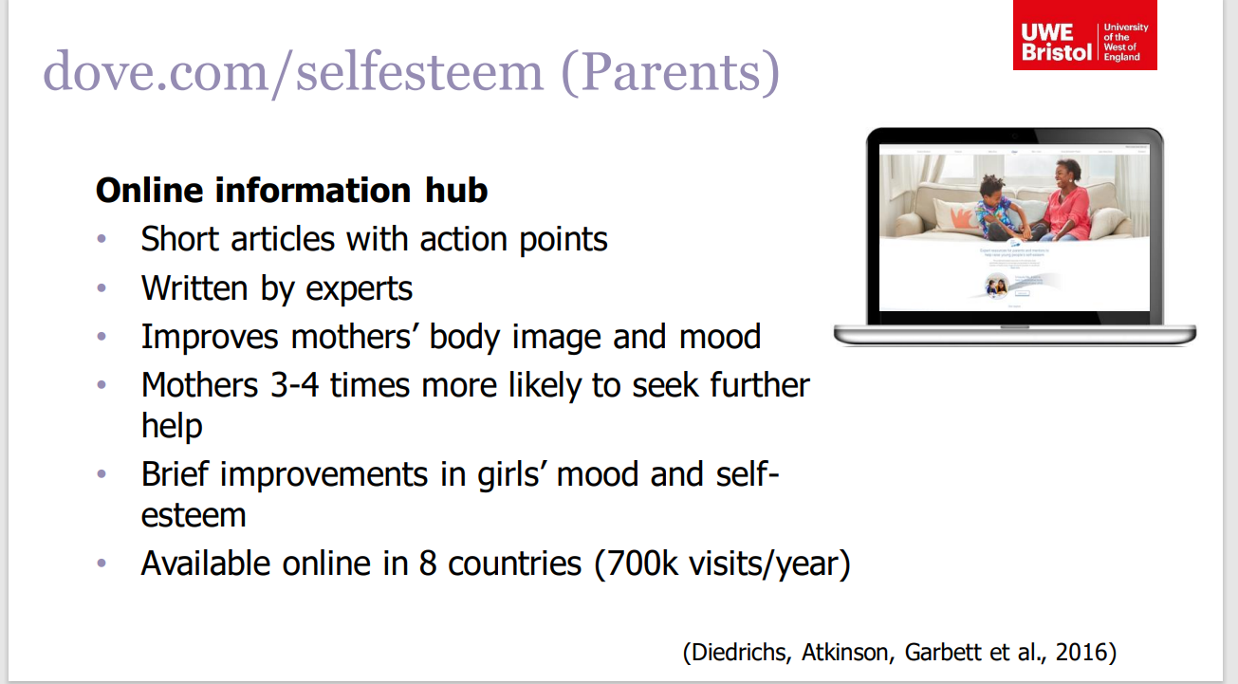
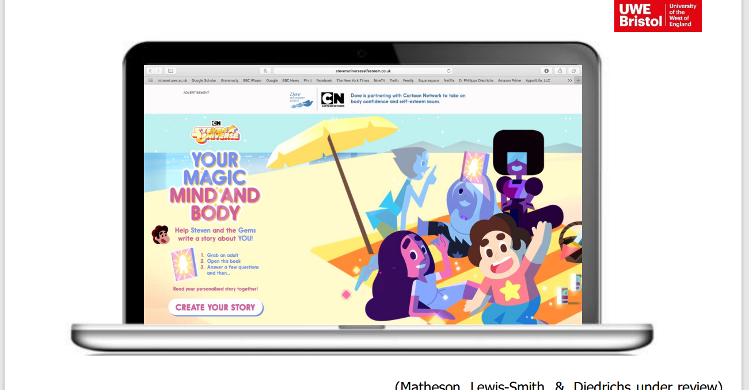

Slide 34
Resources
BEAT - Delivered by clinicians with extensive experience in the field of eating disorders. Spotting the early warning signs, risk management and screening tools. • The importance of early intervention. • How to approach and have difficult conversations. • • Signposting to treatment services. Suitable for non--specialists – FREE
https://www.beateatingdisorders.org.uk/spot-the-signs-appeal Discussion-starter film including “Know the First Signs” • Teacher’s Guide with short tutorial –plan
MindEd - Knowledge to support wellbeing • Understanding to identify a child at -risk of a mental health condition • Confidence to act on concerns and signpost to services where needed. Suitable for non--specialists – FREE
Mental Health First Aid (Youth) Builds skills and confidence to spot the signs of mental health issues in young people • Offer first aid and guide towards the support their needs, to help speed up a young person’s recovery and to stop mental health issues from getting worse. • Teach participants to listen, reassure and respond, even in a crisis. 1 day courses: £200 pp ½ day course: £75 pp.
https://www.healthylondon.org/new-eating-disorders-guidelines-launched-for-educational-professionals/
https://www.mentallyhealthyschools.org.uk/mental-health-needs/eating-disorders/?searchTerm=eating+disorder - Types of Eating Disorder • How to spot the signs • What schools and further education settings can do (Anna Freud)

Slide 35
BEAT
Skills workshops for carers and those supporting someone with an eating disorder. Online support groups for both those suffering and for carers. Various chat rooms can be accessed by clicking https://www.beateatingdisorders.org.uk/support-services/online-groups
A booklet for parents, families, friends and carers can be accessed
https://www.beateatingdisorders.org.uk/support-services/downloads-resources which covers information about eating disorders and treatment and offers guidance on how you might approach the subject if you’re worried about someone you know.
• Tips poster: spotting the first signs and symptoms is extremely important and this poster provides tips on how to spot the very first signs of an eating disorder. https://www.beateatingdisorders.org.uk/support-services/downloads-resources
• Directory of local services: https://helpfinder.beateatingdisorders.org.uk/
Parents: MindEd, Young Minds, F.E.A.S.T, Around the Dinner Table,
Autism: NAS, National Centre for Eating Disorders, Pathway for Eating Disorders and Autism Developed form Clinical Experience P.E.A.C.E
PPEPCare – E Berkshire Workforce Development Programme

Slide 36
Updates and Signposts
Fantastic FRED
The Fantastic FRED Experience is a school-based, live performance mental health resource for primary aged children delivered by a team of trained actors.
Fantastic FRED is a resource targeted at delivering preventative mental health education in schools for children in reception and Years 1 to 6.
The letters in FRED’s name represent the areas of educational focus: FOOD, REST, EXERCISE, DEVICES https://ccg.thefantasticfredexperience.com/berkshire/portal
The Link Programme – Tailored sessions
15th Feb, 1st March, 15th March
Number 22 Counselling line - A bookable 25-minute telephone appointment for young people between the age of 11-25 years living in Slough, Windsor, and Maidenhead. The telephone service is run by Number 22 counsellors.
The appointment can be used as a:
One off counselling session
Reporting a safeguarding concern
Introduction to counselling – what could a YP expect, allaying fears, taster session
Signposting to other services
number22.org

Slide 37
Updates and Signposts
Spot Purchasing
There are currently 3 spot purchase arrangements that are available.
• Challenging Behaviour SPA for LD/Autism – this funding is available until the new service is up and running – probably December 2022
• Challenging Behaviour SPA for social needs – this funding is currently only available as
Frimley ICS winter surge funding until March 2022
• CAMHS CIC spot purchase arrangements – this funding is available until the new service up and running.
There is also an allocation of £100k per area from CAMHS Local Transformation Plan
underspend for gaps in provision between Getting Help/MHST and Specialist. The details of how this is going to be spent is going to be determined through discussions at a local authority level.

Slide 38
Questions…

Slide 39
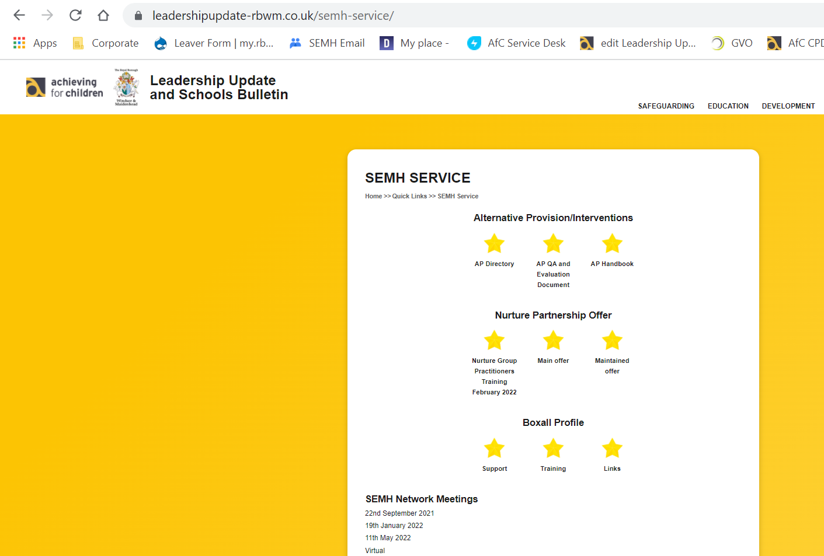
SEMH Service Updates
Leadership Update Website – a quick tour.
Alternative Provision Documents
    Directory – updated (let me know of new provisions you use)
    Guidance
    Quality Assurance
SEMH@ Email semh@achievingforchildren.org.uk
PEAR Panel Form
SEMH Intervention Project
Network Meetings
Online Boxall Profile
https://www.leadershipupdate-rbwm.co.uk/
Notes:
Leadership Website – home page – quick links to the right. SEMH Service is at the top. AP docs – Nurture – Boxall – Network meetings. What else would you like to see here?
SEMH Email – Heads only – had 6 referrals so far – differing outcomes… observations, become part of project/intervention. Signposting and consultations/
PEAR Panel – referrals form Claire Raffaelli/Rosie Gossage/Kelly Nash and Myself + school representatives.
SEMH Intervention project updates – SEMH Intervention Service (amalgamate BST – Cherrelle Long … Maternity… Transitions + Nurture (Rebecca Askew and relaunch)

Slide 40

Questions.
Fill out form
Feedback
Thanks
https://docs.google.com/forms/d/e/1FAIpQLSfWjH8tnWMHlTpeEyVKo2RkETuAHJSxlA-_GUMiueMWKEH9gw/viewform?vc=0&c=0&w=1&flr=0

