Slide 1
SEMH Network Meeting
Moor Hall
22nd September 2021
3.30pm – 5.00pm
Alasdair Whitelaw
SEMH Coordinator
AfC

Slide 2

3.30 Welcome.
3.35 Introductions and Updates.
3.40 Boxall Online Profile update and overview.
3.50 Rachel Endacott (FPJS) presentation of BPO/Nurture practical impact.
4.00 Helen Hannam (MGS) presentation of BPO practical impact .
4.15 Working Break.
Table discussion of BPO application.
Boxall Profile application strategy Individual Setting.
4.30 Helen Daniels (Cookham Rise) Paul Dix – Achievable Behaviour Nirvana.
4.50 Feedback and Agenda items.
5.00 Close.
Agenda

Slide 3
SEMH Service Updates
Alternative Provision Documents
    Directory
    Guidance
    Quality Assurance
SEMH@ Email
SEMH Intervention Project
Network Meetings
Behaviour Support
Online Boxall Profile
https://www.leadershipupdate-rbwm.co.uk/

Slide 4
Online Boxall Profile NurtureUK
65 licences (300 pupil)
SEMH Leads - Administrator
Allocated – Roll out.
Email instructions
Allocation
Super-User
Training (£30)
hello@boxall.org

Slide 5

Rachel Endacott

Slide 6
How we use the Boxall Profile at Furze Platt...
Initially for the Nurture Group (X5/6 pupils in each year group)
Class teachers are responsible for data input
Quick fire, quick response method
Assess pupils once a term (in Autumn after a settling in period)
Nurture targets carried over into the class setting not just Nurture group

Slide 7
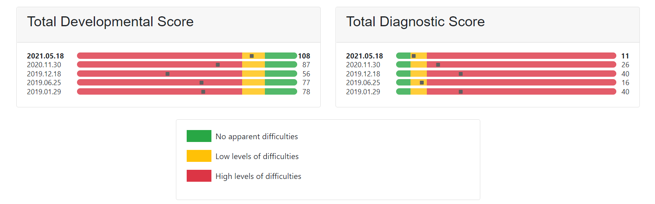
A success story
Pupil J (some data missing due to pandemic)

Slide 8
Other uses of the Boxall Profile at Furze Platt...
Data produced by the Boxall Profile was also useful for any pupil with SEMH
At risk of exclusion/pupils with PSP’s/evidence for EHCPs/Core Groups mtgs
Great measure of progress (or not) for SEMH needs
Evidenced that support in the Nurture group was potentially not meeting the pupils’ needs

Slide 9
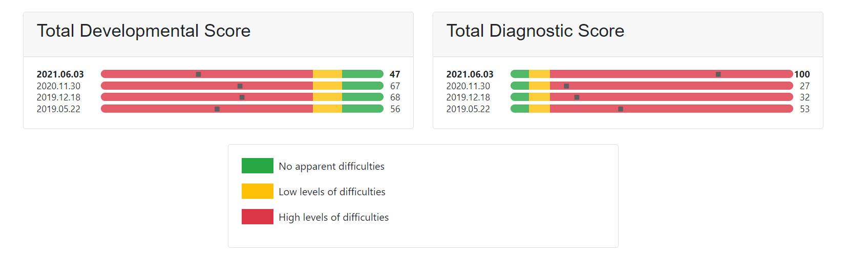
A story that needed more/something different
Pupil O (some data missing due to pandemic)

Slide 10
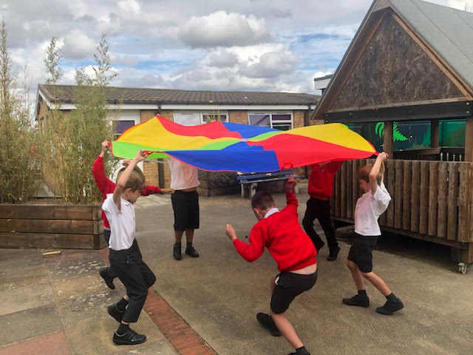
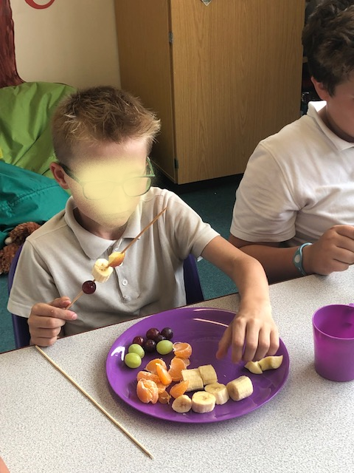
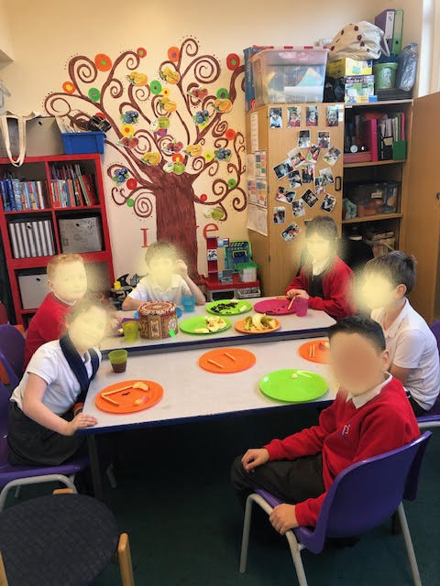
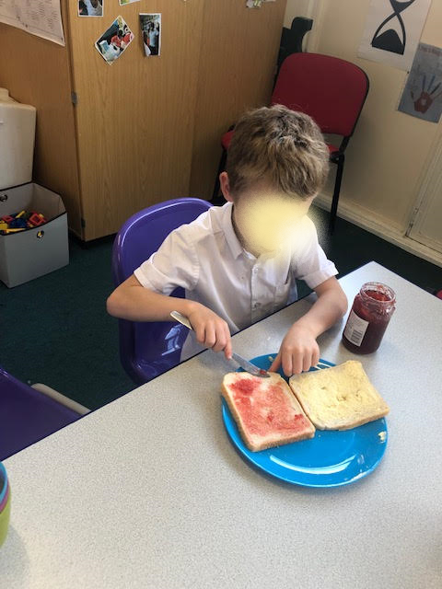
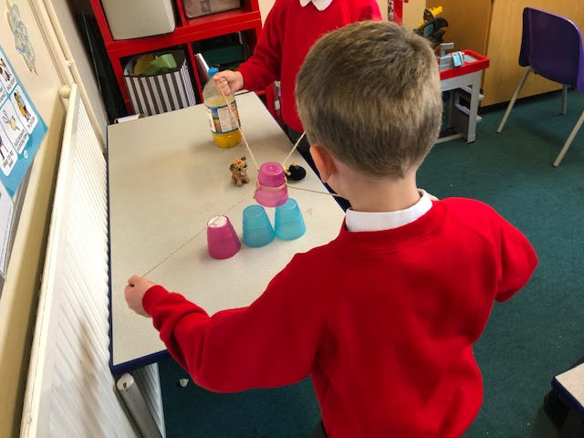
Developing their skills to improve their Boxall Scores

Slide 11


Slide 12



Boxall Profile Impact and Application
In Manor Green School and The Link
Welcome to
your new career.
Helen Hannam
Rachel Goymer
Josie Glover

Slide 13

Introduction and Overview
. . . . . . . . . . . . . . . . . . . . . . . . . . . . . . . . . . . . . .

Slide 14
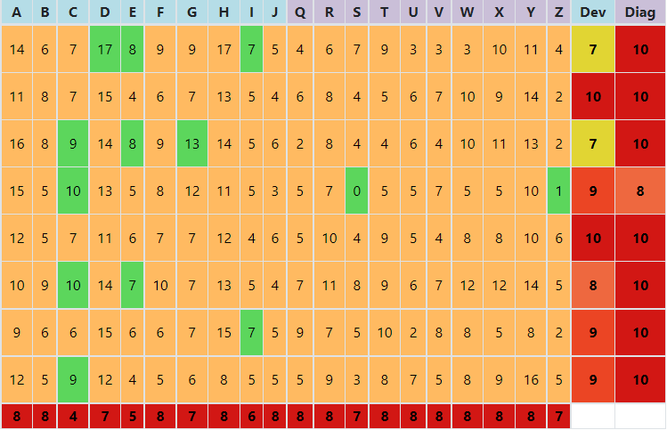
Boxall in The Link
Practical Application
. . . . . . . . . . . . . . . . . . . . . . . . . . . . . . . . . . .

Slide 15
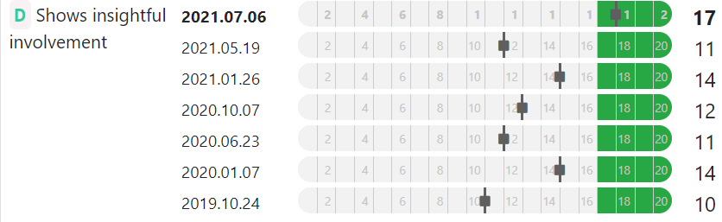
Targeting Strategies for
Individuals
. . . . . . . . . . . . . . . . . . . . . . . . . . . . . . . . . . . .

Slide 16
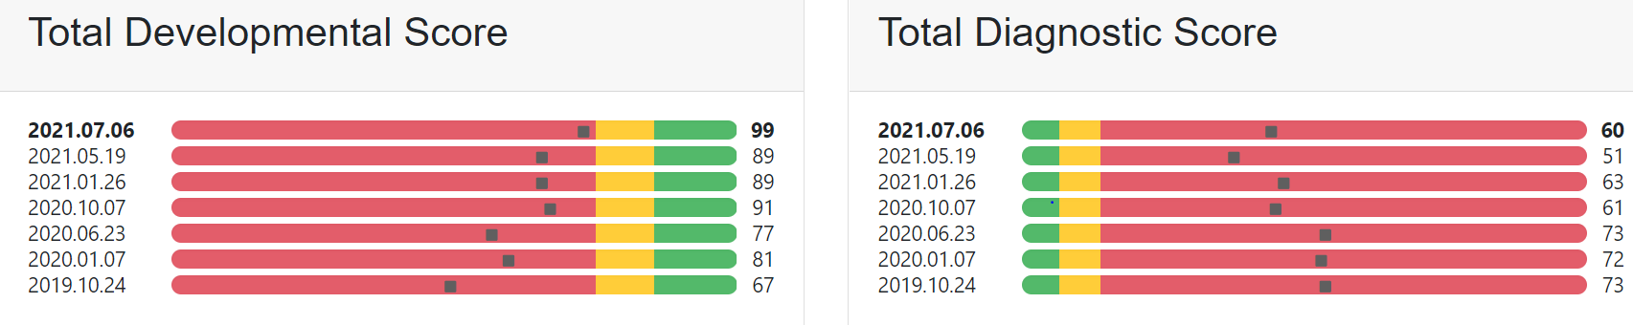
Impact on Behaviour
. . . . . . . . . . . . . . . . . . . . . . . . . . . . . . . . . . . .

Slide 17

Boxall In Manor Green
Whole School Boxall
. . . . . . . . . . . . . . . . . . . . . . . . . . . . . . . . . . . .

Slide 18

Using Boxall in EHCPs
. . . . . . . . . . . . . . . . . . . . . . . . . . . . . . . . . . . .

Slide 19
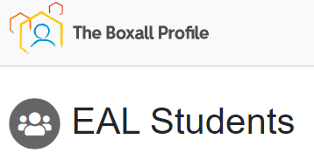
SEMH Project
. . . . . . . . . . . . . . . . . . . . . . . . . . . . . . . . . . . .

Slide 20

Use of Catch-Up Funding
. . . . . . . . . . . . . . . . . . . . . . . . . . . . . . . . . . . .

Slide 21

Any Questions?

Slide 22

Break
Discussion of BPO application.
Boxall Profile application strategy Individual Setting.

Slide 23

Helen Daniels

Slide 24


Behaviour Policy Relaunch
1st July 2021

Slide 25
Consistent, calm adult behaviour – consistency, adult behaviour, emotional control, teacher expectations
First attention to best conduct – rewards, recognition, praise, motivation, engagement
Relentless routines – rules, routines, follow-up, teacher habits, non-verbal cues,
Scripting difficult interventions – de-escalation, disruption, delivering sanctions, confrontation
Restorative conversations – restorative practice, structuring sanctions, working with the most troubled, developing relationships

Slide 26
Consistent, calm adult behaviour
Not only must each individual adult be consistent with how they deal with behaviour; but we need every single member of staff to deal with behaviour in the same manner;
Children find it really difficult if all the adults that they encounter deal with behaviour in a different manner;
Being visibly consistent means that no adult will let behaviours go unchallenged;
Having and using scripted language ensures that all adults are consistent;
We also want to demonstrate visible kindness!
Forming positive relationships is the key underlying principle of our Behaviour Policy;
Every kid needs a champion!
Your pupils need your emotional consistency and agility as a model of
how to be a resilient adult

Slide 27

First attention for best conduct
Make regular deposits into the ‘self-esteem’ bank
Some children start school with a full piggy bank (the lucky ones!)
Others may have empty piggy banks, or even be in debt;
These are the children who are going to need more deposits than the others;
We want to catch children doing the right thing as often as possible - and praise them for this;
Deposits are a way of forming relationships. E.g. a smile at the class door. Ker-ching! How’s your little brother settling in? Ker-ching! Did you watch the match yesterday? Ker-ching!
Our meet and greet from all adults in the room is a really important start to the day

Slide 28


What stage of decay are you at?!

Slide 29
First attention for best conduct
Before helping someone to regulate, make sure you regulate yourself.
punishment clichés away – they won’t help
Make a plan and be ready to adapt it
Be ready not to react to an angry response
Frame the situation – that is calm adult helping distressed child
Respect physical space
Take away time limits – you have ten minutes to comply isn’t going to work now
See the support of adults who have a strong emotional currency with the child
Be ready for waves of emotion, not a single tidal wave

Slide 30
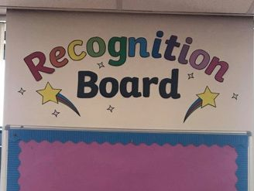
Relentless Routines
Recognition Boards
Here are five ways to stop recognition from becoming rewards:
Refocus recognition so that it is awarded for effort
Recognition should not be part of a cumulative awards system
Recognition is collaborative not competitive
All recognition starts afresh in a new lesson / session
Shift pupils thinking towards competing against their previous best efforts rather than each other
32

Slide 31
Proportionate and productive consequences
Classroom support plan
Calm and easy on every step with time for take up
REMINDER
WARNING AND A MINUTE
LAST CHANCE, SCRIPT AND TWO MINS AFTER THE LESSON
TRIAGE
TEACHER’S CHOICE – QUICK CATCH UP / RESTORATIVE CONVERSATION / IMPOSITION / NATURAL CONSEQUENCE

Slide 32
What does triage look like?
Key principles
Triage is a no-blame environment
Students stay for one lesson only
Class teachers follow up as necessary
Being removed from class is the consequence
(p53 – 54)

Slide 33
Teacher’s Choice …
When the teacher has the power to decide the child stops looking over their shoulder for the higher authority.
A quick catch up can take place anywhere e.g at break / tidying the class after a lesson
Restorative conversation (see next slide)
Impositions are where work is taken home to complete
Natural consequence is e.g. clearing up the mess you made
The most effective way to support a colleague with a child’s behaviour is to stand alongside them.

Slide 34
Six things to try before removing a child from the classroom
Stand close by or sit alongside them
Give them responsibility or a job (but not a fool’s errand)
Positively reinforce good behaviour and reflect back successes
Find a gentle way to change who the child is working with
If they are not disrupting others give them some more time and space to recover their behaviour
Tell them that you want them in the lesson

Slide 35
I’ve recently had some challenging lessons with a pupil
But next lesson I’ll start again
I’ll forgive
I’ll move on
Ill consider new strategies
It will be a fresh start
I won’t bear a grudge
Because I’m the teacher
And they’re still a child

Slide 36


Questions.
Feedback

