Slide 1
Ofsted New Framework
Governors
Notes:
1

Slide 2
New Framework – What it wants to Achieve
High-quality, inclusive education for every child, pupil, learner
Great outcomes for everyone, including for those who are disadvantaged, those with SEND, those known, or previously known to children’s social care
Better information for parents and carers
A collaborative and transparent approach to inspection
Rising standards of education and care.

Slide 3
Ofsted Journey – So Far
The case for change
2024 Big Listen
Taking action
Public Consultation
Introducing change

Slide 4
Summary of changes
New report card
A five-point grading scale​
A renewed focus on inclusion
New inspection methodology
New online
insights platform
New toolkits
A new approach for monitoring schools where improvement is needed
All school inspections led by HMI
An additional team inspector on day 1 of every inspection

Slide 5


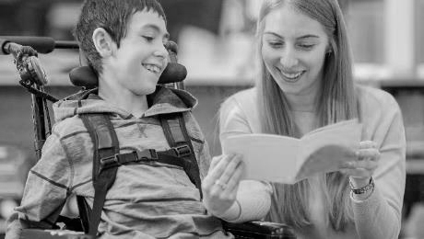
5
Ofsteds Approach
Breaking down barriers to learning and/or well-being
Focusing on barriers
Understanding context
Woven through the framework
to learning and well-being especially for those who are disadvantaged, have SEND, or are known to children’s social care.
by using contextual information and discussions with leaders to understand their particular community and the opportunities and challenges this brings to their work.
Inclusion is woven through evaluation areas, as well as having a standalone inclusion area.

Slide 6

The focus on inclusion
Speaking with leaders about how pupils’ needs are identified and met.
Using discussions and IDSR information to understand the school’s context.
Case sampling to evaluate how support works in practice.
Learning walks to evaluate inclusion in action.

Slide 7

Ofsted will evaluate
Safeguarding (Met or Not Met)
Inclusion
Curriculum and teaching
Achievement
Attendance and behaviour
Personal development and well-being
Early years (if applicable)
Post-16 (if applicable)
Leadership and governance
A new five-point grading scale
Exceptional.
Strong standard.
Expected standard – OLD GOOD
Attention needed.
Urgent improvement.

Slide 8



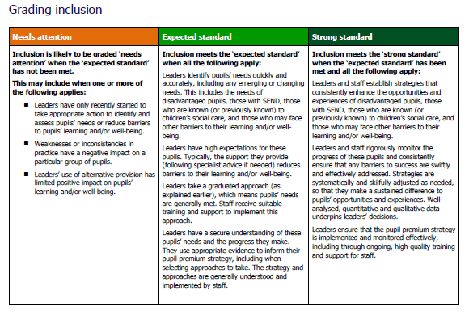
They Have introduced toolkits
Toolkits show providers and inspectors the evaluation areas that we will focus on and how we’ll evaluate and grade providers.
Toolkits include standards that replace grade descriptors currently in our inspection handbook.
The general structure of the toolkit is the same whatever sector you are working in, but we have carefully reflected on how our evaluation areas should apply for different remits.

Slide 9


Toolkit (1/3)
9
The toolkit is broken down into different evaluation areas. Each evaluation area starts with a covering page.
1. A summative statement of what the evaluation area covers – to help leaders and inspectors to understand what the evaluation area is ‘at a glance’.
2. A reminder that our grading standards are based on research, inspection evidence, and statutory and non-statutory guidance set by the DfE.
3. Following that the toolkit sets out the most significant contributory factors that underpin our approaches to evidence gathering and grading.

Slide 10
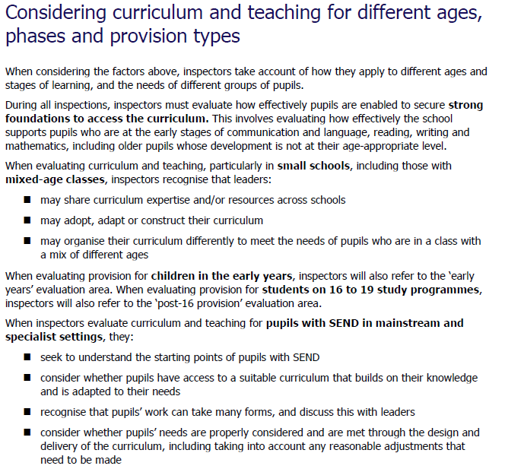
Toolkit (2/3)
Each evaluation area then has a section to explain how this area is applied in the different phases.

Slide 11

Toolkit (3/3)
The next part of each evaluation area explains the evidence inspectors will gather.
Evidence gathering prompts
Theme

Slide 12
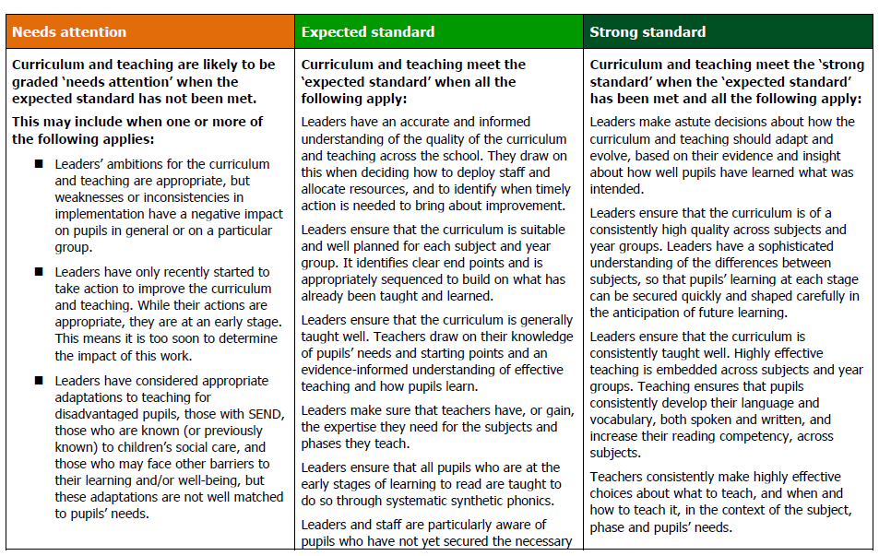
Grading
How will this be received by stakeholders?
Grades Ofsted expect to see most frequently on inspection
Grades across a
5-point scale
Grading
standards
Indicators

Slide 13
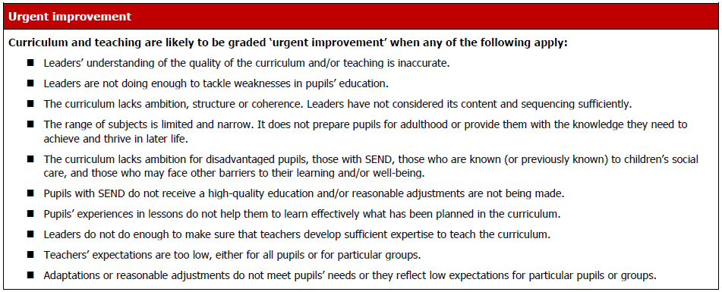
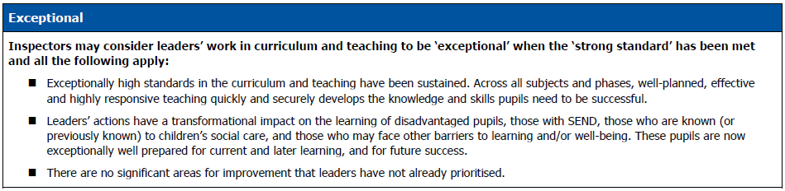
Toolkit
Grades we expect to see less frequently on inspection
Grades across a
5-point scale
Indicators
Standards

Slide 14

Inspections will look and feel different
Context further taken into account.
A more collaborative approach.
A consistent approach to inspection.
Constructive advice with clear recommendations on what to improve.
A continued focus on well-being.

Slide 15

Before an inspector arrives
Notification call
Timetable for inspection
Provider leaders invited to identify an individual(s) to act as nominee(s) – not compulsory.
to enable inspectors to gather evidence relevant to the provider’s context.
Nominee
Planning call/s
help the inspection process run smoothly and collaboratively through planning, communication and engagement with the inspection team
the lead inspector will work collaboratively with the nominee(s) and leaders to identify any necessary reasonable adjustments and understand the context

Slide 16
How the inspection will be structured: Day 1
Single central record will be checked early on day 1.
Gathering first-hand evidence of pupils’ experiences through:
  discussions with pupils at the start of the day and social times
  learning walks with leaders (including discussions with pupils and looking at their work)
  considering, in detail, the experiences of pupils identified for case sampling.
Learning walks.
Dedicated reflection meetings with leaders.
Focused leadership meetings, including safeguarding.
Celebrate
Validate
Highlight

Slide 17
How the inspection will be structured: Day 2
Begins with a reflection meeting with leaders and nominee.
May continue to:
  involve some focused meetings such as governance or speaking to the local authority or diocese
  gather evidence as confirmed at the end of day 1
  include reflection meetings with leaders/nominee
  adapt inspection activity accordingly to explore further as/if required.
Concludes with a grading meeting followed by a final feedback meeting.
Case sampling and learning walks will support throughout.

Slide 18

What will this look like for all primary schools?
Inspectors will prioritise learning walks in EY and KS1 on the day 1.
The curriculum, teaching and achievement focus will be on ‘strong foundations’ which is needed for successful learning across the rest of their education.
An inspector will meet with the SENCo/inclusion leader on day one. ​
Other inspectors will carry out learning walks across the school on day one.
Inspectors will hear some pupils read.

Slide 19

What will this look like for small primary schools?
Inspectors will recognise that published data for small cohorts is likely to fluctuate considerably or that there may be no published data.
Inspectors will want to understand the school organisation and staffing, including mixed-age classes.
Inspectors will be sensitive to the demands:
  on leaders’ time
  of an EYFS/KS1 focus on the morning of day 1.

Slide 20

An example of what this may look like for a secondary school
Learning walks will take place in agreed groups of subjects.​​
A learning walk will focus on inclusion.​​
Inspectors will consider Post 16 provision in relevant inspection activities.
Inspectors will want to understand the breadth of any alternative provision that the school may use.
The role of the nominee.

Slide 21
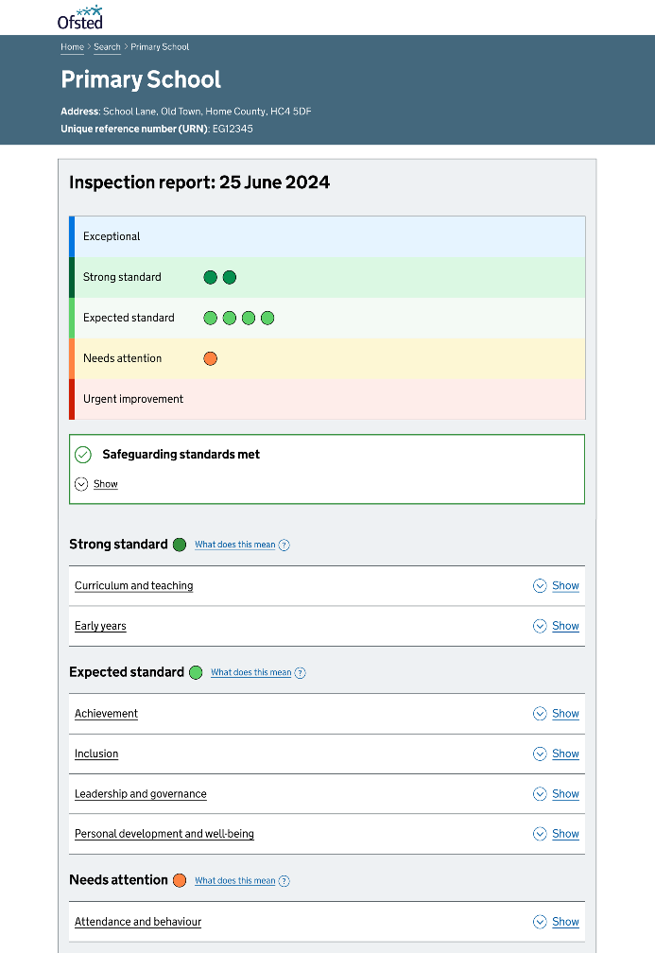
Report Cards
Our new report card will make findings clear and accessible.
The report card will provide a summary overview as well as a detailed explanation for each of the evaluation areas the provider has been evaluated against.
Colours ranging from red, for urgent improvement, to blue, for exceptional will provide a visual overview.
The next steps will be written in a constructive way to make clear what the priorities for improvement are for the provider/phase.

Slide 22

School report card – key points
At the end of the inspection, the lead inspector will write a report card which will:
reflect the evidence gathered
be clear, concise and focused on what matters most, as informed by the school’s context, leaders’ evaluation of their school, and the toolkit
explain the grade given for each evaluation area
make clear what the school should improve
be consistent with the verbal feedback given to the school at the end of the inspection.

Slide 23
Governance
In gathering evidence about governance, inspectors consider the extent to which governors/trustees:
Are knowledgeable about their statutory duties and carry them out effectively
Support and challenge the school’s leaders effectively, using the best methods to assure themselves of the quality and impact of different aspects of the school’s work
Understand their role as the responsible body, where applicable, in considering and addressing leaders’ workload and well-being
Assure themselves that leaders have an accurate understanding of the school’s context and are prioritising the actions for improvement that will have the greatest impact on pupils

Slide 24
Governance
In gathering evidence about governance, inspectors consider the extent to which governors/trustees:
Hold leaders to account appropriately and effectively for the school’s support and provision for disadvantaged pupils, those with SEND, those who are known (or previously known) to children’s social care, and those who may face other barriers to their learning and/or wellbeing
Ensure that systems for monitoring and quality assurance are fair, valid and constructive, and provide leaders and staff with high-quality feedback to inform continuous improvement

Slide 25
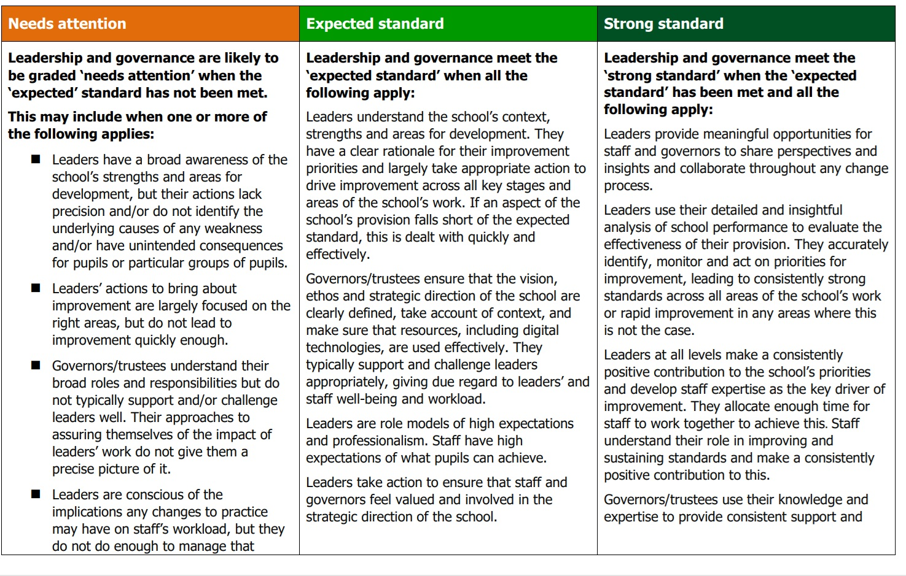
Governance

Slide 26
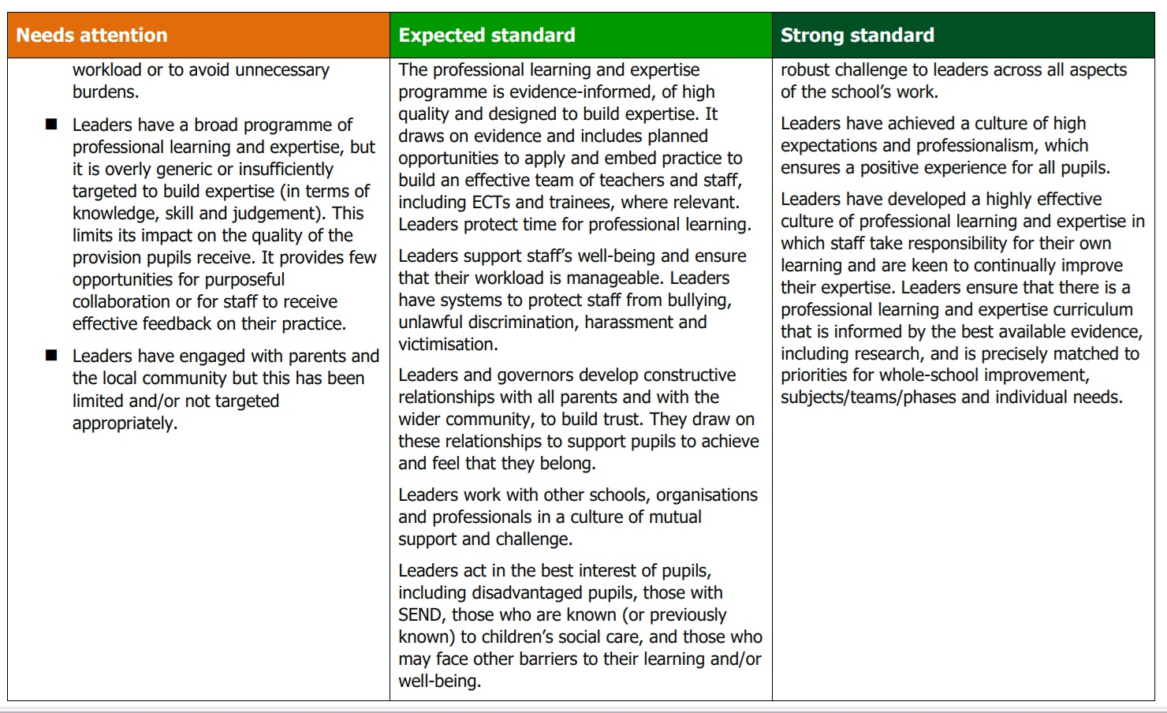
Governance

Slide 27

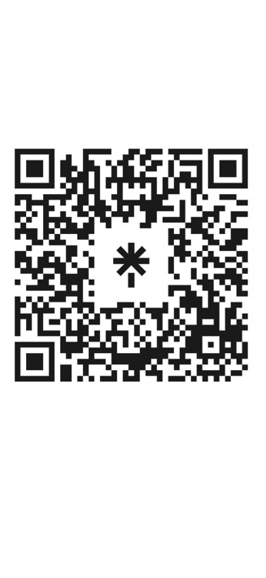
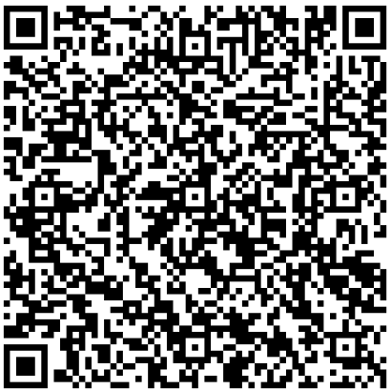
Resources and further information
Scan me
SCAN ME
Formal response to consultation
Toolkits for:
    early years
    Schools
    Further education and skills
    Initial teacher education
Supporting research and evidence
www.gov.uk/ofsted

Slide 28
Thank you – Good Luck

