Slide 1
SEMH Network Meeting
Tuesday 21st October 2025
Welcome to this virtual forum
Notes:
‹#›

Slide 2
Agenda for today
https://www.leadershipupdate-rbwm.co.uk/information-for-all-schools/
https://www.leadershipupdate-rbwm.co.uk/semh-service/
Item franc | Who | Time
Welcome and Updates SEMH Feedback form and next steps - Annual report and ELSA Training | Al Whitelaw / Debbie Nayar | 3.30 pm (15 mins)
Kooth | Carley Seymour | 3.45 (15mins)
Education Boutique | Ian Bailey | 4.00pm (15 mins)
Young Carers | Sarah Collins | 4.15pm (15 mins)
AP and Flexi schooling | Al Whitelaw | 4.35 (10 mins)
Questions and Feedback | Al Whitelaw / Debbie Nayar | 4.40pm (10mins)

Slide 3

Book your place via the link
ELSA Training
Emotional Literacy Support Assistant
An Emotional Literacy Support Assistant (ELSA) is a trained learning support assistant based at a school. The ELSA's role is to support the social/emotional wellbeing of pupils. They are trained by Educational Psychologists and receive ongoing group supervision.
6 Days Training
Day 1 Wednesday 21st January 2026
Day 2 Thursday 22nd January 2026
Day 3 Wednesday 28th January 2026
Day 4 Thursday 26th February 2026
Day 5 Wednesday 4th March 2026
Day 6 Wednesday 11th March 2026
Cost: £575 per ELSA (RBWM) or 7 hours EP Traded time
£675 per ELSA (Outborough and Independent)
Price includes 6 full days training and 2 supervision sessions for Spring and Summer terms 2026.
Refresher
Day 2 Thursday 22nd January 2026
Day 3 Wednesday 28th January 2026
Day 6 Wednesday 11th March 2026
Cost: £325 per ELSA (RBWM) or 4 hours EP Traded time
£425 per ELSA (Outborough and Independent)

Slide 4

The ELSA refresher training is for ELSAs that have previously completed ELSA training with a provider (usually a local authority service), who are registered with the ELSA Network, and hold the ELSA Network Quality Mark Standard. It is open to ELSAs who have had a break of two or more years from registered ELSA practice. The ELSA should be working within an educational setting and have access to line management from a senior member of staff from this setting. Those wishing to refresh their training, attend three days of the annual six day ELSA training. The three days will cover the key aspects of ELSA practice as follows:
active listening skills and reflective conversations
setting SMART (specific, measurable, achievable, relevant, and time-bound) targets and goal
based outcomes
ELSA supervision
emotional literacy
loss and bereavement
planning and guidelines for school ELSA implementation
top tips for ELSAs
Schools are asked to agree to a number of commitments in order to ensure that ELSA’s work can be optimally effective in school.
Headteachers are asked to register their commitment as part of the training application process
ELSAs will need:
Timetabled time and suitable space to work with identified children
Access to appropriate material for use with C/YP
Assistance from a nominated member of senior staff to clarify and enable the ELSA
role in the school context
Line management
Release from school to undertake initial training and regular ELSA support and group supervision (a charge will be incurred for supervision from September 2026)

Slide 5
Payment via invoice will be processed week beginning 12.01.2026. There will be an ongoing cost for 5 group supervision sessions and a full day conference for the academic year 2026 – 2027 invoiced in September 2026
If you would like any further information please contact:
Fozia Salar, Senior Business Support or
Rebecca Askew, Senior Educational Psychologist on 07926 075 218
or email edpsych@achievingforchildren.org.uk.
Please note non-attendance will be charged at full rate.

Slide 6
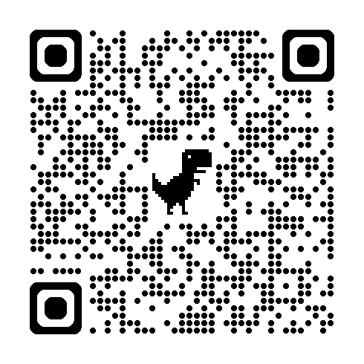
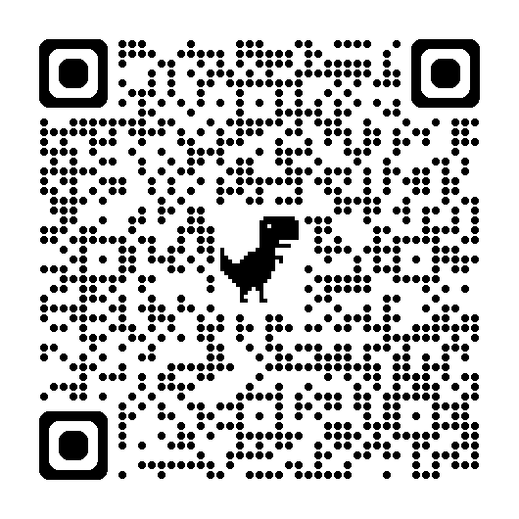
SEMH Intervention Service Page
Alternative Intervention Directory
Mental Health and Wellbeing request for Primary / Secondary representation on Network 2nd June - email Rebecca Askew
New Training (Special schools – info)
https://www.leadershipupdate-rbwm.co.uk/send-and-inclusion-training/
Young Carers Transition Booklet
Wellbeing and Schools Bill – Policy Summary
Boxalls Update – Only Nurture Partnership schools
Alternative Provision Strategy
FASD (Foetal Alcohol Syndrome) Guidance. Theresa Allen (attached in prior email)
Flexi Schooling
Transition Support

Slide 7
Carley Seymore
Kooth
https://uniqueinclusion.wixsite.com/website-1

Slide 8






Welcome
Training session
for healthcare professionals -East Berkshire
Free, safe and anonymous digital mental health support

Slide 9



This session covers
Kooth as a mental health support service
The evidence based outcomes from online delivery
How we support you to refer young people to Kooth
Q&A

Slide 10




First some housekeeping
Please mute your mic to minimise noise
Feel free to turn off your camera
Please ask questions at the end
Follow-up resources via email

Slide 11

Who are Kooth Digital Health?
Founded in 2001, Kooth is a trusted online mental health platform
NHS Boards commission us to provide
free, anonymous mental health support at Kooth.com
We can support children
as young as 11, and young people as old as 17
Kooth is accredited by the BACP; the leading association for counselling professionals in the UK
All our practitioners (who can contacted for a single session of counselling) are real people, not bots

Slide 12
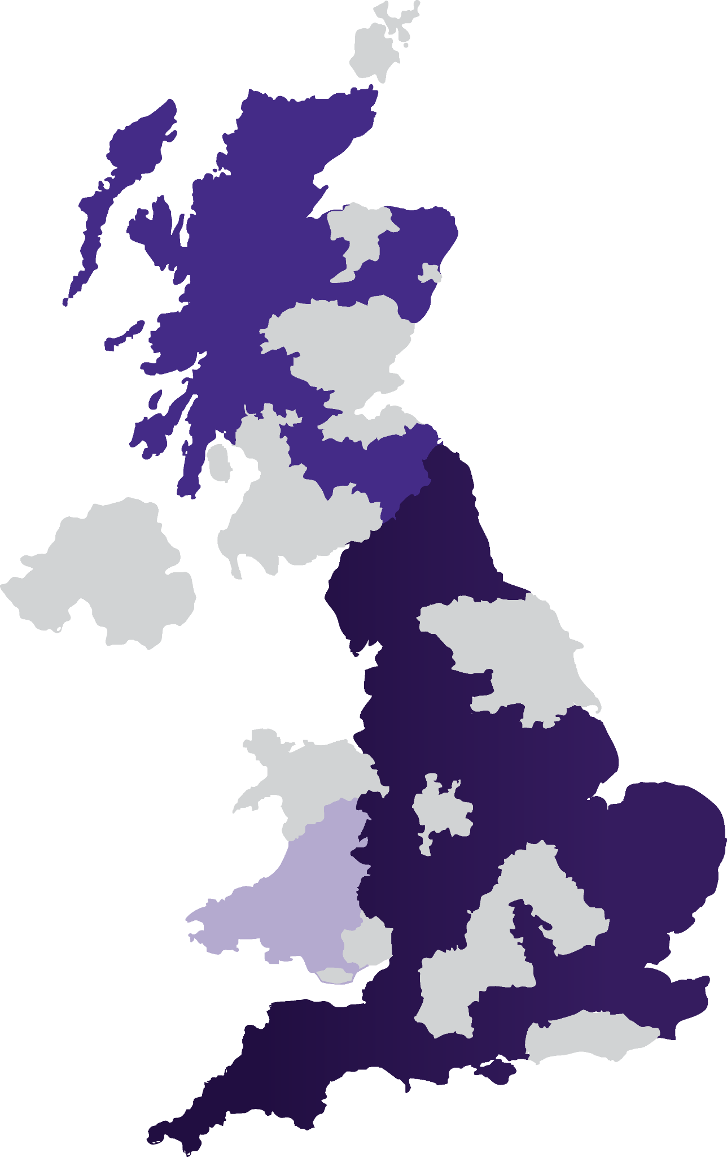


Who are Kooth Digital Health?
Founded in 2001, Kooth is trusted and proven
at scale to support the nation’s young people
BACP accredited service
Kooth have delivered 1.1 million hours of mental health support and moderated 1.4 million messages
We’re a trusted partner of the NHS
Kooth is available free to 7.0M people in 73% of England, 22% of Wales & 42% of Scotland
24 years of data
Our experience with the NHS has allowed us to deliver support in line with Long Term Plan (LTP) priorities. Kooth is the No 1 contributor to NHS England Digital MHSDS
Scotland
England
Wales
Areas where Kooth is commissioned today for young people

Slide 13

Access to all
No referral is needed, and there’s no waiting list or threshold to meet FOR A SINGLE SESSION of Counselling
While access to Kooth.com is 24/7, 365 days a year, chats with a practitioner are during set times:
12pm -10pm, weekdays
6pm - 10pm, weekends
There can be wait times during busy periods

Slide 14

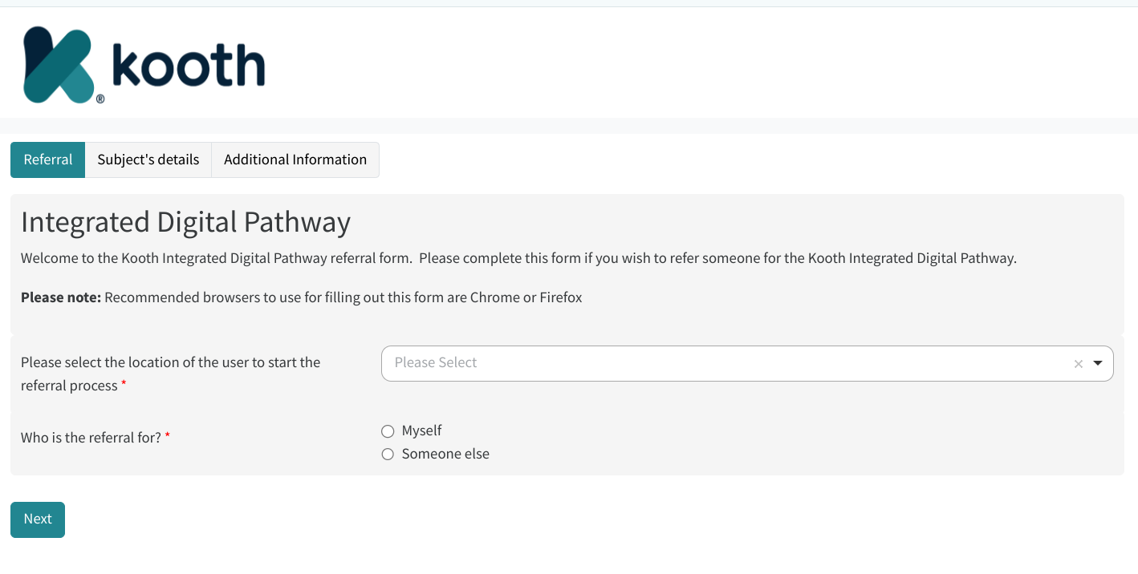
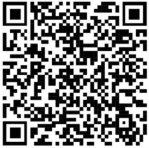
The referral process is still possible for Professionals:
Just click on our go.kooth.com/idp or scan the QR code to sign up, then put in your contact number or email and ensure your first and last name are on the form

Slide 15

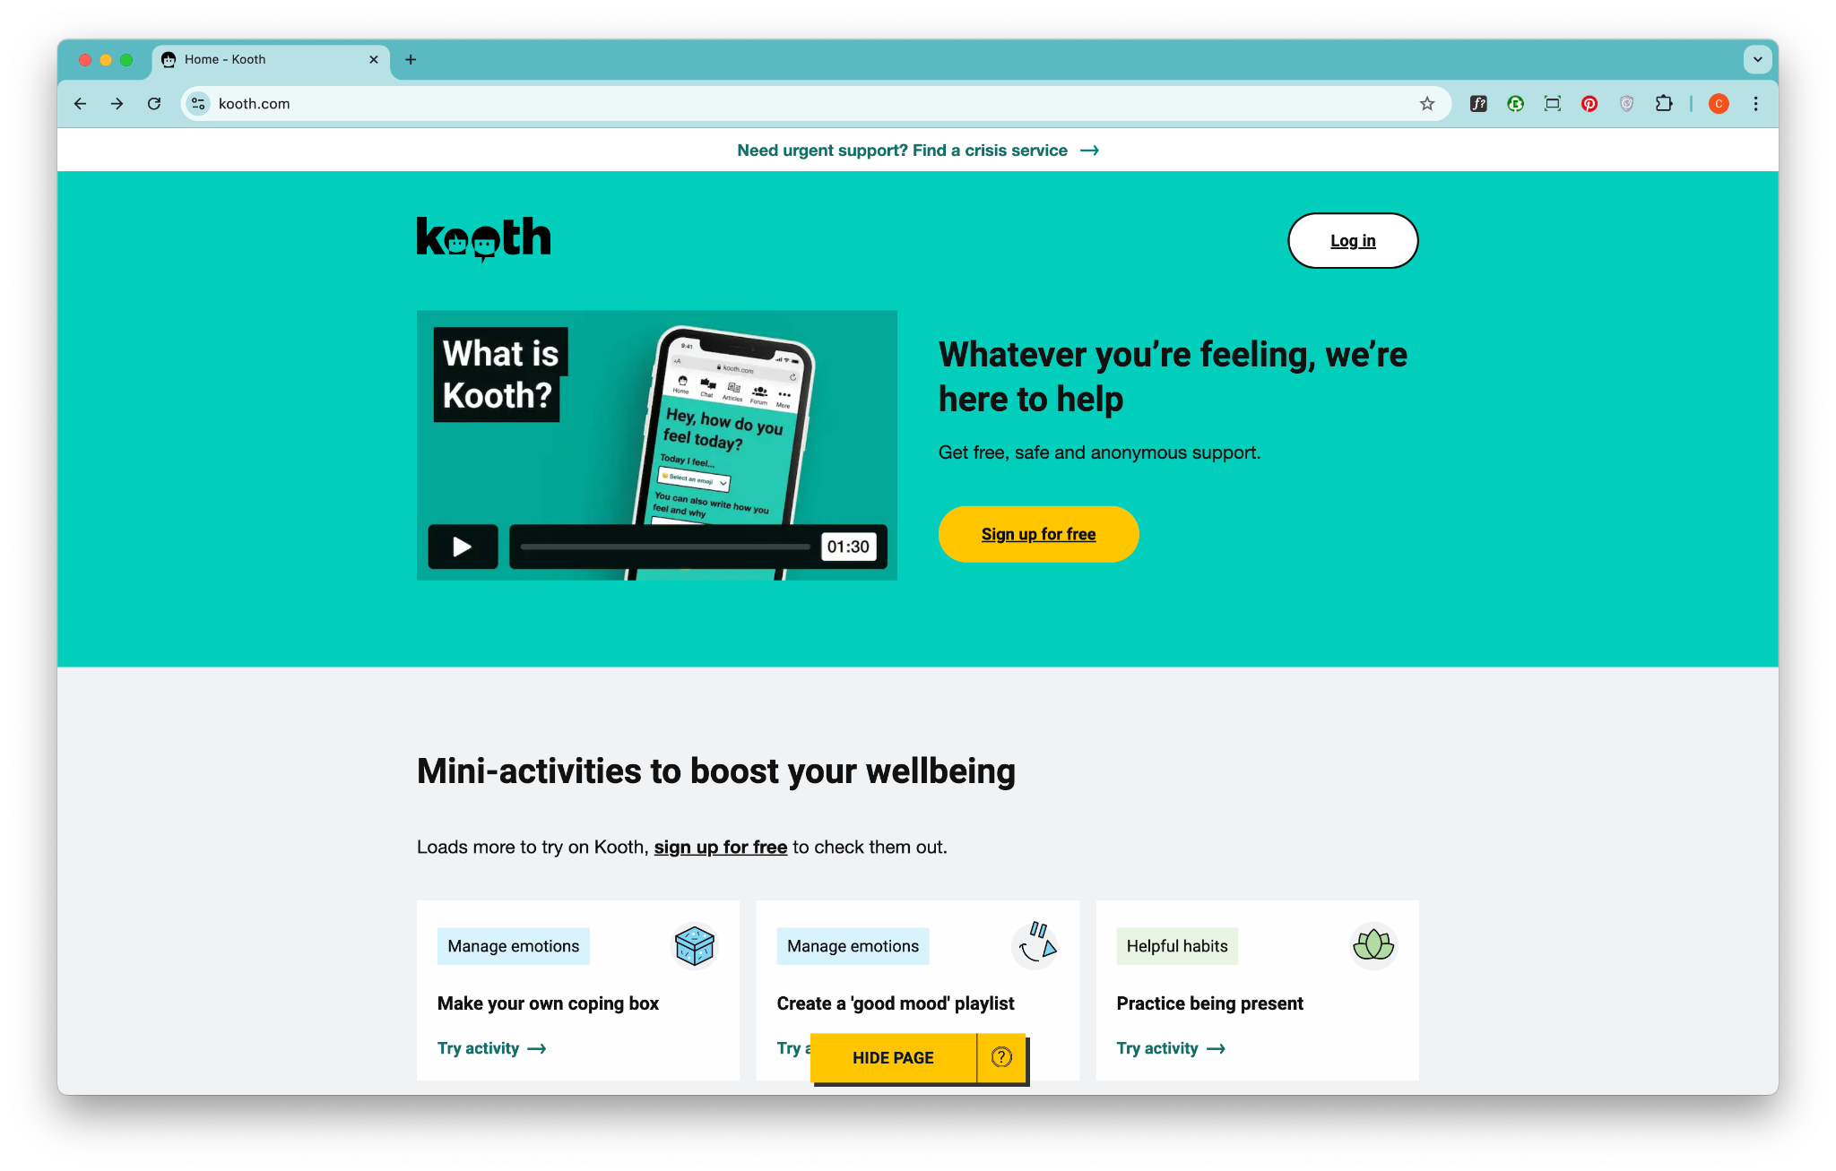
Tools for the future
Kooth can be a helpful
and vital addition to a young person’s wider
care package

Slide 16
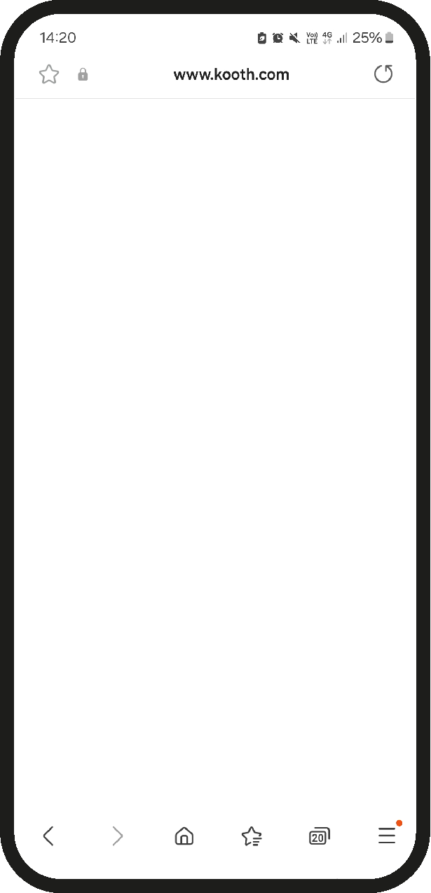
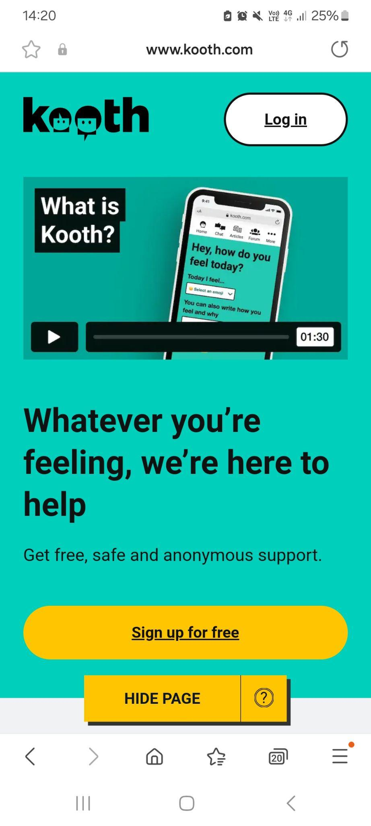
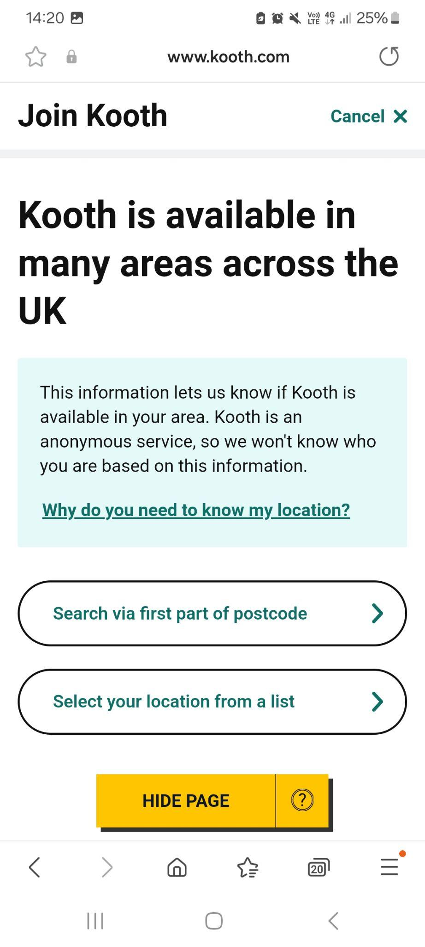
Sign up - Mobile
All they need to do is click on the ‘Sign up for free’ button to get started (from any internet-enabled device)
They can sign up by postcode or select a location from our dropdown list

Slide 17
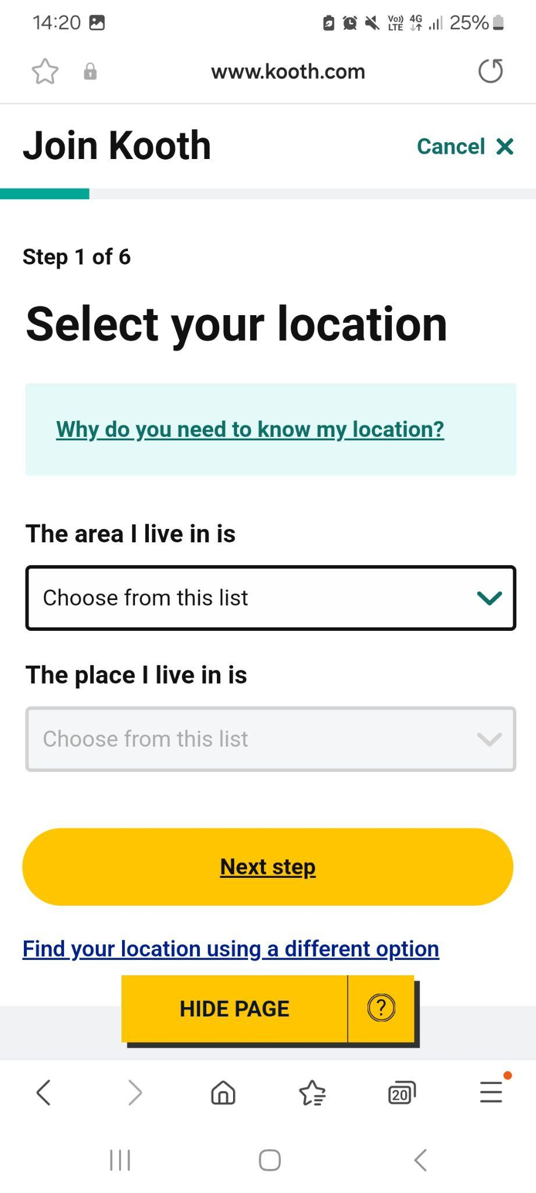
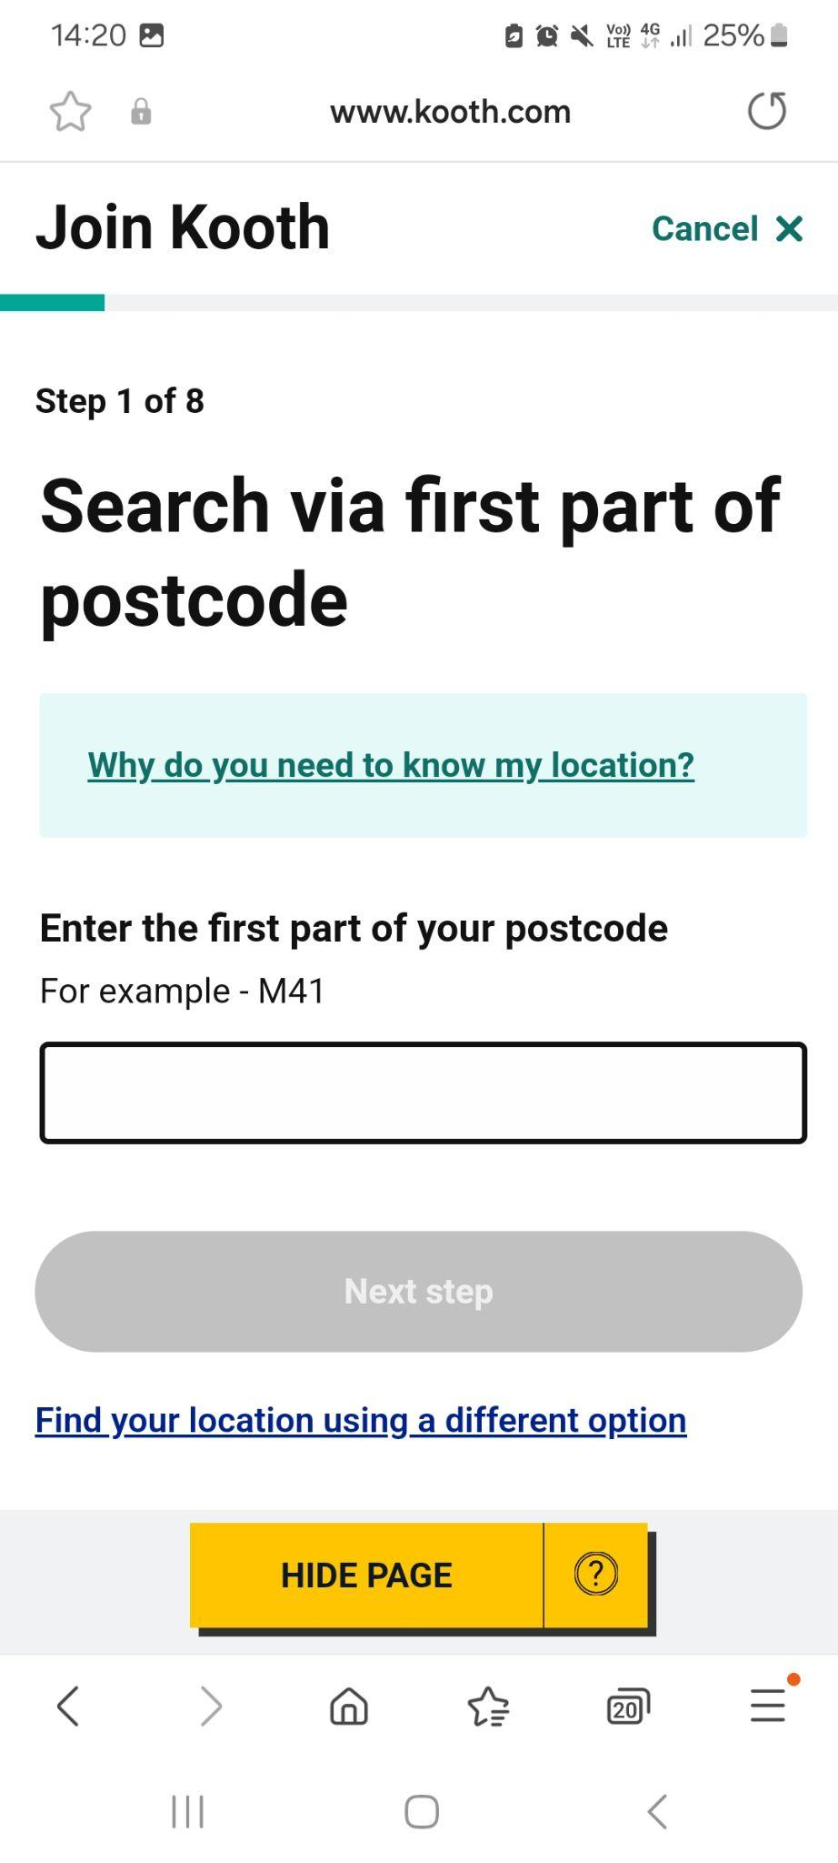
Sign up - Mobile
They can enter the first part
of their postcode of
home address
OR
Choose their area from
the dropdown
lists provided

Slide 18
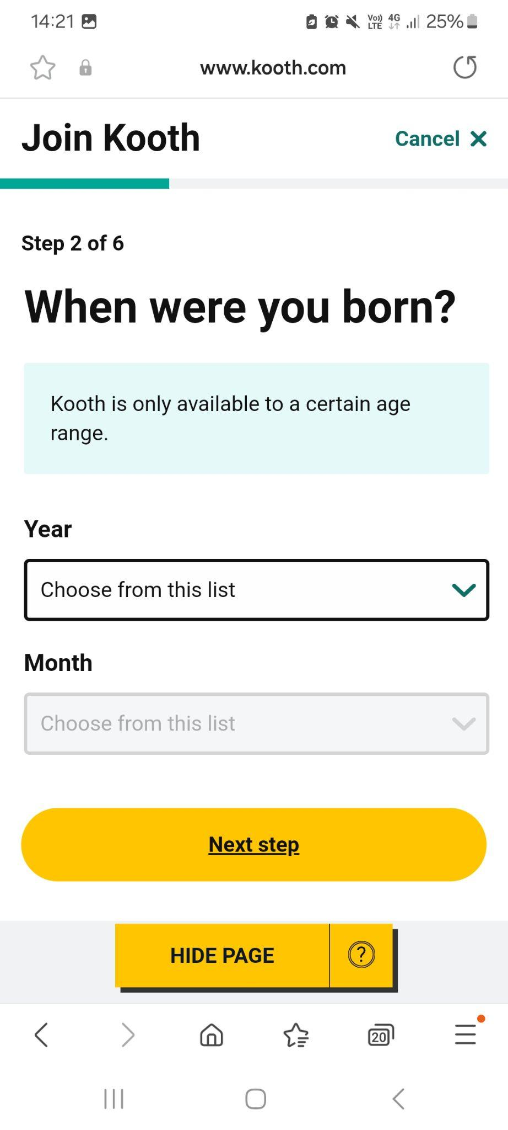
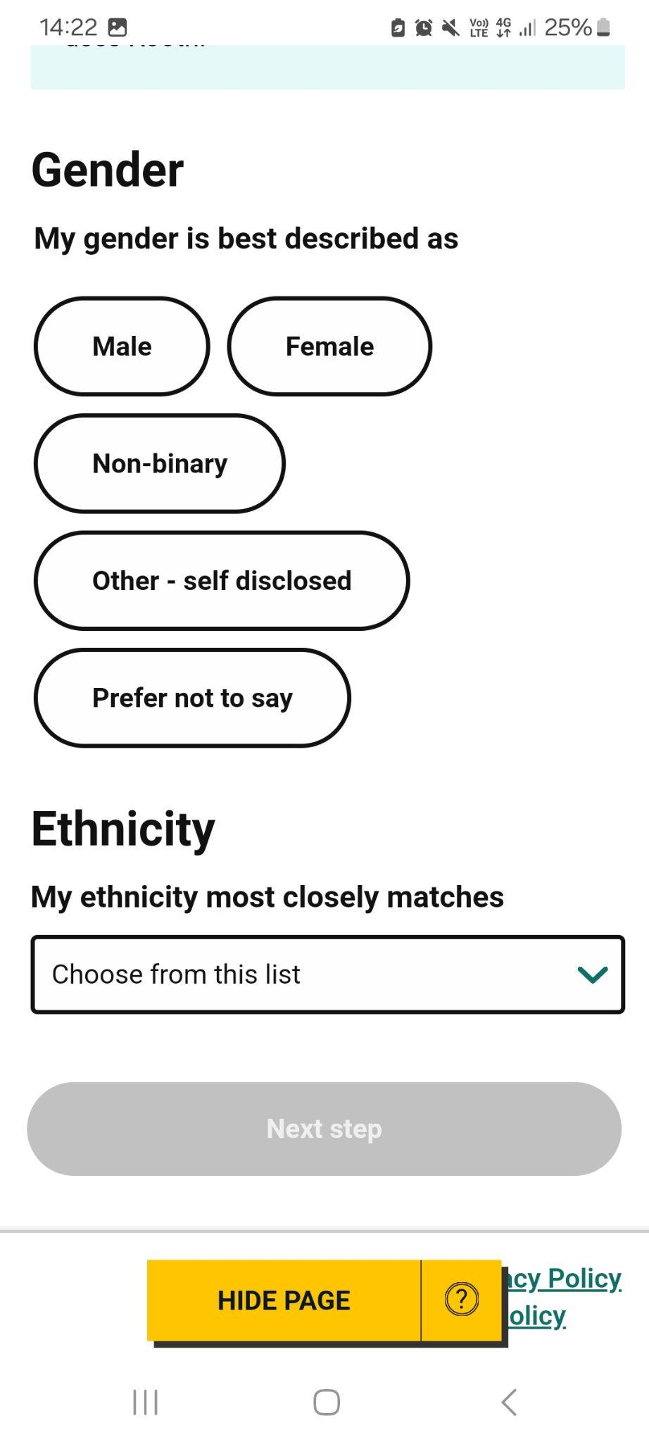
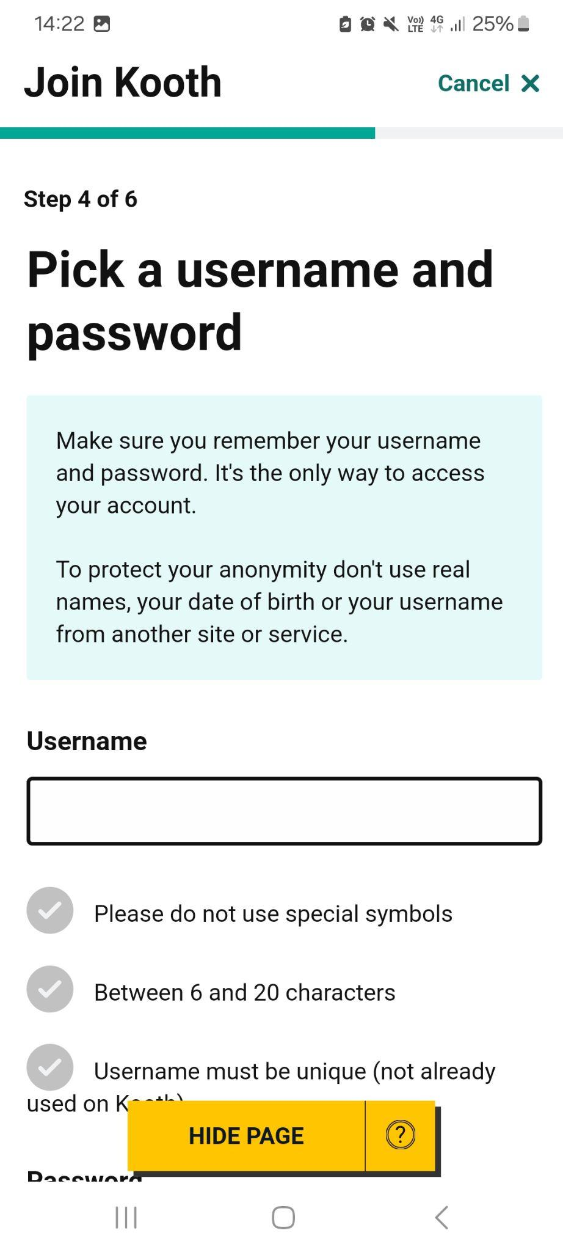
Sign up - Mobile
They can select the month and year of birth
Select their gender and ethnicity
However much or little they decide to share regarding their gender or ethnicity will not affect the support offered at Kooth
They can create an anonymous username and
secure password

Slide 19

Culturally competent support
We're mindful of the barriers some individuals may face around gender, ethnicity, or other identity-related concerns
Ensuring the safety and wellbeing of every user is a shared responsibility. We collectively support diversity in practice through tailored training, regular audits, and expert oversight
This ensures our care remains responsive, inclusive, and grounded in the realities of the people we support

Slide 20

94%
would recommend
Kooth
20%
registrations from minority ethnic communities
67%
users achieved a Goal Based Outcome
72%
logins
Out of Hours
(after 5pm)
Our use nationally in 2024
Top 3 presenting issues
Anxiety/ Stress
Suicidal Ideation
Friendships

Slide 21



Personalised, accessible support
Anonymity:
Removing stigma
and barriers
Democratise
access at scale:
A free service accessed via
any internet-enabled device
(Kooth is not an app)
Community
Peer support network
Speed of support:
Accessible with no referral needed, no thresholds
Safety:
Embedded throughout
the platform with clinically sound and fully moderated content
Autonomy:
Users empowered to
choose support options
Live Chat
Single Session Support from qualified mental health practitioners
Self-help
Content & Activities
Accessible:
Designed to provide an inclusive experience for people with disabilities in line with WCAG 2.1

Slide 22
Community
Support
Discussion Boards
Our vibrant community interacts with other users via our peer to peer support forums
Magazine & Podcasts
Thousands of articles with a majority being user generated
Support centred around you

Slide 23
Community
Support
Self-help
Discussion Boards
Our vibrant community interacts with other users via our peer to peer support forums
Magazine & Podcasts
Thousands of articles with a majority being user generated
Activities
Our inclusive and accessible mini-activites support in building a range of healthy habits and valuable life skills
Goal Setting
Personal goals can be set and monitored in a safe, moderated environment
Journal
A private yet simple and effective way to track mood
Support centred around you

Slide 24
Community
Support
Self-help
Professional
Support
Discussion Boards
Our vibrant community interacts with other users via our peer to peer support forums
Magazine & Podcasts
Thousands of articles with a majority being user generated
Activities
Our inclusive and accessible mini-activites support in building a range of healthy habits and valuable life skills
Goal Setting
Personal goals can be set and monitored in a safe, moderated environment
Journal
A private yet simple and effective way to track mood
Live Chat
Access to qualified practitioners through drop-in or pre-arranged online chat for A single session of Counselling.
Messaging
Message any time of the day and receive a response from a practitioner within 24-48 hrs
Support centred around you

Slide 25


We have four pathways of support based on different needs. All users begin on the self-guided pathway and our moderation team will make contact to offer further support if needed
Users can also message our mental health practitioners at any time and choose one-to-one support. Users can move freely between pathways depending on what support they need

Slide 26


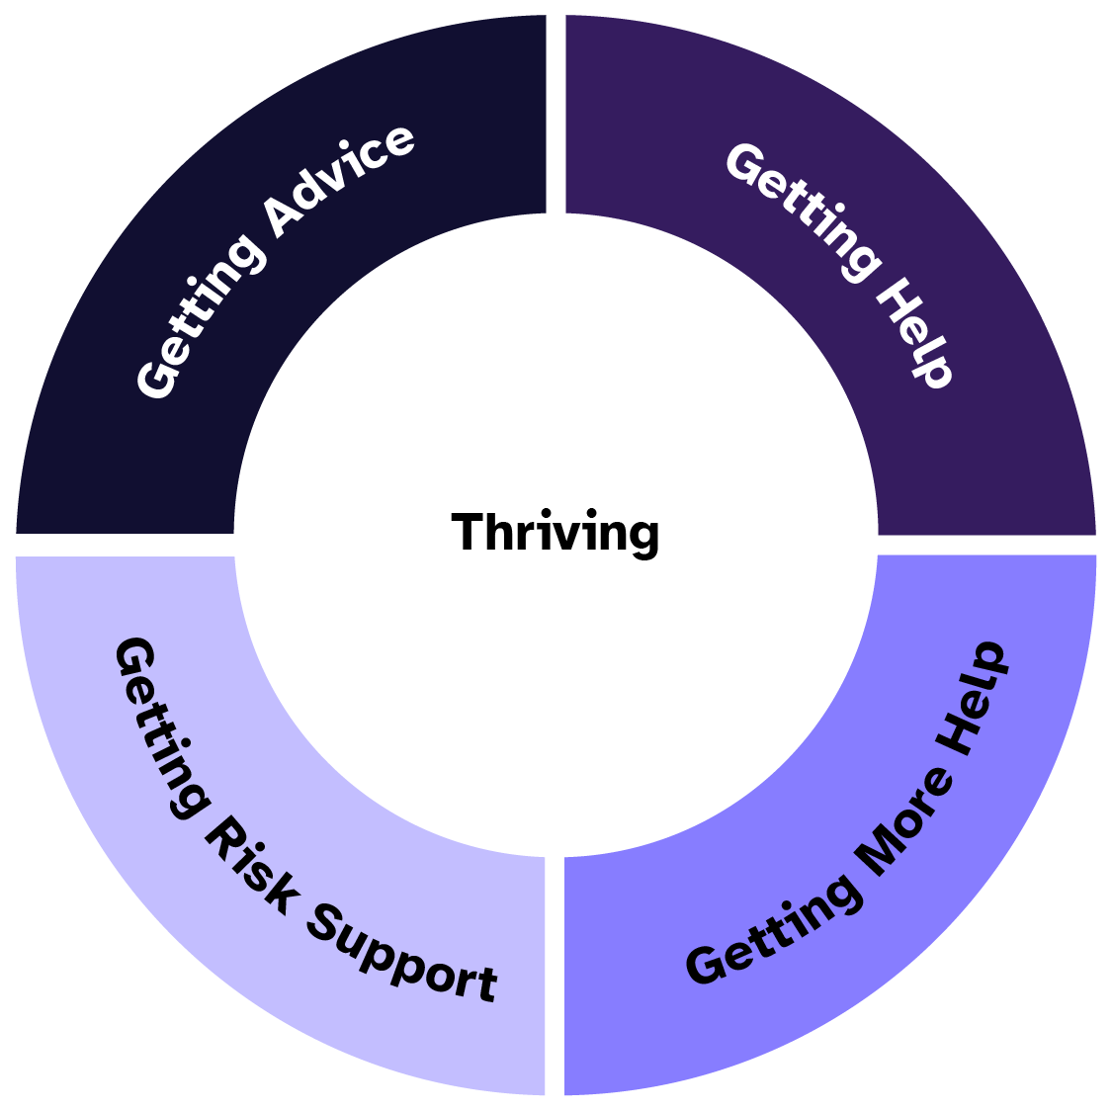
Tailored support pathways aligned with iTHRIVE
All users are on the Self-Guided pathway
(Getting Advice)
Tools, resources, community
Brief message support
Safety support and signposting
Responsive pathway
(Getting Support)
1:1 professional support
Single session approach
Brief risk assessment
Brief message support if needed
Complex Needs pathway
(Getting Risk Support)
1:1 professional support (assessment + 1- 3 sessions with named practitioner)
In-depth risk assessment
De-escalation intervention
Safety planning
External referral / liaison
Structured pathway
(Getting More Support)
Assessment chat
1:1 professional support (Single sessions with named practitioner)

Slide 27
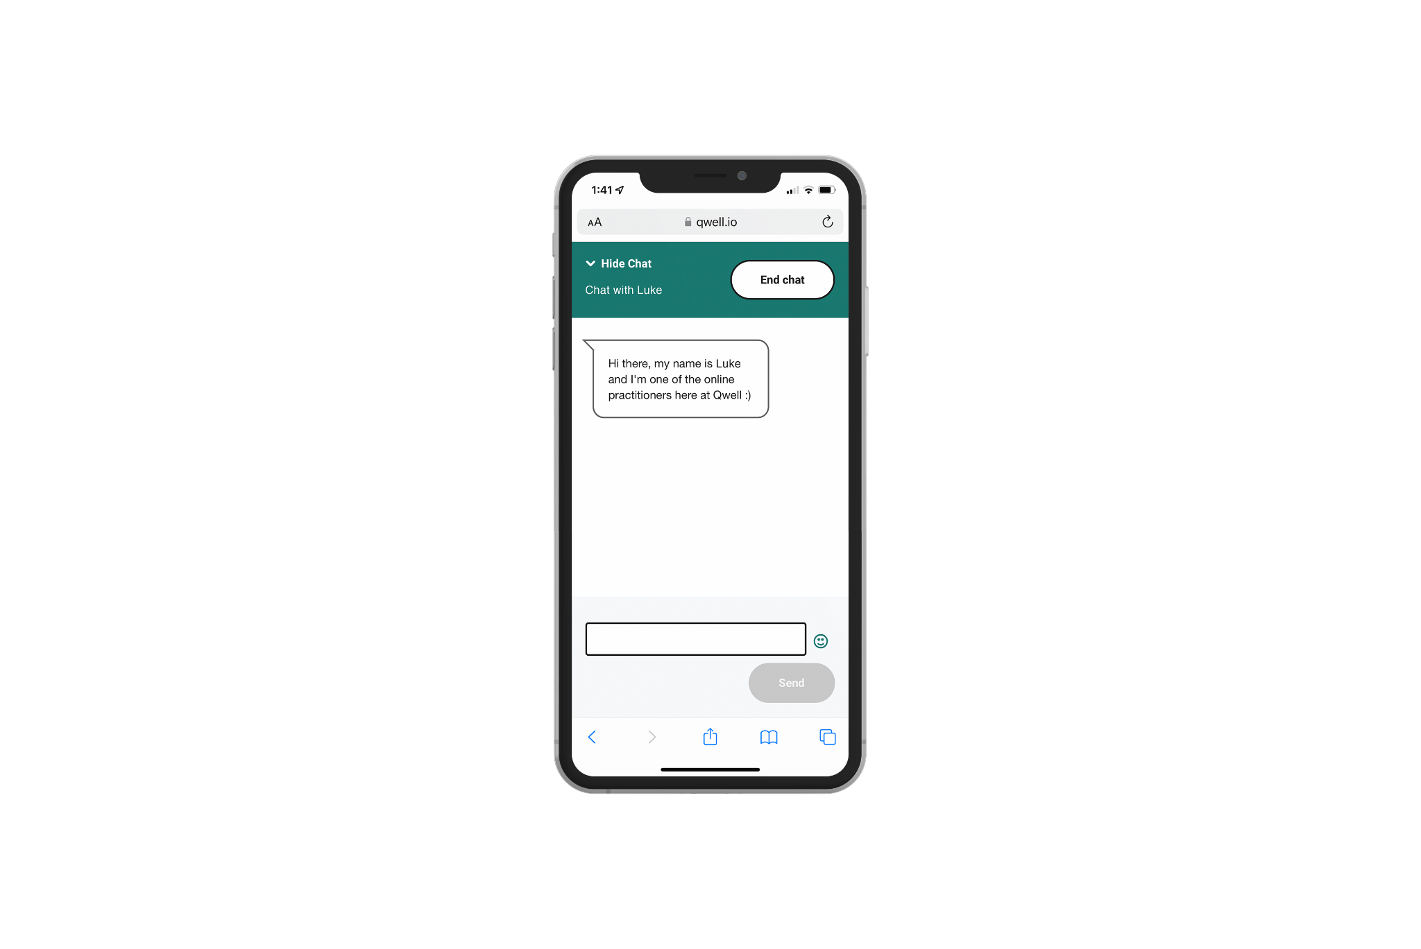
Professional support
Live Chat
When a user first comes to chat, we will talk to them about:
Understanding a little bit about them
Exploring their current difficulties and what's
brought them to Kooth
Thinking together about the best way we can
support them
Messaging
Many users in our community message our practitioner team - an option open to them anytime. Responses are within 24-48 hours

Slide 28

Safeguarding:
Our duty of care
If a user is considered a risk to themselves or from others, our practitioner will ask for their personal details and their consent
to share with external services.
Even if consent is not given, if our practitioner feels there is
a safeguarding issue then we will still refer, letting the user know who we are passing details to and why.
When we feel a person is in danger we collaborate with emergency services, letting the person know who we are
passing details to and why.

Slide 29
Safeguarding without identifiable information
We work with a user to reduce risk and develop a safety plan, whilst attempting to understand and address barriers to accessing other services.
We’ll also provide psychoeducational materials and signpost them to other relevant services.
Our anonymity supports effective safeguarding rather than acting as a barrier. We believe someone who is actively choosing to seek help is taking a really positive step for themselves.
Our users consistently tell us that the anonymity aspect enables them to share things that they wouldn’t otherwise.

Slide 30

A trusted ‘front door’ for those who might not otherwise seek support

Slide 31

How Kooth helped Sam*
Sam’s (male, 13 years) experience of grief & loss.
He suffered anxiety, self harm, loss of appetite, social isolation and shame.
Sam heard about Kooth in a school assembly and liked the sound of an anonymous service.
The following interventions on our Structured pathway were used to aid Sam:
Used Kooth journal initially to express his thoughts and feelings
Worsening presentation picked up (through moderation) so
chat was recommended (matched with a male counsellor
at his request)
Full risk assessment provided in chat, support given around
self harm, with follow up chat offered for continuity &
further assessment
Joined a forum with other peers about grief and loss
(identified trigger)
Engaged with Kooth’s mini self help activities
recommended by peers
*Sam is a pseudonym

Slide 32

Structured Pathway
Community
System & Financial
CORE-YP score: from medium to mild
Risk rating: amber to green
Presentation: lots of problems to goal achievement
Support: from weekly to asynchronous chat as needed
Sam still benefited from the other areas of Kooth. The self guided/community elements are always available regardless of what level of professional support a young person is accessing
Sam went from passive recipient to active user (helping others through content)
Sam has not required more costly and potentially lengthy face to face input OR deteriorated whilst sitting on a waiting list
Specialist resources are protected for those who require this level of support
The outcomes for Sam*,
the community and the system
*Sam is a pseudonym

Slide 33

Turning the tide on a growing crisis

Slide 34
Fit for the Future
The NHS’ 10 year plan projects a clear direction for the future centred around working towards 3 key shifts:
Analogue to digital
Kooth delivers digital, clinically-governed mental health support accessible via any device without the need for referrals or waiting lists. By offering scalable and stigma-free support, Kooth exemplifies how digital innovation can transform mental healthcare delivery
Sickness to prevention
Kooth offers early intervention and prevention designed to reduce escalation. However, our open access means we do see young people who need immediate support. Early intervention and prevention are crucial in providing safe spaces to talk, and digital services can effectively work with people to create harm reduction strategies and develop safety plans
Hospital to community
Kooth Engagement Leads are embedded in local communities to work alongside and alleviate pressures on the wider system. We are collaborative partners to support mentally healthier populations. We help de-stigmatise conversations around mental health and broaden access to support, enabling young people to safely connect to and support one another at Kooth.com
connect.kooth.com/Kooth-in-the-community

Slide 35
The role of education and the wider community
While the primary focus of Fit for the Future is on healthcare, the plan does highlight the role of education. In aiming to improve access for CYP, expanding support and reducing waiting times, the plan commits to all schools and colleges having MHSTs by 2030
The plan underlines the importance of collaboration between the NHS, local authorities and education to deliver preventive and community-based support

Slide 36

How we work alongside other support services
Support for people whilst waiting for specialist
services including CAMHS
Help for those that do not meet thresholds/criteria
for other services
‘Out of hours’ support with practitioners online
until 10pm each night
Aftercare once discharged from other services
Support for people who wish to remain anonymous,
or face barriers accessing support services
Early intervention & prevention: a space to ‘try it out’
Safely connect with others who have similar experiences
Reiterating skills and psychoeducation learned
in other services
Notes:
We are grateful for the work of other services, and Kooth can work alongside those services. Kooth is something you can offer NOW to your patients - both directly to young people but also to concerned parents/ carers

Slide 37





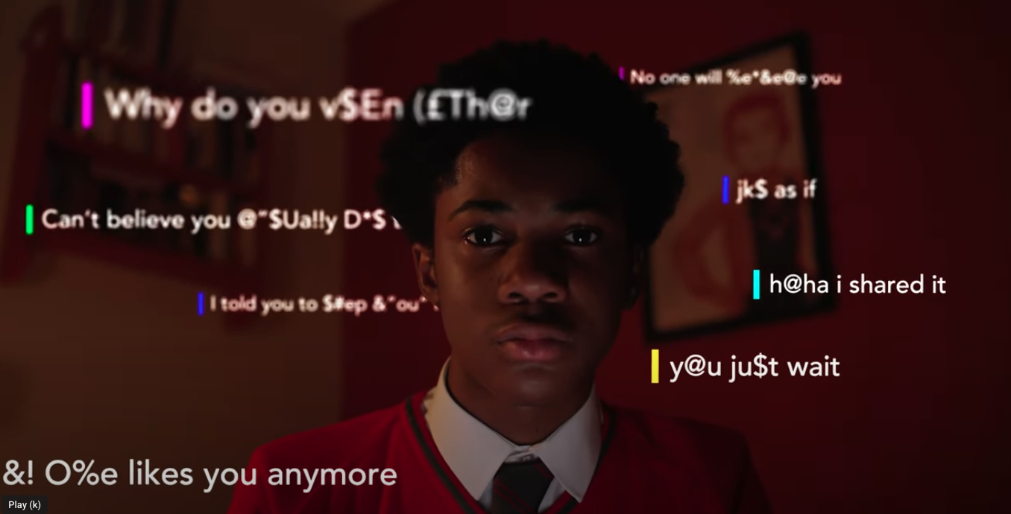

Oct/Nov focus
Kooth and The Diana Award:
Tackling bullying together
Through our partnership with The Diana Award we set out to raise awareness around bullying - particularly ‘invisible’ cyberbullying which can be hard for parents/carers to spot.
Together, we produced a short, emotive film based on bullying experiences shared with our mental health practitioners on Kooth. We worked on the concept and script with a panel of young people before filming with a group of talented young actors from the Sylvia Young Theatre School.
In addition, we commissioned Survation to ask 1000+ 11-18 year olds about their experiences of bullying.
See this page for a summary
of our campaign.
Kooth and Mind: Supporting conversations around suicide
We have partnered with Mind to support conversations around suicide, recognising that it might feel difficult knowing how much to ask and what language to use.
Our memorable ‘ABCD’ guide is aimed at helping people have these important conversations.
We commissioned the brilliant artist Eva Malley to illustrate our text, turning it into a cartoon strip to share as a carousel post on social media. This will be posted on 10th September - World Suicide Prevention Day.

Slide 38
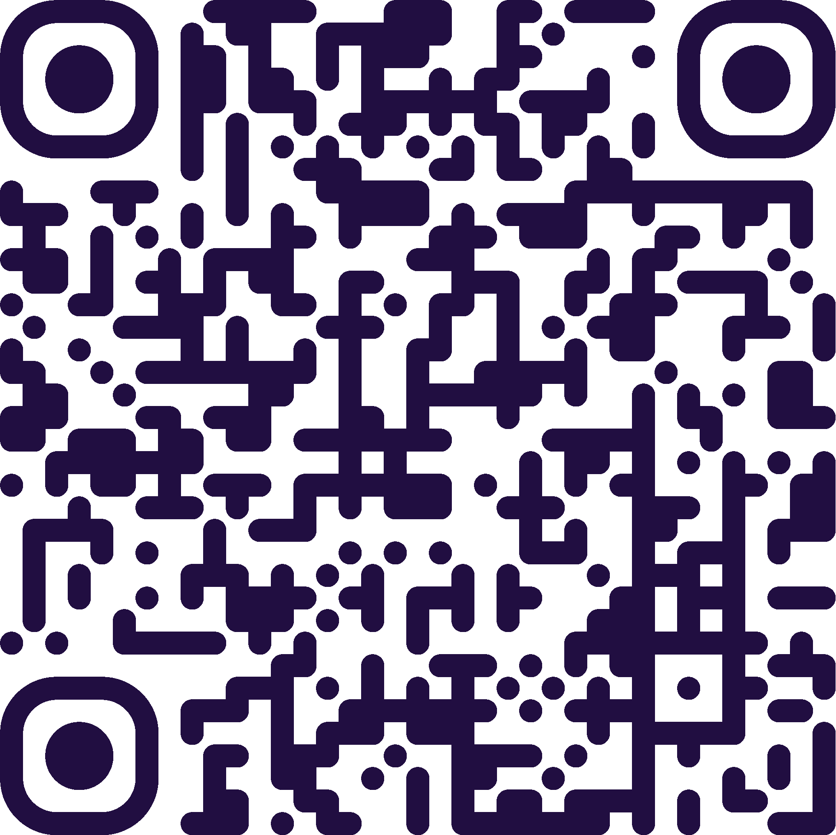

Signposting
Signpost a self-referral to kooth.com with a printed pocket card or A5 leaflet
Signpost in your discharge letters and waiting list letters
Place printed posters in public spaces (including backs of toilet doors) and load a digital poster on waiting room screens
Promote Kooth in your SMS patient messaging, newsletter, social media and website
Sign up to our free monthly newsletter
Healthcare booking form
We have an engagement team who can provide you with
free resources and training about Kooth
Please email kel@kooth.com to contact your local KEL

Slide 39


Thank you
Any questions?

Slide 40
Francesca Wells
Education Boutique

Slide 41
Sarah Collins
Young Carers
https://uniqueinclusion.wixsite.com/website-1

Slide 42
Supporting Young Carers in Education
Family Action Young Carers
sarah.collin@family-action.org.uk

Slide 43

Who is a Young Carer?
A young carer is someone under 18 who helps look after someone in their family
who is ill, disabled or misuses drugs or alcohol.
Young Carers care for on average for 3 years before being identified;
some caring for over 10 years.
Notes:
According to the 2021 UK census, there are 22,636 pupils living in RBWM. Research has indicated that that 20% of children have a caring role, the top 10% of whom have significant caring responsibilities. This equates to a potential of 4,527 young carers resident in RBWM.
Young Carers Research, Practice and Policy: An Overview and Critical Perspective on Possible Future Directions, Joseph et al (2020)

Slide 44

Young Carers’ Lived Experience
Caring tasks:
Practical tasks
Personal care
Emotional Support
Sibling Care
Impact of caring:
Physical and emotional health
Educationally
Socially
Environmentally
It is very important that a young person has a voice and a choice in the types of tasks being undertaken, and that they are
age- and gender- appropriate.
While they continue to provide care, young carers should be able to lead healthy and fulfilling lives.

Slide 45
Consider;
What processes does your school have in place to identify Young Carers?

Slide 46
Identify and code Young Carers
From Spring 2023, Young Carers were included on the school census return. This enables local authorities to build a much better picture of the number of young carers in schools but also provides opportunities to use this data to monitor attendance and attainment of young carers.
Schools will be able to use the following code set (CS118):
Education settings do not need a Young Carers Service to confirm whether a young person is a young carer. This may result in some young carers not being identified should there be barriers to them accessing an external support service.
Code | Young Carer Indicator
N | Not declared
P | Identified as a Young Carer by parent or guardian
S | Identified as a Young Carer by school

Slide 47
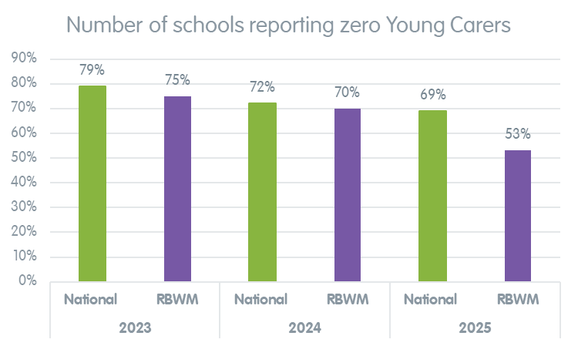
Identify and code Young Carers
294 young carers recorded in RBWM (up from 162 in 2024)
The school census (2025) identified: 64,500 were identified
The National Census (2021) identified: just over 120,000

Slide 48
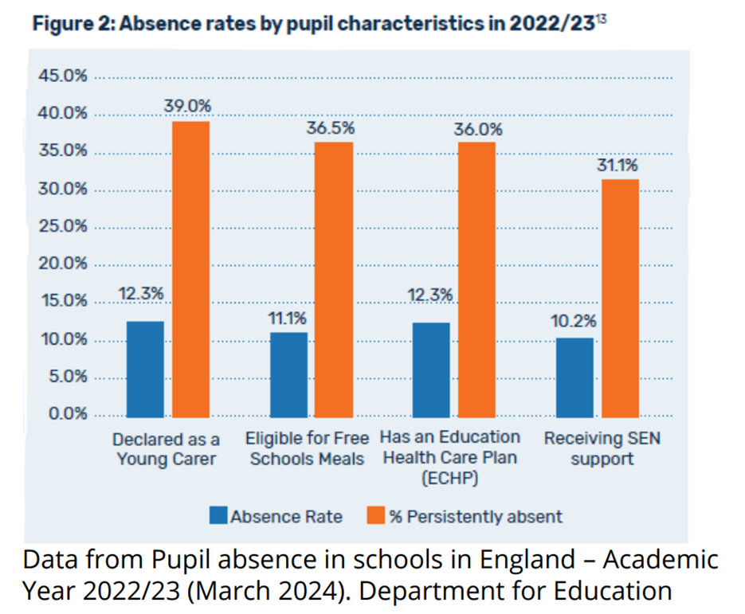
Impact of Caring - Education
On average, young carers miss 23 days of school each year, with nearly half persistently absent.
They are twice as likely to be suspended or excluded as their peers.
Many report bullying, lateness, and difficulties completing homework due to their caring responsibilities.

Slide 49
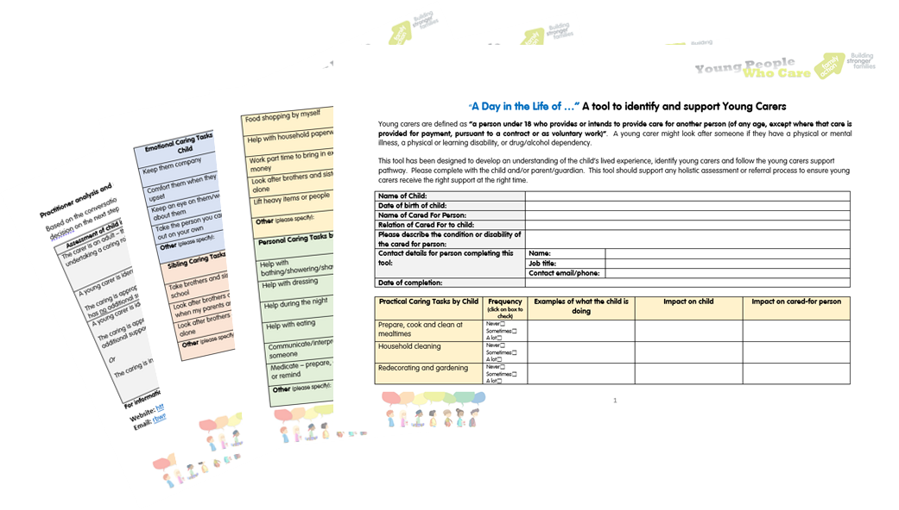
Young Carers Pre-Screening Tool
Things to consider
Are the caring tasks a reasonable demand on the young person?
Does the young person enjoy caring?
Is the young person safe in their caring role?
Are there any tasks they wish they could stop doing?
What do they worry about?
Is there potential for the care-giving tasks to have a negative impact on the young person’s physical, emotional and/or social wellbeing?

Slide 50
Confidentiality & Safeguarding
Be aware of,
Your organisation’s confidentiality and safeguarding procedure
Seek consent to share information, unless there is a risk of harm
Only share what is proportionate to the role and need at the time
Safeguarding Officer >> Safeguarding Referral
>> 999 Emergency
This list is not necessarily in order – if you believe there is an immediate risk of harm then action must be taken either to the police or the SPA Team without delay.

Slide 51
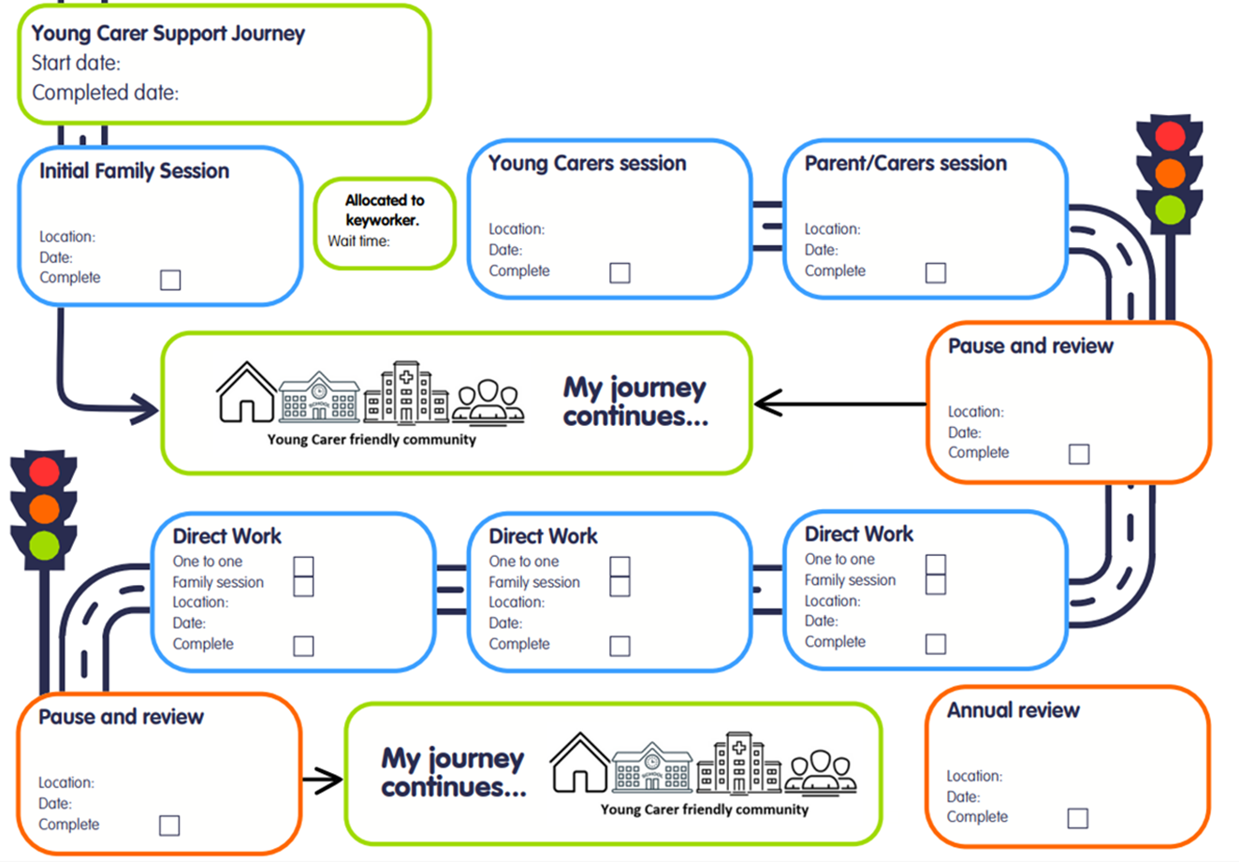
Family Action Young Carers – RBWM
RBWM Family Action is committed to making sure that caring is a positive experience for all young carers.
We provide a 6–10 week intervention. Families can re-refer to our service at any point if there continues to be a support need for a caring role within the family.
Our Support Offer includes;
Widening support networks
One to one support
Family sessions
Representation at meetings
Community Outreach programme
YC Ambassadors Programme

Slide 52
Action;
What do you think your school needs to do to improve the identification of Young Carers?

Slide 53
Thank you
Time for questions…

Slide 54
Visit our website for further resources
Contact the team at rbwm.yc@family-action.org.uk

Slide 55
Questions and
Feedback Form
Leadership Update Website.
All things SEMH and more.
Notes:
‹#›

