Slide 1
SEMH Network Meeting
Tuesday 6th May 2025
Welcome to this virtual forum
Notes:
‹#›

Slide 2
Agenda for today
https://www.leadershipupdate-rbwm.co.uk/information-for-all-schools/
https://www.leadershipupdate-rbwm.co.uk/semh-service/
Item | Who | Time
Welcome and Updates | Al Whitelaw / Debbie Nayar | 3.30 pm (15 mins)
Support in Knife Crime awareness | Theresa Allen | 3.45 (15mins)
Unique Inclusion | Michelle Underwood | 4.00pm (10 mins)
PAWs | Alice Lockwood-Smith | 4.10pm (10 mins)
Gr0ve | Jess Garner | 4.20 (10 mins)
Questions and Feedback | Al Whitelaw / Debbie Nayar | 4.30pm (10mins)

Slide 3
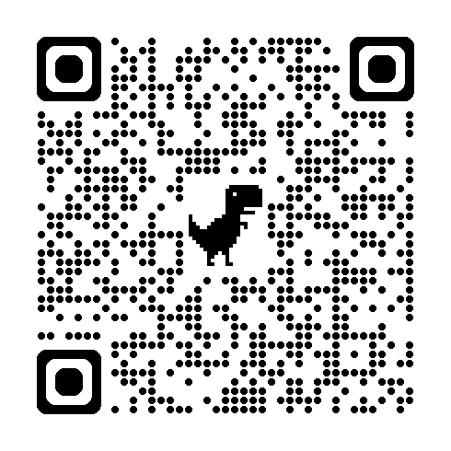
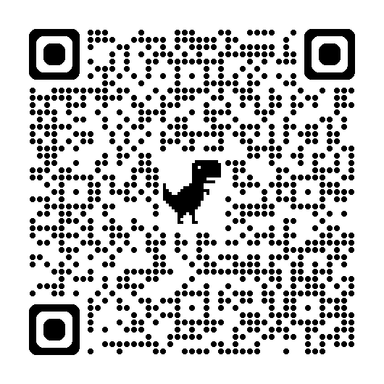
SEMH Intervention Service Page
Alternative Intervention Directory
Mental Health and Wellbeing request for Primary / Secondary representation on Network 2nd June - email Rebecca Askew
New Training (Special schools – info)
https://www.leadershipupdate-rbwm.co.uk/send-and-inclusion-training/
Young Carers Transition Booklet
Wellbeing and Schools Bill – Policy Summary
Boxalls Update – Only Nurture Partnership schools
Alternative Provision Strategy
FASD (Foetal Alcohol Syndrome) Guidance. Theresa Allen (attached in prior email)
Flexi Schooling
Transition Support

Slide 4
Onwards and Upwards
Moving to Secondary…
Summer Transitions 2025
Closing date is the 19th May for all schools to refer in.

Slide 5
Who are we?
About us…
The programme has been running in RBWM for 10+ years, this is delivered in collaboration between the Family Hub Service and SEMH and Behaviour Service. Both services are apart of Achieving for Children who deliver Children’s Services in the Royal Borough of Windsor and Maidenhead.
Our services work across early help, education and social care providing targeted support for families.
Programme Manager - Chris Caughey
Programme Lead - Cherrelle Long

Slide 6
Programme Information 2024
Date: 26th - 28th August
Time: 10.00am - 3.00pm
(Attendance is required for all three days)
Location: Windsor Family Hub, 65 Alma Road, SL4 3HD

Slide 7
Who does this programme most suit…
The programme most suits those young people with low-medium school related challenges which would be supported by short term intervention to ensure a successful start to secondary education.
Attendance should be supported by additional transitions support by the current and transferring education settings.
This is for those young people with low self esteem and confidence who need a boost.

Slide 8
Programme Summary
The onwards and upwards programme is run informally using small group work, creative tasks, team building activities and is flexible to the young person's needs.
The programme is structured to suit a ‘normal’ school day with breaks and lunches and includes an evening activity to replicate that of homework.
The teaching style is informal and young person centered.
The programme gives the young person the opportunity to reflect on their journey and enables expression of feelings.
Rules and Boundaries are created on the first day to provide safety for all.

Slide 9
Programme Aims
To feel better prepared for secondary school by:
Having increased confidence and esteem
Learning strategies to manage emotions
Building positive relationships
Understanding the importance of good routine and organisation
Facing challenges as an individual and a team
Being able to express thoughts and feelings
Having fun

Slide 10
Criteria
The young person must:
Be an RBWM child
Be able to participate independently and positively in a group environment
Attend all three days
Be able to attend without a parent/carer being present
Understand why they have been referred

Slide 11
Additional Information
If a young person requires 1-1 support, this must be organised by the referring education setting/service.
Travel is not provided
Pre and post programme school visits will be completed to build relationship and complete short assessments
All referrals are assessed individually, referrals are accepted or declined on the discretion of the staff team to ensure the programme is suitable for each young person and group dynamics are managed.

Slide 12
Theresa Allen
Support in Knife Crime Awareness
https://uniqueinclusion.wixsite.com/website-1

Slide 13


Support for Youth Violence /Knife Crime

Slide 14
A worrying minority of children continue to have direct experiences of violence.
20%
of teenage children have been a victim of violence.
Children commit violence in reaction to others.
16%
of children have been a perpetrator of violence.

Slide 15
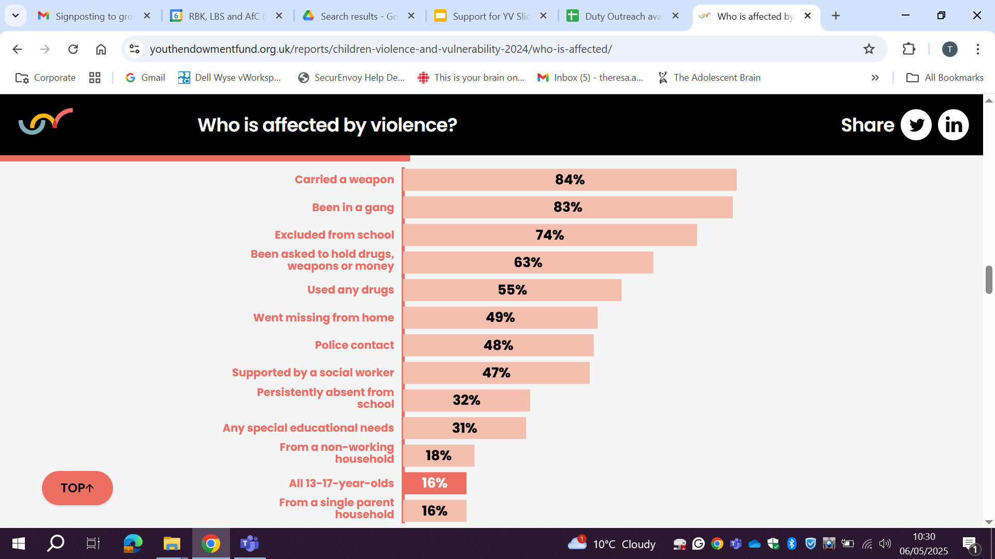

Slide 16
Voice of the child ….
https://youthendowmentfund.org.uk/reports/children-violence-and-vulnerability-2024/who-is-affected/

Slide 17


Virtual Reality Impact
VR uses science of adolescent decision-making process.
Offers immersive virtual reality experiences for real scenarios.
Addresses gang culture, youth violence, and risk-taking behaviors.
Workshops customised for various audiences and training purposes.

Slide 18










Slide 19


Slide 20
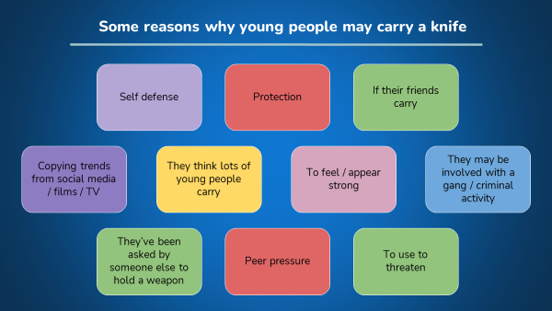
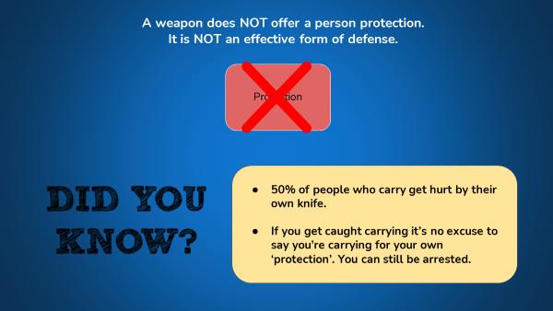
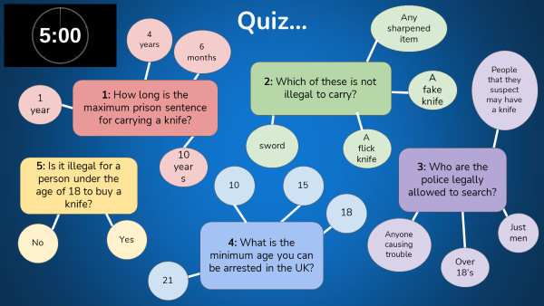

Slide 21
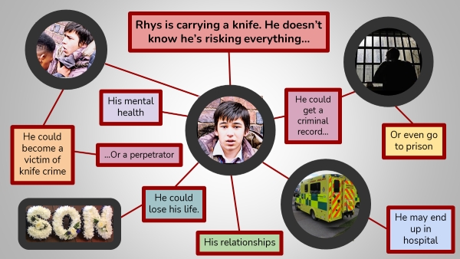
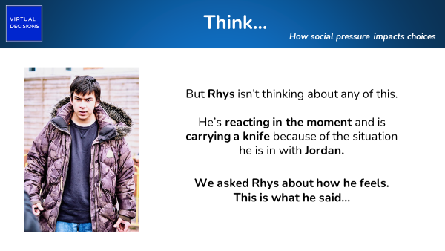
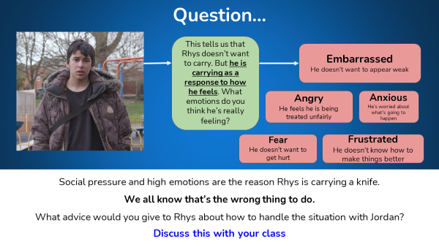

Slide 22
Knife Crime Feedback | Gangs Education Feedback
24 young people have used the Knife Awareness VR Experience 54% - Male 41.7% - Female 4.2% - Not expressed Ages 34.8% - 12 -13 yrs 30.4% - 14- 15 yrs 26.1% - 16 -17 yrs 4.3% - 1- 11 yrs Area 52% - Windsor 40% Maidenhead 8% - Ascot 88% - Enjoyed the format of learning about knife crime with the VR experience. 96% -Felt that the experience helped them to think more about the consequences of knife crime. 92% - Shared that the experience made them think about their actions. 71% - Shared that they would seek the support of a trusted adult for support if they knew a friend was carrying a knife. 100% - Felt it was a good way to learn about knife crime. 92% - Felt that they learned something new. | 16 young people have used the Knife Awareness VR Experience 88.7% - Male 13.3% - Female Ages 50% - 12 -13 yrs 30% - 14- 15 yrs 10% - 16 -17 yrs 10% - 1- 11 yrs Area 56.3% - Windsor 43.8% Maidenhead 87.% - Enjoyed the format of learning about the impact of gang violence with the VR experience 100% - Felt that they learned the consequences of being involved in gang violence 81.3% - Shared that they would be more likely to report an assault like the one they saw in the VR experience 93.8% - Shared that they thought it was a good way to teach safer choices about gang violence 93.8% felt that they learned something new

Slide 23
Comments Shared - Knife Awareness | Comments Shared - Gangs Awareness
about carrying sharp objects Laws around carrying knives at school That carrying a knife can get you arrested if you are stopped by the police Walk away I learnt what the consequences are to carrying a knife Empathy for young people and the pressures they face i learnt that you shouldnt carry like knifes and stuff How to spot the opportunities to leave a dangerous situation safely About joint enterprise taught me what to do and not what to do okay About criminal sentences for drugs and knife crimes That you can go to jail for up to 4 years for carrying a knife Well I didn't know you could get arrested at 10 years old, so that new. Bit shocking but makes sense because of the two 10 year olds who killed a boy. And it makes sense why my parents don't let me go to parks. And now I'm kind of glad I don't live in London anymore. i learnt about knife crime and the responsibility | to think about your actions before you act upon them If you are in a bad situation with your friends you can get into serious trouble if you do not make the correct choices. Very well delivered Not to always trust your friends If you post something it can effect you later in life New perspective and understanding regarding peer pressure. Not to be in a gang and not to be with the wrong peoples I learnt that you have very little time to make a decision and tend to go with the flow. I learnt that many young people will be a 'sheep' and just follow the others without thinking of the consequences. They are also manipulated or groomed into gangs. That actions always have consequences Very informative i felt i learnt the different ways gangs attitudes can change regarding your decisions

Slide 24
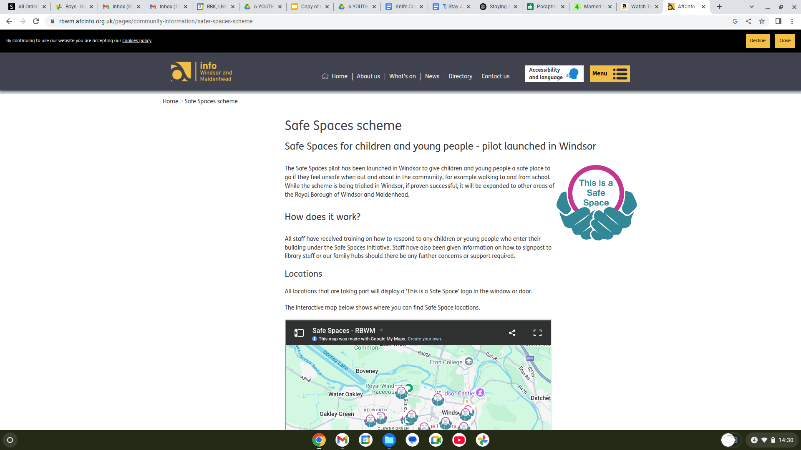

Slide 25

List of the Safe Spaces currently registered:
All libraries in RBWM, including Windsor Library and Dedworth Library
All Saints Church, Alexandra Road
Costa Coffee, Dedworth Road
Harvester – Windsor Lad, Maidenhead Road
Imperial Park Café, Imperial Road
Tesco Superstore, Dedworth Road
Thames Valley Hospice Shop, Dedworth Road
Windsor Baptist Chruch, Victoria Street
Windsor Family Hub
Windsor Leisure Centre
Woodys Cafe, Dedworth Road

Slide 26

Knife Crime Awareness Week - 19th - 24th May
Family Hubs KC Campaign
Vote for your Tagline
4 Community Events
Sport
Art
Music
Nature

Slide 27
To make a referral for support
Early Help
CP/CIN - social worker can make referral direct
Intel
https://www.thamesvalley.police.uk/ro/report/ocr/af/how-to-report-a-crime/

Slide 28
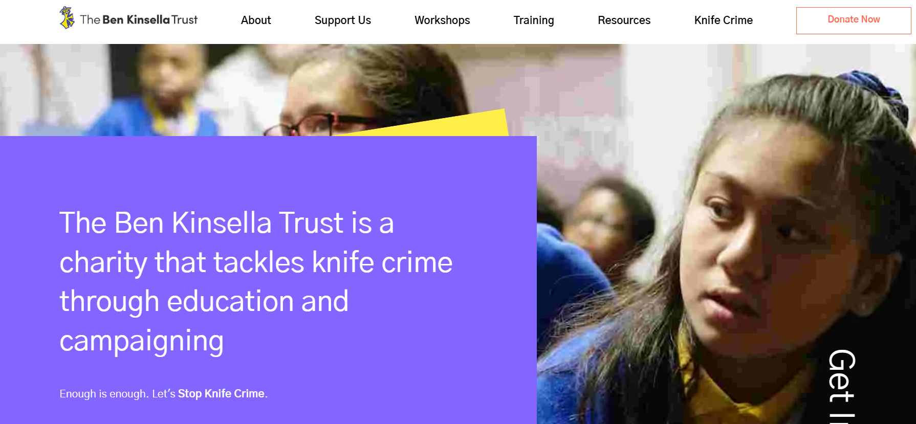
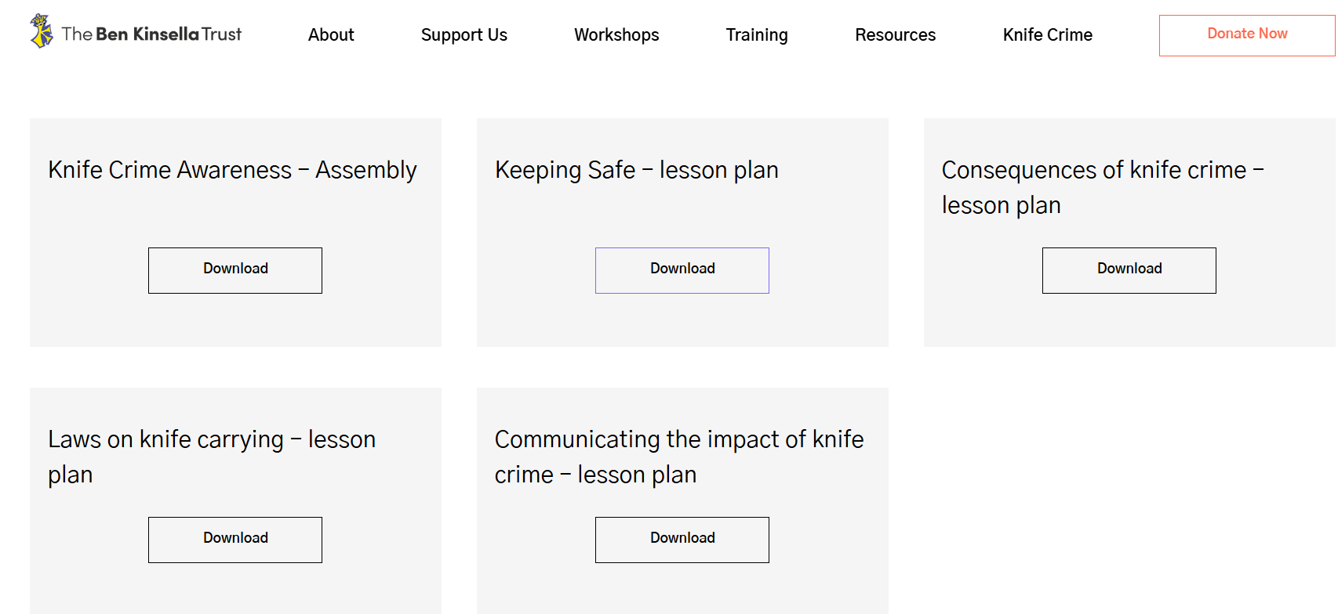
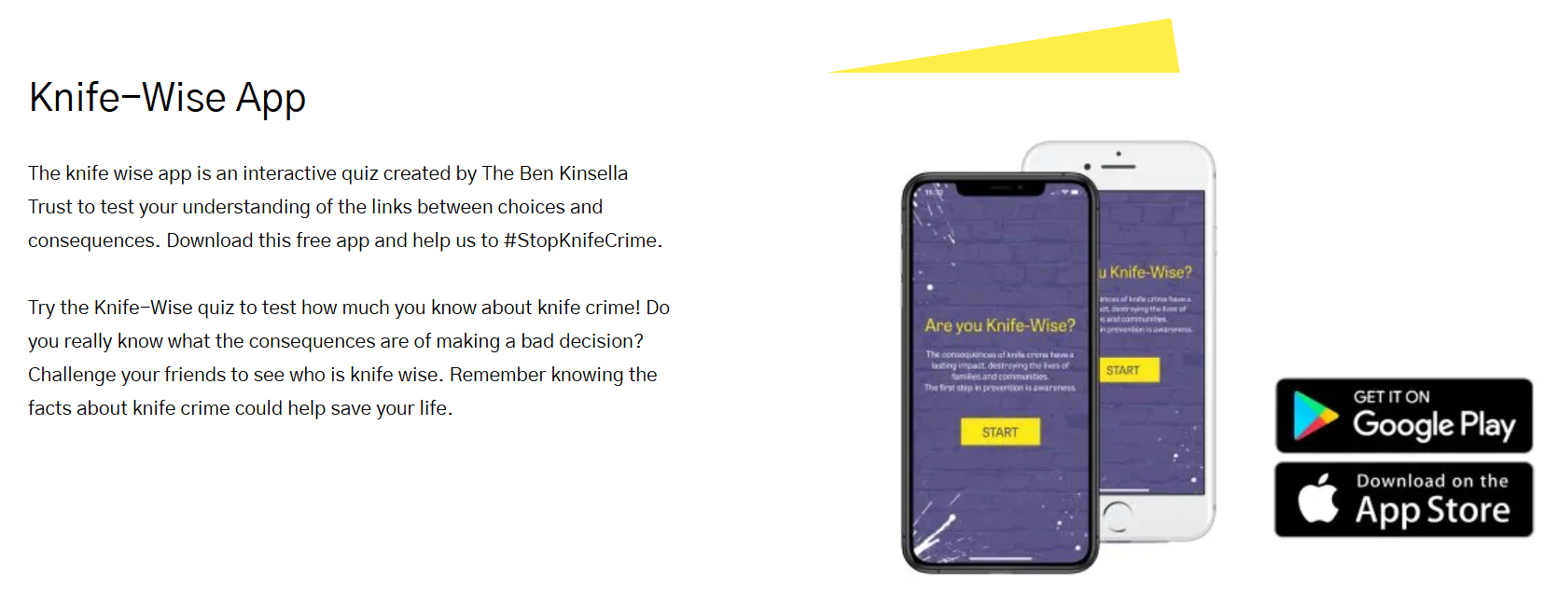

Slide 29

Youth Endowment Solutions
Youth Endowment Fund supports violence reduction efforts.
Provides funding for evidence-based programs addressing youth violence.
Focuses on early intervention to prevent youth violence.
Offers resources to help implement effective youth programs.
https://youthendowmentfund.org.uk/toolkit/

Slide 30
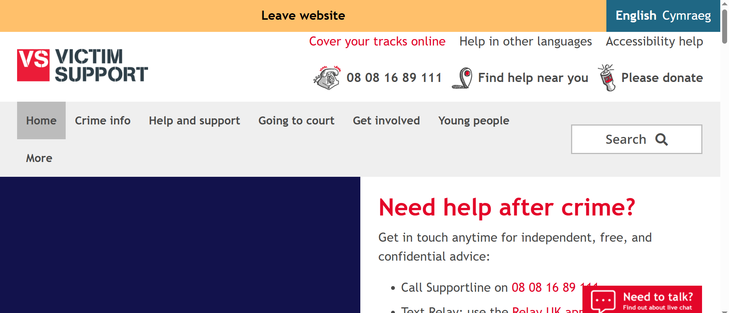
https://www.victimsupport.org.uk/

Slide 31
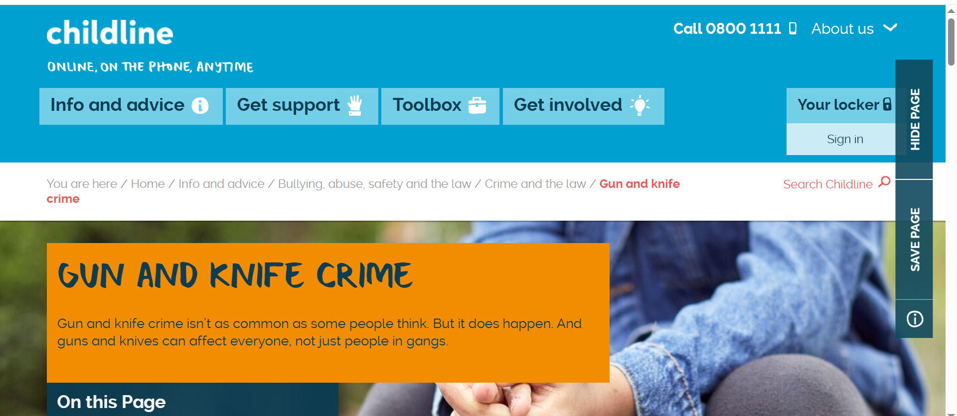
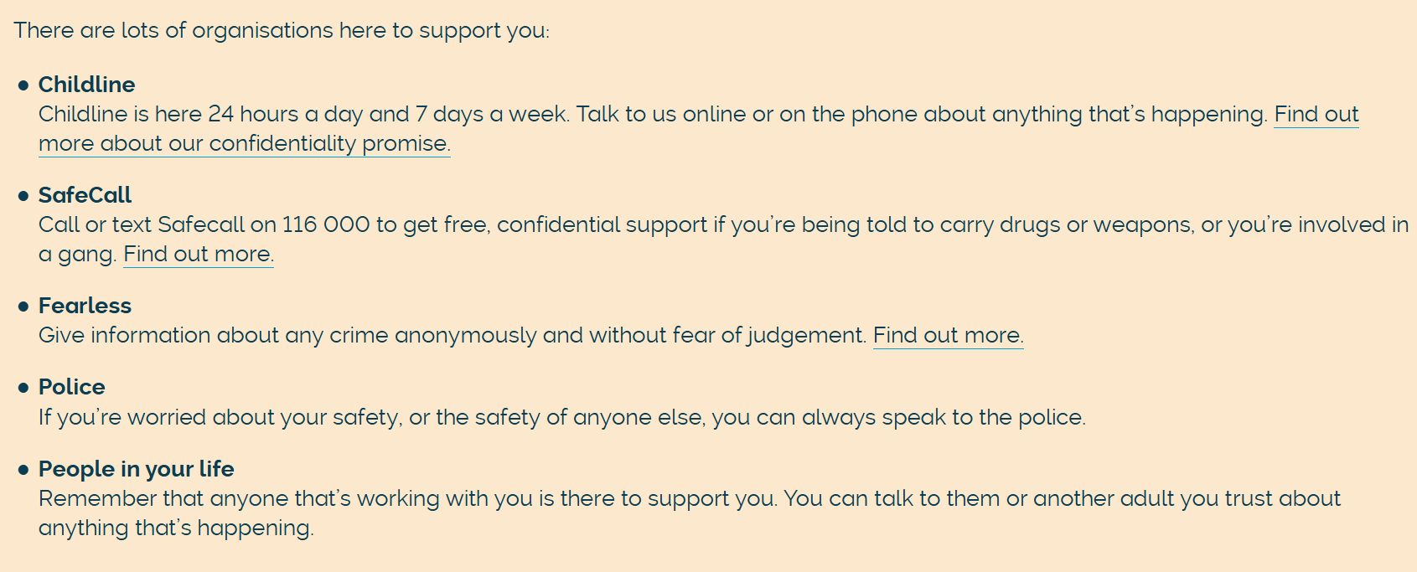

Slide 32
THANK YOU

Slide 33
Michelle Underwood
Unique Inclusion
https://uniqueinclusion.wixsite.com/website-1

Slide 34
Understanding behaviour
Michelle Underwood
BCBA, UKBA (cert), MSc

Slide 35
Agenda
Background
ABCs
Functional assessment
Regulation planning

Slide 36
Background
`
Registrations: BCBA, UKBA (cert), ACBS- cpd, exam, supervised practice
BSc Psychology
MSc Behaviour Analysis
Research degree
GTP
24 years working with autistic CYP- parent funded/charities/ social enterprise
BFC Education & Learning since 2019
BFC, RBWM, WBC social care work since 2017
CAMHS funded work since 2023
BILD PBS level 4/5 tutor since 2025
Direct work for schools through LA funded work
Notes:
Context and range of experience

Slide 37
Behaviour Analysis
1
2
3
4
5
6
Understand why there are barriers (learning or social)
Identify missing skills to help practise difficulties
Break down into small steps to build confidence
Identify environmental changes that could help
Increase motivation
Understand self/ child/ student - additional parent/pupil work

Slide 38
Offer to RBWM schools
Needs-led support, no requirement for EHCP or specific diagnosis
Individualised strategies based on unique pupil profiles, strengths, preferences and motivations
Proactive, preventative support/ trauma-informed, therapeutic, not consequence focused

Slide 39
Format of work
Single visits with summary report and recommendations
Detailed assessments with optional implementation support
Staff consultation, training, modelling, upskilling and empowering
Direct pupil work where appropriate
Parent/carer work where needed

Slide 40
Costs
Price per referral from £300
Credit/12 month package- can be shared across schools, from £62.50 per hour onsite, flexible approach to credits used for multiple pupils, observations if required, parent work/TAC etc

Slide 41
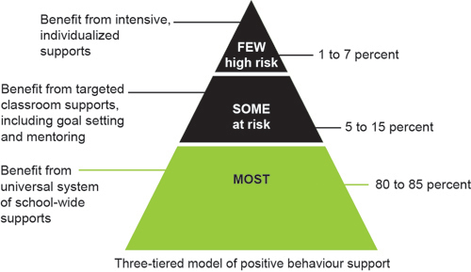
SWPBS
Time, resources, cost

Slide 42
Questions?

Slide 43
Alice Lockwood-Smith
PAWs
https://uniqueinclusion.wixsite.com/website-1

Slide 44

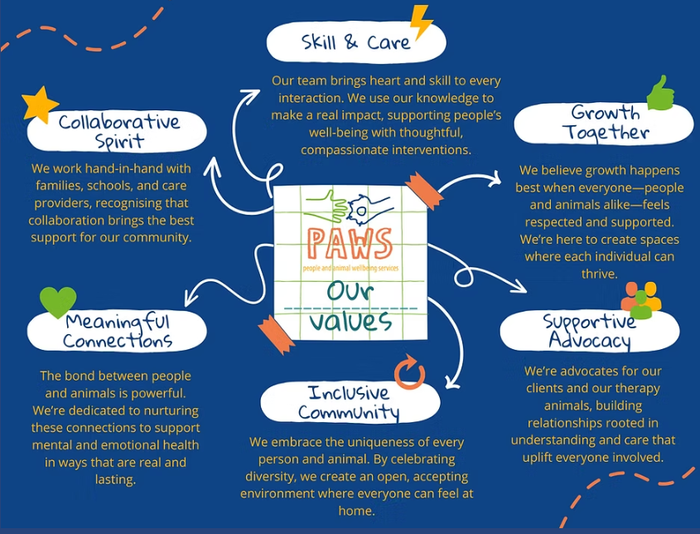


Who are we & what do we do?
Not For Profit offering outreach support for children and young people who are struggling with complex needs, trauma and accessing their education
We do this through delivery of therapy and education sessions with our incredible therapy dogs 1:1 in the home, in schools and in the community.
Utilising the Human Canine bond we are able to make connections and build relationships faster than many traditional interventions.
Every programme is person centered - at the core of everything we do are the needs of the person in front of us.

Slide 45








Our Programmes
Emotional Literacy & Communication
School Re-Engagement
ASDAN Shortcourses
Maths & Literacy Education Support
Enquiries to info@pawswellbeing.org
  Identification of need through referral form and discussion
  Allocation of practitioner and team
  Termly reporting
  Regular review of service provision and impact

Slide 46
Jess Garner
Gr0ve
https://uniqueinclusion.wixsite.com/website-1

Slide 47


The information contained in this webinar is provided for information purposes only and is not intended to amount to advice and you should not rely on any of the contents of this webinar. Professional advice should be obtained before taking or refraining from taking any action as a result of the contents of this webinar. GROVE Neurodivergent Mentoring & Education disclaims all liability and responsibility arising from any reliance placed on any of the contents of this webinar. ​
​
Copyright © 2025 GROVE Neurodivergent Mentoring & Education LTD. All rights reserved. These works are protected by copyright laws and treaties around the world. We grant to you a worldwide, non-exclusive, royalty-free, revocable licence to view these works, to copy and store any materials provided alongside these works and to print pages of these materials for your own personal and non-commercial use. You may not reproduce in any format any part of the works without our prior written consent.​
Copyright © 2025 GROVE Neurodivergent Mentoring & Education LTD. All rights reserved.​

Slide 48



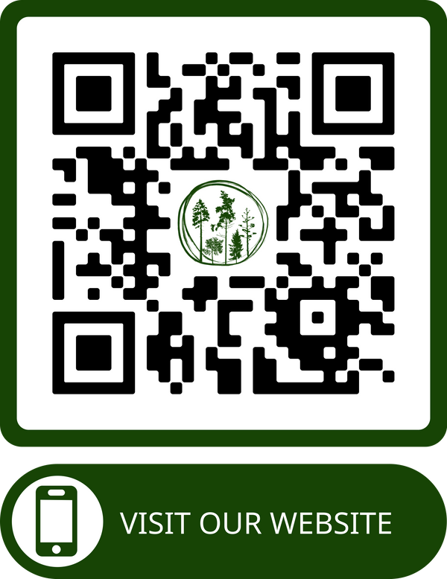



ABOUT
JESS
GROVE
Late identified Autistic / ADHD, Parent​
​
QUALIFICATIONS & TRAINING:​
​
~ BA Hons English ~ PGCE English/Drama & QTS ~ MA Autism (note: 2022-2025) ~​
​
~ Level 3 Supporting Children, Teenagers & Young Adults with PDA ~ Level 4 ADHD ~​
​
~ Enhanced DBS with barred lists ~ Designated Safeguarding Lead for GROVE (DSL) ~​
​
~ PREVENT ~ Safer Recruitment ~​
​
~ Trauma Informed Practice ~
~ Safeguarding Vulnerable Adults ~ Suicide & Self Harm Awareness ~​
​
Our Vision​
GROVE is a safe online community for Autistic children & young people to connect through shared interests & experiences.​
We support our children & young people’s personal growth by fostering a positive & authentic Autistic identity through neuro-affirming programmes of mentoring & education.​
founder@gr0ve.org
GROVE's Parent/Carer Facebook Group:
https://www.facebook.com/groups/gr0vecommunity/ ​
Copyright © 2024 GROVE Neurodivergent Mentoring & Education LTD. All rights reserved.​
Notes:
I'm Jess, a late identified autistic ADHD'er, Mum to autistic PDA ADHD children both of whom experienced barriers to school attendance, before I needed to stop work to support them I spent 17 years teaching English and Drama in UK secondary schools. I am currently studying a MA in autism centring children and young people's experience and in the process of launching Grove - an online service for young people to connect with neurodivergent mentors, with their peers and to explore their lived experience.

Slide 49
GROVE’S NEURO-AFFIRMING FOUNDATIONS
  Our approaches are grounded in the principles of Neurodiversity Paradigm.
  We recognise the pervasive role of ableism within society, including the influence of internalised ableism.
  We aim to challenge ableist narratives about neurodivergent people.
  We are committed to being anti-racist.
  We are committed to being LGBTQIA+ affirming.
  We recognise and respect each individual’s intersectional identity and are committed to unpacking one’s own privilege.
  We aspire to work in a way that is trauma informed.
  We respect all forms of communication and presume competence.
Our Foundations enable us to aspire, wherever possible, to create an accessible and emotionally, psychologically, sensorially, relationally safe space for GROVE’s young people, their families and those with whom we work.
These foundations create the potential for authentic connection, community and growth in a way that is meaningful for each individual – for instance, developing meaningful relationships, a sense of belonging, possibly developing self-understanding, positive self-esteem and neurodivergent identity.
Copyright © 2024 GROVE Neurodivergent Mentoring & Education LTD. All rights reserved.​
Notes:
Just a very quick run down of some of the language we'll be using in this evenings webinar.
QUICK READ THROUGH.

Slide 50
INDIVIDUAL MENTORING
  Autistic Mentors:
    Lived experience and deep knowledge of autism, reflective and committed to ongoing learning.
    Safer recruitment with Enhanced DBS with children’s barred list check
  Flexible Sessions:
    Content differs for every young person.
    30-minute, 45-minute or 1-hour sessions, with weekly options and no set duration.
  Communication:
    Adapted to the needs of each young person.
  Young person-led:
    Driven by the young person's preferences and needs.
    Low-demand
  Potential impact:
    Safe, supportive environment & relationships
    Acceptance, belonging & validation
    Improved self-confidence & self-worth
    Positive Autistic role model
    Affirming knowledge of autism
    Improved self-understanding & ability to access accommodations & supports, use strategies for executive functioning, to self-advocate & so on
Copyright © 2024 GROVE Neurodivergent Mentoring & Education LTD. All rights reserved.​
Notes:
Just a very quick run down of some of the language we'll be using in this evenings webinar.
QUICK READ THROUGH.

Slide 51
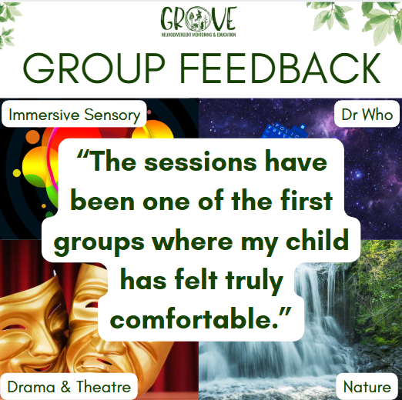

PEER GROUPS
Copyright © 2025 GROVE Neurodivergent Mentoring & Education LTD. All rights reserved.​
Notes:
Just a very quick run down of some of the language we'll be using in this evenings webinar.
QUICK READ THROUGH.

Slide 52


BEING ME
Knowing myself, valuing myself, being myself
Copyright © 2024 GROVE Neurodivergent Mentoring & Education LTD. All rights reserved.​
Notes:
Just a very quick run down of some of the language we'll be using in this evenings webinar.
QUICK READ THROUGH.

Slide 53
Questions and
Feedback Form
Leadership Update Website.
All things SEMH and more.
Notes:
‹#›

