Slide 1
SEMH Network Meeting
Wednesday 31st January 2024
Welcome to this virtual forum
Notes:
1

Slide 2
Agenda for today
SEMH Intervention Service –
Schools Consultation Form
Item | Who | Time
Welcome and Updates | Al Whitelaw | 3.30 pm (10 mins)
Thames Valley Police | Jake Haynard | 3.40 pm (15 mins)
Child on Child Abuse | Ray Tait | 3.55pm (15 mins)
Commando Joes | Paul McGill | 4.10pm (15 mins)
DASH Charity | Gabby Lakin | 4.25 (15 mins)
GEMs | Julia Wales / Mamta Martin | 4.40 (5 mins)
Questions and Feedback
https://www.leadershipupdate-rbwm.co.uk/semh-service/
https://www.leadershipupdate-rbwm.co.uk/information-for-all-schools/
TEAM TEACH – Little Muddy Me

Slide 3
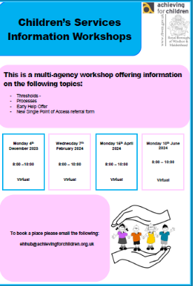
This is a multi-agency workshop offering information on the following topics:
Thresholds
Processes
Early Help Offer
New Single Point of Access referral form
To book a place please email the following:
ehhub@achievingforchildren.org.uk
Monday 4th December 2023
8:00 –10:00
Virtual
Wednesday 7th February 2024
8:00 – 10:00
Virtual
Monday 15th April 2024
8:00 – 10:00
Virtual
Monday 10th June 2024
8:00 – 10:00
Virtual

Slide 4
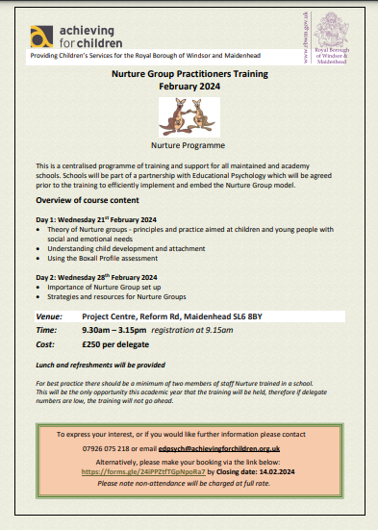
Nurture Group Practitioners Training February 2024 Nurture Programme
Day 1: Wednesday 21st February 2024
Theory of Nurture groups - principles and practice aimed at children and young people with social and emotional needs
Understanding child development and attachment • Using the Boxall Profile assessment
Day 2: Wednesday 28th February 2024
Importance of Nurture Group set up
Strategies and resources for Nurture Groups
Venue: Project Centre, Reform Rd, Maidenhead SL6 8BY
Time: 9.30am – 3.15pm registration at 9.15am
Cost: £250 per delegate
Notes:
There are still spaces on the training.
Closing date for bookings: 14th February
Dates for training are Wednesday 21st February and Wednesday 28th February
This training is only offered once an academic year.
I have attached the flyer just in case it needs to be added to any other post meeting information.

Slide 5
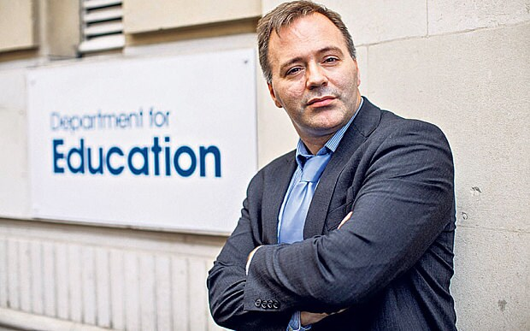
Behaviour in Schools webinars
Webinar: Creating and Implementing a Positive Behaviour Culture in practice
Webinar Date/Time: Thursday 08 February 2024, 4:00 PM - 5:00 PM
Join the Department for Education’s Lead Behaviour Advisor, Tom Bennett OBE for a free 60-minute webinar to discuss the underlying principles of creating a strong behaviour culture and how to implement this in practice in a way to ensure all school maintain calm, safe and supportive environments that can benefit both staff and pupils.
The webinar will also include two head teachers from our £10 million Behaviour Hubs Programme. They will share their experiences of how to create calm, safe and supportive environments and how to implement DfE guidance in a practical way.
This session is open to all school leaders and school workforce, Local Authorities, and governors. It is the second in a planned series, the first of which (‘Behaviour in Schools’) can be accessed here.
This session is free to attend – please register below.
Should you be unable to attend/view the events live, it will be recorded and made available online or via link access shortly after the session.
Sign Up Instructions

Slide 6
Thames Valley Police
Jake Haynard

Slide 7
Temporary Schools Officers
PC Jake Hynard
Jake.Hynard@thamesvalley.police.uk
07391862820
PC Ben Whitburn
Benjamin.Whitburn@thamesvalley.police.uk
07800703165

Slide 8
What can we help with?
General queries
Advice – when to report to the police?
Safeguarding concerns
Safeguarding visits – on or off school premises
Assemblies
1-1 or group inputs
Crime prevention advice

Slide 9
When to report?
Has a crime occurred?
What evidence is there that a crime has occurred?
Is anyone at risk of harm?
101 or 999?
Consider alternatives – is it suitable to deal within the school? Partnership intel form?
If unsure, ask us for advice.

Slide 10
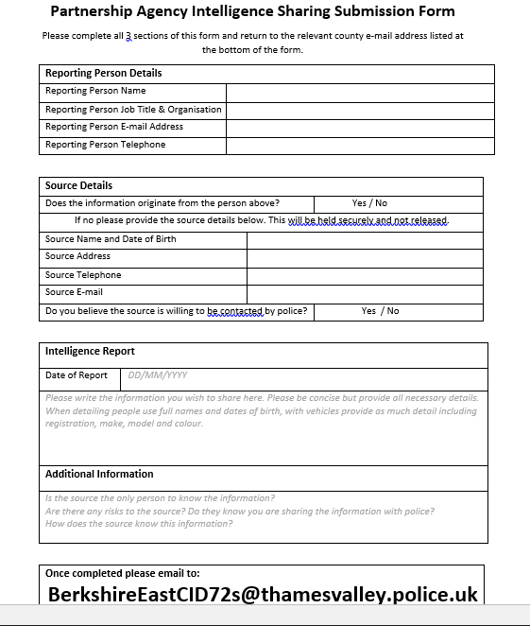

Slide 11
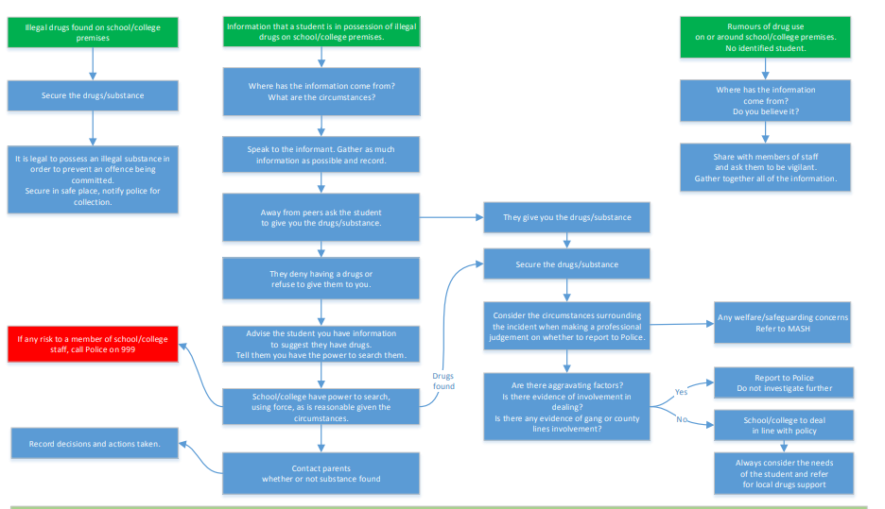

Slide 12
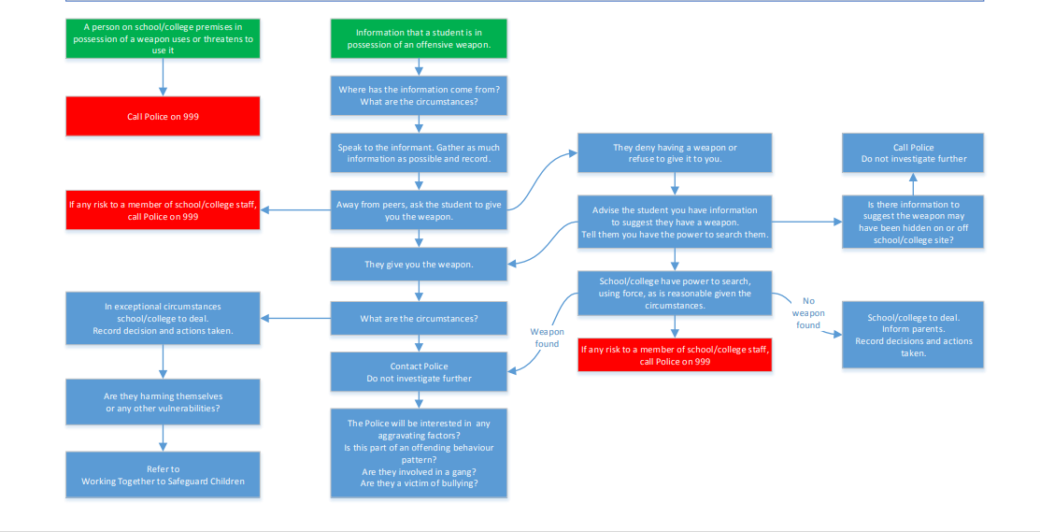

Slide 13
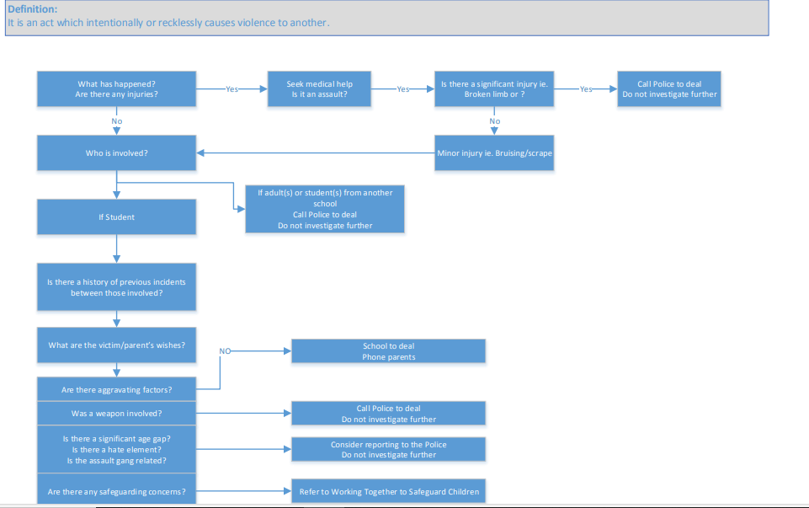

Slide 14
Child on Child Abuse
Ray Tait
CHILD-ON-CHILD ABUSE TOOLKIT & RESOURCES FOR SCHOOLS

Slide 15

Harmful Sexual Behaviour Practitioner
Presentation to SEMH LEADS
31 January 2024
By Ray Tait
Harmful Sexual Behaviour Practitioner
Windsor & Maidenhead Youth Justice Service

Slide 16
What Is Harmful Sexual Behaviour?
Harmful Sexual Behaviour (HSB) is developmentally inappropriate sexual behaviour displayed by children and young people which is harmful or abusive this can also include the use of technology.
Peer-on-peer sexual abuse is a form of HSB where sexual abuse takes place between children of a similar age or stage of development. Child-on-child sexual abuse is a form of HSB that takes place between children of any age or stage of development.
Problematic sexual behaviour (PSB) is developmentally inappropriate or socially unexpected sexualised behaviour which doesn’t have an overt element of victimisation or abuse.
(NSPCC and AIM Project, 2024; Allotey & Swann, 2019)

Slide 17
Why Work with Children who have Displayed
Harmful Sexual Behaviour?
A recent Freedom of information request revealed that 32,452 reports were made to the Police in England and Wales between 2012–2016 involving sexual offences by children against other children. This represents an average of more than 22 initial concerns of this nature everyday (Barnardo's, 2017).
The number of cases reported to the Crown Procurator Fiscal Services in Scotland during this period involving a sexual offence committed against a child by a child rose by 34% (COPFS). These shocking Statistics highlight that harmful sexual behaviour displayed by children and young people is widespread, and is a form of sexual abuse that is increasingly being reported to statutory authorities such as the Police and Social Work Professionals in the UK and Beyond (AIM Project, 2019).
It is estimated that one third of child sexual abuse is committed by children and young people (Hackett, 2014).

Slide 18
Why Work with Children who have Displayed
Harmful Sexual Behaviour?
Children and young people are not adults and the motivations for their behaviour are often very different. Children who display harmful sexual behaviour have often had adverse experiences themselves and may be meeting a need through the harmful sexual behaviour that is not just about meeting their sexual needs although this can be the case (AIM Project 2019; Allardyce & Yates, ; Hackett, 2001).
Working with young people who have displayed harmful sexual behaviour and those who have displayed problematic sexual behaviour helps to reduce the number of potential future victims of sexual abuse and can help children and young people who have displayed harmful sexual behaviour to meet their needs in healthy ways and have positive futures (Hackett, 2001; AIM Project 2019; NSPCC, 2017; NICE, 2018).

Slide 19
Role of Harmful Sexual Behaviour Practitioner
Providing Consultation to professionals in Early Help, Social Care and Education about whether a Child or Young Persons (8-18 years) behaviour is Healthy, Inappropriate, Problematic or Harmful.
Providing Consultation to professionals about how best to respond to the sexual behaviour of children.
Offering advice to professionals around Safety Planning.
Direct work with children and young people aged 8-17 years of age who have displayed harmful sexual behaviour or who have displayed problematic behaviour on several occasions.

Slide 20
Role of Harmful Sexual Behaviour Practitioner
Assessments to determine:
What vulnerabilities may have contributed to the child or young person’s pathway into any harmful sexual behaviour that may have taken place and what need any behaviour may have met:
Whether the Child/Young Person will benefit from an HSB interventions, or if a different assessment or intervention would be more suited (for example - Neurological assessment, hearing assessment, sight test).
Whether the family or Child/Young Person may benefit from any other support.
Interventions with children and young people who have been assessed as needing in depth support to provide them with the skills needed to:
Manage their sexual and general behaviour in healthy ways
Meet their needs in healthy ways
Recommendations of interventions our partner agencies could put in place to support the children or young people we are working with (for example - anti-bullying workshops, safe use of social media workshops)..

Slide 21
Specific Help for Education Professionals
Purpose of an HSB Consultation
To give professionals from Early Help, Social Care, Health, and Education the opportunity to discuss concerns they may have about a child or young person’s sexual behaviour.
To respond to complex cases in a systematic way that is underpinned by current good practice and research.
To provide a framework that will help them consider what vulnerabilities may have contributed to the child’s pathway into problematic or harmful behaviour and what need the behaviour may be meeting.
To provide a framework that will help professionals to consider whether the behaviour being displayed by a child or young person is “Healthy, Inappropriate, Problematic or Harmful” in complex cases or where there have been several instances of concerning behaviour. This can include the HSB practitioner completing an AIM Checklist to help support forward planning for the case.

Slide 22
Specific Help for Education Professionals
Purpose of an HSB Consultation
To help formulate a plan as to what can be done to help the child or young person meet their needs in healthy ways.
To consider whether any actions need to be taken to keep the child concerned and other children safe while any assessment or intervention work is undertaken i.e. advice about Safety Planning.
To promote professional curiosity.
To help professionals decide whether they should make a Section 47 Referral to Children’s Social Care or Section 17 Referral to Early Help Services.

Slide 23
Referrals and Support
If an educational professional is concerned about the sexual behaviour of a child and would like a consultation, then they should email Ray Tait at the following email address: ray.tait@achievingforchildren.org.uk.
A HSB Consultation Request Form will then be sent out which will need to be completed before a Consultation Session takes place.
Further Information:
RBWM Children’s Safeguarding Policy & Procedures.
NSPCC Website.
AIM Project Website.

Slide 24
Commando Joe’s
Paul McGill

Slide 25
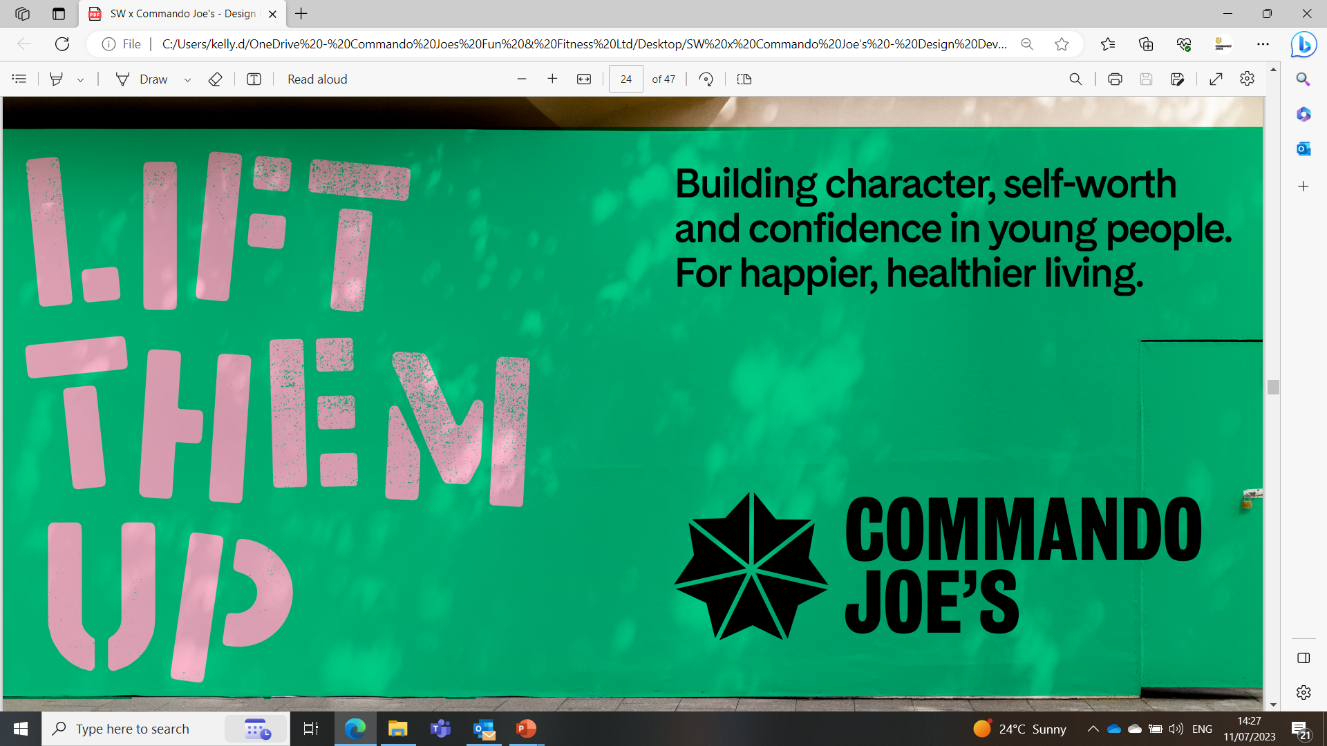

Slide 26
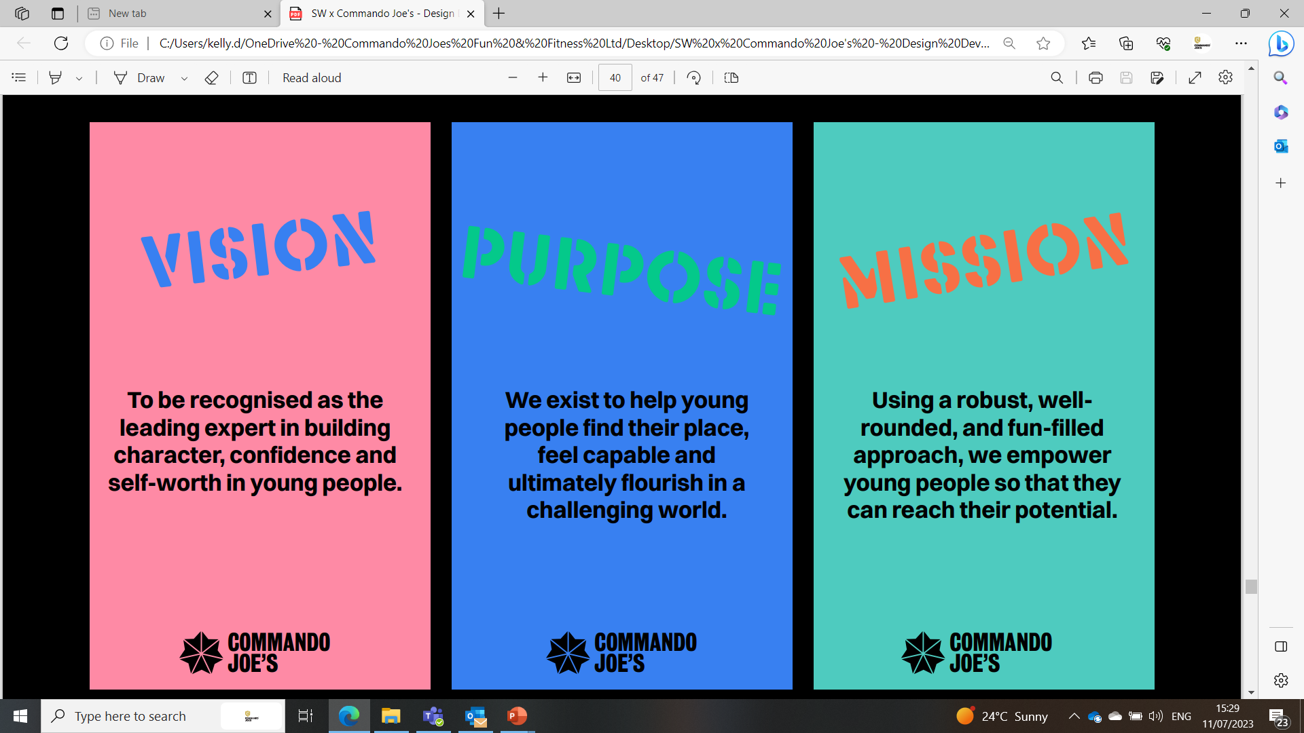
OUR VPM

Slide 27

INSTRUCTOR LED PROGRAMME
A custom-made programme tailored around the needs of your school, and the pupils within.
Assertive mentoring
Whole class sessions
Intervention group work
Classroom support
Breakfast/Break/lunchtime/after school clubs
Guided reading
Character education programme
Parental/community activities
Staff team building and health and wellbeing

Slide 28
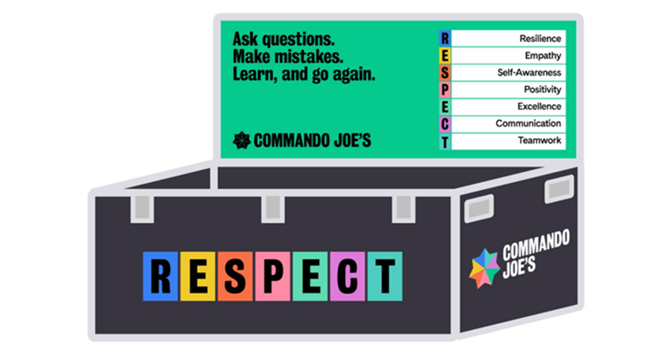
Character Education Resource Portal
SCHOOL LED PROGRAMME
Staff Training (plus programme review days)
Complete Equipment Set (The Box)..
Character Progress Tracking Tool
Termly CPD Week
ACE Membership
Parents Character Portal

Slide 29


Slide 30
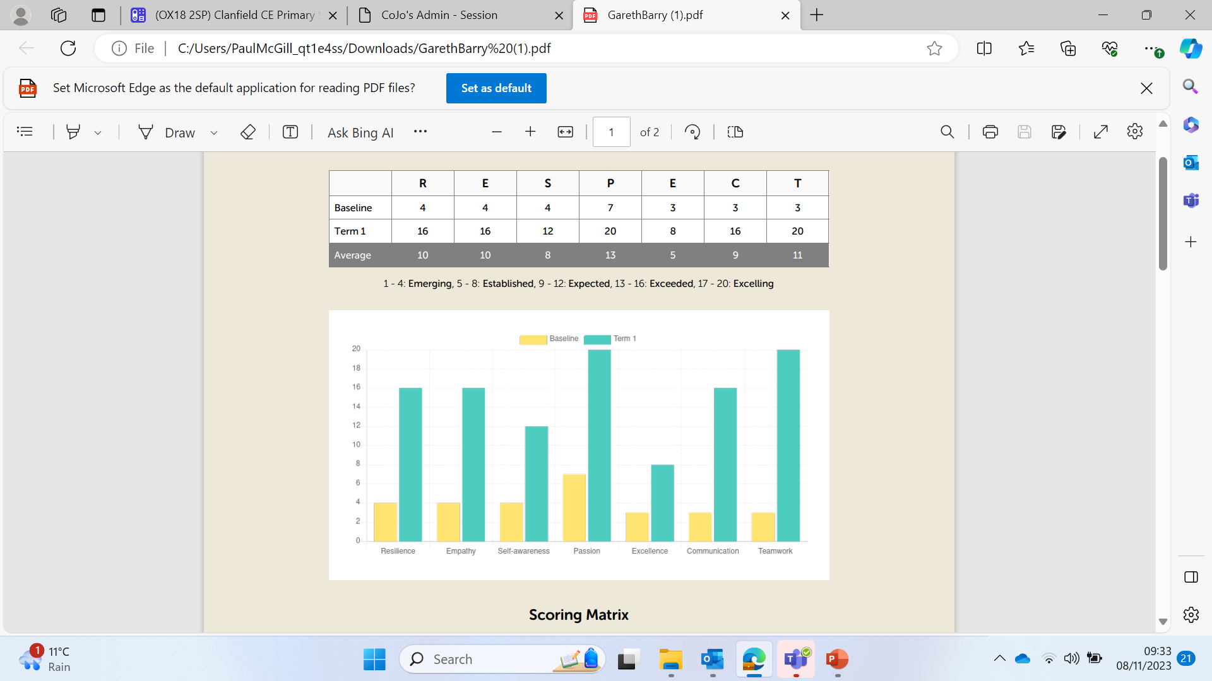
Parents/Guardians
Governors
Ofsted
The pupil
Meta-Cognition conversations
Sports Premium/Pupil premium

Slide 31
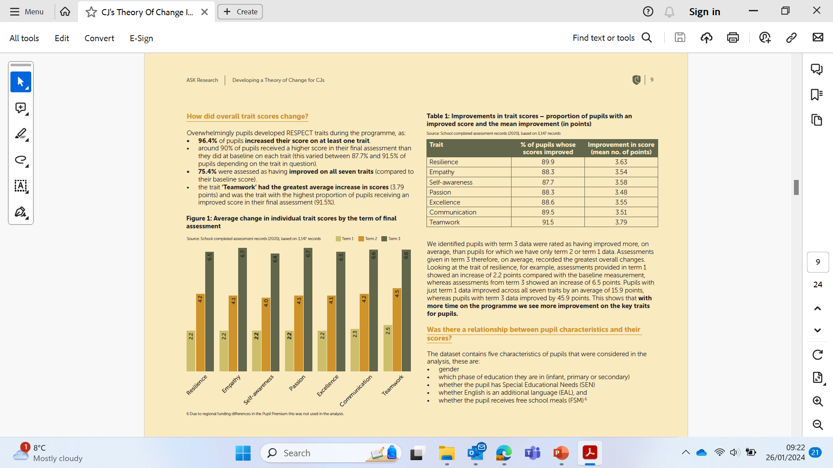

Slide 32


Slide 33

MCGILL.P@COMMANDOJOES.CO.UK

Slide 34
DASH Charity
Gabby Lakin

Slide 35

Domestic Abuse and The Dash Charity

Slide 36
Any incident or pattern of incidents of controlling, coercive, threatening behaviour, violence or abuse between those aged 16 or over who are, or have been, intimate partners or family members regardless of gender or sexuality.
The abuse can encompass, but is not limited to:
Psychological
Physical
Sexual
Financial
Emotional
DEFINITION
Notes:
Cover age stats, types of DA, gender, coercive control and stalking being more accurate predictors of significant harm than physical violence, financial barriers and link to housing.

Slide 37
statistics
Only 1 in 8 children who are abused are known to the police and children's services.
Those most likely to experience domestic abuse are aged 16-24
Each year nearly 2 million people in the UK suffer some form of domestic abuse
1 in 4 women and 1 in 6 men will be victims of domestic abuse in their lifetime
Domestic abuse has the highest rate of repeat victimisation of any crime
Police receive a domestic abuse call to 999 every 30 seconds in the UK

Slide 38
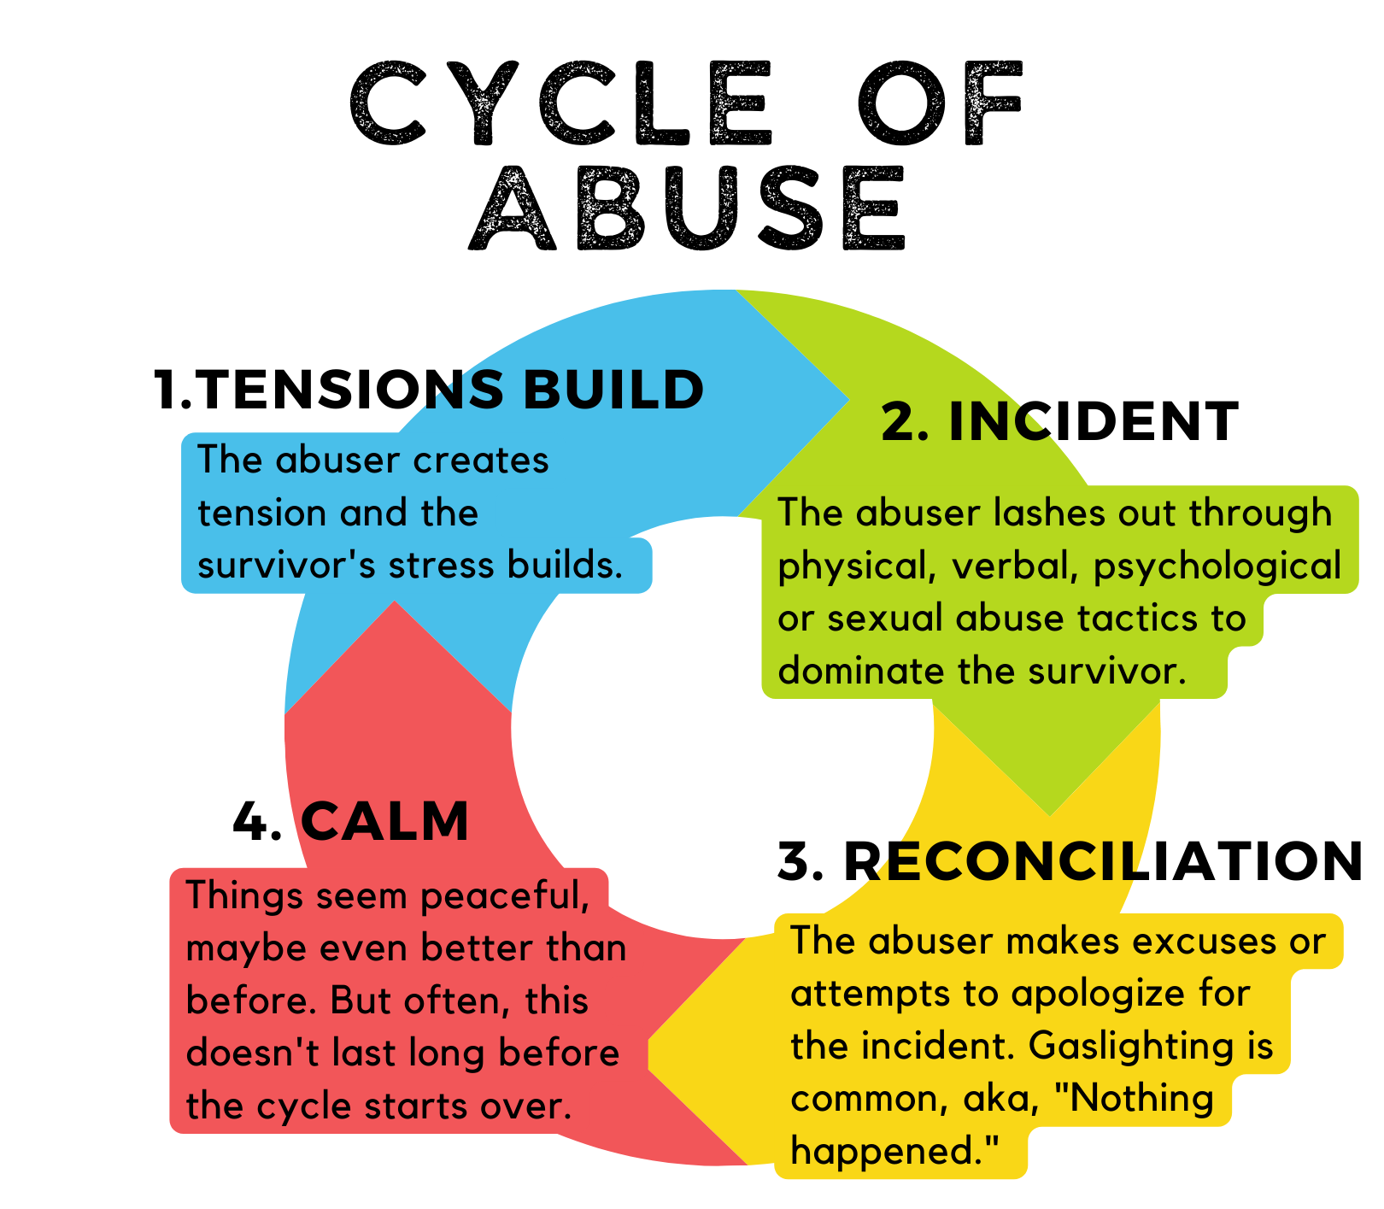
There are traits in each
perpetrator and below are just some tactics perpetrators use:
Bullying
Emotional Abuse and Gaslighting
Involving the Children
Isolation
Lying
Persuasion
Sexual Abuse
Coercive Control
TACTICS AND CYCLE OF ABUSE

Slide 39
The Dash Charity

Slide 40
IDVAs (Independent Domestic Violence Advocates) and Outreach Workers are there to support the survivor - this could be immediately after an incident, or in dealing with longer term harassment, child court or the effects of domestic abuse.
Address client’s safety and priorities with practical and emotional support
We liaise with the police, work closely with social care, advise clients on legal orders available, and support clients with moving, among many other things.
Our Diverse Communities Outreach workers support hard-to-reach communities in Slough to ensure support is available to all.
Advocacy and outreach

Slide 41
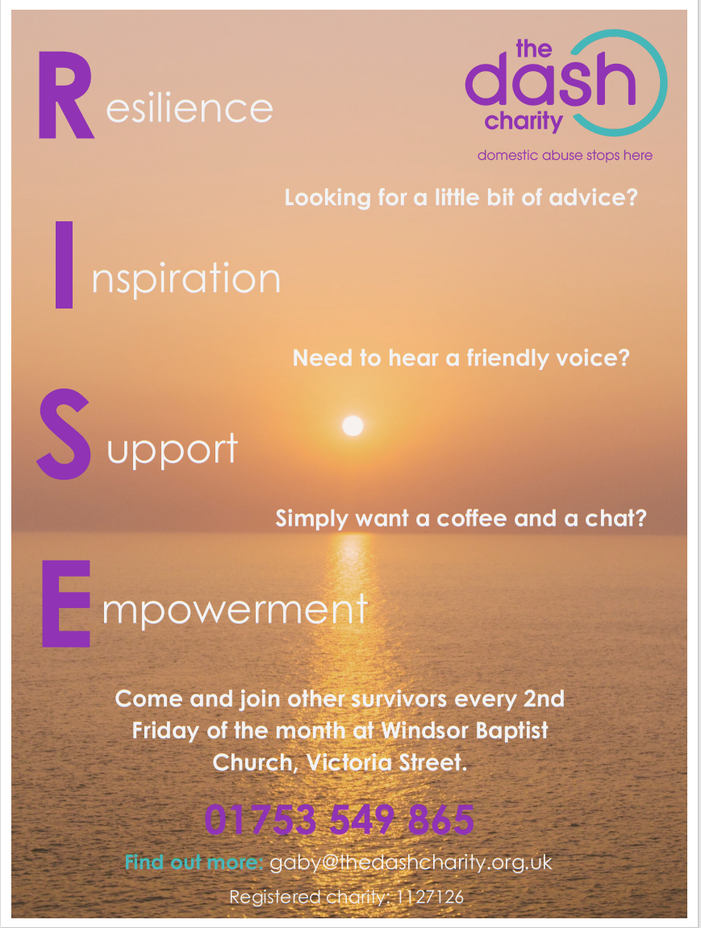
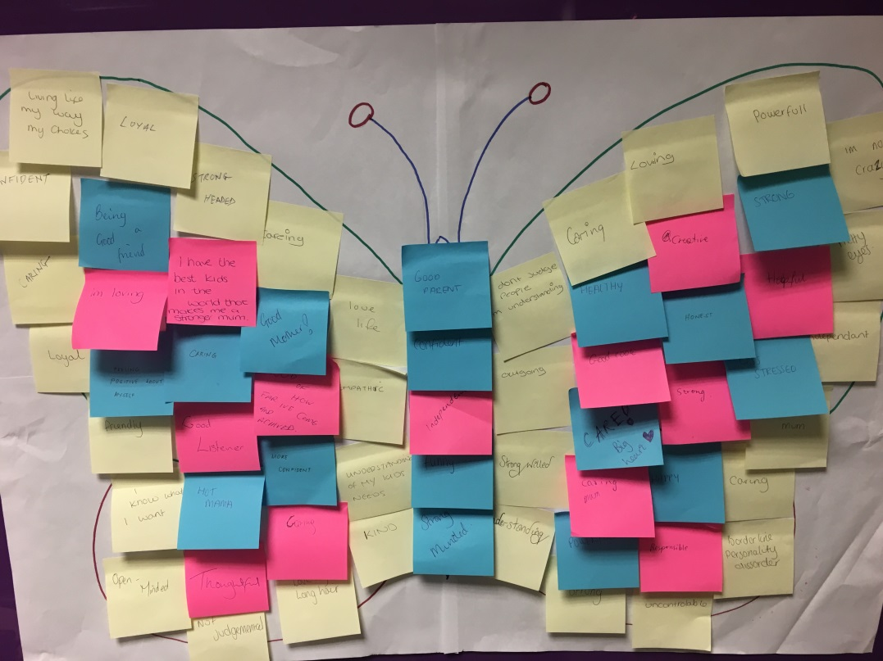
The Freedom Programme
A 10 week group which allows women to discuss, share experiences, learn from others and get mutual support.
A ‘positive thought’ butterfly from a Freedom Group, after discussing the effects of domestic abuse on children
RISE Coffee
Monthly coffee drop in for women who have been closed to the service but would still like to be able to link in with other survivors.
Advocacy and outreach
Support Groups

Slide 42
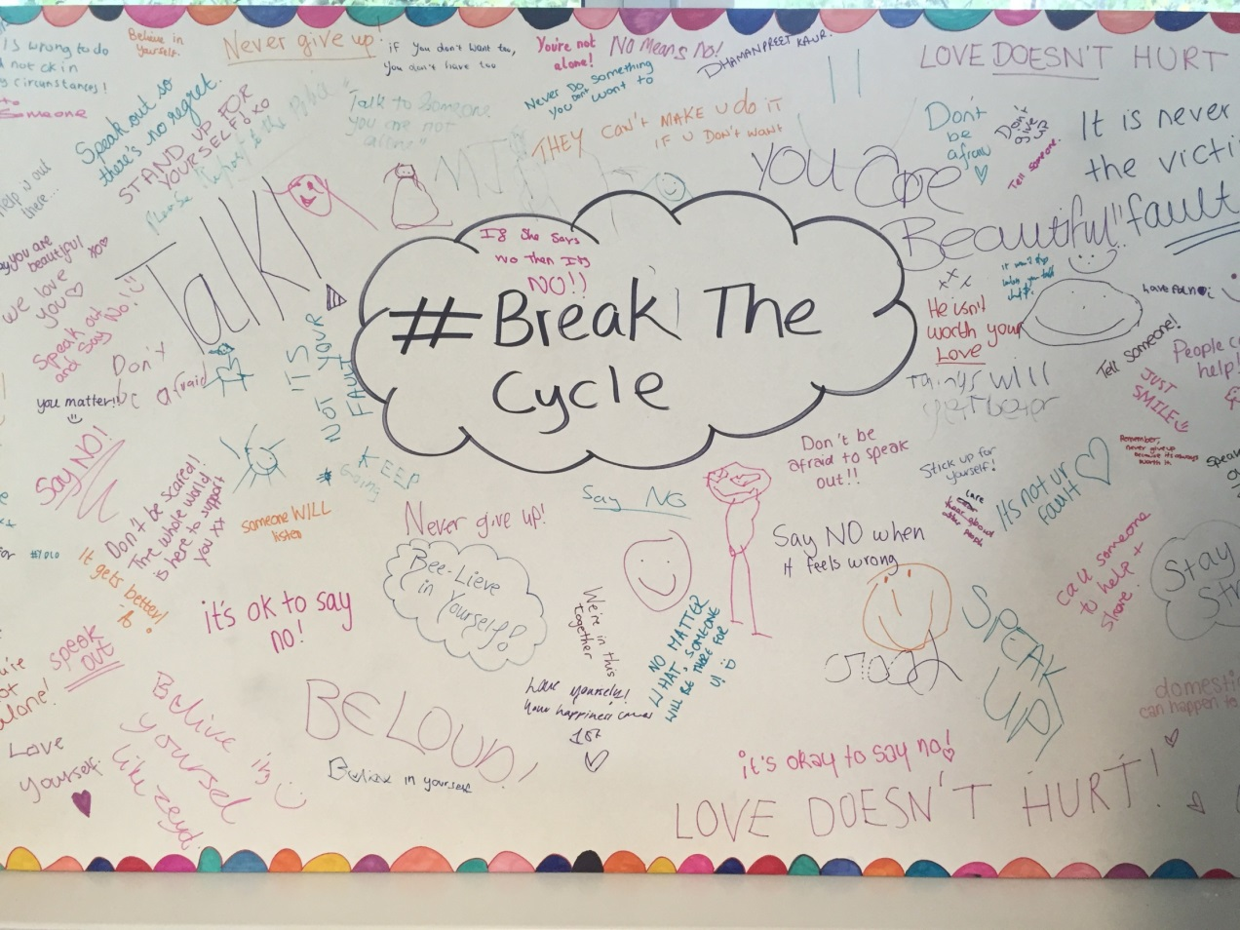
Children who have witnessed or experienced domestic abuse aged 5 -18 can be referred to our Children’s IDVA.
The 8 week program aims to:
-Understand domestic abuse and recognise they are not to blame
-Develop their understanding of what makes a safe, non-abusive relationship
-Express anger in a healthy way
-Develop skills to enable them
to identify an unsafe situations
and react in an appropriate way
-Develop problem solving techniques
-Create a positive self image to
improve confidence and self esteem
Children’s Services
Notes:
Can assist children up to 24 with SEND

Slide 43
Schools Prevention Work
Healthy Relationship Workshops created by the Dash Charity and Women’s Aid on a range of age appropriate topics.
The program is flexible to the needs of the school
The program aims to:
    -Raise awareness of domestic abuse in children and young people (aged 9+)
    -Educate primary pupils around respect, arguments and gender norms
    -Help secondary pupils identify abuse and its warnings signs, and how to get help with an abusive relationships.

Slide 44
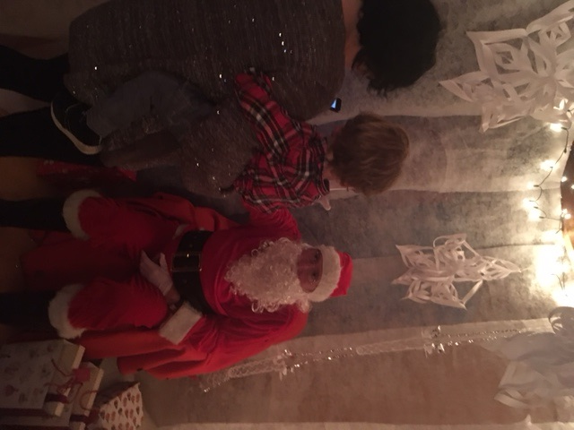
We can house up to 14 families at a time, and have access to the national network of refuges to find space for clients.
Our refuges are for women and children who have fled their area because they were at risk of harm in the area they have fled from.
Temporary accommodation - we help the client get back on their feet, apply for benefits, and help them apply for new housing.
One of our trustees (a police officer for 30 years) dressed as Santa delivering presents to refuge residents and their children
Refuge

Slide 45
SUPPORT
IDVA Support
      intensive practical support for victims at immediate risk of harm, including advocacy with services, attending court/police interviews, and direct work to understand their experiences
Outreach Support
      medium risk support that will often focus on practical and emotional support for victims
Diverse Communities Support
      support for clients in hard-to-reach communities e.g. LGBTQ+, minority communities.
Refuge
      Safe housing for those who need to flee their current area and require specific domestic abuse support
Children’s Support
      for children who have witnessed and experienced DA and need help processing those feelings and family changes
Signposting to other Agencies
Notes:
Each are in the UK will have a commissioned domestic abuse (DA) service, but what they provide will differ from service to service. Support will contain a variety of: [below]
It is imperative that you are aware of support in your area so you can inform your tenants and clients of their rights and options. The details of these can be found on your council’s website, and if you are ever in doubt- ask us!

Slide 46
Referrals and Contact

Slide 47
REFERRALS TO DASH
We are a voluntary agency, with most support via telephone
We need consent in order to contact clients
Safety comes first in contacting - please advise us of the safest way to contact, and whether we can text/leave voicemails
We complete a risk assessment with every client to assess their needs, and will share this information with MARAC if the case is deemed high risk
We may not be the right service for cases involving dementia - the tactics/behaviour are not the same and our safety plans do not work in these cases
Notes:
Each are in the UK will have a commissioned domestic abuse (DA) service, but what they provide will differ from service to service. Support will contain a variety of: [below]
It is imperative that you are aware of support in your area so you can inform your tenants and clients of their rights and options. The details of these can be found on your council’s website, and if you are ever in doubt- ask us!

Slide 48
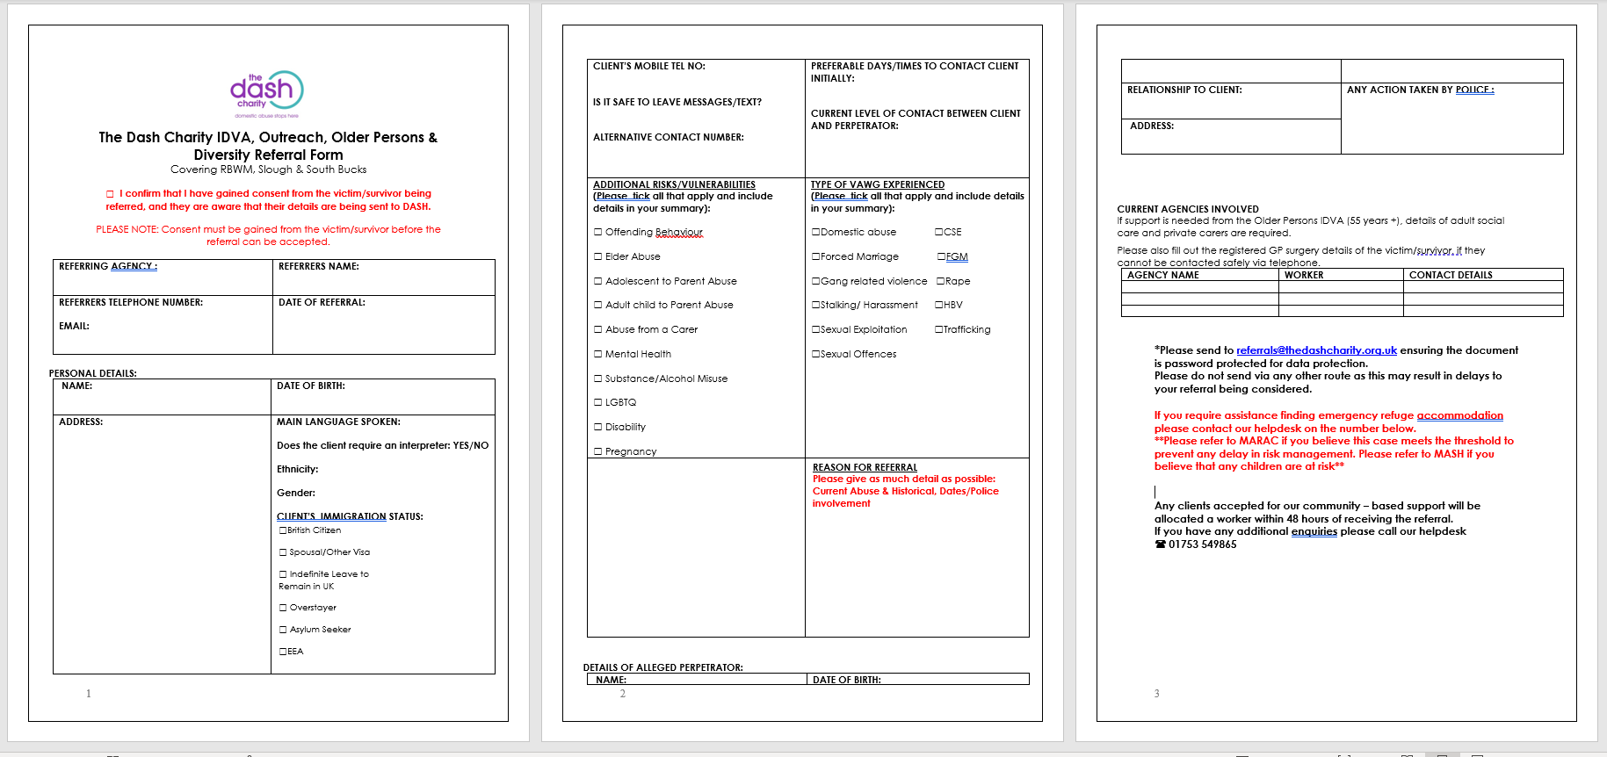
REFERRAL FORM

Slide 49
GEMS
Mamta Martin
Julia Wales

Slide 50
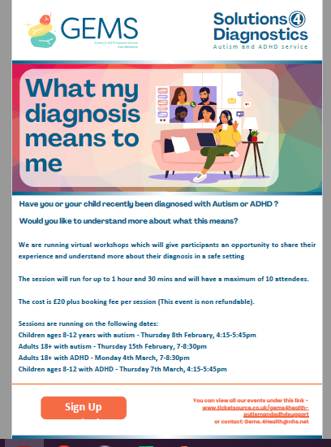
What my diagnosis means to me –
We are delighted to announce the launch of some new workshops for adults and children.
Have you or your child, recently been diagnosed with Autism or ADHD ?
Would you like to understand more about what this means?
These virtual workshops will give participants an opportunity to share their experiences and understand more about their diagnosis in a safe setting.
The sessions will run for 1 hour and 30 mins and will have a maximum of 10 attendees.
The cost is £20 plus booking fee per session (This event is non-refundable).
Sessions run on the following dates:
Children ages 8-12 years with autism - Thursday 8th February, 4:15-5:45pm
Adults 18+ with autism - Thursday 15th February, 7-8:30pm
Adults 18+ with ADHD - Monday 4th March, 7-8:30pm
Children ages 8-12 with ADHD - Thursday 7th March, 4:15-5:45pm
To book your space please use the following link : www.ticketsource.co.uk/gems4health-autismandadhdsupport

Slide 51
Questions and
Feedback Form
TEAM TEACH – Little Muddy Me
Notes:
51

