Slide 1
SEMH Network Meeting
Tuesday 28th February 2023
Welcome to this virtual forum
Notes:
1

Slide 2
Agenda for today
Item | Who | Time
Welcome | Al Whitelaw | 3.30 pm (5 mins)
Early Help | Sarah Scott | 3.35 pm (15 mins)
Updates ERSA Toolkit Child on Child Abuse Parent Carer forum | Al Whitelaw | 3.50pm (20 mins)
Mental Health and Wellbeing updates | Rebecca Askew | 4.05pm (15 mins)
Questions

Slide 3
Early Help
Sarah Scott

Slide 4
Early Help
Achieving for Children

Slide 5
Why is early help so important?
Early Help is all about identifying needs within families early and providing coordinated support to build resilience before problems become complex.
‘Providing Early Help is more effective in promoting the welfare of children than reacting later. Early Help means providing support as soon as a problem emerges, at any point in a child’s life, from the foundation years through to the teenage years. Early Help can also prevent further problems arising.’ (Working Together to Safeguard Children 2018)
Early Help is a non-statutory service area that supports children, young people and families to improve their outcomes and reach their goals and aspirations. It does this through positive engagements, sustaining their power, finding out more about the power they have, exploring with them their needs and helping them to identify the things that they would want to change in order to be the person and/ parent they want to be.

Slide 6
FAMILY HUBS- KEY PRINCIPLES
To ensure that Family Hubs will support predominantly targeted families across the age range of 0-19 years (or age 25 years where young people have learning difficulties and/or disabilities).
The service be flexible in approach and be delivered where the need is, rather than being ‘buildings centric’.
To work in partnership with children, young people, families and carers by supporting them to be more resilient.
In response to community concerns about rising knife crime and County Lines activities enable workers to operate in partnership with the Police and Community Safety, with targeting of crime hotspots
Ensuring that we predominantly focus on those who are at risk of poor outcomes for example children living in poverty, children being exploited, or at risk of being exploited.

Slide 7
KEY PRIORITIES
Children not meeting their health and development milestones
Children who are not immunised against preventable contagious and serious diseases.
Children and young people at risk of or already experiencing poor mental health.
C&YP who are living with parents with poor mental health.
C&YP whose parents require extra support in their parenting i.e. teenage parents, parents with physical disabilities or learning needs.
C&YP who misuse substances and are affected by parental substance misuse.
C&YP at risk of exploitation and online dangers.
C&YP who go missing
Children who don't attend school or have poor school attendance thus risking achieving their educational potential.
Young people at risk of not accessing education, employment or training (NEET).
C&YP who are exposed to violence, either at home or in their communities, including those young people at risk of becoming involved in gangs, serious youth violence or engaging in extremism

Slide 8
1-1 Support for families
Substance Misuse
Support for children and young people who are impacted by parental substance or alcohol misuse
Children Criminal Exploitation
Child Sexual Exploitation
Digital Life
Knife carrying/crime
Low mental health
Harmful Sexual Behaviour
Employment, education and training support
Housing advice
Benefits advice
Healthy Relationships
Family Relationships
Managing emotions
Parenting 1-1
Wishes & Feelings
Restorative Intervention
Parental Conflict
Reunification
Parenting Group
Parents as first teachers
Baby Massage
Emotional first aid
Charity Funding Referrals.
Baby Bank referrals.
Foodshare referrals
Independent living
Domestic Abuse

Slide 9
GROUP SUPPORT FOR FAMILIES
For Parents
Online live Q&A covering:
  Child Criminal Exploitation
  Child Sexual Exploitation
  Substance Misuse
  Digital World and Safety
Freedom Programme
Emotional First Aid
Incredible Years
Triple P Parenting
Baby Massage
For Children/Young people
Esteem Project
Value (for those at risk of exploitation)
School workshops covering:
  Child Criminal Exploitation
  Child Sexual Exploitation
  Substance Misuse
  Digital World and Safety
  Realities of Pornography

Slide 10
FAMILY HUB WEBSITE LINK
https://rbwm.afcinfo.org.uk/pages/community-information/information-and-advice/family-hub-service

Slide 11
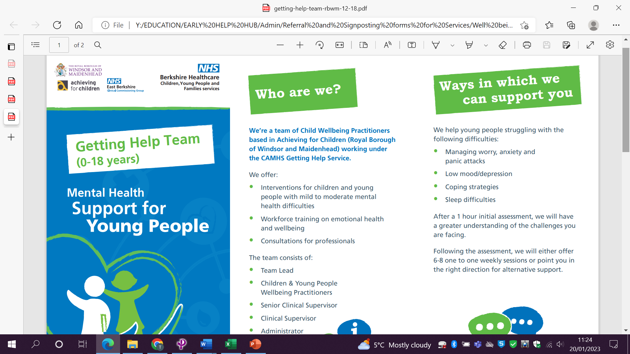
GETTING HELP TEAM

Slide 12

GEMS4Health

Slide 13
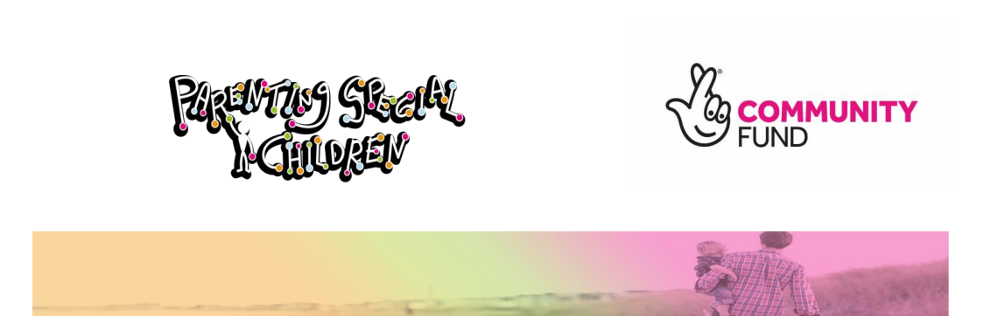
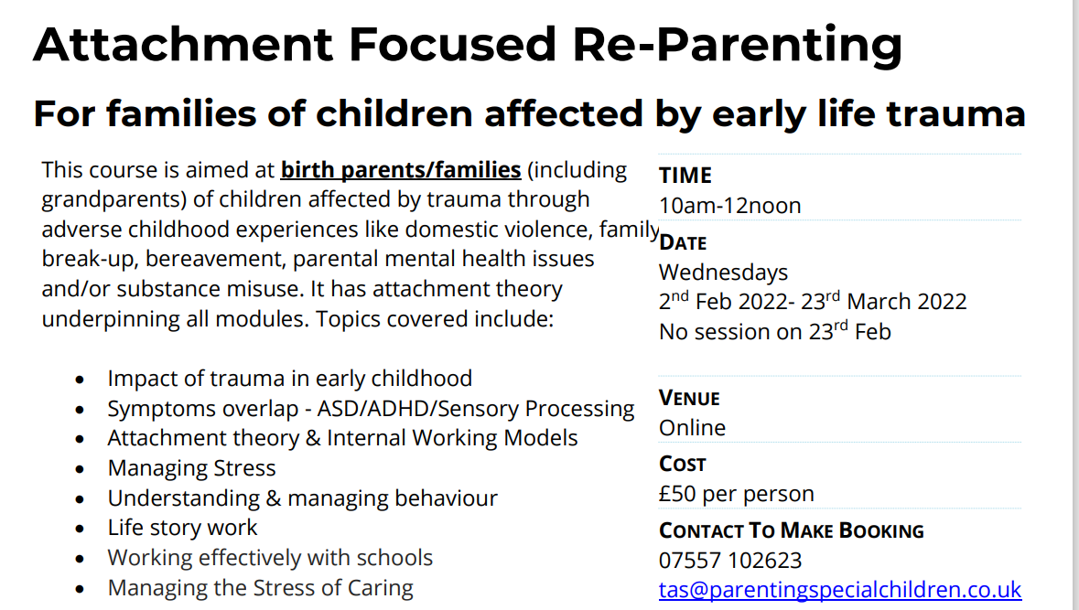

Slide 14
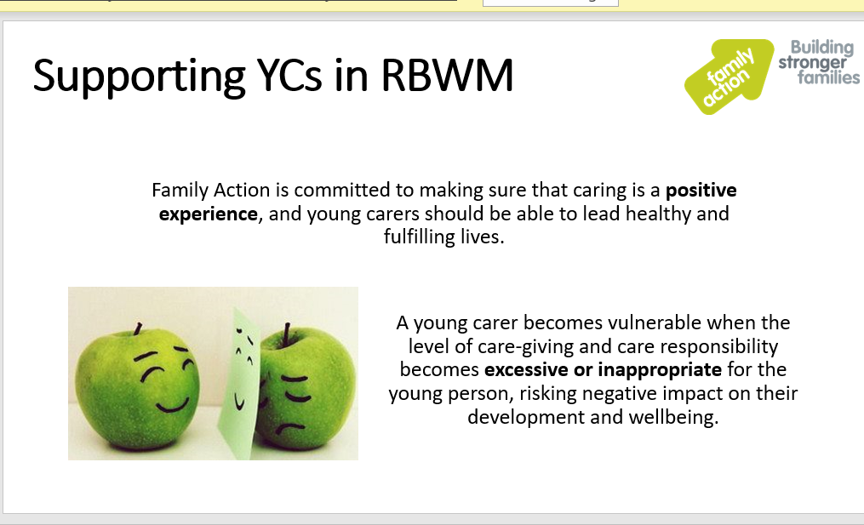
FAMILY ACTION/Young Carers

Slide 15

Kooth.com

Slide 16
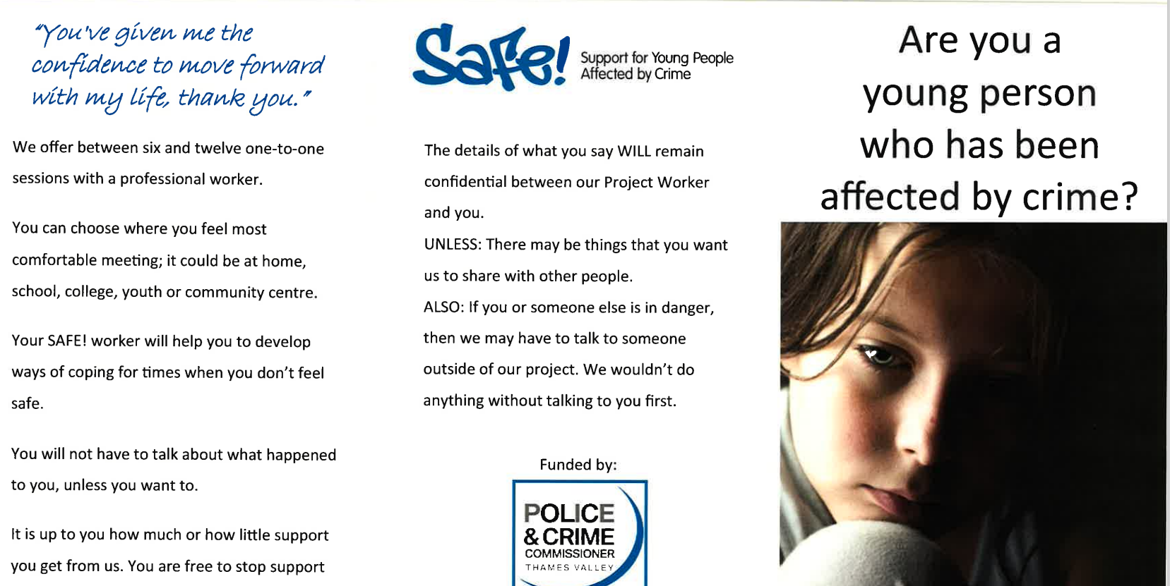
SAFE

Slide 17
SEMH Updates
Notes:
17

Slide 18
Updates
Overview and Outcomes
Team Changes
Training
SEMH Leads and Information sharing
Transition Support – Onwards and Upwards
Boxalls feedback
Virtual Drop in Consultations
DSLs ensure all safeguarding actions followed up - Ofsted

Slide 19
Leadership Update Website
ERSA Toolkit
Child on Child Abuse
https://www.leadershipupdate-rbwm.co.uk/semh-service/
https://www.leadershipupdate-rbwm.co.uk/information-for-all-schools/

Slide 20
Parent Carer Forum Update
Was PaCiP (disbanded October 2021) *Any flyers and leaflets should be removed from reception areas etc…
New steering group created and supported by Contact (small committee of around 7 parents)
Grant released and now SEND Voices: RBWM has been created (with the support of Bracknell SEND voices) wider launch at Inclusion Summit Feb 23
Aug 17 10:26

Slide 21
How can you help?
Please share any updates on SENCo Newsletter with your families
Encourage families to join the Inclusion summit and sign up for membership
Host coffee mornings on behalf of the forum
Consider having a parent representative in your school to co-ordinate directly with the forum

Slide 22
Mental Health & Wellbeing Updates
25th January 2023
SEMH Network
Rebecca Askew

Slide 23
RBWM Wellbeing Interventions
Nurture
Check ins – EPS Service Nov 2022 –June 2023
Nurture Hubs – 1 per term
Nurture Practitioner Training – 28th Feb & 7th March 2023 (Reform Road, Maidenhead)
Whole School Twilights
PPEPCare Training
Mixed model – whole school and online (summer term)
Modules: Child/adolescent anxiety, communication now, depression/low mood, self harm, promoting resilience and separation anxiety.
CAMHS – workforce offer – PTSD, OCD, specific phobia, autism and eating disorders

Slide 24
RBWM Wellbeing Interventions
Emotionally Related School Avoidance (ERSA)
ERSA steering group of multidisciplinary professionals in Sept 21 have developed and launched a toolkit for schools to implement and support children in all 65 RBWM schools.
Currently offering training and consultations to all RBWM schools. Helping schools identify children and implement a support plan. Parent and School Quick Guides are available to raise awareness of ERSA. Resource Booklets for schools available to gather information and provide activities to include in the child’s support plan
Emotional Wellbeing Champions Programme 2023
The Wellbeing Team invites you to take part in the 2023 Senior School Mental Health Ambassadors programme. The programme supports schools to develop a positive culture around mental health. A training day on 14th March (9.30am-2.30pm) offers students the opportunity to further their knowledge and create their own anti stigma campaigns within their school. New for this year is the opportunity to explore the use of rap music to express messages around Mental Health. Are you interested in taking part?
2023 Emotional Wellbeing Champions programme for Primary Schools. The Wellbeing Team invites you to take part in the 2023 Emotional Wellbeing Champions programme for Primary Schools. The programme supports schools to develop a positive culture around mental health. Workshops offer students the opportunity to further their knowledge and create their own anti stigma campaigns within their school.
Please contact Natalie Evans natalie.evans@achievingforchildren.org.uk or Hariette Sarner hariette.sarner@achievingforchildren.org.uk for further programme and registration information.

Slide 25
RBWM Wellbeing Interventions
Parent Child Attachment Play
Would you like to develop skills to help your child with their emotions?
Explore ways to help your child make positive choices and reduce challenging behaviour?
Strengthen your relationship with your child?
If you answered yes to either of these, the Parent Child Attachment Play Course could help!
What is Parent Child Attachment Play?
A 12-week therapeutic parent skills group, led by Play Therapist Natalie Evans. There will be 5 face to face 2-hour group sessions and 7 one to one sessions either by telephone or online. It is not a quick fix for your child but a sustainable way of using your established relationship to create therapeutic, long-lasting change. Whilst boosting both you and your child’s confidence.
Course Arrangements
Tuesday mornings 10-12 for group sessions. Venue to be confirmed
18th April, 25th April, 9th May, 23rd May and 27th June.
Please contact natalie.evans@achievingforchildren.org.uk for more information.

Slide 26
On-going MH initiatives
Oxwell Survey – Feb-March 2023
Survey to launch in February and close in March 2023.
In partnership with the University of Oxford – Department of Psychiatry - offering schools/colleges (excluding Special schools) in East Berkshire to take part, at no cost, in an Online Student Survey on Health and Wellbeing.
Measures the wellbeing (Health and Happiness) of Children and Young People.
For pupils in years 5 -13, There are 3 age-matched versions (years 5-7, years 8-11, years 12-13/FE).
The Primary, Secondary, and the Year 12/FE surveys differ slightly and are age appropriate, approved by the University of Oxford Research Ethics Committee.
The survey is anonymous and designed to be engaging and easy for pupils to use, took most pupils about 30 minutes and can be comfortably fitted into a lesson period.
Last year only 4-5 secondary schools and 6-7 primary schools in RBWM took part in the survey.
More details are on the research team’s website: https://www.psych.ox.ac.uk/research/schoolmentalhealth
Mental Health Practitioner
Instead of Social Prescribers being responsible for triaging referrals and offering support within the community, CAMHS are introducing a new Band 6 role to work alongside the Social Prescribers - Mental Health Practitioner.
This role will sit in CAMHS and the primary care network and will be responsible for triaging referrals that don’t meet CAMHS threshold but are too challenging for early support.
Aim to have a Mental Health Practitioner in each primary care network going forward.

Slide 27
On-going MH initiatives
Kooth
More registrations than previous year
Referrals from health services are improving
Highest SE registrations from Maidenhead, then Windsor
Now view presenting issues by ethnicity, gender & age
Track specific presenting issues over a certain period
December 2022
218 log ins and 30 registrations
Main age groups: 12, 13, 15, 16 yrs
Log in mainly occur out of hours (9am-5pm)
Mainly female
Short Kooth Promotional video Here
Kelly Middleditch, Customer Success Manager: London & SE
kmiddleditch@kooth.com 07359242608
Lana Nagle lnagle@kooth.com new engagement lead will be able to provide school promotion and comms/ social media handles.

Slide 28
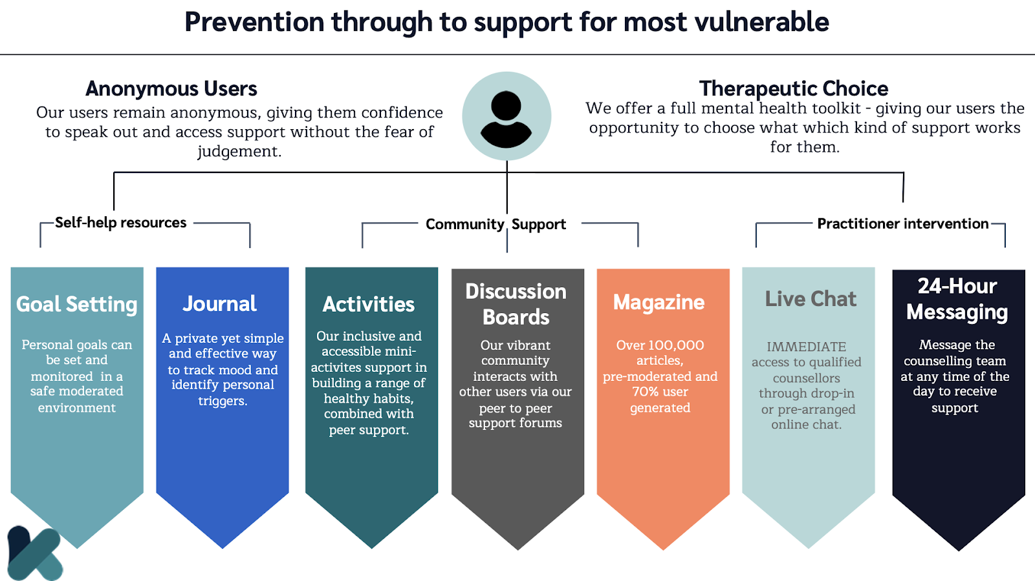

Slide 29
I-THRIVE Kooth adapt to the level of need of the individual and CYP can and move fluidly between the levels of support.
Getting Advice
Information sharing. peer advice and signposting within the Community domain, a moderated online forum with a community based on mental health
Getting more Help
Those who need more resources for their needs engage with Structured and Ongoing domains allocated workers to address complex needs and presentations and tailored plans in collaboration with wider care
Getting risk support
Multi-disciplinary work to approach clinical risk, with clinical governance at all domains providing local safeguarding, multi-agency work, de-escalation and referral to specialist services
Getting Help
Those who need intervention engage with our Reactive domain and achieve in-session or therapeutic goals as early intervention or prevention in one or multiple sessions, While waiting or discharged from CAMHS

Slide 30
Charlie Waller
Free guides and workbooks for professionals, parents, young people and others interested in mental wellbeing.
All resources are available as free downloads, and some are available as printed copies.
https://charliewaller.org/resources
CAMHS Getting Help and Mental Health Support Team - WaM
Telephone number: 0300 247 3002
The phone line is open from 09:00 – 17:00, Monday to Friday. Outside of these hours, please leave a message and they will return your call.

Slide 31
Questions and
Feedback Form
Notes:
31

