Slide 1
SEMH Network Meeting
Virtual
11th May 2022
3.30pm – 5.00pm
Alasdair Whitelaw
SEMH Coordinator and EWS Manager
AfC

Slide 2

3.30 Welcome and outline of SEMH Network Meeting
3.35 Online Boxall Profile update and overview
3.40 Rosie Gossage - ERSA (Emotionally Related School Avoidance)
4.00 Working Break.
Breakout rooms ERSA.
ERSA practical application strategy Individual Setting.
4.15 Eleanor Heywood-Bourne - DASH Charity Outreach Service
4.35 Matthew Flavell – B.E a Warrior Foundation
4.50 SEMH Updates and Feedback.
5.00 Close.
Agenda

Slide 3
Boxall
64 Schools
47 Super User
Secondary Working Party
Primary Yr 6’s (transition)

Slide 4
ERSA
Rosie Gossage – Inclusion and Access Officer

Slide 5
Promoting and Supporting School Attendance
Emotionally-Related School Avoidance (ERSA) Graduated & Multi-agency Pathway and Toolkit Guidance

Slide 6
Introduction & Background
Schools & support services have seen an increase in children and young people presenting with ERSA (Emotional Related School Avoidance).
The definition of ERSA: ERSA describes a group of children and young people who experience difficulties attending school which can be linked to school, parents/carers and/or child factors as well as wider societal factors.
A number of agencies developed a working party to think about how ERSA needs to be widely recognised and what tools and support can be developed to help professionals to further support children who are presenting with ERSA
The working party developed four key documents and toolkits which are; a graduated multi-agency pathway, whole school audit, risk & resiliency profiling tool and a support plan

Slide 7
The Continuum of ERSA
In school with heightened anxiety. Occasional absences. Parents may report some reluctance to attend. | Increased absences. These may be sporadic or have a pattern. Parents may report some reluctance to attend. | Persistent non-attendance and extreme reluctance to attend school.
Internalising | Externalising
Anxiety, worry and fearfulness Tiredness Low mood Self-consciousness Somatic complaints without physical illness Uncomfortable bodily sensations e.g., racing heart, difficulty breathing, etc. Difficulty sleeping | Crying Non-compliance Running away Aggression Refusal to get ready for school or leave the house Clinging to others Panic attacks Threats of self-harm Expression of negative feeling about attending school

Slide 8
What causes ERSA? – Risk factors
School risk factors | Child risk factors
Bullying (most common school factor) Transition to secondary school Structure of the school day Academic demands/high levels of pressure and performance orientated classrooms Transport or journey to school Exams/tests Peer or staff relationship difficulties | Fear of failure and poor self confidence History of absenteeism Physical illness Age (5-6, 11-12 & 13-14 years) Special Educational Needs if unidentified or unsupported Attachment and trauma
Parent / family risk factors | Societal risk factors
High levels of family stress (e.g. poor parental physical / mental health) or change in family dynamic Loss and Bereavement Family history of ERSA Young carer | Disruption to ‘normal’ daily life (e.g. global pandemic) Attitudes towards education Educational policies related to curriculum and attendance

Slide 9
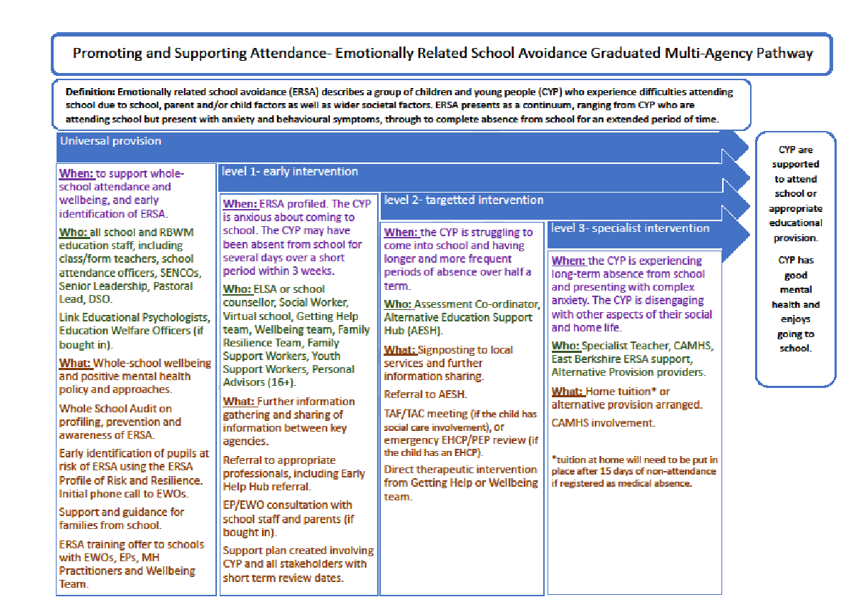

Slide 10
Key tools for ERSA Pathway
Three key tools were developed to support the ERSA pathway, these include:
ERSA Whole School Audit
ERSA Profile of Risk and Resilience
ERSA Support Plan

Slide 11
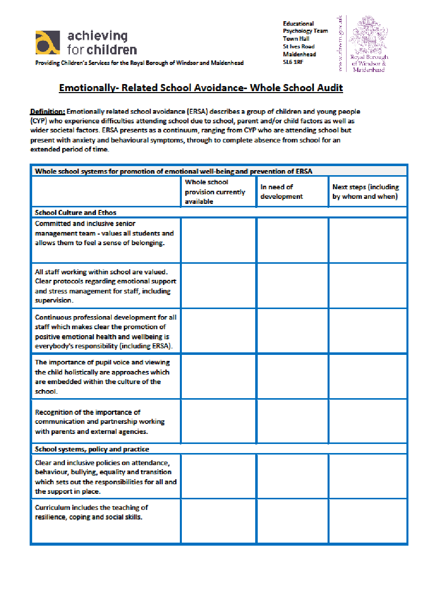
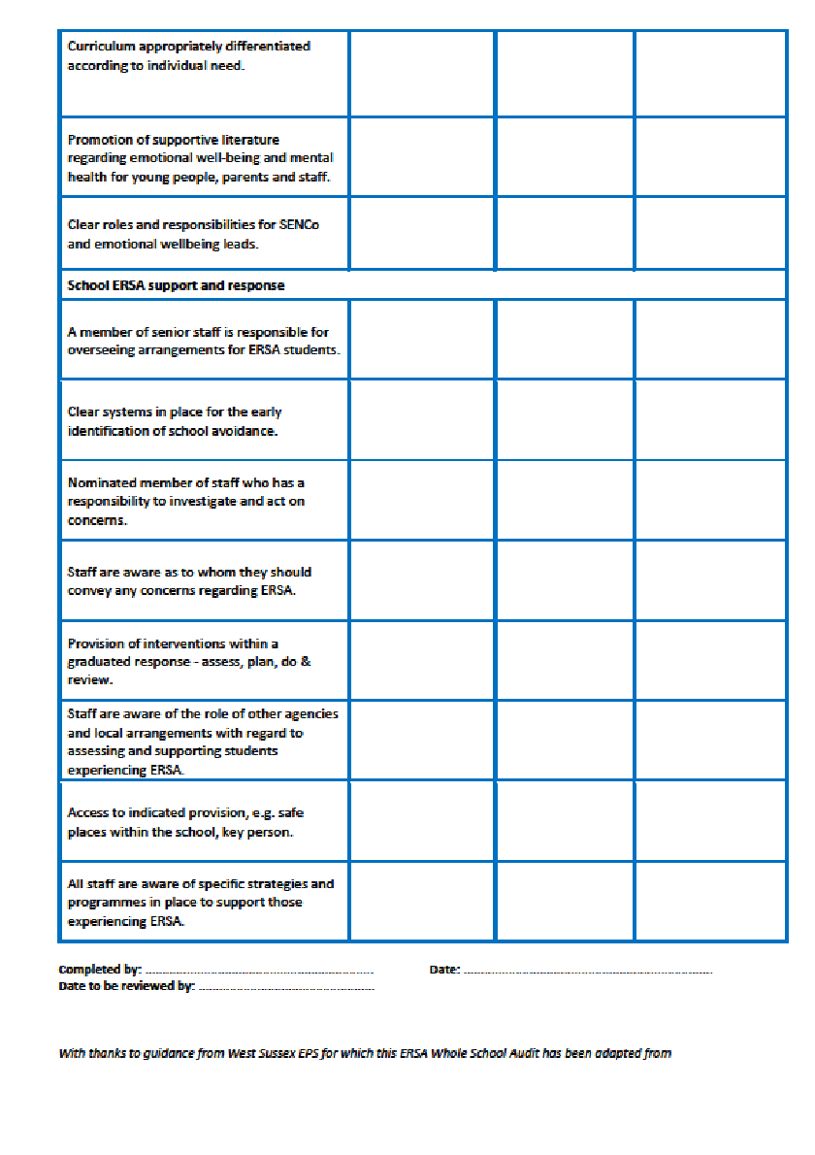
Using the ERSA Whole School Audit

Slide 12
ERSA Whole School Audit
The audit tool is for senior members of staff to use to help contribute to looking at how ERSA is responded to in schools
The tool provides schools with the opportunity to review their responses to ERSA and mental health support
Identifies trusted adults within school to further support young people
Key staff who identify attendance patterns/class teachers identifying absence/early signs of anxiety or mental health
What internal interventions are offered?
Internal pathway for providing support to young people presenting with ERSA and who and when escalates this
Allows schools to consider their culture, ethos, systems, polices and practice which all contribute to how ERSA is responded to

Slide 13
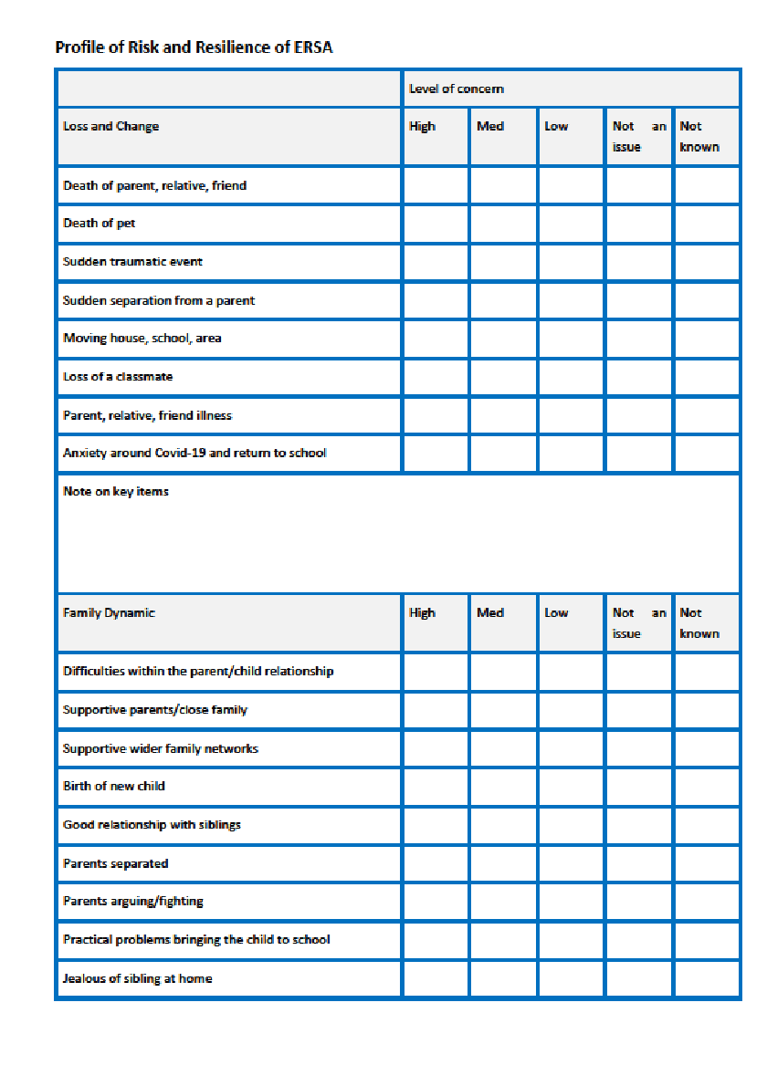
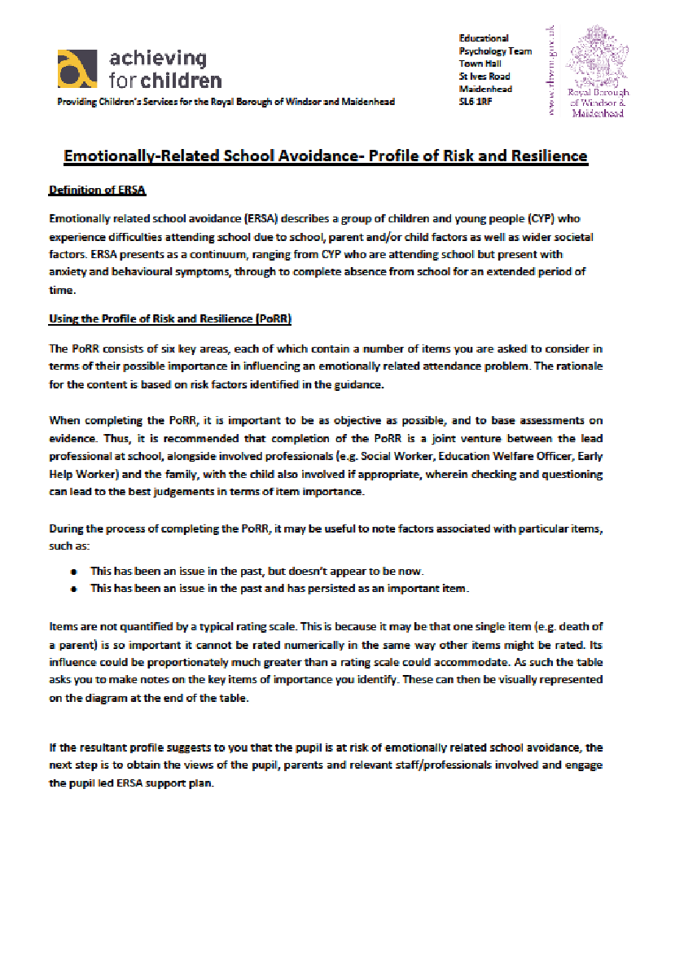
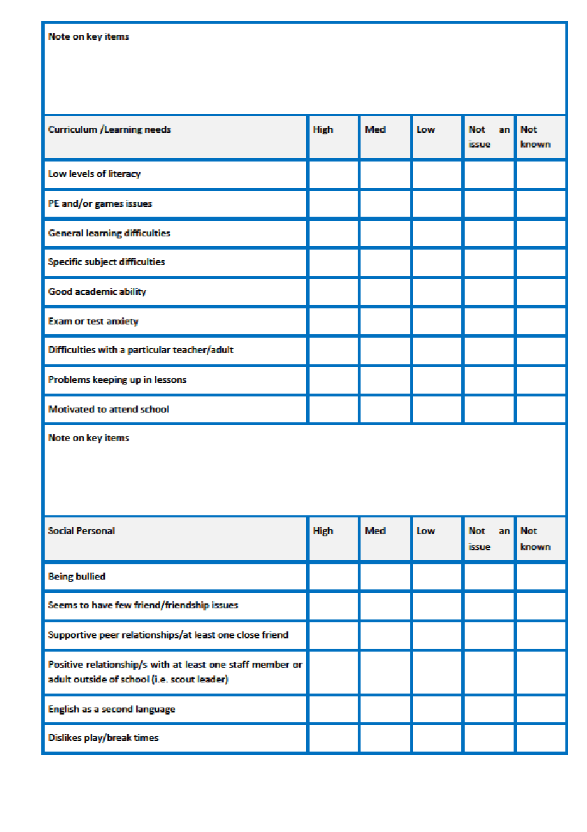
Using the ERSA Profile of Risk and Resilience

Slide 14
ERSA Profile of Risk and Resilience
This tool is for all professionals to use to help identify the risk and resiliency factors that may be contributing to ERSA
Provides a simple check list that prompts professionals to ask the right questions (for example, there may be something that has happened inside/outside school that nobody is aware of (not even the parents) which is causing the young person to avoid attending school
Good practice is for the tool to be completed by the school, the pupil, the parent and key professionals involved
Whilst generally schools would lead on completing the tool, there is no reason that other professionals involved cannot use or suggest completing the tool e.g. Education Welfare Officer, Early Help Services, Educational Psychologists, Wellbeing Practitioners, Social Workers
As ERSA can be complex and have a number of contributing factors, the risk and resilience profile allows the opportunity to unpick the route cause

Slide 15
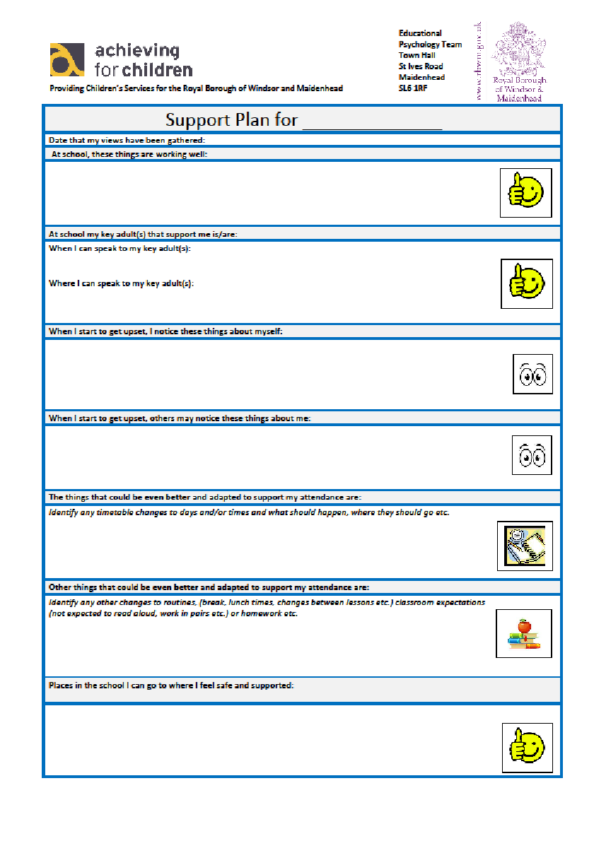
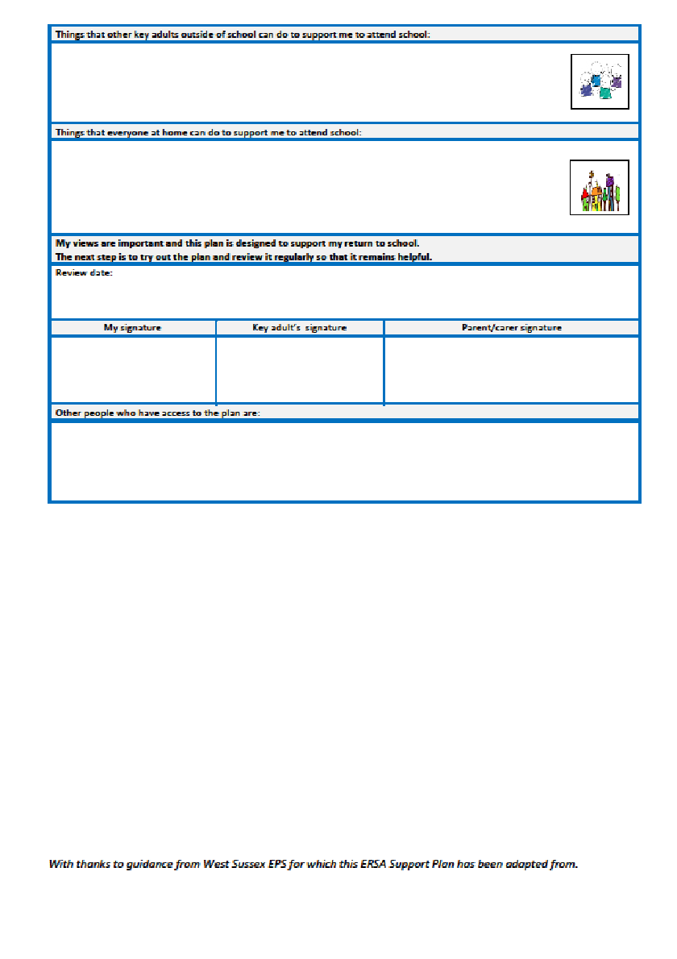
Using the ERSA Support Plan

Slide 16
ERSA webinar
A webinar has been developed by Educational Psychology and Well-Being Service
The webinar also provides a step by step guide of how to implement the tools and guidance that have been developed by the working party
The webinar includes an in depth guide to supporting children presenting with ERSA
There are also additional tools and school based strategies included in the webinar which have not been covered today
You can contact your Education Welfare Officer, link Educational Psychologist, Well-Being Practitioner or myself for further information or support
We will be fully launching the ERSA toolkit to schools in September 2021
https://drive.google.com/file/d/1du3SRu6_MYuSRd5Tj6YcyQWffNGSQOKa/view?usp=sharing

Slide 17
Thank you for listening!
Thank you for listening, any questions are welcome!

Slide 18
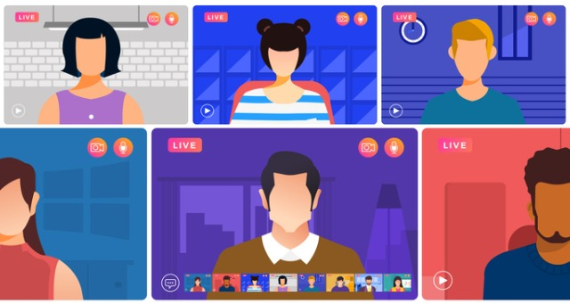
Break – Breakout rooms
Discussion of ERSA application.
ERSA application strategy Individual Setting.
Domestic Abuse – impact in school and support in place?

Slide 19
Welcome Back
DASH

Slide 20

Children and Domestic Abuse

Slide 21
any incident or pattern of incidents of controlling, coercive, threatening behaviour, violence or abuse between those aged 16 or over who are, or have been, intimate partners or family members regardless of gender or sexuality.
The abuse can encompass, but is not limited to:
Psychological
Physical
Sexual
Financial
Emotional
The Definition

Slide 22
Effects of domestic abuse on children
Children will respond to domestic abuse in unique ways.
The impact is dependant upon multiple factors; age, gender, stage of development, their role in the family, extent & frequency of the abuse, and child’s own personality.
Children do not need to directly witness or experience abuse in order to be affected- under current UK legislation, children are considered to be at risk of harm if they are aware of or can hear the ill-treatment of another.

Slide 23
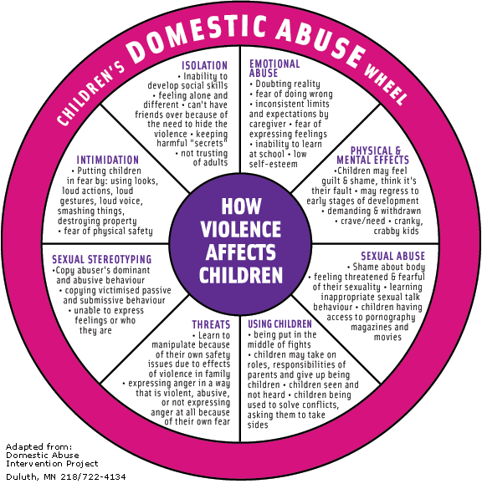

Slide 24
Impact on learning
Some may show strong signs- some might show none at all
Distracted, possibly aggressive methods of problem solving, being more affected by arguments or incidents in school.
Pressure to perform in school, significant changes in learning behaviour, more emotional during the school day, or more vacant.
Disclosures in class- ‘my parent does that!’
Some symptoms of experiencing trauma can present as ADHD traits.

Slide 25
How to approach
Disclosures can come from a supportive environment where children know they can talk about home without judgement.
Ask around the subject (not leading questions), and avoid any terms that carry a lot of meaning, like ‘abuse’.
Make sure you’re alone and the child cannot be overheard.
Consider who’s best having this conversation- is there a teacher this student is particularly close to etc?
On average it takes 9 disclosures from children for parents to get effective help.

Slide 26
Schools Prevention Work
Healthy Relationship Workshops created by the Dash Charity on a range of age-appropriate topics.
The program aims to:
    Raise awareness of domestic abuse in children and young people (aged 9+)
    Educate primary pupils around respect, arguments and gender norms
    Help secondary pupils identify abuse and its warnings signs, and how to get help with an abusive relationships.
  The program is flexible to the needs of the school in terms of time, date topic etc

Slide 27
The Dash Charity- Who We Are
We are the commissioned domestic abuse support providers for RBWM.
There are three main areas of our work:
    Advocacy and Outreach- survivors of domestic abuse supported by our IDVAs and Outreach workers, to advocate on their behalf and to lower the risks that the client faces
    Refuge- housing and support for women and children fleeing domestic abuse from outside our area (not suitable for RBWM clients)
    Children’s Services- Awareness and support programs for children and young people; done in groups and on a one-to-one basis

Slide 28
Children’s IDVA
The 8 week program aims to:
- Understand domestic abuse and recognise they are not to blame
- Develop their understanding of what makes a safe, non-abusive relationship
- Express anger in a healthy way
- Develop skills to enable them to identify an unsafe situations and react in an appropriate way
- Develop problem solving techniques
- Create a positive self image to improve confidence and self esteem

Slide 29
Children’s IDVA
Three rules for referrals:
1. Limited contact between child and abusive parent/step parent
2. A memory of the abuse
If a child does not meet the criteria, they may be suitable for our 1-1 Healthy Relationships work
Unlike our adult work, the Children’s IDVA program is not an emergency service- wait times are approx. 3 months

Slide 30
Referrals
Adults:
    Referral form from agencies
    Clients can self refer through 01753 549 865
  Children
    Children’s referral form from agencies
    We need: ethnicity, concise info on what the child ha experienced around DA rather than a social care history, safe contact information
  Please make referral to referrals to referrals@thedashcharity.org.uk
  If you need either of these forms, please email info@thedashcharity.org.uk

Slide 31

any questions?
01753 549 865
info@thedashcharity.org.uk
Please consider giving to our Amazon Wishlist for our Christmas Present Drive on our website/social media

Slide 32

Matt Flavell

Slide 33
The B.E A Warrior foundation (BAWF) operates as an alternate provision that offers services to schools and other local authority agencies such as Youth offending teams.
The BAWF works predominately with teenage males and includes those who are at risk of exclusion, struggling to engage or attend education, and those who are at risk of, or have already offended.
- These two aspects are often interlinked.

Slide 34
The BAWF operates by providing positive older male role models to deliver:
Boxing, fitness and nutrition coaching
Mentoring/Counselling
Engagement and support with education.

Slide 35
The program format
Time frame – 6 weeks to 12 months (3-6 months for tangible results) – Operates via a referral process
The first 6 weeks focus is on relationship building and obtaining engagement through a number of methods, which primarily is boxing coaching, but can be any other activity that will engage (others sports, board games or even cooking.
This is also an assessment period that helps to identify the root causes of the young person's behaviour. From the information gathered the intervention can be tailored to provide more bespoke solutions and strategies.

Slide 36
Once the relationship has been established the focus can then begin to be shifted to addressing and/or challenging some of the young person's behaviour/thought processes.
This stage will also aim to help the young person discover and sense of direction and build aspiration for their future, along with helping them develop strategies for managing better in school and re framing the need for education in terms they understand.
During this time there may be other elements involved such as communicating with the school about strategies and methods they could be using to gain more effective results, and helping to rebuild the relationship between the young person and the school.
There may also be other aspects of communicating with family members or primary caregivers (this can often be done in conjunction with other agencies if they are involved).

Slide 37
The final aspect is assisting the young person with their education once they are ready to continue with it.
This often involves one to one support helping them to catch up to a suitable level, or can involve attending lessons with them to help them manage better in class.
This can also include offering/delivering recognised award schemes that contribute towards their GCSE’s.
Once the young person has achieved a suitable level of stability in their attendance, behaviour and achievement, the program can be positively discontinued.

Slide 38
Boxing coaching
Primary method of engagement
(Fun, motivating due to meeting them at their level of need )
Primary relationship builder
(Establishes you as the leader, gets them used to following your instructions)
Primary development tool
(Build physical, mental and emotional capabilities)
Primary method of assessment
(Exposes what they need to work on and crucially raises the young persons self awareness)
Links to education
(A.B.A boxing award scheme and ASDAN accredited GCSE’s)

Slide 39
Mentoring
Provides one to one focussed attention
Offers lived experience
Provides an opportunity to discuss topics neutrally and without judgement
Helps meet mental health needs
Helps give the young person a voice and empowers them to make better choices
Helps them understand themselves and open their mind to a new direction

Slide 40
Engagement with education
This is where the magic happens!
(The culmination of a strong relationship foundation)
Helping them take those first steps
(Reframing, Overcoming anxiety/apprehension)
Helping find ways to cope with learning
(Breaking learning into chunks, stress balls, time outs)
Helping them get up to speed – one to one
Helping them manage in the classroom – attending with them
Performing the hand over/ re- integration

Slide 41
To be successful
Requires good communication between school and mentor
Requires transparency and a willingness to makes changes to procedures by the school
Needs to be brought in as an early intervention

Slide 42
Case studies (Names changed)
James, prevented from exclusion
Sean, got back into education
Garry and George

Slide 43
YEF FUNDING
Questions

Slide 44
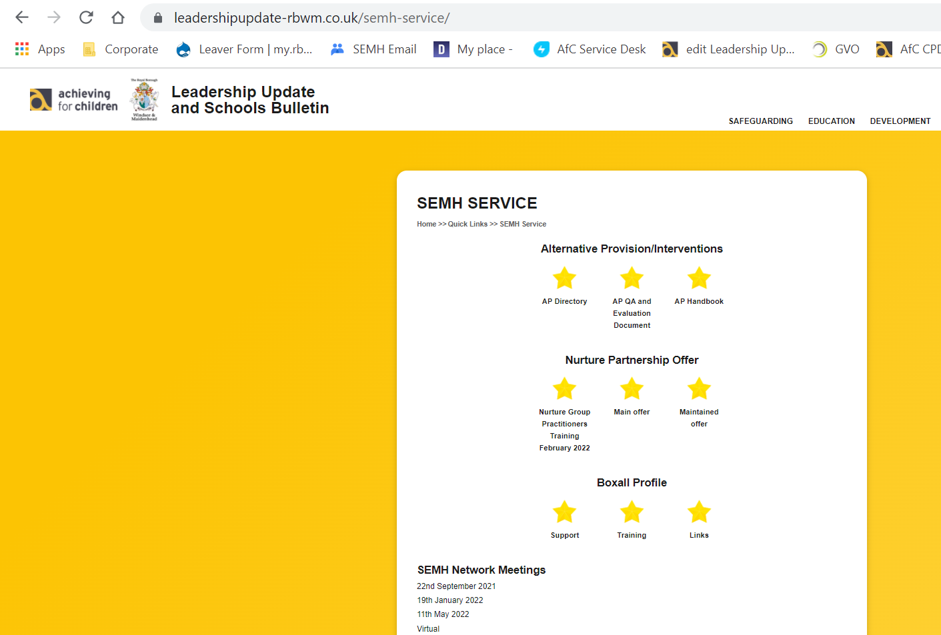
SEMH Service Updates
Leadership Update Website
Alternative Provision Documents
    Directory – updated (let me know of new provisions you use)
    Guidance
    Quality Assurance
PEAR Panel Form
SEMH Intervention Service
Network Meetings (New Academic Year)
https://www.leadershipupdate-rbwm.co.uk/

Slide 45

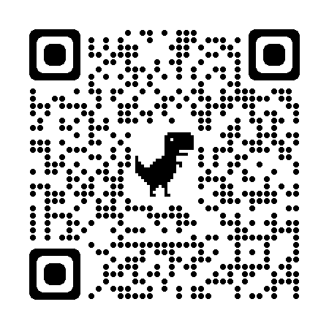
Questions.
Fill Out Feedback Form
Feedback
Thanks
https://docs.google.com/forms/d/1mRwNHkeeMBLaKTNj28Y4iaZH9vEgTVUIr6ltKoLanAw

