Slide 1

Clerks’ & Governance Professionals’ Briefing – January 2026
Wednesday 14th January
Thursday 15th January
Clive Haines & Vicky Brand

Slide 2
Welcome!

Slide 3
AGENDA
Welcome
Leadership Update for January 2026 - Highlights
Governance Training
Ofsted Update
Spring term governance activity
Audit Question
Discussion forum… and questions

Slide 4
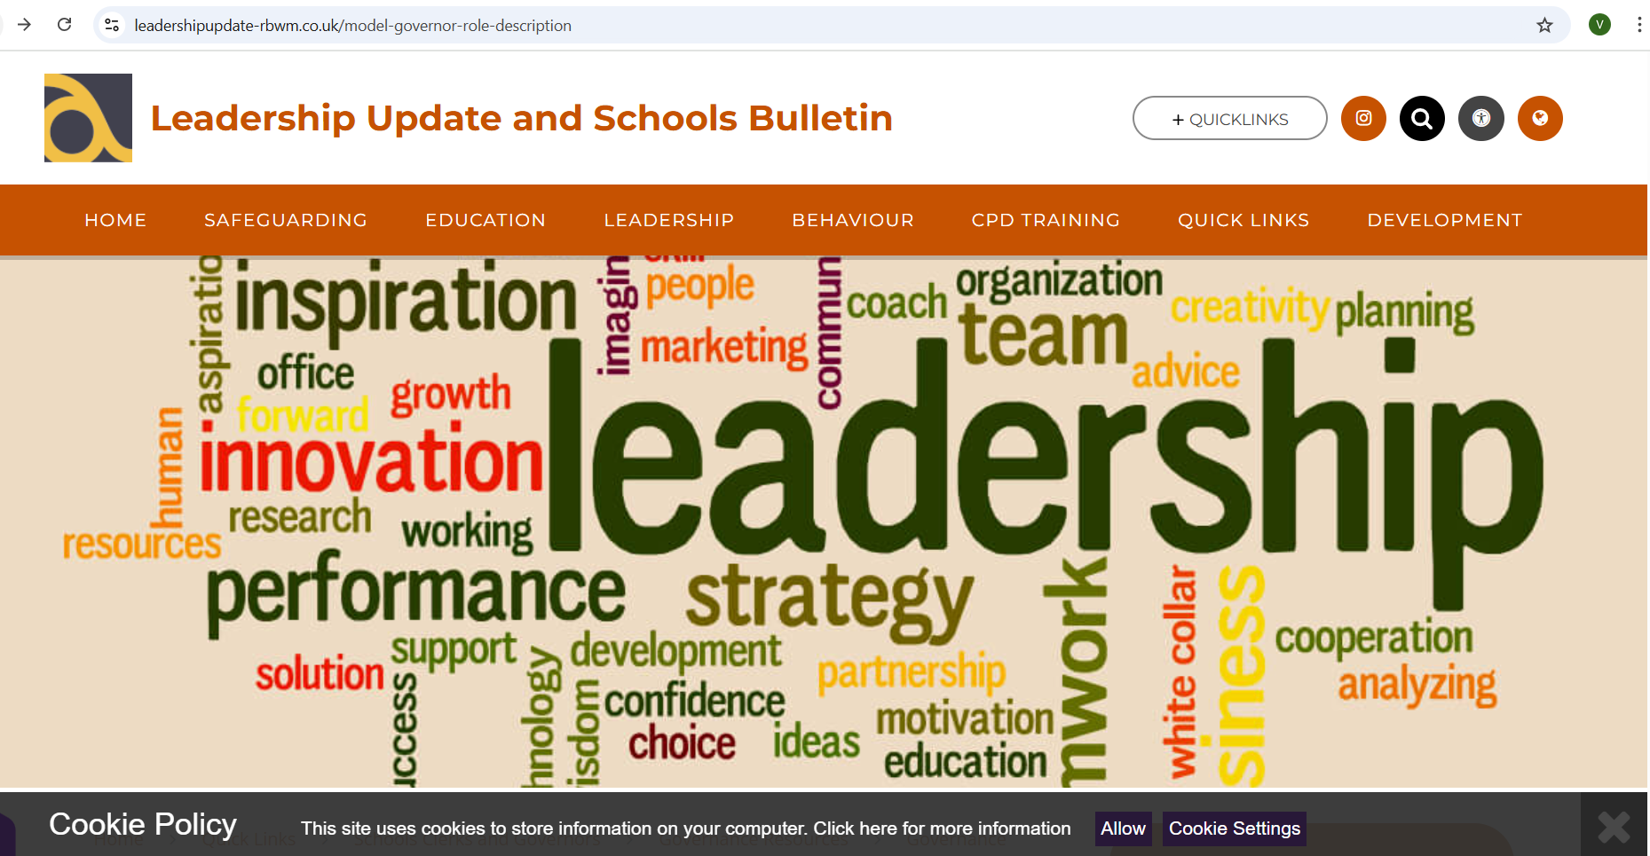
NEW LOOK LEADERSHIP UPDATE – September 2025
www.leadershipupdate-rbwm.co.uk/
The Leadership Update Word Document will be circulated following the briefings. It can also be downloaded from:
Clerks' and Governance Professional's Briefing Jan 2026 Leadership Update and Schools Bulletin

Slide 5
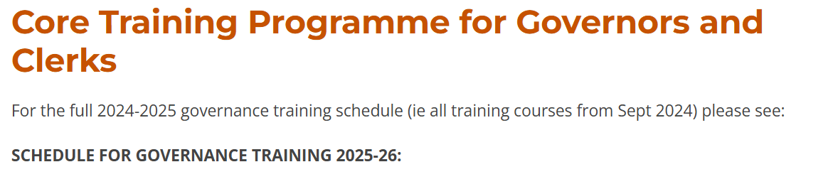
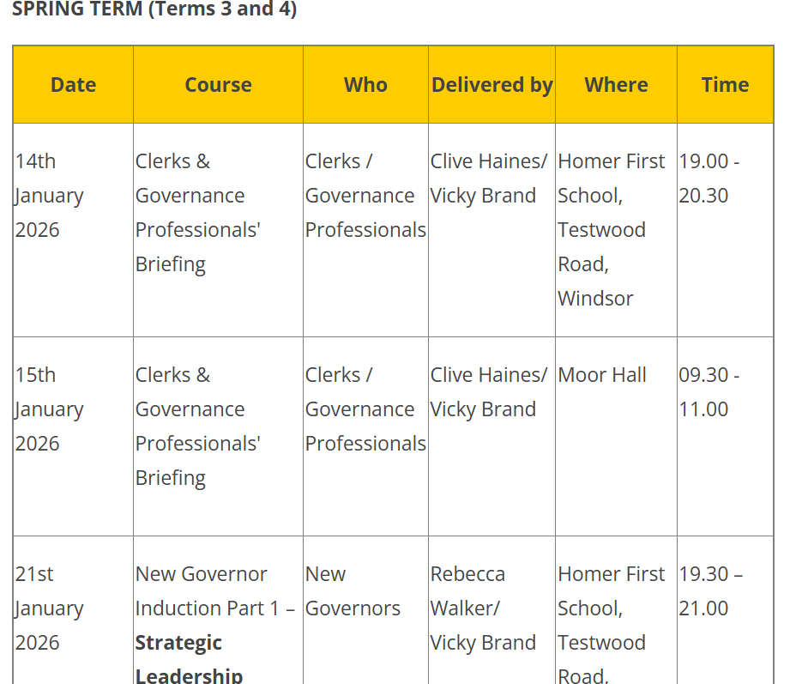
Governance and clerking training schedule for 2025/26
The whole year is planned with a few spaces to respond to changes, particularly Ofsted.
Please also note Educational Leadership Forum dates have also been included for Chairs.
DISCUSSION
Are there any further needs for training or support?
How did Governors like the Ofsted video vs PowerPoint slides?
https://www.leadershipupdate-rbwm.co.uk/core-training-programme-for-governors-and-clerks/

Slide 6
Governance and clerking training schedule for spring 2026
Wednesday 21st Jan - New Governors Induction Part 1 – Strategic Leadership
Wednesday 28th Jan - New Governors Induction Part 2 – The Support and Challenge Role
Wednesday 4th Feb – SEND Governance (Delivered by Anne Bishop Area SENCo)
Wednesday 11th Feb- New Governors Induction Part 3 – Accountability in School Governance
Wednesday 25th Feb – New Governors Induction Part 4 – Safeguarding: the governors role
Wednesday 4th March – Budget Planning (Delivered by Sian Bolton AfC Bursar Support)
Wednesday 11th March – Ofsted Updates - tbc
Wednesday 18th March – Ofsted Updates - tbc
Friday 20th March – Education Leadership Forum – Chairs of Governors (RBWM Schools)
Wednesday 25th March – Chairs and Clerks/Governance Professionals Joint Surgery
Education Leadership Forum (chairs of schools in RBWM are invited) – Friday 20th March 2026

Slide 7
OFSTED - Summary of changes
New report card
A five-point grading scale​
A renewed focus on inclusion
New inspection methodology
New online
insights platform
New toolkits
A new approach for monitoring schools where improvement is needed
All school inspections led by HMI
An additional team inspector on day 1 of every inspection

Slide 8

Ofsted will evaluate
Safeguarding (Met or Not Met)
Inclusion
Curriculum and teaching
Achievement
Attendance and behaviour
Personal development and well-being
Early years (if applicable)
Post-16 (if applicable)
Leadership and governance
A new five-point grading scale
Exceptional.
Strong standard.
Expected standard – OLD GOOD
Attention needed.
Urgent improvement.

Slide 9
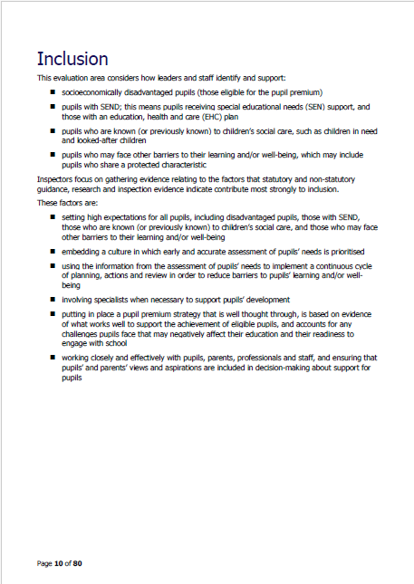

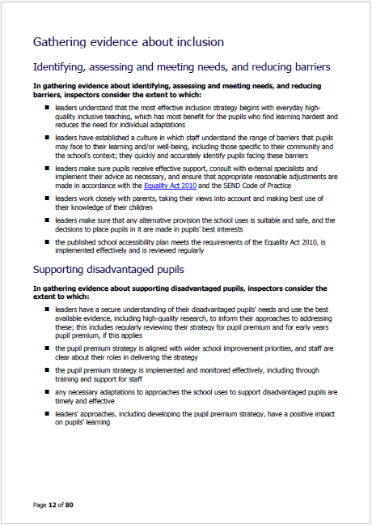
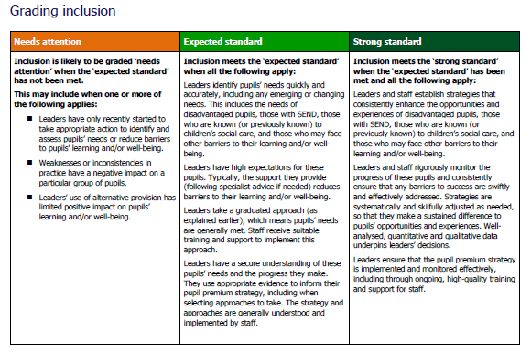
They Have introduced toolkits
Toolkits show providers and inspectors the evaluation areas that we will focus on and how we’ll evaluate and grade providers.
Toolkits include standards that replace grade descriptors currently in our inspection handbook.
The general structure of the toolkit is the same whatever sector you are working in, but we have carefully reflected on how our evaluation areas should apply for different remits.

Slide 10
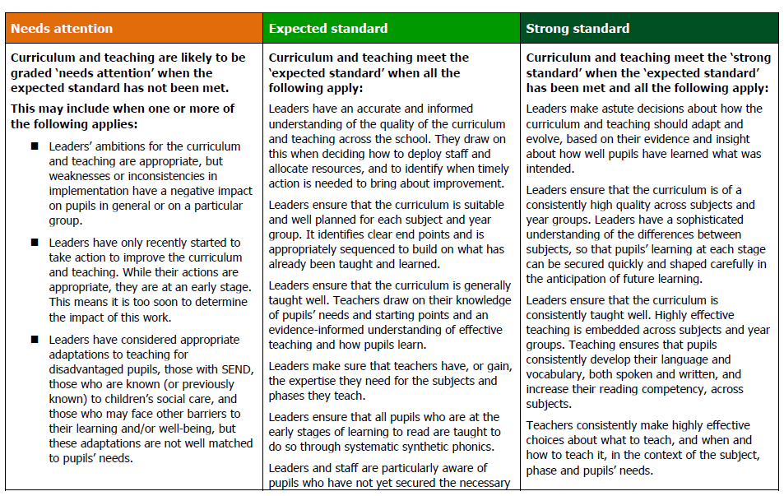
Grading
How will this be received by stakeholders?
Grades Ofsted expect to see most frequently on inspection
Grades across a
5-point scale
Grading
standards
Indicators

Slide 11
Governance
In gathering evidence about governance, inspectors consider the extent to which governors/trustees:
Are knowledgeable about their statutory duties and carry them out effectively
Support and challenge the school’s leaders effectively, using the best methods to assure themselves of the quality and impact of different aspects of the school’s work
Understand their role as the responsible body, where applicable, in considering and addressing leaders’ workload and well-being
Assure themselves that leaders have an accurate understanding of the school’s context and are prioritising the actions for improvement that will have the greatest impact on pupils

Slide 12
Governance
In gathering evidence about governance, inspectors consider the extent to which governors/trustees:
Hold leaders to account appropriately and effectively for the school’s support and provision for disadvantaged pupils, those with SEND, those who are known (or previously known) to children’s social care, and those who may face other barriers to their learning and/or wellbeing
Ensure that systems for monitoring and quality assurance are fair, valid and constructive, and provide leaders and staff with high-quality feedback to inform continuous improvement

Slide 13
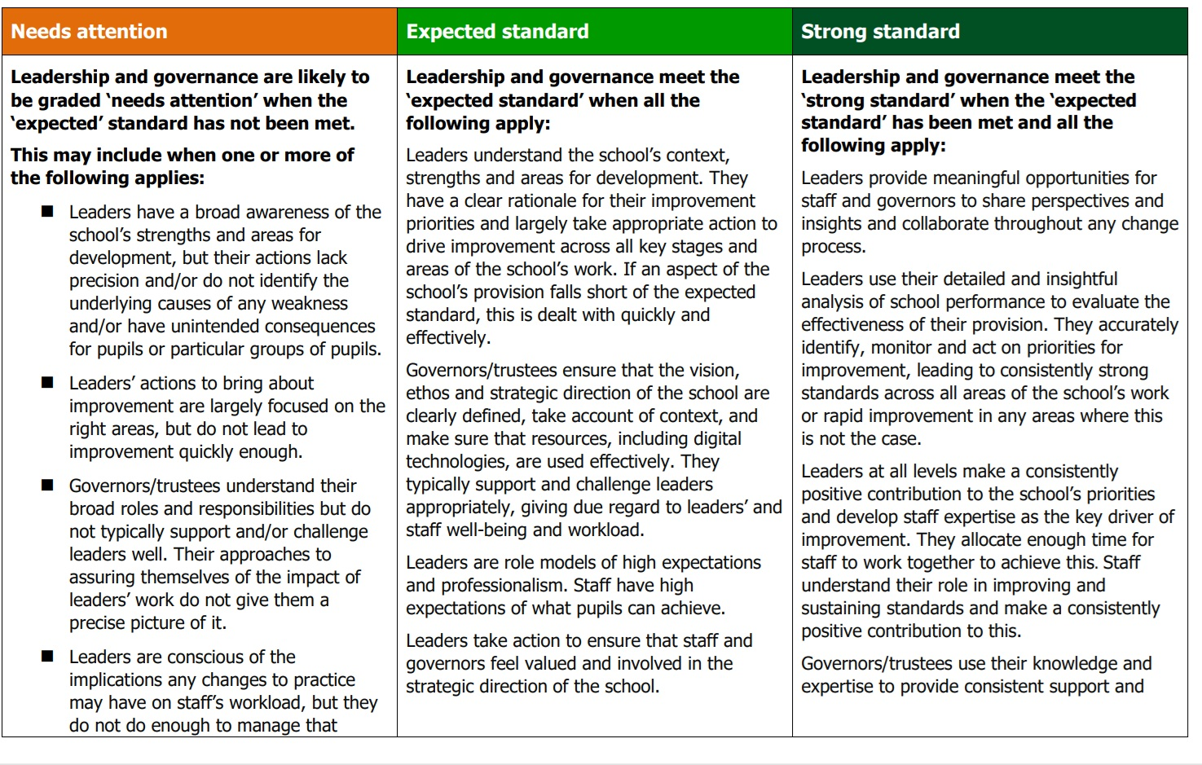
Governance

Slide 14
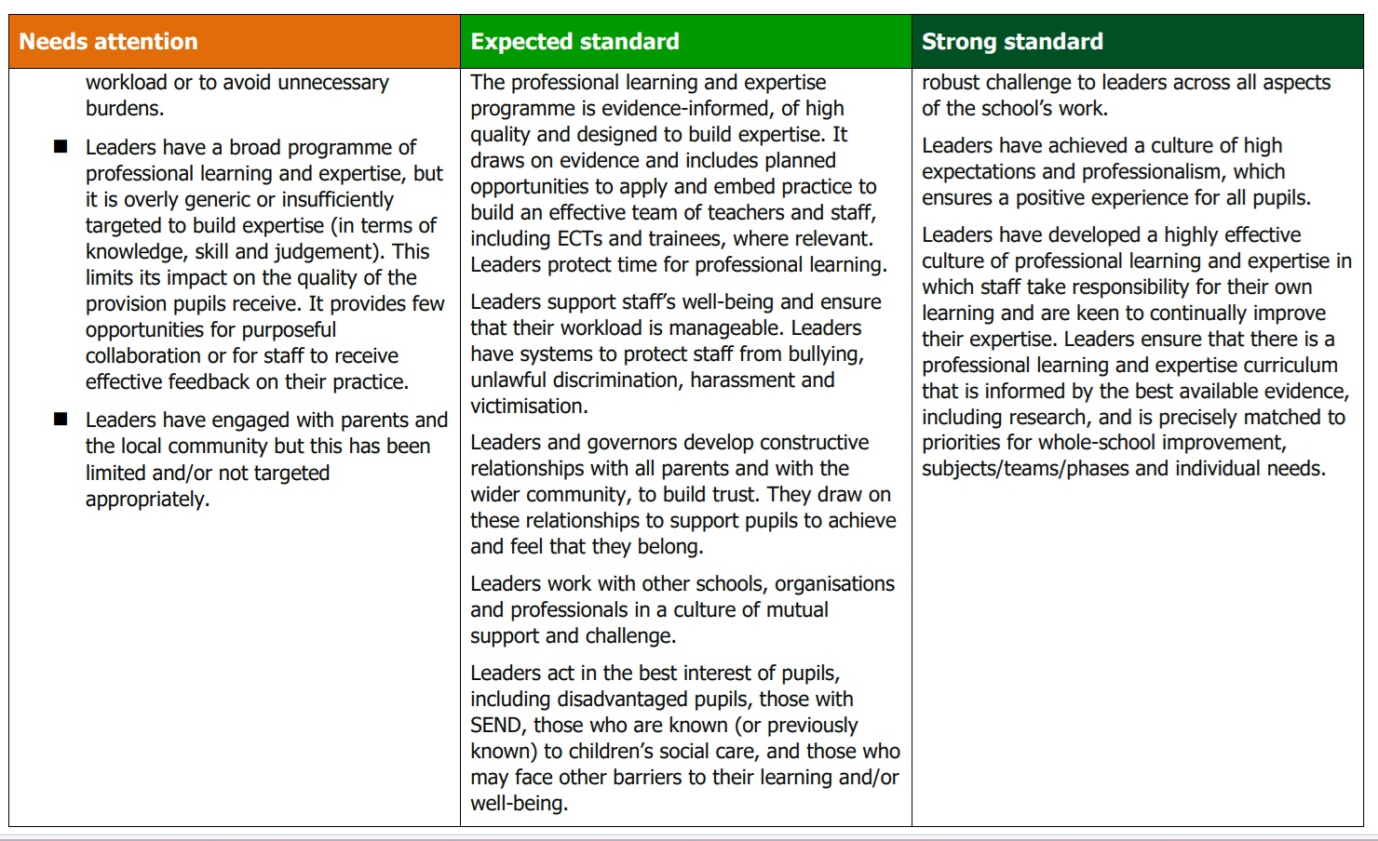
Governance

Slide 15

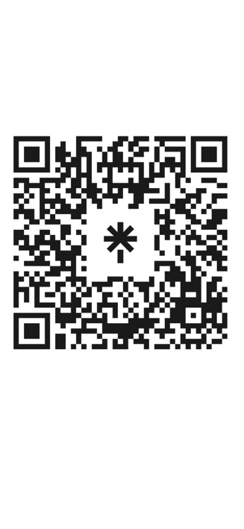
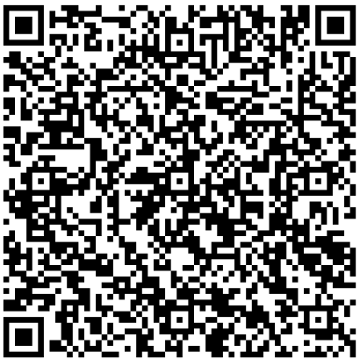
Resources and further information
Scan me
SCAN ME
Formal response to consultation
Toolkits for:
    early years
    Schools
    Further education and skills
    Initial teacher education
Supporting research and evidence
www.gov.uk/ofsted

Slide 16
Autumn term governance activity:
Governance business
Record meeting attendance
Interests to be declared (ongoing and in meetings in relation to the agenda)
Minutes from previous meeting to be approved at next meeting
Report on any actions re vacancies and upcoming ends of terms of office
Address and update rolling action log
Ongoing monitoring of governor CPD attended (ask for reports from governors)
Ongoing monitoring of governor section of website and GIAS Governor Section
Clerk’s report from January clerks’ briefing and circulate Leadership Update
If there were changes to the Terms of Reference following Autumn FGB, ensure these are approved at this next FGB meeting (official delegation).

Slide 17
Key Priority focus
Receive a Headteacher’s report
Receive other school reports (subject leaders, external moderation, end of Autumn term data, survey results etc)
Monitor the progress against key priorities / targets set / School development plan
Receive committee minutes/headlines and governor visit reports
What do the reports and data tell us?
TRIANGULATION
Policies
Policy review as per school’s policy cycle - approval by FGB or delegated to committee as per terms of reference
Monitoring trends/groups: Attendance, Exclusions, Behaviour, H&S etc - is school policy embedded and having a positive impact?
Safeguarding - a standing item?
Review other policies as per the school’s policy review cycle – some may be delegated to committees as per Ts of Ref. Not all policies require GB approval (see DfE list of statutory)

Slide 18
Likely Spring term activities
Maintained: 9 month YTD report to be approved and submitted to LA (Jan)
Maintained: School Financial Value Standard to be approved at FGB (31st Jan)
Monitor YTD expenditure reports (monthly)
Financial benchmarking
Review of SLAs and licences
Budget planning (maintained)
HT recruitment (if applicable)
Any staffing restructuring (if applicable) to forward plan the staff structure for the next academic year
Determination of admissions arrangements (VA and Academies) by 28th Feb. Publication by mid-March.
Admissions Committee - primary
Committee meetings and governor visits - monitoring key priorities and estate/resources/statutory compliance (written visit reports)
Safeguarding Governor visit with DSL
Academies (additional)
Publish Financial Statements (31st Jan)
School Resource Management self-assessment checklist (deadline mid-March)

Slide 19
Audits
How many of you have had your school audited recently?
Terms of References for FGB’s is best practise.
Link to Leadership Update
leadershipupdate-rbwm.co.uk/model-terms-of-reference
A filled in example………

Slide 20
Discussion forum
and questions

