Slide 1

Clerks’ & Governance Professionals’ Briefing – April 2026
Wednesday 22nd April
Thursday 23rd April
Clive Haines & Vicky Brand

Slide 2
Welcome!

Slide 3
AGENDA
Welcome
Leadership Update for April 2026 - Highlights
Governance Training
Summer term governance activity
Prevent Training/ Working Together Safeguard Children
Discussion forum… and questions

Slide 4
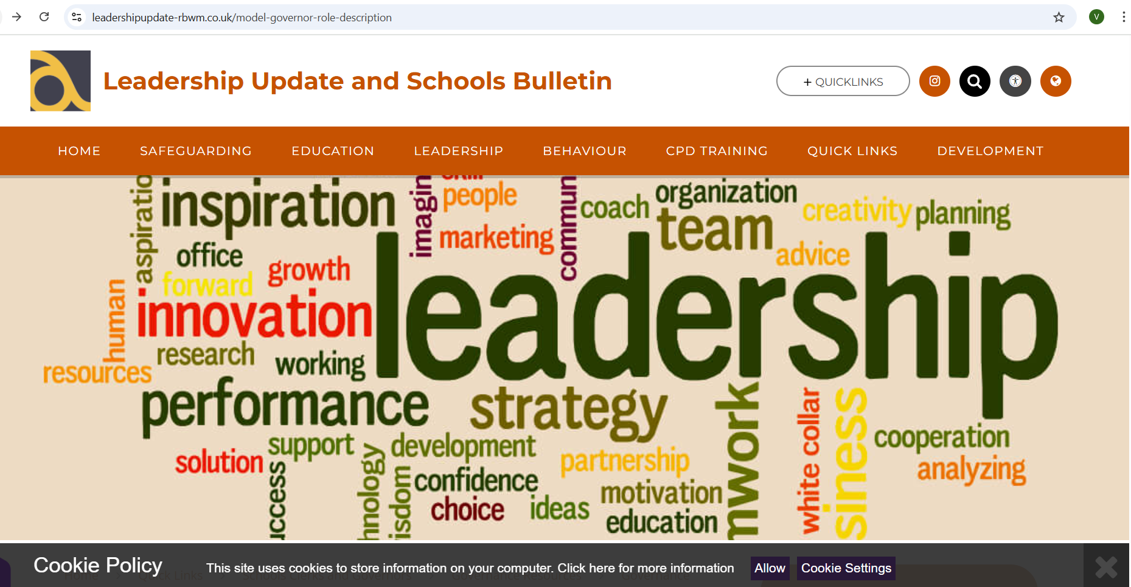
NEW LOOK LEADERSHIP UPDATE – September 2026
www.leadershipupdate-rbwm.co.uk/
The Leadership Update Word Document will be circulated following the briefings. It can also be downloaded from:

Slide 5
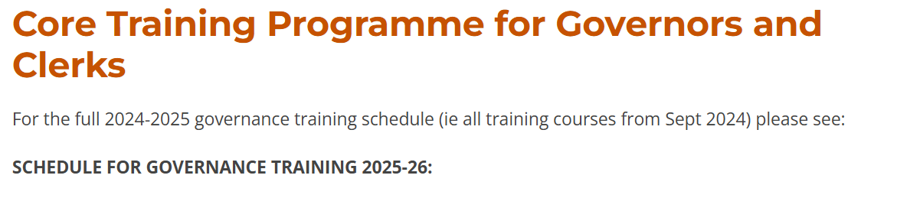
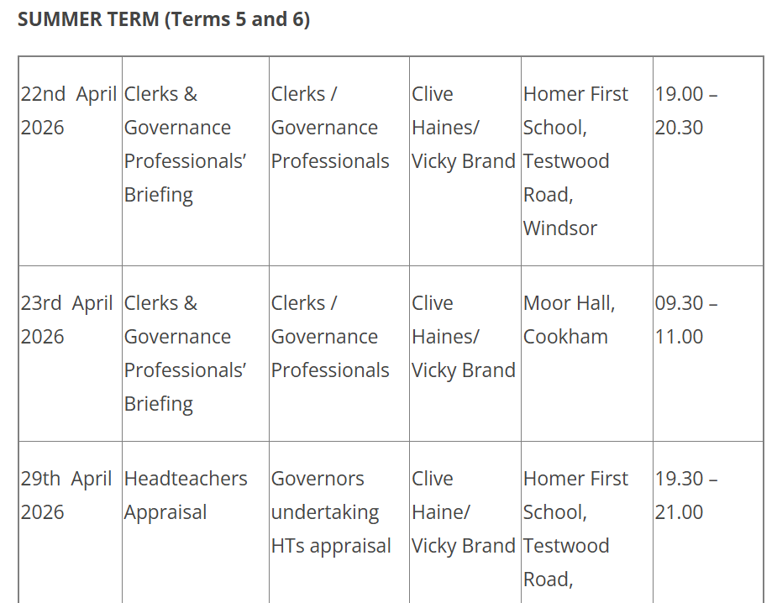
Governance and clerking training schedule for 2025/26
The whole year is planned with a few spaces to respond to changes, particularly Ofsted.
Please also note Educational Leadership Forum dates have also been included for Chairs.
BOOKING TRAINING
Please complete and return booking forms to Elaine Norstrom; elaine.norstrom@achievingforchildren.org.uk
The form can be found below the training schedule on Leadership Update.
https://www.leadershipupdate-rbwm.co.uk/core-training-programme-for-governors-and-clerks/

Slide 6
Governance and clerking training schedule for summer 2026
Wednesday 29th April – Head Teacher Appraisal
Wednesday 6th May - New Governors Induction Part 1 – Strategic Leadership
Wednesday 13th May - New Governors Induction Part 2 – The Support and Challenge Role
Wednesday 20th May - New Governors Induction Part 3 – Accountability in School Governance
Wednesday 3rd June – New Governors Induction Part 4 – Safeguarding: the governors role
Wednesday 10th June – Modern Governance
Wednesday 17th June – SEND Governance (Delivered by Anne Bishop Area SENCo)
Wednesday 24th June – tbc
Wednesday 1st July - Chairs and Clerks/Governance Professionals Joint Surgery
Wednesday 8th July - tbc
Friday 10th July – Education Leadership Forum – Chairs of Governors (RBWM Schools)
Education Leadership Forum (chairs of schools in RBWM are invited) – Friday 10th July 2026 at Moor Hall Cookham 9am.

Slide 7
Summer term governance activity:
Governance business
Record meeting attendance
Interests to be declared (ongoing and in meetings in relation to the agenda)
Minutes from previous meeting to be approved at next meeting
Reporting on any actions re vacancies and upcoming ends of terms of office
Address and update rolling action log
Ongoing monitoring of governor CPD attended (ask for reports)
Ongoing monitoring of governor section of website and GIAS
Clerk’s report from May clerks’ briefing and circulate Leadership Update
T6 additions….
Review of the year’s governance - self-evaluation and development planning
Agree next year’s meeting schedule

Slide 8
Key Priority focus
Receive a Headteacher’s report
Receive other school reports (subject leaders, external moderation, end of Spring term data, survey results etc)
Monitor progress against key priorities/ targets set / School development plan
Receive committee minutes/headlines and governor visit reports
What do the reports and data tell us?
TRIANGULATION
Term 6 additions….
Celebrate the successes of the year.
Likely key priorities for the next year?

Slide 9
Policies
Policy review as per school’s policy cycle - approval by FGB or delegated to committee as per terms of reference
Monitoring trends/groups: Attendance, Exclusions, Behaviour, H&S etc - is school policy embedded and having impact?
Safeguarding - a standing item?
Term 6 additions….
Safeguarding governor annual report to the GB (minimum annual)
Looked After Children - designated teacher’s annual report to the GB
DPO - annual report to the GB
Sports Premium Report (must be on school website by end of July)
Policy review per school’s policy cycle - approval by FGB or delegated to committee as per terms of reference
Monitoring trends/groups: Attendance, Exclusions, Behaviour, H&S etc - is school policy embedded and having +ve impact?

Slide 10
Likely Summer term activities
Maintained: Budget plan approval (1 year and 3 year plan) - RBWM deadline mid-end of May.
Committee meetings and governor visits - monitoring key priorities and estate/resources/statutory compliance (written governor visit reports)
Safeguarding Governor visit - preparing the annual SG report to the GB
Likely end of year activities
Possibly - leaving events, summer school fairs & events and celebrations (governor attendance maybe)
Academies (additional)
Budget planning including financial benchmarking, review of SLAs etc
Audited financial statements to Companies House (for financial year end 31st Aug the deadline is 31st May)
Annual review of risk register
End of year…
Approve budget plan for the next academic year.
Budget Forecast Return submissions to ESFA by end July (proforma goes live in June)
Annual review of risk register
Review upcoming changes to Academies Handbook

Slide 11
Prevent Duty Training/Safeguarding Policy Update (WTTSC)
https://www.support-people-susceptible-to-radicalisation.service.gov.uk/portal#awareness-course
This training from GOV.UK is free to complete and takes approximately 30 minutes. Upon completion, a certificate can be printed.
All governors should complete some form of Prevent training, whether through this online module or your respective schools.
Working Together to Safeguard Children has some recent updates and your school policies will need to reflect this with the dates within the schools Safeguarding Policy.

Slide 12
Discussion forum
and questions
Code of Conduct
AI
Mandatory allergy awareness training for all staff, and governors?

