Slide 1
Attendance Lead Network Meeting
Tuesday 9th June 2026
Welcome to this virtual meeting
Notes:
‹#›

Slide 2
Agenda for today
Item | Who | Time
Welcome | Al Whitelaw / Annette Taylor | 3.30 pm (10 mins)
Children Missing in Education | Emma Aquilina | 3.40pm (5 mins)
Fixed Penalty Notices and Single Justice Procedure | Satnam Bahara | 3.45m (5 mins)
Education Welfare Update | Annette Taylor | 3.50 (10 mins)
Kinship Care | Lizzie Hogan | 4.00pm (15 mins)
Questions

Slide 3
Children Missing In Education
Emma Aquilina
Notes:
‹#›

Slide 4

Child Missing from Education (CME)
1. Make Reasonable Enquiries (Days 1–15)
Take all reasonable steps to establish the child’s whereabouts:
Contact parent/carer via telephone, text, letter, and email
Check with other schools, alternative provisions, and known professionals
Conduct a home visit
If applicable, ask for proof of travel and/or admission to another school
2. Identify as CME
Classify as CME after 15 days if the reason for absence is unknown or education has not been identified.
3. Share Information
If the child remains missing, inform the local authority using the CME referral form.
Please do not take off roll until you receive confirmation.
Need advice or to make a referral?
Emma.aquilina@achievingforchildren.org.uk | 07557930449

Slide 5
The Single Justice Procedure
Satnam Bahara
Notes:
‹#›

Slide 6
What Is the Single Justice Procedure?
The SJP is a criminal court process introduced under the Criminal Justice and Courts Act 2015.
Low-level, non-imprisonable offences such as parking, littering and term time absences are dealt with by a magistrate supported by a legal adviser.
Faster processing of cases, reduced court time and there is no requirement for the defendant to attend court.
Relevant legislation includes:
Education Act 1996
School Attendance (Pupil Registration) Regulations
National Framework for Penalty Notices (2024)

Slide 7
The SJP Notice contains:
Details of the alleged offence
Summary of evidence
Plea options
Means Form for financial assessment
Response deadline

Slide 8
If a Parent Pleads Guilty:
  The parent is:
  Convicted
  Fined
  Required to pay the prosecution’s costs
  Required to pay a victim surcharge

Slide 9
If a Parent Pleads Not Guilty
The case leaves the SJP process and a traditional Magistrates' Court hearing is scheduled
Evidence may be challenged
Witnesses may be required
Schools may be asked to provide statements or supporting evidence.
Common Defences Raised include:
Belief that absence was authorised
Exceptional circumstances arguments
Administrative errors
Disputes about attendance records
Procedural concerns

Slide 10
AfC specific requirements:
Form ED221:
  The school is required to complete and return.
  Shows the relevant entries on the Attendance Register.
  Signed by the Headteacher.
Provide details of when and how (website, letter, newsletter etc) parents are informed of the school’s Attendance Policy.

Slide 11
Education Welfare Updates
Annette Taylor
Notes:
‹#›

Slide 12
VYED Updates - Absence returns
The 10-Day Unauthorised Absence: Any pupil who has hit 20 consecutive sessions (10 school days) of continuous unauthorised absence (using codes G, N, O or U).
The 15-Day Sickness: Pupils who have accumulated 15 or more total days of illness absence in the academic year-to-date. This is designed to trigger professional curiosity and support and also helping schools identify emerging mental health issues, medical needs or ERSA early. It also helps to identify any students who may need further support via our Teacher for the Medically Vulnerable, Clare Rafaelli.
These reports will support in the completion of our absence returns form;
25/26 Unauthorised and Medical Absence Return Form
EWOs have emailed their schools to highlight any we have not yet received
The returns from schools are a statutory requirement from the DfE and must be completed - currently we have only received 25% of expected returns from schools.
Support with finding the information on the portal can be found here

Slide 13
Reduced and Reintegration Timetables
The Expectation: Schools must notify the Education Welfare team as soon as possible when a student successfully transitions off a reduced/reintegration timetable and is expected to attend full time.
Why It Matters: This ensures our borough-wide tracking is entirely accurate, aligns with DfE safeguarding compliance and allows us to celebrate successful transitions.
How to Notify Us: Email your EWO directly with the end date so we can update our records. If you have any outstanding please email your EWO this week.
A link to the new form for next academic year will be sent at the beginning of September for you to notify us of any reduced timetables for 26/27. Please complete new paperwork then for anyone who remains on a reduced/reintegration timetable from this academic year.

Slide 14
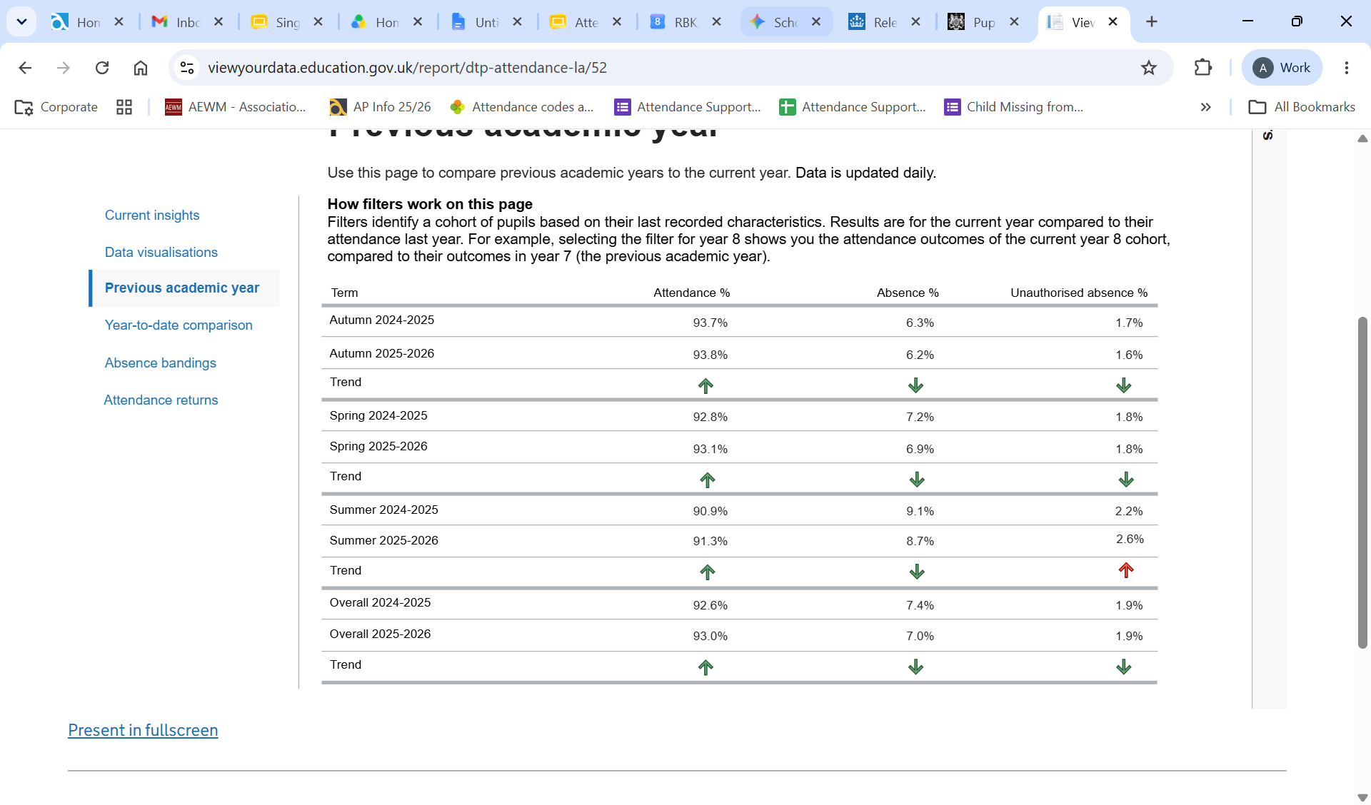
RBWM 24/25 vs 25/26

Slide 15
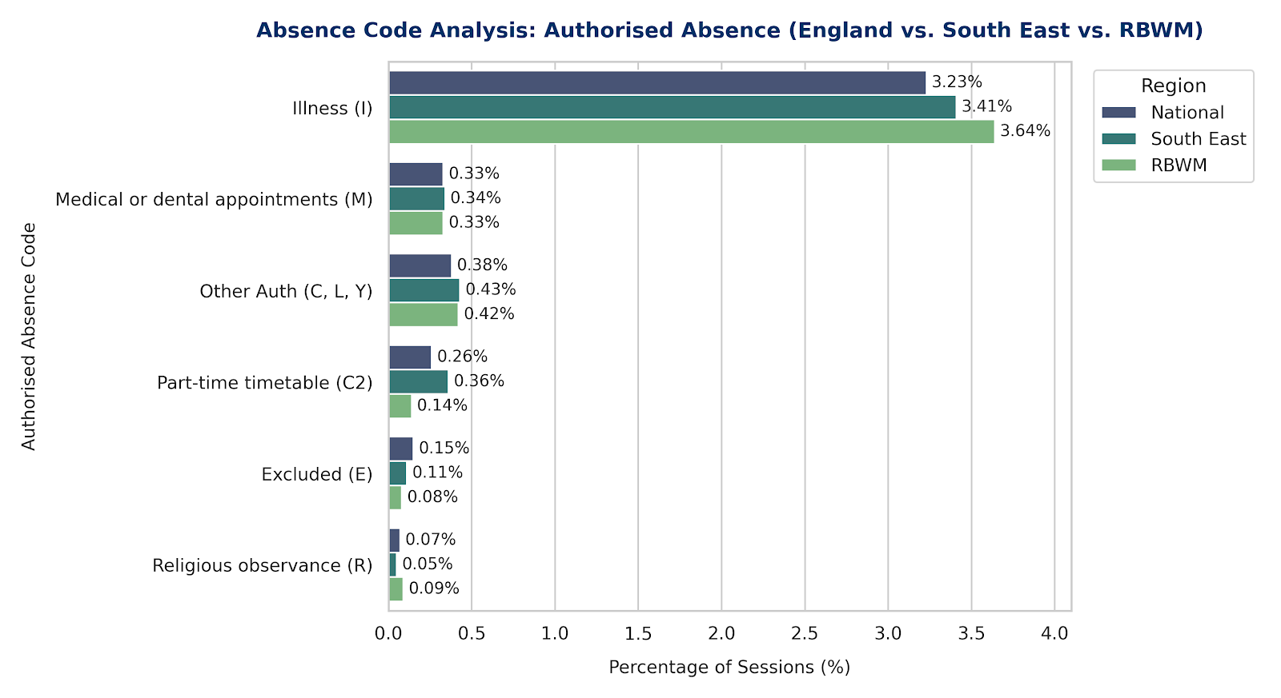
Authorised Absence: National vs South East vs RBWM

Slide 16
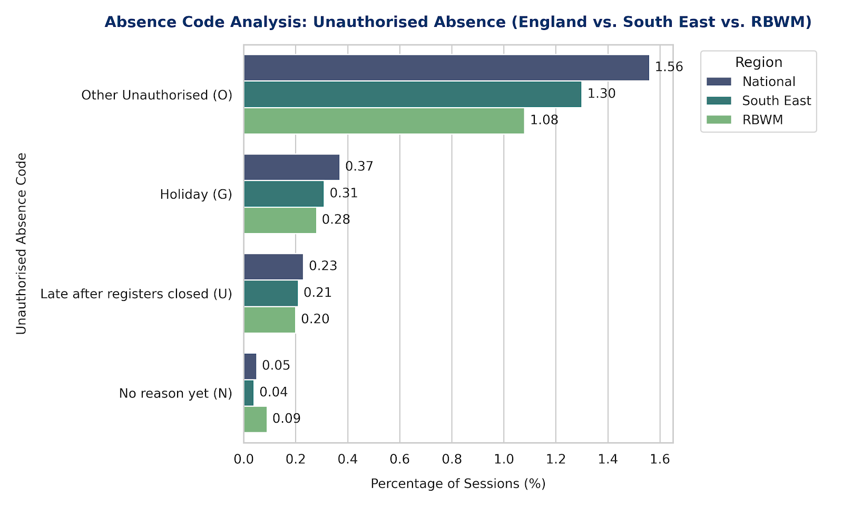
Unauthorised Absence: National vs South East vs RBWM

Slide 17
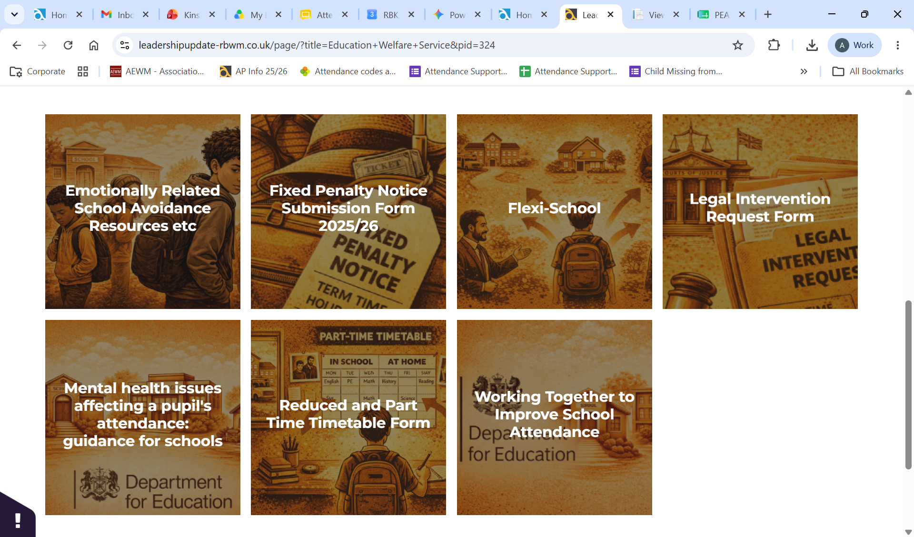
Leadership Update Website
Your Central Hub: Access all local authority guidance, templates and attendance resources in one place.
Evolving Over Next Half Term: Content is being actively updated and expanded over the coming weeks.
Co-Design With Us: Tell us what resources, tools or templates you need and we can add them where needed.
The Education Welfare Service section can be found here

Slide 18
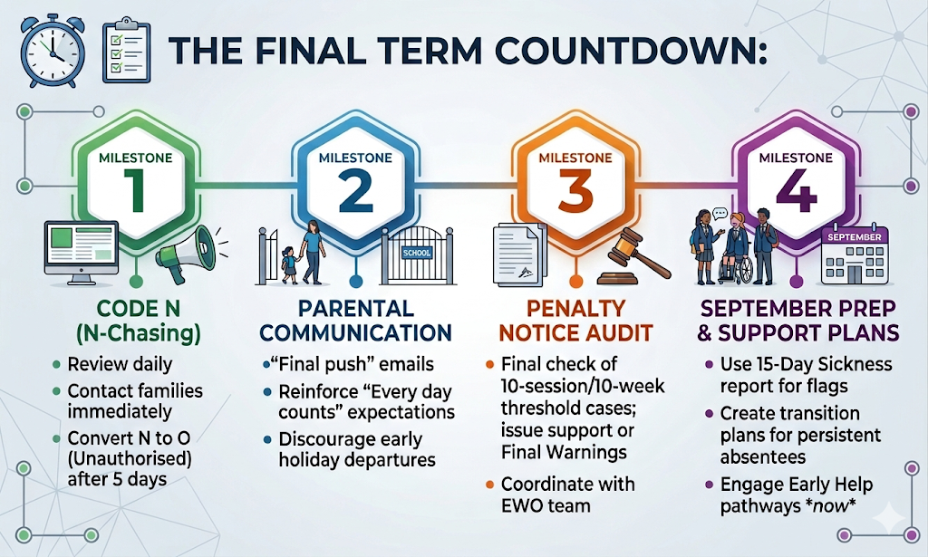

Slide 19
Kinship Care
Lizzie Hogan
Notes:
‹#›

Slide 20
Thanks, Questions and Feedback
https://forms.gle/s6a5S7pXZnnqMmS58
Notes:
‹#›

