Slide 1
Attendance Lead Network Meeting
Tuesday 10th March 2026
Welcome to this virtual meeting
Notes:
‹#›

Slide 2
Agenda for today
Item | Who | Time
Welcome | Al Whitelaw / Annette Taylor | 3.30 pm (10 mins)
OFSTED and Attendance | Harry Ingham | 3.40 pm (20 mins)
Education Welfare Updates | Annette Taylor | 4.00pm (15 mins)
ERSA - Communities of Practice | Zoe Price | 4.15pm (15 mins)
Questions

Slide 3
OFSTED and Attendance
Harry Ingham
Senior OFSTED Inspector
Notes:
‹#›

Slide 4
Education Welfare Service Updates
Notes:
‹#›

Slide 5
Strengthening our Practice
Absence Returns
Filling in absence returns shouldn't sit solely on the Attendance Lead's shoulders.
Consider involving Form Tutors, Heads of Year, or Administrative Support Staff.
hose closest to the student often have the most up-to-date "on-the-ground" context, making the returns more accurate and robust.
Elective Home Education (EHE): A Parent-Led Choice
EHE must always be a parent-led decision.
While we can (and should) discuss the implications of EHE if a parent raises it, school staff must never suggest or encourage it as a solution to attendance or behavioral issues.
We are pleased to share that we are currently recruiting an additional EHE Coordinator to provide further expertise and oversight in this area.
Medical Coding (Code I): Following the Guidance
A gentle reminder that schools do not strictly require medical evidence (like a GP note) to code an absence as "I" (Illness).
As per DfE guidance, if you are satisfied that a child is genuinely unwell, you can apply the code. This includes mental health.
Only seek formal medical evidence if you have a genuine reason to doubt the authenticity of the illness. This reduces the burden on both parents and the NHS.

Slide 6
Inclusion EWO
Update
Notes:
‹#›

Slide 7
Inclusion Matters: Supporting Vulnerable Pupils
The Inclusion EWO role is designed to provide additional support for children under the vulnerable umbrella (those with an EHCP or social worker).
Data-driven insight
Closely monitoring pupil data to identify and understand individual barriers to their school attendance.
Collaborative working
Empowering social workers to widen discussions around ERSA.

Slide 8
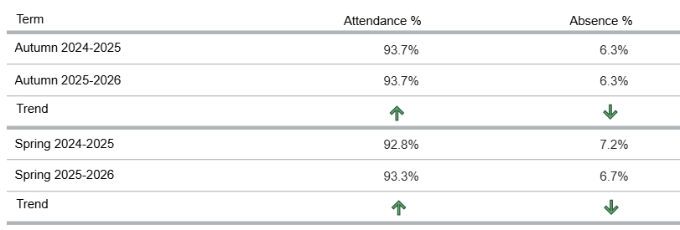
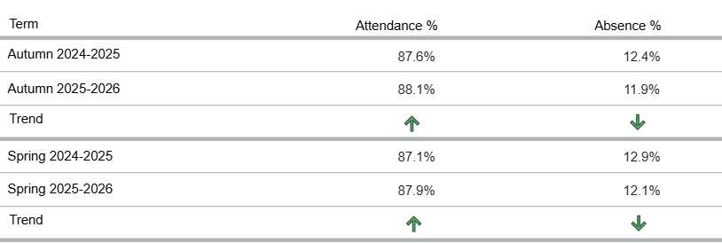
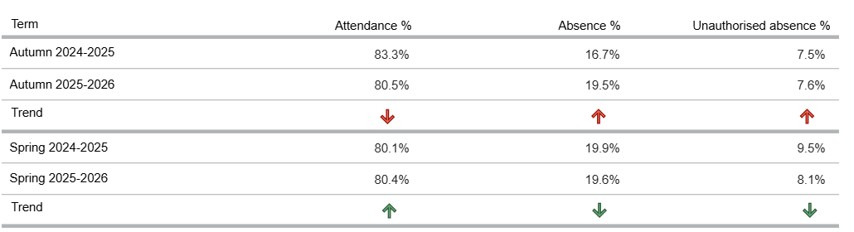
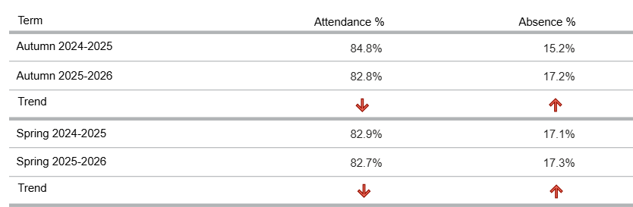
RBWM
Pupils w/ EHCP
Pupils on CIN Plan
Pupils on CP Plan
Please ensure your MIS accurately reflects this cohort of pupils.
Notes:
Analysis of data:
EHCP pupils:
- autumn and spring term both show increase in attendance vs last years data
CIN pupils:
- spring term shows an increase in attendance vs last years data
CP pupils:
- decrease in attendance since last year
Please request attendance leads to cross reference their MIS vs the data available on VYED for these cohorts, and for them to reach out to their EWO highlighting any discrepancies

Slide 9
Educational Neglect
Keeping Children Safe in Education (KCSIE), notes low school attendance as a form of educational neglect:
28. Neglect: the persistent failure to meet a child’s basic physical and/or psychological needs, likely to result in the serious impairment of the child’s health or development.
177. Children being absent from education for prolonged periods and/or on repeat occasions can act as a vital warning sign to a range of safeguarding issues including neglect and child exploitation.
Notes:
Encourage schools to view non-school attendance as a branch of neglect

Slide 10
Fixed Penalty Notices
Notes:
‹#›

Slide 11
FPNS this academic year to date
Over 230 FPNs issued to parents/guardians so far this academic year.
Current figures are directly on par with the 2024-25 academic year.
Unauthorised term-time holidays remain the leading cause for intervention (representing over 60% of all notices).
The 3-Year Rolling Period & Escalation
Under the updated 2024 guidelines, we now track FPNs over a rolling 3-year period.
The "Second Strike" Penalty:
  We are seeing an increase in families receiving a second fine within this window.
  These are charged at the higher rate of £160 (with no early-payment discount).
To date, no families have reached the third holiday within the 3-year period.
Many parents are still unaware that the 3-year clock does not "reset" every September.
When a family requests a second holiday, the school should explicitly warn them of the £160 flat fee to manage expectations.
Aside from holidays, we must continue to monitor the 10-session (5-day) threshold for persistent unauthorised absence.

Slide 12
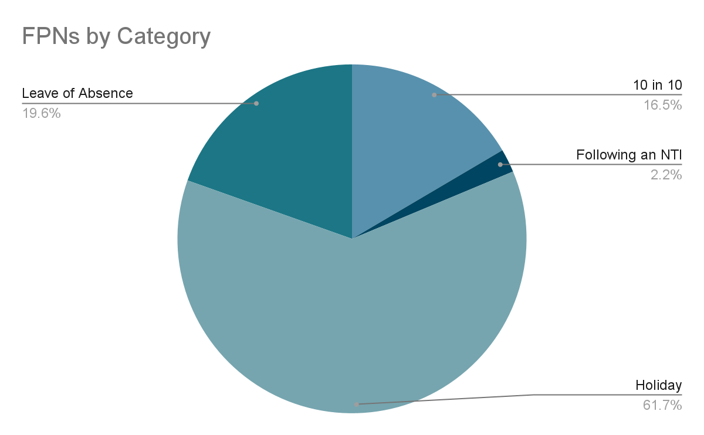

Slide 13
An FPN is the conclusion of a support process, not the beginning.
Before a fine is considered, schools must demonstrate a "Support-First" approach.
The "Notice to Improve" (NTI):
  This is the final formal bridge before legal action.
  It provides a monitoring window
  If attendance improves during this window, no fine is issued.
Robust Audit Trails
  Detailed logs are required for every intervention.
  Must Document: Phone logs,emails, home visits, and invitations to attendance meetings.
  Without evidence of support, an NTI FPN may be legally unenforceable.
All Fixed Penalty Notices must be signed off by a Headteacher or Attendance Lead on SLT. These can be submitted by your Attendance Officer or admin teams.
We have two information sources for parents on FPNs.
  Parents are less likely to react with hostility if the rules were clearly communicated in advance.
  Clearly outlines the move from £80 to £160 (and the 3-year rolling period).
  Gives them the knowledge needed to avoid financial penalties
Ensure these reminders or similar if you have your own are included in your next three school newsletters and updated on the school website.

Slide 14
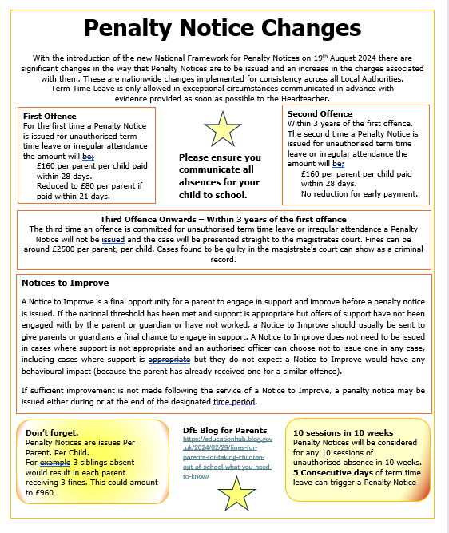

Slide 15


Slide 16
Expressions of Interest for 2026/27
Notes:
‹#›

Slide 17
Expressions of interest for EWS for 26/27 are being circulated now.
Packages can be mixed and matched where needed. Packages available;
Education Welfare 2026/27
Package Hours | Costs
120 | £6,900
90 | £5,175
60 | £3,450
30 | £1,725
15 | £863
7.5 | £436
Google form to complete;
Education Welfare Service - Expression Of Interest 26/27 - Google Forms

Slide 18
ERSA Communities of Practice
Zoe Price

Slide 19

Communities of Practice Professional Pathway
What is a CoP?
A community of practice (CoP) is a group of people who share a common interest in a topic and who come together to share best practices and develop new knowledge to advance professional practice related to that topic.
Outcome
To develop a comprehensive document that outlines the graduated pathway of ERSA support across the local authority. This highlights the universal provision that is expected to be embedded within schools, initial exploration of patterns of absence using the ERSA toolkit and professional services (community and local authority) that can be referred to at different levels of ERSA (emerging versus entrenched).

Slide 20
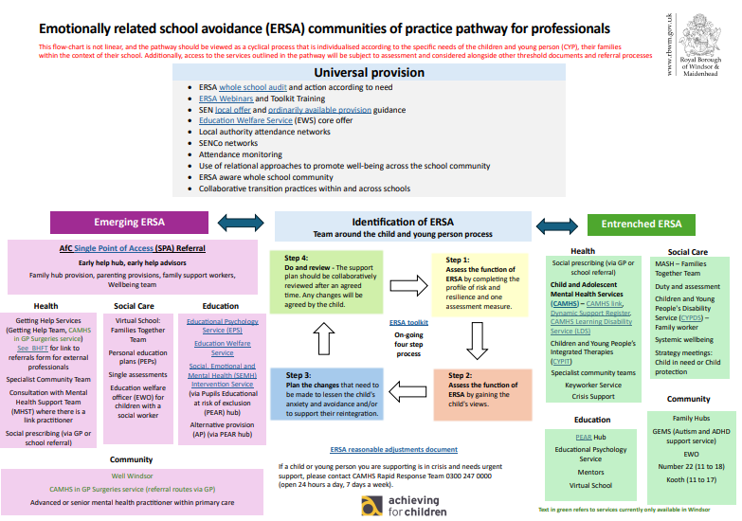
Communities of Practice Professional Pathway

Slide 21
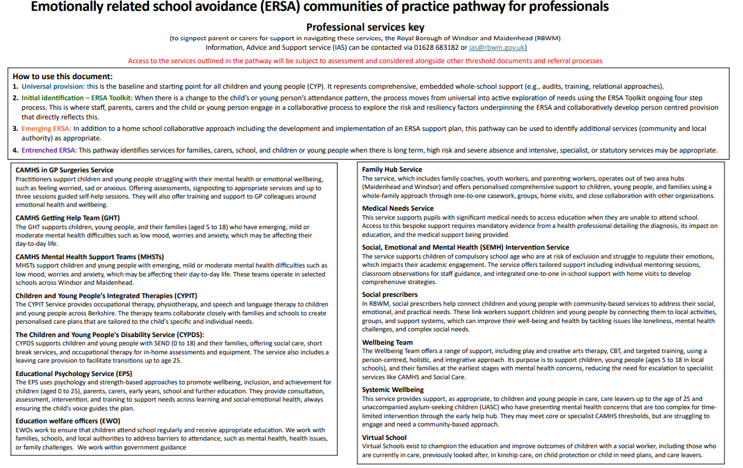
Communities of Practice Professional Pathway

Slide 22
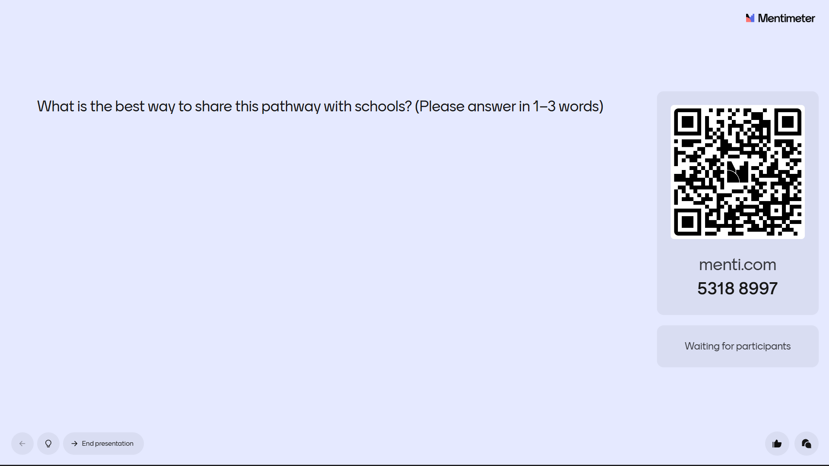
Communities of Practice Professional Pathway

Slide 23
ERSA Pilot Project Updates
Updated timeline
July/September 2025: School audits to be completed and co-produced, individual goals and objectives to be developed
September 2025: Whole school community surveys to be circulated & analysed
October- March 2026: Focus Groups of all key stakeholders to inform early intervention parent/carer groups/drop in and targeted psychoeducational groups and therapy learning walks in schools.
November - February: Speech and Language Therapist and Occupational Therapist learning walks
February - December 2026: Parent/ school workshops rollout and data analysis. Midway review June 2026.
Spring term 2027: Performance report on outcomes, sustainability and support/training to other services/neighbours to operationalise this model and approach adapted to each secondary school community on a graduated phased roll out.

Slide 24
Thanks, Questions and Feedback
https://forms.gle/s6a5S7pXZnnqMmS58
Notes:
‹#›

