Slide 1
Attendance Lead Network Meeting
Tuesday 18th November 2025
Welcome to this virtual meeting
Notes:
‹#›

Slide 2
Agenda for today
Item | Who | Time
Welcome | Al Whitelaw / Annette Taylor | 3.30 pm (10 mins)
Annual Report | Annette Taylor | 3.40 pm (10 mins)
Fixed Penalty Notices update | Satnam Bahra | 3.50pm (5 mins)
Ofsted and Inclusion Alternative Provision EHE Flexi schooling | Al Whitelaw | 4.00pm (20 mins)
ERSA Communities of Practice | Zoe Price | 4.20pm (15 mins)
New EWO and Inclusion EWO introduction | Delphine Green / Chesca Iorio | 4.35pm (10 mins)
Questions

Slide 3
New Attendance Expectation and Support Measures
Al Whitelaw
Notes:
‹#›

Slide 4
Attendance Baseline Improvement Expectations (ABIEs): Action Required for 2025/26
AI-powered, tailored minimum improvement targets
calibrated based on your school’s context (location, pupil needs, and deprivation) compared to similar schools.
ABIEs are a floor, not a ceiling; schools should strive for the greatest possible improvements
Utilise Peer Data: Use the Similar Schools Report, which now names higher performers in your peer group, to create informal communities of practice and share best practice
RISE Attendance & Behaviour Hubs: Access expert-led peer support via the expanding network of hubs. LAs urge schools interested in joining to sign up via the expression of interest form.
Updated Attendance Toolkit: Access new guidance, including strategies targeting critical transition moments (e.g., primary-to-secondary transition, where attendance drops are significant).
Schools can sign up for the next DfE webinar on Tuesday 25 November 2025 (4pm to 4.45pm) to find out more about the latest features in the reports.
Union Response
Attendance and Behaviour Hubs
For support with your Similar Schools Support visit:
https://www.gov.uk/government/publications/rise-support-for-improving-attendance-

Slide 5
Access new features in your similar schools comparison report on attendance
Mainstream schools can now access comparison reports to see the names of higher performing ‘schools like yours’, with guidance on how to contact them to learn from their approach. Your report also contains your indicative 2025 to 2026 attendance baseline improvement expectation (ABIE). Your ABIE is not a ceiling for ambition, but the minimum expected improvement in overall attendance for your school. You may be offered support, if required. Reports were temporarily unavailable last week. Updated versions are now available to download. To access your reports: log into View your education data (VYED) using your DfE Sign-in credentials select 'monitor your school attendance' select 'your similar schools comparison reports' If you do not have access, find out how to access your school attendance data.

Slide 6
EWS Annual Report
Annette Taylor
Notes:
‹#›

Slide 7
Changes in Service
2024/25 marked the second year of the combined Core Offer and Traded Service model aligning with the statutory “Working Together to Improve School Attendance” guidance.
The full-year implementation prior to the guidance becoming statutory ensured a smooth transition and consistent practice across the service.
One full-time EWO relocated; the vacancy was filled on 1 October 2025.
The EWO role for Children with a Social Worker was restructured into a bespoke Inclusion EWO role from 1 September 2025, focusing on children with SEND and social workers.
An Inclusion and Business Support Officer was appointed in May 2025 to assist with Fixed Penalty Notices and unpaid fines.

Slide 8
 | 2024/25
 | Overall Absence Rate | Authorised absence rate | Unauthorised absence rate | Percentage of PA (10% or more)
RBWM | 6.4% | 4.8% | 1.6% | 16.6%
National | 6.9% | 4.5% | 2.3% | 18.7%
 | -0.50% | 0.30% | -0.70% | -2.10%
RBWM Primary | 5.00% | 3.90% | 1.20% | 12.30%
National Primary | 5.20% | 3.70% | 1.50% | 13.50%
 | -0.20% | 0.20% | -0.30% | -1.20%
RBWM Secondary | 7.6% | 5.50% | 2.1% | 23.60%
National Secondary | 8.60% | 5.30% | 3.30% | 24.30%
 | -1.00% | 0.20% | -1.20% | -0.70%
Attendance in the RBWM was 0.5% above the national average; Persistent Absence was 2.1% lower.
RBWM outperformed national averages in overall absence, unauthorised absence, and persistent absence.
Primary schools showed slightly better attendance and lower persistent absence than national figures.
Secondary schools had significantly lower unauthorised and overall absence rates.
Authorised absence was slightly higher in RBWM, though overall trends remained positive

Slide 9
23/24 vs 24/25
 | Overall |  | Primary |  | Secondary |  | Special |  | Female |  | Male |  | National
 | 24/ 25 | 23/ 24 | 24/ 25 | 23/ 24 | 24/ 25 | 23/ 24 | 24/ 25 | 23/ 24 | 24/ 25 | 23/ 24 | 24/ 25 | 23/ 24
Overall Attendance | 93.7% | 93.4% | 95.0% | 94.8% | 92.4% | 92.1% | 83.3% | 87.5% | 93.8% | 93.3% | 93.7% | 93.4% | 92.9% | 0.8%
Overall Absence | 6.3% | 6.6% | 5.0% | 5.2% | 7.6% | 7.9% | 11.7% | 12.5% | 6.2% | 6.7% | 6.3% | 6.6% | 7.1% | -0.8%
Un- authorised Absence | 1.6% | 1.9% | 1.2% | 1.4% | 2.1% | 2.2% | 2.5% | 2.7% | 1.6% | 1.8% | 1.6% | 1.8% | 1.8% | -0.2%
Overall attendance improved compared to the previous year.
Unauthorised absence decreased across most school phases and gender groups.
Special schools experienced a decline in attendance vs last academic year.
Overall, RBWM is performing above national level.

Slide 10
Vulnerable Groups Data
 | FSM |  | SEN |  | EHCP |  | LAC |  | PLAC |  | CIN |  | CP
 | 24/ 25 | 23/ 24 | 24/ 25 | 23/ 24 | 24/ 25 | 23/ 24 | 24/ 25 | 23/ 24 | 24/ 25 | 23/ 24 | 24/ 25 | 23/ 24 | 24/ 25 | 23/ 24
Overall Attendance | 88.8% | 88.4% | 90.9% | 90.2% | 87.6% | 87.9% | 90.2% | 88.7% | 89.7% | 90.2% | 81.1% | 90.6% | 83.2% | 82.1%
Overall Absence | 11.2% | 11.6% | 9.1% | 9.8% | 12.4% | 12.1% | 9.8% | 11.3% | 10.3% | 9.8% | 18.9% | 9.4% | 16.8% | 17.9%
Un- authorised Absence | 3.8% | 4.1% | 2.8% | 3.1% | 3.2% | 3.2% | 1.7% | 2.4% | 2.5% | 2.2% | 9.5% | 2.4% | 6.7% | 8.1%
Most vulnerable groups, including FSM, SEN, and LAC, showed improvements in attendance and reductions in unauthorised absence.
Children in Need experienced a decline in attendance and an increase in both overall and unauthorised absence.
Support around EHCP and CIN attendance will be supported increasingly by our new specialist EWO.
Looked After Children improved in attendance and reductions in absence.

Slide 11
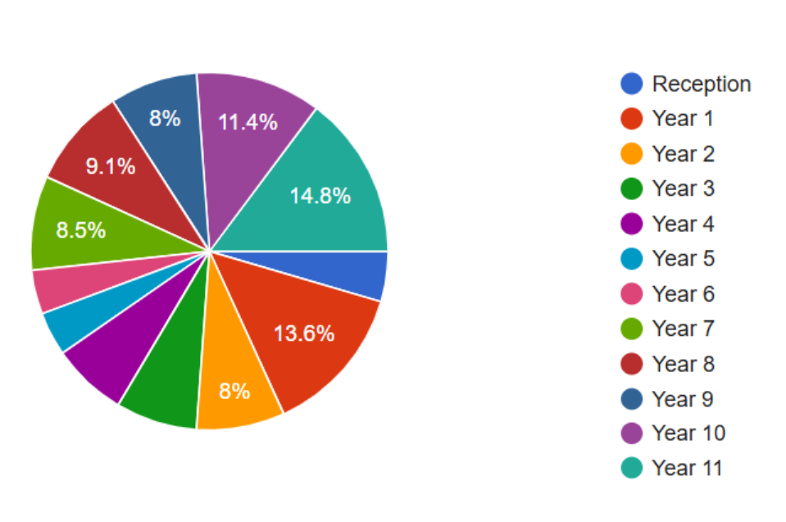
Reduced Timetables
A borough-wide working party reviewed the RTT submission process to improve efficiency and a streamlined form was co-designed and is scheduled for launch in September 2025.
176 RTTs were opened during 2024/25, representing a 32.6% decrease from the previous year.
59.8% of RTTs were for secondary-aged pupils; 40.2% for primary-aged pupils.
Year 1 and Year 11 remained the most common year groups for RTTs.
At the time of RTT initiation:
  28.9% of pupils were not yet persistently absent.
  9.9% had attendance below 25%.

Slide 12
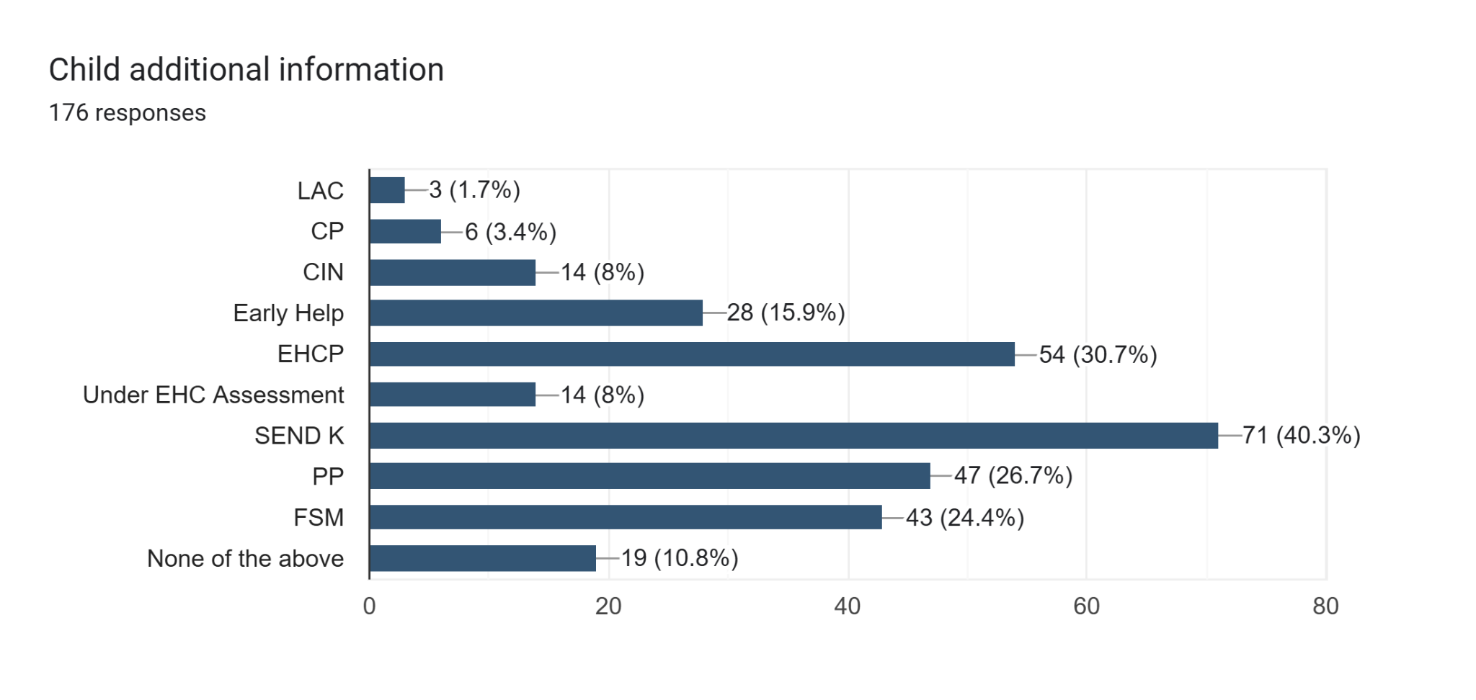
Additional Information and Needs
30.7% of pupils on RTTs had an EHCP.
40.3% had an identified SEN.
11.4% were open to Social Services.
15.9% were receiving Early Help support.
24.4% were eligible for Free School Meals.
26.7% were identified as Pupil Premium.

Slide 13
Fixed Penalty Notices
Satnam Bahra
Notes:
‹#›

Slide 14
My role is the first point of contact for incoming FPN requests.
The aim is to issue the FPN as soon as possible after approval.
The average time spent on raising each FPN is about 20 mins –
from receiving the request, raising the invoice and posting it.
The aim is to be proactive in dealing with enquiries from parents
and chasing non-payers.
A reminder email is sent to the parent on the 21st day. I believe
that this has resulted in prompt payment and avoiding the legal
route.
We have raised 181 FPNs from 32 schools this academic year.

Slide 15
The school can assist by ensuring that parents’ details are up to
date.
Please attach all the relevant documents to the request: such as
attendance certificate(s), parents’ leave request, school’s
response and any other communication that may help us.
We are unable to issue an FPN to a parent of no fixed abode
If parents live apart, then we need both addresses. Otherwise the
FPN cannot be issued.
Moving forward we will now be escalating unpaid FPNs. If an FPN is unpaid you will receive a request for more information from school. This will need to be completed within 5 working days of the request being made due to restricting timescales in the escalation process.

Slide 16
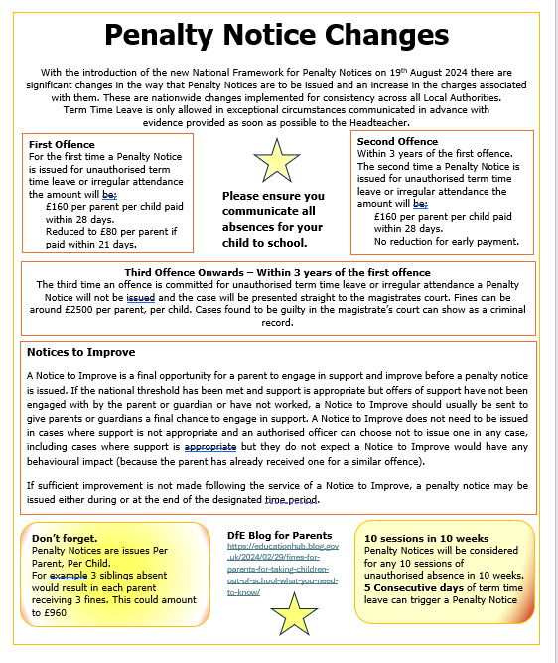

Slide 17
Additional Updates
Al Whitelaw
Notes:
‹#›

Slide 18
Ofsted and Inclusion
Notes:
‹#›

Slide 19

The Inspection Framework will introduces 6 specific, graded evaluation areas for schools. These are graded on a 5-point scale:
Exceptional
Strong Standard
Expected Standard
Needs Attention,
Urgent Improvement
Inclusion | A new, distinct, and graded area of inspection.
Attendance and Behaviour | A core graded area, separated from overall conduct/development.
Curriculum and Teaching
Achievement
Personal Development and Well-being
Leadership and Governance
Safeguarding | Evaluated separately on a ‘met’/‘not met’ scale.

Slide 20
Case Sampling
Narrative
Interventions
Learning Walks
Demographics
Internal and External support
Cross service working
RTT, Flexi Schooling, APs and Attendance.
SEN Reg
EHCP
LAC
PLAC
Kinship Carers
PP
Young Carers
Legislation
Equality Act 2010:
Human Rights Act 1998
Children and Families Act 2014:

Slide 21
Alternative Provision
Notes:
‹#›

Slide 22

Alternative Provision Standards
Ensure that the provision meets the needs of pupils
Establish clear processes for reviewing the provision
Ensure staff have the right skills and experience

Slide 23
Overview and RBWM Context
Currently Voluntary but will become mandatory through legislation.
Currently we do not hold an Approved List. Commissioners QA APs. LA will QA AP where are primary commissioners and its placement is part of EHCP and named on plan.
We are considering working towards AP approved list and are working with AP unreg providers through AP Network meetings and with neighbouring LAs.
Time limits (12 weeks F/T or 2days - 4 sessions - for as long as is needed) may come in spite of opposition from those responding to the consultation.
Schools will be required to inform councils of placements they have commissioned for students in unregistered alternative provision as part of a government move to tighten up the way these providers are used.
The government has also said it is moving ahead with plans to create new national standards for non-school alternative provision and to introduce time limits on student placements.
The government will also prevent councils from using unregistered alternative provision to fulfil their legal duties to ensure children who are not registered at a school are receiving an education.
The government had planned to extend local council oversight of any unregistered alternative providers delivering special educational provision known as “education other than at school” (EOTAS) for pupils with SEND. However, the DfE response advises that it will carry out further work before the government decides whether to proceed with these proposals.

Slide 24
Main points
Schools will be required to inform councils of placements they have commissioned for children in unregistered AP as part of a government move to tighten up the way these providers are used.
The government has also said it is moving ahead with plans to create new national standards for non-school alternative provision and to introduce time limits on student placements.
The government will also prevent councils from using unregistered alternative provision to fulfil their legal duties to ensure children who are not registered at a school are receiving an education.
The government had planned to extend local council oversight of any unregistered alternative providers delivering special educational provision known as “education other than at school” (EOTAS) for pupils with SEND. However, the DfE response advises that it will carry out further work before the government decides whether to proceed with these proposals.

Slide 25
Important AP Links
AP on the Leadership Update Website
  AP Policy
  AP Handbook
  AP QA Framework - Word Doc
  AP Intervention Plan Blank - Word Doc
  AP Directory (NOT an approved list)
Arranging Alternative Provision
A Guide for Local Authorities and Schools

Slide 26
Flexi schooling
Notes:
‹#›

Slide 27
Flexi Schooling
Flexi Schooling is a legal option that parents/carers can request and can be agreed between the head teacher of a school and the parents/carers.
The LA do not have a Flexi Schooling policy but have provided guidance to support schools in their decision making
https://leadershipupdaterbwm.ovw9.juniperwebsites.co.uk/attachments/download.asp?file=51&type=pdf.
The LA must be informed if a child is subject to a Flexi School Agreement.
It is the schools responsibility to inform the LA via this form.
https://docs.google.com/forms/d/e/1FAIpQLSc89uyDrEyRIsAt-Sdvt2sNQkhF14xX9w14AVzRhYHsypwaJg/viewform
Schools also need to inform the LA when a Flexi School Agreement ceases.
Link to Flexi Schooling on the Leadership Update Website.
Requests Increasing
HT decision
Child’s Best Interest Principle
Process
Data Capture
Google Form
Working Party

Slide 28

Elective Home Education
Notes:
‹#›

Slide 29
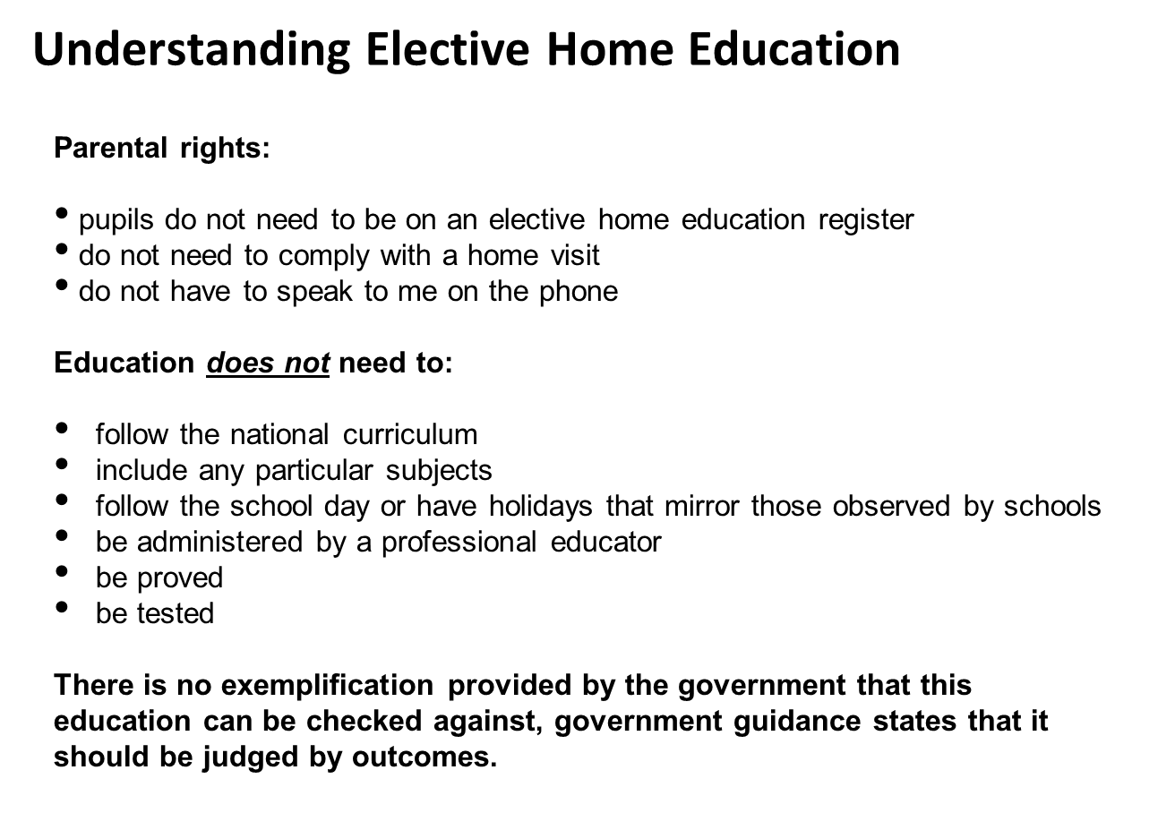

Slide 30
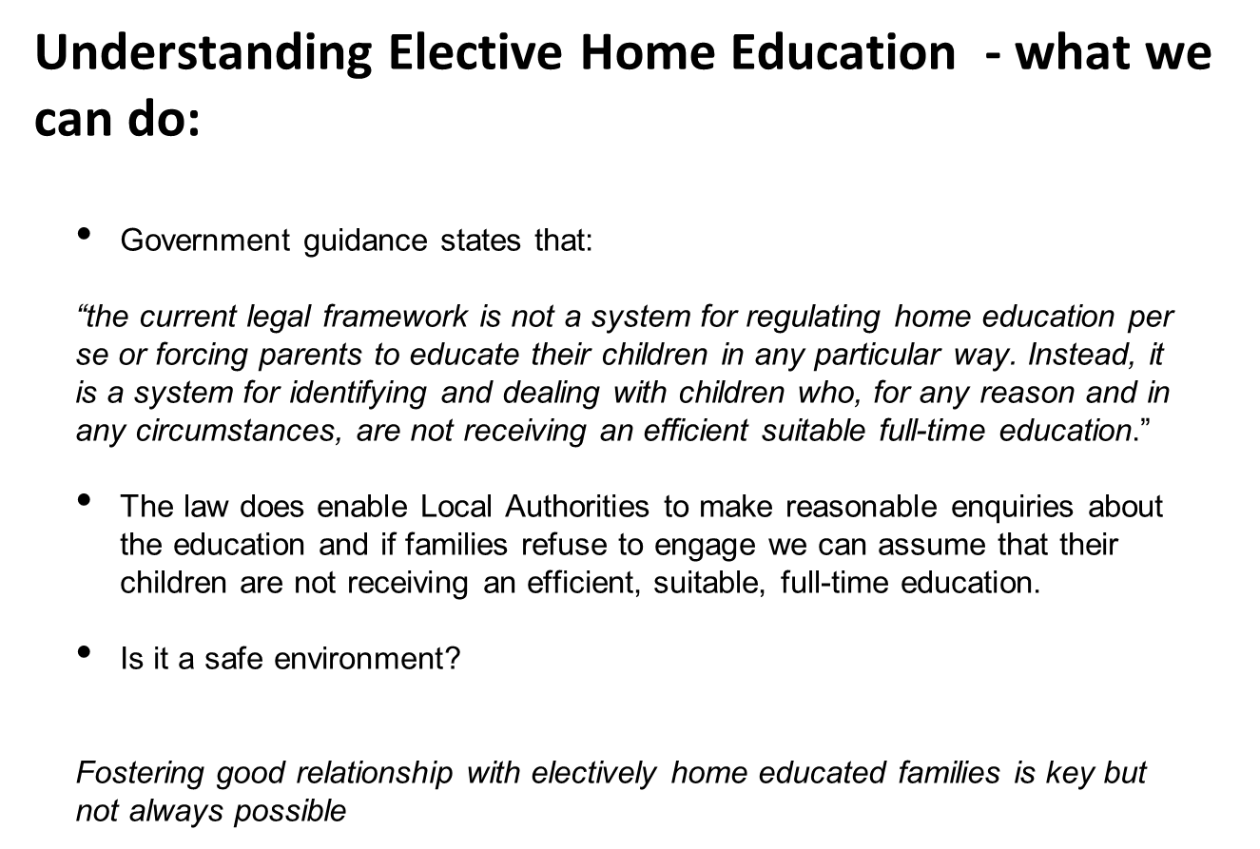
https://forms.gle/xTuKd7oUiP11Pvf19

Slide 31
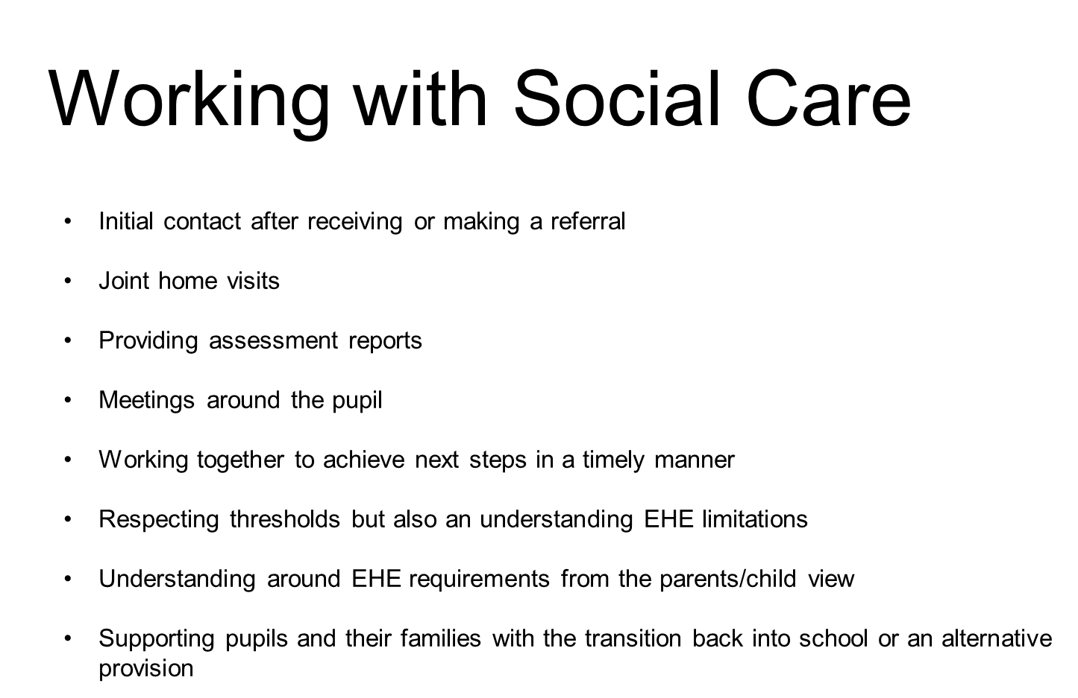

Slide 32
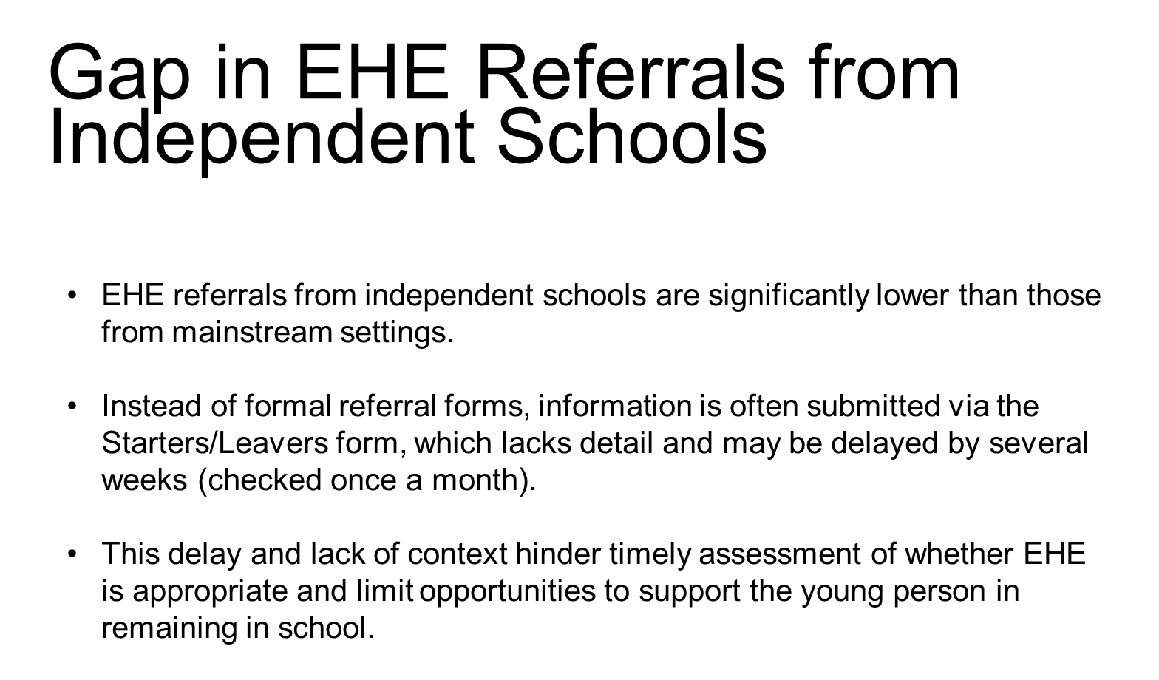

Slide 33
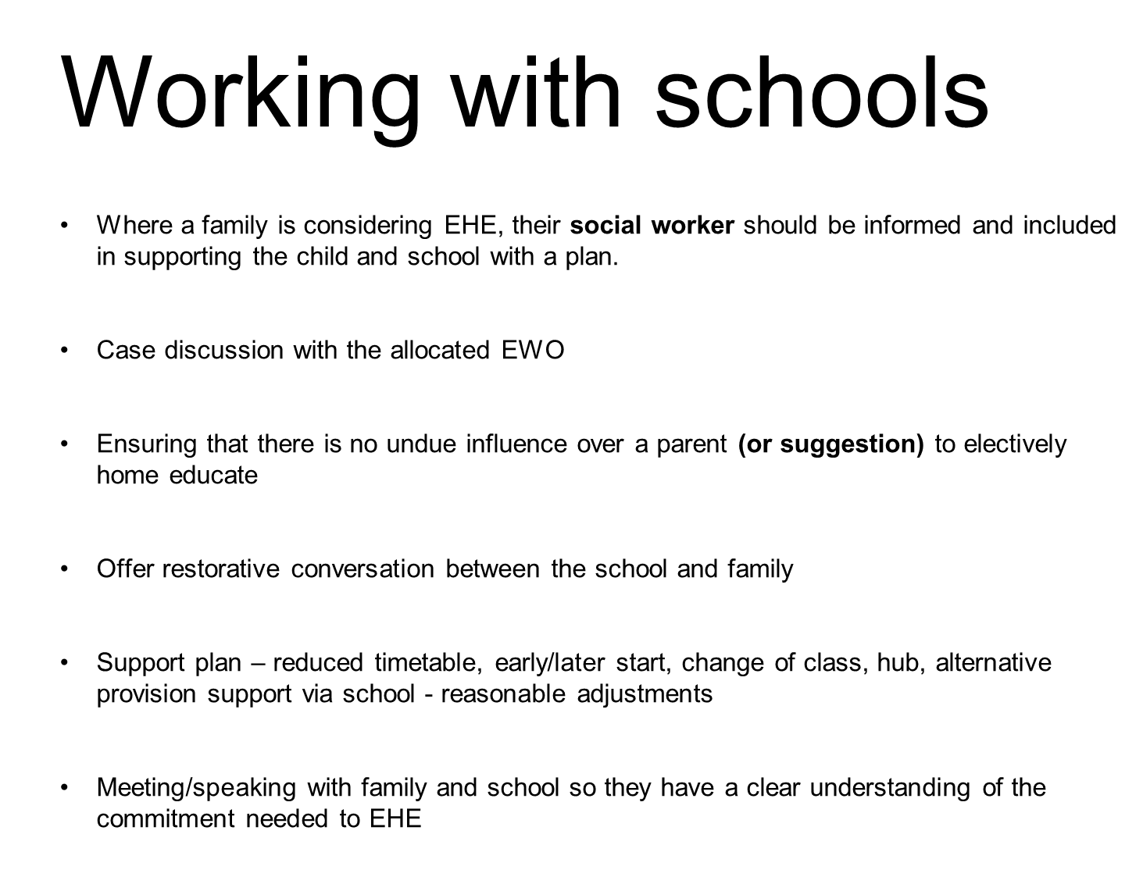

Slide 34
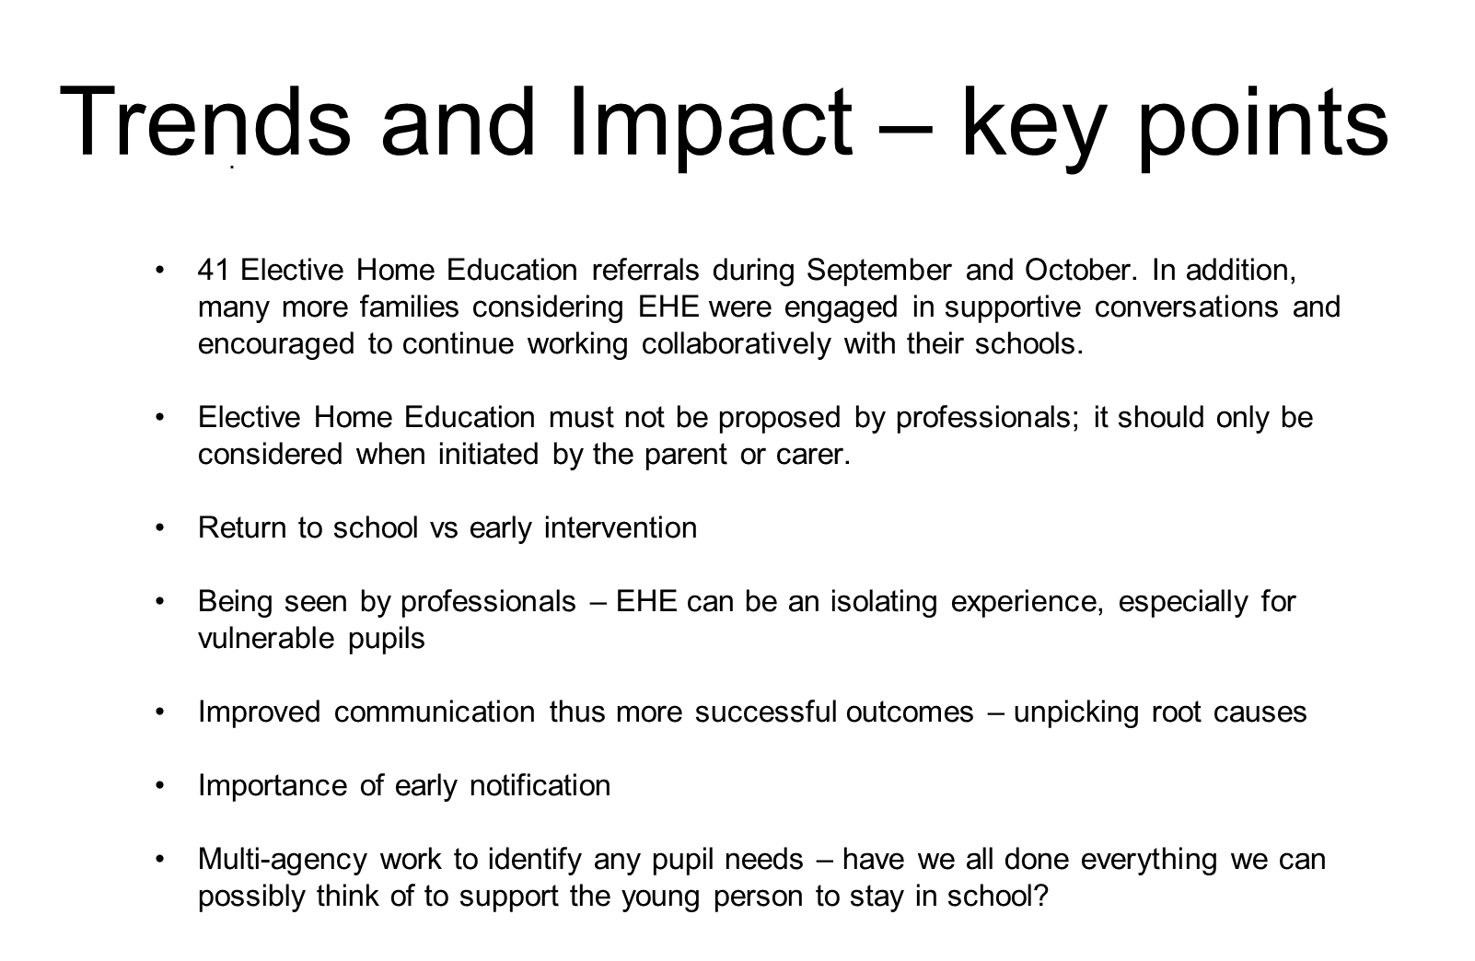

Slide 35
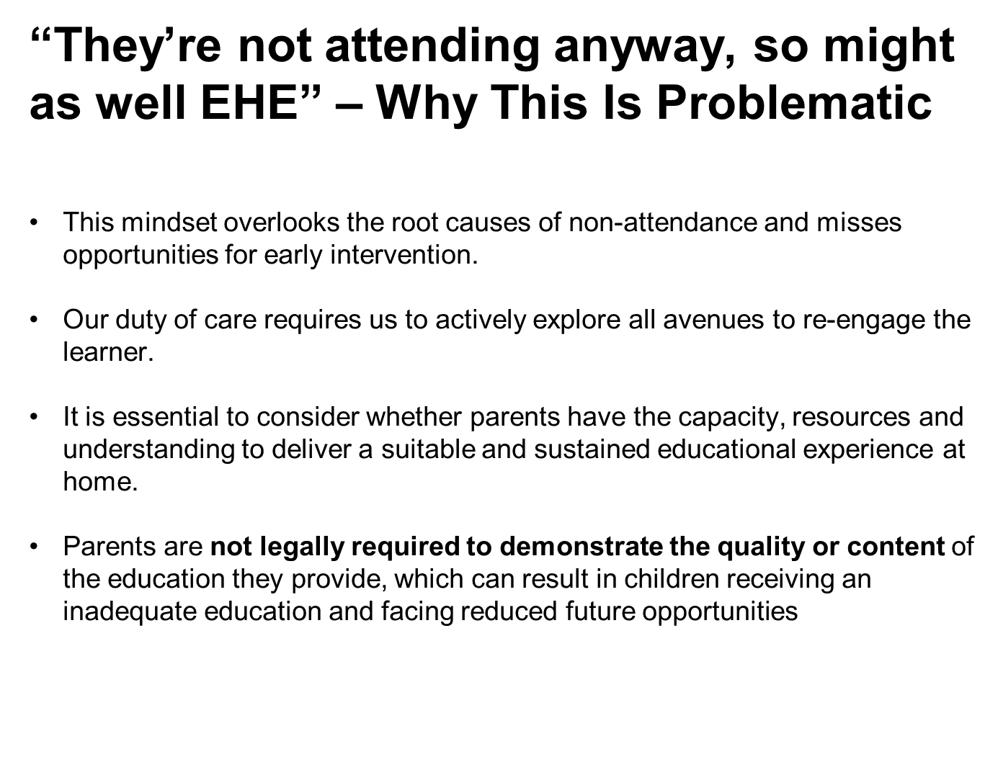

Slide 36
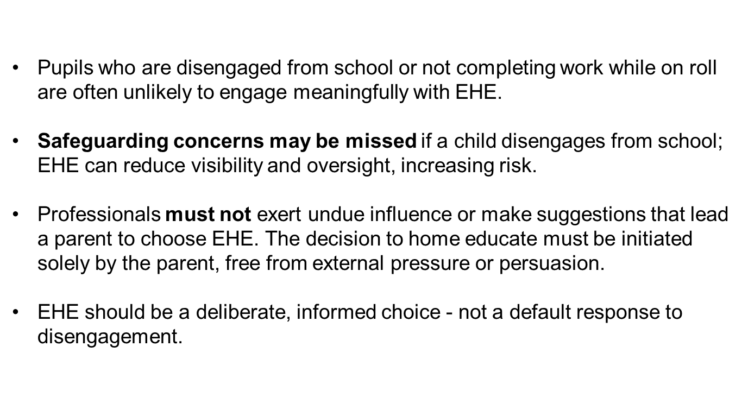

Slide 37
ERSA Communities of Practice Update
Zoe Price
Notes:
‹#›

Slide 38
Emotionally Related School Avoidance (ERSA)
Communities of Practice Pathway and Pilot Project

Slide 39
Communities of Practice (CoP) professional pathway
What is a CoP?
A community of practice (CoP) is a group of people who share a common interest in a topic and who come together to share best practices and develop new knowledge to advance professional practice related to that topic.
Outcome
To develop a comprehensive document that outlines the graduated pathway of ERSA support across the local authority. This highlights the universal provision that is expected to be embedded within schools, initial exploration of patterns of absence using the ERSA toolkit and professional services (community and local authority) that can be referred to at different levels of ERSA (emerging versus entrenched).

Slide 40
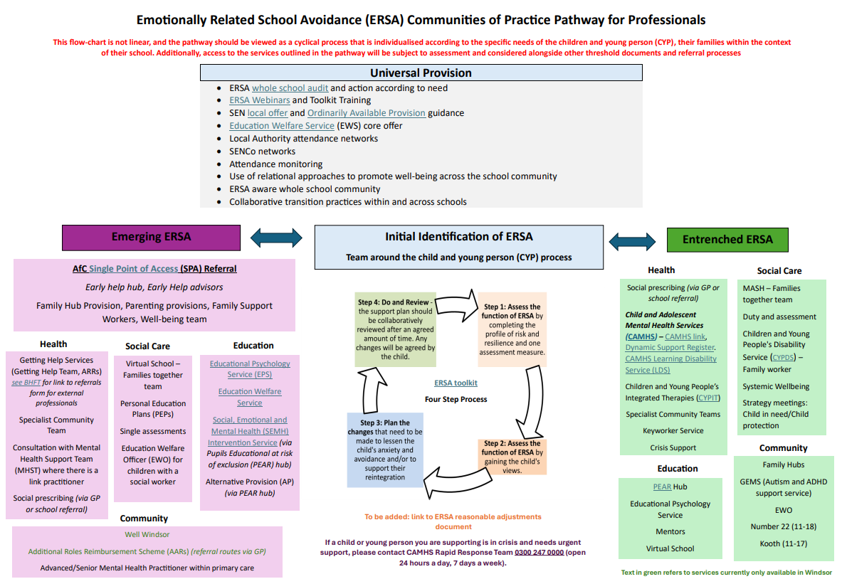
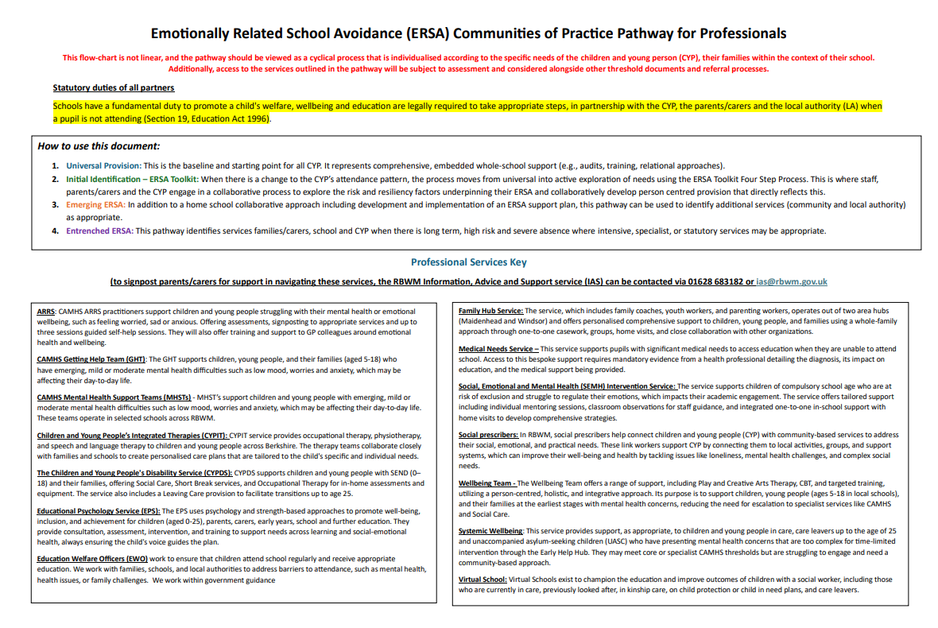
CoP Pathway: Development and Timeline
Launch: Spring Term 2026 as part of a number of new aligned initiatives outlining quality inclusion practice for attendance.
Notes:
CYCLICAL NATURE OF SUPPORT - WHERE THE IMPORTANCE OF THE TOOLKIT AS THE CENTRE OF SUPPORT IS NOT LOST

Slide 41
ERSA
Pilot Project

Slide 42
Pilot Model: Parent/School support groups, facilitated by Educational Psychologists
Step 1) Multi-informant stakeholder (staff, parents/carers, children and young people (CYP)) surveys and focus groups in each school to introduce pilot and determine how best to set up parent support groups in the particular school. Themes and topics linked to common issues, strengths, needs and gaps related to ERSA needs to be captured for each schools specific context.
Step 2) Prepare and deliver universal introduction, identification and interventions workshop on ERSA. Co presented with key senior school staff. Repeated termly so that there is a wider choice for parent access and sign up. School will be supported in producing a webinar aligned to this training which all parents can access (3 per academic year).
Step 3) In addition, termly parent/school workshops offer- psychoeducational on specific themes, joined by partner professionals as appropriate depending on the topics elicited from the focus groups eg. OT linked to sensory needs, wellbeing practitioner linked to anxiety and low mood.
Step 4) Support school in developing and empowering parents and staff’s understanding and implementation of ERSA practice and support within the school’s contect. For example through creating individualised graduated response diagrams, directories of specific reasonable adjustments and what that looks like in practice, develop website pages on ERSA.
Step 6) Create neuro affirming communities of practice reflective school consultation groups and CYP’s participation groups to share good practice,learning, feedback, resources and enable peer support.

Slide 43
Proposed timeline of the project
July/September 2025: School audits to be completed and co-produced, individual goals and objectives to be developed
September 2025: Whole school community surveys to be circulated & analysed
October-December 2025: Focus Groups of all key stakeholders to inform early intervention parent/carer groups/drop in and targeted psychoeducational groups and therapy learning walks in schools.
January - December 2026: Parent/ school workshops rollout and data analysis. Midway review June 2026.
Spring term 2027: Performance report on outcomes, sustainability and support/training to other services/neighbours to operationalise this model and approach adapted to each secondary school community on a graduated phased roll out.

Slide 44
New EWO Introductions
Delphine Green
Francesca Iorio
Notes:
‹#›

Slide 45
Education Welfare Officer
Delphine Greene
delphine.greene
@achievingforchildren.org.uk
07345488518

Slide 46
Schools
Schools
Windsor Girls
Churchmead
Wraysbury Primary
Datchet St. Mary's
St Peter’s Middle
Altwood
Bisham CE School
Braywick Court
St Luke’s Primary
Riverside Primary
St George’s Ascot
The Marist
St Mary’s Ascot
Upton House

Slide 47

CWSW
Inclusion EWO
Chesca Iorio
Inclusion EWO

Slide 48
Educational Neglect
When absence becomes a safeguarding concern.
Educational neglect should be considered when:
The child is not accessing any education (including alternative provision)
The family is not engaging with support
The child is at risk of harm due to lack of supervision, structure, or unmet needs
Attendance below 50% should be treated as a safeguarding red flag, requiring immediate review and multi-agency plan.

Slide 49
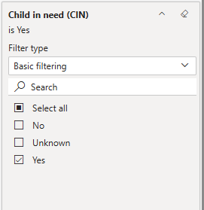
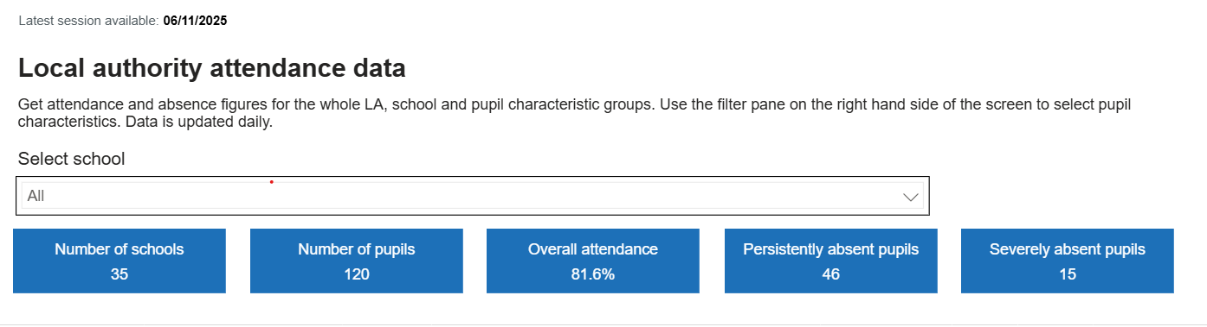
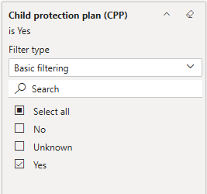
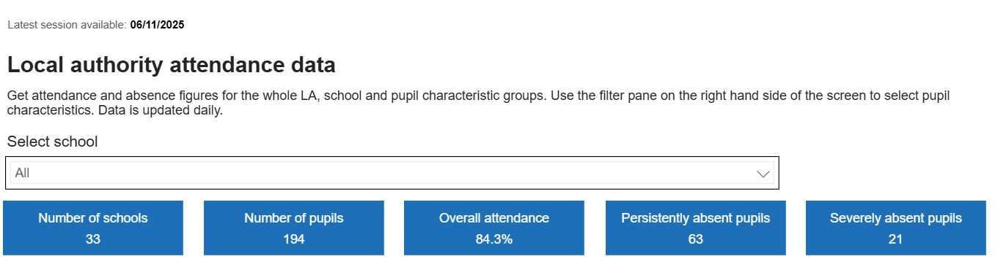
VYED Data

Slide 50
EHCP Support Forum
Launching January, one forum every big term
Create a collaborative space for schools
Share challenges and solutions around attendance and inclusion
Vision
Empower staff with practical tools and guidance
Improve outcomes for vulnerable pupils
Why Now
Rising complexity of needs
Need for joined‑up, proactive approaches
Opportunity to share resources

Slide 51
Thanks, Questions and Feedback
https://forms.gle/s6a5S7pXZnnqMmS58
Notes:
‹#›

