Slide 1
SEMH Network Meeting
Tuesday 27th January 2026
Welcome to this virtual forum
Notes:
1

Slide 2
Agenda for today
New SEMH Page on Leadership Update Website.
Item | Who | Time
Welcome and Updates | Al Whitelaw / Debbie Nayar | 3.30 pm (10 mins)
Youth Justice | Harrison Bird Tania Mughal | 3.40 (20mins)
Number 22 Counselling Service | Sarah Luke | 4.00pm (15 mins)
GEMS | Debbie Nayar | 4.15 (10 mins)
SEMH IS Working Party | Al Whitelaw | 4.25 (5mins)
Physical Intervention | Al Whitelaw | 4.30 (10mins)
Questions and Feedback | Al Whitelaw / Debbie Nayar | 4.40pm (10mins)

Slide 3
Youth Justice
Harrison Bird
&
Tania Mughal
https://uniqueinclusion.wixsite.com/website-1

Slide 4
Youth Justice Case Worker
RBWM Youth Justice Service
Harrison Bird – January 2026

Slide 5
Overview of my role
Direct support to the children (10-18 Years Old) and families who come to the attention of the YJS
Complete an assessment to identify the needs of the child and family, as well as any risks to them or others
Tailor the intervention to the needs of the child and relate it to their offence
Attend court and custody as required
Work alongside other agencies involved with the child/family

Slide 6
Levels of YJS interventions
Preventative interventions – When a child (10-17 years old) gets arrested for an offence but the seriousness of the offence does not meet threshold for court, a low level voluntary intervention is offered to the family
Joint decision interventions – intervention types are agreed by the police and YJS following an assessment and would usually involve a level of condition/requirements to be met – some of these interventions may be statutory
Court orders – if the offence is serious in nature and is sent to court, the court can impose a court order which is a statutory intervention and can hold certain conditions or requirements
Custodial sentence – When a young person is sentenced to custody – YJS will still support the young person until the age of 18 whereby probation will be handed over too

Slide 7
Sessions offered
Mental health and wellbeing
Physical health
Substance misuse
Depending on the needs of the child, sessions/ support can be offered for:
Consequential thinking
Weapons awareness
Harmful sexual behaviour
Etc

Slide 8
Summary
1
2
3
4
Communicate with the Child, family and wider professional network
Tailor intervention to the child
Support young people to learn and build pro-social identities
Support in building protective factors for the child/young person

Slide 9


Slide 10
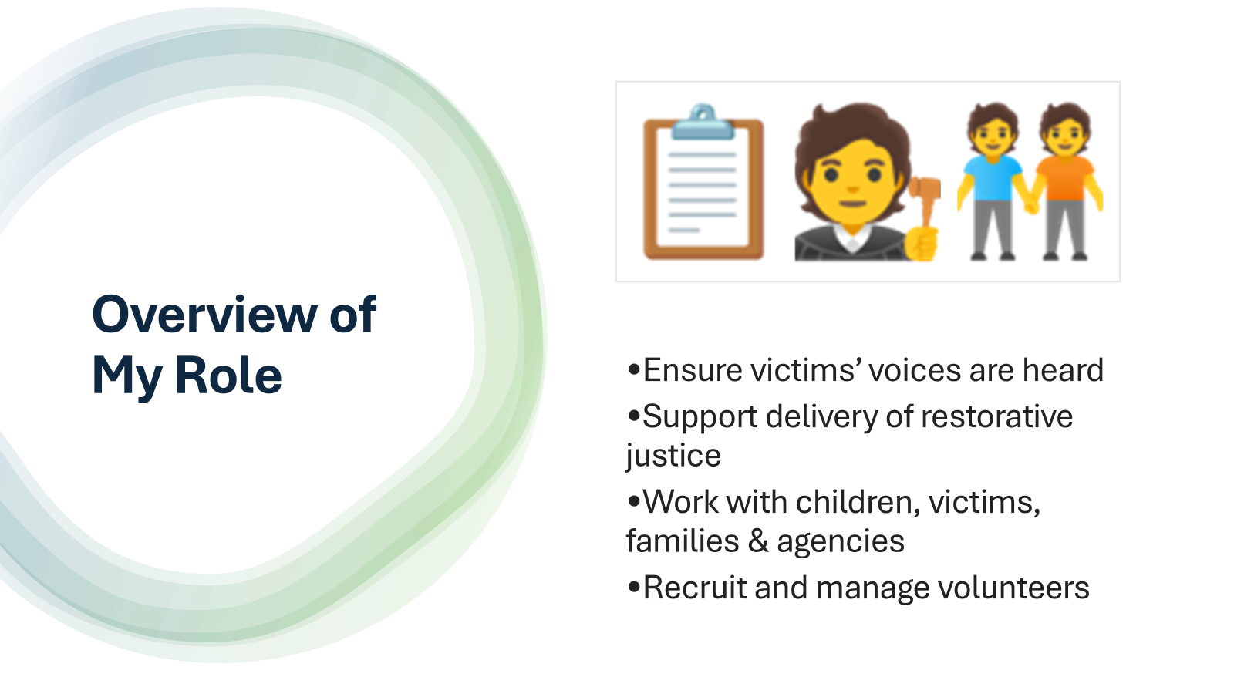

Slide 11
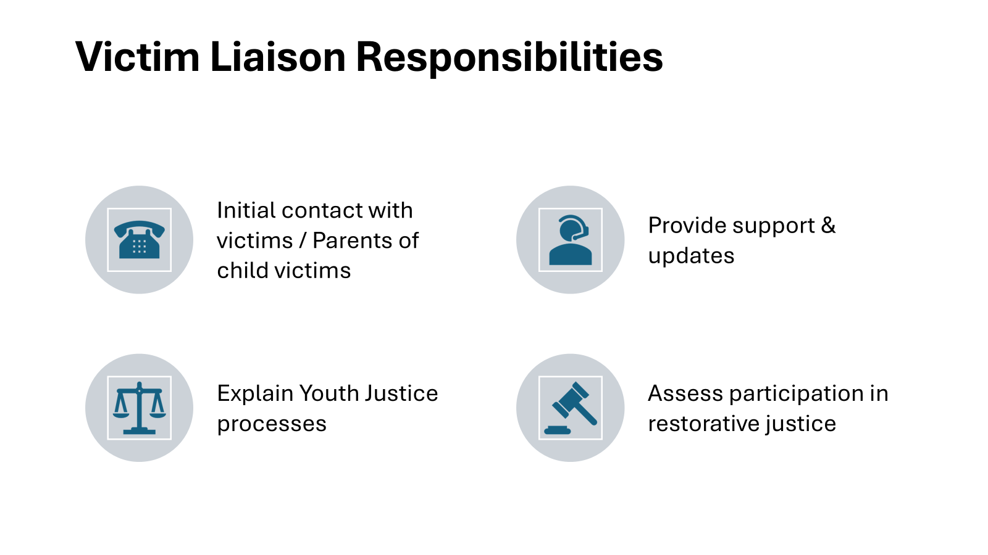

Slide 12
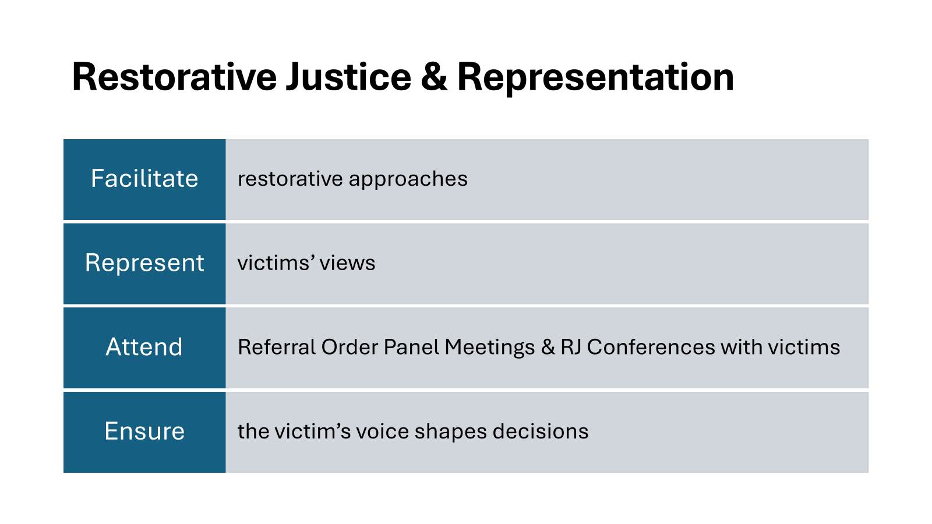

Slide 13

VICTIM SUPPORT OFFER
Information & Guidance: We explain how the youth justice system works and can provide you updates.
A Space to Talk: we offer meetings to listen to your side of the story and answer any questions you may have.
Safety & Specialist Help: We can help to refer you to support services like:
external victim services
mentoring with our YJS Volunteers
We can also support with:
safety planning
constructive activities
liaising with other agencies e.g.
education, health.

Slide 14
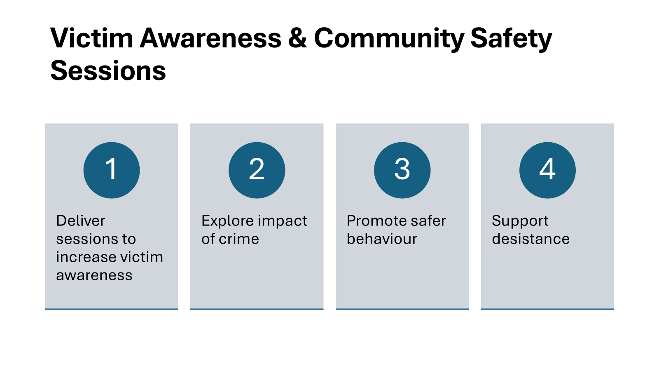

Slide 15


Slide 16
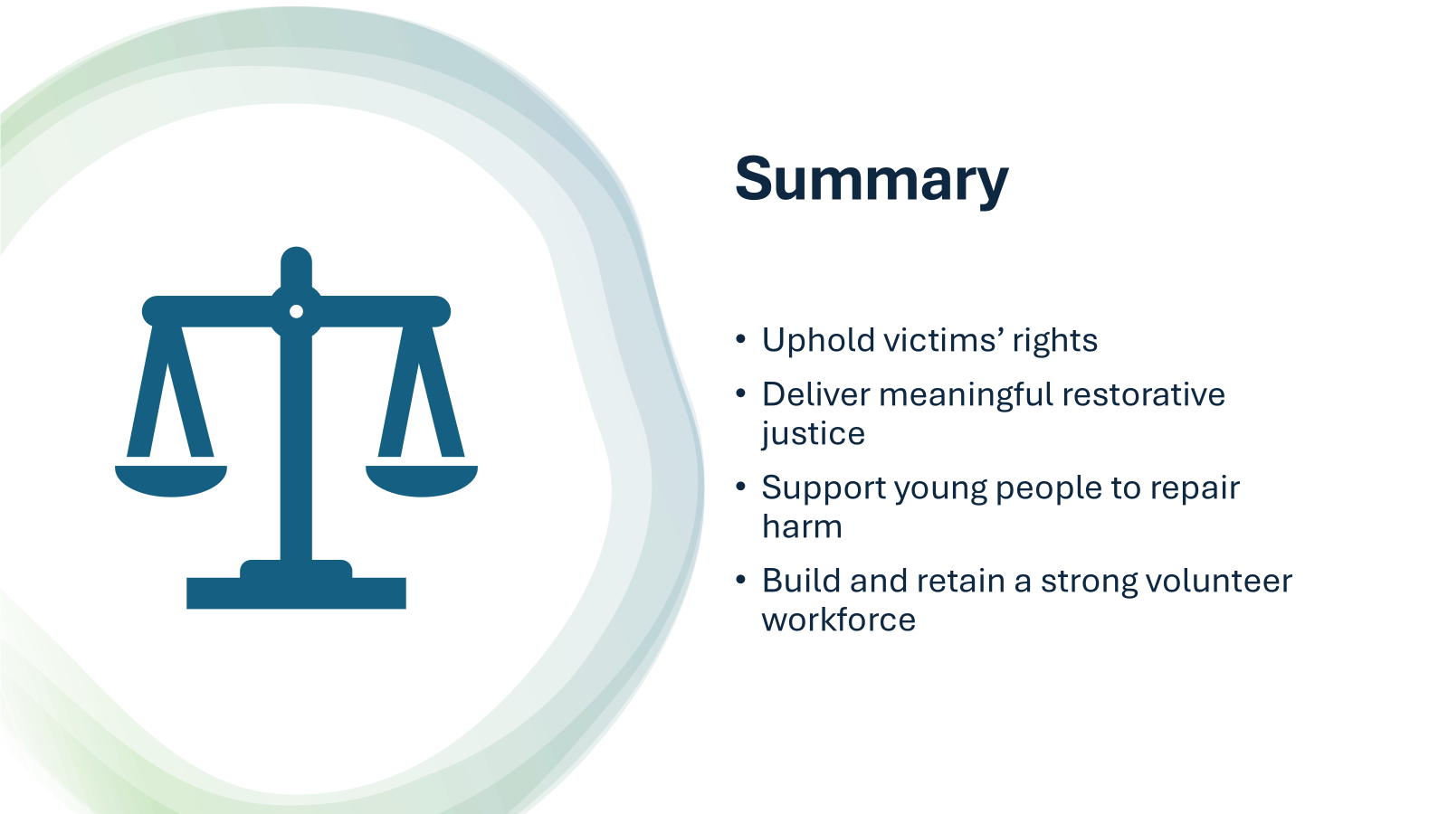

Slide 17
Number 22 Counselling Service
Sarah Luke

Slide 18
Number 22
Whole School Approach
Support for children and young people, parents, carers and staff

Slide 19
Number 22 is a long-standing counselling organisation, providing support to adults and young people. Each year, we support hundreds of individuals through our counselling services.
Our work in schools forms a significant part of what we do.
Counselling Service - one-to-one counselling sessions for young people.
Parent Consultations – to help parents build the skills they need to support their child's resilience and overall mental well-being.
Wellbeing/Reflective Practice support for Staff.
Provide critical incident support.

Slide 20
Our Counselling Service is currently embedded in 31 schools across Slough, Windsor & Maidenhead.
Providing 100’s of counselling hours each week.
Working across primary and secondary school settings
Schools

Slide 21
All of our work in schools is bespoke, designed to meet the specific needs of each school.
Brief Service Overview:
5 hours per day of therapeutic support
Time can be split between student counselling and parent consultations depending on your school’s needs
Schools can purchase as many days as required
Each young person is offered 10 counselling sessions
Young People Counselling (CYP) & Parent Support

Slide 22
Our wellbeing sessions are designed to support staff with their own wellbeing.
From conversations with staff working in education, we know many experience high levels of stress, burnout, and workload. To support this, we offer confidential wellbeing sessions.
Sessions can be used to support:
Professional challenges: difficulties with team dynamics or reflecting on your work with students, safeguarding decisions, dual roles.
Personal challenges: managing stress, anxiety, depression, health issues, lack of confidence, family issues.
Benefits of the sessions:
Enhance problem solving skills, increase confidence and clarity in decision-making, improve self-awareness, increase resilience, support better communication, reduce stress and burnout, support personal and professional growth, support for mental health needs.
Wellbeing Support For Staff

Slide 23
Our wellbeing services support staff at every level of the school community, including:
DSLs and safeguarding leads
Senior leadership teams
Headteachers
Teaching and support staff
Administrative staff and cleaners
Sessions can be held F2F or online.
One to One or in groups.
Our Wider Wellbeing Reach
40 schools | 6 counties - 4 colleges.
100s of staff wellbeing sessions for Thames Valley Police

Slide 24
If you’re interested in finding out anymore about services.
You can reach me directly by:
Email – sarahluke@number22.org
Mobile - 07958621222

Slide 25
Gems
Debbie Nayar

Slide 26





East Berkshire GEMS Service
East Berkshire GEMS Service

Slide 27

About GEMS
GEMS serves as a central point of contact across East Berkshire, providing tailored advice, information, signposting, and support for parents, carers, and families of children and young people aged 0–25 who are autistic, have ADHD, or may be exploring neurodivergence.
The service offers access to a broad range of support options, including workshops, courses, virtual coffee mornings, informative resources, and one-to-one guidance—ensuring that every family can access the support that best aligns with their individual circumstances and strengths.
GEMS is available to families living in, or registered with a GP in, Slough, the Royal Borough of Windsor and Maidenhead, or Bracknell Forest.
Since its establishment in October 2020, GEMS has continued to expand, reaching an increasing number of families across the region with empathy, expertise, and a commitment to promoting understanding and acceptance of neurodiversity.

Slide 28




Our Service Offer
Single point of contact where you can access information, advice, support and signposting
Workshops, courses, coffee mornings & animated learnings for parents and carers
A programme of social groups, for children and young people aged 5 to 10 years

Slide 29


Support
Our helpful and supportive team are available to provide advice, information, signposting and navigation to access the most appropriate form of support.
GEMs also works with our partners to deliver free workshops, courses and one one on support for parents and carers,
The team also regularly deliver coffee mornings and social activities for children (aged 5 to 10) and their parents to come together and meet other families and have fun.
The service is open Monday - Friday, 9am - 5pm you can contact the team directly via the telephone or email.
Website: https://www.gems4health.com/
Email: Gems.4health@nhs.net
Call: 01753 373244 / 0800 999 1342

Slide 30


Workshops and Courses
We have a range of workshops on offer, you can find out more information about the workshops by contacting GEMs or via our website, where are links are available to book
Currently on Offer:
ADHD Course
Autism Course
Sensory Processing
Sleep - Autism & ADHD
Managing Anxiety
Empowering Calm
Barriers to School, cant go, not wont go!
Understanding Emotional Regulation
Interoception
AuDHD
PDA
One off workshops
Tweens and Teens
Autistic Burnout

Slide 31

Home Visits and Support sessions
Home Visits - An online or in person, 1.5 hour visit offering one to one tailored support regarding Autism.
Perfect for parents and carers who do not have access to IT, English as a second language, hearing or vision impairment, parent/carer who are Autistic themselves or have additional needs or difficulties with group settings.
1 on 1 Support session -An online or phone, 60 minute session offering support and advice regarding Autism.
Suitable for parent and carers requiring strategies for a new presenting issue.
Please note that there is limited availability for homes visits and 1 on 1 support sessions

Slide 32

Virtual Coffee mornings
At GEMS, we recognise the importance of connection, understanding, and support for parents and carers. To help foster a sense of community, we have introduced a series of virtual coffee mornings designed to bring families together in a safe, welcoming space.
These informal sessions provide an opportunity to share experiences, exchange advice, and connect with others who truly understand the challenges and joys of supporting a neurodivergent child.
Some sessions are themed to focus on specific topics, while others offer open discussion to suit the needs of those attending.
Examples of previous themed sessions include:
  Eating and Food
  Oral Health
  Emotional Regulation, Meltdowns, and Dysregulation
  Demand Avoidance
  School Avoidance
  Autism, ADHD, and the Family

Slide 33

Social Activites
As a parent/carer you may feel that your child would benefit by joining a social session.
Sessions encourage social communication, participation, confidence, fun and making new friends!
For children aged 5 to 10 years.
CURRENTLY NOT RUNNING.

Slide 34
What People say about our service
“Brilliant service”
“Friendly, helpful, and easily accessible”
“Very easy, friendly, and professional”
“The workshops were great. They were very informative.
It was also refreshing to have others that are going through the same as us looking for support.”
“What a fabulous resource and service you are for people in your area.
Your website contains so much valuable information which I’m sure for many parents and families is so very helpful.”
“Thank you so much for your time. I found it a great help even just talking with you”.

Slide 35




gems4health.com
01753 373 244 | 0800 999 1342
gems.4health@nhs.net

Slide 36
SEMH Working Party
Al Whitelaw
https://uniqueinclusion.wixsite.com/website-1

Slide 37
SEMH Intervention Service Sept 2019 - April 2027.
Staffing
Network
Training
PEAR
Needs and Outcomes
SEMH Data
Total number of schools supported | 50
Total number of schools revisited | 54
Total number of children supported | 188
Total number of children permanently excluded that have had SEMH Intervention Service support | 8

Slide 38

Next Steps
Working party panel
Dates
Options Paper
Schools Forum (Nov ‘26)
Capture your voice and feedback to shape service.
Leadership Update Website
Year | Total: | Secondary | Primary
2019/20 | 20 | 15 (75%) | 5 (25%)
2020/21 | 20 | 18 (90%) | 2 (10%)
2021/22 | 25 | 21 (84%) | 4 (16%)
2022/23 | 16 | 12 (75%) | 4 (25%)
2023/24 | 18 | 9 (50%) | 9 (50%)
2024/25 | 20 | 16 (80%) | 4 (20%)
2025/26 | 6 | 2 | 4

Slide 39
Physical Intervention Updates
Al Whitelaw
https://uniqueinclusion.wixsite.com/website-1

Slide 40
Key Changes in Physical Intervention Guidance
• 2013 Document: Use of Reasonable Force: Advice for headteachers, staff and governing bodies
• 2026 Document: Restrictive Interventions, including use of reasonable force, in schools
2013: Clarification & Confidence
To clarify the power to use force and help staff feel "more confident" using it.
Primarily non-statutory advice.
"Reasonable Force" (Control and Restraint).
2026: Minimisation & Accountability
To "proactively minimise" the use of interventions and ensure safety and transparency.
Contains new statutory duties regarding recording and reporting.
"Restrictive Interventions" (Umbrella term for Force, Restraint, and Seclusion).

Slide 41
Terminology
2013: "Reasonable Force"
Focused narrowly on physical contact to control (passive contact) or restrain (hold back).
Defined "control" and "restraint" as the two main purposes.
2026: "Restrictive Interventions"
Introduces "Restrictive Intervention" as the umbrella term for any physical or non-physical action that restricts movement.
Restraint: Now explicitly includes non-physical acts (e.g., removing a pupil’s crutches or blocking a path).
Seclusion: Formally defined as a distinct category

Slide 42
Seclusion
"non-disciplinary intervention involving keeping a pupil confined to a place away from others, and preventing them from leaving either by physical obstruction, blocking, or making them believe they will be punished if they try to leave".
Key aspects of this definition and its application include:
Prevention of Leaving: The pupil is prevented from leaving the area not just by physical locks or barriers, but also potentially through the threat of punishment.
Non-Disciplinary Nature: Seclusion is explicitly defined as non-disciplinary; it must never be used as a punishment. It is distinct from disciplinary measures such as "removal," where a pupil is sent out of the classroom for a limited time to continue their education elsewhere.
Permitted Circumstances: It should only be used as a safety measure to protect others from harm when a pupil is experiencing high levels of emotional or behavioural dysregulation and is not acting with intent.
Supervision and Safety: The pupil must be supervised at all times during seclusion, and the environment must be safe and not feel threatening.
Reporting Requirements: Under the new regulations, every incident of seclusion must be recorded and reported to parents

Slide 43
Statutory Recording Duties
2013: Discretionary
Advice: It is "good practice" to record serious incidents.
Decision: "It is up to schools to decide" how best to record.
2026: Mandatory
Legal Duty: Governing bodies must ensure a procedure is in place to record every "significant incident" of force and every instance of seclusion or restraint.
Timeline: Must be recorded as soon as practicable, endeavouring to do so no later than the same day.
Detail Required: Records must now include the pupil’s SEN status, potential triggers, preventative strategies used, and injuries.

Slide 44
Statutory Reporting to Parents
2013: Discretionary
Advice: "It is up to schools to decide whether it is appropriate to report the use of force to parents".
Good Practice: Encouraged speaking to parents about "serious incidents".
2026: Mandatory
Legal Duty: Schools must report each significant use of force and all seclusion/restraint to parents
Team Teach
Myles Gresswell - Wraysbury

Slide 45
Questions and
Feedback Form
Leadership Update Website.
All things SEMH and more.
Notes:
45

