Slide 1
SEMH Network Meeting
Tuesday 5th May 2026
Welcome to this virtual forum
Notes:
1

Slide 2
Agenda for today
New SEMH Page on Leadership Update Website.
Item | Who | Time
Welcome and Updates | Debbie Nayar | 3.30 pm (10 mins)
Cobra | Ruth Fettes | 3.40 (15mins)
Neurodiverse Community | Kirsty Northam | 4.00pm (15 mins)
Storyy Group | Arran Bayle | 4.15 (15mins)
SEMH Transition offer | Cherrelle Long | 4.25 (10mins)
IAS- Information and Advice Service | Jean Hobson | 4.30 (10mins)
Questions and Feedback | Debbie Nayar | 4.40pm (10mins)

Slide 3
Cobra
Ruth Fettes

Slide 4

Cobras AP – Who are we?
Small nurturing setting in Bagshot
Created to support all YP to achieve their potential
Can provide outreach and on site support.

Slide 5
Cobras AP – What do we do?
Support YP from Key stage 2-5
Focus on re-engaging through mentoring & support
Build relationships – unpick the why?
Emotion coaching in a safe, calm space
Create individual plans that build confidence and support achievement

Slide 6
Cobras AP – How do we work?
Three main strands – Creative, sport and nature.
Partnership with Cobras Basketball Club and Jealotts Hill Community Landshare.
Academic work at an appropriate level
From 1 session per week to 6/12 week placements

Slide 7
Cobras AP – How to book?
Referral via our website, cobrasap.co.uk
Cost £49ph- discounts on extended bookings

Slide 8
Neurodiverse Community
Kirsty Northam

Slide 9
Storyy Group
Arran Bayle

Slide 10


Storyybrook School, Malt Hill,
Warfield, Bracknell, RG42 6JQ

Slide 11



Slide 12
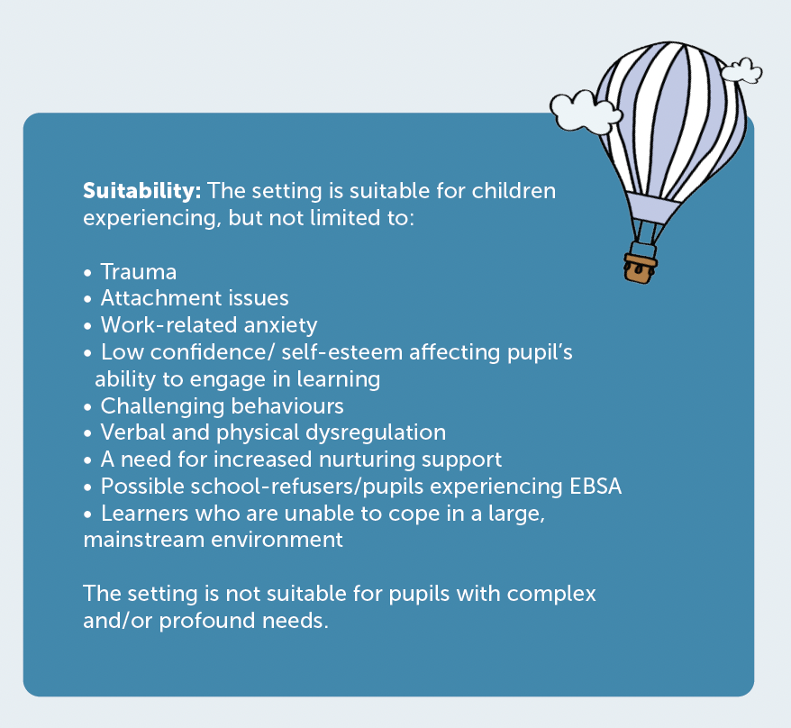
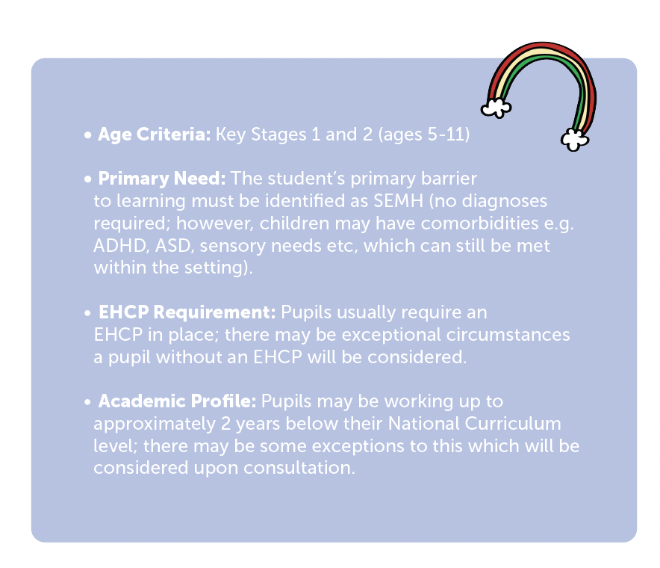

Slide 13

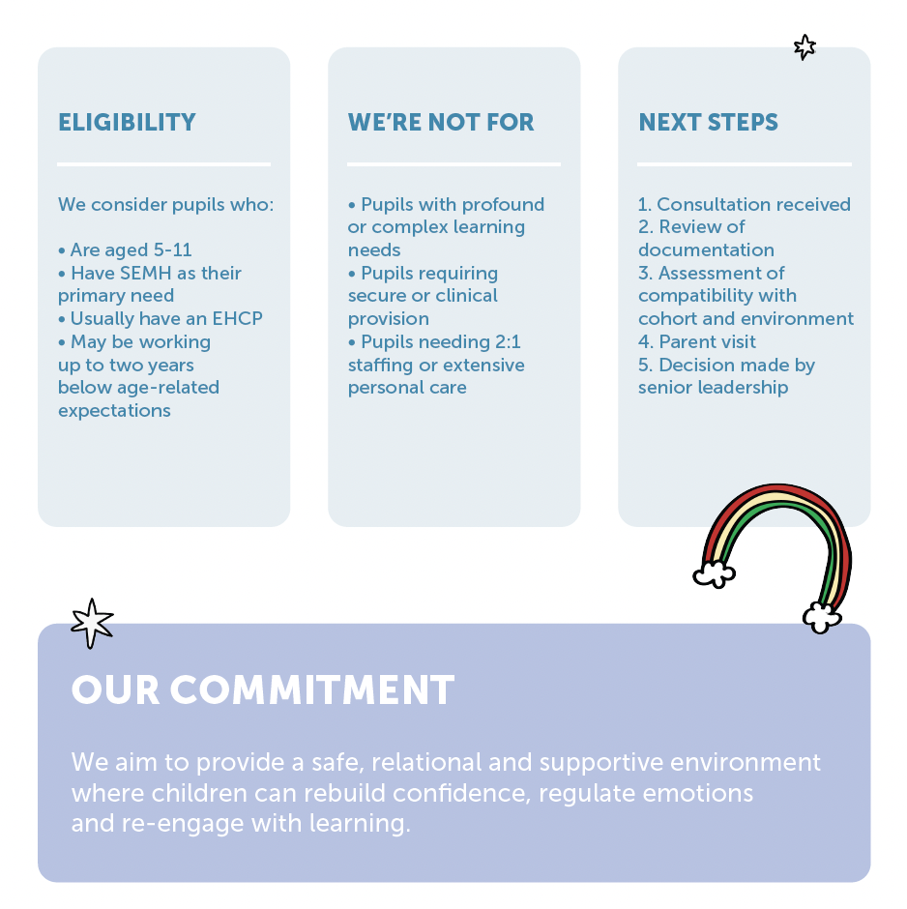
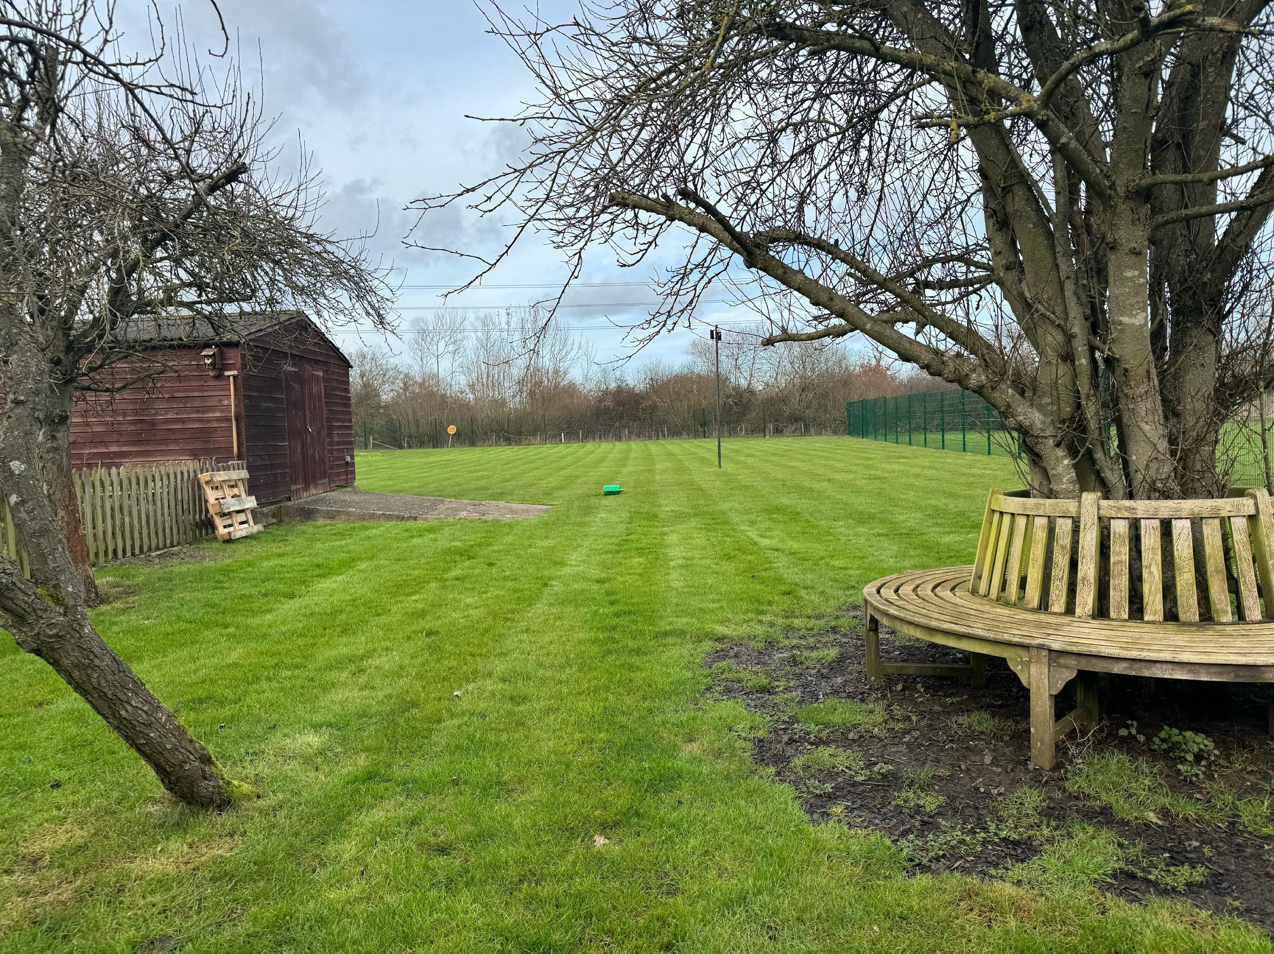

Slide 14
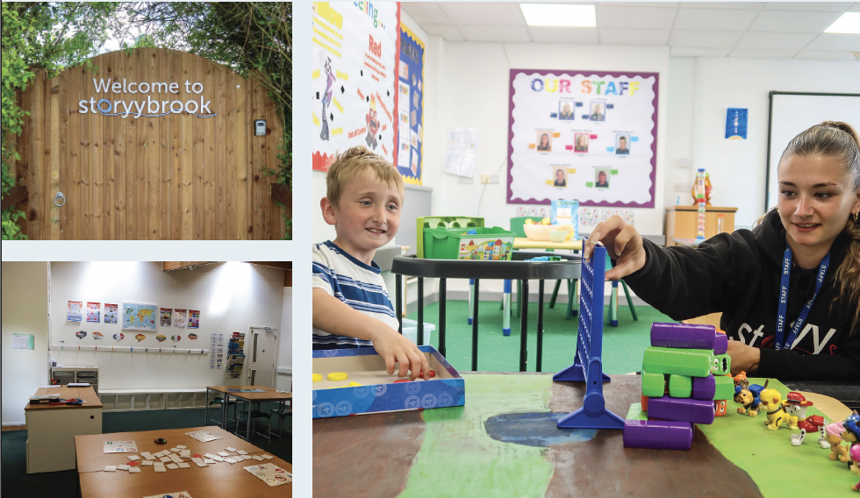
Our Cost
A place at our fantastic school is £57k per student, we will be offering some additional professional therapy in that cost, each student will be offered individual plans if needed.

Slide 15

Our Plan
We recently passed the DfE Online application and are now waiting for the OFSTED Pre Registration visit.
We hope this happens in the next 2/3 months and we will open in September this year.
We cannot accept official consultations until we have the DFe number but we are happy to discuss any potential students.
Please contact rob.sherwood@storyy.group.

Slide 16
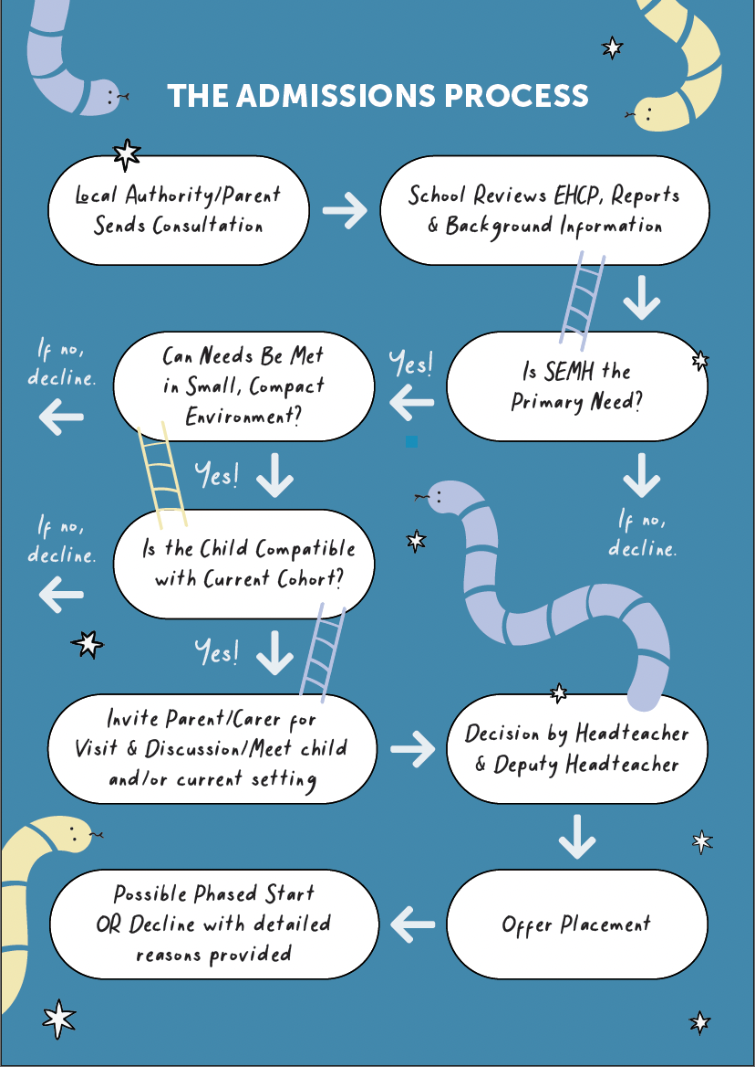


Slide 18
SEMH Service
Transition Offer 2026
Cherrelle Long

Slide 19
Moving On Up
Moving On Up transition programme supports pupils moving to Junior and Middle Schools.
Closing date was 1st May.
Small group (maximum of six) of pupils.Parental consent form will need to be completed for this support.
The programme consists of three sessions.
Sessions are between 45 minutes- 1 hour, running in Term 6.
A follow up visit will take place at the pupil’s new school during Term 1.
Moving on Up was beneficial for the children in the group- First School class teacher

Slide 20
Programme summary
A pre and post questionnaire will be used to focus on the key topics of school transition.
Organisational skills
Problem solving
Communication skills
Reducing anxiety around transition

Slide 21
Onwards and Upwards
Onwards and Upwards summer transition programme, supporting those young people in RBWM moving to secondary/upper school in September 2026, who have been recognised by education staff as likely having additional challenges with a successful move.
X has come out each day and said he loves it! I know this programme is very different and nothing to do with holiday clubs but over the years I have found it very difficult to get X involved and we have tried lots! Onwards and Upward parent 205

Slide 22
Programme summary
Programme dates: 25th - 27th August 2026 (Attendance is required for all three days)
Time: 10.00am - 3.00pm
Location: Windsor Family Hub
The programme is structured to mirror a school day with breaks and lunches and includes an short evening activity to replicate that of homework.
The teaching style is informal and young person centered.

Slide 23
Referral information
Closing date Monday 18th May
Young people referred must be an RBWM resident.
The young person can be currently attending or moving to schools in the surrounds areas.
No charge to the families but the families need to provide transport and packed lunch.

Slide 24
Programme assessment
Before the programme
Young People's Pre Assessment - Face to Face with a member of the Onwards and Upwards Team in school (June/July)
Family meet and greet visit at the venue if required.
Online Parent/Carer pre Assessment and medical form to be completed for their child prior to the start of the programme.
After the programme
Young People's Final Day views.
Online Parent/Carer Post Assessment.
Follow up school visit by a member of the Onwards and Upwards Team to do post assessment- October
Attendance percentages for Term 1.

Slide 25
Transition Contact for
Moving On Up and Onwards and Upwards.
Cherrelle Long: cherrelle.long@achievingforchildren.org.uk

Slide 26
IAS
Information and Advice Service
Jean Hobson

Slide 27
Information, Advice and Support (IAS) Service
Jean Hobson, Donna Hembury, Kate Barnes,
Lucy Ellwood and Millie Rust-Clarke

Slide 28
What we do
For parents and carers
For children and young people with special educational needs and/ or disabilities (SEND), up to 25 years of age
“Arm’s length” – impartial and independently trained advisers
Free and confidential
Information, advice and support relating to SEND - encompassing education, health and social care
Including the law, local policy and practice, the Local Offer and Education, Health and Care (EHC) needs assessments and plans
To help people make informed decisions and to find the best solutions to problems, should they arise
Notes:
For children and young people, many of those introductions are made by their parents, but CYP can self-refer.
Aim always to help families feel engaged and empowered by giving them the information and the level of support they need.

Slide 29
Our aims
Responsive to individual needs, giving advice and practical support:
  to understand and contribute confidently to assessments and planning
  to participate in the decisions affecting their education, health and social care provision
  to maintain positive working relationships, confidence and trust
Notes:
Really important where everyone in the system is under strain, to manage expectations

Slide 30
How we can help
  Listening to views and concerns
  Impartial perspective
  Help to organise thoughts and ideas
  Explaining options, rights, responsibilities
  Practical help with forms, letters, reports
  Preparation for meetings
  Statutory process – EHCNA, Annual Reviews, exclusions
  Resolving disagreements
  Complaints and appeals

Slide 31
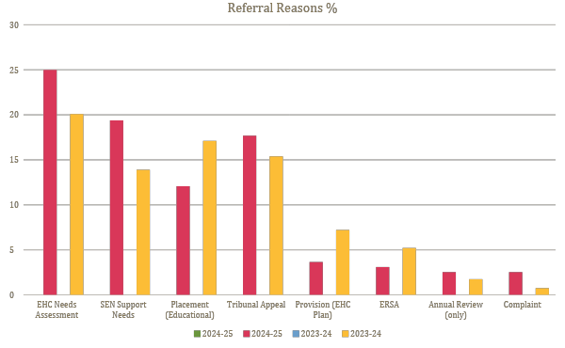
Most common referrals 24/25

Slide 32
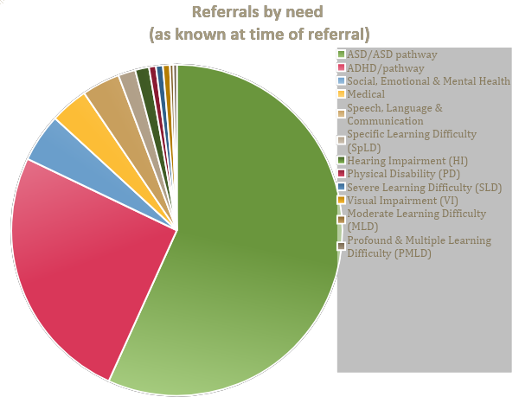
Referrals by need 2024-25
56% ASD or pathway (48+8)
25% ADHD or pathway (19+6)
5% SEMH
4% SLCN
Notes:
AS A GUIDE - Neurodiverse CYP still very significant
NB, we are not using ERSA as a need descriptor – the ERSA cohort will often be in these main groups, having identified or unidentified ND

Slide 33
How we work together
Children, young people and their parents can refer to the IAS Service as many times as they wish
We will continue to work with individuals for as long as they need our support, with the aim of increasing knowledge, skills and confidence
The focus of the IAS Service involvement is to enable children, young people and their parents to contribute their views and to manage situations as they arise by giving them relevant information, proposing and discussing strategies and giving practical support where needed

Slide 34
Referrals
Self referral by children, young people and parents/ carers
Via the IAS Service Helpline or email
Helpline: 01628 683182
Email: ias@rbwm.gov.uk
Referrals from schools and other agencies, with the consent of the parent, child or young person
Visit https://www.ias-rbwm.info/ for more SEND information

Slide 35
Questions and
Feedback Form
Leadership Update Website.
All things SEMH and more.
Notes:
35

