Slide 1

Clerks’ & Governance Professionals’ Briefing – September 2025
Wednesday 17th September
Thursday 18th September
Clive Haines & Vicky Brand

Slide 2
Welcome!

Slide 3
AGENDA
Welcome
Leadership Update for September 2025 - Highlights
Governance Training
Ofsted Update
Keeping Children Safe in Education Updates
Guidance changes coming up for September
Cyber Support Training
Changes in education 2025/26
Maintained schools' governance guide: summary
Autumn term governance activity
Discussion forum… and questions

Slide 4
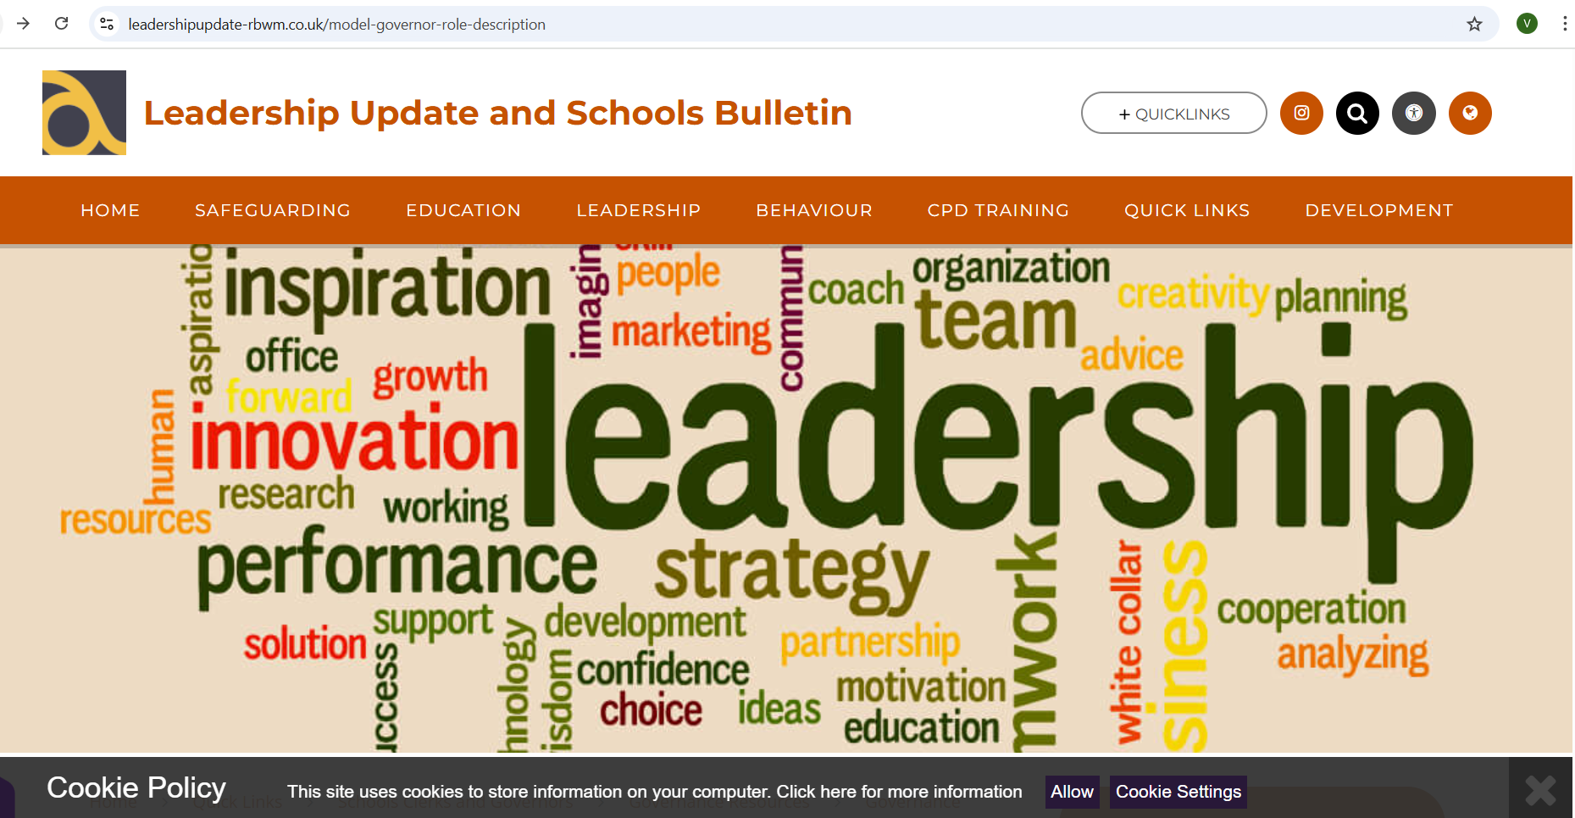
NEW LOOK LEADERSHIP UPDATE – September 2025
www.leadershipupdate-rbwm.co.uk/
The Leadership Update Word Document will be circulated following the briefings. It can also be downloaded from:
Clerks' and Governance Professional's Briefing September 2025 | Leadership Update and Schools Bulletin

Slide 5
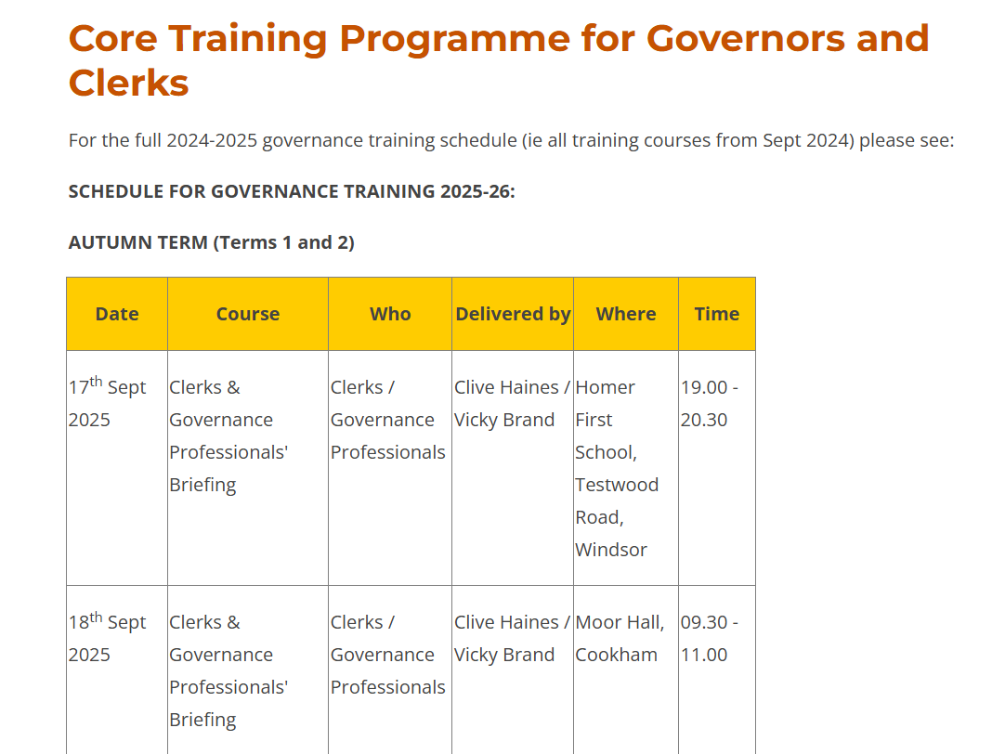
Governance and clerking training schedule for 2025/26
The whole year is planned with a few spaces to respond to changes, particularly Ofsted.
Please also note Educational Leadership Forum dates have also been included for Chairs.
https://www.leadershipupdate-rbwm.co.uk/core-training-programme-for-governors-and-clerks/

Slide 6
Governance and clerking training schedule for autumn 2025
Wednesday 24th Sept – The Role of the Safeguarding Governor
Wednesday 1st Oct - New Governors Induction Part 1 – Strategic Leadership
Wednesday 8th Oct - New Governors Induction Part 2 – The Support and Challenge Role
Wednesday 15th Oct - New Governors Induction Part 3 – Accountability in School Governance
Wednesday 5th Nov – New Governors Induction Part 4 – Safeguarding: the governors role
Friday 7th Nov – Education Leadership Forum – Chairs of Governors (RBWM Schools) – OFSTED
Wednesday 19th Nov - School Complaints – Investigation and Panels
Wednesday 26th Nov – Governor Visits to School
Wednesday 3rd Dec - Chairs and clerks/governance professionals joint surgery
Friday 5th Dec – Safer Recruitment
Education Leadership Forum (chairs of schools in RBWM are invited) – Friday 7th November 2025

Slide 7
Breaking News: Ofsted Confirm New-Look Inspections
Ofsted has confirmed its changes to school inspections, moving the system to a new “report card” format for every school from November. Single-word judgements are replaced by a new five-point grading scale across six to eight judgement areas, and a separate judgement for safeguarding.
Governance is more prominent in this framework and is included in a refined “leadership and governance” evaluation area, while “inclusion” is also added as a standalone evaluation area for the first time. At the same time, the Department have also explained their updated approach to accountability, including the introduction of school profiles and additional improvement support for struggling schools.

Slide 8
What will Leadership and governance be evaluated against?
Under the leadership and governance evaluation areas, inspectors will consider the extent to which governors/trustees:#
are knowledgeable about their statutory duties and carry them out effectively
support and challenge the school’s leaders effectively
understand their role in considering and addressing leaders’ workload and wellbeing
assure themselves that leaders have an accurate understanding of the school’s context and are prioritising the right actions for improvement
ensure that systems for monitoring and quality assurance are fair, valid and constructive, and inform continuous improvement
hold leaders to account for the impact of the school’s professional learning programme for staff
hold leaders to account for the school’s support and provision for disadvantaged pupils who may face barriers to their learning and/or wellbeing

Slide 9
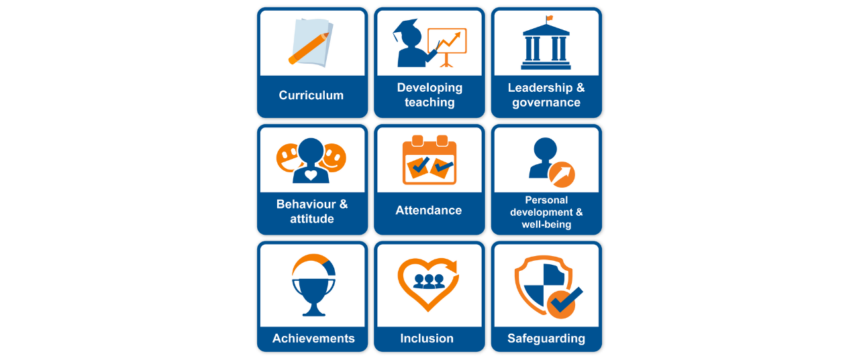
A new 5-point grading scale to set high expectations, while encouraging improvement where it is needed. In response to feedback from professionals and parents about the proposed terminology, the final set of grades has changed to:
  Urgent improvement
  Needs attention
  Expected standard
  Strong standard
  Exceptional
  Safeguarding MET or NOT

Slide 10

Keeping Children Safe in Education – Updates 2025
The 2025 update to "Keeping Children Safe in Education" (KCSIE) includes several key changes, primarily focusing on aligning with other recent guidance, strengthening safeguarding practices, and clarifying responsibilities. These changes emphasize early help, evidence-based decision-making, and enhanced online safety measures.

Slide 11
Key Themes: Keeping Children safe in Education
Alternative Providers: KCSIE 2025 clarifies that schools need to obtain written confirmation from alternative providers regarding the safeguarding checks they have carried out on their staff.
Online Safety: The guidance now includes links to the DfE's filtering and monitoring self-assessment tool, cybersecurity standards, and new guidance on the use of generative AI.
Sexual Violence and Sexual Harassment: The document incorporates the DfE's advice on sexual violence and sexual harassment between children in schools and colleges.
Attendance: The "Working Together to Improve School Attendance" guidance is now statutory, reflecting the daily data-sharing duty introduced in 2024.
Low-Level Concerns: The guidance provides more information on managing low-level concerns related to safeguarding.
Human Rights and Equality Legislation: KCSIE 2025 sets out the safeguarding implications for schools related to human rights and equality legislation.
Data Sharing: The guidance emphasises the importance of information sharing, particularly daily data-sharing for school attendance.

Slide 12
Guidance changes coming up for September
All Schools - PE and Sport Premium
A requirement for the chair to sign off the school’s digital reporting form return detailing how the school has used its PE and sport premium allocation.
Maintained Schools
A greater emphasis on the requirement for governing bodies to demonstrate the active promotion of fundamental British values
The need for all governors to have a basic understanding of the school’s legal requirements on procurement as well as on accountability and spending, along with links to relevant guidance and services.
Guidance to support the promotion of good behaviour of pupils, including the use of mobile phones and searching, screening and confiscation in schools.
A greater emphasis on the requirement for the school premises and facilities to be kept up to a standard

Slide 13
Academy Trusts
The need to remain compliant with statutory and contractual requirements relating to procurement, along with links to relevant guidance and services.
The recommendation for trusts to undertake external reviews of governance every three years.

Slide 14
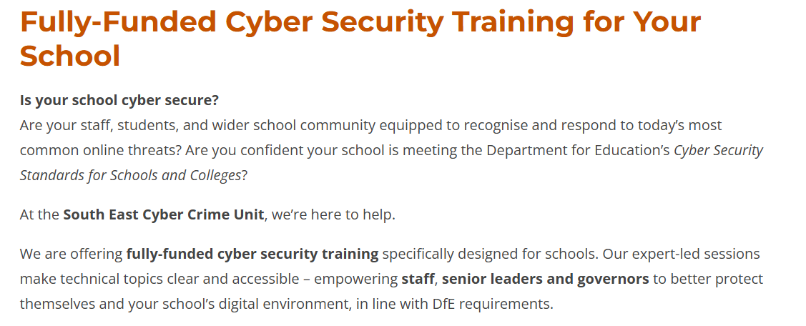
https://www.leadershipupdate-rbwm.co.uk/page/?title=Fully%2DFunded+Cyber+Security+Training+for+Your+School&pid=337

Slide 15

Changes in education 2025/26
Get up to speed on the key changes to government guidance that are likely to affect your school this academic year and find resources to help you delve a bit deeper.
Updates to the governance guides
New inspection framework expected in the autumn
Teachers to receive 4% increase in pay award
Keeping Children Safe in Education (KCSIE) and other safeguarding updates
Updated relationships and sex education (RSE) guidance
Updated statutory guidance on reasonable force
Academy Trust Handbook (ATH) 2025 published
Safeguarding changes to EYFS framework
The Children's Wellbeing and Schools bill
Upcoming staffing and employment changes
A new schools white paper
https://schoolgovernors.thekeysupport.com/school-improvement-and-strategy/government-policies-legislation/changes-in-education-202526/

Slide 16
Maintained schools' governance guide: summary
Effective governance
Strategic leadership
Accountability
People
Governance structures
Evaluation
Compliance
Statutory policies
Download our summary
https://schoolgovernors.thekeysupport.com/the-governing-body/the-role-of-the-board/maintained-schools-governance-guide-summary-of-changes/?origin=governorhub&sync=true

Slide 17
Autumn term governance activity:
Governance business
Governor records and contact details
Register of Business & Related Party Interests - annual review & re-sign forms
Governor Code of Conduct- annual review
Governor attendance for previous year - review and put on website
Review any upcoming ends of terms of office and vacancies - notify the board
Elections of officers - Chair / Vice-Chair (if your board does this annually)
Safeguarding governor & any other designated monitoring roles (check in place)
Clerk’s report from September clerks’ briefing , and circulate Leadership Update for national & local education priorities

Slide 18
Key Priority focus
Review of school performance at end of previous academic year and the school‘s current Self Evaluation - leading to….
Agree the key priorities for GB monitoring over this academic year (review of the School Development Plan)
Review Terms of Reference and Committee membership - to ensure ongoing effective monitoring including new key priorities
Review governor skills audit - schedule any CPD/training required (including annual refreshers for the designated roles)
Agree key focus areas for governor visits and mechanism for conducting these (Governor Visits Protocol and Report Proforma)
Policies
Safeguarding Policy (KCSIE updates - Sept)
Pay Policy (STPCD changes – Sept/early Oct)
Admissions policy and arrangements (VA schools and Academies)
Pupil Premium Report (to be on website by 31st December)
SEN Information Report (must be updated at least annually)
Review other policies as per the school’s policy review cycle – some may be delegated to committees as per Ts of Ref. Not all policies require GB approval (see DfE list of statutory)

Slide 19
Likely Autumn term activities
Safeguarding Governor visit with DSL
Committee/link governors (as per Ts of Ref) – to be monitoring the key priorities and estate/resources/statutory compliance
Numbers on roll @ October census date (early October) - feeds forward planning discussions
Pay and Performance review (by 31st Oct)
Headteacher’s appraisal (by 31st Dec)
Governor visits (aligned to key priorities)
Conduct clerks’ appraisal (chair & clerk)
Monitor YTD expenditure reports (monthly)
Maintained schools: 6 month YTD report to be approved by the board and submitted to the borough (mid Oct)
Consult on admissions arrangements / changes (VA and Academies by 31st Jan)
Admissions Committee - secondary

Slide 20
Academies (additional)
Ensure practice is in line with the latest version of the Academies Handbook (updates every September)
Companies House annual return
AGM including approval of Financial Statements & summary reports (are submitted to ESFA by 31st Dec)
An example year planner is available on Leadership Update at https://www.leadershipupdate-rbwm.co.uk/example-year-planner/

Slide 21

To download all today’s resources please scan the QR code

Slide 22
Discussion forum
and questions

